Slide 1
UNDP CIRDA Country Program Managers Workshop 25-27August 2015 Addis Ababa, Ethiopia
Report from Strengthening National Climate Information/ Early Warning System (CI/EWS) Project
Uganda
Pascal Onegiu Okello
Project Manager
Notes:
Instructions: Complete items in red italics

Slide 2
Content:
Introduction
Organizational Structure
Role of Key Partners
Progress to date
Opportunities & Challenges
Future plans for CIRDA
Conclusion

Slide 3
The Delegates:
Khalid Muwembe; Director Forecasting-UNMA;
Onesimus Muhwezi; TL Energy & Env-UNDP CO;
Pascal Onegiu Okello; PM-SCIEWS Project;
Jennifer Kiiza; FAA-SCIEWS Project

Slide 4
Introduction:
Overall objective:
“To strengthen the weather, climate and hydrological monitoring capabilities, EWSs and available information for responding to extreme weather and planning adaptation to climate change in Uganda.”
Changing implementation frameworks:
Global: Sustainable Development Goals;
National: New National Development Plan (2016-2020);
Country Office: Country Programme Document(2016-2020)

Slide 5
Project Organisation Structure
Project Board
Senior Beneficiary/ies:
MWE, OPM, MAAIF
Executive:
MWE
Senior Supplier:
UNDP
Project Assurance
UNDP (CO & UNDP GEF)
Project Manager
Project Support
Admin/Financial officer;
Procurement Associate
Technical and implementation support:
UNMA,DWRM,DRDPM,MAAIF,DLGs,UCC,MoFPED, CSOs and the Private Sector.
Notes:
This slide and the two that follow are intended to help you make three slides per Department/Agency.
This effort will result in a stack of slides that cover your nation’s government agencies that are relevant to the accomplishing the objectives of the CIRDA program. You should have contacts in all these agencies. E.g., National Meteorological Service, Ministry of the Environment, Ministry of Agriculture/Ag Met Extension Program, Ministry of Water, Ministry of Emergency Management.
Do NOT make the slides too detailed. Focus on high-level, big-picture items.

Slide 6
Contribution of Key Partners (IP/RPs):
UNDP: Quality Assurance
UNMA: Lead IP; Weather forecasting; Aviation briefing;
DWRM: Water level monitoring & CbWRM structures
OPM: NECOC/Dissemination of EW; Disaster Mgmt;
MAAIF: Extension/outreach services
MoLG: Sub-National linkage (DDMCs)
UCC: Oversight & Coordination of Telecommunications service providers
MoFPED: Focal Point for GEF Projects

Slide 7
PROGRESS TO DATE:
Outcome 1 | Output | Status
Enhanced capacity of the UNMA and DWRM to monitor and forecast extreme weather, hydrology and climate change. | Output 1.1: (16 new AWLS and repair of 45WLS) | Proc.via UNDP CO; Evaluation stage Proc of AMSS @ evaluation stage;
 | Output 1.2: (25 new AWSs and repair of 32 WSs) . | Up to 30 AWSs via LTA and civil works via national contracting both at evaluation stages.
 | Output 1.3 :Weather and climate forecasting facilities upgraded | Procured 270 new Thermometers; re-stocked upper air balloons & radiosondes for 1 year
 | Output 1.4 : Capacity developed for operating and maintaining observation networks. | Accessing TA from KMS ; Protocol and MoU for UNMA/DWRM data sharing developed

Slide 8
CONTINUED:
Outcome 2 | Output | Status
Efficient and effective use of hydro-meteorological and environmental information for making early warnings and LT development plans. | Output 2.1 :Technical capacity of UNMA and DWRM is strengthened through training. | Placed 5 UNMA staff at KMS;
 | Output 2.2 :Tailored weather and climate info. developed and made accessible to users. | Trained 8 Hazard & Vulnerability mapping
 | Output 2.3: Weather and climate information mainstreamed into national policies, annual work plans and local development . | Formed sub-national EW Committees; M&E Framework in place
 | Output 2.4 :Govt. and Non-Govt. communication channels and procedures for issuing alerts developed and in use. | Produced a Communications Strategy for UNMA
 | Output 2.5: Sustainable financing options identified, developed and implemented (for the operation and maintenance)/sustainability. | Cost-Benefit & marketing strategies for UNMA in place;

Slide 9
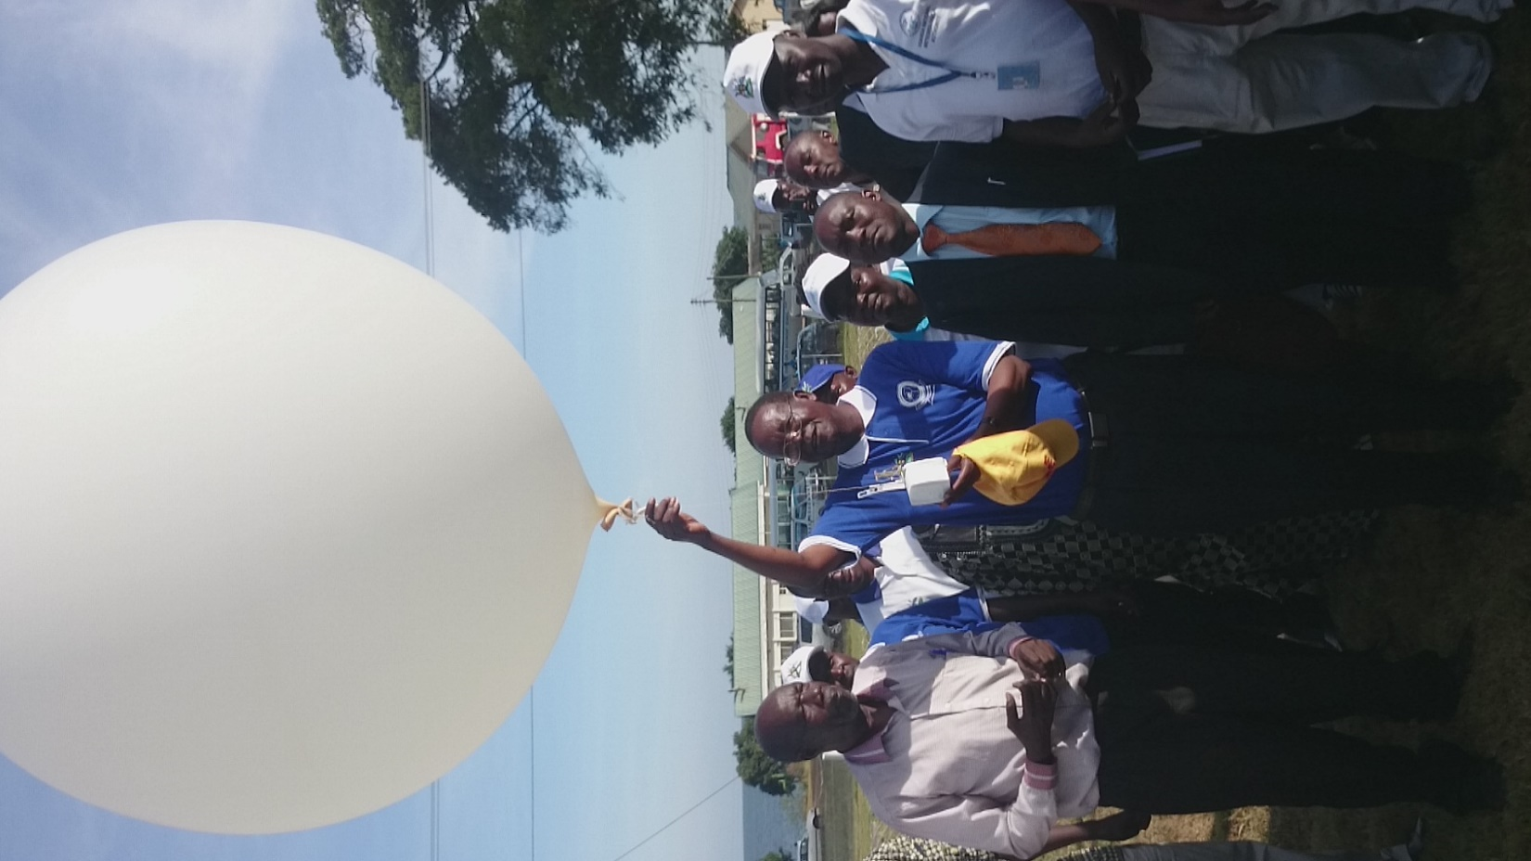
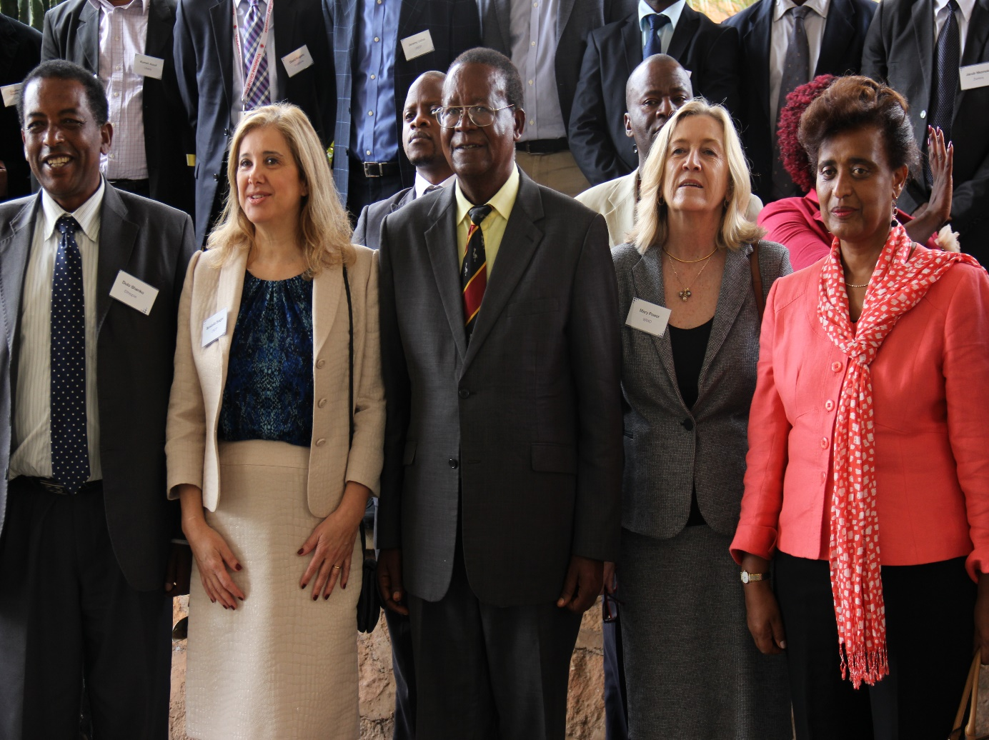
Opening of the March 2015 PPP –UNDP/CIRDA Conference, Golf Course Hotel, Kampala.
Hon. Minister of Water & Environment releases balloon to re-launches the upper air sounding service

Slide 10
Contribution to Key events(visibility):
CIRDA Public Private Partnership conference in Uganda-March,2015;
World Meteorological Day March,2015;
World Water Day-March 2015;
World Environment Day- June 2015;
A week long Agricultural show-July 2015;
UNMA Stakeholders’ workshop May,2015;
International Day for Disaster Reduction(October)

Slide 11
Opportunities:
Political support for meteorological services;
UNMA Act- a legal basis to exercise its mandate;
UNMA has a new Management team that could bring in a new approach to doing business;
Assessment Reports( MDA, Cost Benefit&Market) with options for improving income generation;
Income generation through Govt., partnering with Telecommunications Companies & other private sector;

Slide 12
CHALLENGES:
Operational:
Transition from DoM to UNMA affected NIM hence request for services via UNDP;
Delayed procurement affecting delivery (24% SCIEWS);
Programmatic:
Balancing the status quo and need for innovation in technology transfer;
Demand for high quality and reliable weather data;
Poor visibility of UNMA(DoM)

Slide 13
SOCIAL & ECONOMIC IMPACT:
Nominal impact:
Sectors: Aviation , agriculture, Water Resources , Desaster Mgmt;
Media: radio, TV (UBC), web-site (courtesy of GiZ/USAID), cell phones;
Generally a growing interest/value in meteorological products among population in disaster and hazards prone areas;
The Sugar Corporations /plantations (Kinyara, Kakira) are two key business sectors interested in weather data;
NECOC , MAAIF and CSOs are instrumental in dissemination of data downstream.

Slide 14
FUTURE PLANS:
Integrating SCIEWS outcomes within the CPD 2016-2020 structure;
Strengthening the District structures for utilizing meteorological products;
Linking all weather stations to the NMC/AMSS;
Increasing the density of AWSs (>200) using low price options and improving data quality and services;
Developing applications: contents and packaging weather products for commercial use and the general public;

Slide 15
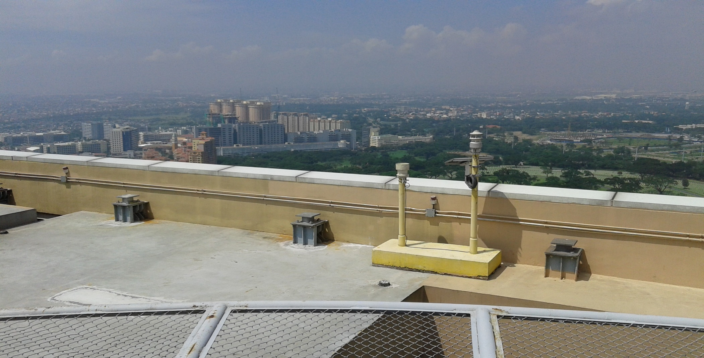
Is mounting AWSs on flats an option??
THANK YOU!!

