Slide 1
United Nations Development Programme
Japan-Caribbean Climate Change Partnership
Project Overview
Yoko Ebisawa, Project Manager
Inception Workshop
26 January 2015
Barbados

Slide 2
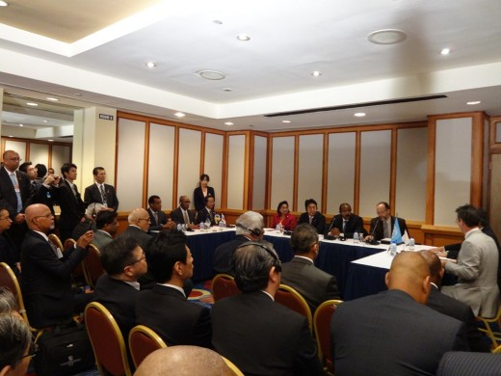
Background
July 2014 Agreement between the Prime Minister of Japan and Heads of CARICOM Member States
Negotiation with the countries
Mar 2015 Project Appraisal Committee
May 2015 Project commenced preparation stage
Oct 2015 1st Board Meeting
Jan 2016 Inception Workshop and Launch

Slide 3
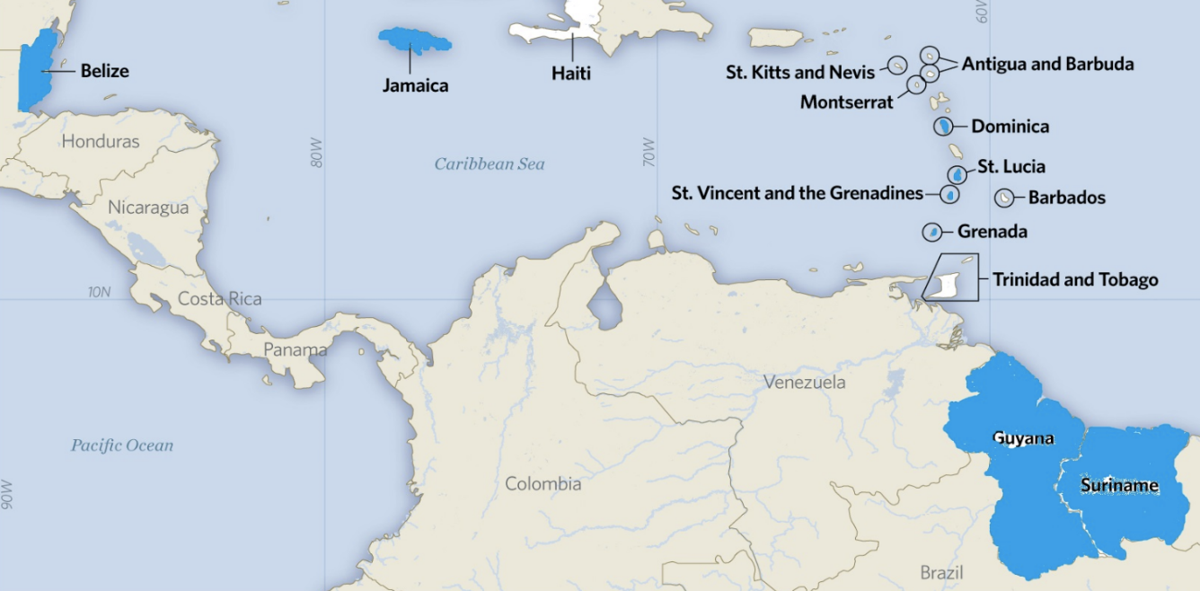
General Overview
Duration: May 2015 until December 2017
Donor: the Government of Japan
Total Resource: JPY 1,526,000,000 (USD equivalent 15,000,000)
Target Countries:
Belize, Dominica, Grenada, Guyana, Jamaica, Saint Lucia, St. Vincent and the Grenadines, and Suriname
Implemented by: UNDP

Slide 4
Outcomes
Notes:
Objectives: The Project aims to support countries in advancing the process of inclusive low-emission risk-resilient development
by improving energy security and integrating medium to long-term planning for adaptation to climate change within, or aligned with, improved development planning and budgeting processes
In the pursuit of this objective, the initiative will support policy innovation through the development of a number of NAMAs and NAPs that will help guide Caribbean countries towards a green, low-emission and climate-resilient development pathway.
The Project will then also support the implementation of actual technology that is both low-emission and advances climate risk management, including demonstration in the target countries.
The Project will also strengthen institutional and technical capacities in selected countries for iterative development of comprehensive NAMAs and NAPs that are country-driven, and based on existing national/subnational development priorities, strateties and processes.
Each country will be able to tailor the specific assistance it will receive as informed by its priorities and needs.

Slide 5
Management Arrangement and the Role of Partner
Project Organization Structure
Project Board
Beneficiary Representative
Beneficiary countries
CARICOM Secretariat
OECS Commission
Executive/Project Director
UNDP SRO, Barbados
UNDP RBLAC Regional Hub, Panama
Development Partners
Government of Japan
Project Assurance
UNDP SRO, Barbados
UNDP RBLAC Regional Hub, Panama
Technical Advisory Group
CCCCC
CIMH
CARPHA
CANARI
CARDI
UWI
CDEMA
UNFCCC RCC
FAO
GWP-C
Project Management Unit (UNDP Barbados)
Project Manager
Two Technical Specialists
Communications Specialist
Project Associate
UNDP Country Offices
Belize, Barbados and the OECS,
Guyana, Jamaica, Suriname
National Focal Points
Belize, Dominica, Grenada, Guyana, Jamaica,
Saint Lucia, St Vincent and the Grenadines, Suriname
Notes:
I will move on the Management Arrangement and the Role of Partner

Slide 6
Management Arrangement and the Role of Partner
Project Management Unit
Position | Name
Project Manager | Yoko Ebisawa
Technical Specialist | Donna Gittens
Technical Specialist | Neisha Manickchand
Communications Specialist | Penny Bowen
Project Associate | Sherri Frederick
National Focal Points
Country | Name | UNDP Country Office
Dominica | Claudine Roberts | UNDP Barbados & the OECS
Grenada | Annlyn McPhie
St. Lucia | Kurt Prospere
St. Vincent and the Grenadines | Ruthvin Harper
Belize | TBD | UNDP Belize Sub-Office
Guyana | Astrid Lynch | UNDP Guyana Office
Jamaica | TBD | UNDP Jamaica Office
Suriname | Sharon Legiman | UNDP Suriname Office
Notes:
I will move on the Management Arrangement and the Role of Partner

Slide 7
Management Arrangement and the Role of Partner
Role of UNDP Offices
UNDP Unit | Role
Barbados & the OECS – Lead Implementing Partner (Co-Chair of the Project Board) | Accountable for the overall leadership, decision making and project management Develop regional work-plan Implement regional actions/activities in addition to OECS Report to Donor Conduct Audit, Evaluations
Regional Hub, Regional Bureau of Latin America and Caribbean (Co-Chair of the Project Board) | Responsible for the oversight and quality assurance Provide technical support
Country Offices (Belize, Guyana, Jamaica, Suriname) | Implement agreed actions/activities into CO level annual work-plans Accountable for activities that have been agreed to for implementation at the CO level

