Slide 1
Nationally Appropriate Mitigation Actions (NAMAs)
Drivers, Needs & Opportunities
Emily Chessin
Representative of Regional Specialist
Climate Change Mitigation, UNDP-GEF
Meister Consultants Group
J-CCCP Inception Workshop
Jan 26-27, 2016
Barbados
Notes:
Good morning, my name is Emily Chessin and I am serving as a representative of the UNDP-GEF Regional Technical Advisor for the Caribbean region on mitigation and I am pleased to be participating in this meeting. I first want to thank the UNDP-OECS office for organizing this important meeting. This morning I am going to give a brief overview of the drivers that have led to the development of NAMAs, what roles NAMAs can plan in a country’s broader development objectives, the support that is often required to develop NAMAs, and what opportunities and support processes are out there to assist country’s in developing and implementing NAMAs. The aim of this presentation is to set the stage for the conversations we will be having throughout this workshop.

Slide 2
The Development of NAMA’s
The Bali Action Plan at 13th Conference of Parties (COP) to the Kyoto Protocol (2007)
Nationally appropriate mitigation actions (NAMAs) are to be undertaken by developing country Parties in the context of sustainable development, supported and enabled by technology, financing and capacity building, in a measurable, reportable and verifiable (MRV) manner.
Notes:
I first want to provide a little background on the development of Nationally Appropriate Mitigation Actions (NAMAs).
NAMAs came out of the Bali Action Plan at COP 13 in 2007.
This was the first time developing countries agreed to develop and implement voluntary mitigation measures.
In the BAP, NAMAs are defined as mitigation actions undertaken by developing country Parties in the context of sustainable development, supported and enabled by technology, financing, capacity building, in a measurable, reportable and verifiable manner.
Given this definition, NAMAs are intended to be a tool to help countries achieve mitigation objectives and a vehicle for channeling international support in the form of technology, financing and capacity building.
After the Copenhagen Accord (2008) and the Cancun Agreement (2009), developing countries started developing and submitting NAMAs to the UNFCCC.

Slide 3
Overview of NAMAs
NAMAs
Sectoral Approaches
Policies & Strategies
Programs
Projects
Aligned with country’s national development plans & strategies
Achieve GHG emission reductions
Sustainable development impact
Monitor, report and verify (MRV) impact
Government coordinated, but involves private sector, civil society organizations, academia, etc.
Unilateral NAMAs: Financed using national funds
Supported NAMAs: Financed using international funds
Notes:
There is no universally accepted definition or rules for what a NAMA is and overtime NAMAs have evolved to take many forms including sectoral approaches, policies, strategies, programs or projects all with the aim of helping a country reduce its GHG emissions.
NAMAs are also classified in one of two ways. They are either unilateral NAMAs meaning they are financed using domestic sources of funding or they are supported NAMAs meaning they are financed using international sources from development partners such as bilateral or multilateral agencies or international climate funds.
NAMAs include a few main elements:
They are to be aligned with a country’s national development plans and strategies
They are to contribute to the mitigation of GHG emissions
The impact of a NAMA should be measureable, reportable and verifiable. This is particularly important for internationally supported NAMAs.
And finally NAMAs should be developed by the government, but should involve a breadth of stakeholders including the private sector, civil society, academia and other relevant organizations that could contribute to NAMA development and implementation.

Slide 4
NAMAs within a country’s development strategy and the UNFCCC process
National Development Strategy
Long-term Strategy
Low-Carbon Development Strategies or Plans (LEDs)
Commitments
Pledge
Intended Nationally Determined Contributions (INDCs)
Mitigation Targets
Activity/
Tools
NAMA
MM
REDD+
Etc.
NAMA
MM
REDD+
Etc.
NAMA
MM
REDD+
Etc.
Source: Boos et al, July 2015, “How are INDCs and NAMAs Linked?”
Notes:
It is important to situate NAMAs within a country’s broader national development objectives. This diagram provides one representation of how NAMAs can fit into a country’s national development strategy. Within a country’s national development strategy they may have a low emission development strategy. In order for the country to achieve its LEDs a country may layout a series of commitments including pledges, intended nationally determined contributions (INDCs) that many countries submitted at COP-21 and/or mitigation targets. There are then a range of mechanisms that countries can use to support their commitments including NAMAs, market mechanisms, REDD+ and other tools.
So NAMAs are really one of the many tools within a country’s toolbox that can be used to meet a country’s national development objectives. It’s important to recognize that NAMAs are not an end in themselves, but a means to an end.

Slide 5
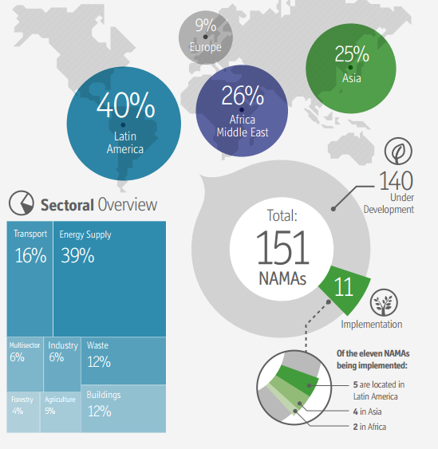
Status of NAMAs Globally
Source: Tilburg et al., 2015, “Status Report on Nationally Appropriate Mitigation Actions Mid-year update 2015.”
Notes:
When we take a look at how NAMAs have progressed over the last few years we see that there has been substantial growth in NAMAs. As of 2015 there were 151 NAMAs worldwide. 140 are still under development and 11 are currently under implementation. When you look at the breakdown of NAMAs across the world, the majority of them have been undertaken by countries in Latin America, followed by Africa and the Middle East, Asia and finally Europe.
It’s interesting to note that there is almost no presence of the Caribbean in this global snapshot. From my understanding only Costa Rica and Dominican Republic have submitted NAMAs to the UNFCCC, but they are often grouped with Latin America.
Over the course of this workshop I am looking forward to exploring and learning why this is the case

Slide 6
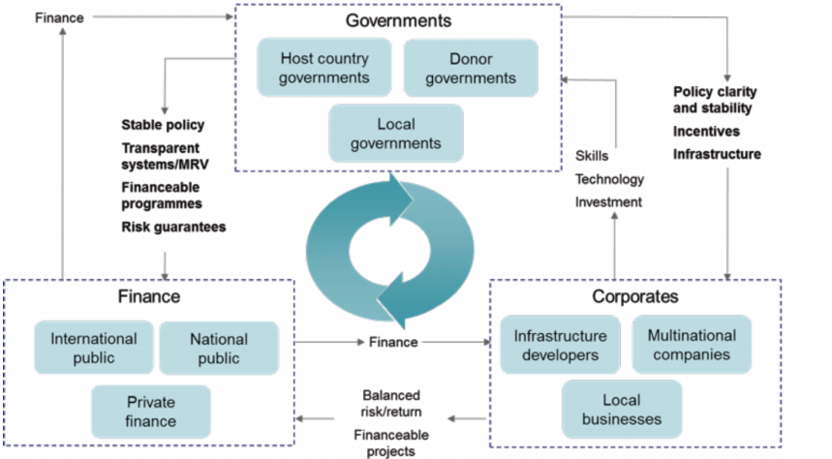
Country Needs: Preparing & Implementing NAMAs
Source: KPMG, 2011
Notes:
But before we discuss the Why I would like to layout some of the support countries may need in order to develop and implement a NAMA.
As this figure shows, developing and implementing a NAMA requires the involvement of many stakeholders from the national government to development partners, the private sector and civil society. Sometimes developing countries do not have the resources required to either develop or implement a NAMA and this is where international support can play a major role.

Slide 7
Country Needs: Preparing & Implementing NAMAs
Political
  Enabling environment for investment
Institutional
  Guidance and staff capacity to prepare NAMAs
  NAMA coordination and managing authorities
  Outreach activities and liaising with donors & investors
  Established public private dialogue & promotion of public-private partnerships
Technical
  National Technical Implementing Entity established
  MRV system in place, operational and well maintained
  NAMA progress and results regularly reported
Financial
Effective allocation of funds
Promoting investment opportunities
Promoting public finance mechanisms to catalyze private investment flows.
Capacity Building
Technology
Finance
NAMA
Notes:
By providing capacity building, technology or financing development partners can support country’s in preparing and implementing a NAMA. This support can assist a country’s various stakeholders in carrying out the many roles required to implement a NAMA.
These roles can be broken down into a few main categories including political roles, institutional roles, technical roles and financial roles.
From the political perspective, the government needs to develop an enabling environment to facilitate the investment in NAMAs.
From an institutional perspective, the government needs to have the staff capacity to prepare a NAM and guidance on how to go about doing this.
From a technical perspective, it needs to have the capacity, financing and technology available to establish, implement and maintain an MRV system
And from a financial perspective it needs to be able to attract public international finance in order to bring in larger scale private sector investment

Slide 8
Opportunities & Support Processes: Development, Implementation & Financing
Japan Caribbean Climate Change Partnership
Mitigation assistance tailored to country’s specific needs
Support development and/or implementation of NAMAs
Strengthen institutional knowledge and technical capacities
Support investment in mitigation technologies via pilot projects (e.g. solar PV for irrigation and electricity needs)
Notes:
Fortunately there are a lot of opportunities for countries to seek out support for developing NAMAs and over the next two days we are going to discuss one of the most recent support mechanisms the Japan Caribbean Climate Change Partnership. As mentioned earlier, the JCCCP is a new support mechanism for NAMAs and NAPs being implemented by the UNDP.
In terms of mitigation, The objectives of the JCCCP is to provide mitigation assistance that is tailored to a country’s specific needs
Support the development and/or implementation of a country’s NAMAs
Strengthen a country’s institutional and technical capacities and
Support the investment in mitigation technologies via pilot projects

Slide 9
Opportunities & Support Processes: Development, Implementation & Financing
A Snapshot of Some Existing Initiatives
UNDP (MDG Carbon/Low Emission Capacity Building)
Climate Technology Centre and Network
GIZ
NAMA Facility (UK)
NAMA Registry
LECB Programme (EU, Germany, and AusAID)
Green Climate Fund
GEF 6
Climate-related ODA (Germany)
International Climate Initiative (Germany)
International Climate Fund (UK)
Climate & Development Knowledge Network (UKAid and Ministry of Foreign Affairs of the Netherlands)
Nordic Environmental Finance Corporation (Denmark, Finland, Iceland, Norway and Sweden)
Bi-Lateral Climate Related ODA (AusAid)
Multi-lateral Climate Assistance (World Bank, IDB, ADB etc)
Notes:
There is also a suite of additional support mechanisms for developing, implementing and financing NAMAs. This slide provides a brief snapshot of some of them and we will be learning more about other support international and regional mechanisms later this morning.

Slide 10
Summary
NAMAs are a tool that can help countries achieve reach their mitigation targets and longer-term national development objectives
Opportunities for J-CCCP and other development partners to support the Caribbean region in preparing and implementing NAMAs
Notes:
In summary NAMAs can provide an opportunity to help country’s reach their mitigation goals and in turn their longer-term national development objectives and low-emission development strategies.
I look forward to learning from you about how NAMAs might serve as a tool to help your country reach its mitigation goals and national development objectives and I am excited to explore how the JCCCP and other development partners can support the region in meeting mitigation targets and objectives.
Thank you.

Slide 11
Thank you!
Emily Chessin
Regional Specialist, Representative
Climate Change Mitigation, UNDP-GEF
Meister Consultants Group
emily.chessin@mc-group.com

