Slide 1
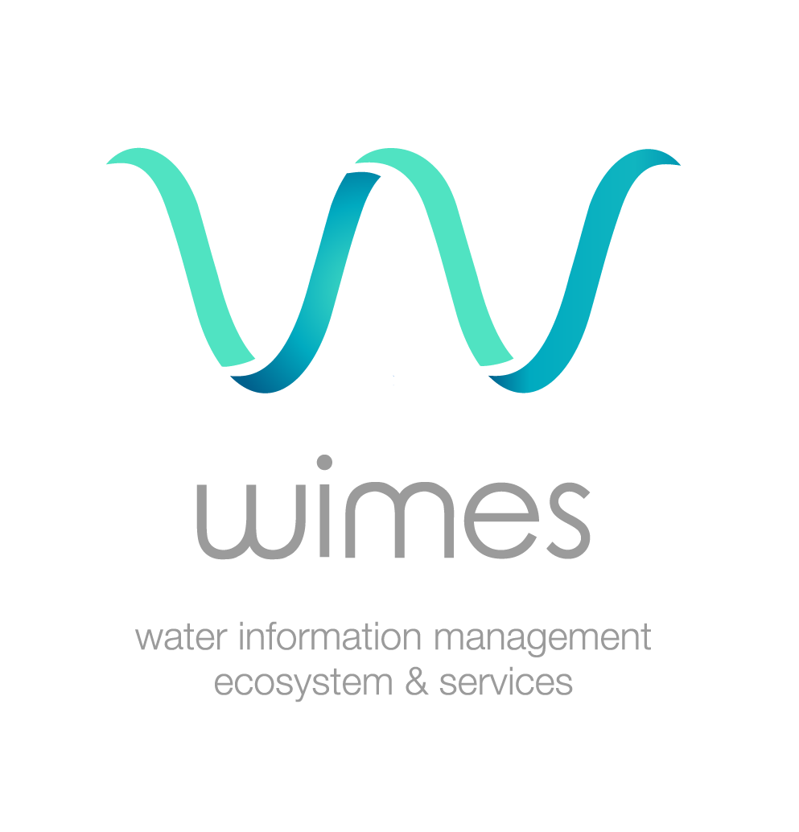
Hydrological Software Solutions for Integrated Water Resource Management
Presentation of the BRL’s WIMES solution

Slide 2
Presentation outline
Integrated Water Resources and Flood Management
WIMES framework & components
Examples
BRL Group and BRL Ingenierie

Slide 3
Presentation outline
Integrated Water Resources and Flood Management
WIMES framework & components
Examples
BRL Group and BRL Ingenierie

Slide 4

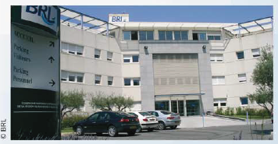
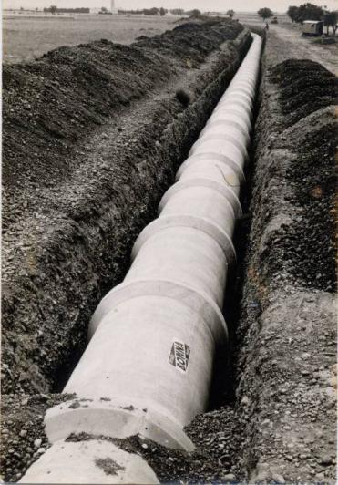
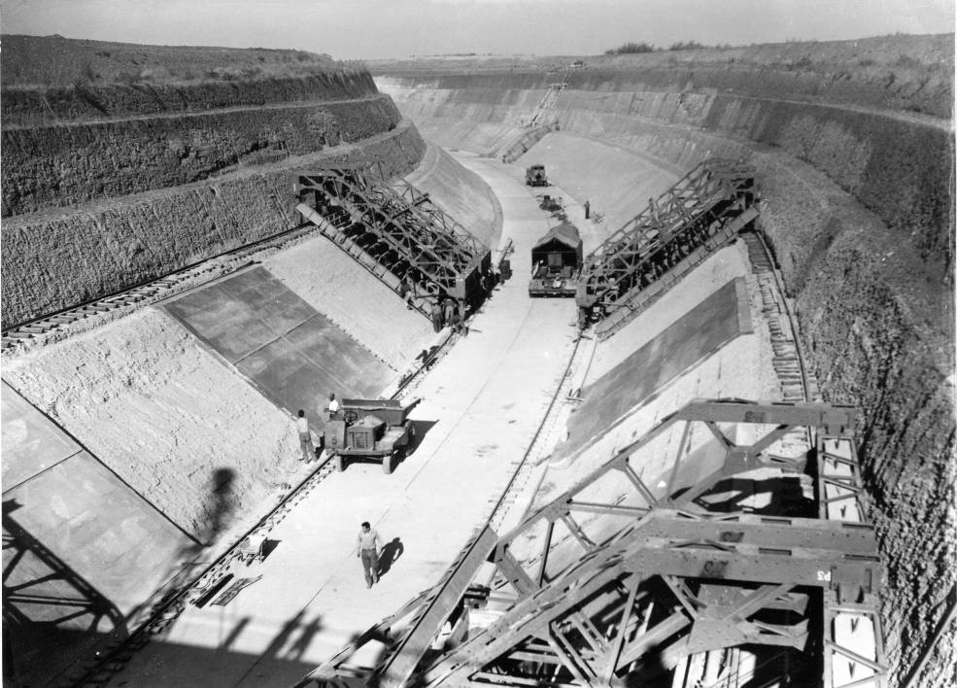
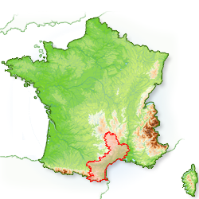
The BRL Group
Founded in 1955
Objective :
    To provide essential water resources to meet agricultural and urban needs (especially in the new coastal resorts)
    To help modernise and diversify agriculture thanks to water

Slide 5
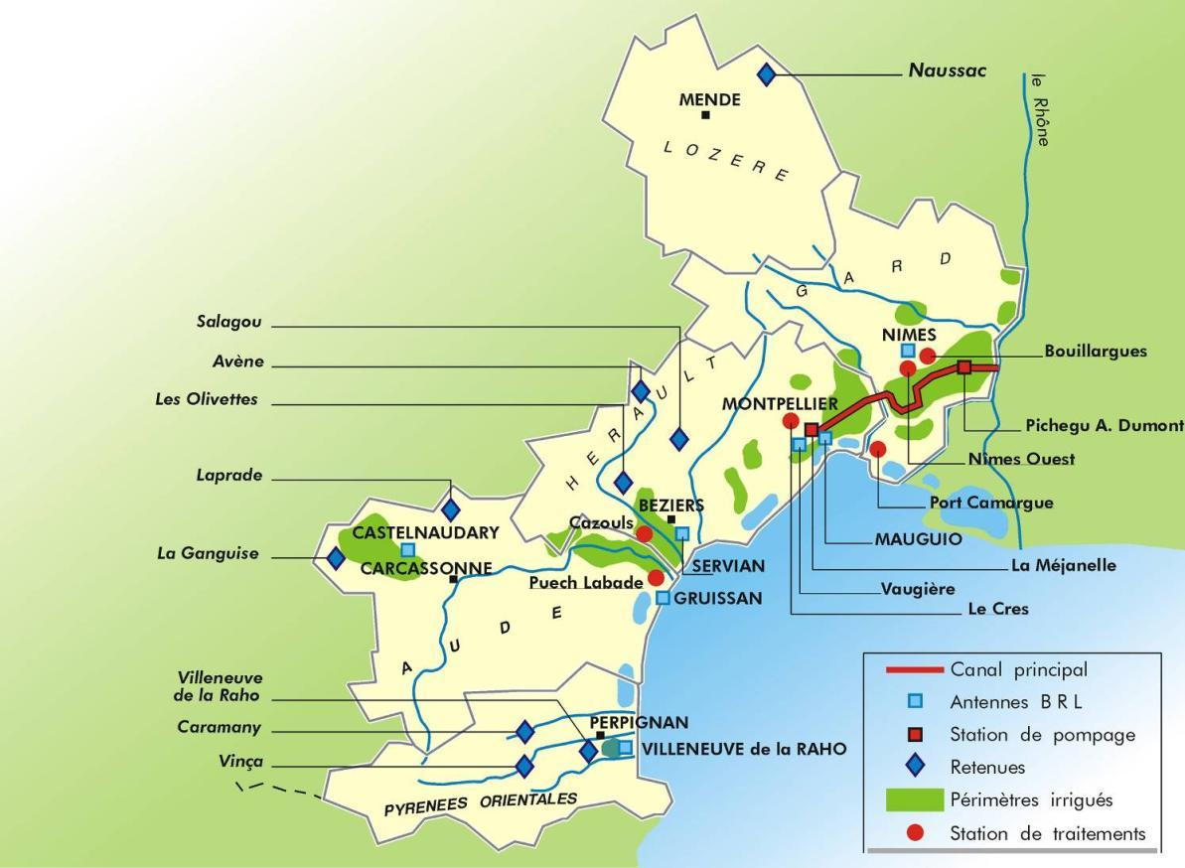
The infrastructures
      3 main licensed intakes with guaranteed water availabilities: the Rhone, Monts d'Orb Dam and Ganguise Dam
      9 dams
      105 km of canals
      125 pumping stations
      5 000 km pressure pipes
      6 drinking water treatment plants
      130 000 ha hectares command area

Slide 6
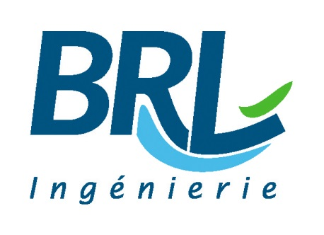

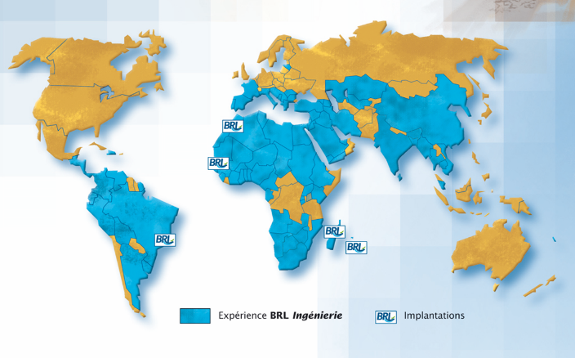
Consulting branch of BRL Group – combining technical expertise and innovation
Turnover 24 million € - 60% abroad – 75% in Africa
200 employees - engineers, experts, highly skilled technicians - A broad spectrum of skills across the fields of water, the environment and land-use management.

Slide 7
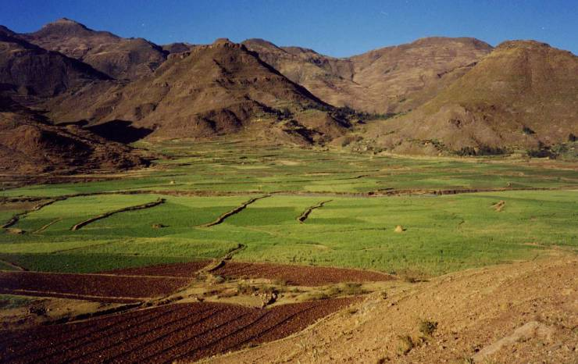
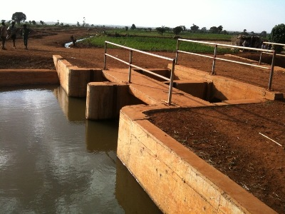
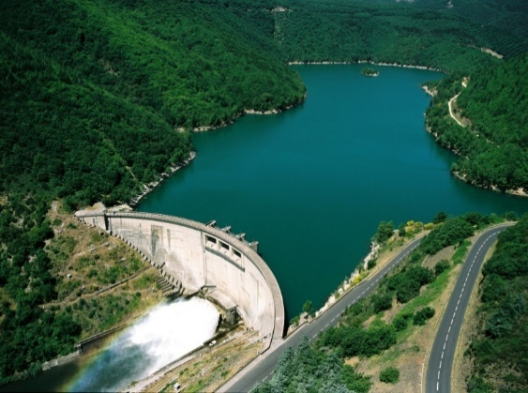

Products and Services
Studies and design
Project organisation
Design, Procurement, Construction Engineering and Management
Support to the Management and operation of water works
Technical Assistance
Asset management assistance services
Training
Institutional Consultancy

Slide 8
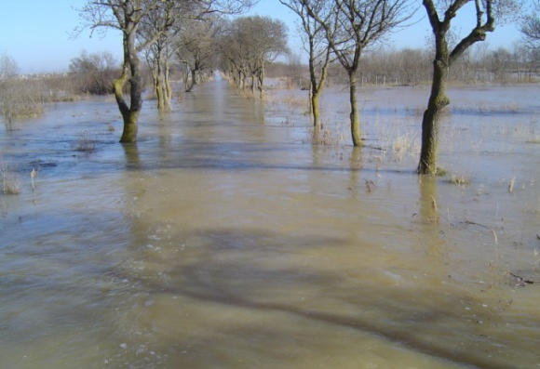
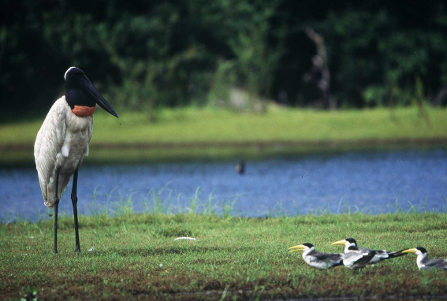
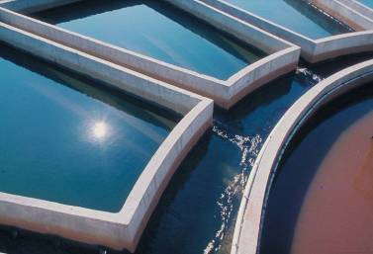
Fields of activity
Water and risk
Integrated water resources management
Drinking water supply and sanitation
Water for agriculture and food security
Large-scale transfers and water works
Regional & Local development
Environmental assessment
Managing biodiversity and natural resources
Sea and coastal areas
Navigation and Ports

Slide 9
Water and Risk Integrated Water Resources Management
Diagnosis and assessment of flood and submersion risk
Risk prevention strategy
Flood Defence
Risk management, surveillance, forecasting and early warning systems
Quantitative and qualitative management
Protection of aquatic habitat
Transboundary river basin management
Water Information Systems
Strategic Planning
Institutional studies

Slide 10
Presentation outline
Integrated Risk management
WIMES framework
Examples
BRL Group and BRL Ingenierie
WIMES components (LTA)

Slide 11
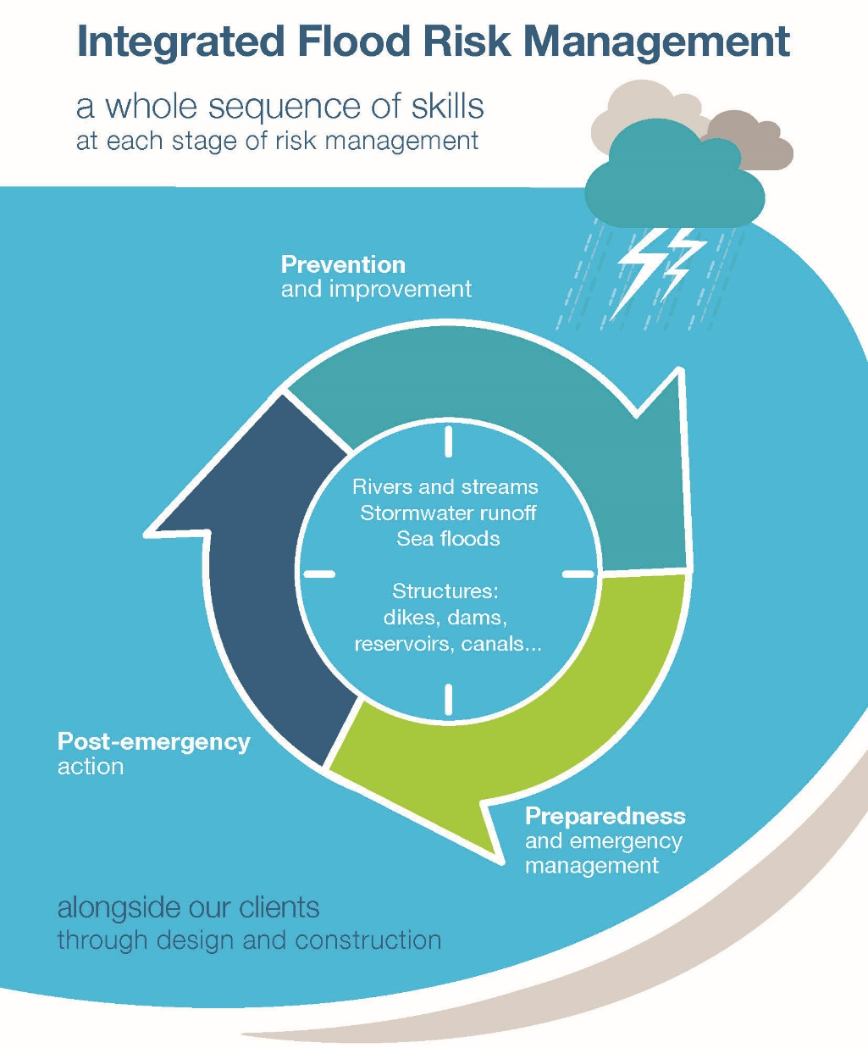
Integrated Risk Management
Risk Management :
3 main stages : BEFORE / DURING / AFTER
BEFORE = prevention, knowledge improvement, anticipation
DURING = decision making
AFTER = improvement by feedback
All natural risks management can be represented by this time cycle

Slide 12
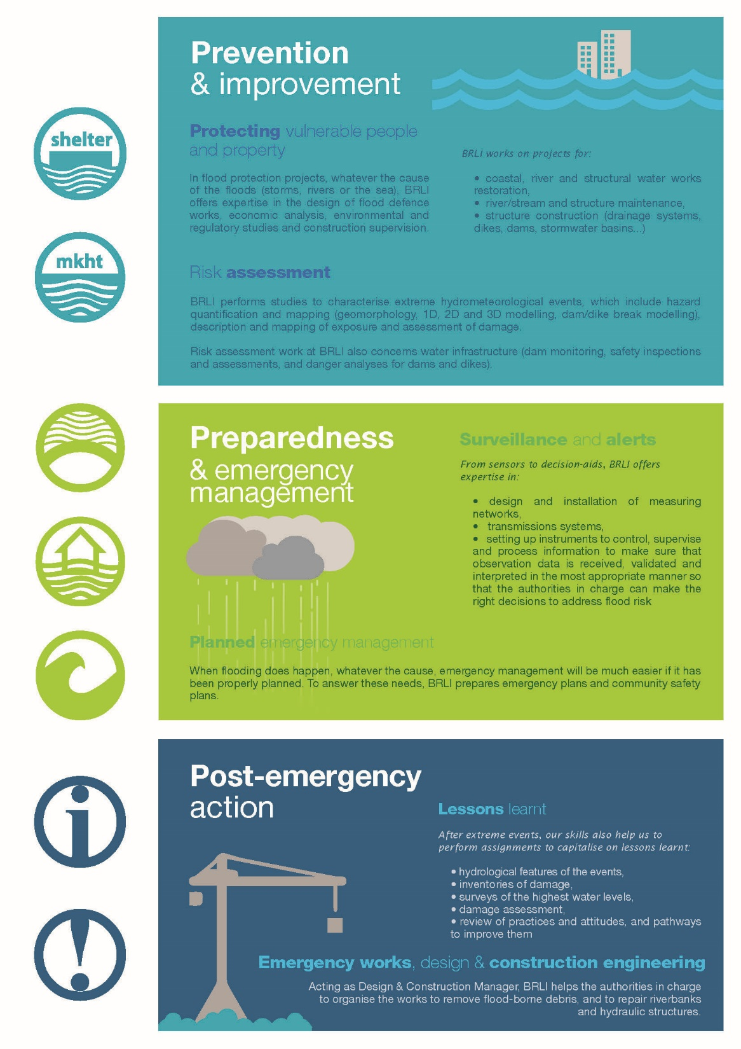
Integrated Risk Management
  Knowlegde improvement and risk assessment
    Characterization hydrometeorological events, hazard mapping, description and mapping of exposure, assessment of damage
  Vulnerable people and property protection
    Design of flood defense work, economic and environmental analysis, construction supervision
  From sensors to decision-aids tools
    Measuring network, transmission system, data quality validation, interpreted data (new data with added value) -> help authorities to make the right decision at the right moment
  Emergency plans
  Lesson learnt
    Hydrological analysis, inventories of damage, review of practices and pathways to improve them,
  Emergency works
Notes:
The prevention phase is probably the longest phase. It include knowledge improvement and risk assessment works such as hazard mapping with hydraulic models or based on field informations, mapping of vulnerable people exposure. This phase corresponds to the normal situation in fact. This phase can also be used to build GIS databases such as the one shown by Sierra Leone during this conference. This information of knowledge of the regions is essential during the decision-making phases.
The emergency management phase is the phase I will develop in the following slides. It’s the main topic of this workshop. the effectiveness of this phase depends on different components from the sensor to the decision-aids tools. Each component is as important as the others.
And as already said several times during this workshop, feedbacks are very important for continuous improvement of the entire decision making process. what worked ? what could be improved ?

Slide 13
Integrated Risk Management
  3 main key concepts will be presented in the following slides :
  Time is a key factor
  A full set of technical inputs improve the efficiency
  A broad vision of the events is essential
  => Major in the decision making process

Slide 14
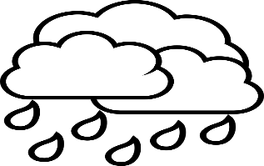

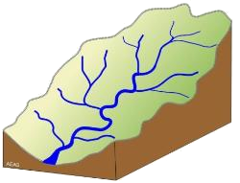



Integrated Risk Management
Real time of the event
with only manual stations, you don’t have enough time to alert before the flood occurs
Time available to send alert
And prepare for flooding
With automatic stations, people can be alerted more quickly and have time to take shelter
With rainfall forecast and hydrological model, people have more time to protect their life and livelihood

Slide 15









Integrated Risk Management
How is the best way to manage naturals risk and to make the decision easier ?
…by combining data and appropriated and user-friendly tools
Field stations network
Efficient transmission system
Decision-makers
faced with
naturals risks
Hydrological model
IWRMS to manage data and tools

Slide 16












Integrated Risk Management
Without central database => ponctual and by sub-catchment vision
+
With central database => ponctual (but at watershed scale) vision
With centralized database and hydrological model, => a global vision at watershed scale

Slide 17

Integrated Risk Management
The same rainfall event doesn’t always lead to the same consequences
Notes:
.

Slide 18
Presentation outline
Integrated Risk Management
WIMES framework
Examples
BRL Group and BRL Ingenierie
WIMES components (LTA)

Slide 19
Conceptual Framework
WIMES® is a registered trademark of the BRL Group, a set of services with a software platform intended for local authorities, public and private enterprise, and national and international institutions in charge of risk management, water resource management and managing the associated water infrastructure assets.
The idea is to bring a customized solution covering all the issues to address, from data acquisition to strategic planning: from big data to smart decisions.
WIMES is an open, modular, upgradable, scalable solution which aims to:
Produce a tailored system fitting with the specific user requirements,
Avoid useless functionalities,
And involve end-users during the implementation.

Slide 20
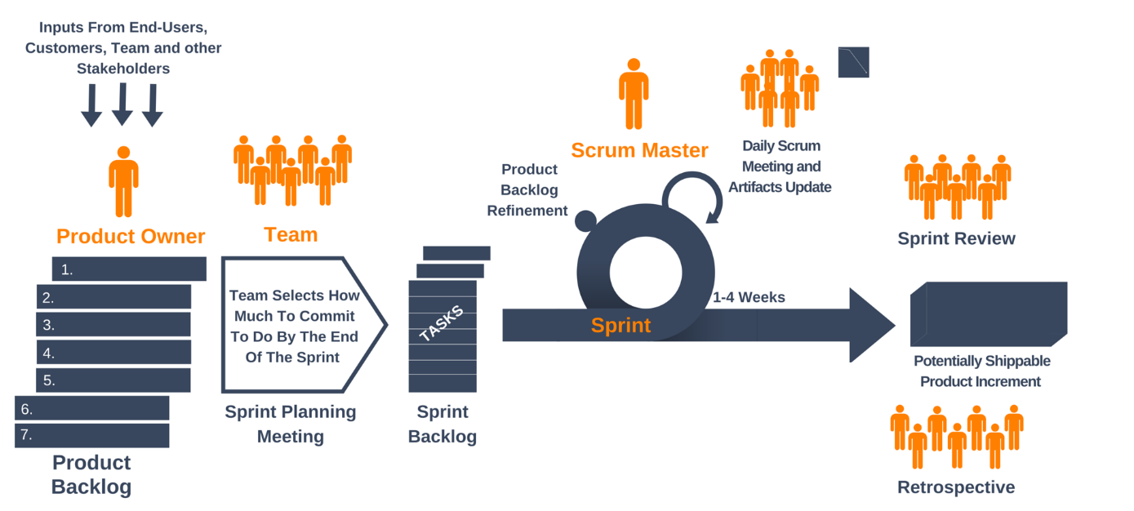
Agile Framework
Iterative and incremental development of the expected features in short cycles (3 to 4 weeks) “Delivering value in each iteration”: the SCRUM method
Reduction in the technical debt / test driven development: the XP method
The design process is industrialized beyond development: the DEVOPS method
A multi-discipline team:
  - DEV: Front End, Back End & specific expertise developers (hydrologists, etc.),
  - OPS: Technicians, Support and Administrators.

Slide 21
Software components
WIMES provides software components for building:
Data collection platforms of measurement, field observation, forecasting dataset, hydrological indicators and modelling tools
Real time interfaces with existing data collection platforms using OPC standard or customized API
User interfaces for batch data import or single observation data entry, available both from a laptop, workstation or from a mobile device
Statistical and hydrological analysis using R engine
Data dissemination using web services
Data export and file download
Data visualization components such as maps and charts, customizable as per business requirements
WIMES embeds a Content Management System, which allow web sites administrators to:
Manage Users and Roles – The user right management system apply to the content of the web site and to the data dissemination API as well,
Create, Update and remove web pages, manage page users access,
Insert functional module existing web page, manage module users access.

Slide 22
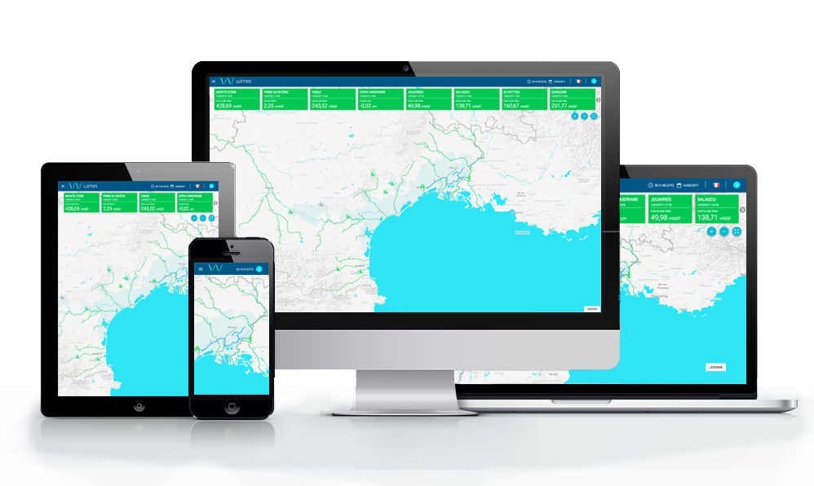
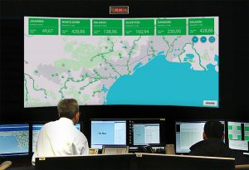
High-Tech Solutions
Which meet international standards and safety criteria
Big Data including document storage and research
A real-time web application solution based on Open Source technologies
Docker, Java Play, React/Redux, postgreSQL/postGIS
Satellite data integration: satellite imagery and altimetry data
HPC (High Performance Computing)
RWD (Responsive Web Design) solution

Slide 23
Presentation outline
Integrated Risk Management
WIMES framework
Examples
BRL Group and BRL Ingenierie
WIMES components (LTA)

Slide 24
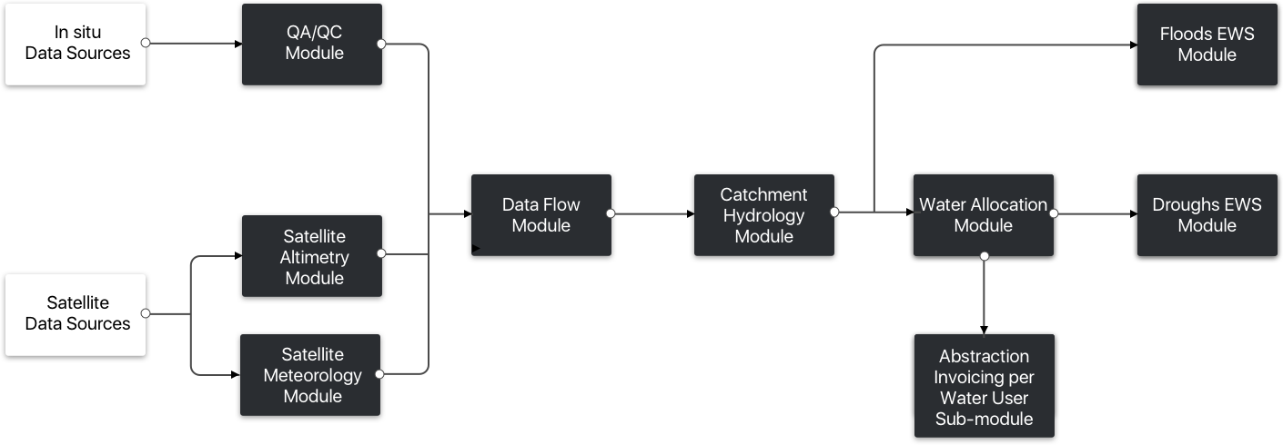
Functional Architecture

Slide 25
Managing Data Flow
Bibliographical data
  Hydrological studies, flood prevention reports, Water & Irrigation Master Plans, etc.
GIS data
  Administrative regions, etc.
  Basins and sub-basins delineations, hydrographic network, etc.
  River gauging stations, rainfall stations, weather stations, groundwater stations
Observation data format based on software and proprietary standards :
  Automatic or manual stations
  Weather, hydrological, hydrogeological,… stations
  Probably tabular files (Excel, .csv, .txt) used to store historical data at the meteorological centers, to be loaded in the IWRMS
Satellite-based and grid-based observation & forecast data
  Cloud-based data, less dependent of the local context
  Idem, excepted seasonal forecast weather data shared by the meteorological centers.

Slide 26

Quality assessment and control
WIMES proposes a large panel of features for real-time checking, error detection, data cleaning, data flagging, bias corrections and rating shift management. Automated procedures eliminate the majority of the tedious manual data workup processes:
  Automate QA/QC to produce real-time data end-users can trust,
  Spend time on high value analysis by automating low level data cleaning,
  Get timely email warnings of hydrological events & sensors failures issues.
WIMES automatically builds a data processing, correction, and editing log. The audit log tracks all corrections, metadata, notes, and remarks for time series data, by reviewing a log to quickly find who performed what, when, and why:
  Maintain a permanent record of all your original data,
  Data quality control workflow,
  Apply data grades (quality codes) to time series data.

Slide 27
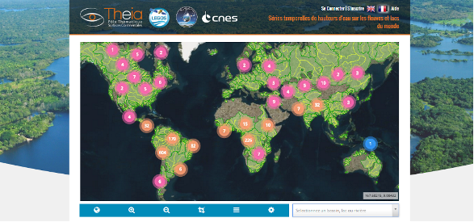
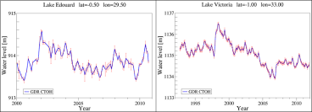
Satellite altimetry water level monitoring system
Data sources
► SWOT will be launched in April 2021
Data processing
The Satellite altimetry water level monitoring module will use Hydroweb services.
Output
Water level time series at « virtual » river gauging stations (intersection of the satellite traces and river branches) to complement the in situ hydrometric network.

Slide 28
Satellite soil moisture/ETP monitoring system
Data sources
Soil moisture
Rainfall & ETP : EUMETSAT Services (observed & forecast)
Data processing
The Satellite evapotranspiration monitoring module developed, use EUMETSAT services delivering every 30 minutes or daily by FTP services.
Output
Meteorological time series for each sub-basin for hydrological modelling used by the next modules: catchment hydrology, water resources allocation, floods, droughts.

Slide 29
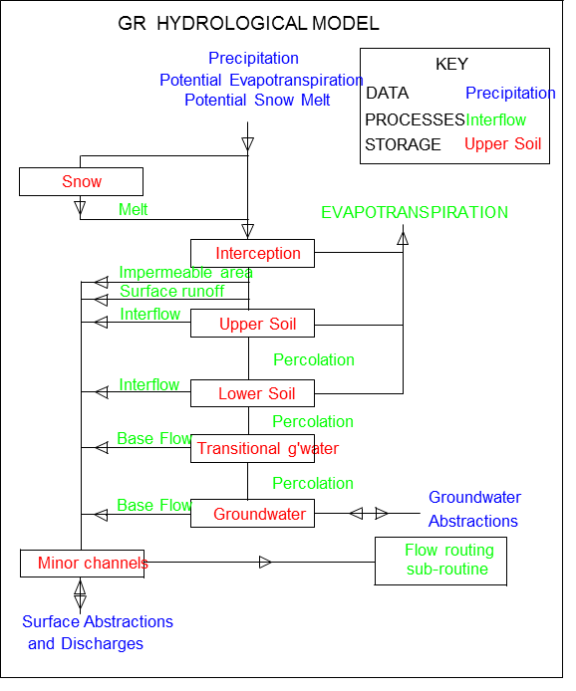
Catchment hydrology
The hydrological modelling tools include:
Rainfall-runoff modelling with the GR-suite developed by IRSTEA,
River discharge routing with parametric hydraulics routines (modified Puls, Muskingum and series of reservoir models),
Stage-discharge rating curves to convert river water levels into river discharges.
These hydrological and hydraulics tools are coded in R packages and are fully integrated within WIMES.

Slide 30
Water resources allocation
The HSS will include a Water resources allocation planning module that can:
Receive data from the HSS,
Combine these with data on abstraction of water by water users,
Provide an overview of these abstractions and the impact thereof on the water balance.
The module will be set-up with the following inputs:
The input data concerning the water resources (surface water and ground water), the water users (time series) and the reservoirs (main characteristics),
The input data concerning the water losses and gains (e.g. losses in line and net losses for reservoirs and lakes),
The “hard” constraints related to mitigation measures (e.g. minimum flow requirement for environment),
The water allocation rules.

Slide 31
Floods
River level alarm levels (based on observations):
For all water courses wider than 5m, the operator will be able to pre-set alarm levels which, if the observed water level exceeds these, prompt the operator via an electronic message (via email and SMS).
Based on short (1 day) and medium range (up to 10 days at least) weather forecasts, obtained from the meteorological service and/or from NOAA's Global Forecast System or the ECMWF's Integrated Forecast System, the HSS will be able to calculate river levels at the same time-scales.
Based on the river level forecasts, the HSS will be able to provide riverine flood advisories, watches and warnings.

Slide 32
Droughts
The HSS will include a Drought monitoring and forecasting module that, based on the available data on river streamflow, ground water levels, soil moisture and/or evapotranspiration, can monitor droughts and provide forecasts for droughts:
For agricultural droughts, the HSS will retrieve satellite derived observations of actual and potential evapotranspiration and/or satellite derived observations of soil water status.
For hydrologic droughts, the HSS will provide forecasts, based on satellite observations, data from existing in-situ observation systems, and seasonal weather forecasts.

Slide 33
Presentation outline
Integrated Water Resources and Flood Management
WIMES framework
Examples
BRL Group and BRL Ingenierie
WIMES components (LTA)

Slide 34
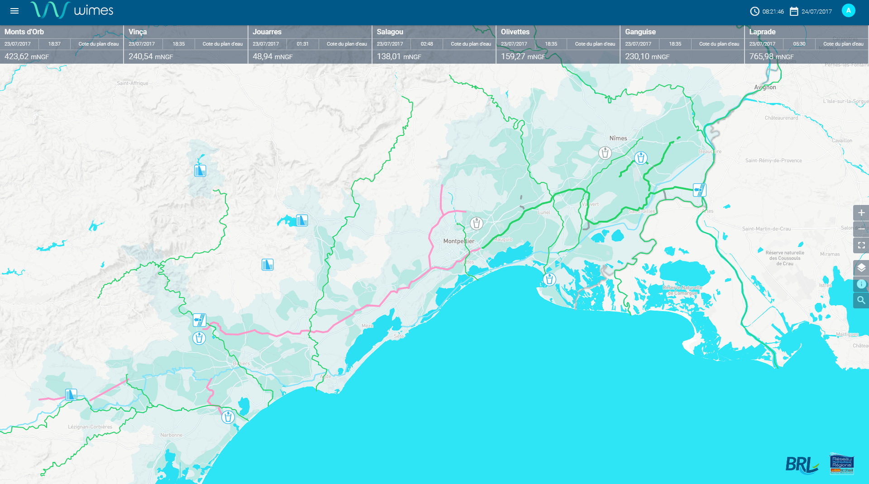
Examples of screenshots
Example of HSS powered by

Slide 35
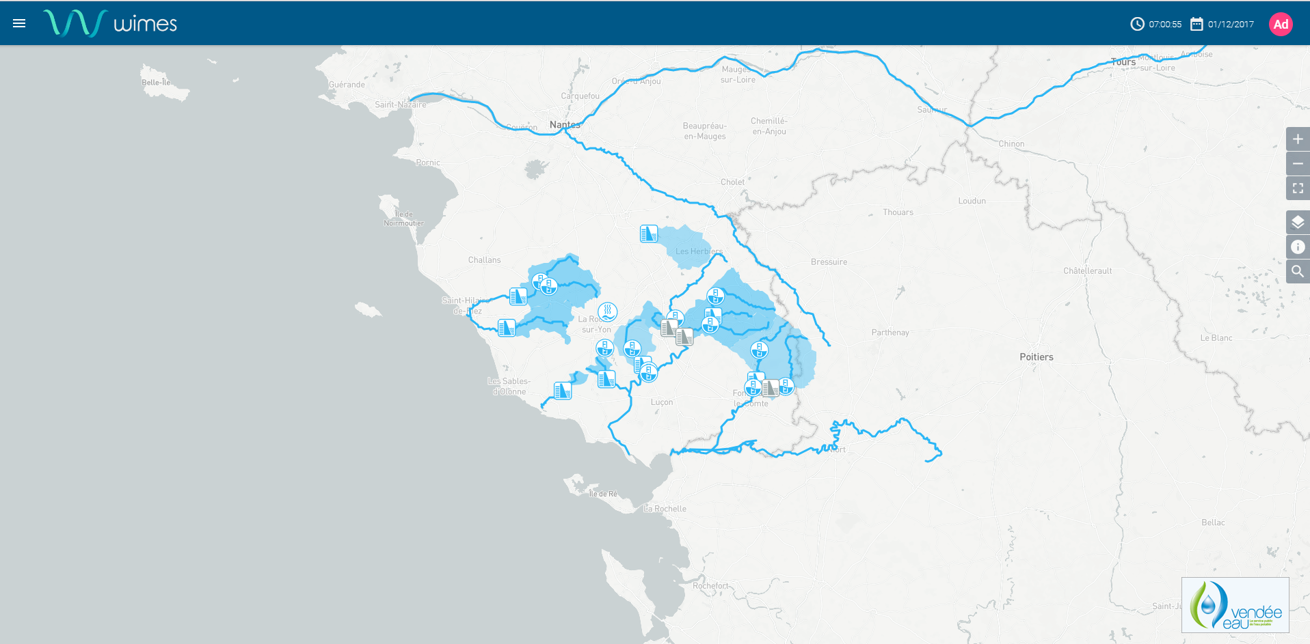
Examples of screenshots

Slide 36
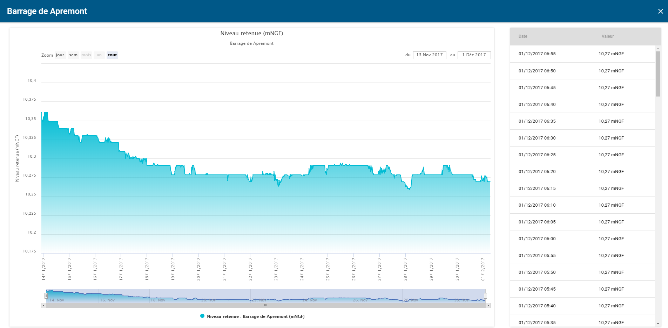
Examples of screenshots

Slide 37
Thank you for your attention

