Slide 1

Experience of Armenia: building resilience through integrated climate change adaptation and disaster risk reduction
Side Event at COP 22, Marrakech, Morocco
Republic of Armenia
Simon Papyan
Deputy Minister of Nature Protection of the Republic of Armenia
November 16, 2016

Slide 2
Republic of Armenia
Total area – 29,743 sq. km
Population – 2,998,600 (2016)
Landlocked mountainous country

Slide 3
Climate Change and Adaptation in Armenia
Ministry of Nature Protection is the responsible agency for UNFCCC
and development and coordination of National Adaptation Plan
Ministry of Emergency Situations is responsible for disaster risk
management, including hydrometeorological observations and early
warning system
Climate change impact in Armenia
Mean surface temperature is increased by 1.22 degree Celsius
Precipitation decreased by 10%
Intensification and increased frequency of extreme weather events
Degradation of the potential of the mountainous ecosystems environmental services
Shifting of the agroclimatic zones

Slide 4

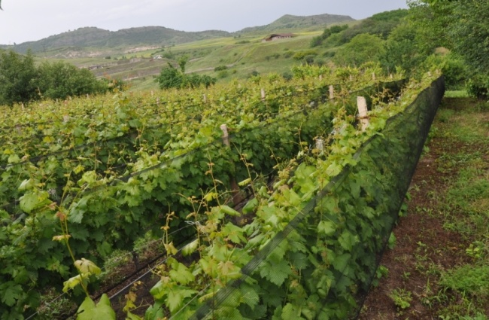
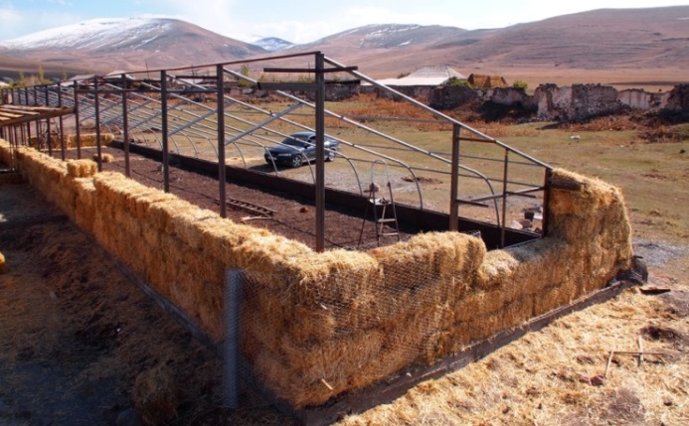
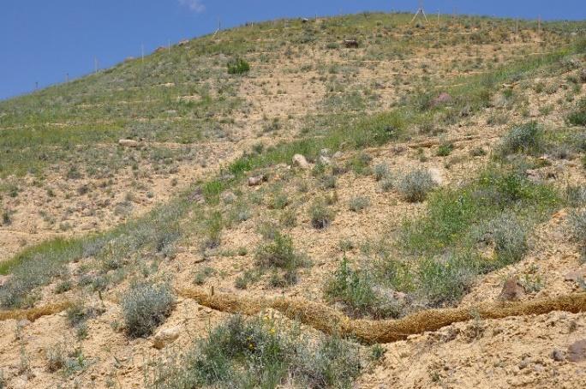
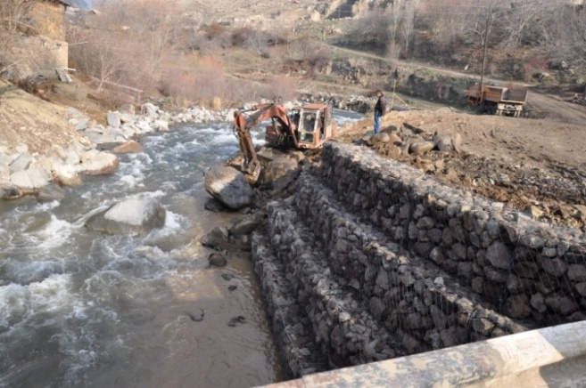
Pilot Projects under
“Integrated Climate Risk Management Programme” UNDP
2013-2016
2 pilot regions, 8 rural communities
Anti-hail nets
Passive solar greenhouse
Enforcement of river banks
Installation of straw wattles
Terrace orchards
Drip irrigation

Slide 5
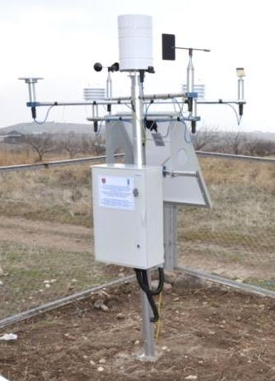
Strengthening of National Institutions’ Capacity
Training of the staff of Hydrometeorogical Service
Automatic agrometeorological stations
Website of agrometeorological unit of the Service for timely provision of information on extreme weather events to farmers

Slide 6
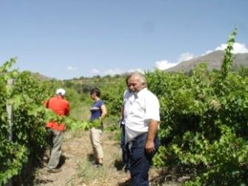
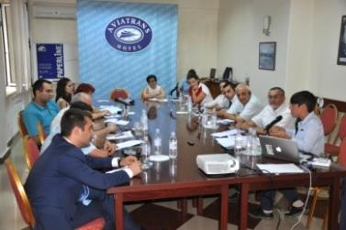
Agricultural Insurance
Needs assessment on introduction of the Weather Index Insurance helped to held discussions with Ministry of Agriculture and insurance companies in the country
Contributed to follow-up activities by the Ministry of Agriculture and cooperation with KfW and insurance companies

Slide 7
Integration of Climate Risk Mitigation in National and Local Planning Processes
The Disaster Risk Reduction National Platform is used for increasing stakeholder participation in informed decision making on climate change risk management
Climate Change and Disaster Risk Management is integrated in the guidelines for development of 4-year community development plans
The tools for local level risk assessment are developed
The assessments and lessons learned are considered in the course of development of National Adaptation Road Map, Technology Needs Assessment, Disaster Risk Management National Strategy under Sendai Action Plan for 2016-2030 (pending approval).

Slide 8
Thank you!
Շնորհակալությու՛ն

