Slide 1
Japan Caribbean Climate change partnership (JCCCP)-
Supporting regional climate Action
UNDP/J-CCCP, Donna Gittens
The Caribbean Community Climate Change Centre

Slide 2
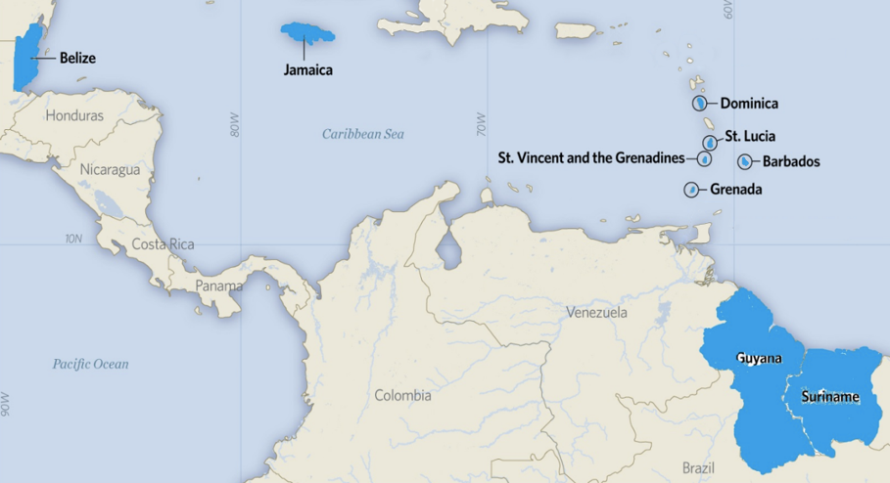
Project Background
Duration: May 2015 until December 2018
Donor: the Government of Japan
Total Resource: JPY 1,526,000,000 (USD 14,892,923.12)
Target Countries: Belize, Dominica, Grenada, Guyana, Jamaica, Saint Lucia, St. Vincent and the Grenadines, and Suriname
Implemented by: UNDP
Notes:
The year 2014 was Japan-CARICOM Friendship Year and commemorative events were held in Japan and CARICOM member countries to enhance the Japan-CARICOM relationship in diverse fields such as culture, trade and tourism. ​
In July 2014, Japan-CARICOM summit meeting was held in Trinidad and Tobago. In that occasion, Prime Minister, Mr. Shinzo Abe presented Japan’s CARICOM policies consisting of 3 pillars. One of them was ​
“cooperation towards sustainable development, including overcoming the vulnerabilities particular to small island states”.​
During this occasion, the agreement was made between UNDP and the Government of Japan for this Japan-Caribbean Climate Change Partnership.

Slide 3
Main Objective
To support countries in advancing the process of inclusive low-emission climate-resilient development by improving energy security and integrating medium to long-term planning for adaptation to climate change within, or aligned with, improved development planning and budgeting processes.
Notes:
support policy innovation through the development key policy documents as drivers towards achieving the objectives outlined in the INDCs
support the implementation of actual technology that is both low-emission and advances climate risk management, including demonstration in the target countries for improved climate resilience

Slide 4
Barriers and Limitations
Strengthening of horizontal and vertical coordination for advancing climate change adaptation planning for the medium to long-term.
Coordination
Limited human resources
Resources and capacity
Information availability and access
Relevant information needed to make climate-smart investment decisions. Climate information must be integrated with key economic, political and social information.
Integration into planning and budgeting
Need for climate-resilient planning and budgeting to be embedded within the existing annual/periodic planning and budgeting processes.
Notes:
A number of barriers were noted in the design of the project which I am sure are not unfamiliar to anyone working in the region
Many of these have been considered during implementation to address these challenges and many of the project activities speak to tackling them

Slide 5
How does the JCCCP address…
Activities established to strengthening institutional and technical capacities for NAP and NAMA development
Climate Policy
Actions towards support of the incubation of climate technology as practical measures to enhance climate resilience.
Active community engagement for, identification and selection of community level adaptation and mitigation measures
Climate Technology
Community Engagement
Notes:
Climate Policy Level
Activities have been established with the objective of strengthening institutional and technical capacities for iterative development of comprehensive NAPs and NAMAs in selected Caribbean countries.
There is a demonstrated need for policy instruments such as NAMAs and NAPs to provide tailored frameworks to expand access to clean energy and to prioritise adaptation measures in diverse sectors
Such frameworks can harness climate finance and help reduce the overall risk environment for potential investors, spurring actual investment in clean energy and adaptation technologies
Where countries have already initiated this process the project will build on and address gaps in current activities. This will operationalise the request by parties to the COP for assistance with their long-term adaptation and mitigation planning needs.
Climate Technical/ Research Level
The initiative will support the incubation of climate technology into targeted public sector organisations and community groups and enterprises so that green, low-emission climate-resilient technologies can be tested, refined, adopted, and sustained as a practical measures to enhance national, sub-national and community level resilience.
Stakeholder capacity needs assessment and an analysis of national priorities should be carried out as part of the activity formulation and guide the programme management setup, and forms the basis upon which resources are provided for support
Climate Individual/ Community Level
Active community engagement at for all aspect of the initiative, inclusive of policy development, identification and selection of appropriate climate technologies and implementation of community level adaptation and mitigation measures for improved community level response and resilience
Sustainability of on-the-ground activities will be achieved through the active participation of local communities in the implementation of the adaption measures proposed by the project

Slide 6
Project Approach
Notes:
We address each of the areas under the three main components of the project
​
1st component supports medium to long-term adaptation and mitigation planning through developing Nationally Appropriate Mitigation Actions (NAMAs) and National Adaptation Plans (NAPs). ​
​
2nd component facilitates actual technology transfer that is both low-emission and advances climate risk management at the community level and to implement relevant adaptation measures.
​
3rd component,
Supports strengthen knowledge networks to
Fosters south-south cooperation and north-south cooperation through sharing experiences and lessons leaned on climate change mitigation and adaptation policies and initiatives, natural hazard risk and resilience
​

Slide 7
Outcome 1: National Adaptation Plans (NAPs)
Belize
Integrated National Adaptation Plan for the Agriculture and Water Sectors
Guyana
Overarching National Adaptation Plan which builds on the draft Climate Resilience Strategy and Action Plan (CRSAP)
Jamaica
Nap Coordination Support to support ongoing adaptation work and mobilization the national focal point network
St. Vincent and the Grenadines
National Adaptation Plan with sector action plan and investment strategy for one priority sector
St. Lucia
National Adaptation Plan with sector action plan and investment strategy for one priority sector
Suriname
Overarching National Adaptation Plan which builds on the draft National Climate Change Policy Strategy and Action Plan (NCCPSAP)
Notes:
Utilising the NAPs as a framework for the identification of medium- and long-term adaptation needs towards the development and implementation of strategies and programmes to address those needs. ​
​Undertaking this work in 6 countries Belize, GUY, JAM, SVG,SLU and SUR). ​
​Undertook a consultative process and a comprehensive baseline assessment of climate actions identify suitable interventions based on the existing initiatives and efforts in each country. Each interventions was based on the country’s unique needs. ​
​For example, we support over-arching National Adaptation Plans for St. Lucia and St. Vincent and the Grenadines, but we focus on Agriculture integrated with Water Management for the National Adaptation Plan in Belize. ​
​In Jamaica, as other development partners have already supported this area, we will support the government to enhance their coordination capacity. ​
​We are coordinating with other UNDP global initiatives and other development partners, such as NAP Global Support Programme. This is a joint programme by UNDP and UN Environment Programme (UNEP) which have already supported various NAP processes in the world. We also coordinated closely with NAP Global Network, which enhances bi-lateral coordination on NAP process supported by US and German government. ​

Slide 8
Outcome 1: Nationally Appropriate Mitigation Actions (NAMAs)
Energy Sector
Transport Sector
Water Sector
Dominica
Grenada
Guyana
Suriname
St. Lucia
Belize
St. Vincent and the Grenadines
Jamaica
Determination of Standardised Baselines for the highlighted countries in collaboration with UNFCCC
Model to be utilized determine the SBLs for Transport Sector
Notes:
In order for us to support this activity, we consider the NAMA as a tool to implement National Determined Contributions (NDCs), which each Party should prepare according to the Paris Agreement.​
​The J-CCCP project is supporting all of the beneficiary countries
Prior to the initiations, we conducted two-day seminars in 6 countries in order to enhance understanding the concept and key elements of NAMAs, based on which each country identified their priority area of focus. ​
​Sectors selected related to Energy Production ,introduction of renewable energy , greening transportation sector or the improved efficiency towards reduced energy consumption in the Water Sector all of which are consistent with their NDCs. ​
​​Support has been provided by the UNDP LECB and the UNFCCC. At present UNFCCC is preparing to undertake SBL calculation training in 3 countries this year
Data has been challenge especially with respect to those countries who are undertaking activities within the Transport sector. Information on fuel consumption is not readily available. Consideration being given to modelling the emission factors for these countries based on information, on traffic flows, drive cycles and topography etc.

Slide 9
Outcome 2: Community Level Interventions
Demonstration Projects
Water Resource Management
Sustainable Agriculture
Community Based Climate Smart Infrastructure
Renewable Energy and Energy Efficiency
Notes:
​
Under the 2nd component of the project, we will be supporting the implementation of 36 pilot projects across
​
We have four priority focus areas listed here: Water Resources Management, Sustainable Agriculture, Community-based, Climate-Smart Infrastructure, and Renewable Energy and Energy Efficiency. ​
​
Each country has decided their interventions according to their priorities. ​Development of projects was top or bottom up dependent on the country.
​
One of the popular initiatives is related to water resources management. The picture here was taken in Jamaica in February. In this community of Victoria, Clarendon. Several times per week, they trek with carts and donkeys to fetch water from the river. The proposed project try to improve their water availability during draught, by rehabilitating their old rain-water harvesting system. ​
​
Another popular initiative is related to sustainable agriculture, and especially address to the adaptation to the drought. The picture was taken in St. Vincent and the Grenadines in February. This farm belongs to one of the committed young farmers. This project is to promote adaption of climate smart agriculture among small-scale producers by establishing model plots with rainwater harvesting systems with drip-line technology, and provide soil conservation measure. This project will be conducted with an Inter-government organization, called Inter-American Institute for Cooperation on Agriculture (IICA).

Slide 10
Outcome 2: Community Level Interventions
Status | No. of proposals | Country
Approved | 22 | BZE(1), GRN(4), GUY(1), JAM(3), SLU(2), SVG(7), SUR(4)
TAG Review | 5 | DOM (2), GRN(1), SLU(1), SUR(1)
PMU Initial Screening | 7 | DOM(2), GRN(3), SVG(1), SUR(1)
Proposal Development | 2 | GUY(1), SUR (1)
Total | 36

Slide 11
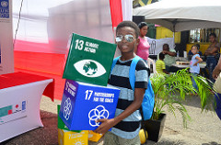
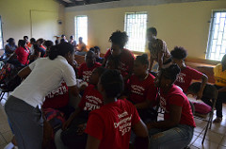
Outcome 3: Strengthen Knowledge Networks
KAPB Studies
Research driven approach to knowledge sharing and climate communication KAPB Studies
Communication Campaigns
Increasing climate knowledge and promoting behavior change
North-South Training and South-South Cooperation
Capacity building and regional knowledge exchange
Youth Empowerment
Sensitization, exposure and awareness building
Notes:
Undertook Knowledge, Attitude and Practices/Behaviour (KAP/B) studies to understand the public’s knowledge of climate change and how best to tailor and disseminate climate information. Based on this results, com strategies and coms campaigns were undertaken ​
​
Study tours in order to obtain knowledge on related technology from Japan. ​
​
South-south cooperation NAP Assemblies
​
Youth – Games, YCC ongoing in Jamaica (40 youth from 8 beneficiary countries, delegates from Sophia University in Japan and youth from across Jamaica)- Partnering with Ja REECH, GOJ and USAID- CYEN was a key partner in the initiative as well.

Slide 12
What have we learned so far
Integration of gender considerations in national strategies and climate activities can be incredibly challenging
Substantial amount of knowledge at the community level of the impacts of climate change
The level of resources (human, financial, information etc.) needed to implement key climate actions is often not adequately considered
A number of climate coordination mechanisms exist but many are not functioning optimally
Integration of climate considerations at a broader government level can be viewed as a burden
The need for robust baseline data needs to be underscored
Notes:
Ensuring that there is an understanding of how gender considerations re responsiveness and mainstreaming can be undertaken and are included

Slide 13
What have we learned so far
Continuous monitoring, evaluation and reporting is paramount to ensure impacts and to communicate results to the wider community
Comprehensive records are necessary for capturing key lessons and to contribute to the refinement of national baseline information
Regional Collaboration is critical to maximizing resources and multiply impacts

Slide 14
Supporting Climate Action
Climate policy development and frameworks for improved planning and integration into existing planning and budgetary frameworks
Innovation and adoption of technologies for improved resilience
Capacity development to equip key stakeholders to better understand, plan for and respond to the impacts of climate change
Building regional awareness and undertaking activities to promote behavioral change

Slide 15
Parting Remarks
The Government of Japan through this initiative has reaffirmed their commitment to supporting regional actions in the face of climate change Recognizing the work already done in the Caribbean, the initiative seeks to build on these efforts to support innovation and ongoing efforts J-CCCP will continue to work towards completion of ongoing activities and capturing key lessons to inform future work

Slide 16
Please visit :
UNDP Barbados & the OECS Website:
http://www.bb.undp.org/
Project Information
http://adaptation-undp.org/projects/japan-caribbean-climate-change-partnership
J-CCCP Instagram:
japancaribbeanpartnership

Slide 17
+00 123 456
Address 12, City Country (CO)
www.website.com
emailcontact@mail.com

