Slide 1
2017 Board Meeting: UNDP Programme on Climate Information for Resilient Development in Africa (CIRDA)
Dr. Bonizella Biagini
CIRDA Manager
16 February 2017

Slide 2
Progress on Global Support
Technical Assistance to National Teams
  19 Country Missions to 10 partner countries (2016)
  Missions to Malawi, the Gambia and Zambia on data rescue (technology transfer and on site support)
  Workshops on last mile services and opportunities
  Procurement support to Uganda, Burkina Faso, Liberia, Sierra Leone, Malawi, the Gambia, Zambia
  3 Long Term Agreements (LTAs) to enable acquisition of CI (met and hydro) technologies and services
  National workshop in Tanzania on data assimilation to enhance forecasting capacities
Private Sector Engagement
  Publication on the potential to establish public private partnerships to enhance access to climate information. Based on experiences through the project and included contributions from stakeholders
  Market study to identify partnerships and potential for revenue streams
  Climate Action Hackathon for application development
  Uganda workshops on private sector engagement and stakeholder outreach
  Outreach to mobile phone companies, technology providers, financial sector and other PS potential partners (IBM, Airtel, GSMA)
Knowledge Management and best practices sharing
  Facilitating dialogue among government and non governmental stakeholders
  Communication toolkit for national projects
  Communication platform to share achievements, best practices and lessons learned (among the 10 most visited sites for UNDP adaptation projects)
  South South Cooperation to identify best practices- missions and advice on training opportunities
  Presentations during key climate meetings (SBI, NAP Expo, COP 22)
  Key donor outreach

Slide 3
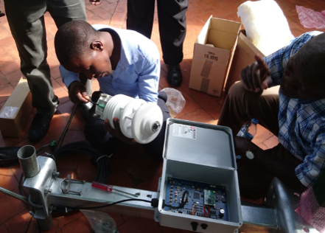
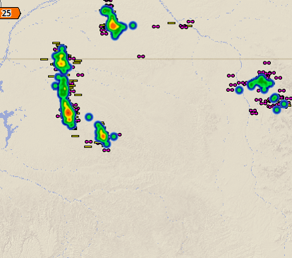
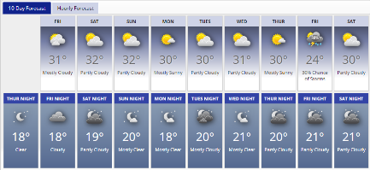
Where the Progamme is now
Status of implementation:
  Some countries are still in the process of acquiring technology that forms the basis for climate information and early warnings
  Most countries that have acquired the technology have not yet transformed the basic observations from their systems into useful and actionable information
  68% of the CIRDA budget (USD 3,078,116) has been executed. In 2016, the Programme saw an 83% delivery rate.
Next steps: weather and climate observations to be included into:
  Weather and climate forecasts
  Fundamental input to the NAPs
  Public “Last Mile” products and services (early warnings), and
  Private “Last Mile” products and services (sustainability applications)

Slide 4
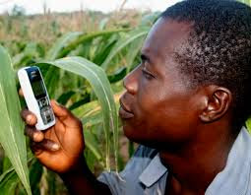
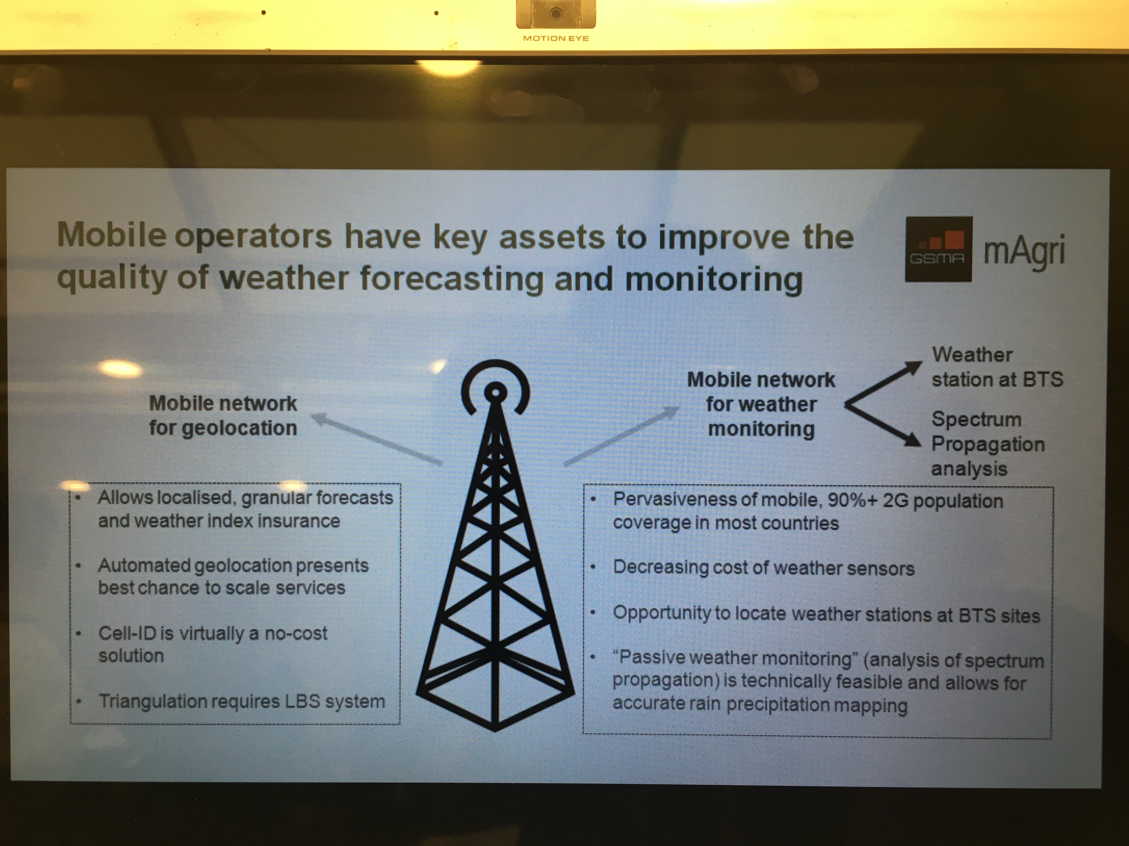
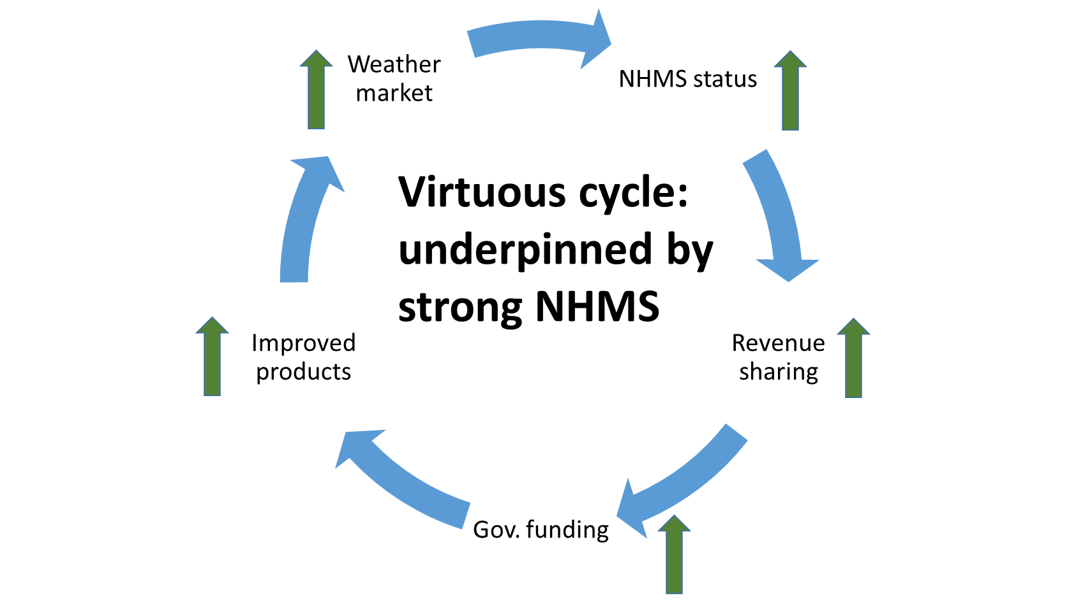
Looking Forward
Now we increasingly have the data collection.
How can we transform data to information, and communicate the last mile to help vulnerable communities?
This is how:
Explore pathways to make the data available to end users through local networks, technology, and partnerships, including identification of end users’ needs
Consider market opportunities in the form of new weather products and services with the benefit of a Market Study in the 11 partner countries
Explore relationships and partnerships with private weather services, NGOs, and others that can help national climate services reach the Last Mile – and become more sustainable
With technical support, work on country strategies for the next phase of the CIRDA program to reach end users and get to last mile

Slide 5
2017 Annual Work Plan
2017 Budget: USD 942,448
Turning data into information
Training to integrate Adcon data
Mission Support
Missions to all countries installing equipment and inputing software to ensure that installation of new equipment is done properly
Hydrology support (use of RFP)
Regional workshop on converting data into products (August, Burkina Faso)
Sharing best practices
Country fact sheets and case studies
Academic articles
Donor outreach
Blogs (ongoing) and google forum discussions
In country missions to support individual country needs

Slide 6
2017 Budget

Slide 7
2017 Budget

Slide 8
2017 Budget

Slide 9
2017 Budget

Slide 10
2017 Budget
Funds will remain to continue the Programme well unto 2018 (USD 524,600)

Slide 11
Topics for Approval
Approval of the 2017 AWP and Budget
One year extension of the UNDP CIRDA Programme (Dec 2018)

Slide 12
Thank you
Dr. Bonizella Biagini
CIRDA Manager
UNDP-GEF
bonizella.biagini@undp.org
www.undp-alm/porjects/cirda
www.undp-cirda.blogspot.com

