Slide 1
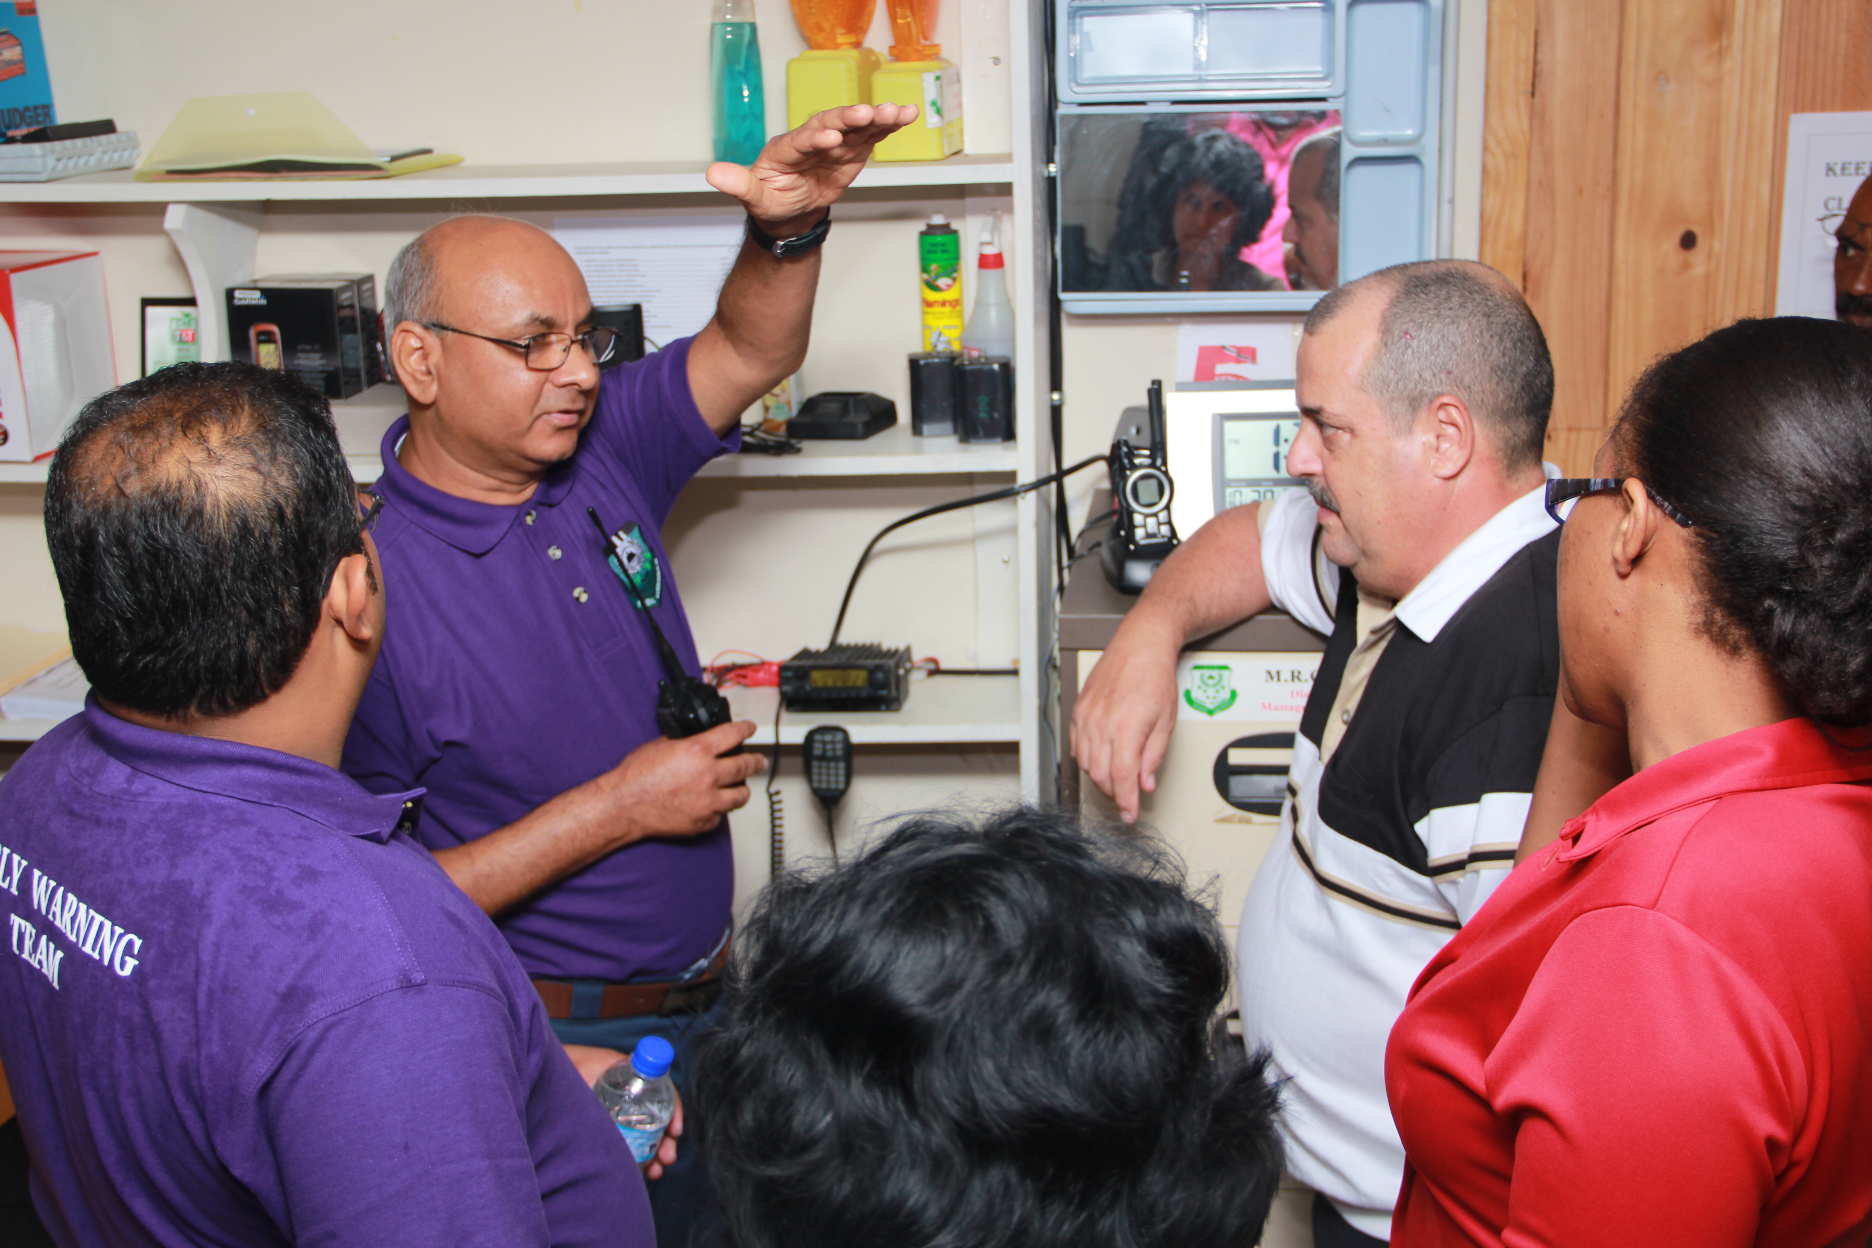


SHARING WHAT WORKS
Tips on Regional Project Management: Cooperation and Knowledge Management
Presented by Jacinda Fairholm

Slide 2
JCCP: OUTPUT 3
3.1 CAPACITY BUILDING WITHIN REGION TO SUSTAIN AND ENHANCE APPROACHES TO CCA AND MITIGATION
3.2 COMMUNICATION CAMPAIGN ON BENEFITS OF MITIGATION AND ADAPTATION
3.3 JAPAN CARIBBEAN TRANSFER OF TECHNICAL, PROCESSES AND EXPEREINCES

Slide 3
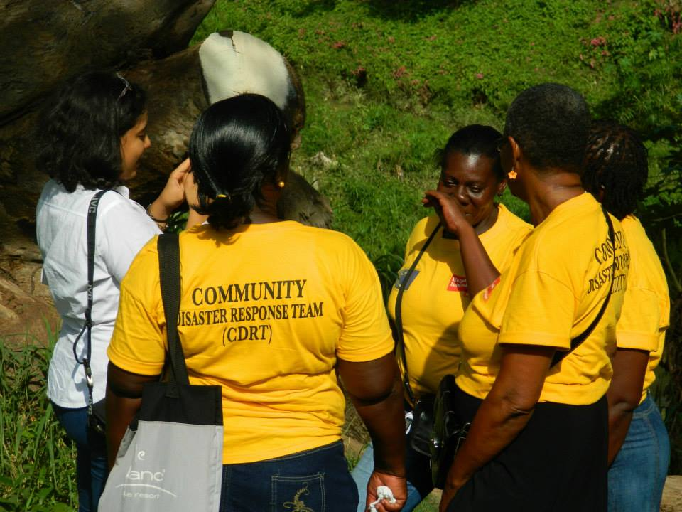
Caribbean Risk Management Initiative (CRMI): Regional Project 2012 - 2015
Realistic Implementation Timelines; take into account local political and administrative context
Capacity assessments should inform any training processes
  Establish pilot criteria (vulnerability, capacity, political support, possibility of scale-up); establish criteria for measuring success.
Consider mechanisms for community engagement:
  Role of local authorities
  who is designing community activities?
  Does the intervention leverage existing community structures?
  How are pilots to be sustained?
  Regional and national monitoring plans
  Document in-kind contributions
Sustainability Planning: Exit Strategy
Horizontal Exchange
Knowledge Management and Communications a Priority

Slide 4
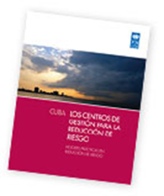
South-South Cooperation: Process
2009-2014
Systematization of the Cuban experience
Training and tool development related to Cuban experience
  Study tour workshop for UNDP Focal Points, National DM Authorities and Local Decision Makers
  Training for Technical Specialists
  Videos, Guidebooks, Toolkits
Facilitation of adaptation and implementation in five Caribbean countries:
British Virgin Islands, Dominican Republic, Guyana, Jamaica, and Trinidad and Tobago
Coordination of technical assistance: Cuba to pilot countries
Support to pilot project management
Assessment and Documentation of lessons learned

Slide 5
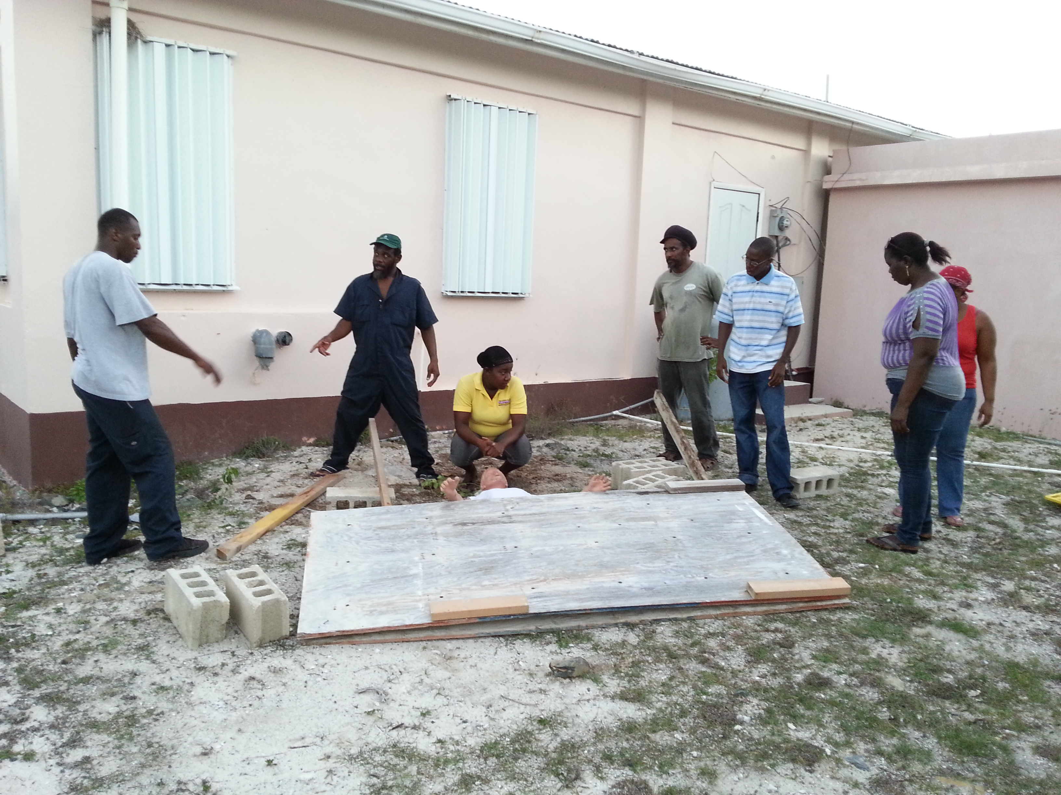
N-S/SS Cooperation:
Go beyond the panels
Understand Supply and Demand
Understand the provider experience
Ensure that it is documented
Identify how cooperation will align with priorities in recipient country
Preliminary exchange
Collaboration agreements

Slide 6
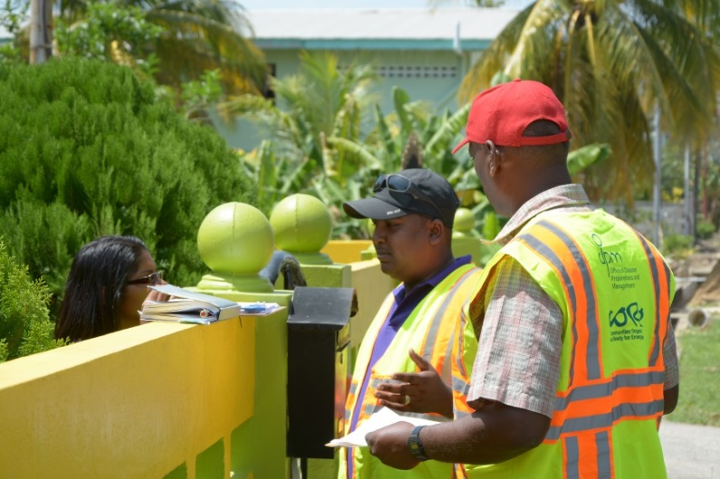
Cooperation: its all about being flexible
Adapt
Comprehensive needs & capacity assessment
Context analysis –complement existing structures
Adapt instruments, tools, and mechanisms
Technical assistance from provider country

Slide 7
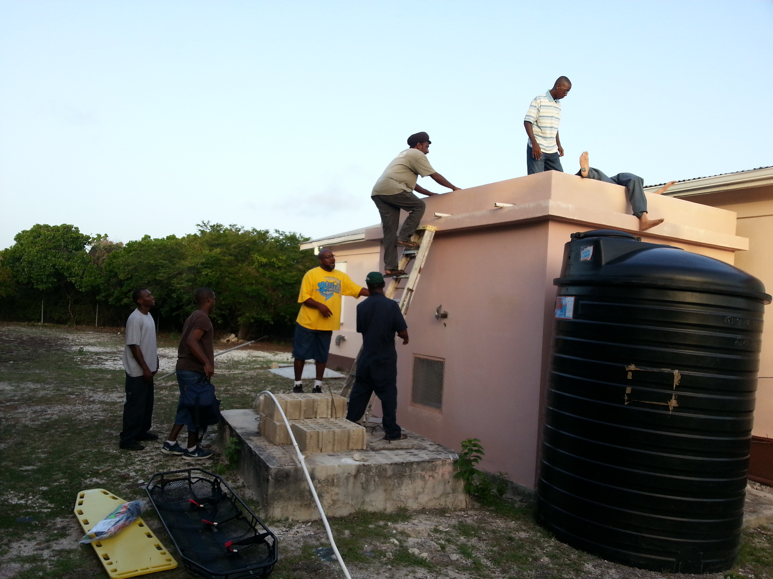
Cooperation: putting it into practice
Consolidate
Design action/work plan
Implement transfer activities, using adapted tools
Deepen exchange
Ensure local, national and provider responsibilities are clearly defined
Develop knowledge products - how has the new knowledge been used? What was learned?

Slide 8
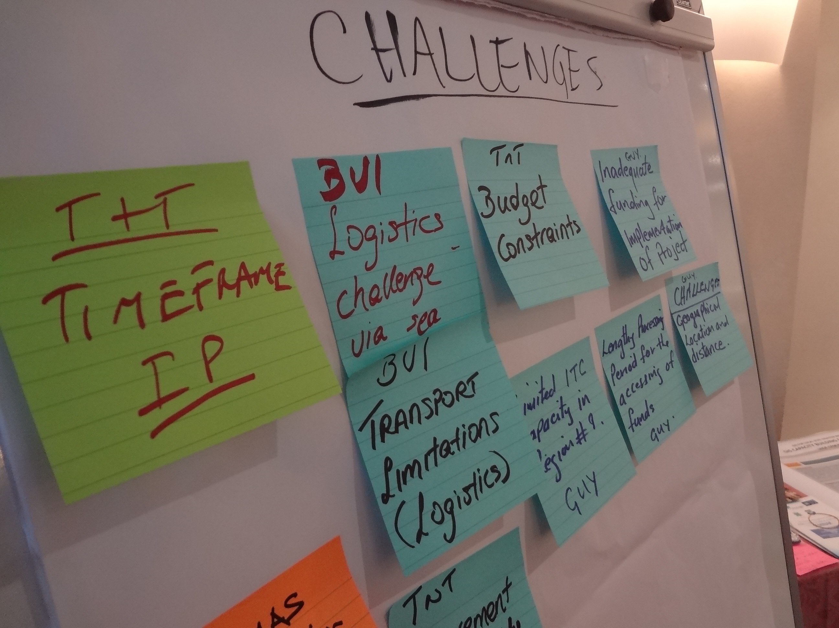
Cooperation: that was nice, now what?
Share the Experience
Lateral exchanges – workshops, virtual platforms
Knowledge products – for national upscaling (templates, flow charts, standardized products)
Communication products: case studies, videos, blogs
Analyze the process as well as the results (recipient and provider)

Slide 9

Mechanisms for SSC | Possible actions
Agreements and Diagnosis | Agreement to exchange/MOU/ Agreement on terms and components to be transferred. Mission from host to recipient country to assess context and design project/SSC Capacity assessment of recipient country system. Field visits are carried out with the purpose of demonstrating provider country experience Review process of frameworks (standards, protocols, procedures and processes)
Knowledge Exchange | Workshops or Technical roundtables for knowledge exchange Experience exchange in regional and bi-national forums Use of Virtual forum for sharing experience. Construction of knowledge networks/platforms Online courses
Capacity Development | Technical assistance in process design, planning, monitoring and follow-up Technical visits from recipient to host for training Mentoring from supply to recipient country Internships and study tours to supply country from recipient country or countries Technical working panels for methodological transfer
Technical Guidance | Development of didactic aids Methodology, templates, applications, procedures, operations manual, and handbooks adapted. Training provided to supply country as to how to implement SSC, including theoretical approach, methodology and training materials
Implementation | Action plan is constructed specifying short, medium and long term actions to facilitate the adaptation of experience to other contexts Pilot projects based on practical application of provider country’s best practices Adaptation and implementation of frameworks (SOPs, protocols, and processes) Strategic support and intervention by supply country for implementation of the initiatives Reiterative process: lessons learned during the SSC process monitored in order to reorient and reformulate. Evaluation tools to allow effective continuity of activities

Slide 10
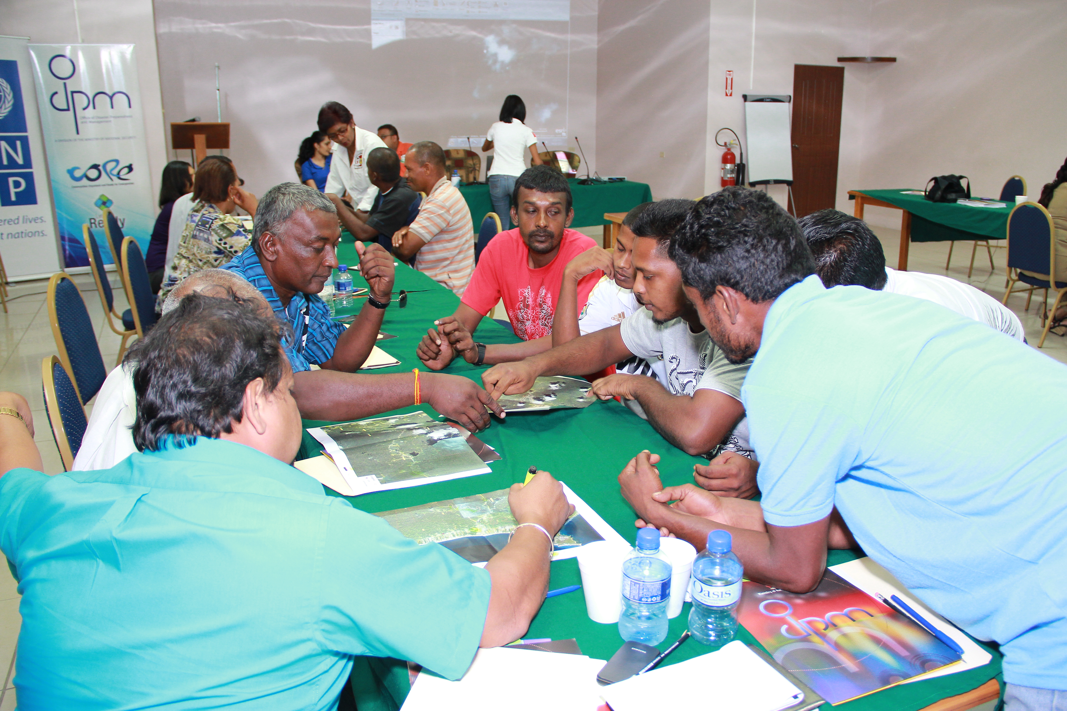
NS-SS Cooperation is:
A process
Is adaptive in nature and therefore experimental and innovative
Is responsive to need/demand
Builds on existing strengths
Based on engagement
Contributes to knowledge pool

Slide 11
What will the JCCP project optimize NS or
SS Cooperation?
How will you share the results of country
level activities with each other and larger
community?
www.crmi-undp.org

Slide 12
SUSTAINABLE DEVELOPMENT and RESILIENCE
UNDP Regional Center for Latin America and the Caribbean in Panama
(+507) 302-4566 / rsclac.cps@undp.org / www.undp.org
www.crmi-undp.org

