Slide 1
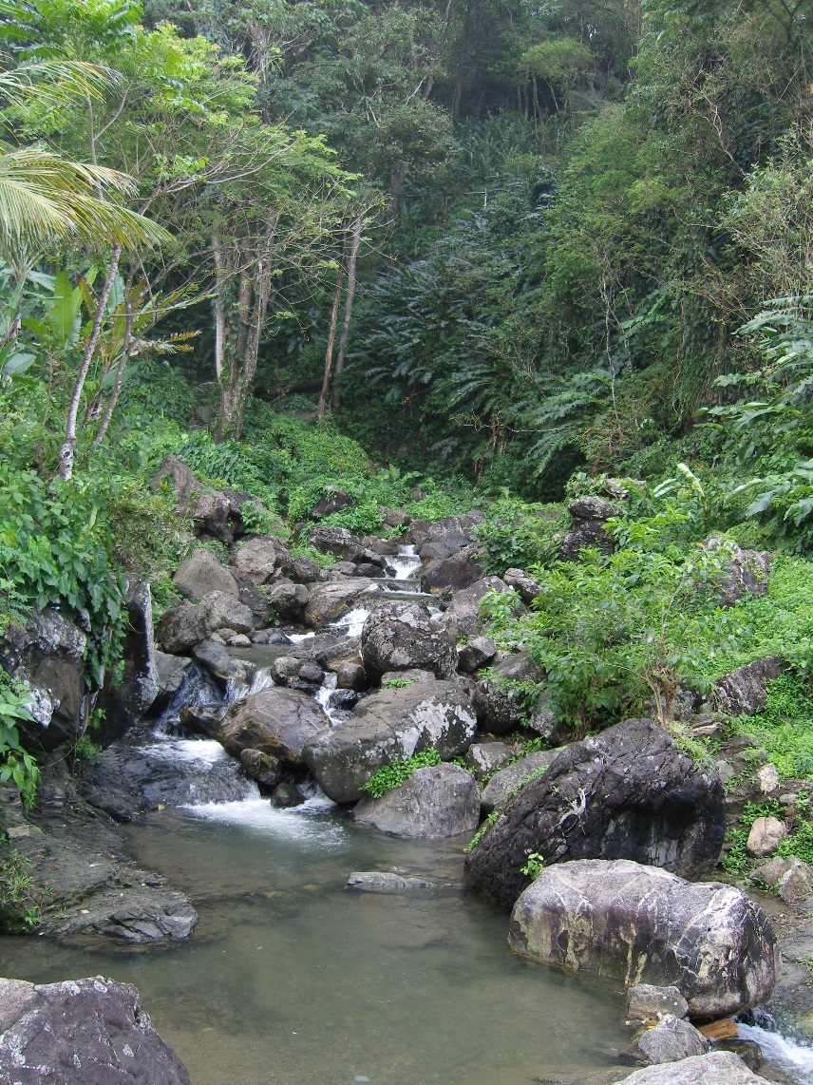
Introduction to Global Water Partnership – Caribbean
Patricia Shako
Regional Coordinator, GWP-C
26th January 2016

Slide 2
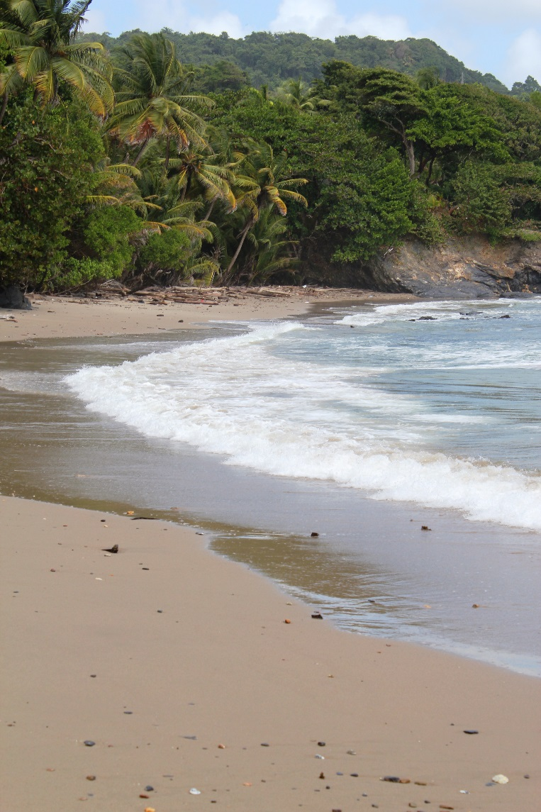
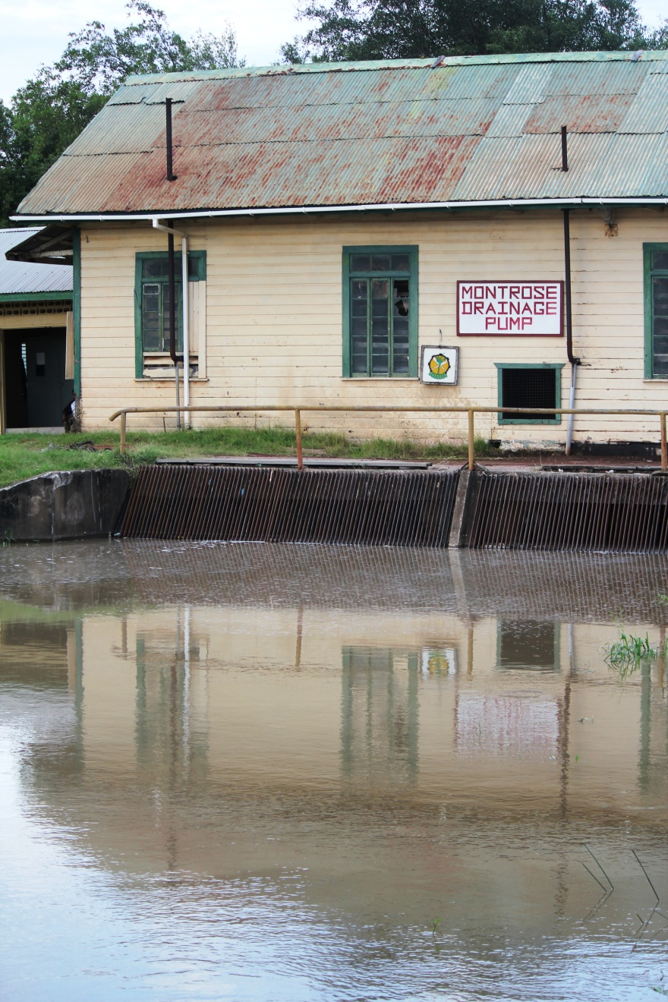
Who we are
GWP-C is a non-governmental
organisation (NGO) representing one of thirteen regions of the Global Water Partnership Organisation
(GWP-O).

Slide 3
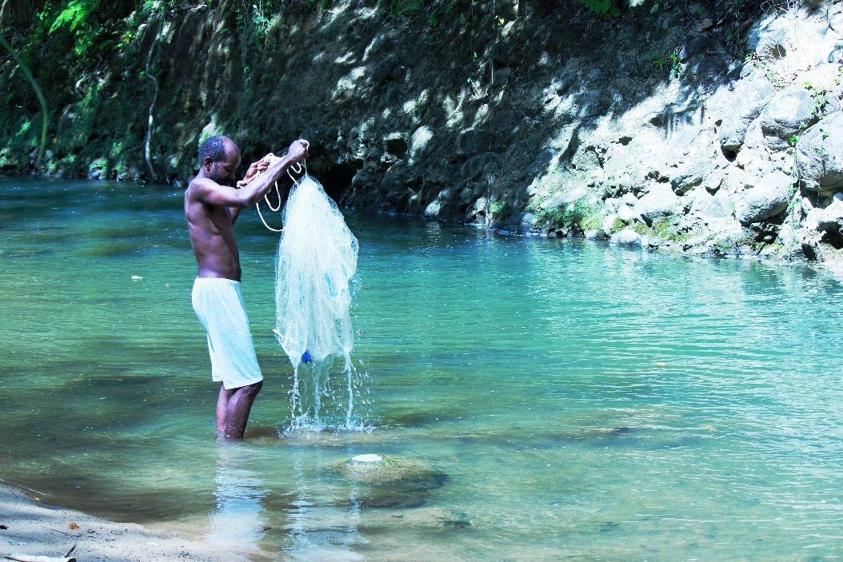
Our organisation
We are a network of over 90 partners in more than 20 countries, all dedicated to promoting and fostering an IWRM approach in the Caribbean.
Partners include: Water utilities, Government Agencies, Private Sector, NGOs, Consultants, Youth groups, Universities

Slide 4
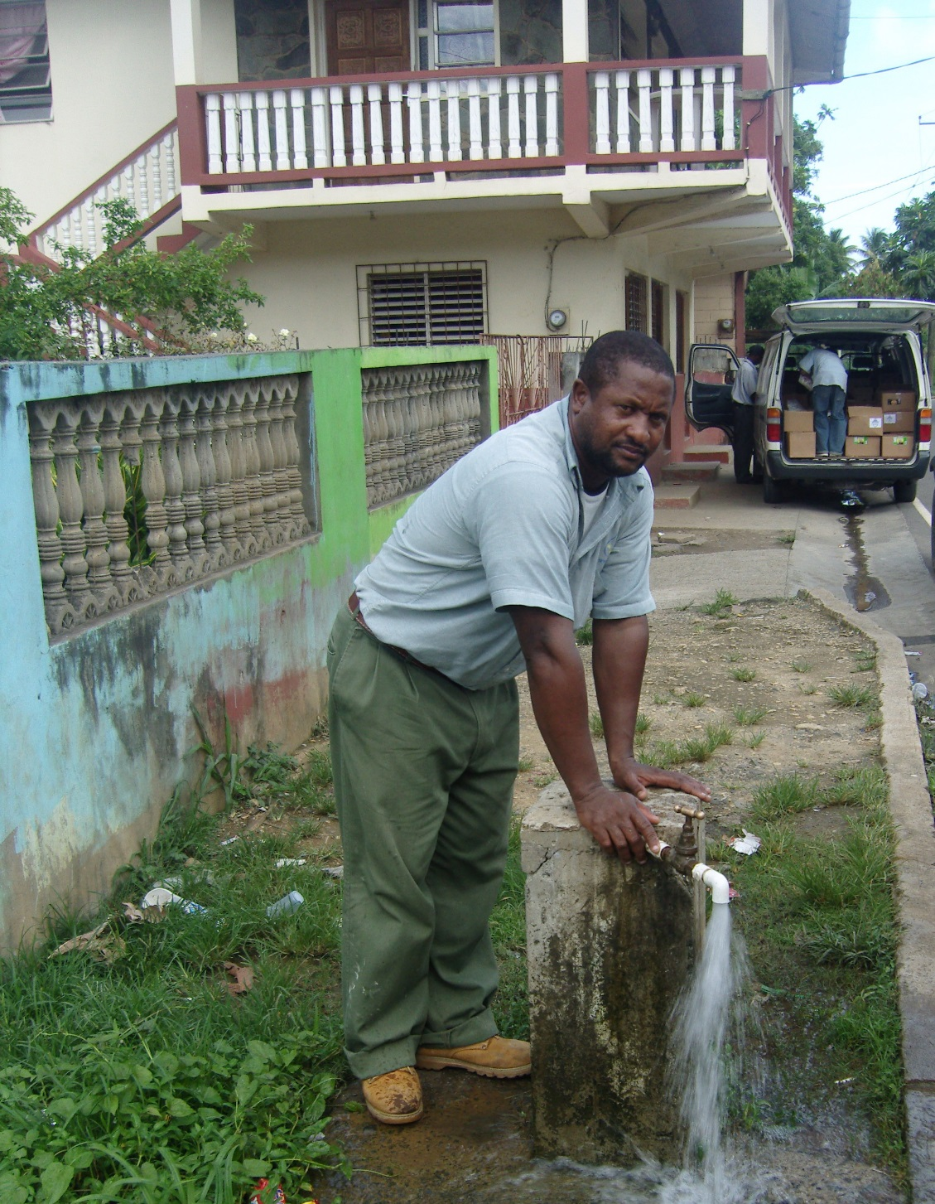
What we do
GWP-C facilitates, brokers, partners, builds capacity and exchanges knowledge to support Integrated Water Resources Management (IWRM) in the region.

Slide 5
Climate change impacts on SIDS related to water
Agriculture
Tourism
Fisheries
Health
Transport
Energy
Ecosystems and ecosystem services

Slide 6
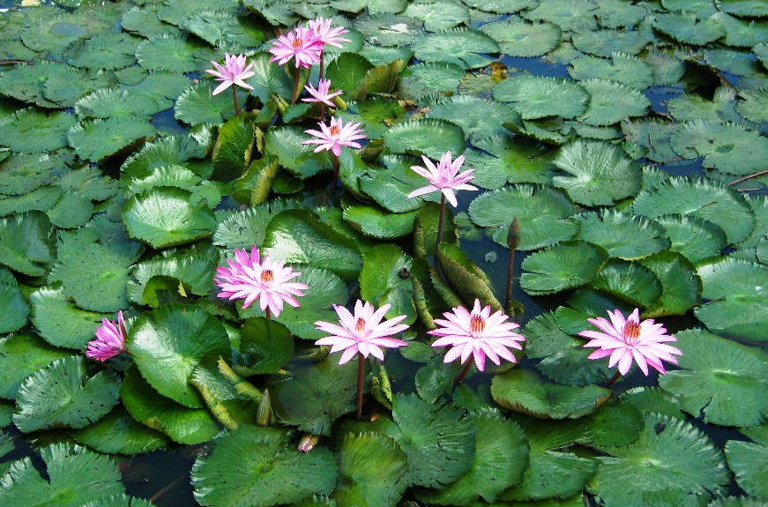
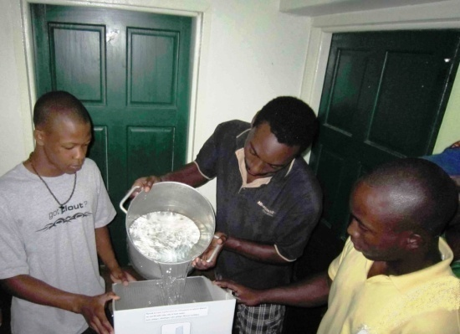
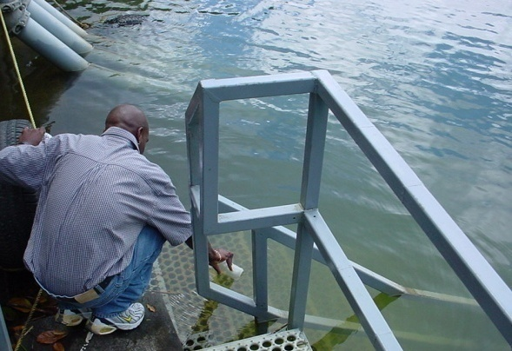
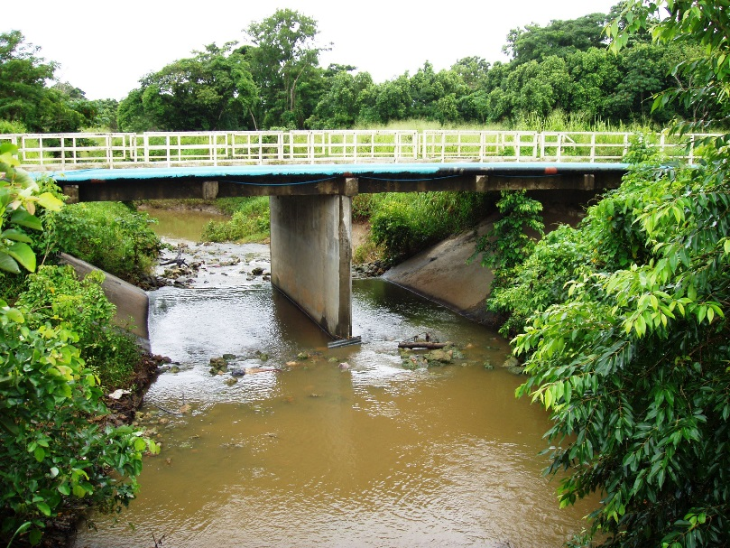
Integrated Water Resources Management
  IWRM is defined as a process which promotes the coordinated development and management of water, land and related resources in order to maximise economic and social welfare in an equitable manner without compromising the sustainability of vital ecosystems.

Slide 7
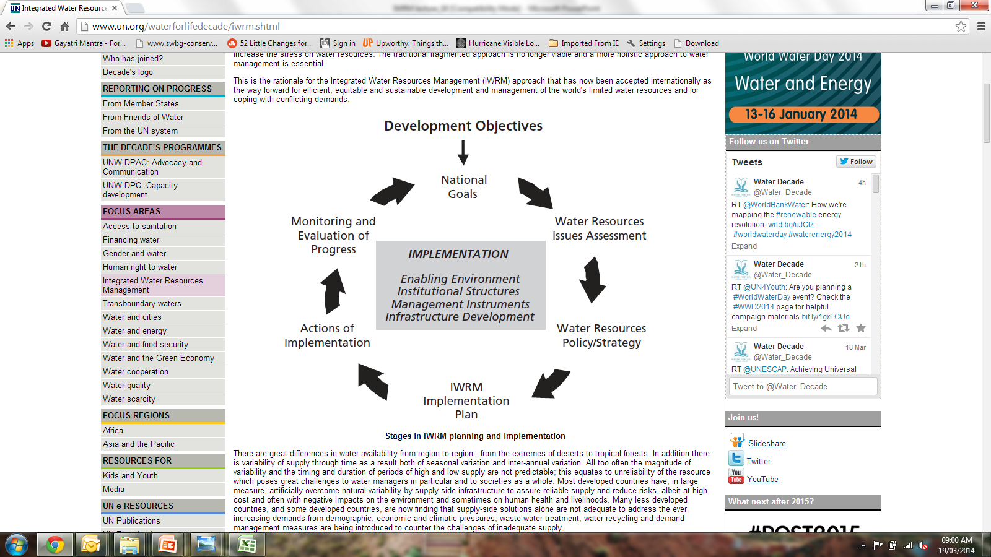
The IWRM Process
/accountability
Image adapted from UNDESA 2014 http://www.un.org/waterforlifedecade/iwrm.shtml

Slide 8


Enabling environment for successful IWRM Process
Awareness raising
Capacity Building
Participatory Process
Institutional Framework
Image adapted from UNDESA 2014 http://www.un.org/waterforlifedecade/iwrm.shtml

Slide 9
Current programmes
Regional and National Cooperation for IWRM (to prevent duplication of effort and streamline use of resources):
  Various technical programme areas, including
    the Water, Climate and Development (WACDEP) Programme
    the Rainwater Harvesting (RWH) Programme
    the Integrated Urban Wastewater Management (IUWM) Programme
Water Policy, Legislation and Governance:
  Support to countries to develop and implement water policies, roadmaps, and master plans (e.g. Guyana and Grenada, Antigua).
  Provide a platform for Ministerial level discussions on IWRM e.g. through the GWP-C Annual High Level Forum (HLF) for Water Ministers hosted in partnership with the Caribbean Water and Wastewater Association (CWWA).

Slide 10
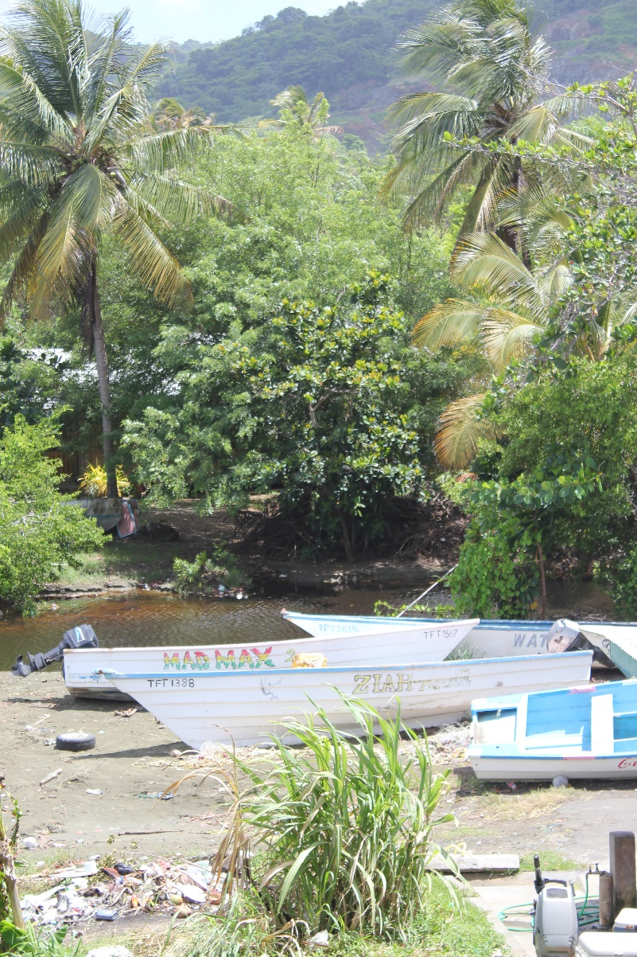
Current programmes
Investment Planning and Financing for IWRM
  Caribbean Regional Investment Plan for Water and Climate (support to regional agencies working in IWRM), including leveraging of funding for IWRM initiatives
  National Investment Plans for Water and Climate
IWRM Demonstration Projects
  Facilitation of projects or support of partners’ demonstration projects that provide new knowledge and lessons for IWRM in the Caribbean.
Capacity Building on IWRM Sub-themes, including
  IWRM as a tool for adaptation to climate change
  Water and Sanitation
  Water Use Efficiency

Slide 11
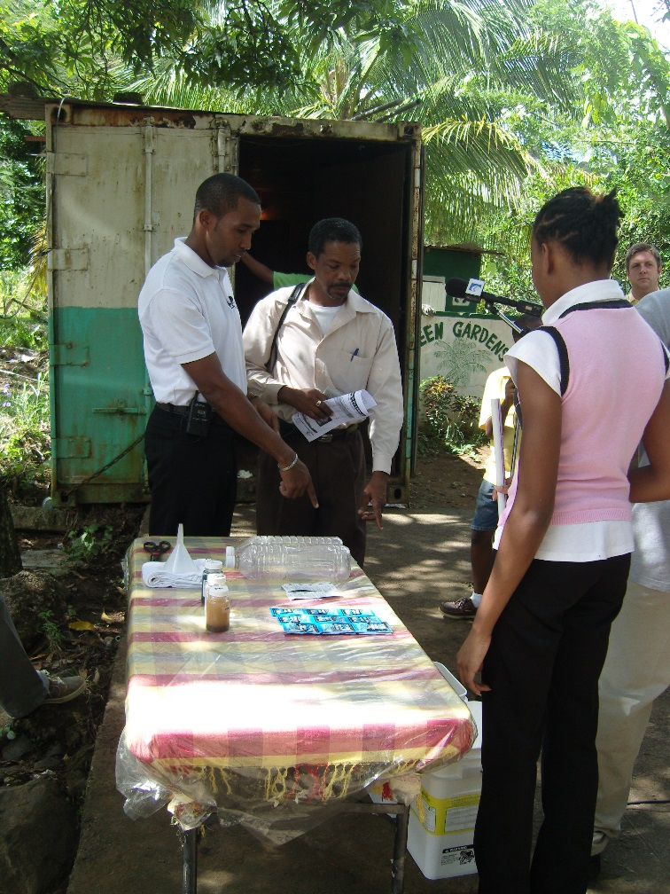
Current programmes
IWRM Expertise & Knowledge Exchange:
  Information hub for Caribbean IWRM stakeholders.
  Development of information products on IWRM to support various Caribbean audiences e.g. videos, online databases, technical papers, models.
  Dissemination of IWRM information and resources using various media including social media.
  Knowledge exchange on IWRM among the global, regional and national levels.

Slide 12
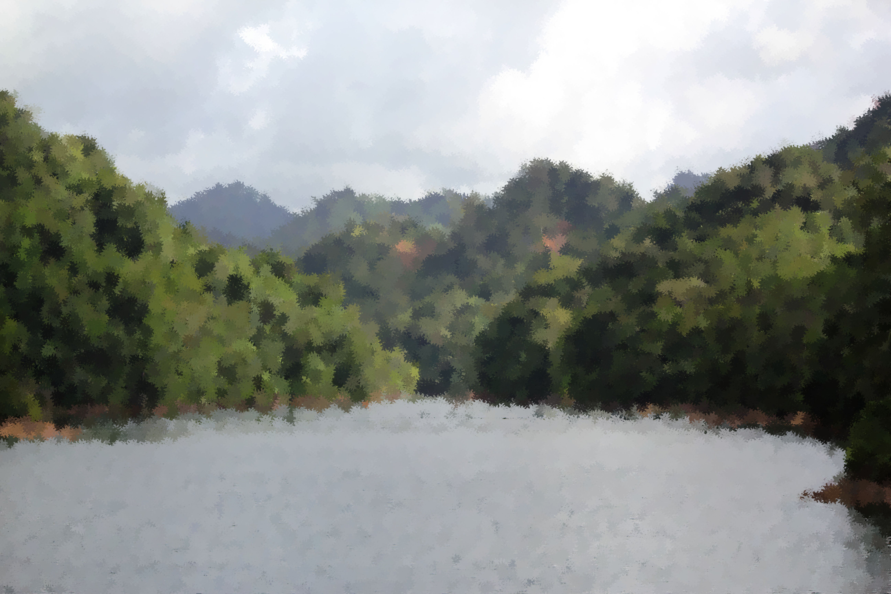
Thank you!
E-mail: info@gwp-caribbean.org
Website: www.gwp-caribbean.org

