Slide 1

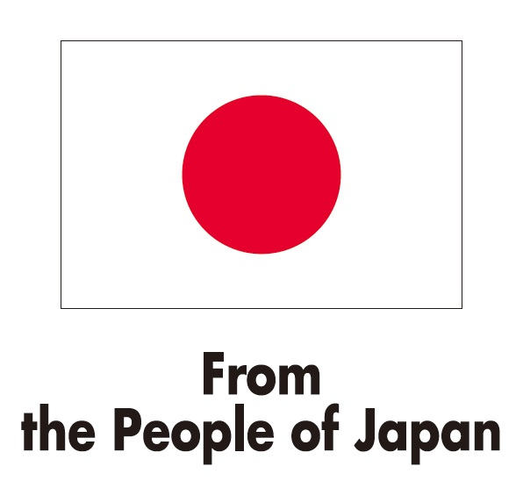
United Nations Development Programme
COMMUNICATION PLANNING
Japan-Caribbean Climate Change Partnership
January 27, 2016

Slide 2
The Problem of Communication…
Communication plays a strategic role in the design and implementation of intervention strategies;
BUT, this role is not always recognised, fully understood or appreciated
Different types of communication approaches are often used interchangeably without understanding their strengths and weaknesses.

Slide 3
Communication Analysis and Planning…
Draws on:
Public Relations
Public Awareness and Education Campaigns
Social Marketing and Behaviour Change Communication
Communication for Development

Slide 4
What else do you need to know?
Communication is continuous. Plan and then communicate with all parties, all through out the process
Always remember who and why; who are you communicating with and why are you telling them
Always acknowledge your donors
and partners

Slide 5
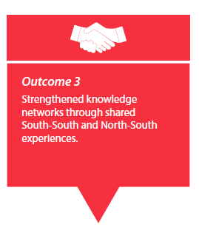
J-CCCP Outcome 3

Slide 6

External Communication
Communication campaigns in each country: public awareness, social marketing or ComDev depending on country needs
Visibility and partnerships: public relations highlighting outcomes of the GoJ/UNDP partnership
Virtual: UNDP websites (COs, RBLAC, global), Facebook, Instagram, YouTube, newsletters
Knowledge sharing: study tours, training
sessions, conferences, case studies

Slide 7
How can you help?
Take photos!
Share photos!!
Take and share good photos!!! ☺
Share lessons learnt, milestones achieved and best practices
Help us gain visibility #JCCCP

Slide 8
Internal Communication
Quarterly information bulletins/updates
Bi-monthly project team briefings
Knowledge platform for information sharing and queries

Slide 9

What communication approach do you think is necessary?

