Slide 1
Formulating and implementing national adaptation plans (NAPs)
JCCCP Inception Workshop
26-27 January 2016, Radisson Aquatica Resort, Barbados
Julie Amoroso-Garbin
Adaptation Programme, UNFCCC secretariat

Slide 2
Outline
Evolution of mandates defining NAPs
Guidance in formulating and implementing NAPs
The NAP technical guidelines
Designing the process to formulate and implement a NAP
Aligning the NAPs with the intergovernmental process

Slide 3
Evolution of mandates defining NAPs

Slide 4
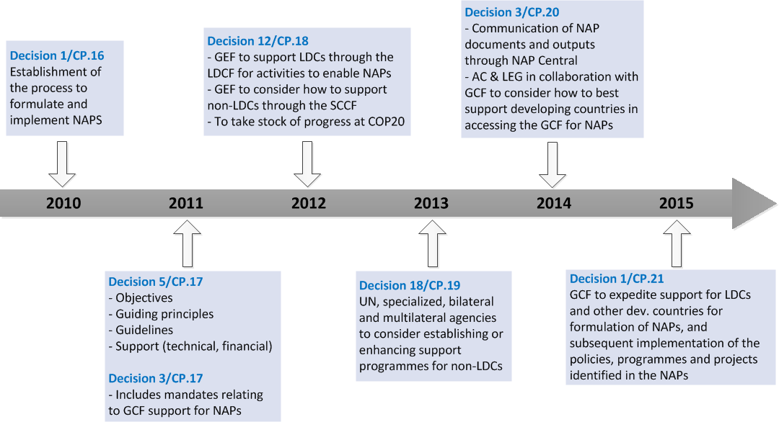
COP decisions on NAPs

Slide 5
Objectives
  To reduce vulnerability to the impacts of climate change, by building adaptive capacity and resilience;
  To facilitate the integration of climate change adaptation, in a coherent manner, into relevant new and existing policies, programmes and activities, in particular development planning processes.
Decision 5/CP.17, paragraph 1
Notes:
COP 16 agreed that adaptation is a challenge faced by all Parties, and that enhanced action and international cooperation on adaptation is urgently required to enable and support the implementation of adaptation actions aimed at reducing vulnerability and building resilience in developing country Parties, taking into account the urgent and immediate needs of those developing countries that are particularly vulnerable;

Slide 6
Global goal on adaptation
    enhancing adaptive capacity, strengthening resilience and reducing vulnerability to climate change, with a view to contributing to sustainable development and ensuring an adequate adaptation response in the context of the temperature goal
< 2⁰ C
FCCC/CP/2015/L.9/Rev1, Article 7

Slide 7

Guidance
2011: Initial guidelines are contained in decision 5/CP.17, annex
2012
Technical guidelines for the NAP process, developed by the LEG in response to decision 5/CP.17 paragraph 15 are available at <http://unfccc.int/7279>
Supplements to the technical guidelines
Sample NAP process
2015: Paris Outcome
LEG and AC to develop methodologies on how countries should take into account the <2⁰C in undertaking plans and actions;
GCF is requested to expedite support for the formulation and implementation of NAPs
Notes:
Of course GCF is now requested to expedite support for developing countries in formulating and implementing NAPs
Given the upcoming milestones e.g. the 2018 review of the progress on NAPs and the ongoing discussion on support and the target of 100B by 2020, this will have to happen very quickly

Slide 8
The NAP technical guidelines

Slide 9
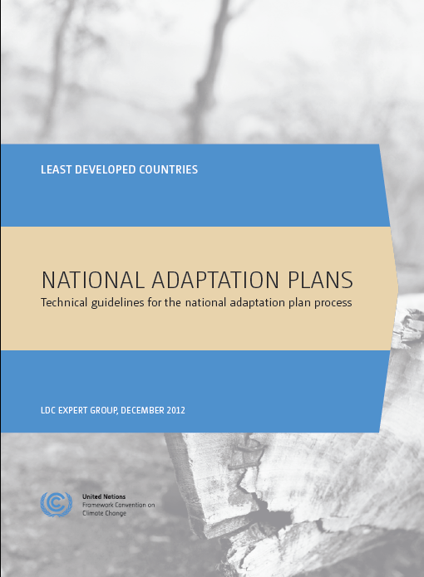
Technical guidelines for the formulating and implementing NAPs
Laying the Groundwork and addressing gaps
A.1. Initiating the NAP process
A.2.: Stocktaking
A.3.: Addressing Capacity Gaps
A.4.: Development Needs and Climate Vulnerabilities
Preparatory elements
B.1. Analysing Current & Future Climate
B.2. Assessing Climate Vulnerabilities and Adaptation Options
B.3. Review and Appraisal of Options
B.4. Compiling, Communicating NAPs
B.5.Integrating NAP into Development, Planning
Implementation strategies
C.1. Prioritizing CCA in National Planning
C.2. Long-term Implementation Strategy
C.3. Enhancing Capacity for Planning, Implementation
C.4. Promoting Coordination and Synergy
Reporting, Monitoring, Review
D.1. Monitoring the NAP Process
D.2. Assess Progress, Effectiveness, Gaps
D.3. Iteratively Update NAPs
D.4. Outreach and Reporting on Progress

Slide 10
Essential functions
In its further guidance to the NAP process, the LEG has consolidated the activities that the NAP process would undertake and support, into 10 essential functions
The essential functions are being applied to:
  Provide a basis to examine national adaptation capacity (human, institutional, systemic)
  Guide the development of monitoring and evaluation protocols for the NAP process – to facilitate a successful process (“PEG M&E Tool”), to complement efforts aimed at monitoring and evaluation of adaptation (projects/programmes, as well as outcomes of such efforts in the long run)

Slide 11
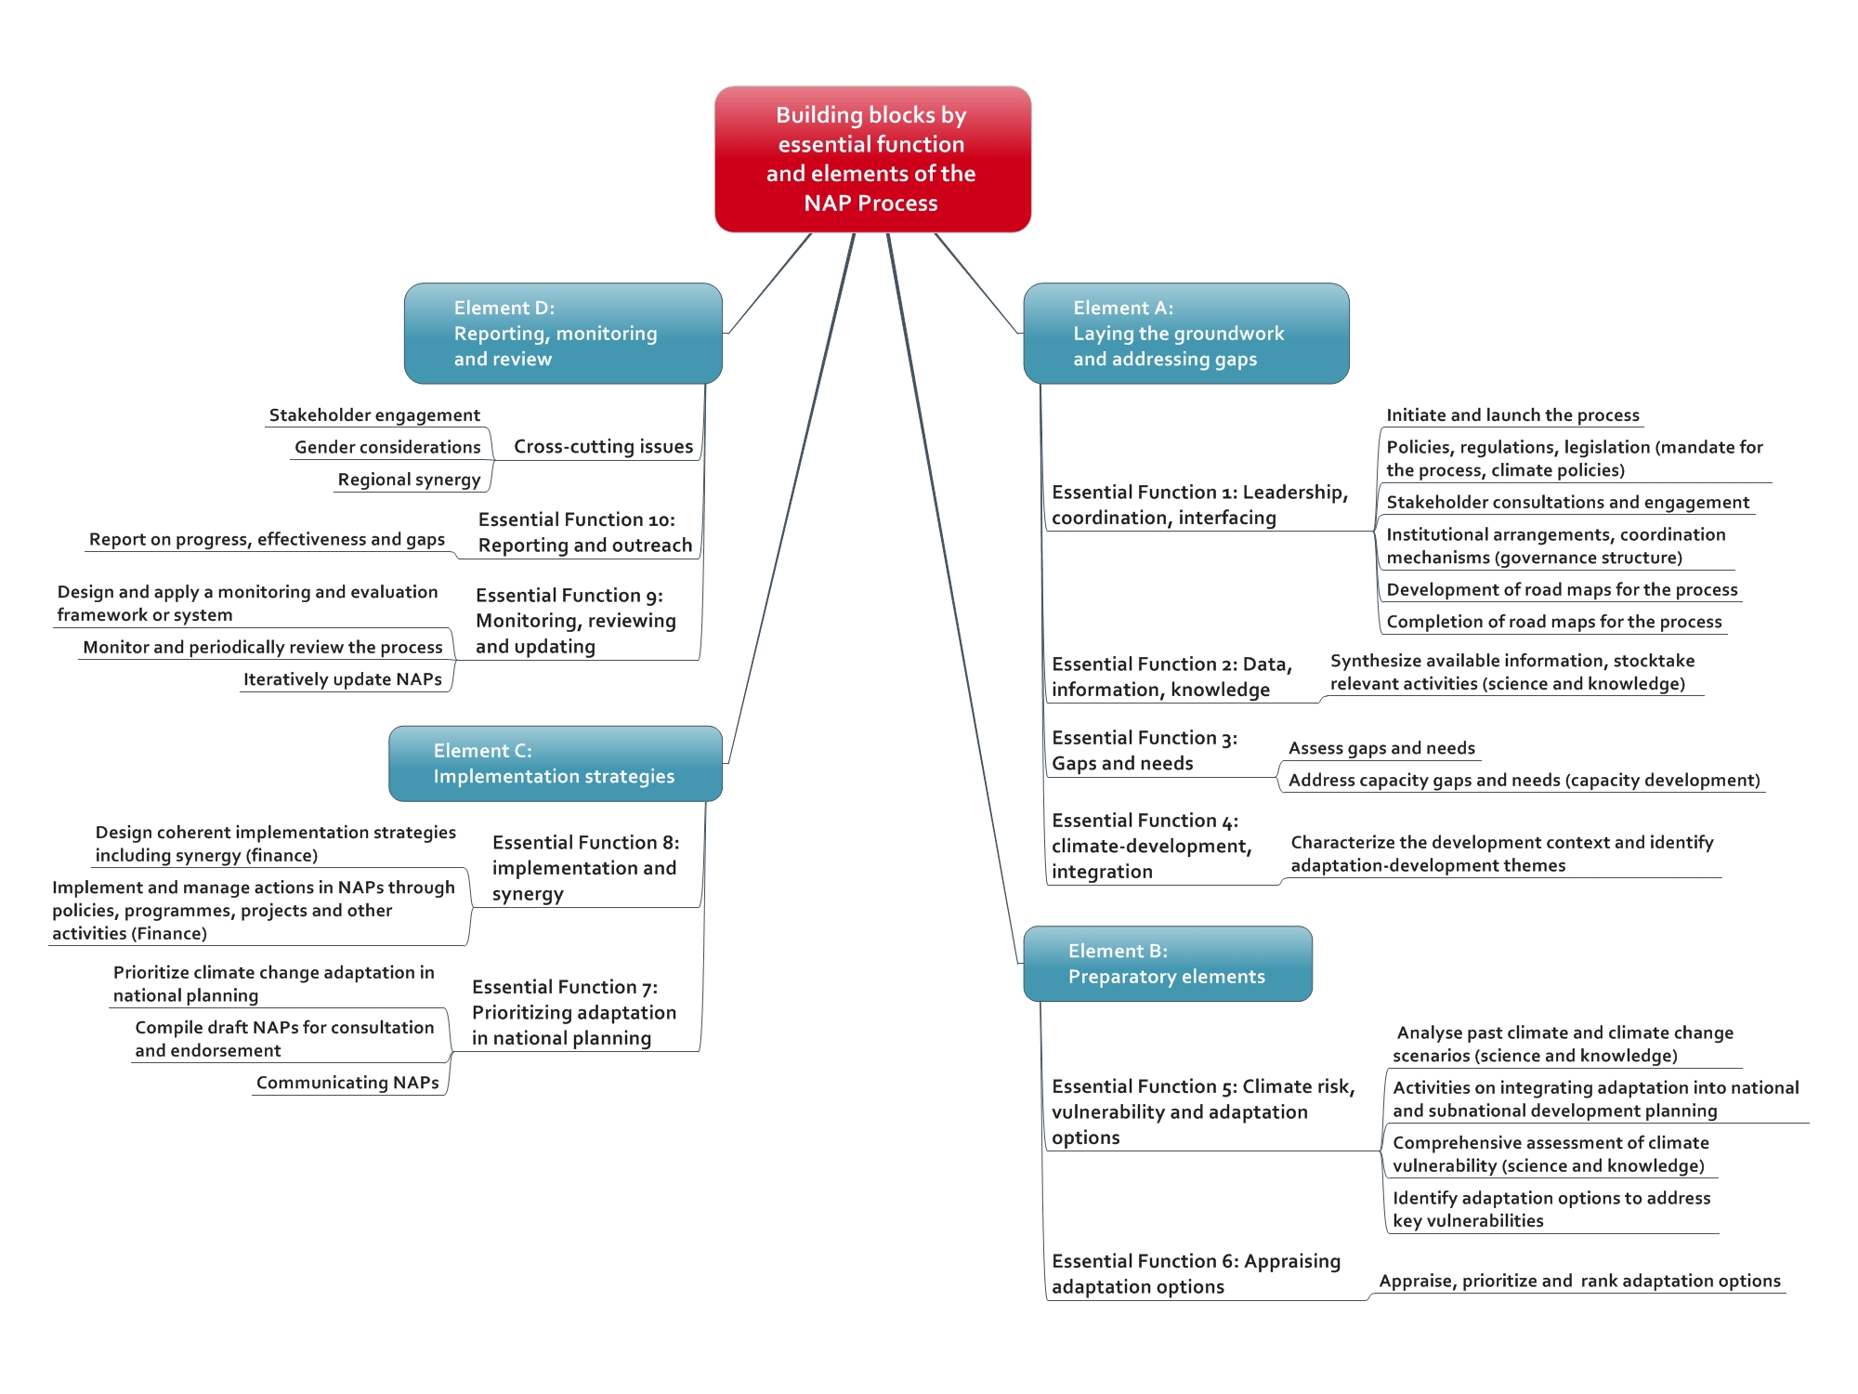
Essential functions

Slide 12
Designing the process to formulate and implement a NAP

Slide 13
How to apply the technical guidelines
The LEG, with input from other experts, have prepared a sample NAP process that shows the flow of information and outputs from one step to another
  Shows the main steps and outputs of a typical NAP process
  While the activities are shown sequentially, in reality they would be carried out in parallel and mainly on a continuous basis.
An initial activity would then be to go through this sample NAP process to get a better understanding of what would be required, add any missing steps or outputs, then use this flow to conduct a stocktaking of what exists, in effect what identifying gaps and needs in terms of what is needed to carry out the NAP process
The initial scoping establishes a baseline, and helps in assigning activities to different workstreams – teams of actors working on activities of the NAP process based on their mandate and functions

Slide 14
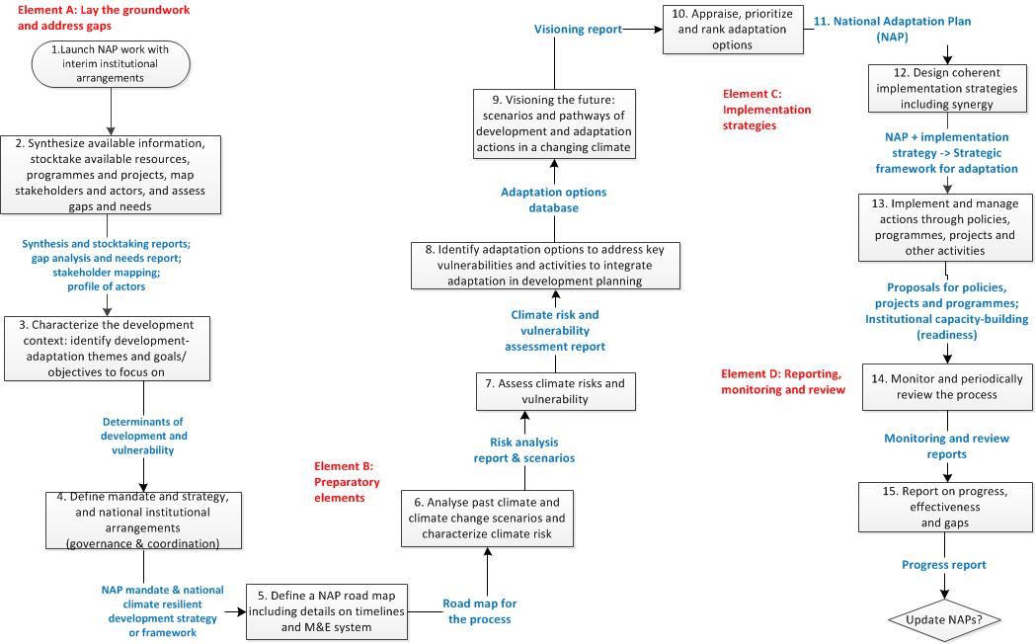
Sample process for formulating and implementing a NAP
Notes:
Important to note the stage where they need to produce a NAP and endorse it, not only at the technical level but engaging other stakeholders and how this will now be the basis for implementation of action – GCF will define in their Governing instrument on how it will support the implementation of NAPs

Slide 15
How to apply the technical guidelines
The LEG, with input from other experts, have prepared a sample NAP process that shows the flow of information and outputs from one step to another
  Shows the main steps and outputs of a typical NAP process
  While the activities are shown sequentially, in reality they would be carried out in parallel and mainly on a continuous basis.
An initial activity would then be to go through this sample NAP process to get a better understanding of what would be required, add any missing steps or outputs, then use this flow to conduct a stocktaking of what exists, in effect what identifying gaps and needs in terms of what is needed to carry out the NAP process
The initial scoping establishes a baseline, and helps in assigning activities to different workstreams – teams of actors working on activities of the NAP process based on their mandate and functions

Slide 16
Creating workstreams
The activities and steps of the process to formulate and implement NAPs can be clustered into workstreams that would be managed by different stakeholders;
Together, the workstreams could form a programme that would be “the NAP process”;
The coordinating mechanism of the NAP process would manage the relationships and flow of information between the workstreams, and sufficient authority would be delegated to leaders of each workstream to ensure the effective and efficient delivery of intended outputs and outcomes of the NAP process;
See pages 119 to 124 of the technical guidelines for the NAP process for sample workstreams.

Slide 17
Proposed workstreams
We can divide work into 6 workstreams, to correspond to some of the key actor groups for a NAP process:
High-level decision-making: Policy and institutional arrangements
Technical: Development-first systems approach to the assessment
Technical: Climate risks
Project management and planning: Implementation strategies (combined with WS6)
Cross-sectoral/multi-stakeholder: Appraisal and visioning
Multi-sectoral: Implementation

Slide 18
Aligning the NAPs with the intergovernmental process

Slide 19
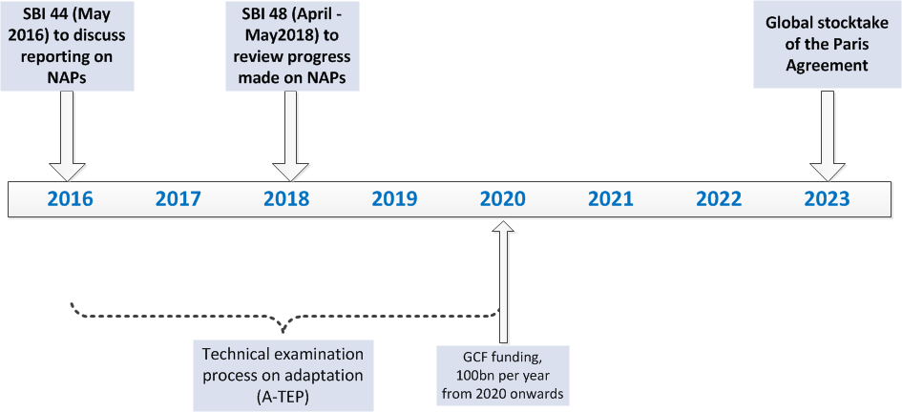
Timeline of major processes
How to ensure that collective progress on NAPs takes into account these major processes?

Slide 20
Paris Agreement
NAPs by design contain/cover information on the adaptation provisions to be reviewed/assessed under the Paris Agreement:
Element A - Laying the groundwork and addressing gaps: contains stocktaking which would generate information on Parties’ adaptation actions/efforts;
Element B - Preparatory elements: has assessments that can be linked to V&A under NatComms, information on impacts, etc…;
Element C – Implementation strategies: carries information on national adaptation priorities, support needed, etc…;
Element D – Monitoring, reporting and review: has monitoring and evaluation of progress, effectiveness and gaps which can be linked to the overall review

Slide 21

How to submit NAPs
Submission of NAPs through NAP Central, and encouraged other Parties to forward relevant outputs and outcomes related to the process to formulate and implement NAPs to NAP Central as invited in decision 3/CP.20, para. 9
NAP Central
The NAP Central is a universally accessible, web-based central repository and hub for information on the process to formulate and implement NAPs. It was developed primarily so countries are able to have an accessible platform from which they can extract information on support, progress and relevant resources, tools and methods.
http://unfccc.int/nap

Slide 22
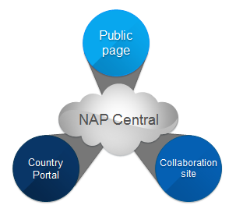
The NAP Central has three main categories:
Public pages: these comprise the NAP technical guidelines and relevant resources on the process to formulate and implement NAPs, information on support, event pages, country dashboards, navigators and database, and case studies;
Country portals: these provide countries with the opportunity to manage their NAP materials, including archiving documents. They also serve as submission portals through which countries can share outputs and outcomes of their NAPs with the secretariat;
Collaborative sites: the user groups include the LEG, the Adaptation Committee and any partner organizations and programmes working on NAPs.
Countries submit their national adaptation plans to the UNFCCC through the Country Portals
http://unfccc.int/nap

Slide 23
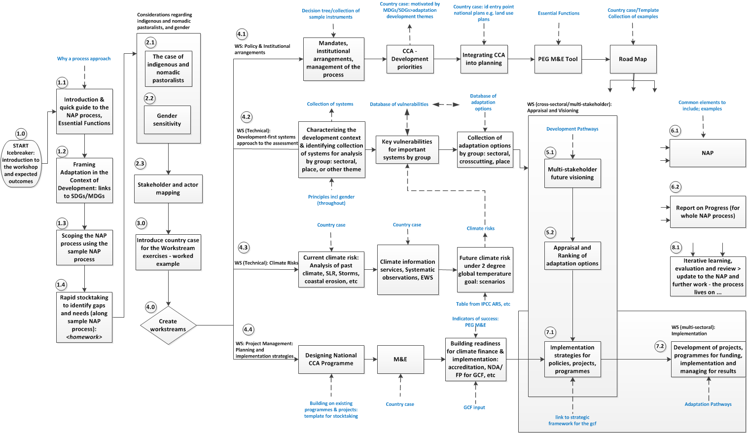
Flow diagram – example from a typical NAP workshop

Slide 24
For more information
http://unfccc.int/6057
Join The Adaptation Exchange on Facebook
http://www.facebook.com/The.Adaptation.Exchange

