Slide 1
Nationally Appropriate Mitigation Actions (NAMAs) as Vehicle to Implement NDCs
Drivers, Needs & Opportunities
Alexandra Soezer
Climate Change Technical Advisor
UNDP LECB Programme
NAMA Training
June 16th -17th , 2016
St. Vincent

Slide 2
Outline
Learning from the CDM
Introduction to NAMAs
NAMA success factors and guiding questions

Slide 3
Learning from the CDM

Slide 4
What is CDM and NAMA
What is CDM Assist Parties not included in Annex I to the Convention in achieving sustainable development and in contributing to the ultimate objective of the Convention, and to assist Parties included in Annex I in achieving compliance with their quantified emission limitation and reduction commitments under Article 3 of the Kyoto Protocol. emission reductions are real, measurable and verifiable, and additional to any that would occur in the absence of the project activity;
What is NAMA : Nationally Appropriate Mitigation Actions by developing country Parties in the context of sustainable development, supported and enabled by technology, financing and capacity building, in a measurable,reportable and verifiable manner "aimed at achieving a deviation in emissions relative to business-as-usual emissions in 2020.“
Notes:
CDM and NAMAs have 3 key features in common:
The CDM mechanism and NAMAs shall reduce emissions that are measureable, real and verifyable.
Both shall contribute to sustainable development and
Both shall provide technical and financial support for the implementation of mitigation actions.
The key difference between the CDM and NAMAs is that the CDM was designed as a mechanism that allowed Annex 1 countries to achieve
Compliance with their emission reduction targets while NAMAs shall support developing countries to deviate from business as usual and transform their economies.

Slide 5
CDM Experience to Develop NAMA
Governance Structure
Accounting Structure (centralized system, registry)
Methodological standards – Comparable quality and fungible
Ensure Environmental Integrity
MRV provision and consistent MRV requirements
Transparency and Independence.
Participatory approach (local/global stake holder)
QA/QC procedures on data quality
Notes:
We can build on key features from the CDM to design robust NAMAs –
in particular the MRV provisions and consistent MRV requirements,
the participatory approach through local and global stakeholders and
an accounting standards that includes registries at the UNFCCC.

Slide 6
Steppingstone – from PoA to NAMA
Support implementation of Policy /Programme measure.
Elements such as
  Definition of Eligibility criteria
  Project identification and inclusion
  Programme finance
  Setting boundaries
  MRV process
  Management structure
  Cross sectoral projects (urban built)
Design and Implementation elements of PoAs (concept of CPA , Sampling approaches, data quality issues)
Notes:
Elements from the PoA design that looked at sectoral programmes rather than individual CDM projects and was embedded in national
Development strategies, are highly relevant for the preparation of a NAMA that can also attract private sector:
I
n particular the elibitility criteria for inclusion of new projects, project identification and inclusion process, MRV process, and the management structure.

Slide 7
CDM MRV System
  Is internationally accepted
  Has a fully operational assessment apparatus
  Has accreditation system for third party validators/verifiers
  Has registry for issuing and tracking credits
  Is used across the world as the source of rules for mitigation activities
  Enjoys a unique political legitimacy
Notes:
Under the CDM a wealth of GHG baseline and monitoring methodologies were developed that can be easily also applied for NAMAs,
increasing focus is put on simplified methodology approaches with default values and standardized baselines. These features are highly relevant for NAMAs too.
All UNDP supported NAMAs use existing approved CDM methodologies and standardized baselines which makes the MRV of NAMAs simpler and cheaper while
Ensuring transparency and comparability.

Slide 8
Introduction to NAMAs

Slide 9
NAMA Concept Creation
The Bali Action Plan at 13th Conference of Parties (COP) to the Kyoto Protocol (2007) decided that:
Nationally appropriate mitigation actions (NAMAs) are to be undertaken by developing country Parties in the context of sustainable development, supported and enabled by technology, financing and capacity building, in a measurable, reportable and verifiable (MRV) manner.

Slide 10
Further key decisions regarding NAMAs
Copenhagen Accord (2009)
  Introduced the term “supported NAMA” to refer to NAMAs seeking international support for their implementation
  Stated that supported NAMAs should be subject to internationally agreed MRV standards
Cancun Agreement (2010)
  “developing country Parties will take nationally appropriate mitigation actions…aimed at achieving a deviation in emissions relative to ‘business as usual’ emissions in 2020”, but that “developed country Parties shall provide enhanced financial, technological and capacity building support for the preparation and implementation of nationally appropriate mitigation actions of developing country Parties”

Slide 11
Objective of NAMAs
NAMAs
Sectoral Approaches
Strategies
Programs
Projects
Aligned with country’s national development plans & strategies
Achieve GHG emission reductions
Sustainable development impact
Monitored, reported and verified (MRV)
Government coordinated, but involves private sector, civil society organizations, academia, etc.
Notes:
Although there is no universally accepted definition or rules for what a NAMA is, overtime NAMAs have evolved and have incorporated many elements of the CDM, including sectoral approaches, strategies, programs and projects.
NAMAs include a few main elements:
They are to be aligned with a country’s national development plans and strategies
They are to contribute to the mitigation of GHG emissions
The impact of a NAMA should be measureable, reportable and verifiable.
And finally NAMAs are usually coordinated by the lead sector ministry, but should involve private sector, civil society, academia and other relevant organizations that should contribute to NAMA development and implementation.

Slide 12
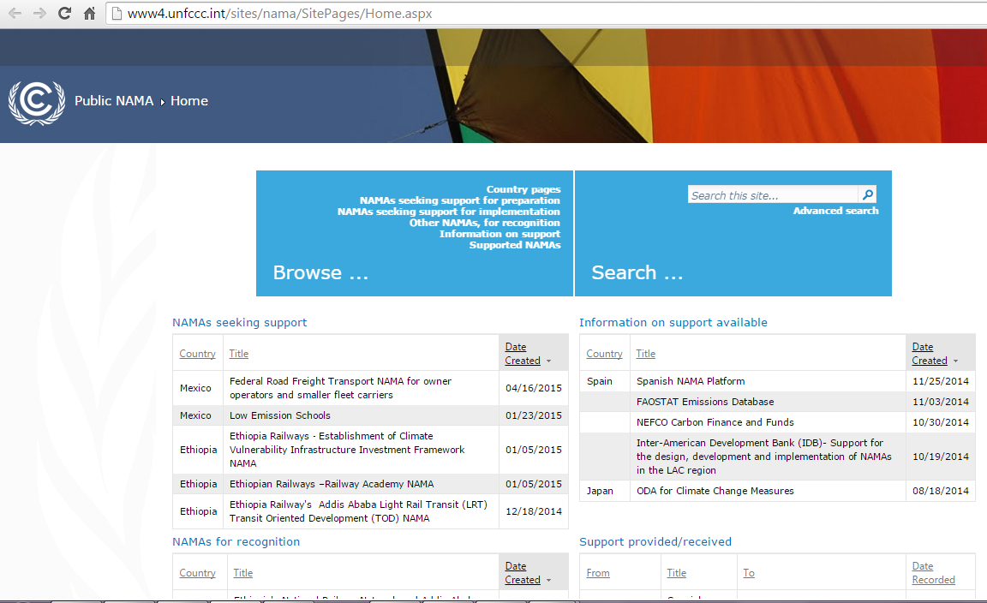
NAMA registry
UNFCCC launched in 2012 an online NAMA registry to record NAMAs seeking international support and facilitate matching of finance, technology and capacity development

Slide 13
NAMAs within a country’s development strategy and the UNFCCC process
Strategic level
Tactical level
Operational level
Low Carbon
Development
Strategies
Nationally
Determined
Contributions
Nationally
Appropriate
Mitigation Action
Source: NAMA guidebook 2016
Notes:
It is important to situate NAMAs within a country’s broader national development objectives. The figure shows how strategy, tactics and operation can be linked: long-term strategies are designed to become overarching national low-emission frameworks which guide the preparation of progressively ambitious NDCs, and translate them into concrete implementable measures (NAMAs) in order to achieve this target.
The iterative NDC process should lead the country to achieve its long term vision of low emissions development.

Slide 14
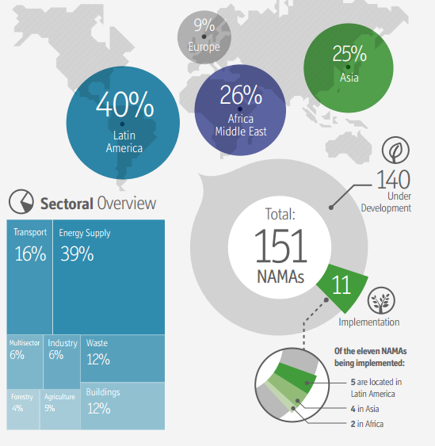
Status of NAMAs Globally
Caribbean??
Source: Tilburg et al., 2015, “Status Report on Nationally Appropriate Mitigation Actions Mid-year update 2015.”
Notes:
When we take a look at how NAMAs have progressed over the last few years we see that there has been substantial growth in NAMAs. As of 2015 there were 151 NAMAs worldwide. 140 are still under development and 11 are currently under implementation. When you look at the breakdown of NAMAs across the world, the majority of them have been undertaken by countries in Latin America, followed by Africa and the Middle East, Asia and finally Europe.
It’s interesting to note that there is almost no presence of the Caribbean in this global snapshot. From my understanding only Costa Rica and Dominican Republic have submitted NAMAs to the UNFCCC, but they are often grouped with Latin America.
Over the course of this workshop I am looking forward to exploring and learning why this is the case

Slide 15
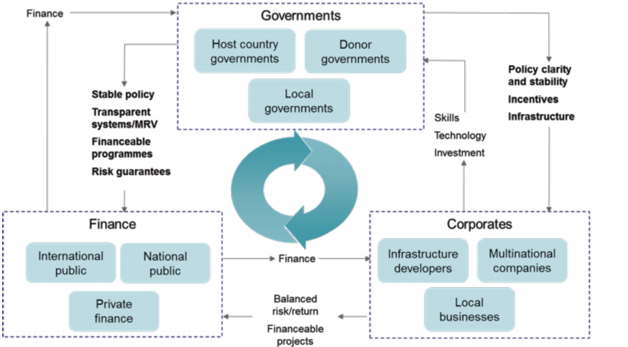
Country Needs: Preparing & Implementing NAMAs
Source: KPMG, 2011
Notes:
As this figure shows, developing and implementing a NAMA requires the involvement of many stakeholders from the national government to development partners, the private sector and civil society. Sometimes developing countries do not have the resources required to either develop or implement a NAMA and this is where international support will play a major role.

Slide 16
Country Needs: Preparing & Implementing NAMAs
Political
  Enabling environment for investment
Institutional
  Guidance and staff capacity to prepare NAMAs
  NAMA coordination and managing authorities
  Outreach activities and liaising with donors & investors
  Established public private dialogue & promotion of public-private partnerships
Technical
  National Technical Implementing Entity established
  MRV system in place, operational and well maintained
  NAMA progress and results regularly reported
Financial
Effective allocation of funds
Promoting investment opportunities
Promoting public finance mechanisms to catalyze private investment flows.
Capacity Building
Technology
Finance
NAMA
Notes:
By providing capacity building, technology or financing support, development partners can support country’s in preparing and implementing a NAMA. This support can assist a country’s various stakeholders in carrying out the many roles required to implement a NAMA.
These roles can be broken down into a few main categories including political roles, institutional roles, technical roles and financial roles.
From the political perspective, the government needs to develop an enabling environment to facilitate the investment in NAMAs.
From an institutional perspective, the government needs to have the staff capacity to prepare a NAM and guidance on how to go about doing this.
From a technical perspective, it needs to have the capacity, financing and technology available to establish, implement and maintain an MRV system
And from a financial perspective it needs to be able to attract public international finance in order to bring in larger scale private sector investment

Slide 17
NAMA success factors and guiding questions

Slide 18
Challenges / Success Factors
NAMA Preparation
Identify a ‘Champion’ to drive the NAMA development process
Stakeholder engagement (continuous, transparent, inclusive)
Political commitment to meet mitigation & development targets
  Identify lead institutions/ministries to coordinate and ensure continued buy-in
Promote local technical capacity - to ensure lasting technical support during NAMA and MRV system preparation
Identify a national financial institution - to manage large amounts of funds for effective allocation of financial resources
Put the private sector center stage – engage in dialogues, encourage policy frameworks to facilitate investment in ventures under the NAMA framework

Slide 19
Guiding Questions – NAMA Preparation
Is a leading institution identified that will drive the NAMA preparation process?
Is the proposed NAMA a political priority, having full support from the key Ministries, and is aligned to national policies (INDCs)?
Is there financial commitment for the future implementation of the NAMA?
Does a national FI exist that will effectively allocate national and international financial resources and transparently monitor the financial support obtained?
Is an institution identified that will lead the MRV of GHG ERs and SD impacts?
Can the private sector get engaged in a dialogue and is there interest to invest in potential NAMA ventures?

Slide 20
Summary
NAMAs are a tool that can help countries achieve reach their mitigation targets and longer-term national development objectives
Opportunities for J-CCCP and other development partners to support the Caribbean region in preparing and implementing NAMAs
Notes:
In summary NAMAs can provide an opportunity to help country’s reach their mitigation goals and in turn their longer-term national development objectives and low-emission development strategies.
I look forward to learning from you about how NAMAs might serve as a tool to help your country reach its mitigation goals and national development objectives and I am excited to explore how the JCCCP and other development partners can support the region in meeting mitigation targets and objectives.
Thank you.

Slide 21
Thank you!
Alexandra Soezer
Climate Change Technical Advisor
UNDP LECB Programme
Alexandra.soezer@undp.org

