Slide 1
Getting Climate Change on the Front Page
Mary Owen, Journalist

Slide 2
Overview
Readers are interested in climate change
How do we reach readers?
Human impact
Simple language
Strong nut graph
Good Sources
Pitching stories
Pre-reporting
Talking to your editor

Slide 3
Climate Change is an important story …
… and readers/viewers agree
UNDP/JCCCP KNOWLEDGE, ATTITUDES AND PRACTICE STUDY ON CLIMATE CHANGE (Excerpts from reports)
SURINAME
Asked whether they have concerns about the pollution of the environment, 70.1% of respondents says yes
ST. LUCIA
91.2% of respondents indicated that they would be willing to receive information on climate change in the future.
GRENADINES
The majority of respondents do not know the exact meaning of the term climate change.
DOMINICA
At least nine in every ten respondents agreed that people need more information on climate change (95%).
GRENADA
A large proportion (62.2%) of respondents felt that people generally needed more information about climate change.

Slide 4
UNDP/JCCCP KNOWLEDGE, ATTITUDES AND PRACTICE STUDY ON CLIMATE CHANGE (Excerpts from reports)
GUYANA
Most respondents from the general survey (78 percent) and those from the student survey 89 percent stated that they would like to learn more about climate change.
BELIZE
An interesting finding is that the majority of households, 76.6%, either do not have or are not sure they have insurance. Similarly, 77% either do not have insurance against climate related hazards or are not sure if their insurance covers climate related hazards. This is significant considering the fact that 45% of homes are situated in vulnerable areas prone to climate related hazards.
JAMAICA
While 14.4% of participants reported not using social media, a large percentage (66.7%) indicated their most frequently used Facebook, followed by YouTube (9.1%) and WhatsApp (6.1%).
DOMINICA
The leading sources of information (both aided and unaided) about climate change were identified as local radio, followed by local television and foreign television.

Slide 5
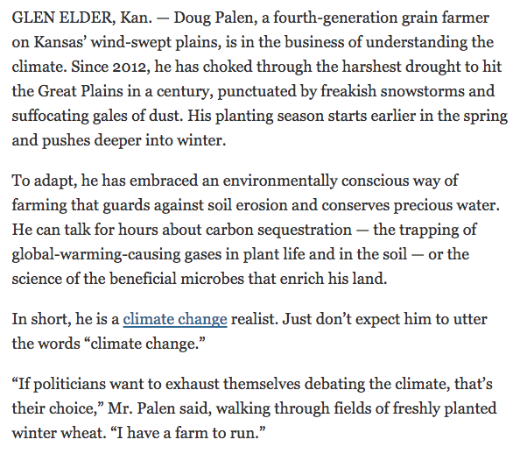
HUMAN IMPACT

Slide 6
Event coverage = Zzzzzz

Slide 7
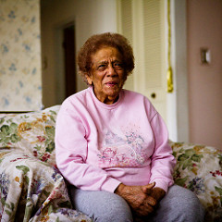
SIMPLE LANGUAGE
How would you explain it to your mother?
Journalists must master the language
Reporters must become experts
Avoid complicated jargon and science
Don’t overwhelm readers with data
Only use compelling data

Slide 8
Be clear about the science
The overarching issue is as settled as things get in science: The planet is warming and humans are largely responsible. As a result, the earth is warming. New, contradictory evidence could come along -- science is always subject to revision. But the idea that humans are causing climate change is not scientifically controversial.

Slide 9
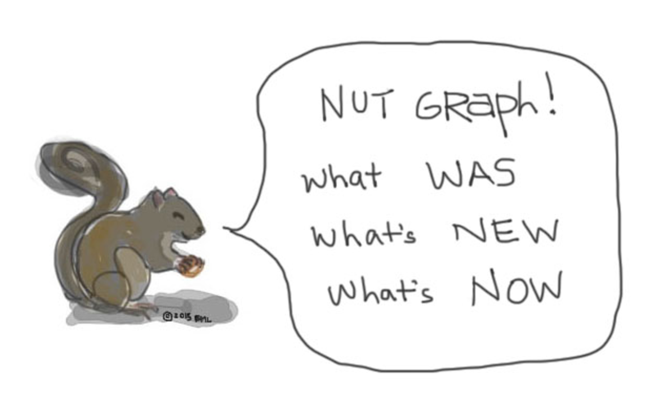
Sometimes, stories can be complicated, filled with jargon/science and miss the bigger picture.
Therefore, THE NUT GRAPH IS IMPORTANT!

Slide 10
The NUT GRAPH has several purposes:
It justifies the story by telling readers why they should care.
It provides a transition from the lead and explains the lead and its connection to the rest of the story.
It often tells readers why the story is timely.
It often includes supporting material that helps readers see why the story is important.

Slide 11
NUT GRAPH HELPS READERS DECIDE

Slide 12
Tips about NUT GRAPHS
Never give away the ending of the story.
Anticipate the questions that readers might be asking early in a story, and address them.
Give readers a concrete reason or reasons to move on.
Should be in 2nd to 5th paragraph
FINALLY, is it clear enough that YOUR MOM WOULD UNDERSTAND?
HAVING TROUBLE? Talk to someone about your story. Think about how you explained the story to them. What did you highlight?

Slide 13
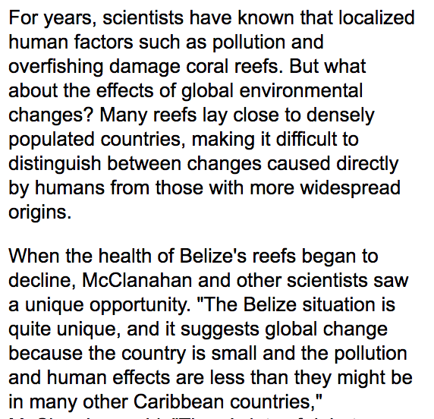

Slide 14
JOURNALISM ETHICS
Fair/unbiased reporting/writing
Watch your language
Don’t make promises about coverage
Avoid the temptation to hype new research findings
Always ask who paid for research
FOLLOW THE MONEY: Who benefits from a new project with environmental concerns? Who has been looking the other way?

Slide 15
PITCHING STORIES
Pre-reporting – DO IT!
Do at least one interview before talking to your editor
Do give your editor a list of who you will be talking to
Do GET OUT OF THE OFFICE!
Routing government meetings are gold mines!
Do work with other departments
Is this an opportunity for collaboration with business, entertainment or metro reporters?
Do work with photographers/web producers/graphics
Good photos can land you on the front page
Photo galleries help with web traffic

Slide 16
Find ways to engage the public
Crowdsourcing
Social media
What’s your story?
Events
Panel discussions/town halls
Investigative reporting
Changing public policy/people’s lives

