Slide 1
Digital Tools for Storytelling
Mary Owen, Journalist

Slide 2
OVERVIEW
Online publishing
Social media
Cellphone hacks

Slide 3
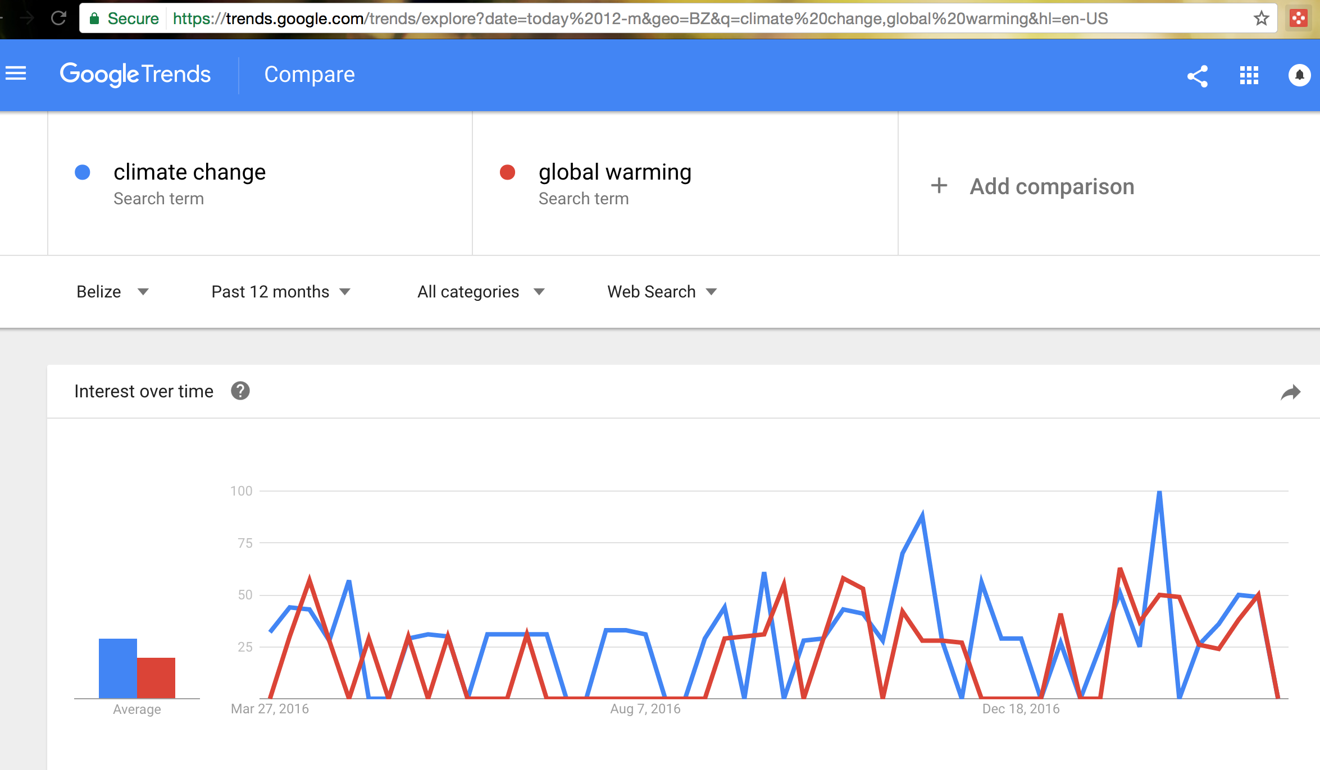
ONLINE PUBLISHING
  Check Google Trends

Slide 4
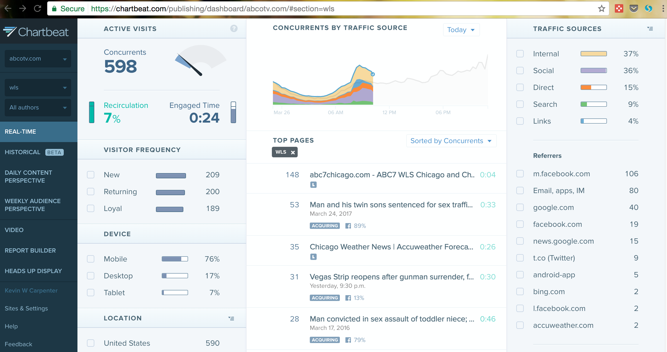
ONLINE PUBLISHING (continued)
  SEO (search engine optimization)/Meta Keywords
    Headlines and first graph terms are primary sources for searches
    If your CMS allows, use meta keywords
    Avoid very local terms in keywords
    Sample words: climate change, coral reef bleaching, Caribbean, environment
  Ask web producers for “back-end” data
    Reference pages, reference words

Slide 5
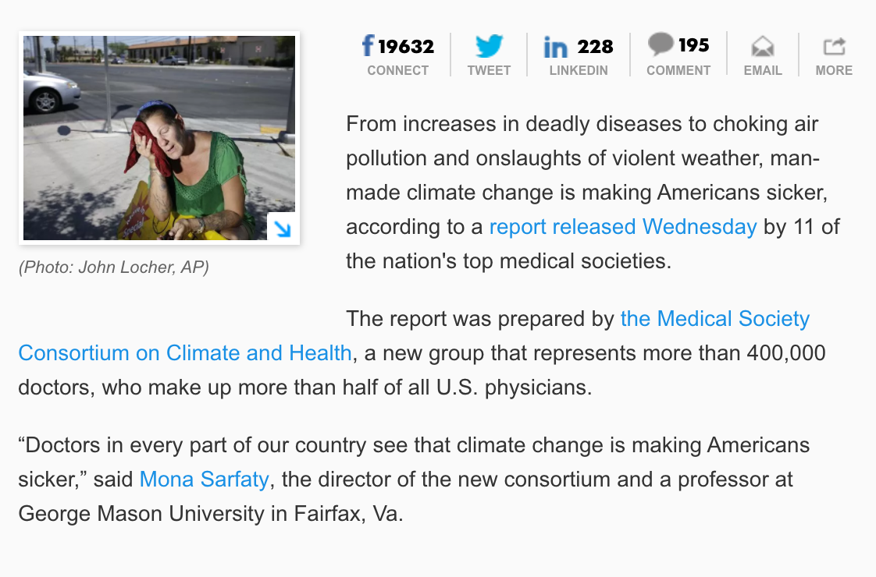
ONLINE PUBLISHING (continued)
HYPERLINK to past stories and related pages.
http://www.usatoday.com/story/news/health/2017/03/15/climate-change-making-us-sick-top-us-doctors-say/99218946/

Slide 6
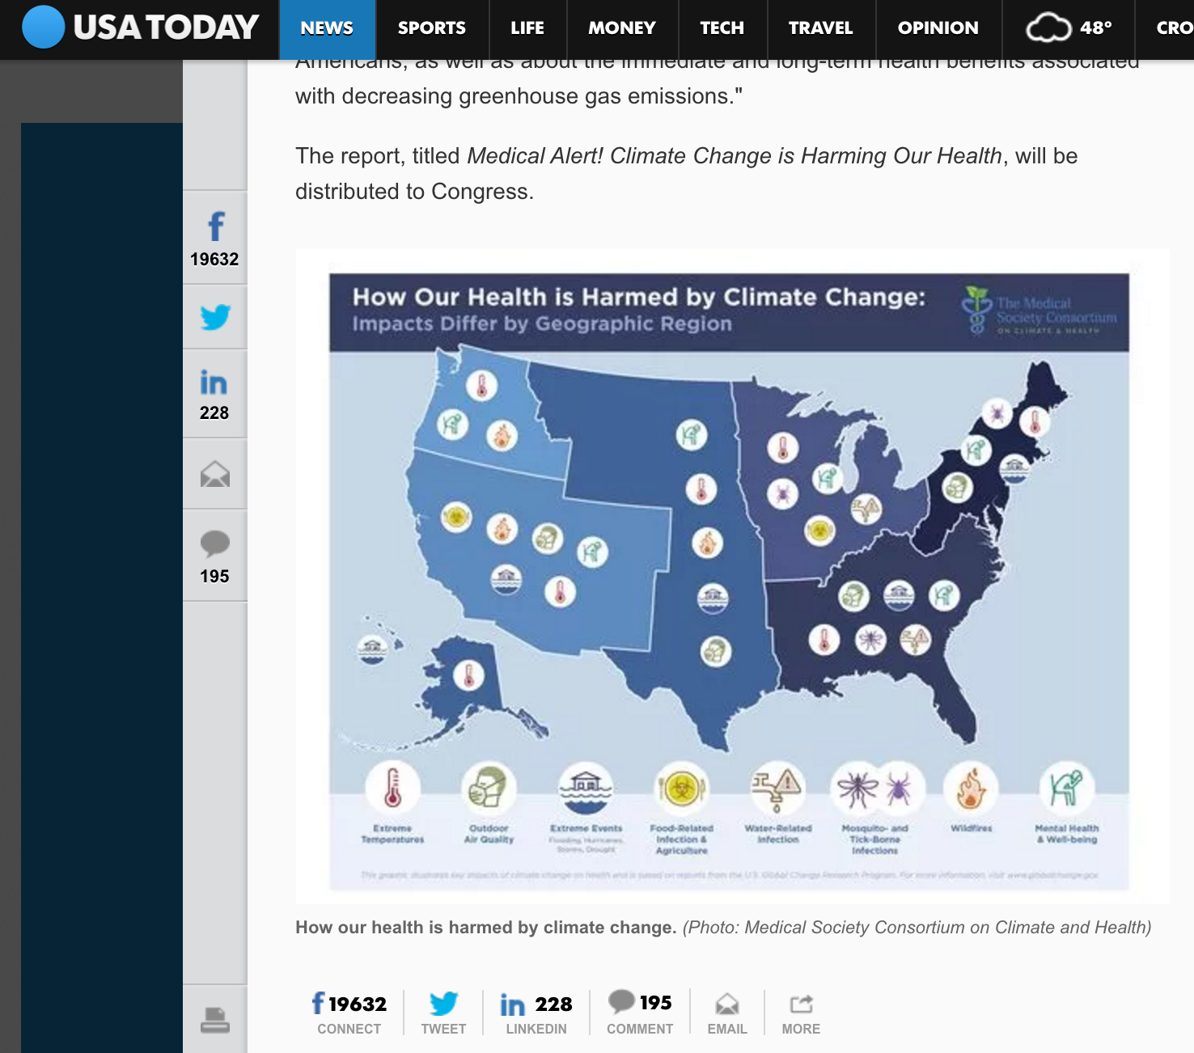
ONLINE PUBLISHING (continued)
USE GRAPHICS!

Slide 7
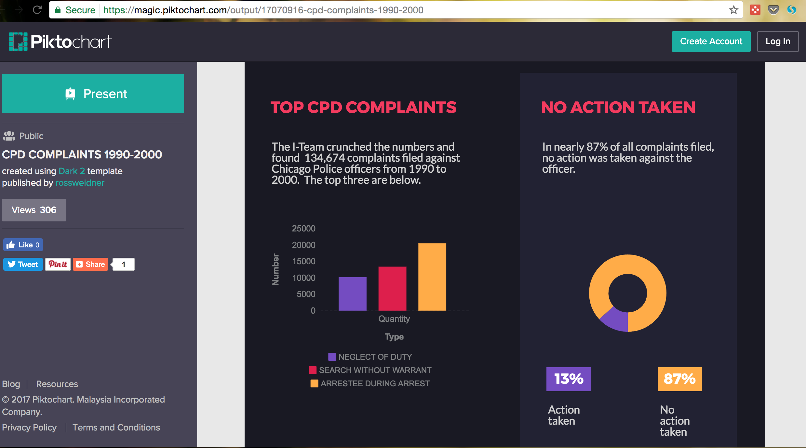
ONLINE PUBLISHING (continued)

Slide 8
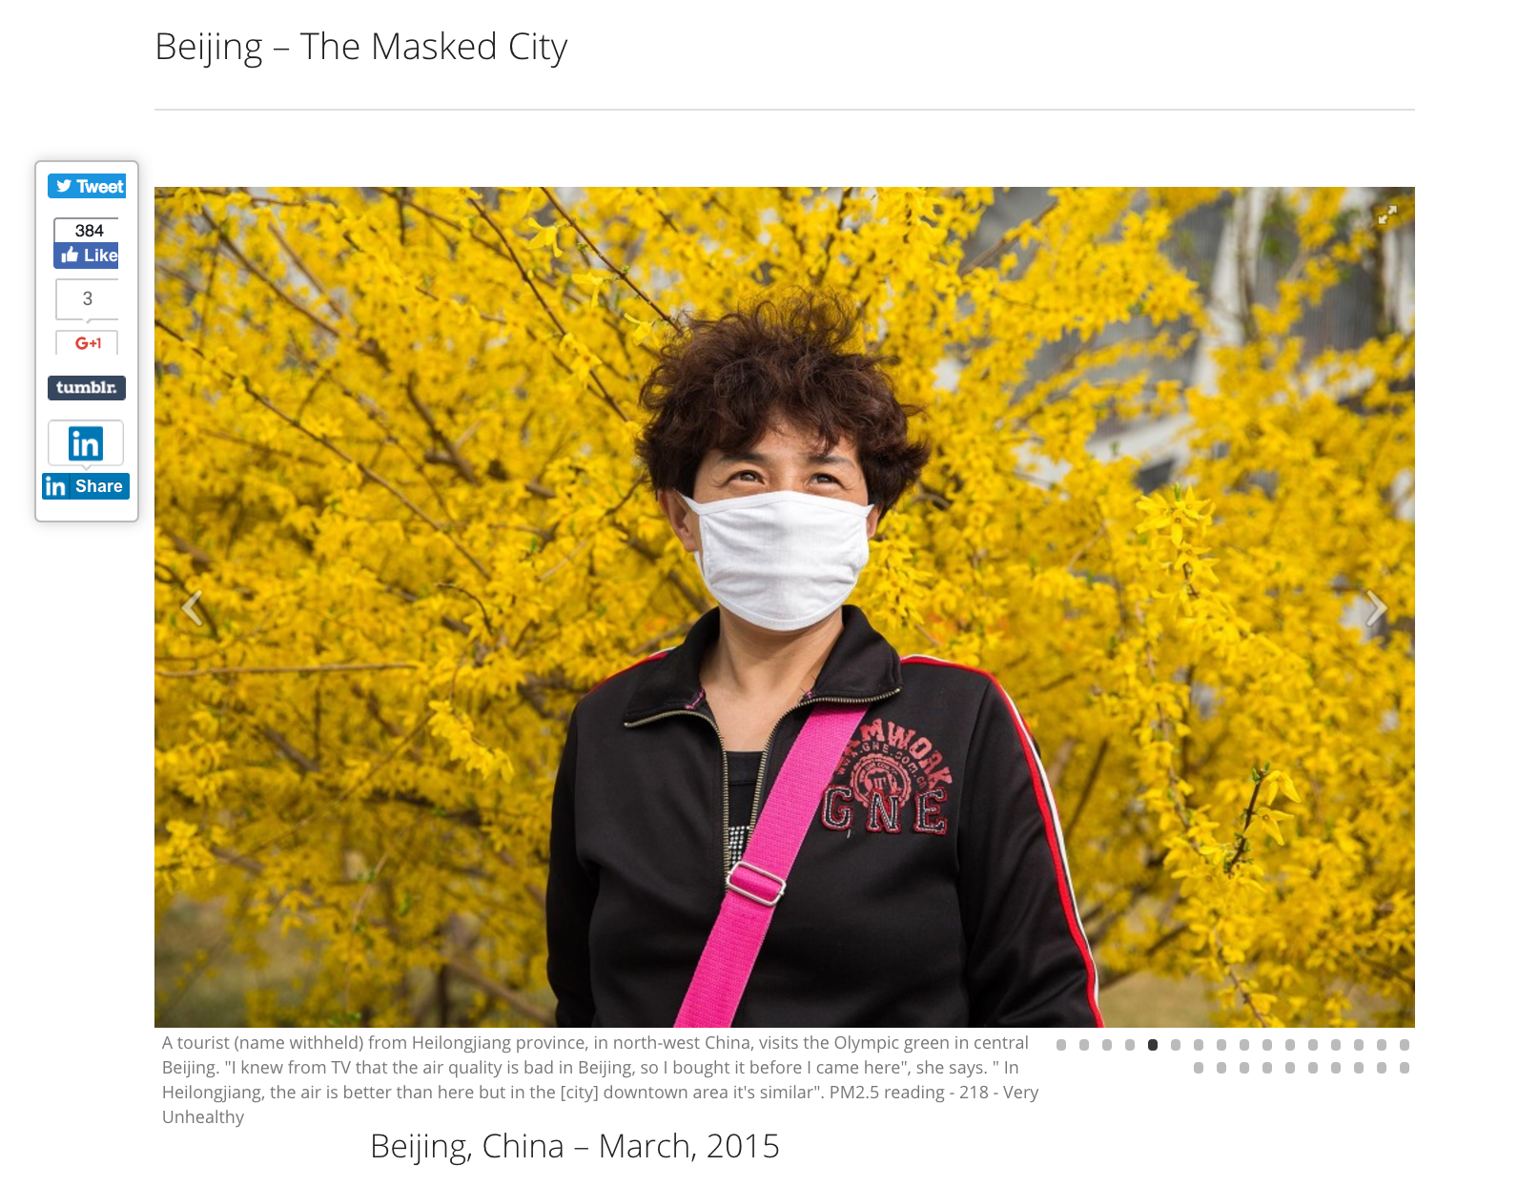
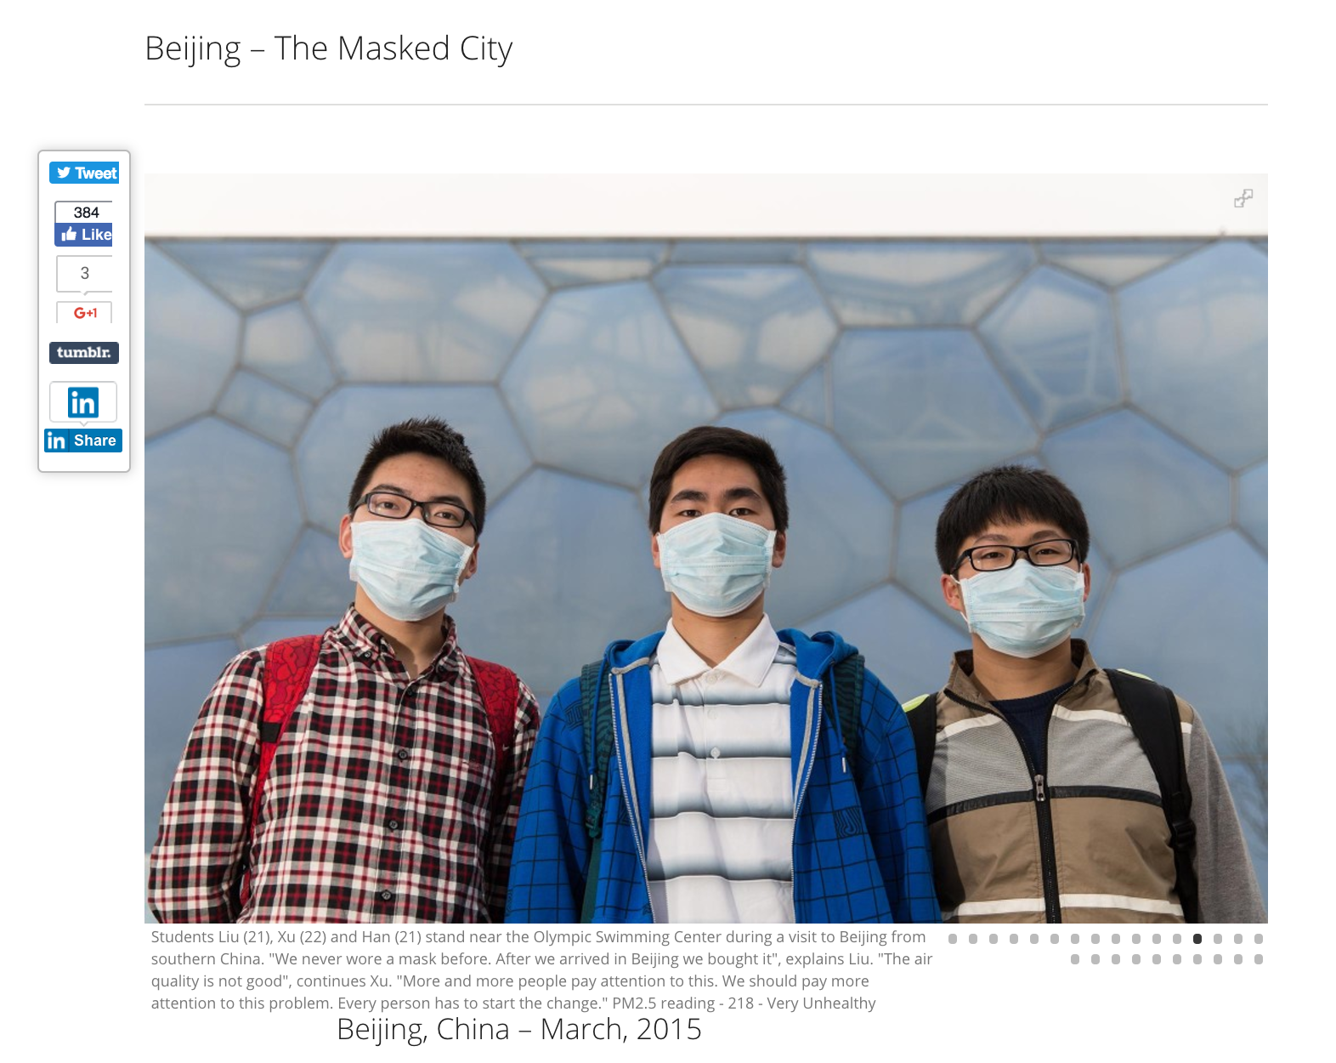
ONLINE PUBLISHING (continued)
PHOTO GALLERIES: Gives readers a different “entry point” and keeps them on your website longer.

Slide 9
ONLINE PUBLISHING (continued)
Embed social media if your CMS allows
Learn to code!
  www.CodeAcademy.com
QUESTIONS ABOUT POSTING ONLINE?

Slide 10
SOCIAL MEDIA - FACEBOOK
The Facebook Algorithm is CONFUSING, SECRET AND EVER-CHANGING!
  Right now, Facebook Live! is prioritized in the algorithm.
  Facebook Live! pushes ALL of your posts up
  Avoid # - Facebook reads this as a post from somewhere else
  Increasing likes improves your algorithm score
  PHOTOS, PHOTOS, PHOTOS
  Use short URLS to help track
  Post at peak times – morning, lunch, before bed

Slide 11
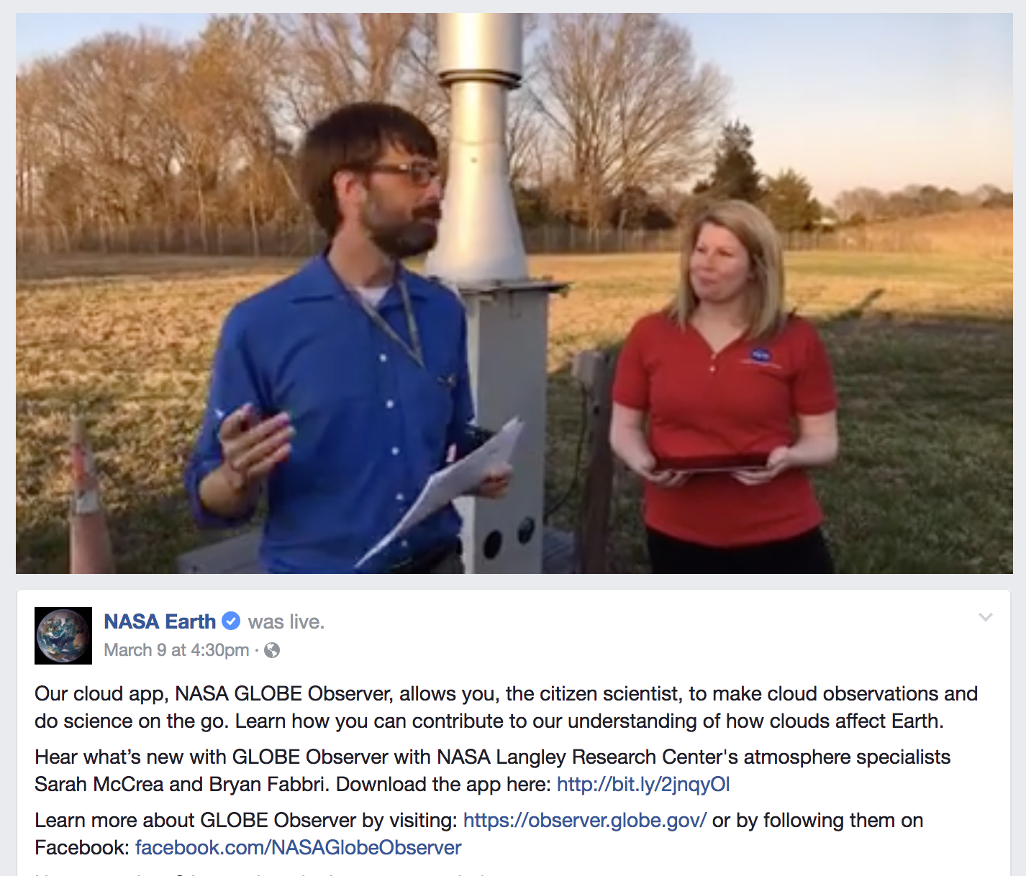
SOCIAL MEDIA – Facebook Live!
Who wants to Facebook Live!?
https://www.facebook.com/nasaearth/videos/10155167536337139/?hc_ref=PAGES_TIMELINE

Slide 12
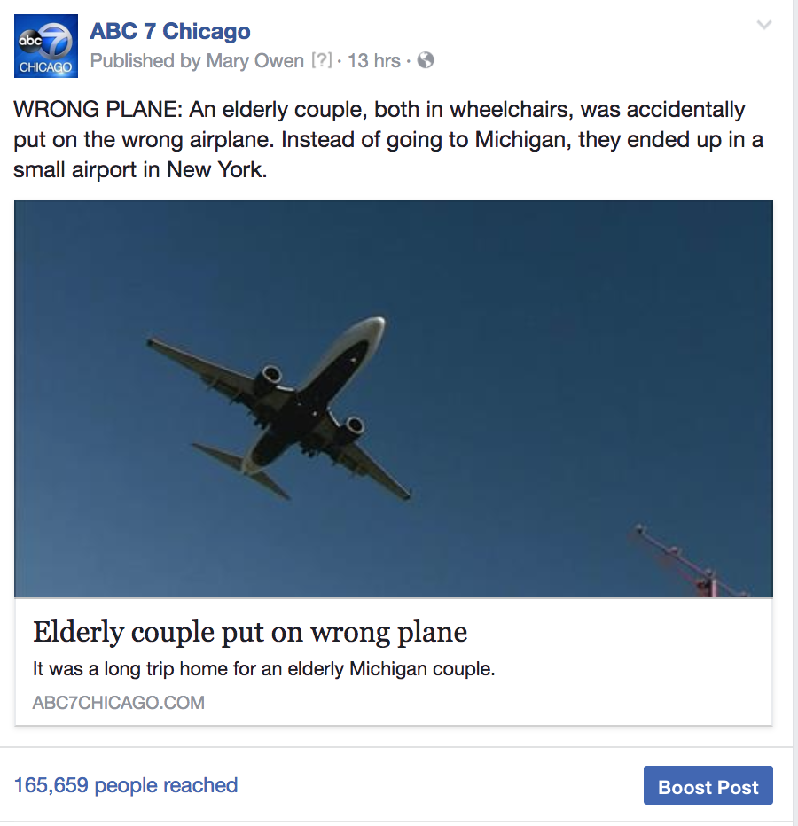
ANATOMY OF A GOOD FACEBOOK POST
Start with a 2-4 word phrase in caps to draw people in. Followed this by a colon and a brief summary, not in caps.
Get the major information at the top. Remember that you are competing for attention in people's busy newsfeed so use short, clear, concise information. It's ok if they have to "click for more" to expand the post, but assume that people will not.

Slide 13
TWITTER
If you are not on Twitter, get on Twitter
Very different from Facebook
  No algorithm, immediate
  Use to break news
    COVERING AN EVENT? TWEET IT!
  Use hashtags
    #ClimateChange
  Good way to engage readers/sources

Slide 14
CELLPHONE HACKS
  Recording interviews
  Photography
  Video

