Slide 1


Inception Workshop
Japan-Caribbean Climate Change Partnership
(J-CCCP)
Overview of Outcome 1
January 2016
Donna Gittens
Technical Specialist
J-CCCP

Slide 2

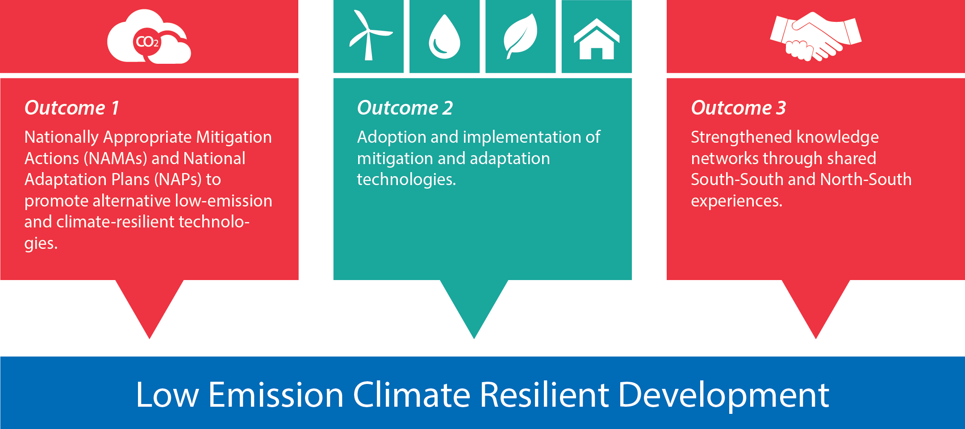
Outcome 1- The Outcomes

Slide 3
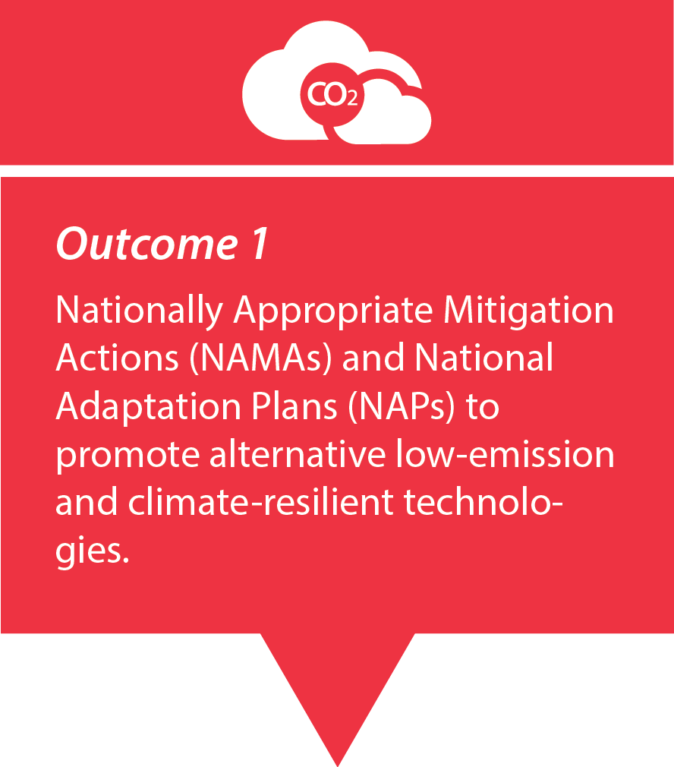
Outcome 1- The Objective
Notes:
Encourage the incorporation of climate risks and opportunities into national and sector planning process.
Emphasize the importance of considering long and medium term planning within the framework of national priorities for low emission and climate resilient development.
Promote comprehensive assessment of the benefits and trade offs of climate change adaptation interventions which is seldom undertaken
Recognising that many countries struggle to implement national strategies that decouple carbon emissions from economic growth
In view of this JCCCP seeks to strengthen institutional and technical capacities for the development of iterative NAPs and NAMAs in the region
Where the process has already been initiatied the project will build on and address gaps in the current activities

Slide 4
Outcome 1- The Goals
Strengthen institutional and technical capacities for development of NAPs and NAMAs
Build on and address gaps in current activities
Support parties to the COP with assistance to long term planning needs
Technical support tailored to country needs and national circumstances
Notes:
Provides the opportunity for the identification of areas where increased sensitization to CC impacts is needed as well as opportunities to strengthen national capacities for the development and implementation of NAPs and NAMAs
Identifying previous work, accessing the country situation to determine ways to address gaps. Provide effective and holistic pathways to accurate climate data
Many agencies few synergies, scattered approach. Foster coordination of key players and encourage the inclusion of climate consideration in national planning ( fiscal plans, national development plans, strategic planning)

Slide 5

Outcome 1- The Outputs
Outcome 1
Output 1.1
Technical support towards national and subnational institutional and coordination arrangements to support the formulation of roadmaps on the NAP technical process
Output 1.2
National teams are trained in the use of tools, methods and approaches to advance the NAP process and budgeting
Output 1.3
Business and usual greenhouse gas emission baseline established and climate change mitigation options for selected sectors relevant of the Caribbean region identified
Output 1.4
Design and implementation of NAMAs in the Caribbean with MRV systems and NAMA registries in place to monitor their execution
Notes:
Support the formulation of national level / strategies for advancing the NAPs
Train technical officers and policy officers from planning ministries on relevant tools and approaches to advance key steps of the NAP process
Establish business as usual GHG emission baselines and identify mitigation options in selected sectors relevant for the region/ country
Design and implement NAMAs and establish MRV systems for monitoring purposes

Slide 6

Output 1.1- Formulation of national roadmaps on the NAP process
Stocktaking of relevant initiatives to inform NAP process
Determination of the scope of the NAP process
Identification/ strengthening of existing country
specific coordination mechanisms
Formulation of NAP roadmaps
Notes:
Will include capacity assessments to identifying strengths, gaps, and key institutional and technical capacity/ review of national strategic development plans/ examine outcomes of relevant regional initiatives
Stakeholder consultations to identify expectations for integrating med to long term planning for adaptation into planning and budgeting processes
Will be used to drive the NAP process (e.g institutional assessments of ministries in preparation of CCA planning)
Formulation of roadmaps -

Slide 7
Output 1.2 – Training to advance NAP process and budgeting
Assess the needs/ gaps for materials, methods and tools that are relevant for informing the NAP process
Undertake national/ regional training on tools and approaches to medium to long term planning
    Costing economic loses due to climate change
    Definitions and methodologies for climate indicators
    Develop tools method and guidelines to advance NAP
    Integration of adaptation costing into sector and public investment plans
Notes:
Inform the NAP process. Will include institutional analysis to determine workflows and entry points to determine strategies for mainstreaming and costs
Strengthen leadership in key ministries re importance of med to long tem adaptation planning and integration of adaptation costs into sector and public investment plans

Slide 8

Output 1.2 – Training to advance NAP process and budgeting
  Design and implement monitoring methodologies
    Data collection methods
    Measurement of CCA causality and impact
    Participatory and evidenced based M&E methods
Notes:
Development of sector specific guidance tools and methodologies, policy materials
Priority ministries identified and trained in costing economic losses re CC and line ministries trained to adopt standardized definitions and methodologies for CC relevant indicators
Aimed development of data collection methods to measure CCA impact and casuality. Participatory evidence based M&E methods designed to promote buy in from planners and households

Slide 9

Output 1.3 – Establishment of GHG baselines and mitigation options
Update or completion of GHG inventories for selected interventions
Determination of national and regional reference baseline associated per selected interventions
Development of national marginal abatement cost
curves for considered mitigation actions
Barrier analysis for mitigation options selected
with NAMAs (Unilateral NAMAS, Supported
NAMAs and Credited NAMAs)
Feasible and consulted NAMAs and
regional actions
Notes:
To include public buildings , community based infrastructure, energy generating and end – use sectors
Includes but not limited retrofitting of inefficient light fixtures, installation of solar voltaic equipment for disaster risk management purposes
Same actions as above and others such as water pumping or agricultural uses mini and micro hydropower electricity generation
Unilateral- voluntary mitigation actions implemented unilaterally/ Supported-need significant technology – have higher cost or entry barriers that high emission technologies/ Credited – mitigation actions that can be encouraged through market mechanisms- sector crediting or carbon markets
Implementation of NAMAs and MRV system- required strong capacity and readiness from a wide range of stakeholders

Slide 10
Output 1.4- Design and implementation
of NAMAs
Policy and financial tools to support the implementation of a mitigation actions programme
Multi-sectorial policy dialogues on potential instruments for the implementation of NAMAs
Coordination mechanisms for NAMA implementation
Establishment of key parameters (quantitative and qualitative) to define and monitor selected NAMAs
Training and certification of MRV and NAMA professionals
Notes:
Actions prioritized in sectors and structured into detailed NAMAs- identification of instruments and policy and financial tools for implementation (fiscal incentives, feed in tariffs, concessional credits)
Broad stakeholder participation in selection of appropriate policy instruments for NAMA implementation – to support policy dialogue on implemnation instruments
National/ regional registry mechanism for mitigation actions for selected interventions
Establishment of key MRV systems. Designed to comply with internationally accepted standards
This initiative promotes learning by doing. In that light it endeavors to produce key bottom up knowledge on the requirements for effective NAMA implementation in the Caribbean and as a result generate important lessons for the international community.

Slide 11
End of Project Targets
NAPs which explicitly address disaster and climate resilience and gender impacts completed in six countries
NAMAs submitted to UNFCCC for six countries

Slide 12
Thank You

