Slide 1
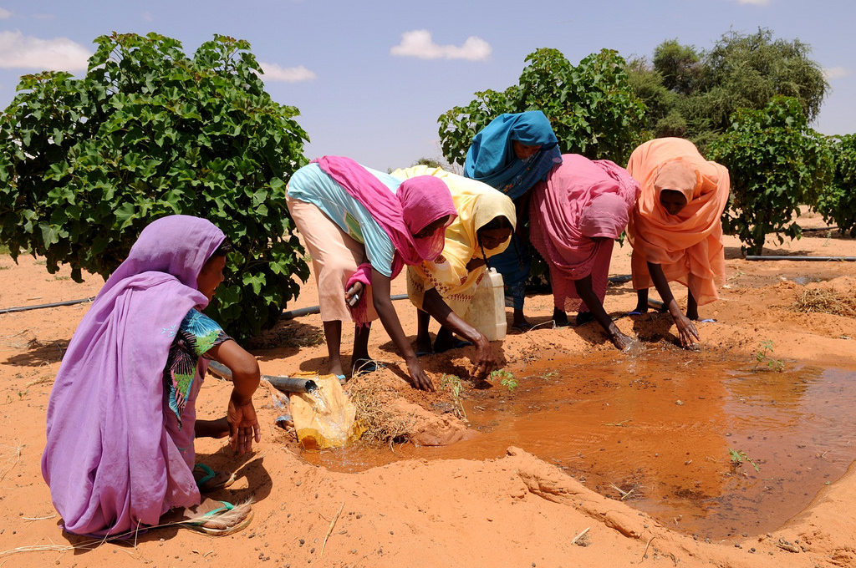

UNDP Support to LDCs
Thirtieth meeting of the Least Developed Countries Expert Group (LEG 30)
7–10 September 2016, Monrovia

Slide 2
Outline
UNDP’s support to LDCs
National Adaptation Plans (NAPs)
  1.1 Technical Assistance
  1.2 Assistance to access finance
2. Support to implement NAPAs
3. Capacity development for risk informed planning and budgeting
4. LDCs Accessing Adaptation Finance with UNDP support

Slide 3
Technical Assistance: One-on-One Support
16 countries between 2013-2016 (Angola, Bangladesh, Burkina Faso, Cambodia, Comoros, DRC, Djibouti, Gambia, Guinea, Liberia, Madagascar, Malawi, Mauritania, Niger, Senegal, and Tanzania)
Assistance with:
  stock-taking exercises
  NAP consultation and development of road-maps
  training at the country level (interactive modules developed by UNDP, UNEP, UNITAR and GIZ).

Slide 4
Technical Assistance: One-on-One Support
Country | NAP GSP support activities
Angola | Ministry of Environment (MINAMB), training to an inter-ministerial team in July 2015. stakeholder mapping Pan to convene high-level briefing for senior decision-makers to launch NAP process.
Bangladesh | A NAP road map produced and reviewed. Now preparing its National Adaptation Plan Supporting with securing DCF funding to support the implementation of road-map
Burkina Faso | NAP technically reviewed by UNDP, and partners including GIZ, GWP and UNITAR in 2014. Finalized in 2015.
Cambodia | Climate Change Department assisted with stocktaking and NAP road-map formulation (by UNDP & GIZ) results incorporated into the Cambodia Climate Change Alliance work plan NAP road-map finalized

Slide 5
Technical Assistance: One-on-One Support
Country | NAP GSP support activities
Union of the Comoros | Consultations and analysis of the institutional framework for the NAP (September 2014) Stocktaking report that assesses policy and institutional entry points for the NAP process Priority intervention areas which can support the country’s fund mobilization for national adaptation planning identified.
DRC | Support mission undertaken in October 2014 National stakeholder consultation conducted Government has adopted a NAP roadmap to advance the NAP process Proposal for NAP funding to the GCF under preparation.
Djibouti | Training workshop for national ministries organized and NAP process launched in April 2015. A stock-take conducted and shared with government
Gambia | National NAP planning meeting, a stock-taking assessment and development of a NAP roadmap (Department of Water, Ministry of Fisheries and Water Resources) Stakeholder consultation in the form of a NAP planning workshop Follow-up support to Gambia by UNDP/FAO on integrating agriculture into the NAPs process

Slide 6
Technical Assistance: One-on-One Support
Country | NAP GSP support activities
Guinea | UNDP/UNITAR led NAP training Carried out a stocktaking exercise 2nd mission is being organized, to support the government with a number of feasibility studies.
Liberia | The Environmental Protection Agency (EPA) organized a multi-stakeholder meeting identify entry points for the GoL to institutionalize Liberia’s National Adaptation Plan (NAP) process, and stocktaking of Liberia’s activities relevant to the NAP process. The government now applying for GCF support for formulation of its NAP process
Madagascar | launched its NAP process through a training workshop and a scoping mission for the development of a new project concept focused on coordination, climate information, and the economics of adaptation modelling. A stakeholder workshop in March 2015; followed by a sensitization workshop for decision-makers. Stocktaking report prepared; it will be used by the Government to assess the institutional framework that is appropriate for the NAP process in Madagascar as well as identify priority interventions to advance national adaptation planning. Applying for GCF funding for the development of its NAP with support from UNDP

Slide 7
Technical Assistance: One-on-One Support
Country | NAP GSP support activities
Malawi | training for inter-sectoral/inter-ministerial group conducted in September 2014 stocktaking exercise conducted through the National Climate Change Programmes Malawi has a technically cleared project for NAP formulation process by the LDCF. No $
Mauritania | Ministry of Rural Development and Environment UNDP, GIZ, UNEP and UNITAR jointly delivered a NAP training in April 2015 on stocktaking, development of adaptation options and monitoring and evaluation.
Niger | stocktaking focused on skills building at the institutional and individual level has been carried out, jointly by the UNDP and UNITAR Submitted a new Project proposal (PIF) for 8.5 million USD to the LDCF focused on adaptation in the water sector and includes climate adaptation mainstreaming activities, on strengthening of coordination mechanisms, the development of climate mainstreaming at local levels and support to monitoring systems. The Government of Niger is also developing a proposal to access GCF funding.

Slide 8
Technical Assistance: One-on-One Support
Country | NAP GSP support activities
Senegal | NAP stakeholder workshop held with the Ministry of Environment Planning fisheries consultations to start the NAP process at the sector level. Developing a proposal to access GCF funding for formulation of the NAP process
Tanzania | Facilitated a NAP stakeholder workshop with the Vice President’s Office followed by support to the health sector to assist in a stocktaking exercise.

Slide 9
Region Based Training (Tools, Methods etc)
  Regional Training Workshops in collaboration with LEG
  Decision-makers from Environment, Planning and Finance Ministries from LDCs oriented on the steps for National Adaptation Planning as well as on leveraging finance by NAP GSP team and partners with the participation of the GEF
    Asia (teams trained from 8 countries)
    Pacific (trained from 4 countries)
    Africa (teams trained from 15 Anglophone countries and 18 Francophone countries) = 120 people
Sensitization on the NAP process and the NAP TG
  Encouraged cross-sectoral collaboration
  Focus on long term planning
  Financing NAPs
  Exchange knowledge and lessons
  Introduced tools and methods

Slide 10
Knowledge Sharing
The e-newsletter of the NAP-GSP has over 2000 subscribers.
The programme has an updated website (http://globalsupportprogramme.org/nap-gsp) and is linked the NAP Central. The portal provides technical and audiovisual material for countries to learn from each other.
The material featured is based on the face-to-face regional training workshops held in Asia, Francophone and Anglophone Africa and the Pacific in collaboration with the LDC expert group.
Partnerships
LDC Expert Group - Training on NAP Guidelines and co-organised Pacific work-shop
WHO – contributed health NAPs perspectives In Africa and the Pacific
FAO – contributed Agriculture and Food Security case studies
GWP – Economics of Adaptation and co-organised the Africa work-shops
GIZ – Application of SNAP tool in clinics
CEEPA South Africa – Training on environmental economics with a focus on climate change

Slide 11
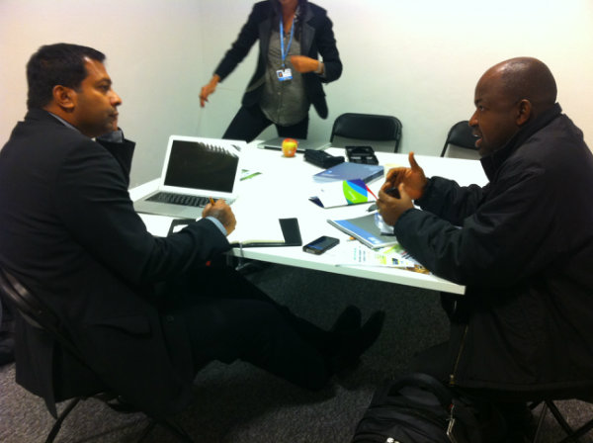
Knowledge Sharing
Working with Global Water Partnership
NAP Trainings in Malawi, Madagascar and Tanzania
Stock-taking in Niger, and Madagascar
Collaboration on regional workshops Africa and Asia

Slide 12
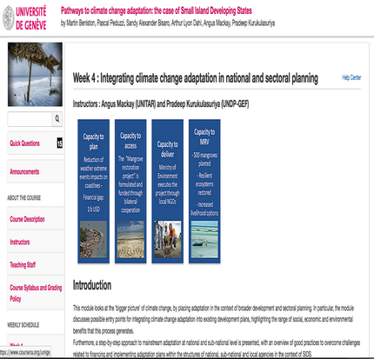
Knowledge Sharing
MOOC on climate adaptation in SIDS
University of Geneva, UNDP, UNEP, UNITAR.
Reached 8318 learners
Nearly 80000 views on our lectures

Slide 13
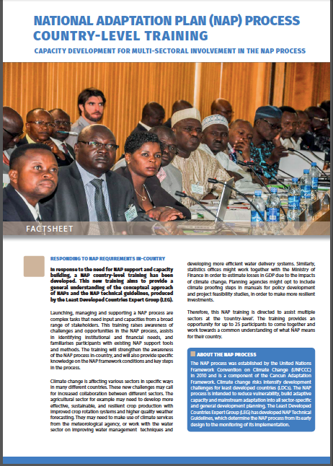
Knowledge Sharing
In-country NAP process training modules package developed
by Deutsche Gesellschaft für Internationale Zusammenarbeit (GIZ)/UNDP and /UNITAR
Applied in Angola, Madagascar, Mauritania, Djibouti, Senegal

Slide 14
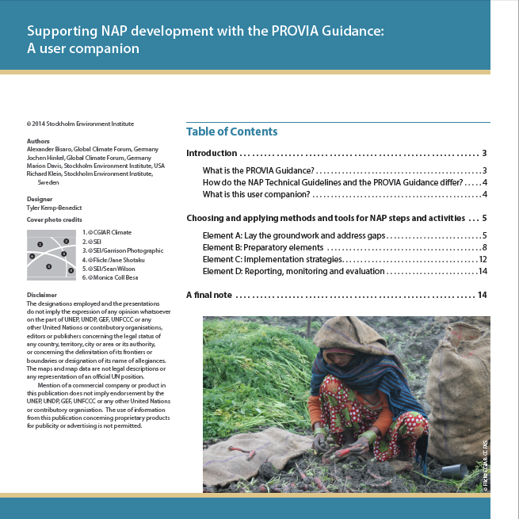
Knowledge Sharing
Companion document to PROVIA Guidance linking NAP Technical Guidance
Good Practices Workshop held by NAP-GSP in collaboration with PROVIA team has identified good practices from Cambodia, Burkina Faso and Comoros for wider dissemination
Case studies on application of NAP technical guidelines

Slide 15
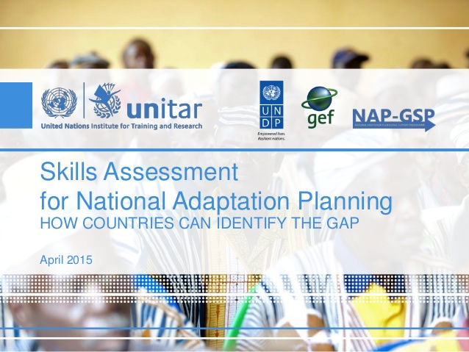
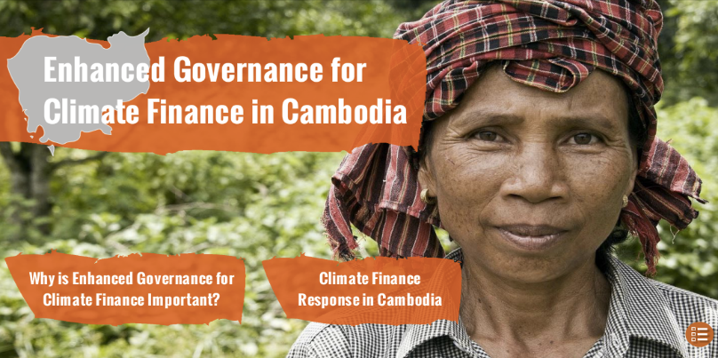
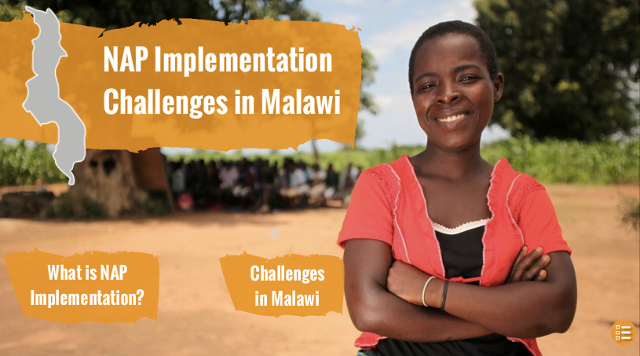
Knowledge Sharing
Partnership with UNITAR
Skills assessment approach for NAPs
Discussed with LDCs at the NAP Expo in 2015, in a dedicated session involving Haiti, Madagascar, Djibouti and Timor-Leste
Interactive E-Country case studies

Slide 16
NEW! Expanded Support to LDCs
Expanded Assistance to LDCs 2016 – 2019 (Phase 2)
Phase 1 Evaluation found that:
  with limited budget, project was designed with a sound regard for the international policy context and for individual countries’ national policy processes.
  participation of the LEG and the UNFCCC secretariat allowed for a continued maintenance of linkages between the GSP and the overall NAP process driven by countries.
Extend support towards building capacity of LDCs:
  to implement and/or advance the NAP process.
  to plan, finance, and implement adaptation interventions through integration of climate change into medium- to long-term development frameworks.
  at least 20 additional LDCs benefit from tailored one-on-one support
  further develop and disseminate tools and methodologies
  Organising 6 targeted training workshops on key elements of the NAP process; and
  South-South and North-South cooperation.
6 million USD.
Launch expected in 4th quarter of 2016 (Marrakesh)

Slide 17

Green
Climate
Fund
NEW! Access to Finance for NAPs
9 LDC countries requested to support development of project proposals to access GCF funding for the formulation and implementation of the NAP process
Country | NAP proposal requests made to UNDP
 | Request for assistance sent (from Gov to UNDP) | NDA Letter to GCF
Burundi | 1-Aug-16
Chad | 30-Jun-16 | 30-Jun-16
Congo DRC | 29-Jul-16 | 29-Jul-16
Guinea Bissau | 27-Jun-16 | 27-Jun-16
Liberia | 14-Jun-16 | 14-Jun-16
Madagascar | 27-Jun-16 | 27-Jun-16
Niger | 21-Jun-16 | 21-Jun-16
Senegal | 5-Jul-16
Tanzania | 19-Aug-16

Slide 18

NEW! Access to Finance for NAPs
LDCF - Funding Approved
Chad | 5431: Chad National Adaptation Plan
Global | 5399: Expanding the Ongoing Support to Least Developed Countries (LDCs) with country-driven processes to advance National Adaptation Plans (NAPs)
LDCF - Technically cleared and awaiting funding
Bangladesh | 5603: Integrating climate change adaptation into sustainable development pathways of Bangladesh
Senegal | 5428: Senegal National Adaptation Plan
Lao PDR | 5397: Strengthening Capacities for the Iterative National Adaptation Planning Process in Lao PDR for Climate Resilient Rural Development (SCNAP)
Niger | 5336: Planning and financing adaptation (NAPs) in Niger
Malawi | 5596: Building Capacity of Malawi’s government to advance the NAP process

Slide 19
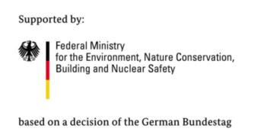
NEW! Access to Finance for NAPs
Government of Germany funded UNDP-FAO Joint Programme for Integrating Agriculture into National Adaptation Plans in 11 countries globally
LDCs covered Nepal Gambia Uganda Zambia | This is a four-year initiative that commenced in 2015. The Main outputs are: Capacity building for addressing adaptation in agriculture sectors and for integrating agriculture into NAPs; Development of agricultural sector road-maps for integration into NAPs; Strengthening the evidence base for adaptation planning in the agricultural sectors; and Knowledge exchange on adaptation planning in the agricultural sectors and on sector and cross-sectoral integration.

Slide 20
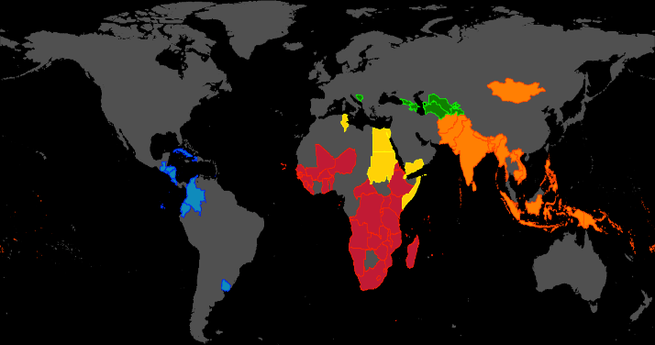
UNDP
A
N
D
CLIMATE CHANGE
WHERE WE WORK
Arab States
Asia
Pacific
Africa
$2.3
billion
since 2008
Latin &
Central America
Europe & CIS
Global
Notes:
29% of $2.3B = $643 million for adaptation

Slide 21
Implementation of NAPA Priority Projects
33 current and former LDCs with the development of National Adaptation Programmes of Action (NAPAs)
Thematic areas and sectors supported under NAPA include:
  adaptation in coastal areas,
  livelihood and agricultural interventions,
  water resource management,
  ecosystem based adaptation,
  community based adaptation,
  early warning and climate information, as well as
  disaster preparedness.
institutional strengthening and capacity development in policy, planning and budgeting for national and sub-national levels
Engagement of private sector for adaptation investment and micro, small and medium enterprise

Slide 22
Capacity Development
Risk informed Planning and Budgeting
Climate Change Budgeting & Financing Frameworks:
  supports development of integrated financing frameworks and public expenditure and institutional reviews targeting climate finance through:
    Climate Change Financing Frameworks (CCFF) and
    Climate Public Expenditure and Institutional Reviews (CPEIRs).
LDCs Supported: Bangladesh, Cambodia, Nepal;
Non-LDCs: Indonesia, Pakistan and Thailand
Expenditure Review using the CPEIRs methodology in Bangladesh, Cambodia, Nepal, and Samoa as well as in China, Indonesia, Pakistan, Thailand Vietnam, Fiji, Kiribati, Tonga, Vanuatu, Uzbekistan, Uganda, Tanzania, Rwanda, Ethiopia, Morocco and Ghana
In process in Benin, Mozambique, Kenya, Zambia and Namibia
Review also conducted in five district governments in Bhutan and published in 2014

Slide 23
Capacity Development
Risk informed Planning and Budgeting
Capacity Building Programme on the Economics of Climate Change Adaptation (ECCA)
Skill development in economic appraisal methods for climate change impacts on key sectors, including cost benefit analysis of investment options
10 countries in Asia, Maldives. Bangladesh, Cambodia, Indonesia, Lao PDR, Mongolia, Nepal, Sri Lanka, Thailand, and Viet Nam.
Together with USAID’s Adapt Asia-Pacific Project, the Global Water Partnership (GWP), the Asian Development Bank (ADB), GIZ and Yale University.
Boots on the Ground Programme
Network of 26 national climate change specialists and 4 regional advisors:
  aims to provide sustained institutional support and capacity development services to LDC governments in the area of climate change
  is supporting 26 low-income countries, including 23 LDCs, in the climate change arena

Slide 24
Capacity Development
Risk informed Planning and Budgeting
Guidelines for Integrating Disaster Risk Reduction into National Adaptation Planning
UNISDR and UNDP are collaborating in the production of guidelines for Integrating Disaster Risk Reduction into national adaptation planning; updated draft is available as of mid-2016.
Climate Finance Readiness Programme
To prepare developing countries to effectively and efficiently plan for, access, manage, deploy and monitor financing for climate change actions through the Green Climate Fund.
The target countries include two LDCs – Benin and Nepal – and seven non-LDCs - El Salvador, Colombia, Ghana, Fiji, Kenya, Philippines, and Uzbekistan.
GCF’s own Readiness Programme (Delivery Partner for approx 10 countries)

Slide 25
LDCs Accessing Finance for Adaptation

Slide 26
Green
Climate
Fund
LDCs Awaiting
Finance for Adaptation
Country | Project Focus | Grant (USD) | Source of Grant Funds
Afghanistan | Adapting Afghan Communities to Climate-Induced Disaster Risks | 5,800,000 | LDCF
Bangladesh | Enhancing Women and Girls Adaptive Capacity to Climate Change in Bangladesh | 35,464,933 | GCF
Bangladesh | Integrating climate change adaptation into sustainable development pathways of Bangladesh | 7,100,000 | LDCF
Bhutan | Climate Resilient Villages (CRV) in Bhutan | 9,125,000 | LDCF
Bhutan | Increasing food self-sufficiency in Bhutan through climate resilient agriculture and improved market access | 62,370,000 | GCF
Burkina Faso | Promoting index-based weather insurance for small holder farmers in Burkina Faso | 7,150,000 | LDCF
Burkina Faso | Climate resilience in the Nakambe Basin | 4,566,210 | LDCF

Slide 27
LDCs Awaiting
Finance for Adaptation
Country | Project Focus | Grant (USD) | Source of Grant Funds
Burundi | Adaptation governance and community resilience in Burundi | 13,950,000 | LDCF
Chad | Community-based climate risks management in Chad | 4,150,000 | LDCF
Democratic Republic of Congo | Climate resilient growth and adaptation in Democratic Republic of Congo | 8,442,500 | LDCF
Ethiopia | CCA Growth: Implementing Climate Resilient and Green Economy plans in highland areas in Ethiopia | 9,075,000 | LDCF
Ethiopia | Responding to the increasing risk of drought: building gender-responsive resilience of the most vulnerable communities | 94,070,000 | GCF

Slide 28

Contact:
Pradeep Kurukulasuriya
Head- Climate Change Adaptation
UNDP
pradeep.kurukulasuriya@undp.org
Visit: adaptation-undp.org
Notes:
29% of $2.3B = $643 million for adaptation

