Slide 1


Overcoming Challenges in the
Preparation and Implementation of NAMAs
Japan-Caribbean Climate Change Partnership
Barbados – Jan. 27, 2016
James M. Vener, P.E.
Technical Specialist, LECB Programme, UNDP
www.lowemissiondevelopment.org

Slide 2
Introduction
From Strategy to Preparation – the Pre-Preparation stage
How do we define NAMA preparation?
How do we define NAMA implementation?
Challenges/success factors in both phases
Technical assistance available
Guiding questions during preparation and implementation
Case Studies: Namibia and Trinidad & Tobago

Slide 3
LECB Programme – Overview (1)
Objective: Build capacities to design and implement Low Carbon Development through national mitigation actions in the public and private sectors
Five main work areas
GHG inventory management systems
Low-Emission Development Strategies (LEDS)
Nationally Appropriate Mitigation Actions (NAMAs)
Measurement, Reporting and Verification (MRV)
Participation of selected industries in mitigation actions
Donors:
European Commission, German and Australian Governments

Slide 4
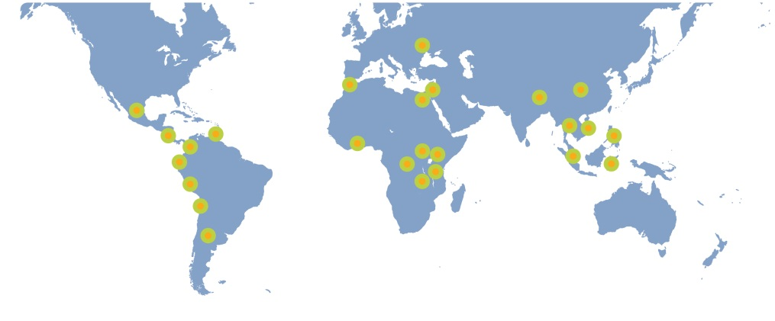
LECB Programme – Overview (2)
Start date: January 2011
End date: December 2016
Funding: US$ 45 million
Scale: 25 countries
Sectors: Energy, transport, industrial processes (cement, iron & steel, fertilizer, mining), waste, agriculture, LULUCF
Deliverables: - 60 NAMAs with MRV systems
- 13 LEDS
- 17 national GHG inventory systems
- INDC support ongoing
Notes:
Increasing focus on INDCs (2015 guidebook on how to design INDCs with WRI)

Slide 5
LECB Partner Countries
Phase | Africa | Asia | LAC | Arab States | Europe/CIS
Phase 1 (2011) | DRC | Philippines | Argentina | Egypt
 | Kenya | China | Chile | Morocco
 | Uganda |  | Colombia
 | Zambia |  | Ecuador
 |  |  | Mexico
 |  |  | Peru
Phase 2 (2012) | Ghana | Bhutan | Costa Rica | Lebanon | Moldova
 | Tanzania | Indonesia | Trinidad & Tobago
 |  | Malaysia
 |  | Thailand
 |  | Vietnam
Total # | 6 | 7 | 8 | 3 | 1

Slide 6
From NAMA Strategy to Preparation
Before preparation can start, a few key criteria need to be in place:
Vision – national governments need to agree on policy goals and overall mitigation targets
Prioritization – policy objectives need to be agreed upon and prioritized among ministries
Champion – an individual or group needs to commit to drive the NAMA development process and achieve results

Slide 7
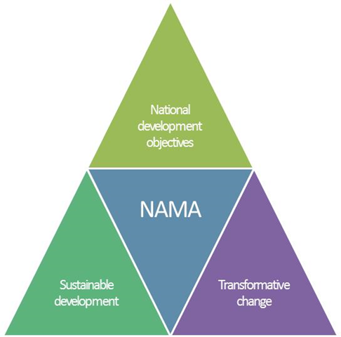
Setting NAMA Objectives
Promote green growth, GHG emission reductions, sustainable development / co-benefits
Align with national development and climate objectives and policies
Spur development of an environment to facilitate ‘Transformative Change’ in the sector
Facilitate private sector participation and investment via enticing regulatory and policy environment

Slide 8
Challenges / Success Factors
NAMA Preparation
Identify a ‘Champion’ to drive the NAMA development process
Stakeholder engagement (continuous, transparent, inclusive)
Political commitment to meet mitigation & development targets
  Identify lead institutions/ministries to coordinate and ensure continued buy-in
Promote local technical capacity - to ensure lasting technical support during NAMA and MRV system preparation
Identify a national financial institution - to manage large amounts of funds for effective allocation of financial resources
Put the private sector center stage – engage in dialogues, encourage policy frameworks to facilitate investment in ventures under the NAMA framework

Slide 9
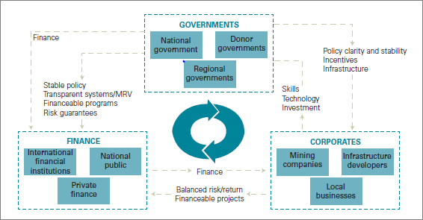
NAMA Implementation Key Steps
Design NAMA Action Plan
Set up coordinating and managing structure (including technical and financial entities to lead in respective areas)
Policy incentives are under preparation
Involve private sector in dialogue and design of business plans
Approve national budget, obtain int’l support for implementation, the private sector is ready to engage

Slide 10
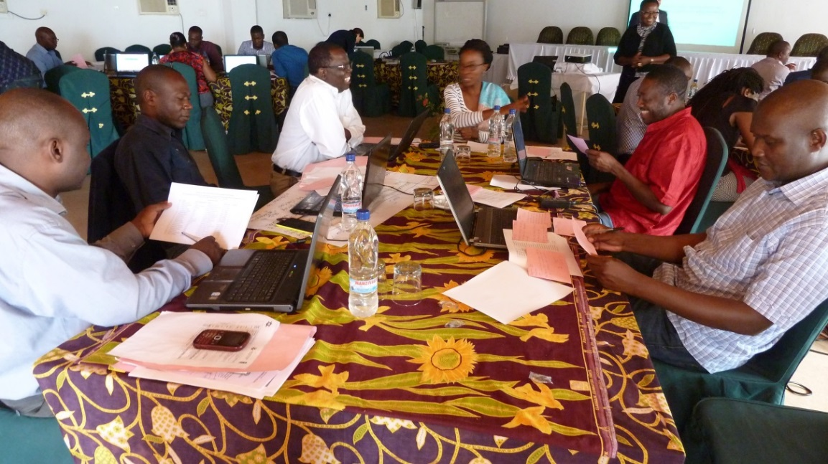
Challenges / Success Factors
NAMA Implementation
Political: Enabling environment for investment successfully created
Institutional: NAMA coordination and managing authorities fully operational; outreach activities and liaising with donors and investors; public-private dialogue and promotion of PPP
Technical: National technical implementing entity established; MRV in place; NAMA progress and results regularly reported
Financial: Effective fund allocation, promoting investment opportunities, promotion of public finance mechanisms to catalyze private investment flows.

Slide 11
Technical Assistance for Preparation
and Implementation
International support for developing and implementing NAMAs currently available through bi- or multilateral cooperation.
UNDP (LECB – NAMA Development)
Climate Technology Centre and Network (Development)
UNEP DTU (Development)
GIZ (Development and Implementation)
NAMA Facility (Implementation)
NEFCO (Development and Implementation)
Green Climate Fund (Implementation)

Slide 12
Guiding Questions – NAMA Preparation
What are key challenges in preparing NAMAs in your country / sector and how did you overcome them?
Efficient coordination / management
Sustained political commitment
Inter-ministerial collaboration
Clear technical and financial roles
Private sector engagement

Slide 13
Guiding Questions – NAMA Preparation
Is a leading institution identified that will drive the NAMA preparation process?
Is the proposed NAMA a political priority, having full support from the key Ministries, and is aligned to national policies (INDCs)?
Is there financial commitment for the future implementation of the NAMA?
Does a national FI exist that will effectively allocate national and international financial resources and transparently monitor the financial support obtained?
Is an institution identified that will lead the MRV of GHG ERs and SD impacts?
Can the private sector get engaged in a dialogue and is there interest to invest in potential NAMA ventures?

Slide 14
Guiding Questions – NAMA Implementation
What are key challenges in implementing NAMAs in your country / sector and how did you overcome them?
Lead institution and political roles
Institutional set-up / NAMA management and coordination
Clear technical roles
Clear financial roles and investment opportunities

Slide 15
Guiding Questions – NAMA Implementation
Are key Ministries involved in decision-making processes?
Does the NAMA have full support from the NAMA coordination authority, and is the NAMA incorporated into regular activities?
Is the NAMA coordination authority liaising with potential donors and fully supporting outreach and promotion activities?
Is there sufficient coordination between key Ministries for successful NAMA implementation?
Is the technical implementing entity established and MRV system in place?
Is the financial institution for fund allocation identified and is it promoting public finance mechanisms to catalyze private investment flows?
Has a public private dialogue been initiated?

Slide 16
Case Study Examples
Namibia NAMA
  National policy alignment
  Eligibility criteria / approval process for intervention partners
  Capacity building
  Institutional structure
  Finance
  MRV
Trinidad & Tobago NAMA
  NAMA development strategy
  Ongoing activities

Slide 17
Case Study - Namibia
“Rural Development in Namibia through Electrification with Renewable Energies” NAMA
Provides access to ‘appropriate’ energy technologies
2011-2015 access to electricity = 47.3% (World Bank)
Covers households, companies, and regions
Replaces fossil fuel usage with renewables
Impacts:
  GHG ER
  SD co-benefits, income generation / new business opportunities, air quality, and improved livelihoods for low income communities

Slide 18
Namibia NAMA
‘Intervention A’
RE mini-grids are established in off-grid, rural communities (esp. near schools and eco-lodges) using solar and wind
Impacts:
  Households: electricity for daily lighting (2 lamps minimum), and radio and phone charging
  Rural Productivity Zones (RPZ): the mini-grid enables income generation opportunities for entrepreneurs and community projects (agro processing units, ice-making units, cooperative milling, sewing unit, internet access, charging of phones, etc.)
  Public buildings: electricity for lighting and internet (schools, government buildings, health centers), computers/printers, mobile charger stations, and basic clinic instruments in health centers

Slide 19
Namibia NAMA
‘Intervention B’
‘Energy Zones’ are created in off-grid areas that do the following:
Consist of new stand-alone RE installations (solar PV, wind, hydro)
Provide electricity in one building/compound
Promote new entrepreneurial activities by providing space and electricity (e.g., for internet cafes, sewing workshops, ice-making, agro-processing)
Located where village households can charge batteries, e.g., for lighting
Serve as an outlet for sale of energy appliances like solar lanterns and light bulbs, focusing on rural areas

Slide 20
Namibia NAMA ‘Intervention A’
Mini-Grid Eligibility Criteria
Criterion | Description
Location | Any off-grid area at least 10 km away from the closest power line
Technology | Energy supply: solar PV, wind, or a combination of those.
 | Battery: Batteries are recommended
 | Backup: Fossil-fuel back-up systems are allowed, however, share of electricity from renewable energies at least 75 percent.
Connections | Must serve a minimum of 20 households.
Service level | Dwellers: at least 2 sources of lighting, radio and phone charging.
 | Opportunities for income generation activities: Agro processing units, Ice-making units, Cooperative milling, Internet access, Charging of phones Activities will be considered via the Point Score system
 | Electricity for 24 hours per day.
Point Score | A project must reach a total Point Score of at least 200. The sub-score for income generation activities must be at least 80.
Implementation | Operational within 18 months of contract award.
Funding | Maximum grant funding is 80 percent of total investment costs. Operation costs must be covered from income of electricity sales.

Slide 21
Namibia NAMA ‘Intervention A’
Mini-Grid Evaluation of Proposals
Reverse Auctioning to evaluate mini-grid proposals
Issue tenders → offers are accepted, starting from the cheapest, until the budget is used up
Proposals are ranked by their Value for Money Index (VMI) using a Point Scoring System
  Extra point score for hospitals, health centers, schools, agricultural development centers, income-generating activities

Slide 22
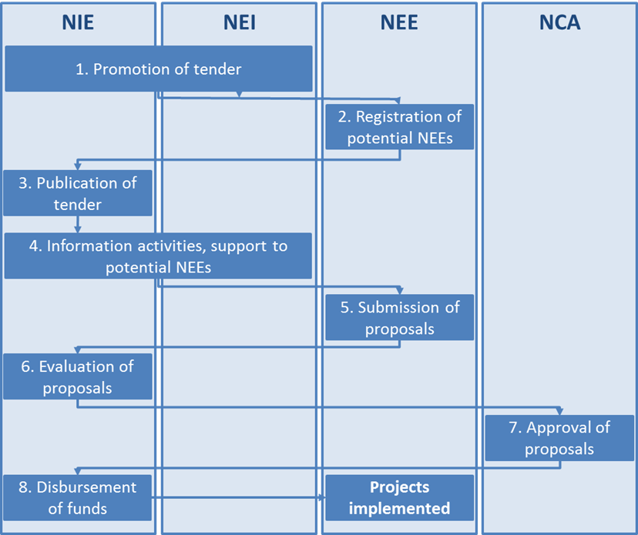
Namibia NAMA ‘Intervention A’
Mini-Grid Approval Process

Slide 23
Namibia NAMA Policy Alignment
Embeddedness / Alignment with national policies
NAMA Objective | National Strategy & Target
Improve electricity access | NDP4, Off-Grid Energisation Master Plan for Namibia (OGEMP)
Improve the share of renewable energies | OGEMP
Reduce GHG emission | INDC, National Climate Change Committee (NCCC)
Provide income generation and new business opportunities | 4th National Development Plan (NDP4)
Improve private sector involvement | NDP4
Achieve additional Sustainable Development (SD) benefits | Vision 2030 (national development strategies & programmes), NDP4

Slide 24
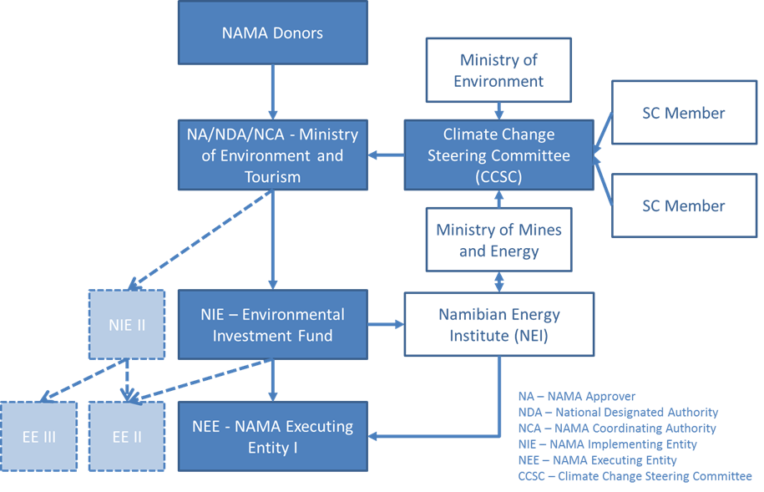
NAMA Institutional Structure

Slide 25
NAMA Institutional Structure
Design Challenges
Does the NAMA have a ‘champion’ that supports the NAMA development and implementation?
Are key Ministries involved in the key decision making processes?
Does the NAMA have full support from the NAMA Coordinating Authority (NCA) and can the NCA incorporate the NAMA programme into its regular activities?
Is the NCA / NAMA Approver / National Designated Authority (vis-a-vis the GCF) in different Ministries, and Is coordination between Ministries sufficient for a successful NAMA coordination?
Does the National Implementing Entity have sufficient human and technical resources to implement the NAMA interventions? If not, is there a technical support structure in place to allow for capacity development over time?

Slide 26
NAMA Budget
Intervention A:
10 mini-grids
100 kW installed capacity
Average costs US$ 7,500/kW
Total investment costs US$ 7.5 million
Intervention B:
13 Energy Zones
10 kW installed capacity
US$ 7,000 for Energy Shop
US$ 190,000 for solar PV system
Total investment US$ 2.47M
NAMA Component | Namibian government [US$] | Private sector [US$] | NAMA donor [US$]
Intervention A | 1,875,000 | 1,875,000 | 3,750,000
Intervention B | 893,000 | 0 | 1,647,000
Capacity building | 405,000 | 0 | 875,000
Total | 3,173,000 | 1,875,000 | 6,272,000
Total NAMA Costs: US$ 11.32M

Slide 27
NAMA Finance
National:
Capacity building
Grant for Intervention A (mini-grid investment costs)
Grant for Intervention B (Energy Shop costs and part of costs of Energy Zones)
Payments by consumers (households, companies)
Contributions to the Maintenance Fund;
International:
Capacity building
Grant for Intervention A (part of mini-grid investment costs)
Grant for Intervention B (Energy Shop costs and part of Energy Zone costs

Slide 28
NAMA Finance – Guiding Questions
Are the overall cost estimates realistic and appropriate?
Is the national financial contribution realistic?
Are the Government allocations designed in a manner that support transformational change and keep the NAMA on-going once the international donor(s) exit the programme?
Is the level of International funding sufficient?
Are the national and international funding streams robust designed and include a payment at delivery principle?
Notes:
sales tax waiver on imports , Tax holidays in respect of an enterprise’s corporate or turnover tax, depreciation
allowances, withholding tax or dividend, should be for priority sectors extended to a period of 15 years, or five
years twice renewable. Approved PPPs should be eligible for the above tax measures, where the total investment for the PPP ventures
exceeds US$250,000. Establishment of a Renewable energy fund….

Slide 29
Design Challenges
Does the selection and the design of the interventions ensure the achievements of the NAMA objectives and targets?
Are the eligibility criteria well designed, broad enough to encourage participation but also sufficiently precise to allow for exclusion of offers that would not fully support the NAMA objectives?
Is there sufficient competition for reverse auctioning?
Will there be sufficient demand for income generating activities?

Slide 30
NAMA Capacity Development
Component 1:
Implement NAMA institutional set-up and processes (technical and financial project cycle), including staff training
Implement NAMA-related regulations and design the contractual conditions
Prepare NAMA project documentation (application forms, call and tender documents, procurement rules, monitoring, evaluation and reporting forms, etc.)
Component 2:
NAMA awareness raising & marketing after implementation to create broad awareness and specific stakeholder-oriented capacity development

Slide 31
NAMA Capacity Development
Design Challenges
Does the Capacity Development support address the needs of the institutions, communities and private sector?
Will the length of the support be sufficient to encourage a transformative change in the sector and allow smooth continuation after the NAMA implementation phase is over?
Are the cost estimates appropriate?

Slide 32
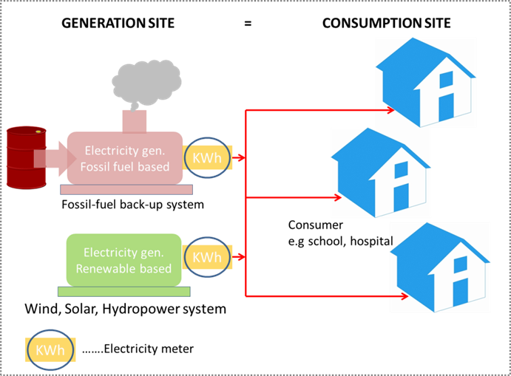
MRV
NAMA GHG Emission Reductions
The GHG Emission Reduction MRV is based on the CDM methodologies:
AMS-I.F: Renewable electricity generation for captive use and mini-grid
AMS-I.L.: Electrification of rural communities using renewable energy
but simplified and set as follows:
Produced electricity = consumed electricity - no grid losses
Fossil fuel baseline emission factor: 1.0 (tCO2/MWh), no tranches, no different levels of load factors
Monitoring: Electricity meter on production site only.

Slide 33
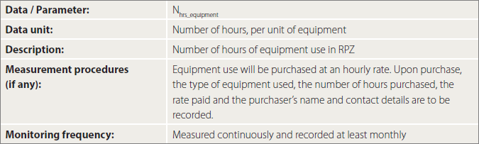
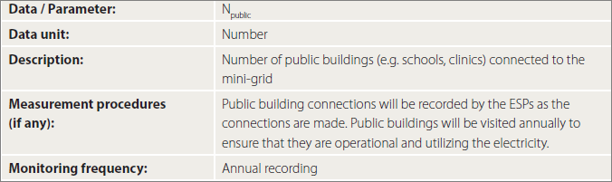
MRV
NAMA SD Benefits

Slide 34
MRV
Design Challenges for NAMAs
Is the GHG ERs quantification methodology robust, built on existing standards and allow the NCA to track the achievements in a transparent manner?
Is the SD reporting transparent and can improvements over the monitoring period be unambiguously monitored?
Is the financial support provided as part of the NAMA also incorporated into the monitoring plan?
Can the NIE implement the MRV plan, technically and from a human staffing point of view?
Are the monitoring intervals feasible?

Slide 35

UNDP SD Tool
The SD tool has been designed to evaluate the SD performance indicators for NAMAs and to evaluate the SD results achieved over the lifetime of the NAMA;
The SD tool is currently applied in 7 NAMAs, e.g. ‘Adaptation and Mitigation Initiatives in Philippines Rice Cultivation’.
http://www.undp.org/content/undp/en/home/librarypage/environment-energy/mdg-carbon/NAMA-sustainable-development-evaluation-tool.html

Slide 36
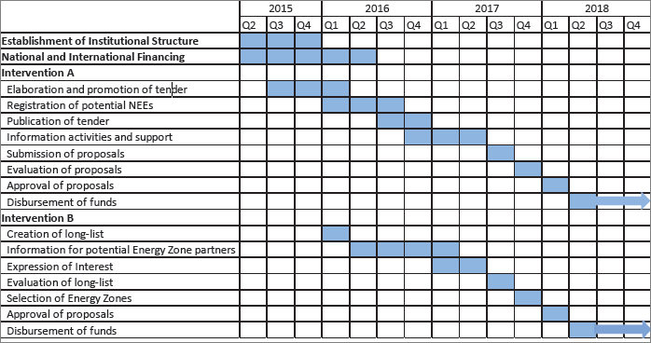
NAMA Implementation Plan

Slide 37
NAMA Implementation Plan
Design Challenges
Are the implementation timelines realistic?
Is the duration of capacity development support provided sufficient to achieve lasting results and a transformational change in the sector?
Minimize risk of losing institutional capacity / brain drain (train in groups, train the trainers)
Maximize opportunities and coincide with key dates

Slide 38
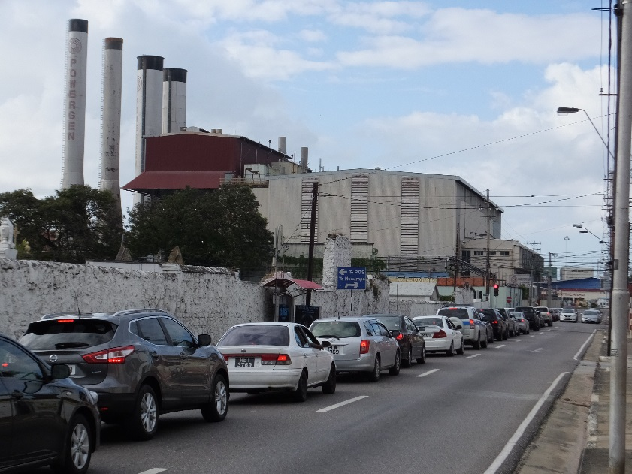
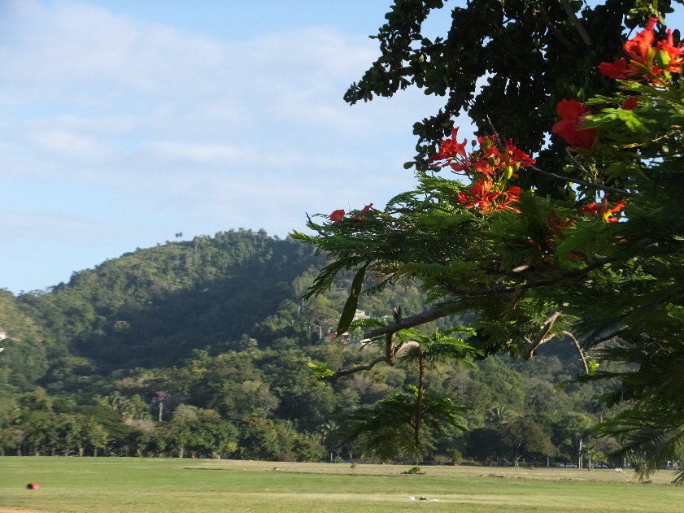
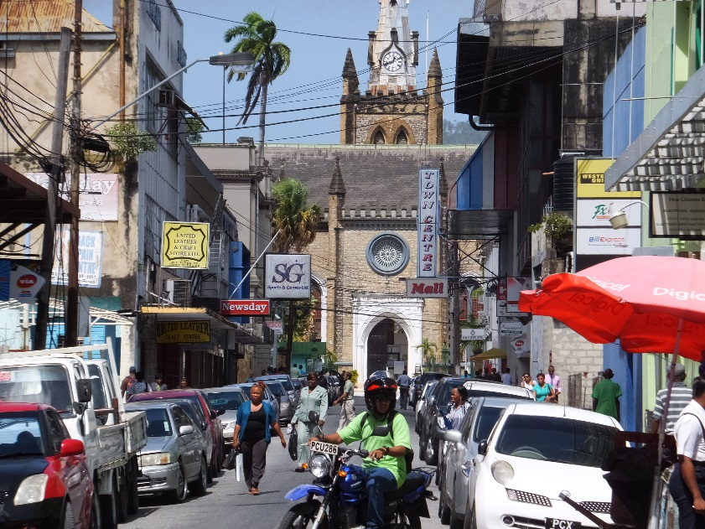
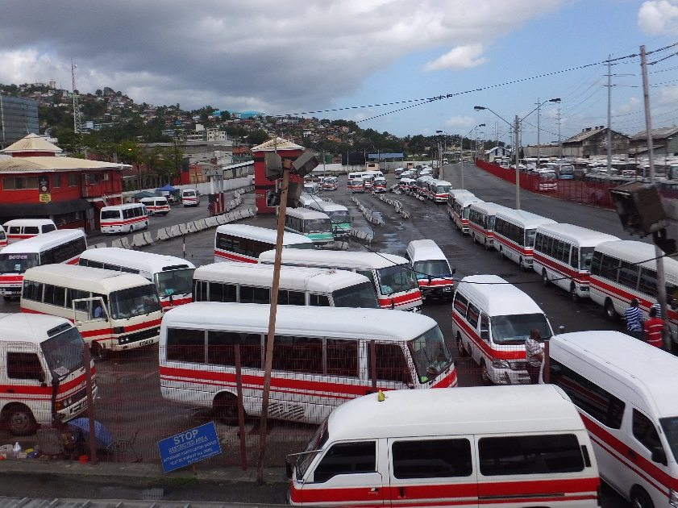
Case Study -Trinidad & Tobago

Slide 39
T&T NAMA Development
Key considerations:
Consistency with CRS, NCCP, INDC
(same 3 target sectors: transport, power, industry)
  NCCP = policy guidance to develop administrative and legislative frameworks
  CRS = basis upon which NAMAs will be developed
  NAMAs = specify and implement the measures to achieve the mitigation goal communicated through the INDC
Ministry of Planning & Development = coordinating agency
40% GDP from oil & gas sector, oil price drops 50% / last 2 years (looking for diversification and stability in local gas supply)
Fossil fuel subsidies (roll-back)

Slide 40
T&T NAMA Development
Current status:
Consultations and sectoral mapping
Steering the process: MPD and UNDP focal points, Technical working group, Inter-ministerial Steering Committee
Data collection
Review of existing and planned policies and regulatory / legal frameworks
NAMA prioritization
  Integrated public transport system
  RE in power generation
  Petroleum sector venting and flaring; Industry EE incentives

Slide 41
T&T NAMA Development
Current status:
Consultations and sectoral mapping
Data collection
Review existing / planned policies & regulatory / legal frameworks
NAMA prioritization
  Integrated public transport system
  RE in power generation
  Petroleum sector venting and flaring; industry EE incentives
Next steps
  Consultations + data
  Emission reduction quantification compared to baseline
  Co-benefits analysis
  MRV system recommendations

Slide 42
Thank You!
James Vener
James.vener@undp.org
www.lowemissiondevelopment.org

