Slide 1
UNDP Workshop on ‘The Last Mile’ : Session 4
Enhancing NMHS Capacity to Generate and Distribute Dynamic Early Warning Content
Current Conditions – Storm Alerts – Point Forecasts
Ari Davidov adavidov@earthnetworks.com
Livingstone Zambia 15 March 2016

Slide 2
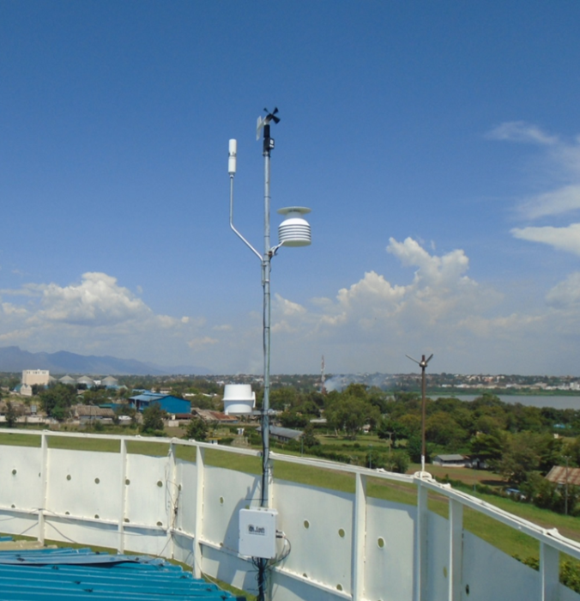
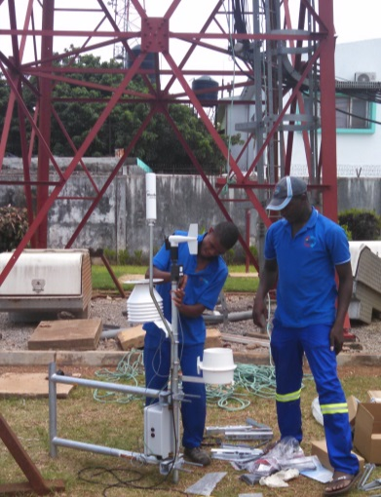
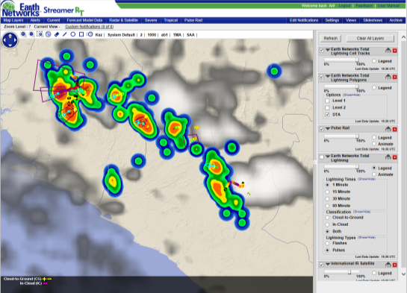
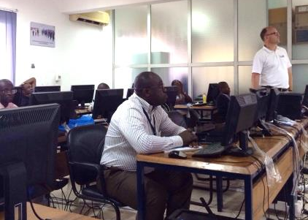
EN Provides Technical Assistance to African NMHS
East
Build and operate innovative weather and lightning detection (proxy radar) networks
Focus on severe weather monitoring, alerting, and disaster risk management
Coverage in 22 African countries (many LDCs) with more development underway
Regional starter programs DNM Guinea, ASECNA, EAC, INAM Mozambique, etc.
Under UNDP CIEWS programs: contracted with NMHS of Uganda; Liberia is being finalized
Co-lead of the USAID/SIDA Global Resilience Partnership (GRP) team project in Uganda
Infrastructure and VAS partnerships with mobile network operators (MNOs) in Africa
Southern
West
Central

Slide 3
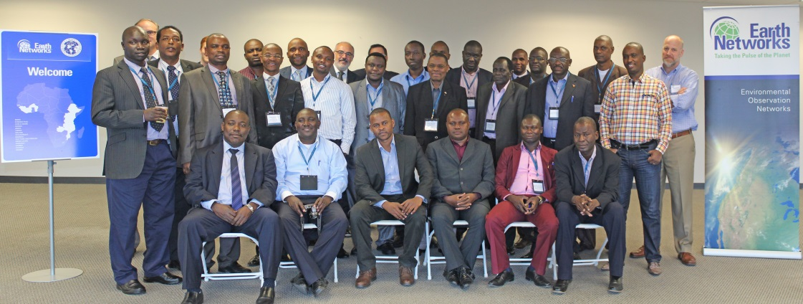
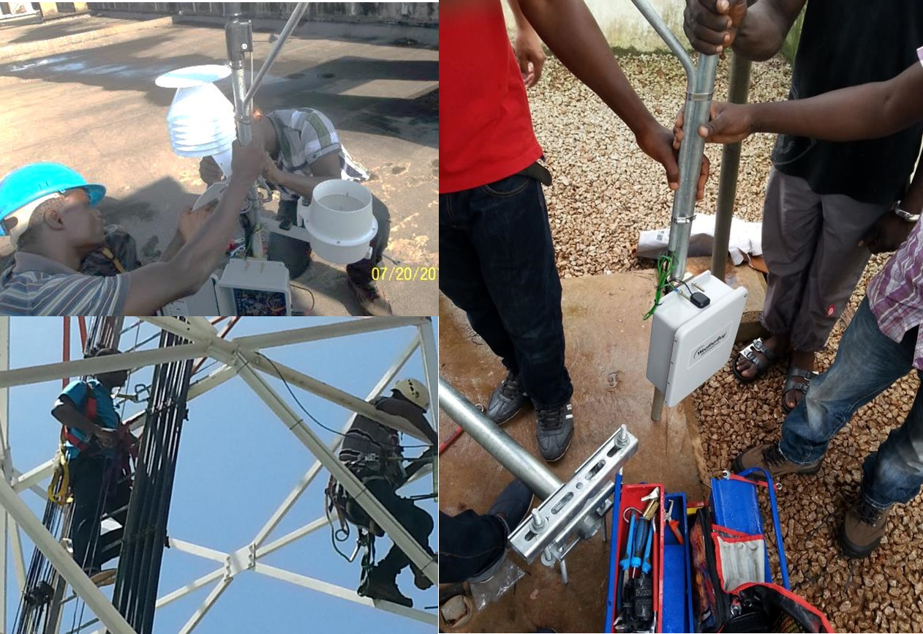

African NMHS Training and Capacity Building
NMHS Management Sensitization – Introduction and continued engagement in-country and in United States
Network Field Engineering Training – Train-the-trainer and professional development of technical staff
End-User / Forecaster Training – Multiple engagements enhancing skills in real-time operational severe weather monitoring and alerting
USTDA Training at EN HQ in United States
Hands-on Installation and Training in Guinea
Forecaster Training at UNMA NFC Uganda

Slide 4
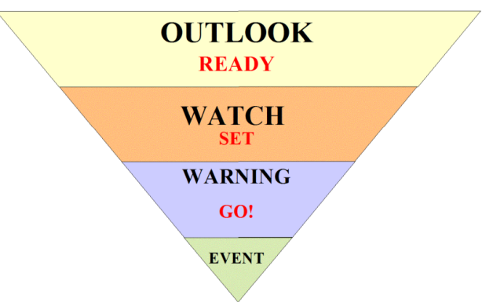
NMHS Support Services Enable Live Mesoscale
Weather Content for Safety of Life and Property
Early Warning Framework
Timescale
Support Svcs
Next 1-2 Weeks Several Days | ENcast Pin-Point Forecasts
Next Few Hours | ENcast DTAs & PulseRad
Next Hour Minutes | DTAs & PulseRad Current Conditions
NOW | Current Conditions Lightning Proximity
Post-Event Assessment | Lightning Database Storm Cell Tracks
TIMELY AND LOCALIZED
EARLY WARNING CONTENT

Slide 5
Real-Time, Quality Controlled Surface Weather: NMHS “Network of Networks” Approach
~30 Measured/Calculated Variables
Field Observations
Wind speed/direction | Wind direction
Barometric pressure rate | Min/max barometric pressure
Outdoor temperature | Average wind speed
Auxiliary temperature | Highest wind gust for day
High for the day | Low for the day
Outdoor temp rate change | Heat chill / Heat index
Precipitation rate and type | Daily, monthly, yearly rain
Solar radiation | Rain/hour rate
Dew point | Max rain rate/hour
Wet bulb | Min rain rate/hour
Relative humidity | Light intensity
Min/max humidity | Max light
Barometric pressure | Last light
NMHS AWS
AWS Data
Real-time
Hyper-local
High-resolution
WMO+ QA/QC
New AWS
3rd Party AWS
Lightning Detection
Other Met Data
Existing AWS Databases

Slide 6
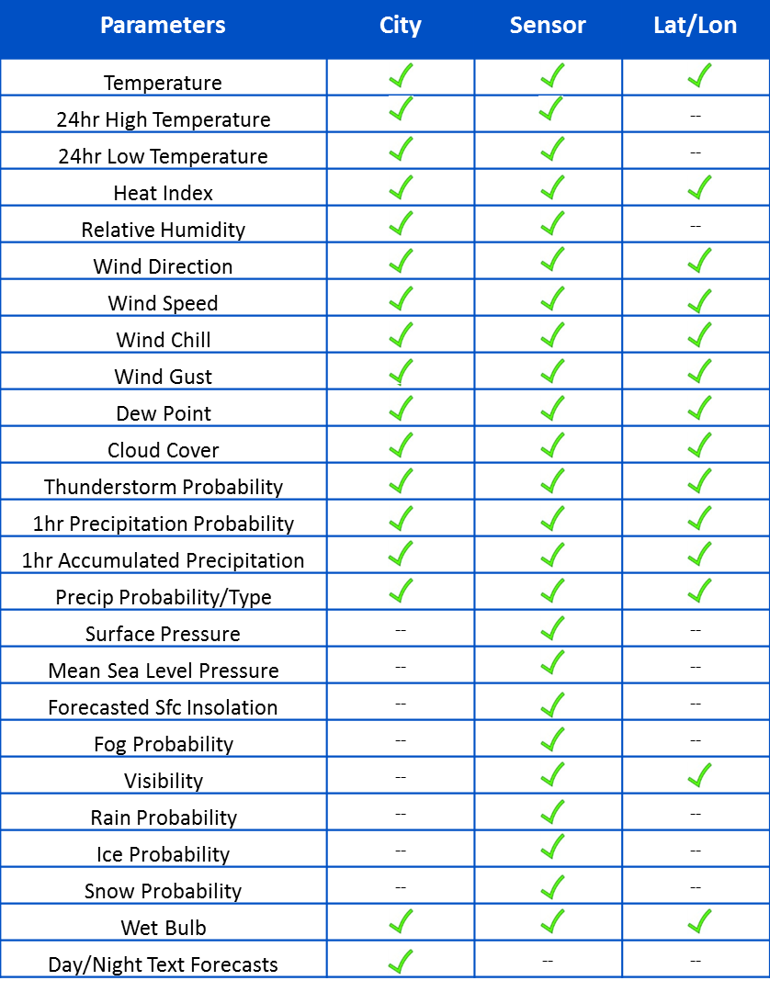
High-Precision Forecasts for Any/All Points: Multi-Model Ensemble MOS Approach
Hourly Point Forecasts out 15 Days
Field Observations
NMHS AWS
Forecast
Model bias adjustment
Consensus forecast
Forward error correction
QA/QC
New AWS
3rd Party AWS
Lightning Detection
Other Met Data
Existing AWS Databases

Slide 7
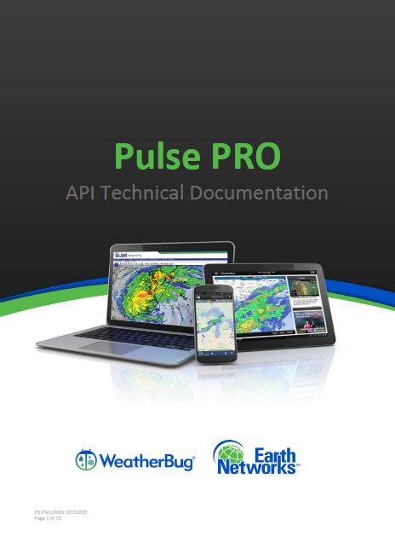
PulseAPI: Reliable Weather Data Source Powering NMHS and Authorized Partner Applications
PulseAPI gives NMHS and its authorized partners flexibility to use/display weather and climate data via Representational State Transfer, also known as REST
An automatic, efficient, and guaranteed online delivery method where you can choose a file type, structure, and data variables from a menu of options
Request made through URL to the API service which returns a JavaScript Object Notification (JSON) format response via standard HTTP internet protocols
JSON format response includes common attributes for different data types and parameters
Multiple data request types can be made, data varies according to parameters passed and set by the NMHS

Slide 8


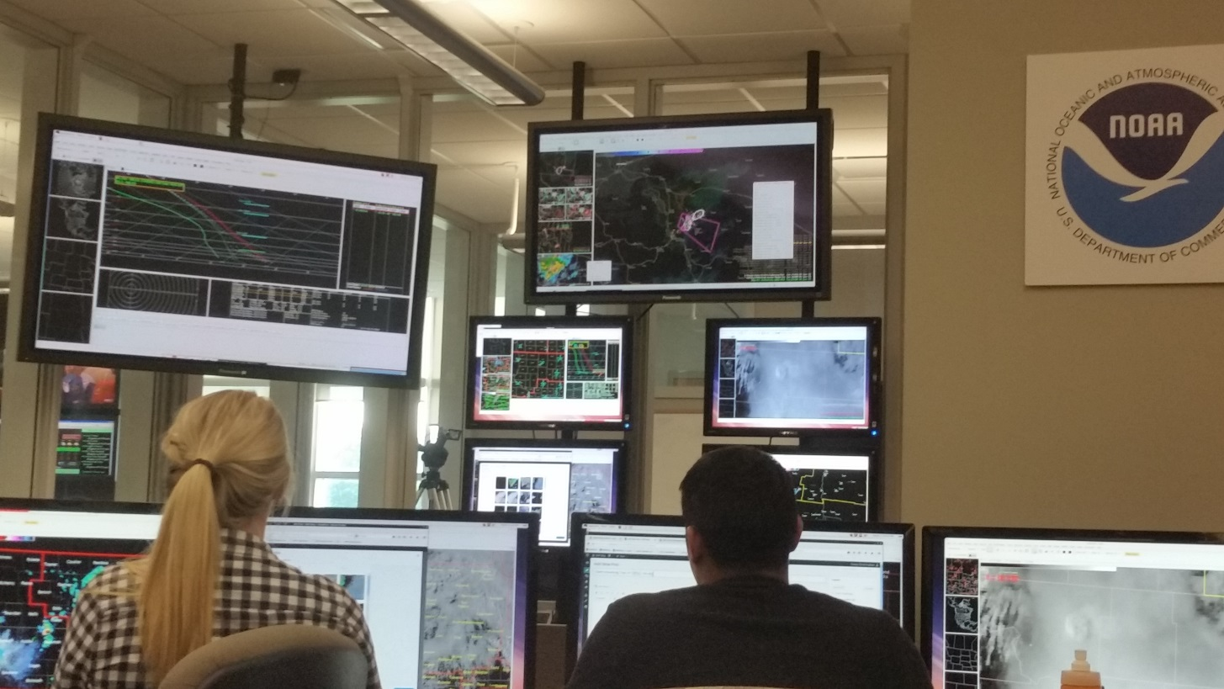


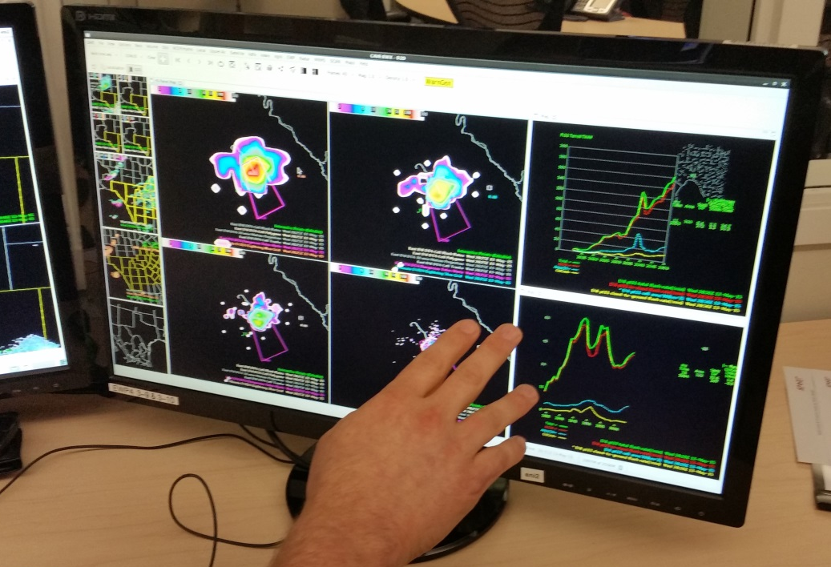
Live EN Total Lightning Data Service and Storm Alert Polygons at US NOAA / NWS
Real-Time Proximity Alerting
50% More Lead Time than Radar
A fraction of the cost

Slide 9
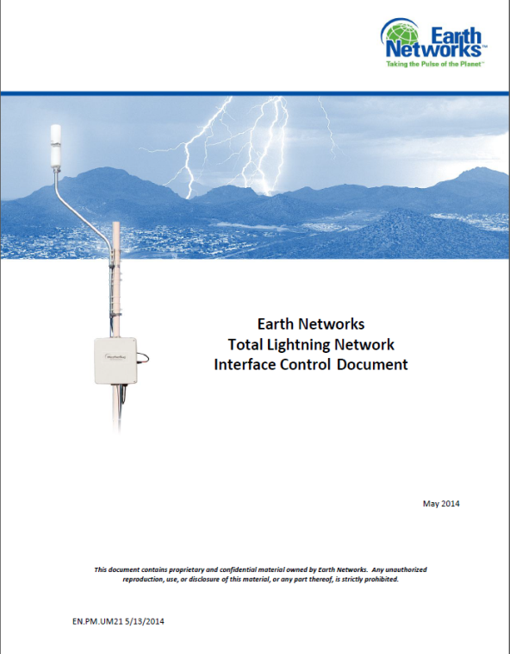
Real-Time Storm Data Feeds and APIs for
NMHS and Authorized Partner Applications
Lightning Data Streams in Binary & ASCii Formats
Storm Analysis: Cell Tracks,
DTAs, PulseRad as API “calls”
Location and timestamp
IC and CG type classification
Peak current
Polarity (CG only)
Flash multiplicity
Location accuracy
Height of IC
Etc.
CAP
JSON
XML
HTTP5
NETCDF
Map tiles
Icons
Etc.
Notes:
Majority of the existing networks are VLF/ LF, such as NLDN, LINET
Other small networks LDAR (mappers) are VHF
Many existing systems only send peaks of the waveforms. With the full waveforms, it would be easier to get rid the noise and reduce false locations.
The important fact is that the IC rate in a storm has a good correlation with the severity of the storm.
1HZ to 12MHZ ELF to HF
ELF 3-30HZ
SLF 30-300HZ
ULF 300-3000HZ
VLF 3-30KHZ
LF 30-300KHZ
HF 3-30MHZ

Slide 10
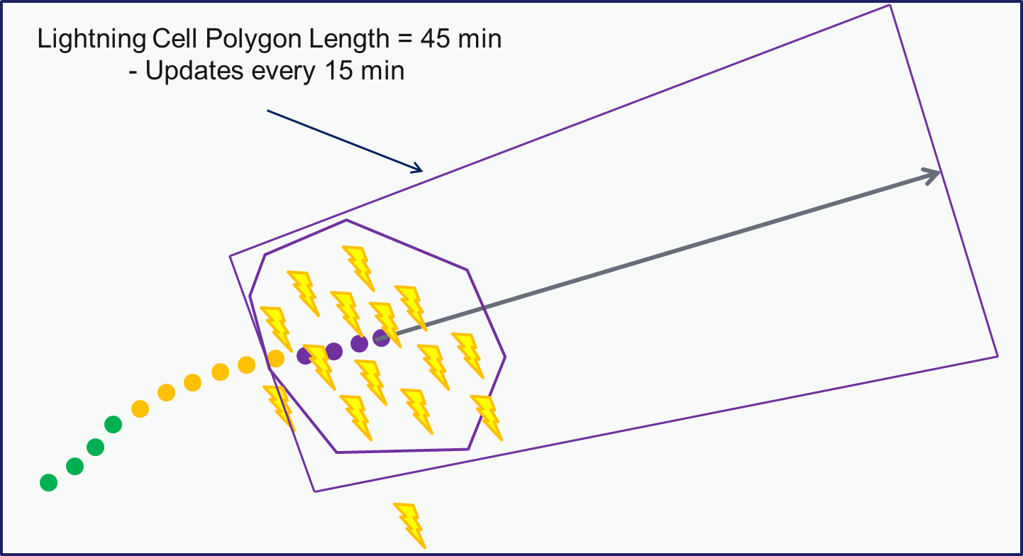
Early Warning Content in WMO Endorsed
Common Alerting Protocol (CAP) Format
Storm alerts (heavy rains, high winds, hail, lightning, etc.) via a data API that returns alert info in CAP format
The CAP alert feed includes a polygon encompassing the area at risk, direction and speed of severe storm activity, communities in route of storm
With sufficient AWS network density along the storm cell path (need wind gust and rain rate data in real time), CAP adds current observations from AWS near or in affected area
A ready-to-use weather bulletin text is provided within the CAP feed and updated automatically for apps to use
Relevant Polygon
Actionable Bulletin

Slide 11
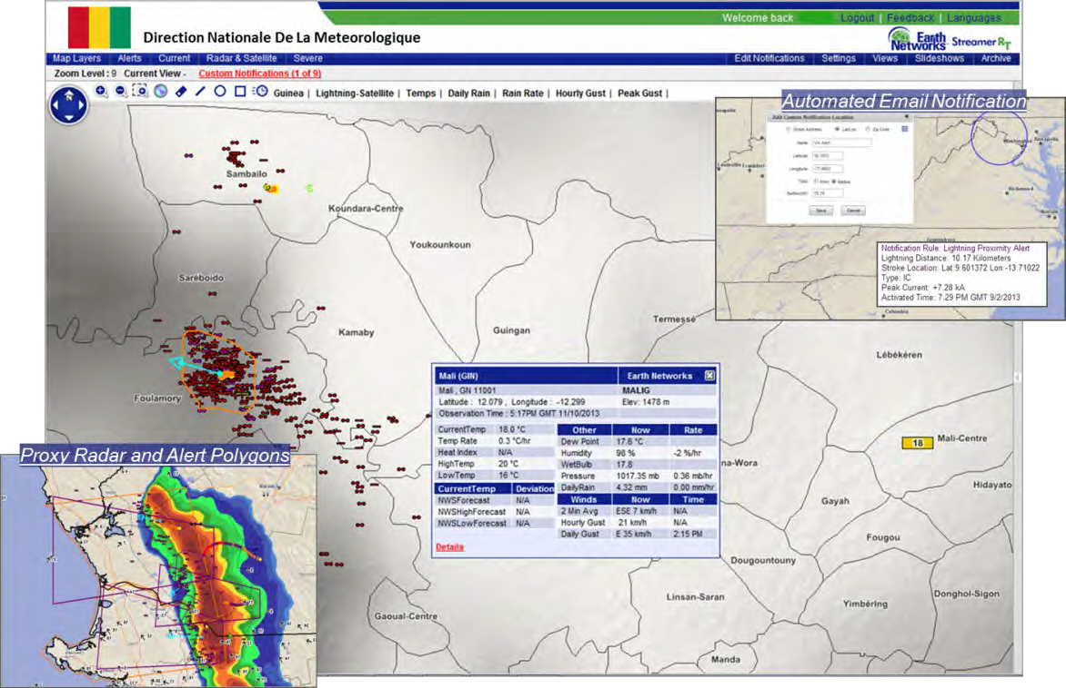
StreamerRT: All-Weather Visualization,
Forecasting and Alerting Portal for NMHS

Slide 12
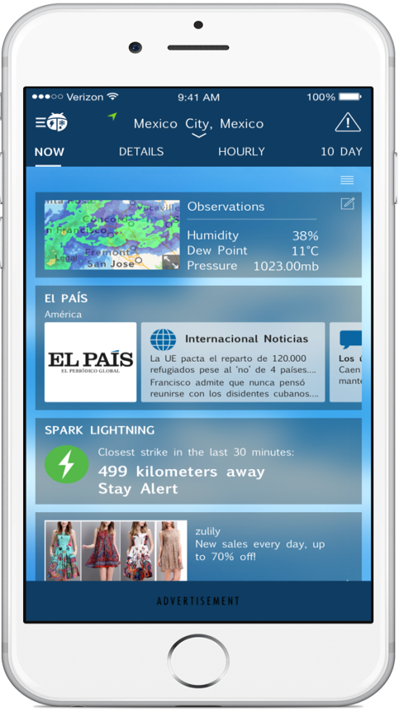
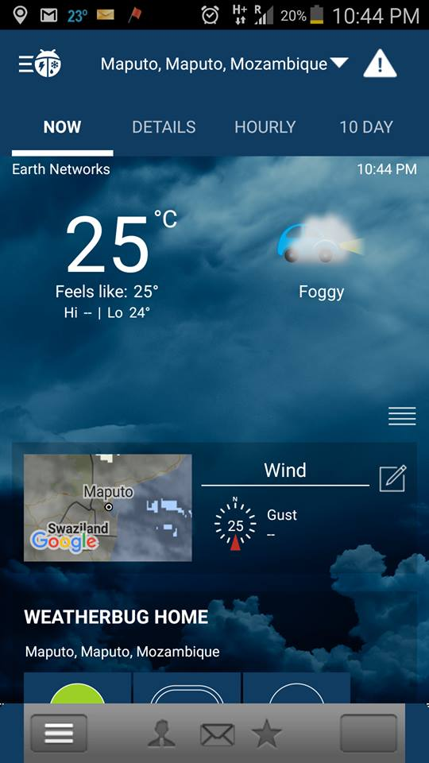





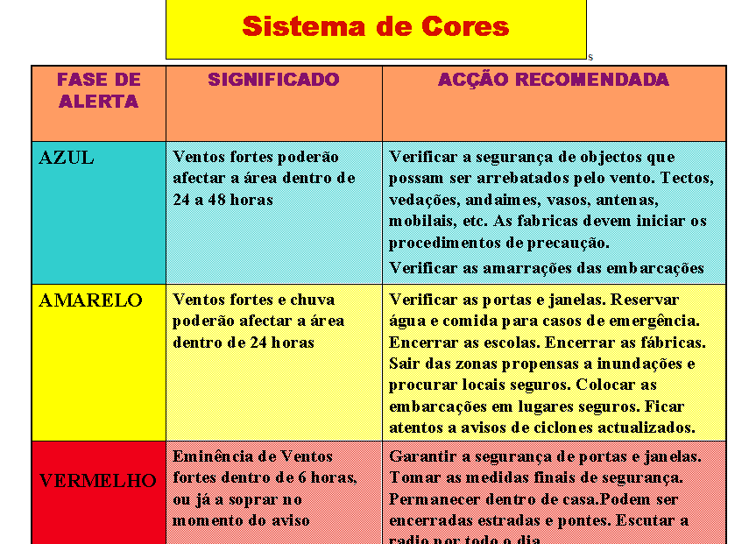
EN’s “Partner” App for Smartphones Enables NMHS to Provide Easy Access to Live Weather Information
Daily use app enhances NMHS community engagement
Allows all partners to feature their web content and social media
Leverages EN’s app development
Extends user satisfaction and loyalty for telecom partner
Additional partner SMS/IVR services enabled with NMHS’s disaster mgmt stakeholders…
Twitter
INAM
Twitter
Facebook
Twitter
INAM
Note: Illustrative Mockup

Slide 13
EN Support for NMHS “Last Mile” Efforts
Live Mesoscale Content from Observation Networks
Current Conditions, Storm Alerts, Point Forecasts
Application Protocol Interfaces (APIs)
GIS-based Weather and Climate Information Display
Smartphone Apps and SMS/IVR Support
Public Private Partnership Enables Sustainability

