Slide 1
Last Mile Application Development and Distribution Panel
Notes:
Thank the organizers for the opportunity to participate on this panel
David McAfee, President and CEO of Human Network International
I’m here today with my colleague Olivia Bell, our Program Manager based in Zambia

Slide 2
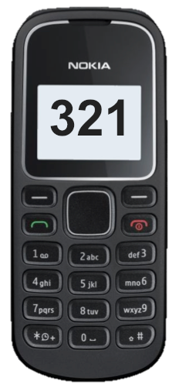
HNI develops information services that people and organizations use every day
Mobile phones can help every organization and individual on the planet
Data Collection Tool
=
Search Engine
    Communications Tool
Early Warning System
Marketplace
Bank Account
Follow Up Messaging
Notes:
American non-profit based in Washington.
We are a capacity-building organization – we help other organizations to use technology in innovative and productive and sustainable ways.
We wake up every day and ask ourselves how can we maximize the potential of mobile technology
Mobile phones have the potential to help every person on the planet
Today I will talk about using simple mobile phones as search engines

Slide 3
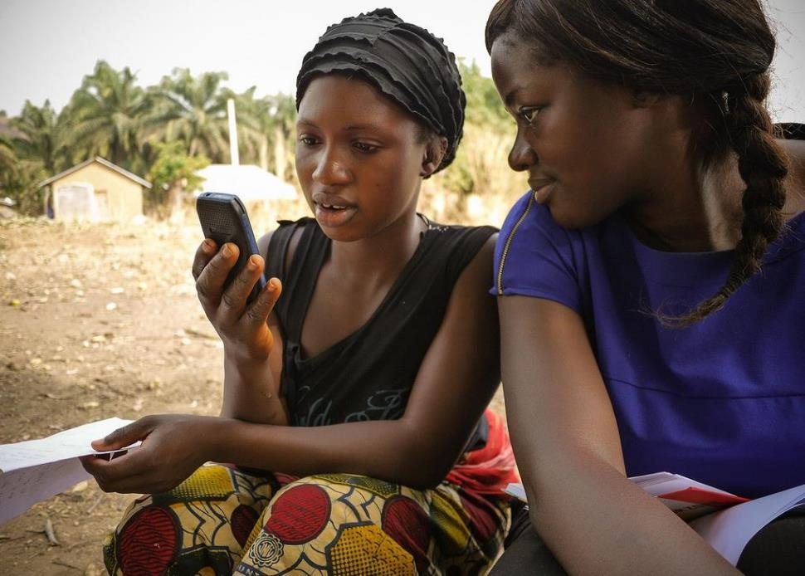
Can we make public service information searchable via simple mobile phone?
Photo Credit: Sylvester Johnson
Notes:
If we, in this room, have a question, we can get a pretty reliable answer
We have access to the internet and search engines like Google
But people at the bottom of the pyramid do not
So can we make public service information available on simple mobile phones?
Major challenges: Access to the Internet, Illiteracy, ability to pay

Slide 4
Simple mobile telephones are everywhere…
Population
7.1
6.9
Mobile phone subscriptions
Source: ITU World Telecommunication. Estimates for 2014

Slide 5
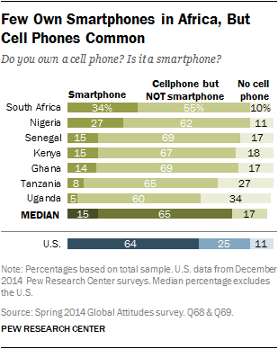

Slide 6
…Zambia Included
Source: DHS 2013 - 2014

Slide 7
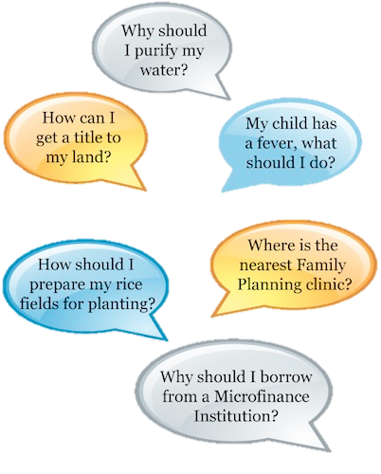
A Simple Solution – 321 Service
A search engine where there is no Internet
Notes:
6 years ago in Madagascar we approached the telecoms with a new idea
We said “Look, we in the development community have something you want: Public Service Information of interest to your subscribers. And we’ll GIVE you the content, free of charge, if you make it available to your subscribers free of charge.”
To our surprise, the largest telecom in Madagascar, Airtel Agreed.
So we came up with a simple solution – the 3-2-1 Service

Slide 8
How does it work?
Callers dial 3-2-1 and listen to public service information in the local language anytime, anywhere, free of charge
Thank you for calling the 321 Service a new service that provides you with useful information. You can call this phone number for free, 10 times each month. After the 10th call, you pay just $0.04 for each call.
You have 8 choices. Listen closely to these subjects, then make your choice. Would you like to know about:
Gender Press 1
Health Press 2
Agriculture Press 3
Micro finance Press 4
Water and Sanitation Press 5
Land Title Press 6
Family Planning Press 7
Emergency Preparedness Press 8
If you have questions, comments, or suggestions about the 3-2-1 service, please call the free number 033 65 00 321. If you want to hear your choices again, press the # button.
Notes:
So how does it work?
Freemium Model – give a little bit away for free, then charge

Slide 9
Sample Message
Vaccines improve immunity for your child, protect from commonly contagious childhood diseases and help your child to grow properly. Before the 9th month, your baby should receive all 5 immunizations to be protected from nine potentially fatal diseases.
Caution! If your baby does not receive vaccines, he/she may get sick or die.
You should take your baby to the health center at the following times to get vaccinated:
At birth
1 and a half months after his/her birth
2 and a half months after his/her birth
3 and a half months after his/her birth
The last shot, when the baby reaches 9 months of age
If your baby is at least 6 months old, ask your health center or community health worker for vitamin A to strengthens your baby’s immune system.

Slide 10
How does it work via text?
Dial *321#
For Health, reply 1, Agriculture, reply 2, Nutrition, reply 3, Family Planning reply 4
Breast milk is the only food that should be given during the first 6 months. It protects infants from sickness and malnutrition.

Slide 11
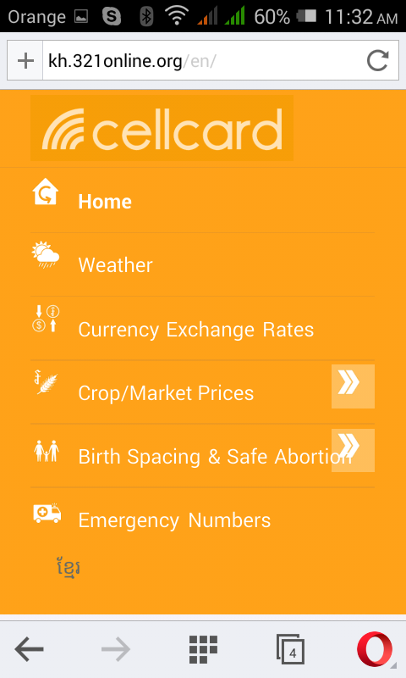
How does it work via the web?
The messages are made available on 321online.org:
Access is zero-rated
Optimized for feature phones and smartphones
Support for non-Latin text, audio & visual content
Content is downloadable for offline listening or sharing
Branded with partner’s logo and colors

Slide 12
How many topics are there?
In Madagascar, users choose from 8 topics, 45 sub-topics and 500 messages
Gender Equality
Agriculture
Microfinance
Water, Sanitation, & Hygiene
Land tenure
Family Planning
Dynamic Information
Violence
Education
Economic Opportunity
Informed Political Participation
Rice
What is a MFI?
Why borrow from a MFI?
Requirements to borrow from a MFI
Difference Loan Terms
Savings Accounts at MFIs
MFIs Near You
Groundwater and environment
Clean drinking water
Sanitation
Hygiene
Information about the Ministry of Water
Request Certificates of Ownership/Maps
Trader Ownership
Request Federal Land and Certificates
Boundary Marking
Transfers
Cancelation of Charges
Definitions and Importance
Benefits
Advice
Methods
Clinics Near You
Weather Emergency Preparedness and First Aid
Injury emergency
Skin burn emergency
Hemorrhage emergency
General Information about emergency preparedness
Yam
Sweet Potato
Potato
Banana
Taro
Cassava
Health
Nutrition
Treatment- Children
Prevention-Children
Adolescent Health
Treatment-Adults
Prevention Adults
Women’s Health
Emergency weather information
Weather emergency alert levels
Water and Health

Slide 13
How is it being used?
Every month, 500,000 people in Madagascar and Malawi
Make 1.5 million+ information requests.
Voice – March ‘10 to Aug ’15
Unique Users | 2 million
Total Calls | 10 million
Average/month 2015 | 200,000
SMS - March ‘10 to Aug ‘15
Unique Users | 3 million
Total SMS | 36 million
Average/month 2014 | 800,000
USSD – Sept ‘12 to Aug ‘15
Unique Users | 1.6 million
Total USSD | 6 million
Average/month 2014 | 200,000
Source: User statistics provided by Airtel and HNI’s IVR software

Slide 14
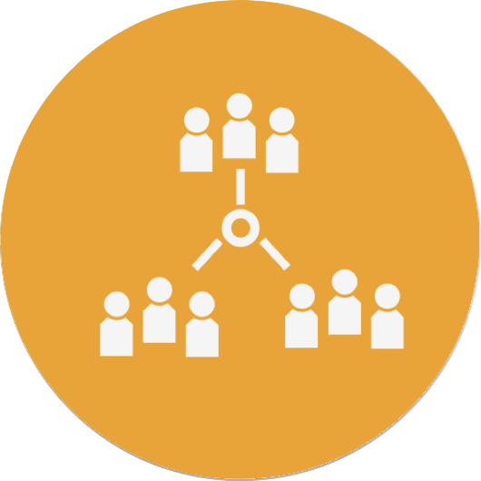
Roles & Responsibilities
Key Stakeholders & Organizations
MNOs
Government Ministries

Slide 15

What are the terms of the deal?
Provides the content for free…
… the telecom makes the content available for free
Airtel’s Motivation:

Slide 16

Why would Airtel give away
+$1 million per year of airtime?
It’s good business
Customer retention
Generate revenue
Promote Mobile Money Services
Great Corporate Social Responsibility
Airtel’s Motivation:

Slide 17


Who owns the 321 Service?
The telecom does…and they promote it

Slide 18


Who pays for the 3-2-1 Service?
Content
Traffic
Marketing
B to B model
HNI Sells Space
Sponsorships
Motivation:
Making their messages available on
simple mobile phones
Motivation:
Reduce churn rate, Generate revenue,
Educate new users, CSR

Slide 19
Malawi 3-2-1 Decision Trees
Agriculture
Gender Equality
Weather
Health
Nutrition
Welcome
Notes:
Launched 321 in Malawi in October 2014
Malawian colleagues? Rains were very late in Malawi this year
Help by putting up a VERY SIMPLE Forecast.
Contacted the Malawian Met Service

Slide 20
Malawi
Mr. JOLAMU L NKHOKWE
Director of Climate Change and Meteorological Services in Malawi
E-mails HNI 5-day forecast and rain statement
Notes:
The Director himself emails it to us.
We then manually translate the forecast, record it and put it onto the 321 Service

Slide 21
Malawi 3-2-1 Decision Trees
Agriculture
Gender Equality
Weather
Health
Nutrition
Welcome

Slide 22
Malawi 3-2-1 Decision Trees
Agriculture
Gender Equality
Weather
Welcome
Nutrition
Health
Shire Valley
Southern Highlands
Central
Lake Shore
Northern
Rain Statement

Slide 23
Malawi 3-2-1 Decision Trees
Agriculture
Gender Equality
Weather
Welcome
Nutrition
Health
Shire Valley
Southern Highlands
Central
Lake Shore
Northern
Rain Statement

Slide 24
Shire Valley Weather Message
“Weather for Shire Valley March 1- March 5: Expect locally heavy rains until Thursday. Thereafter, it will be warm and partly cloudy. To receive free extreme weather alerts press 1”

Slide 25
Shire Valley Weather Message
You have opted in for extreme weather alerts. To send you the correct information for your area would you like to alerts for:
Northern areas? press 1
Central areas? press 2
Southern Highlands? press 3
Shire Valley? press 4
Lakeshore areas? press 5
Notes:
To date, we’ve had over 250,000 people opt-in for emergency alerts

Slide 26
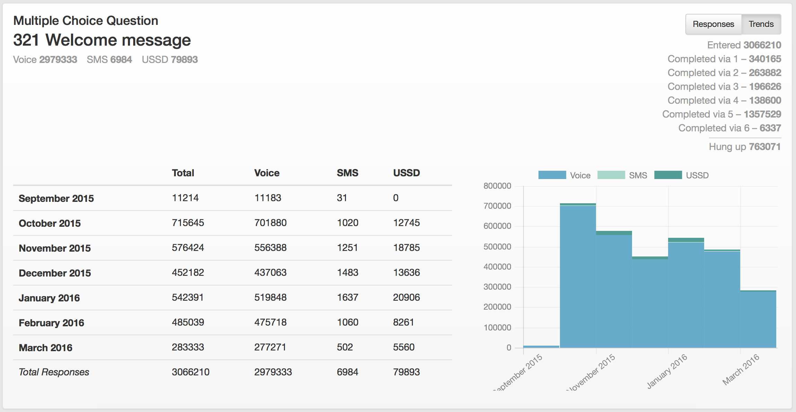
Real-time Analytics
Notes:
The nice part of Information and Communication Technology projects is real time data. No radio/tv station can tell you
In October, when we added the Weather Forecast, the number of callers to the 321 Service doubled
Since beginning of October, we’ve received more than 3 million calls – about 550,000 per month

Slide 27
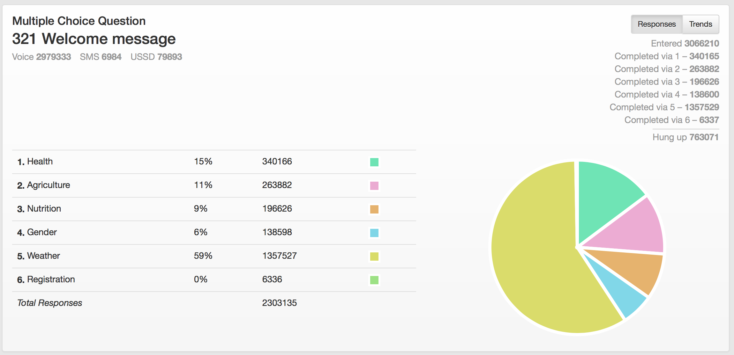
Real-time Analytics
Notes:
What topics are callers selecting? 59% chose weather, more than all other topics combined.
More than 1.35 million calls.

Slide 28
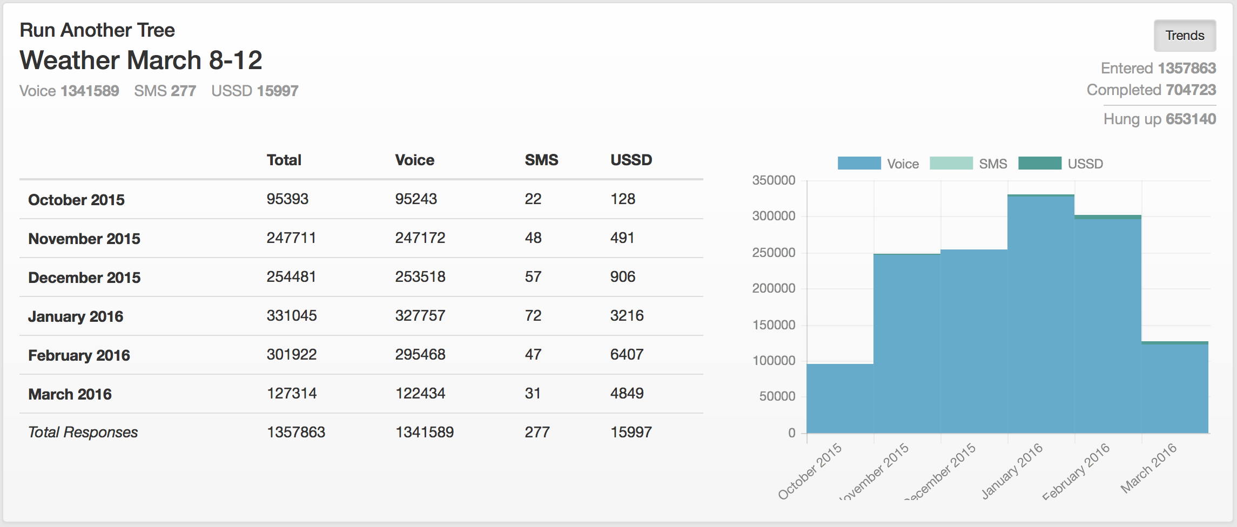
Real-time Analytics
Notes:
We expected the number of weather calls to decline as the rains started.
But in fact, the numbers went up. We now average about 300,000 calls per month, over 10,000 per day.
Quick, simple communication “win”.

Slide 29
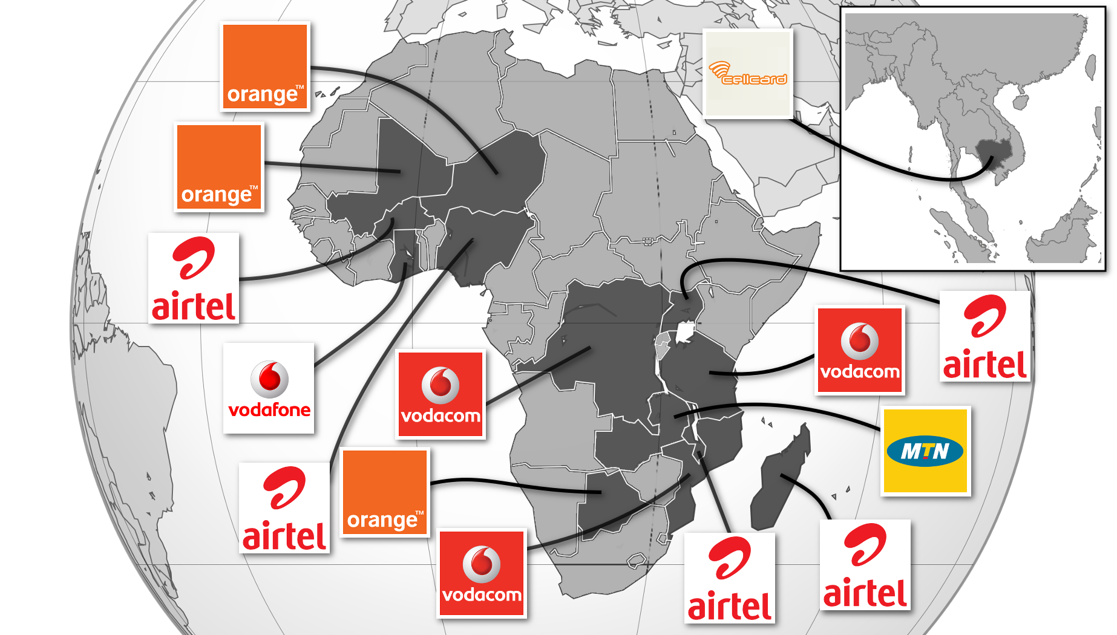
3-2-1 Countries – 100 Million Subscribers

Slide 30
What is innovative about your strategy?
Pull Strategy
Sustainable
Appropriate Technology
Cost Effective
Scalable

Slide 31
Next Steps
Partner with Meteorological Services
Point interested callers to paid services
Automate handshake between Meteorological Data and 3-2-1 Service
  -In real time, update forecasts and alerts
Notes:
The Director himself emails it to us.
We then manually translate the forecast, record it and put it onto the 321 Service

