Slide 1
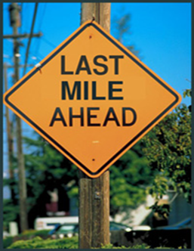
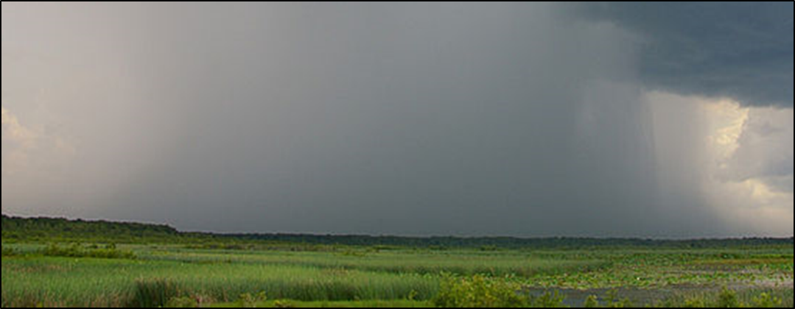
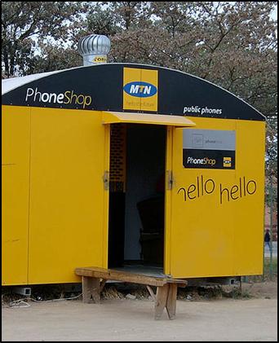
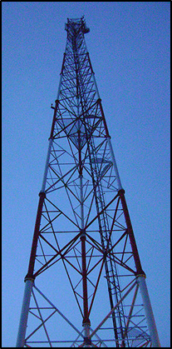
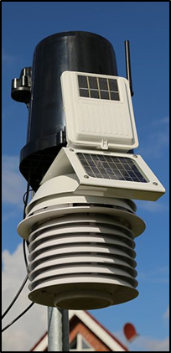
Challenges, opportunities and successes
in crossing the Last Mile:
delivering climate services in Africa
Anthony Mills, CEO C4 EcoSolutions
Cape Town, South Africa
www.c4es.co.za
UNDP-CIRDA Country Partner Project Manager Workshop, 15-17 March 2016, Livingstone, Zambia.

Slide 2
Worthy of deep contemplation:
95% of Africa’s farmers rely on rain
This rain is becoming more erratic as a result of climate change

Slide 3
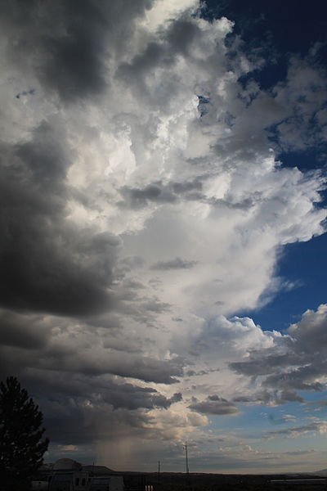
Overview of presentation
Intricacies and complexity of the Last Mile
Weaving ways across the Last Mile
Learning from other sectors (retail, health, adaptation)
Concluding remarks

Slide 4
The Last Mile background
originated in the telecommunications and technology industries
describes the technologies and processes that connect the end customer to a communications network
Last-Mile problem
end link between consumers and connectivity has proved to be disproportionately expensive to solve
Usually individuals, not organizations

Slide 5
Intricacies and complexity
Last Mile
National Hydro- Meteorological Services
Communicators and boundary organizations (e.g. media, agricultural extension, NGOs, CBOs, private sector)
End users (e.g. farmers, pastoralists, rural entrepreneurs)
National Agricultural Research and Extension
National-level end users (e.g. private sector, industry, seed distributors, policy makers)
Institutions
Individuals
Flow of information
Notes:
Important to highlight that this is not a problem unique to climate service/information provision. This is a problem which ALL sectors face. Therefore, it is important to draw on successful case studies/lessons learnt from ALL sectors.

Slide 6
“…timeous and appropriate climate and weather information from the NHMS to the end users, particularly local communities and smallholder farmers.”
“…imperative to communicate accurate, actionable and trustworthy climate and weather information…”
“Raw weather data are of little value to local communities, since they do not provide an actionable warning instruction or prediction…”

Slide 7
“…many climate-related messages…are complex and require a trusted intermediary to assist with interpretation to act accordingly.
“…a common distribution problem that is pervasive across a range of private and public sectors…telecommunications…traditional retail distribution…public transport, primary health care and electricity distribution.”
“…infrastructure required to cross the Last Mile … is costly to install and maintain…the Last Mile remains a challenge even in developed economies.”

Slide 8
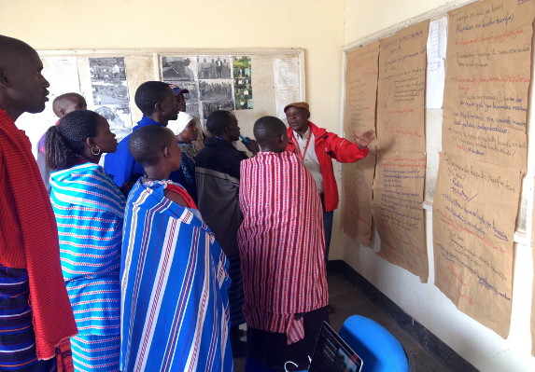
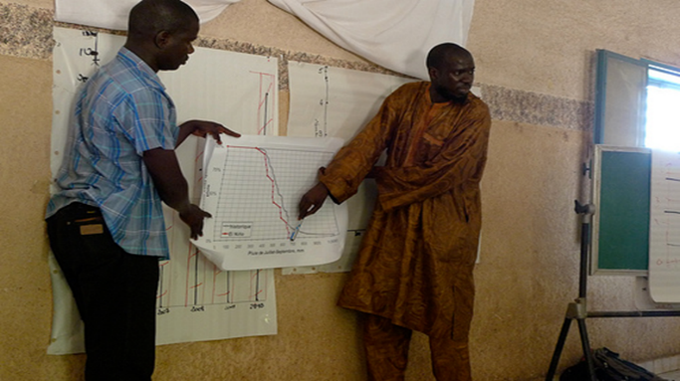
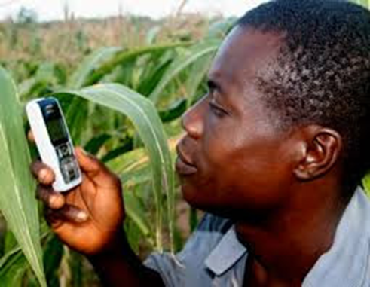
Intricacies and complexity: channels
Traditional
Television, radio and print media
Retail (e.g. supermarkets)
Face-to-face (e.g. church groups, extension workers, fellow farmers)
Non-traditional
Mobile phones (SMS, voice messages)
Social media (Whatsapp, Twitter and Facebook)

Slide 9
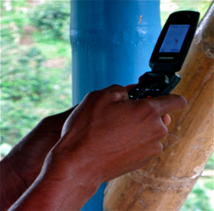
Intricacies and complexity: mobile phones
Mobile network coverage in rural areas?
Ownership of phones (~58%)
Access to smart phones? (~12%)
Translation of SMSs and voice messages?
Literacy? (~60%)
Affordability? (phone as well as data)

Slide 10
Intricacies and complexity: production
Data
Multi-disciplinary teams are needed to generate weather information products:
“…team of agronomists, soil scientists, plant pathologists, and entomologists”.
Information
Products and packaging
Receipt/Trust/Action

Slide 11
Weaving ways across the Last Mile
Study the local context (e.g. cultural norms, women’s vs men’s preferences)
Piggyback on existing networks and infrastructure wherever possible.
Access public funds at the outset. (Jury still out whether last mile can be fully commercial)
Engage with users regularly
Iterate like Coke
Bundle with other services (e.g. loans, insurance, market information, agri extension)
Look for virtuous cycles of value, trust, ease of access

Slide 12
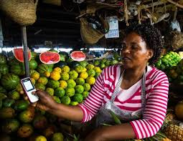
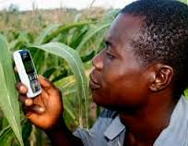
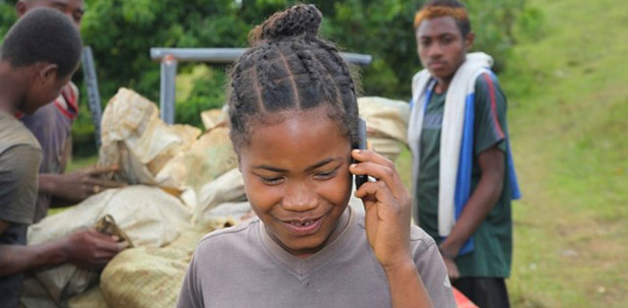
Human Network International's
Service 3-2-1
No internet/data required
Free voice service
~ 3 million subscribers
Service accessed ~50 million times
Public funds
Piggybacked on Airtel
Virtuous cycles of value and trust

Slide 13
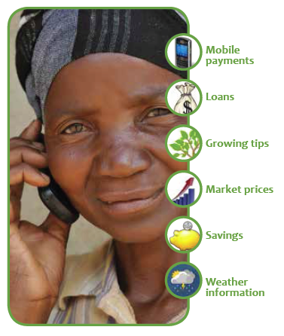
Mercy Corps Agri-Fin Mobile program
Zimbabwe, Uganda and Indonesia
SMS/voice services
100,000 farmers
Banks, mobile network operators, smallholder farmer aggregators
Villagers preferred face to face, TV and radio
Intense training on use of mobile phones
Bundling
Local context
Engagement
Virtuous cycles
Public funds
Piggybacking
Notes:
The Mercy Corps Agri-Fin mobile program provides a “bundle” of advisory and financial services plus market information to the smallholder farmer via the mobile phone.

Slide 14
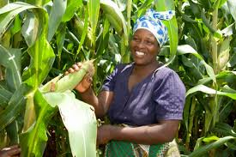
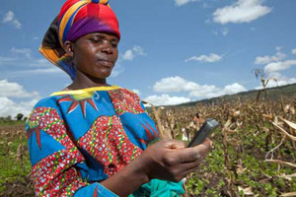
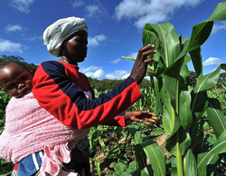
Ecofarmer (Econet, Zimbabwe)
Agri-Fin Mobile partnership with Econet
SMSs: market prices, crop data, weather information
200,000 farmers
60% changing behaviour
Automatic weather stations on mobile phone towers
Data used for weather-index based insurance
Location of farmers determined from cell phone tower data
>1000 farmers signed up (2014)
Bundling
Virtuous cycles
Public funds
Piggybacking
Notes:
The

Slide 15
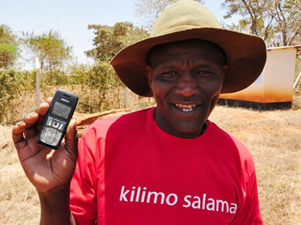
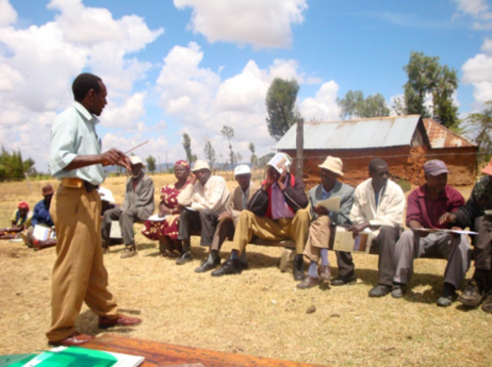
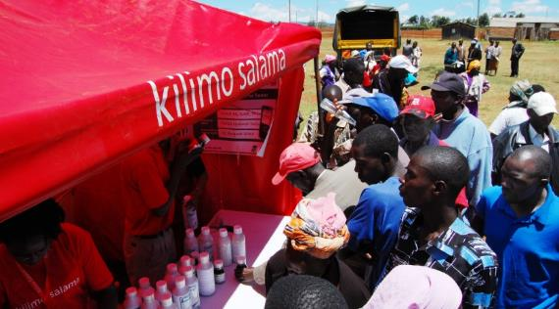
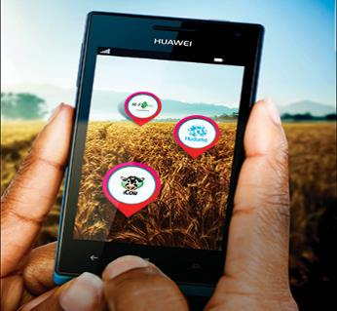
Kilimo Salama (Kenya)
Syngenta Foundation for Sustainable Agriculture (SFSA)
Safaricom and UAP Insurance
Weather index-based insurance
MPESA platform – ease of payouts
Syngenta store network
Local trainers
Insurance with seed purchase
Bundling
Virtuous cycles
Public funds
Piggybacking
Engagement

Slide 16
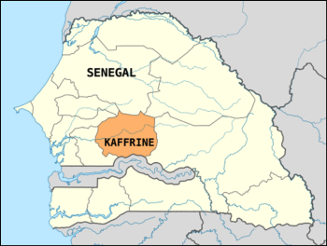
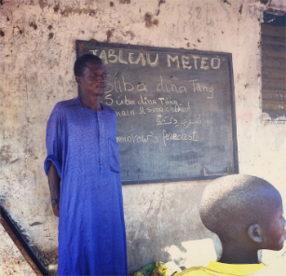
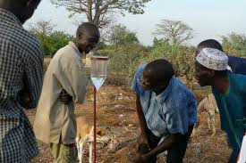
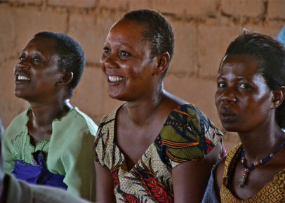
Research in Kaffrine Region, Senegal
CGIAR and CCAF (2011–2012)
3 farmer communities targeted
Provided forecasts and agri-met information
Intensive training and engagement
SMSs in several languages
Red Cross staff trained
Messages posted on boards at communal meeting points (e.g. boreholes)
Bundling
Virtuous cycles
Public funds
Engagement
Local context
Iteration
Notes:
Important to highlight here that through these workshops and the two way dialogue established between forecasters and farmers on forecasting probabilities and farmers needs: i) trust was established, which was critical for the projects’ long term success; and ii) allowed farmers to gain familiarity with seasonal forecasts and weather advisories they has previously not accessed/been exposed to.

Slide 17
Senegal
Context changed at 10 km intervals!
One village wanted messages in a mosque, another at boreholes
Women planted later than men
Women planted different crops (millet vs maize)
Men owned the donkeys/horses needed for ploughing
Women needed weather information on ‘end’ not start of rains
Tanzania GFCS study
Men wanted radio presenters trained
Women wanted extension officers and village leaders trained

Slide 18
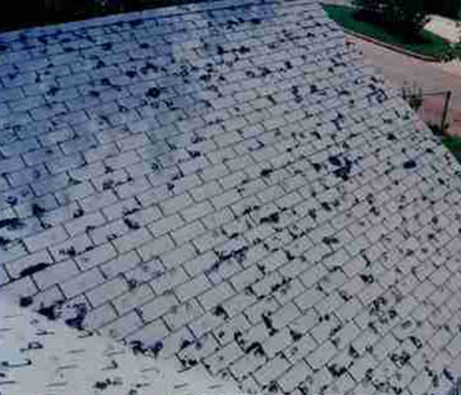
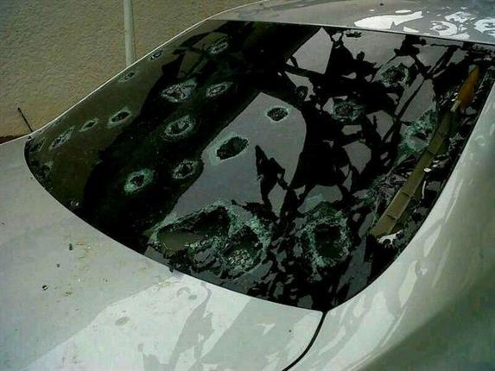
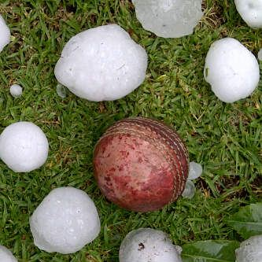
Weather alerts by insurance companies
South African insurance companies
Large customer databases (location, assets)
Tailored SMSs to reduce hail and fire damage.
Bundling
Virtuous cycles
Public funds
Piggybacking
Local context
Engagement
Solely cost reduction

Slide 19
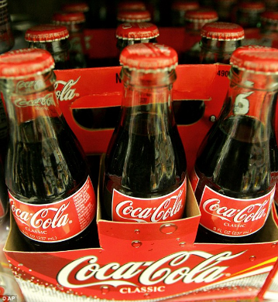
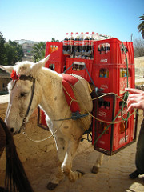
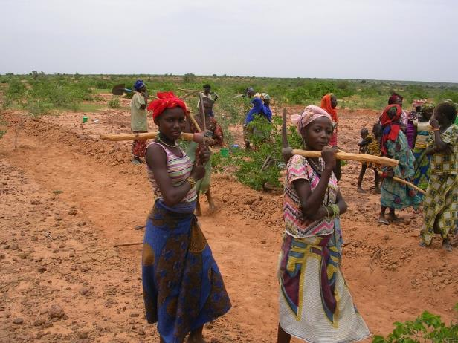
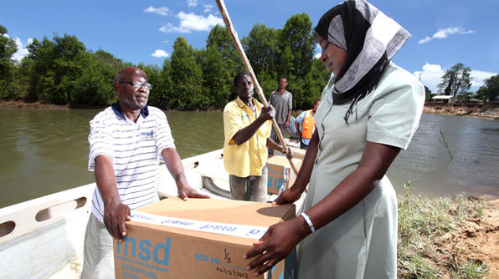
Learning from other sectors
Same problems
Disproportionate costs
Trust needed
Engagement
Notes:
SAB and Coke have both broken through the last mile barrier. What can we learn from them? What have they done? Nearly 50% of people in Africa lack access to critical medicines, yet, you can get a coco-cola nearly anywhere in the world….

Slide 20
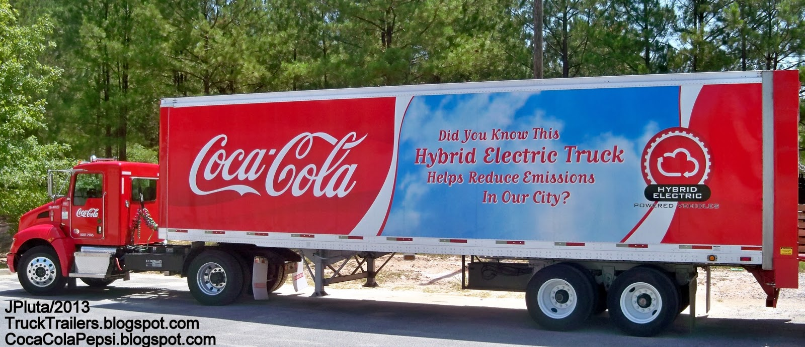
Coca Cola
1.5 billion cokes consumed per day!
Distribution company separate from manufacturing.
Real time data analysis – to find and fix problems like drops in sales i.e. iteration
Notes:
SAB and Coke have both broken through the last mile barrier. What can we learn from them? What have they done? Nearly 50% of people in Africa lack access to critical medicines, yet, you can get a coco-cola nearly anywhere in the world….

Slide 21
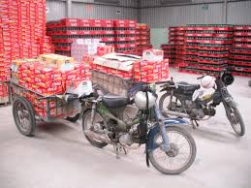
Piggybacking on entrepreneurial networks into rural Africa
Micro-distribution centres
Last Mile consumer
Notes:
SAB and Coke have both broken through the last mile barrier. What can we learn from them? What have they done? Nearly 50% of people in Africa lack access to critical medicines, yet, you can get a coco-cola nearly anywhere in the world….

Slide 22
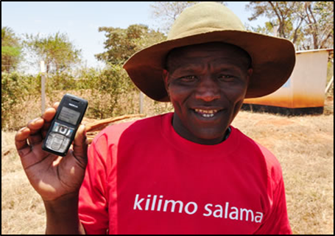
Concluding remarks
Acknowledge intricacy and complexity
Learn from successful operations (including other sectors)
Bundle
Research local context
Engage and train
Use traditional and digital
Develop virtuous cycles based on trust
Seek public funds
Piggyback on infrastructure & brands
Iterate
.
Crossing the Last Mile will be an ongoing journey, not a static system.

Slide 23
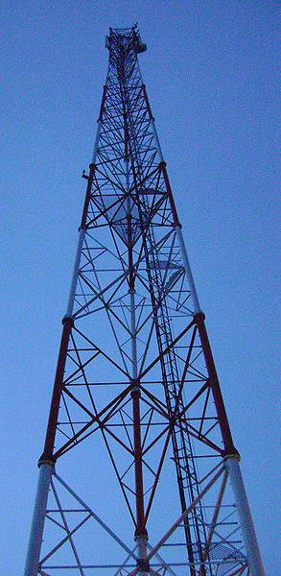
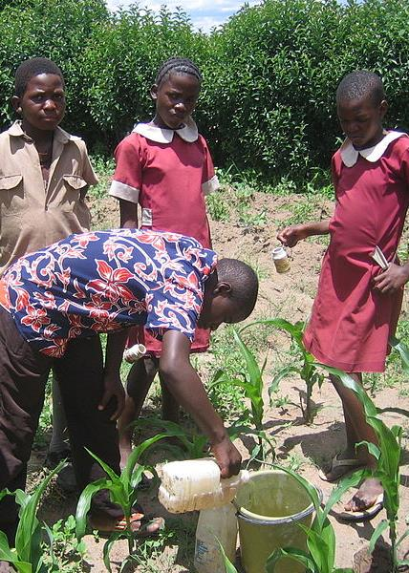
End of presentation
Thank you for your attention.

