Slide 1



The Last Mile: Saving lives, improving livelihoods and increasing resiliency with tailored weather information services Workshop, 15-17 March, 2016, Livingstone, Zambia.
LESSONS LEARNED FROM THE VISIT TO PHILIPPINE WEATHER PHILIPPINES
FOUNDATION AND THE METEO GROUP
Notes:
Instructions: Complete items in red italics

Slide 2
Introduction
Objectives of the trip
Exposing the selected CIRDA countries to best practices in weather monitoring and forecasting that could be emulated in the rest of the CIRDA countries;
Learning from the Philippine’s experience on scaling up weather monitoring and forecasting services using modern meteorological equipment and the private sector involvement in the weather

Slide 3
Introduction
Why the Philippines ?
Experiences >18 Typhoons per year, 6-9 of which make landfall, causing substantial loss of life and damage to property, hence need for accurate early warning.
To learn about their application of weather data for early warning against weather related hazards and disasters.

Slide 4
Lessons learned from the MeteoGroup:
A Private international weather company working in Europe, North America and South East Asia including Philippines;
Provides a variety of weather forecasting solutions, meteorological expertise & t(CSR); 50% of the revenues goes to the country to support weather services;
Large network/coverage of weather stations : 750 AWSs-target 1,000;
Has rich innovation in meteorology, associated technologies and visualization in the country: generates weather products using 10 different weather models including the best models of ECMWF & GFS (European and American weather service);
Notes:
400 employees including 150 meteorologists

Slide 5
Lessons learned from the Weather Philippines Foundation(WPF)
A not-for-profit organization ; provides free weather information to the public.;
A typical example of the CSR that has contributed to the Strengthening of meteorological Sector in Philippines;
Promotes scaling up of cost-effective AWSs (e.g.2,500 US$ including operation and maintenance costs over their 10-year lifespan. This is significantly cheaper than the stations the CIEWS projects are buying;
Using locally manufactured data loggers at reduced cost of installations: WPF is buying locally-produced data loggers (approx. 600 US$ each), and individual sensors from Lufft of Germany, and then assembles the AWSs themselves.
Is a Foundation (partners with MeteoGroup);
Notes:
By bringing together the Aboitiz Group's resources the country's premiere private weather information/content provider
There are also advanced features in the website like (WeatherTV, Satellite Feeds, Forecast Videos, Daily Weather Report, and more
The are seen in the weather.com.ph and Weather Philippines Mobile Application

Slide 6
Lessons learned from the Weather Philippines Foundation
Raises funds from corporate sponsors to procure AWSs, which can be installed at the sponsor's premises, thereby benefiting the sponsor directly, as well as the surrounding community;
Works to complement the role of Philippine Atmospheric Geophysical and Astronomical Services Administration (PAGASA).

Slide 7


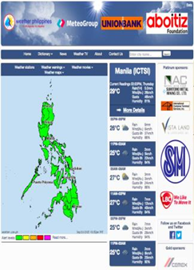
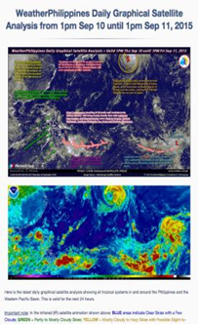

Best practices:
Having good coverage of monitoring network helps to produce reliable weather forecast;
=PAGASA has 58 synoptic stations, 23 Agro-met stations, 155 AWSs, 187 Rain Gauges, 11 weather radars,3 mobile X-Band radar, 6 upper air stations, 2 marine Buoy, 1 wind profiler and 16 VSAT facilities to cover 7000 Islands;
=WPF has 750 automated weather stations distributed in the 7000 islands.
PAGASA collaborates with the MeteoGroup and WPF to have access to some data from the 750 AWSs;
These provides accurate weather forecasting solutions which has proved helpful to the Philippines energy, construction, transport (road, rail, aviation, shipping,), offshore, construction, insurance, agriculture, leisure, water management, media, consumer, retail, building automation sub-sectors and saved lives and properties of the Filipinos.

Slide 8




Best Practices ctd:
Real time information updated every 10 minutes or less improves early warning;
Dissemination of localized information using different approaches e.g. through real time maps and news through weather television;
Provision colour coded alert
www.weather.com.ph

Slide 9
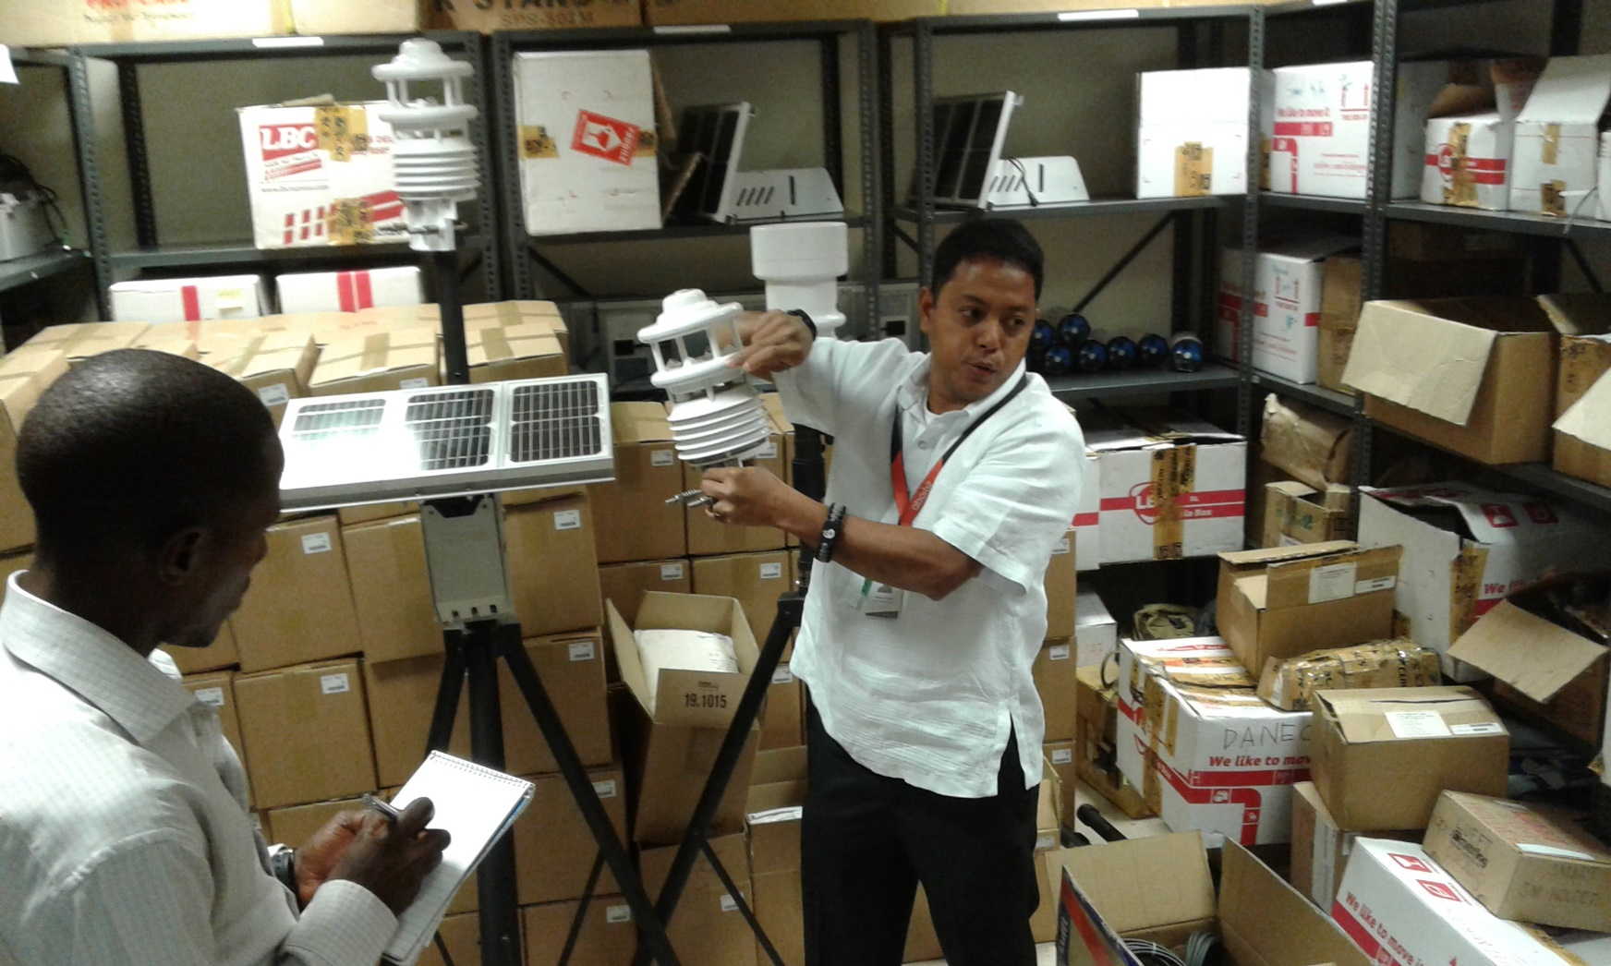
WPF staff illustrating the data logger
Use GSM data loggers because telecommunications network is available almost in every island and the cost of a sms is lower than subscribing for expensive data bundles.

Slide 10
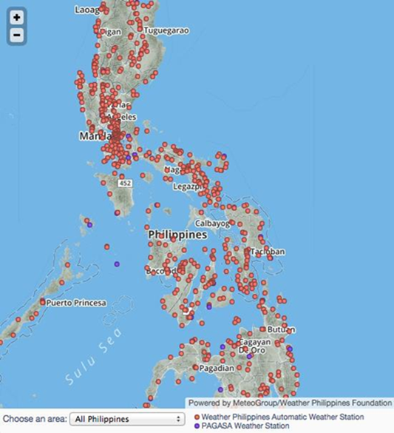
1.Use of CSR as a strategy for acquisition , maintenance and sustainability of AWSs;
2.Installation of AWSs with a service/site partner (e.g. shopping mall) ensures security and continuous power supply;
3.Owning a weather television, weather portal and establishing a weather application apps for android smart phones improves dissemination efforts.
4. Sharing of weather data with the private sector(non-competitive) is possible
Lessons learned from the Philippines:

Slide 11
Recommendations
The PPP approach be adopted and deepened for sustaining the operations of meteorological services;
Installation of AWSs with service partners (e.g. shopping malls, Hotels, Telecomm. towers) to ensure security and continuous power supply;
Operations and maintenance of the AWSs be linked to hardware and availability of the right personnel;
Scaling up dissemination of data via SMSs as it is cheaper than the GPRS or other options. This would increase the outreach and usage of the meteorological products; “
Weather wiser packages” be adopted for educating communities and the public on meteorology. Products be distributed in schools to inculcate culture of early warning and preparedness.

Slide 12
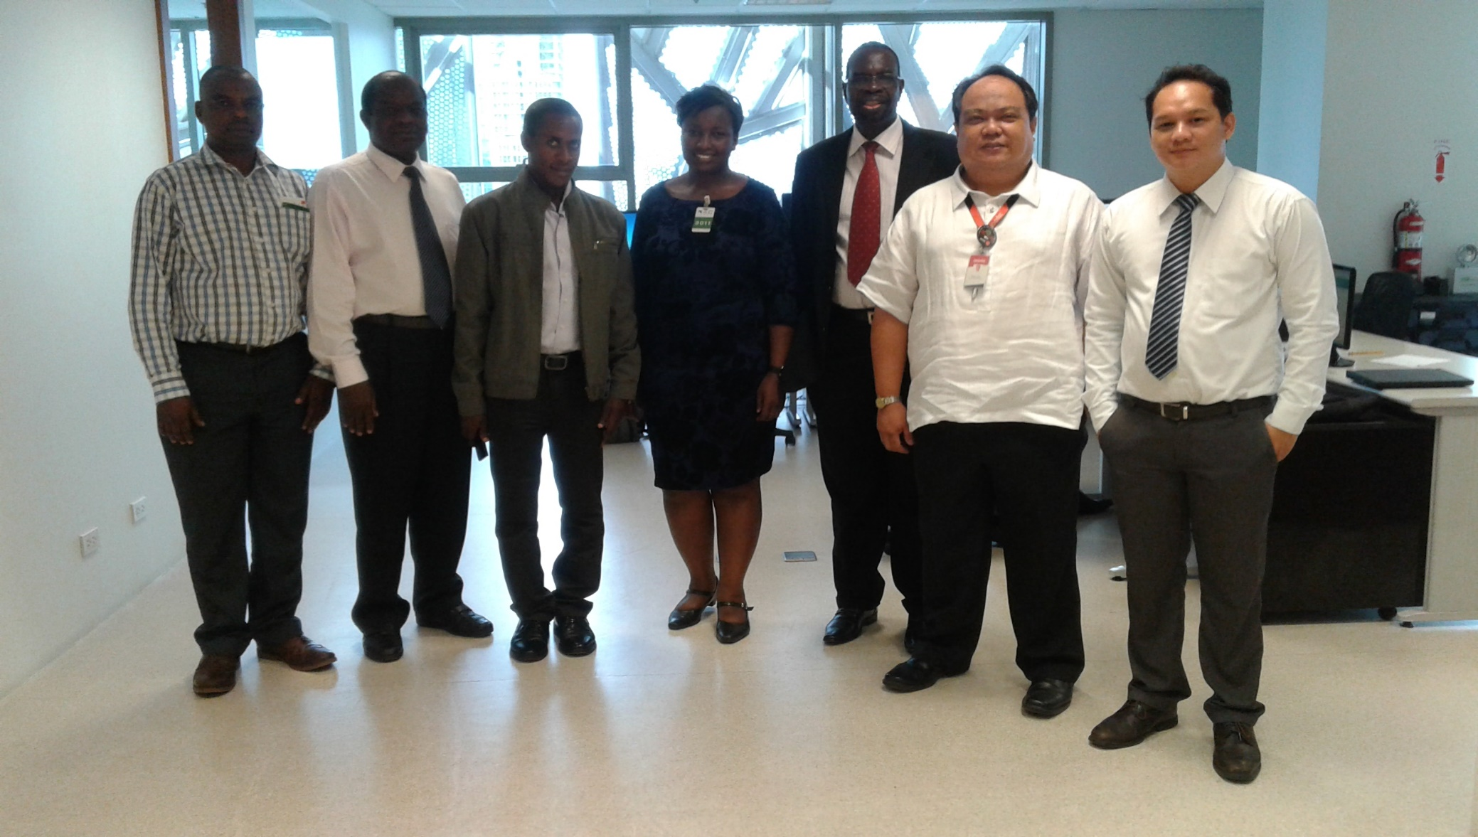
Thank you!!!

