Slide 1
March 2016 CIRDA Workshop
Lessons Learnt by Acre Africa

Slide 2
About Acre Africa
A micro-insurance product designer; providing localized solutions that reduce climate-associated risk.
Main product is weather-based index insurance based on rainfall
Started off as Kilimo Salama in 2009; spun off into a social enterprise in June 2014.
Operates as an insurance intermediary
  A registered insurance surveyor in Kenya
  An insurance agent in Rwanda and Tanzania
Over 300,000 farmers insured in Kenya, Tanzania and Rwanda through products designed by Acre Africa as at 2015.

Slide 3
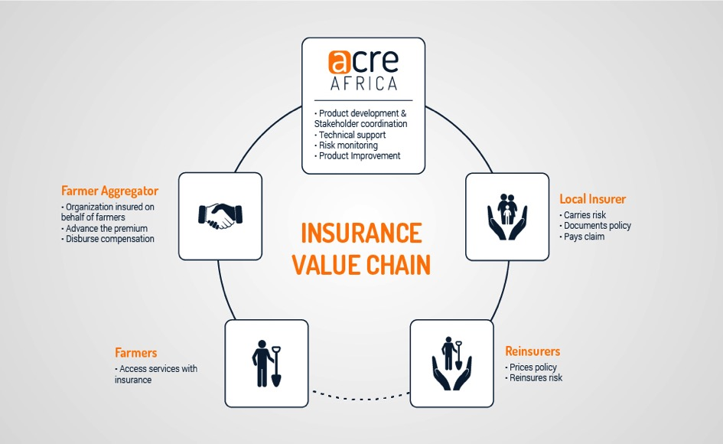
Business Model

Slide 4




Acre’s Investors

Slide 5
Partners
Non-Profit Organizations
Private Sector Service Providers
Donors
Product Users
Govt. agencies
Insurers, Reinsurers
Grant-making institutions
Aggregators (and, ultimately farmers)
Research Institutions
Mobile Network Operators

Slide 6
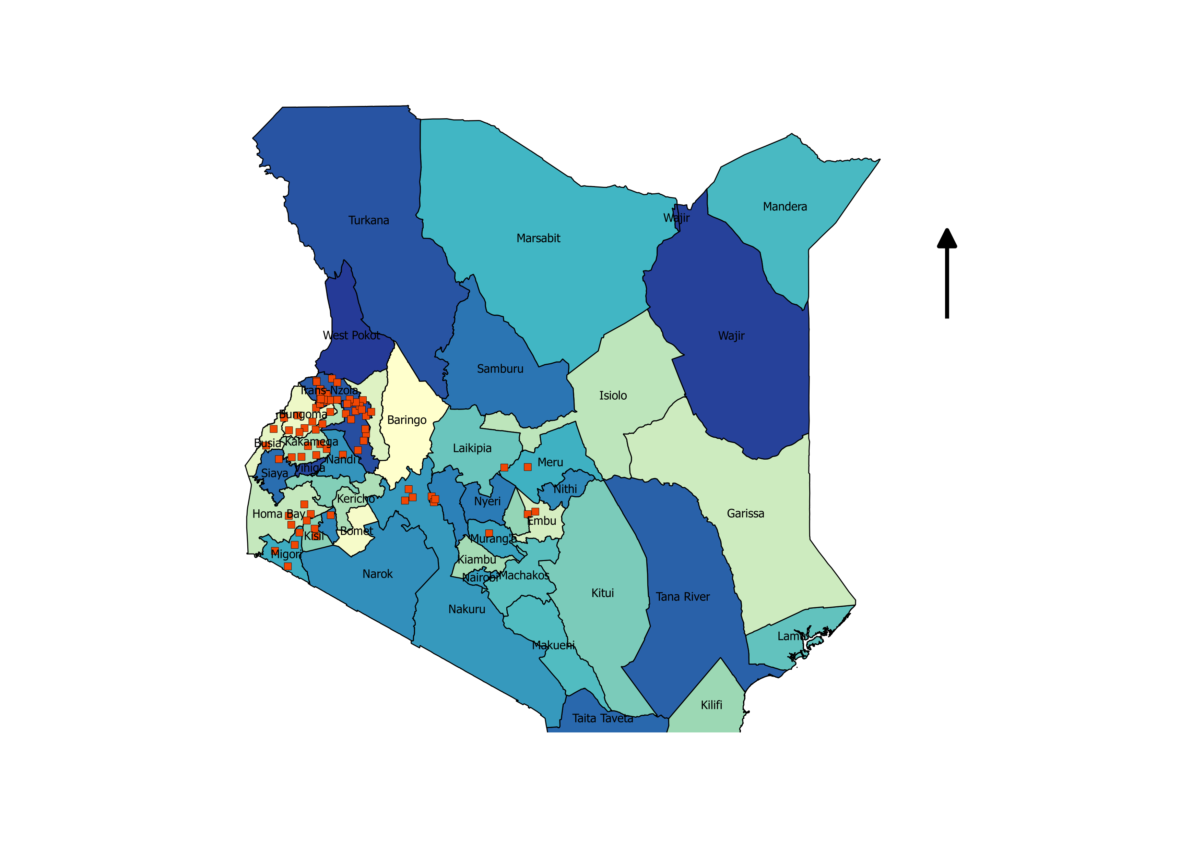
Weather Data Sources Used
78 stations owned by Acre Africa; powered by Adcon Telemetry

Slide 7
Private vs. NHMS-owned Weather Stations
NHMS - owned
Benefits | Weaknesses
Wide variety of high quality data usually available | Lack of flexibility in location of stations
Station maintenance done by NHMS | High cost of data acquisition
 | Data acquisition may not be timely/Bureaucratic processes involved
Privately Owned
Benefits | Weaknesses
Timely data acquisition | High set up and maintenance costs
More flexibility in location | Unintentional duplication of effort
Ideal data source would be NHMS if above issues resolved; for now, satellite data complements our AWS network

Slide 8
Why work with Satellite Data?
Benefits | Weaknesses
Data available in a timely manner | Accuracy varies from one location to another = higher basis risk
Some are available free of charge (stations are expensive to maintain!)
Available for entire continent; complement our stations

Slide 9
Thank You
E: sonyango@acreafrica.com

