Slide 1
UNDP CIRDA Country Program Managers Workshop
25-27August 2015
Addis Ababa, Ethiopia
Reports from Strengthening National Climate Information/ Early Warning System (CI/EWS) Project
TANZANIA
ALFEI DANIEL
NATIONAL PROJECT COORDINATOR
Notes:
Instructions: Complete items in red italics

Slide 2
Outline
Project background, objective and targets
Key Agencies
Organisation chart
Key agency and level of contribution
Social or economic impact/function of each agency ‘s contribution
Future plans
Any other relevant information

Slide 3
Project background, objective and targets
Objective:
To strengthen the weather, climate and hydrological monitoring capabilities, early warning systems and available information for responding to extreme weather and planning adaptation to climate change in Tanzania.
Impact indicator
The key impact indicator for the project is the level of capacity of agencies to monitor, assess and disseminate hydro-climate information for early warnings and long-term planning.

Slide 4
Project components
The project objective will be achieved through the following two components and associated outcomes detailed below.
Transfer of technologies for weather, climate, hydrological and environmental monitoring infrastructure
Enhanced Capacity of Tanzania Meteorological Agency (TMA) and Water Basins to monitor (and forecast) droughts and floods
Climate information integrated into development plans and early warning systems
Efficient and effective use of hydro-meteorological information for making early warnings and long-term development plans

Slide 5
key Departments/Agencies
The project is implemented under National Implementing modality (NIM)
Executing agency
Vice-President’s Office –Department of Environment
Project implementer
Prime Minister’s Office (PMO) Disaster Management Department (DMD)
Responsible partners
Tanzania Meteorological Agency (TMA),Ministry of water, Ministry of Agriculture Food Security and Cooperatives ,Pangani Basin water Board, Ruvuma and Southern Basin Water Board
Pilot zones:
Supporting climate monitoring network coverage in the country
Arumeru district
Liwale District

Slide 6
Organisation chart
Vice President 'Office
Department of Environment
Other Ministries
Disaster Management
President
Ministry of water
Ministry of Transport
Tanzania Meteorological Agency
Ruvuma and Southern Basin Water Board
Pangani Basin Water Board
Prime Minister
Ministry Of agriculture Food Security and Cooperatives
Local Government
Liwale District Council
Arumeru District Council
Notes:
Provide as much information on the above questions as you can.

Slide 7
Vice-President’s Office –Department of Environment
Assume the executing role for the project; Play an active role in the project as co-chairs of the Project Steering Committee;
Advice the project on climate related issues
Provides advice on policy coordination in all issues related to climate change in Tanzania
Mainstreaming climate change into national policies, framework and developing plans
Leading agency of the National plans for Adaptations programs (NAPS)
Participated institution on development of the long-term financing strategy for the hydro-climate monitoring network, including through partnerships and outreach with the private sector
Work under the guidance of Environmental Management Act (2004).

Slide 8
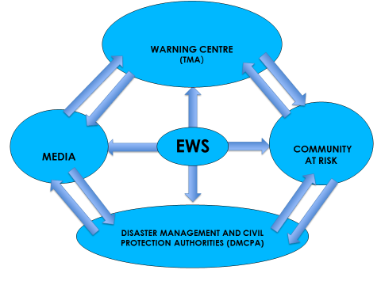
Prime Minister’s Office -Disaster Management Department
Implementing partner and hosting institution
Chairman of the Project steering Committee
Coordinates project activities with all other stakeholders
Coordinating all disaster management response issues in the country including disaster relief operations and preparedness measures
Received initial notification or warning of disaster from multiple sources, chiefly from the TMA (concerning climate-based or weather-based warnings) or from local sources (concerning occurrences of disaster)

Slide 9
Progress made by the Project to strengthen Disaster Management
Completed the study on assessing efficiency of available explicit and implicit operating procedures for issuing early warning. This study highlights basic information which will be used in the revision of the Tanzania Emergency and Preparedness Plan (TEPRP).
The review will include developing a set of Standard Operating Procedures for managing floods and droughts that highlights each partner’s roles and responsibilities, the types of early warning messages, appropriate responses, resources and communication pathways to reach local communities.
The process of Develop Standard Operating Procedures for droughts and floods in consultation with all partners at national and local level, including NGOs and the media has been initiated

Slide 10
Cont…
Initiated the process of establishing operational emergency operations unit that will coordinates EW emission and DR activities for the country
  Completing feasibility study on the setup for the 24-hour Emergency Operation Centre (EoC). The stud has provided:
  Emergency Operation Centre management, functions and structure requirements,
  Staffing requirement in terms of personnel, technical expertise and equipment
  List of communication equipment and estimated budget
  Criteria for site selection,
  Capacity development assessment report
  Engagement with the private sector to long sustain of the Centre
  Modalities of long-term financing opportunities
  List of agencies/stakeholders include their roles and possible synergy areas
The established EoC will be a central command and control facility responsible for carrying out the principles of emergency preparedness and emergency management. The study is providing the following immediate outputs

Slide 11
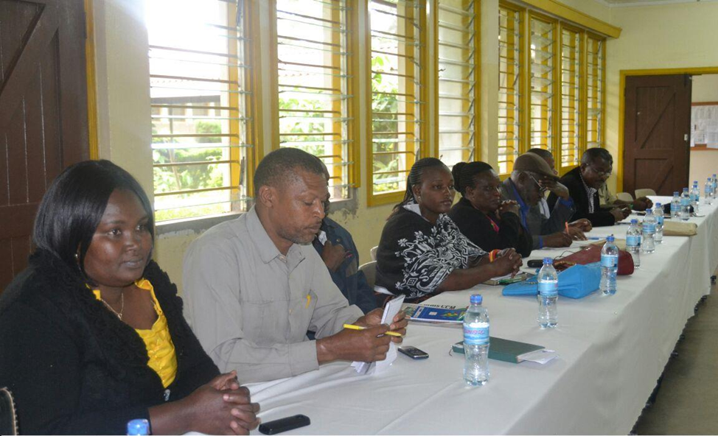
Cont…
Establishing one EWS simulation and adaptation planning exercise in the two project pilot districts
The project conducted a series of consultations meetings to ensure the community understand the importance of early warning and advisories
Mobilized District disaster management committees and CBOs to participate in the simulation exercise
Trained 453 community representatives on the application of climate information in overcoming drought and floods.
Training focused on climate information product can be downscaled to local levels
Notes:
The consultation meetings held on 9th -14th March 2015 focused the Disaster Management Committees (5 members attended), Liwale District council (15 members attended), 50 village leaders and community representatives from Kibutuka division and 25 village leaders and community representatives from Makata division. The meeting focused on project awareness and project milestones which will be achieved in the project implementation period. The project used this opportunity to request for more community participation during the execution of the project interventions

Slide 12
Tanzania Meteorological Agency
Is one of the implementing partners and beneficiaries of Strengthening Climate Information and Early warning Systems project in Tanzania
The department follow under the Ministry of transport, Director report to the Permanent secretary of the Ministry Of transport.
The Agency was established by the Tanzania Meteorology Act No 30 of 1997 and mandated to provide meteorological services to the general public, institutions and individual users of tailor made services for maintaining safety and security of people and their properties and support sustainable social economic development.

Slide 13
Tanzania Meteorological Agency services
Provide meteorological services for international air navigation
Administer efficient networks of surface and upper air stations necessary to capture accurate records of the weather and climatic conditions
Observe, collect, archive and disseminate meteorological and related information
Provide weather, climate services and warnings for the safety of life and property to the general public and to various users including aviation, marine, agriculture and food security, water resources, disaster management, health, construction industry and research Instutions.
Work with Ministry of agriculture to provide an overall forecast of water and food situation in the country
Publish weather and climatological summaries, bulletins and other interpreted products
Collect fees and charges for data, products and services rendered

Slide 14
Technology and Equipment deployed in delivering weather services
Present and required meteorological observational stations network
Description | Number of stations
 | Current | Operational | Needed | Shortage
Conventional Surface synoptic stations | 26 | 26 | 32 | 6
AWS Surface synoptic stations | 14 | 6 | 113 | 107
Agrometeorological stations | 15 | 6 | 20 | 5
Ordinary climate stations | 148 | 131 | 250 | 102
Rainfall stations | 2178 | 700 | 1000 | 250
Automatic Rainfall stations |  |  | 2500 | 2500
Marine weather station | 0 | 0 | 12 | 12
Upper air stations | 1 | 1 | 4 | 3
Pilot Balloon | 1 | - | 5 | 5
Weather Radar | 2 | 0 | 7 | 5
Lightning | 0 | 0 | 10 | 10
Orbiting satellite receiver |  |  | 1 | 1

Slide 15
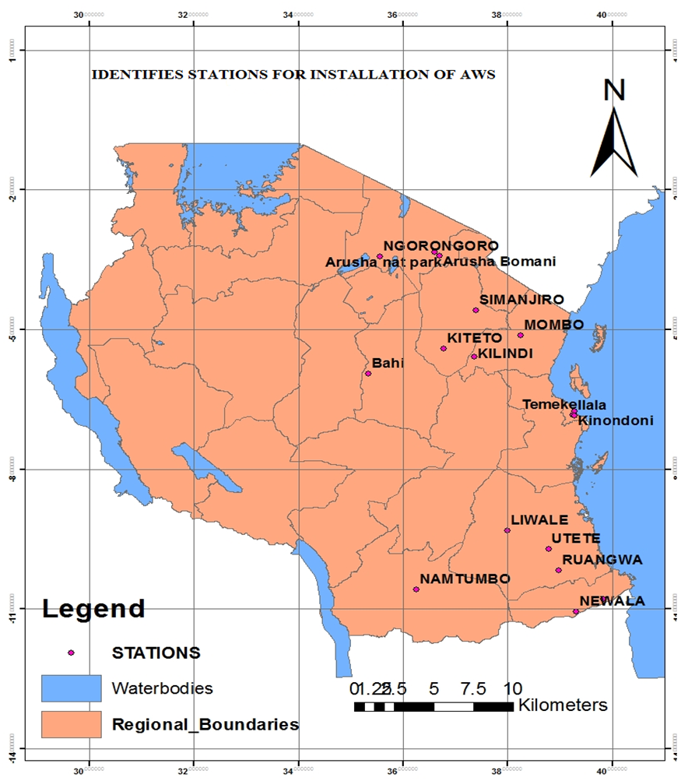
Project progress to strengthen the capacity of TMA
Procured additional 16 Automatic Weather Stations (AWS) with agro-meteorological sensors from Vaisala
Procured 2 field laptops for calibration of new AWS and 2 additional servers for data storage and transmission.
Installation of 16 AWS including enclosure construction
Trained 8 instrumentation specialists on calibration, repairing, maintaining and operating the new supplied AWS
Initiated the process of developing an integrated database to accommodate climate and hydrological data and hosted by MA
Mapped the Weather Stations in Tanzania to get the status and support needed.
Facilitated various Institutions owning weather stations to share climate data with TMA to improve the weather services in the country
Working on the country strategy for harmonisation of collection of observation data basin on the WMO standard
Support data rescuing, digitizing and achieving relevant available historical data from all ministries relevant to the 2 project pilot districts

Slide 16
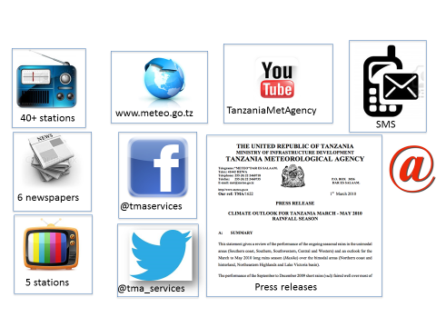
Social and Sector development
Provide daily weather forecasts, advisories and warnings, ten day, monthly and seasonal outlooks and climate change projections. These services contribute to the efficiency of operations of various sectors such to Agriculture and Food security, Health Sector, Transport Sector ,Energy Sector ,Water Resources, Construction Industry ,Tourism and Wildlife Management and Natural Disaster Management
Provide Current observation: short-term predictions of the consequences of specific weather events: e.g. example, heavy rainfall leading to flooding or disease outbreak
Provided climate forecasts and predictions: short- seasonal and long-term weather forecast which useful for early warning and planning at different time scales
Notes:
; medium- (10–30 year) and long-term climate change projections –100yrs. These provide information about the future state of the climate, and are

Slide 17
User of climate services,and how TMA generate revenues
Tanzania Port authority Tanzania Aviation Industry Marine Services Agriculture sector Media houses – ITV,TBC,ITV and AZAM Construction companies Health Sector Water resources Early warning massages is free | Tanzania Tourists Board Researchers Research Institutions/ Universities Mobile companies Farmers Disaster Management Departments Energy sectors

Slide 18
Ministry of Water
Is responsible partner for Strengthening Climates Information and Early warning Systems project
Manage water resources in the country
Manage 9 basin Authorities including Pangani and Ruvuma Basins where the pilot districts are located
Collaboration with other agencies issue early warning related to flood forecasting and early warning
Work with Water Basin Authorities to deliver activities related to flood risk mapping and early warning in the project
Provided Hydrology services in the country– water resource management and river level monitoring

Slide 19
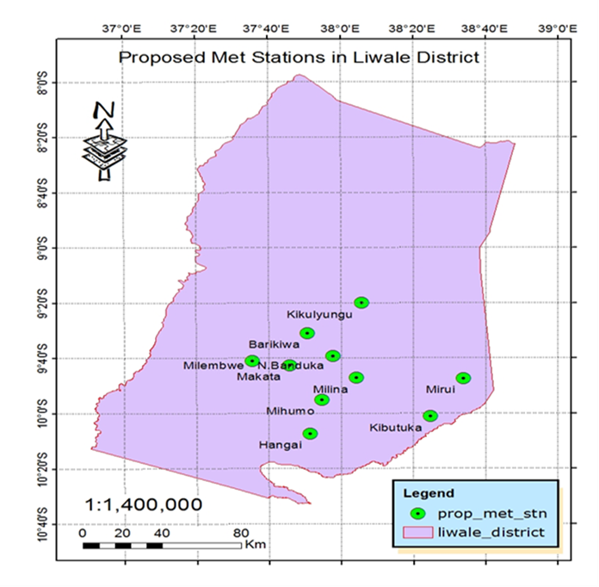
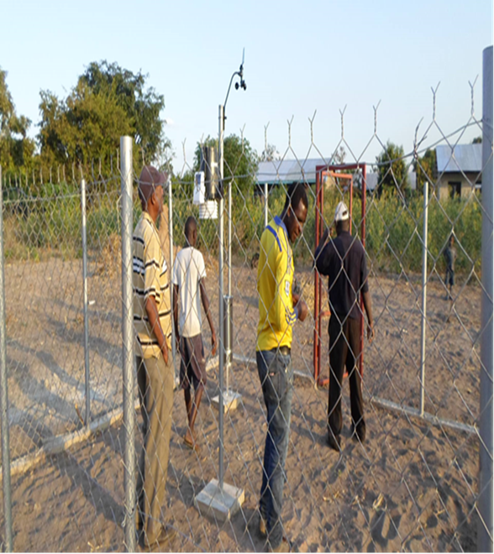
Contribution to the to the National hydrological services
Procured 10 hydrological stations, 50 river gauges, 20 rain gauges and installed in Pangani and Ruvuma basin for water resource management and river level monitoring
14 Hydrology technicians from Ruvuma and Pangani basins trained on calibration, maintaining and installation of new supplied hydrological equipment.
Support on data rescuing, digitizing and achieving relevant available historical data from all ministries relevant to the 2 project pilot districts

Slide 20
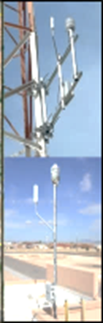
National, regional initiatives ongoing
Support from the Government on maintaining and extension coverage of climate monitoring network
World bank support
Southern Africa Development Community initiative (SADC) on strengthening hydrological services
East Africa Community initiatives on Lightening detection techniques around lake Victoria
UK Met office Support on data management
Support from WMO

Slide 21
Social and Sector development
Water and river flow data is contributing to the efficiency of operations of sectors such to Agriculture and Food security, Health Sector, Energy Sector, Water Resources, and Wildlife Management and Natural Disaster Management
Water basins in collaboration with Tanzania Meteorological Agency use hydrological information to perform various tasks including applications of flood management software that include real-time local flood forecasting based on hydrological and precipitation data, development of GIS-based flood risk maps and models using varied parameters.
The products generated using hydrological information for example flood forecasting models, development of flood risk maps using historical and available climate and hydrological data, updated data coming from the new monitoring stations. This support decision making, better management of hydraulic structures and environmental monitoring.

Slide 22
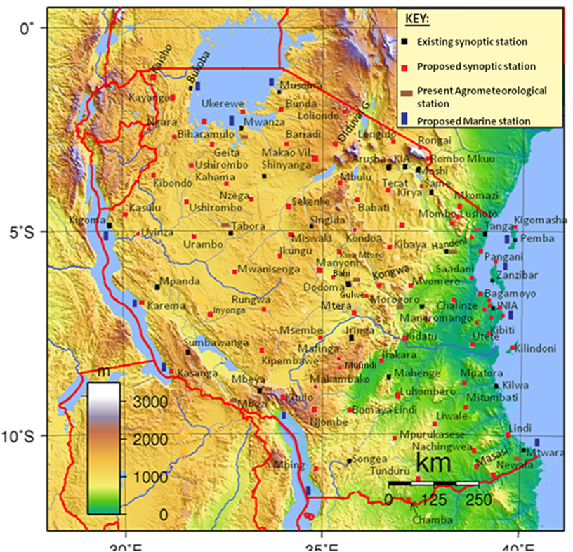
Future plans
Procurement of 20 AWS to continue expanding surface observation stations
Procurement of servers for additional data storage and transmission (2 server TMA)
Procurement of hydrological equipment
Support acquiring flood forecasting software, tools and methodologies
Strengthening the Management of Meteorological Instruments and equipment and Establishment of calibration
Strengthening and enhancing Data rescue activities
Data Processing Systems, acquisition of modern computing facilities and equipment for processing, archiving
Introduce systems to digitise new observation

Slide 23
Cont…
Support adoption of different technologies to improve data quality and improving the weather services
Commercialize products and services through engagement with private partnerships for cost recovery
Improve data assimilation, analysis, and integration into products and services
Support establishing of an operational emergency operations unit that will coordinates EW emission and DR activities for the country, based on SOPs
Strengthening Public weather service delivery including those for early warning
Developing a set of Standard Operating Procedures for managing floods and droughts

Slide 24
Final Thoughts
Inadequate observing network systems, poor communication facilities for data collection and exchange due to inadequate funding
Meeting stakeholder's expectations. For example users of the weather forecasts are expecting TMA to issue localised, time specific and reliable forecasts unlike the present forecasts which cover large areas
Assist in developing a clear policy on agreements with the mobile providers on the use of frequencies, airtime and airwaves for early warning system
Long-term financing of the climate monitoring system through cost recovery.

Slide 25
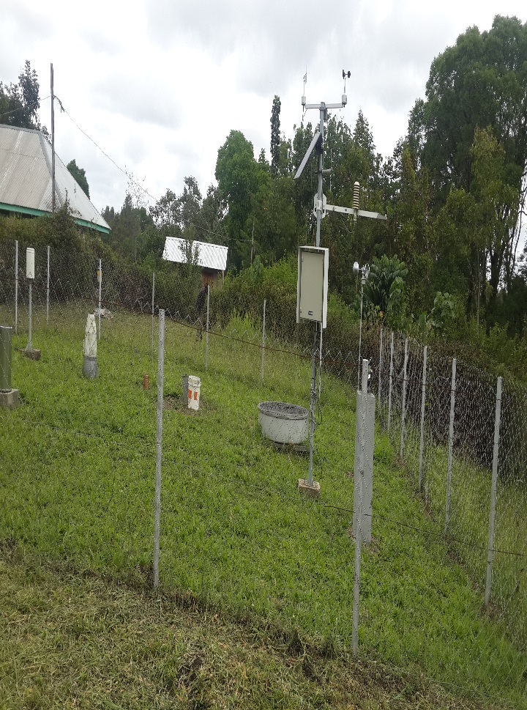
Final Thoughts
inadequate observing network systems, poor communication facilities for data collection and exchange due to inadequate funding
Meeting stakeholder's expectations. For example users of the weather forecasts are expecting TMA to issue localised, time specific and reliable forecasts unlike the present forecasts which cover large areas
Assist in developing a clear policy on agreements with the mobile providers on the use of frequencies, airtime and airwaves for early warning system
Long-term financing of the climate monitoring system through cost recovery.

Slide 26
Thank you for listening

