Slide 1
Unit 3.1: Gender analysis for adaptation
Gender in Adaptation Planning for the Agriculture Sectors
Training Workshop
[Name of presenter]
[Date]
Notes:
Note to trainer: See Unit 3.1 in the Guide for Trainers for ideas for a session on incorporating a strong gender analysis into adaptation planning for the agriculture sectors.

Slide 2
Learning outcomes
Discuss
Discuss what gender analysis is and what questions it helps answer.
Describe
Describe ways that a gender analysis could be carried out to support adaptation planning for the agriculture sectors.
Contribute
Contribute to a basic gender analysis or perhaps undertake one.

Slide 3
What is gender analysis?
Gender analysis is a systematic attempt to identify gender inequalities, their causes and how they are linked to the goals of a policy or plan.
  Sheds light on how inequitable social, economic and political structures and unequal power relations rise to discrimination, subordination and exclusion.
  Clarifies how women and men’s gender, age, ethnicity, culture, etc. contribute to who they are and how they operate in the world.
  Identifies men’s and women’s different knowledge, experience, needs, challenges, roles, responsibilities in relation to adaptation options.
Notes:
Note to trainer: Before defining gender analysis, you may want to ask the participants: Who here has been involved in some sort of gender analysis or drawn on gender analysis for their work? Can anyone tell us what gender analysis is, or what you think it is?

Slide 4
Gender issues to consider in gender analysis for adaptation in agriculture
Gender roles define how women and men “should” act and are linked to the gender division of labour, as well as differences in needs, knowledge and priorities
Discrimination of women leads to devaluing of “women’s work”
Gender roles and gender-based discrimination give rise to gender gaps in
  Labour (including time use)
  Access to and control over productive resources
  Information (including access to services)
  Decision-making (household and public sphere)
  Participation
  Benefit sharing

Slide 5
Why incorporate gender analysis in adaptation planning?
To enrich analysis of climate vulnerabilities
Gender analysis identifies disadvantaged members of a population and the nature of their disadvantage
Use it to differentiate the ways distinct groups experience and respond to climate impacts and produce a more complete vulnerability analysis
To improve sustainability of adaptation options
Gender analysis identifies skills, knowledge, perspectives of women and men
To promote good governance and effective institutional outreach
Gender analysis identifies causes of structural inequalities and power dynamics
Use it to determine adaptation priorities of different groups so proposed solutions meet varying needs (e.g. labour-saving) and address constraints (e.g. access to land)
Use it to develop institutional strategies to minimize disadvantages, improve targeting of benefits (financial and other) and increase access to opportunities of adaptation plans
Gender analysis identifies possible impacts of plans/projects on different groups
Use it to harness existing skills and resources in implementing adaptation options

Slide 6
Gender analysis outputs inform adaptation planning in agriculture
Recommendations of gender issues to consider
Gender equality baseline
Gender-responsive theory of change
Gender-responsive results framework
Gender Action Plan
In plan formulation
In implementation of adaptation strategies
To use as basis for measuring progress on gender equality in implementation of adaptation plan
To frame the planning process
To set gender-related targets
To guide gender mainstreaming during planning

Slide 7
When to conduct gender analysis
Information gathering to collect and assess accurate information and inform policy programming design, baseline.
Design and implementation to include gender concerns in adaptation activities, and inform identification, selection of beneficiaries, partners.
Monitoring and evaluation of adaptation plans, including positive, negative effects on women/men.

Slide 8
What resources needed?
Gender analysis framework
Resource person(s)
Financial, other resources
Access to secondary data
Access to qualitative data as well as quantitative
Expertise to collect primary data if needed

Slide 9
Sources of information for a national-level gender analysis
National policies
National gender strategies
Legislation
Government studies/data
Research institutes
INGOs/NGOs
Other
World Bank Database
OECD Social Institutions and Gender Index (SIGI)
UNDP’s Human Development Index (HDI)
UNDP‘s Gender Inequality Index (GDI)
FAO Gender and Land Rights Database.

Slide 10
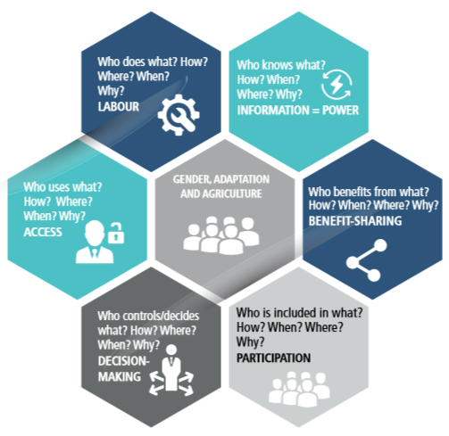
Key gender analysis questions

