Slide 1
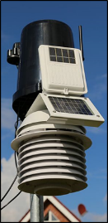
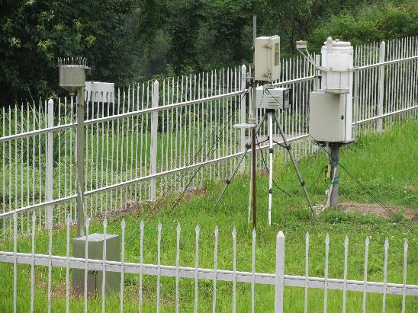
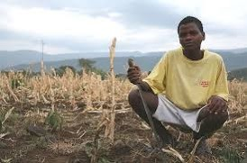
UNDP CIRDA Country Program Managers Workshop 25-27 August 2015 Addis Ababa, Ethiopia
Introduction and Overview of the
CIRDA Market Study
Anthony Mills
CEO C4 EcoSolutions
Cape Town, South Africa
www.c4es.co.za

Slide 2
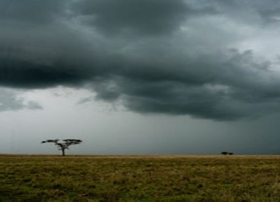
Overview of Presentation
Conceptual Framework
Proposed structure of Market Study
Breaking news from World Meteorological Congress (June 2015)
Facilitating engagement between the private sector and NHMSs
Barriers
Timeline for Assessment
Information required to feed into Market Study
Notes:
Main focus on relation between NHMS and private sector as well as the business to business relationships. What are the type of transactions between all of these players? What has worked and what did not? (examples SA and the NL).
What partnerships are emerging to provide revenue to the NHMS?
What technologies can facilitate the transfer of weather information from the NHMS to the private sector and the people in the field?

Slide 3
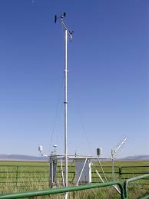
Conceptual Framework
Public Based Organisations
Government
Private sector
Other weather data generators
AfricaWeather
EARS
NGOs and research institutions
NOAA
EUMETSAT
Private weather companies/value adders
CGIAR
USAID
IRI
UN agencies
GFCS
ACMAD
AGRYMET
NHMS
EcoNet
Pilotfriend
Farmers
Private sector climate services consumers
Notes:
Providing the bigger picture of the main stakeholders around the generation, provision and consumption of weather information.
Important to understand the context and the relationships between the stakeholders. Why do certain relationships exist and how are they maintained? This helps to get an idea of what conditions need to be in place for optimal operation of the NHMS.
CGIAR: Consultative Group for International Agricultural Research
IRI: International Research Institute (for climate research)
GFCS: Global Framework for Climate Services
ACMAD: African Centre of Meteorological Applications and Development
AGRHYMET: AGRiculture HYdrology and METerology
WASCAL: West African Science Service Centre on Climate Change and Land Use

Slide 4
Structure of Market Assessment
Study approach (5%)
Institutional Framework (5%)
Public and private weather data generators (5%)
Status quo of NHMSs (15%)
Private sector climate information providers (15%)
Private sector users of climate information (20%)
Last Mile (15%)
Pathways and partnerships (15%)
Recommendations (5%)

Slide 5
How can/should NHMSs engage with the private sector?
World Meteorological Congress Geneva 25 May-12 June 2015
Agenda Item 9: FUTURE CHALLENGES AND OPPORTUNITIES
Future role of the private sector in meteorology
Decisions/actions:
‘…provide guidance on developing relationships with the private sector…’
‘…growing involvement of …private sector…in the full value chain of activities…observations,…data acquisition,…information, processing,…product dissemination…’
Warning: ‘…commercial interests could lead to…weather information…exaggerated to attract attention and business’.

Slide 6
Advantages:
‘…complementary roles NMHSs, academic institutions, research and technological agencies, and the private sector.’
‘…stimulate innovation and cross-fertilisation…’
‘…non-authoritative weather and climate information…’
‘…development of specifications and service level agreements…to ensure accuracy, traceability and delivery of quality services…’
‘…NHMSs as the authoritative sources of weather information, forecasts and warnings…’

Slide 7
Opportunities:
‘…best practices for partnership…’
‘…ensure appropriate legislation…directing part of the benefits made by the private sector using data and products from NMHSs back to their national infrastructure based on appropriate…guidelines of cost recovery.’

Slide 8
Facilitating engagement between the private sector and NHMS
Revenue Expenditure
Government budget
Climate services e.g.
aviation
Grants
Other private sector
climate services
consumers
NHMS
Membership fees
Purchase equipment
Maintenance
Salaries
NHMS
Strengthen and grow the impact of NHMS in support of national development objectives
Grow revenue streams
Notes:
Currently government budget in CIRDA countries to NHMS is limited and unreliable. Aviation is often largest contributor to revenue NHMS. To bridge the financial gap, this study looks at potential of other private sectors to take example of aviation and pay NHMS for their weather services.

Slide 9
Income streams from private sector
What is happening?
What could happen?
High road: considerable income
Middle road
Low road:
minimal income
CIRDA countries
Worldwide
NHMSs
Research institutions
NGOs
Private sector

Slide 10
How to achieve the High Road?
Business approach
What is the NHMS niche?
Branding/marketing
Production of goods
Sale of goods
Strategise
Strategise
Define competitive advantage
Independent, neutral, honest broker
Ensure continuity
Laws/regulations
Considerable infrastructure
Managing a public good
Historical archive/record keeping
Early warnings
Strategise

Slide 11
How to achieve the High Road?
Each country needs to develop its own recipe for the high road and private sector engagement.
What is NHMS’s niche versus the private sector’s niche?
Roles need to be clearly defined
Partnerships forged and formalised
Synergies not conflicts promoted
New technologies
3 D Printing
Google/Amazon ‘big data’
IP-AWS connectivity
Scale?
Field scale versus regional
Complexity of information
New partnerships
GFCS
NGOs
Research institutions
Private sector competitive advantage
Innovation
Big data processing?
Penetrating markets

Slide 12
Climate Services Value Chain
Data
Information
Products and packaging
Fulfillment
Accuracy
Quality of equipment
Needs of user
Skills to interpret data
Tailoring of information
Closing the deal
Cost recovery mechanisms
Notes:
This is the value chain the NHMS needs to follow to receive fulfillment.
Data: do we receive sufficient data to make accurate forecasts? Do we have adequate quality of equipment (p.e AWS) to generate data?
Information: Do we know what information the private sector - weather information users - needs? Do we have the skills to interpret and work with the data received?
Products and packaging: Are we capable to package the required information into a tailored product and sell this product? Is the political environment enabling the sales of such products and services?
4. Fulfillment: Are we closing the deal to the advantage of *all* not just the user. Cost Recovery? Fixed fees for inputs or royalty sharing, based on revenue / turnover targets?

Slide 13
Manufacturing analogy:
Who gets a cut?
Livestock producers
(leather seats)
Mining companies
(metal components)
Electronics companies
(electrical parts)
Car manufacturers
(assemble parts)
Rubber growers
(tyres)
Car dealerships
(distribution and sales)

Slide 14
Value in a SMS
Mining
Stop operations
Evacuate
Increase production to stockpile
Hydropower plant savings in Ethiopia over a decade:
US$1-6.5 billion (Block, 2011)
Farming decisions
Crop type
Sowing of seeds
Irrigation
Fertilisation
Aviation
minimise flight delays
Tourism operators
improve tourist’s experience
Fishing/game viewing etc.
Value to Kenyan farmers:
US$40 per hectare
(Hansen et al. 2009)

Slide 15
Production of the SMS to a farmer
Who gets a cut?
Research institution (e.g. CABI)
Adds agri information
Uses expertise from multi-disciplinary team
Telecoms company
distributes SMS
Satellite data providers
Private weather company (e.g. Africa Weather)
Processes climate data
Packages information
Downscaling to field scale
NHMS
Provides historical data for calibrating models
Provides forecasts
Adds credibility by being honest, independent, broker
Agri-supplier
Provides database of clients

Slide 16
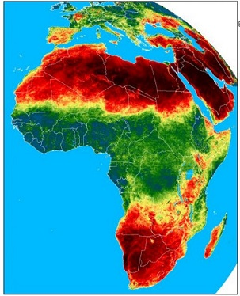
Potential barriers
Training of NHMS staff to provide goods/services to the private sector. (ACMAD/AGRHYMET do not have this service available.)
Private sector companies excluding NHMS
EARS-FESA:
satellite indices for weather index-based insurance.
~0.5 euro per farmer
> 1 million farmers
Private sector companies competing with NHMS
Notes:
Ad 2. The NHMS is probably best positioned to provide public data, for all, at a reasonable (or no) cost. However it can and should also provide premium products to value adders where there is proper fulfilment.
Added value NHMS: independence ( which is important for safety) and continuity
For example, if airlines pay a private weather company for the forecasts for the flight routes and the airlines mention these forecasts are often negative, there might be the risk that private companies will make the forecast more positive out of fear to loose the contract with the airline. However, this can jeopardise the safety. In addition, there is the risk that a company will go broke or is being bought by larger company with different stakes. This jeopardises the continuity of the information.

Slide 17
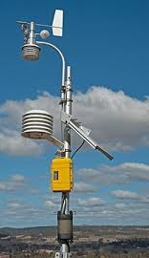
Africa Weather and Weathernews
SAWS, South Africa
No clearly defined mandate for partnership
Best practices not reviewed
Outdated strategies (e.g. equipment)
Insufficient staff within SAWS
Compensation to SAWS insufficient for cost recovery
KNMI, The Netherlands
Clear mandate by law on tasks for NHMS and private weather company from the start
Modern equipment
Sharing of sufficient qualified staff over to company
Sufficient cost recovery
Notes:
South Africa:
Strategies no longer relevant: i.e. manufacturing of automatic weather sensors and support legacy systems when off the shelf was quicker and cheaper.
Sales of products for 10x the price it used to be, which puts consumers off.
Misinterpretation of resolution WMO 40 on information sharing led to SAWS keeping data to itself.
Dependency on experts for software, operations and commercial services, so staff stretched thin. In addition: Experts used were SAWS, so kept adding to costs of SAWS
Example:
Airlines have to pay to fly through national space. This goes directly to the NHMS. The NHMS has to comply with the ICAO regulation and requirement and receive certification for this. Airlines always have to plan their flights based on the forecasts by that institute that complies by the ICAO regulations, which in the NL is KNMI. However, airlines are responsible for making planes free of ice. If the airline wants to have special forecast for this situation, they will receive this from the private weather company.
Strong lobby by private weather company to take over the aviation services, but since this is by law allocated to the NHMS, they can’t. (Source. Cyrill Taminiau, KNMI, Netherlands)
In 1998 KNMI total annual budget of ~45 million euro. Incomes:
‒ Research and government contribution € 32 million
‒ Aviation € 10 million
‒ Commercial Activities € 3 million

Slide 18
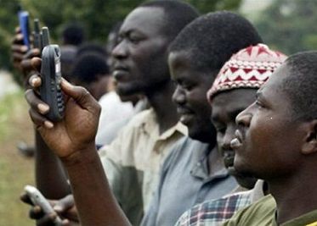
Timeline for the Market Assessment
August | September | October | November
25-27 CIRDA workshop | Interview private sector | Pathways and partnerships | Recommendations
Status quo | Partial draft | Full draft | Presentation in Zambia and Final report

Slide 19
Information required to feed into Market Study
Two approaches for gathering information during our workshop
1. Plenary session
2. Country meetings – 1.5 hour session, +/-4 per day
One representative of each country
Please sign up during lunch today

Slide 20
Information required to feed into Market Study
Mission and mandates of NHMSs (e.g. national plans and strategies)
Medium and long-term outlook of NHMSs (e.g. strategic frameworks, outlooks, etc)
Budget and expenditures (e.g. annual reports)
Existing tailored climate products and services
Barriers for uptake/delivery of climate services information
Potential opportunities
National Framework for Climate Services

Slide 21
Information required to feed into Market Study
Ranking importance of sector | Sector | Contact details | Potential opportunities for partnership | Revenue generated from existing climate services?
Examples important sectors:
Aviation
Agriculture
Disaster risk reduction
Energy/mining
Insurance
Health
Mobile phone
Transport

Slide 22
Information required to feed into Market Study
NHMS Questionnaire
Internal
1. How do you obtain your weather data (NOAA/EUMETSAT, AWS)?
2. How is climate information currently shared in your country (radio, TV, mobile)?
3. What is your scale of operation?
a. short term (up to 30 days) versus long-term (2-10+ years)?
4. How would you rate your NHMS’s technical capacity? (likert)
5. How do you use weather information to measure risks (e.g. lightening, floods)?
6. How effective is the NHMS in sharing accurate, timely and usable weather information? (likert)
7. What is your annual expenditure on procurement of private sector weather data from any of the providers, products and services?
8. Could you please provide a tabulated list of all income generating products and services provided to the national market, and value of sales.
9. Does your country have a Regulating Committee of Meteorological Services?
a. If so, how does it decide the limits on prices of products and services?
b. Is there any data regarding a breakdown on the type and amount of users.

Slide 23
Information required to feed into Market Study
Private sector
10. Do private sector suppliers provide you with weather data for your products and services? (likert)
Type: international privately-owned satellites (companies, satellites, instruments and services) or private weather providers (for e.g. AWS manager)?
Purpose: long term modelling, forecasting & research, short term prediction, and/or early disaster warning?
Is there any collective (combined multi-national) purchasing of services and data?
11. What further opportunities lie over the short- to medium-term (1-10 years) for expanding in-sourcing of private data into the national weather offices products and services?
12. Does your NHMS experience competition with private weather companies?
If so, to what extent?
If not, why?
13. What are major opportunities for growing sales of products & services to private sector, and potential value (over next 10 years)?
14. How can you increase the demand from & use by the private sector of these products & services?
a. Improve quality, resolution / scale
b. Improve pricing
c. New offerings
15. How can communication to rural areas of these weather data products and services be improved?

Slide 24
Information required to feed into Market Study
Partnerships
16. How do you see the role of the private sector as a partner to provide improved weather products and services?
17. Which private sector suppliers, partners or clients could contribute to improving the communication of this data to local rural communities?
a. If so, how? If not, why?
18. What would you say are the relative opportunities are for creating effective PPPs for meteorology? (likert)
a. How conducive are the public policies to fostering PPPs? (likert)
b. Is there an existing legal framework for PPPs, or would one need to be created?
c. How open are businesses to working with the government)? (likert)
19. Is there a dedicated PPP unit in your country?
a. How effective is this unit? (likert)
b. If a unit does not exist, would it be useful?
20. How open is the telecommunications sector to PPPs in your country? (likert)
21 Would you consider a PPP or an other partnership to share weather information (research institutions, Red Cross)?
22. How would you monetize more accurate and timely provision of weather information?
23. Who are the main players in the country in terms of the distribution of products and information?
24. Would these NGOs and/or companies be a potential partner to facilitate distribution of your climate products and services (in terms of infrastructure)/
25. What are the main digital applications and platforms in your country to facilitate communication (e.g. What’s app)?

Slide 25
Value in a SMS
Mining
Stop operations
Evacuate
Increase production to stockpile
Hydropower plant savings in Ethiopia over a decade:
US$1-6.5 billion (Block, 2011)
Farming decisions
Crop type
Sowing of seeds
Irrigation
Fertilisation
Aviation
minimise flight delays
Tourism operators
improve tourist’s experience
Fishing/game viewing etc.
Value to Kenyan farmers:
US$40 per hectare
(Hansen et al. 2009)

Slide 26
Production of the SMS to a farmer
Who gets a cut?
Research institution (e.g. CABI)
Adds agri information
Uses expertise from multi-disciplinary team
Telecoms company
distributes SMS
Satellite data providers
Private weather company (e.g. Africa Weather)
Processes climate data
Packages information
Downscaling to field scale
NHMS
Provides historical data for calibrating models
Provides forecasts
Adds credibility by being honest, independent, broker
Agri-supplier
Provides database of clients

Slide 27
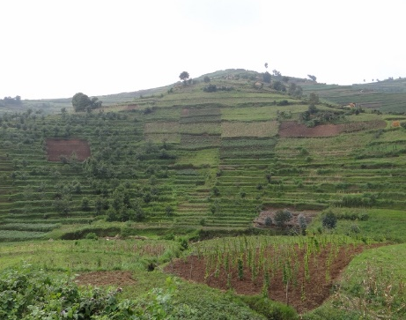
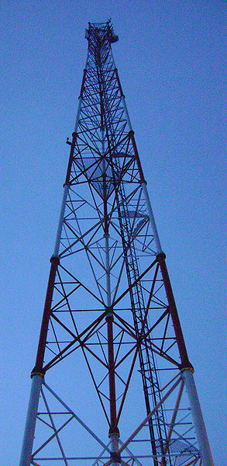
End of presentation
Thank you for your attention!

Slide 28
Partnerships and technologies
Global Framework for Climate Services
1. Across Africa: Climate Services Adaptation and Disaster Risk Reduction in Africa (2011–2016)
2. Malawi and Tanzania: Climate Services Adaptation Programme in Africa - Building Resilience in Disaster Risk Management, Food Security and Health (2013–2016)
3. Climate service partnership: Ethiopia- Enhancing National Climate Time Series (ENACTS)
Multi-institutional partnerships: NGOs and research institutions to build capacity and facilitate dialogue with private sector to develop tailored climate products and services
Notes:
The GFCS enhances partnerships between providers and users of weather and climate services and promotes regional and sub-regional cooperation. The institute has facilitated the implementation of pilot projects in conjunction with other partners within and outside the United Nations system.
Objectives of project: i) building capacity for improved weather and climate services; and ii) developing weather and climate related services for agriculture.
First multi-agency initiative implemented under GFCS.
Objective: to increase the resilience of people most vulnerable to the impacts of weather and climate-related hazards such as droughts and flooding and associated health risks including malnutrition, cholera and malaria.
The project aims to strengthen capacity both to develop and use climate services and combines science with traditional knowledge.
The project represents a unique partnership between climate and social scientists, researchers, development and humanitarian agencies and other key user sectors.

Slide 29
Partnerships and technologies
Potential ground-breaking technologies
3D printing (USAID/NOAA) – costs of weather station US$10,000 -> US$200
Google/Amazon interest (grants)
Internet Protocol-enabled sensors that are linked to the Internet
Community/Grameen phone
Notes:
3D: Lower-cost, higher-technology technology — and 3D printing will likely become an invaluable money- and life-saving solution for weather stations with tight budgets. The Micro-Manufacturing and Assembly project has begun developing affordable, 3D printed meteorological tools with which to equip weather stations. 3D printers can produce nearly all of the necessary parts to manufacture accurate, reliable weather stations, including in many flood-prone areas where formerly it was just too expensive.
Google: Columbia University researchers have used Google grant to amass 30 years of Ethiopian rainfall data into a public mapping system that scientists say could transform the way the country prepares for global warming. The project represents the first time a large amount of reliable meteorological data from an African country has been made freely accessible. Now in the hands of everyone from public health workers to farmers, it can be used to assist Ethiopia's water management, reduce vulnerability of crop loss from drought and better guard against the spread of diseases like malaria, experts say.
Internet Protocol or IP Network Weather Stations update weather servers real-time, providing up to the second data without the use of a PC. There are no networking fees. Perfect for low consumption requirements, remote monitoring applications, or weather station owners that do not want to leave their PC on 24/7.
A grameen phone centre (GPC) serves as a "one stop solution" for customers, with all telecommunications products and services, under a single roof. One person in community has phone with contract that other community memebers can use when paying small fee.

