Slide 1
Unit 4.1: Gender entry points in plan formulation
Gender in Adaptation Planning for the Agriculture Sectors
Training Workshop
[Name of presenter]
[Date]
Notes:
Note to trainer: See Unit 4.1 in the Guide for Trainers for ideas for a session on drafting each section of an agriculture adaptation plan document to ensure that it will contribute to gender-responsive adaptation in the agriculture sectors.

Slide 2
Learning outcomes
Describe
Describe the key characteristics of a gender-responsive adaptation plan for agriculture.
Identify
Identify actions to take to ensure that gender is reflected in each section of a plan document.
Give
Give examples of adaptation options that reflect a gender-responsive approach.

Slide 3
Gender-responsive adaptation plan for agriculture
Contributes to gender equality through:
Recognition of gender differences in adaptation needs, opportunities and capacities
Equitable participation and influence by women and men in adaptation decision-making processes
Equitable access to financial resources and other benefits resulting from investments in adaptation between women and men
Source: NAP Global Network. 2017. “A Framework for Gender-Responsive National Adaptation Plan (NAP) Processes”
Notes:
Trainer:
Refresh training participants’ memory of the definition of “gender-responsive adaptation”, first introduced in Unit 2.1.

Slide 4
If gender is not considered?
The plan could risk reinforcing existing gender gaps in agriculture and discriminatory practices, and thus fail to meet its objectives.
Other risks?
Notes:
Note to trainer –
Ask participants if they think there are other risks to not considering gender

Slide 5
Gender-responsive stakeholder engagement
Engaging with stakeholders addressing gender can lead to more equitable adaptation options.
Diverse stakeholders = diverse perspectives.
Potential stakeholders with gender perspective*:
  Ministry of Gender, similar government bodies
  NGOs/CSOs working on gender issues
  farmers’ organizations
  women’s organization
  research institutions/universities.
Dedicated resources to support engagement process
* Note: May not have much climate change-related experience
Notes:
Note to trainer: This slide is used in Unit 2.2. Refer to Unit 2.2 where gender-responsive stakeholder consultation was discussed, emphasizing that this element of the process is important to develop a document that is gender-responsive

Slide 6
Gender Action Plan
succinct list of goals, responsibilities and deadlines that are agreed to by members of the planning process
can serve as a checklist for the adaptation planning group to ensure that gender is being integrated throughout the formulation of the plan
a guide for further action instead of an endpoint
follow-through possible when there is leadership, staff time, and allocation of financial resources
Notes:
Note to trainer: you can skip this slide if your audience is unlikely to develop a Gender Action Plan
See Box 4.1.1 in the Guide for Trainers for an example of the process of creating Peru’s Climate Change and Gender Action Plan

Slide 7
Key actions to address gender in an adaptation plan for agriculture
Throughout:
  Use specific language (e.g. “women and men” instead of “farmers”)
  Avoid equating gender with women and framing women as vulnerable
  Reflect findings on gender-based differences in risk and vulnerability
  Elaborate on roles of different organizations related to gender equality
  Use sex-disaggregated data
Ask:
  Where is the gender perspective?
  Do the proposed strategies and actions promote gender equality or worsen existing gender gaps?

Slide 8
Gender in each section of the plan (1/4)
1. Preamble and Justification
2. Methodology for developing the plan
3. Context
Relevant national and international commitments on gender equality
Importance of gender in context of adaptation in agriculture
How gender expertise applied throughout by various organizations, experts
Gender in national development context (e.g. education, employment in ag)
Gender issues in agriculture (results of gender analysis)
Climate trends as observed by rural women and men
Notes:
Note to trainer: titles of sections of the plan you are working on/referring to may differ from those here, so be sure to update the terms to reflect the terms used in the adaptation plan in your context.

Slide 9
Gender in each section of the plan (2/4)
4. Climate change impacts and vulnerability analysis
Gender dimensions of vulnerability to climate change impacts including women’s and men’s priorities, opportunities, and constraints in responding to the impacts.
5. Policy and institutional framework
Roles of key stakeholders in meeting gender equality commitments, including those in existing agriculture and climate change policies/plans
Possible barriers to gender-responsive policy implementation (e.g. lack of collaboration between key ministries)

Slide 10
Gender in each section of the plan (3/4)
6. Priority adaptation options
Vision, objectives and guiding principles may include “gender-responsiveness”
Adaptation options
Describe gender considerations used when identifying adaptation options, e.g. access to information/climate services, participation in decision-making, participation in groups, constraining cultural norms, and more.
One gender-focused adaptation option, e.g. “Promote a gender-responsive climate smart agriculture programme”.
Reflect consideration of gender in all adaptation options, e.g.
Gender consideration | How reflected in an adaptation option
Work burden | Develop specific technologies tailored to women’s needs; prioritize adaptation practices that reduce the work loads of women and men
Vulnerability | encourage transition from coping strategies to adaptation by targeting women’s and men’s needs.
Notes:
Note to trainer: in some cases, “adaptation actions” may be used instead of “adaptation options”
Note to trainer: A key message here is that a stand-alone adaptation option focused on gender is not enough for the plan to be considered “gender-responsive”; the other adaptation options should take into account gender considerations (as relevant). You can direct the training participants to further examples of this in Unit 4.1 under the heading “6. Priority adaptation options”.

Slide 11
Gender in each section of the plan (4/4)
7. Coordination and implementation arrangements
Describe institutional arrangements, roles and responsibilities to mainstream gender in implementation
Identify how to close skills gaps
8. Monitoring, reporting and evaluation
Develop a gender-responsive monitoring framework
9. Financing and resource mobilization
Use gender-responsive budgeting principles to allocate resources
Refer to efforts to meet gender requirements of donors
Notes:
Note to trainer: Gender-responsive monitoring frameworks are covered under Unit 5.1; gender-responsive budgeting is described in Unit 4.2

Slide 12
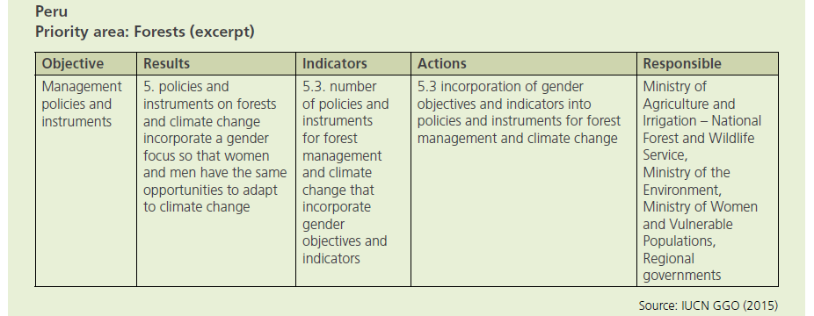
Example
Notes:
Note to trainer: You can include examples from the Guide for Trainers or use a local example

