Slide 1
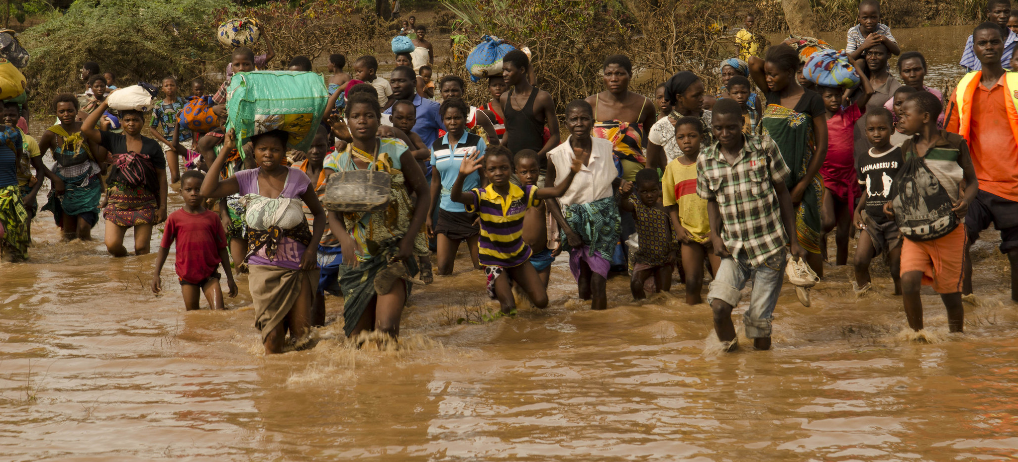
Going The Last Mile
Ensuring climate information and early warnings reach vulnerable end-users
Pradeep Kurukulasuriya, PhD
Head – Climate Change Adaptation, UNDP
Notes:
Perhaps say that ‘last mile’ is open to interpretation – is SMS last mile ? Whilst it might reach someone it needs to be interpretable and actionable which it might not be for various reasons

Slide 2
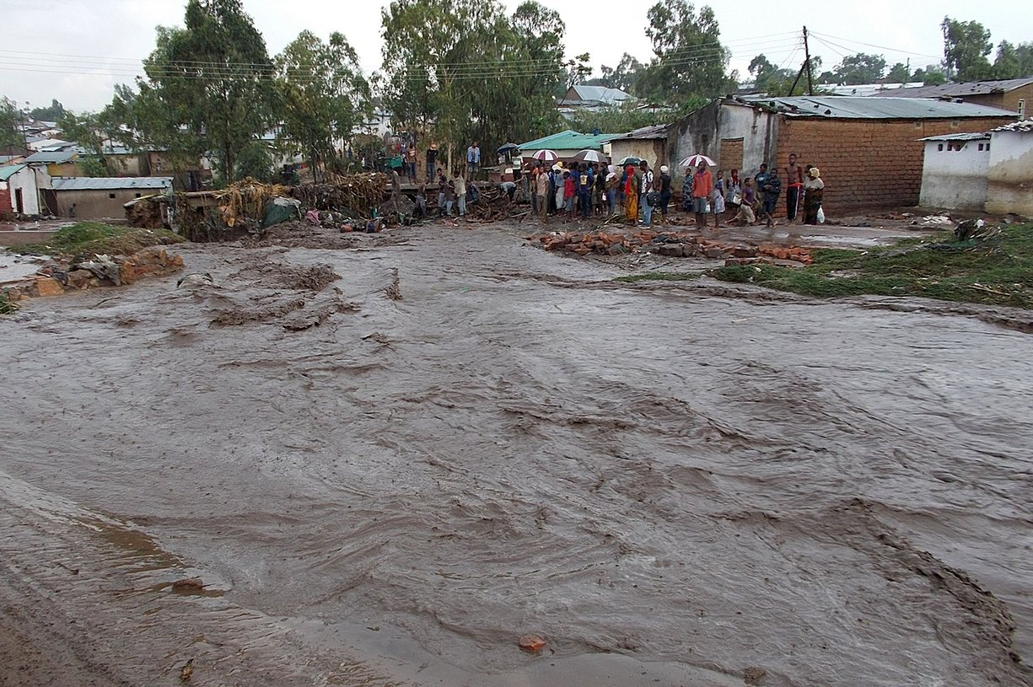


Southern Africa Floods, 2011
Botswana
500 dead
6,000 people displaced
630 schools, 42 health units closed
$200 mill in damages

Slide 3
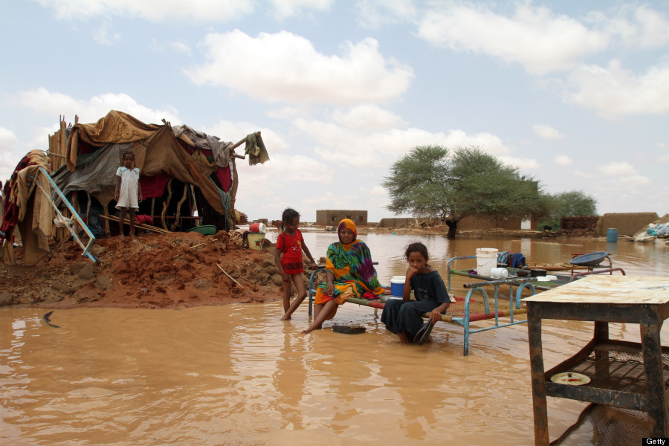

Sudan Floods, 2013
Sudan
45 dead
70 injured
300,000 affected
25,000 homes destroyed

Slide 4
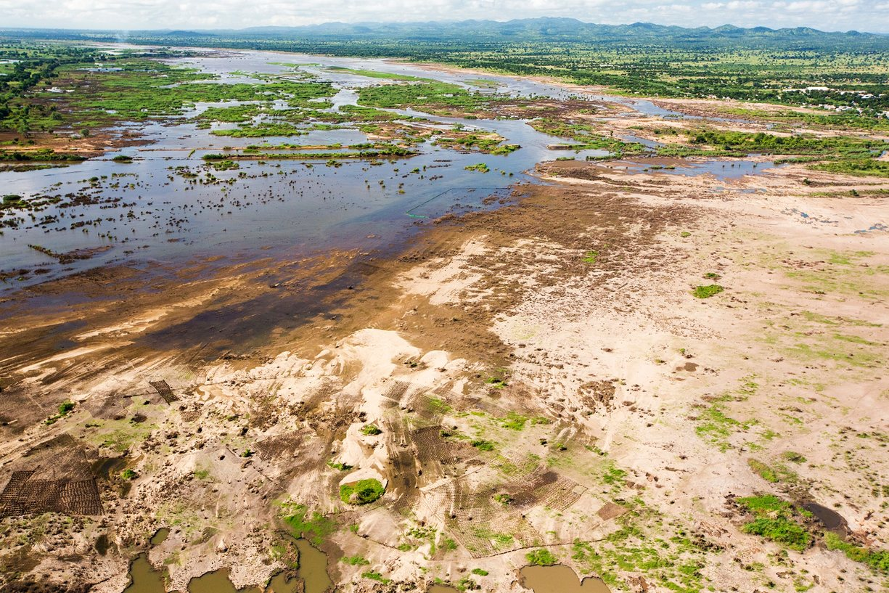
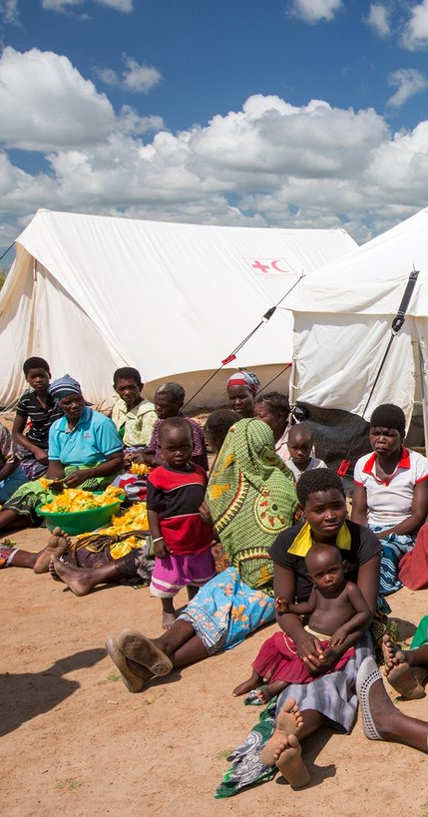
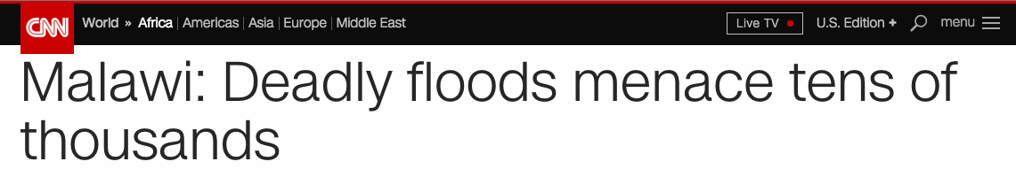
Southern Africa Floods, 2015
South Africa
63,000 ha flooded
400,000 people displaced
48,000 tons food production loss (expected)
616,000 needed food assistance
160,000 still in temp shelters (April 2015)

Slide 5
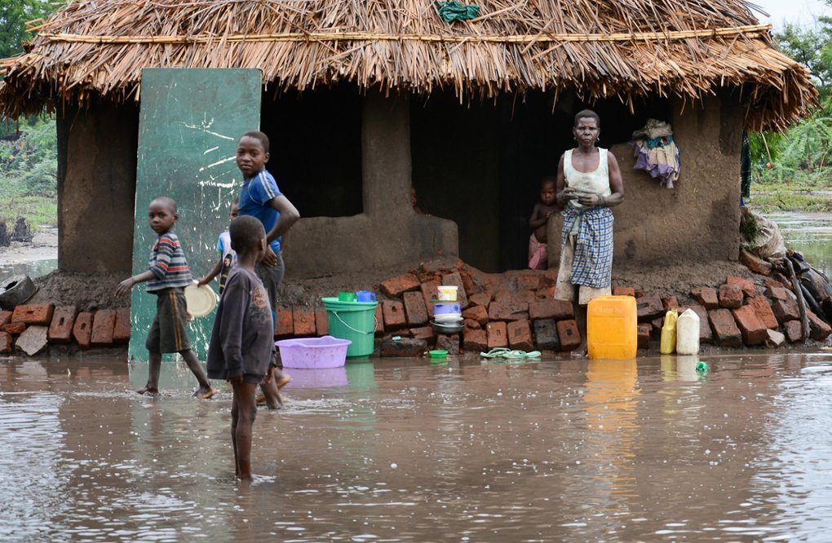
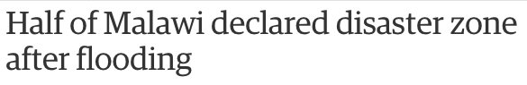
Malawi Floods, 2015
Malawi
300 dead/missing
700 injured
230,000 people displaced
638,000 people affected

Slide 6
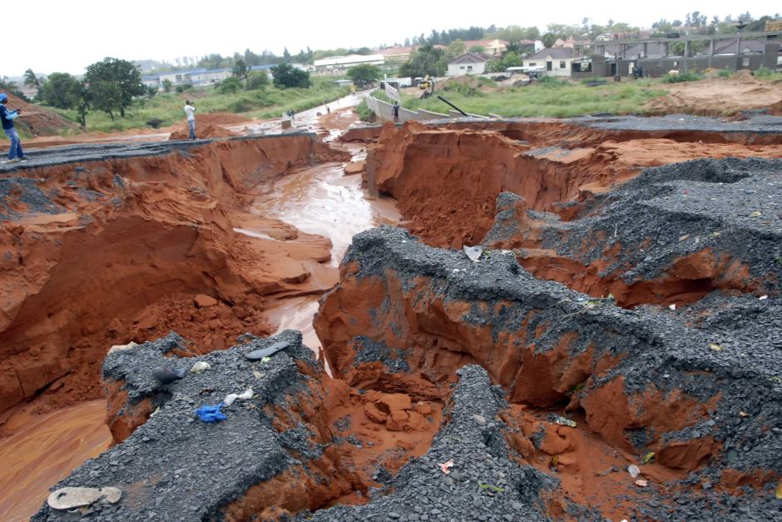
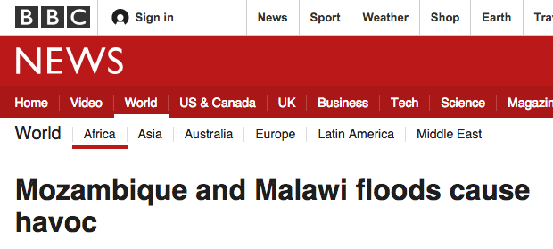
Southern Africa Floods, 2015
Mozambique
Tropical Storm Chedza
54,792 people displaced
4,430 houses destroyed
3,442 houses flooded
$40 million in damages
80 killed

Slide 7
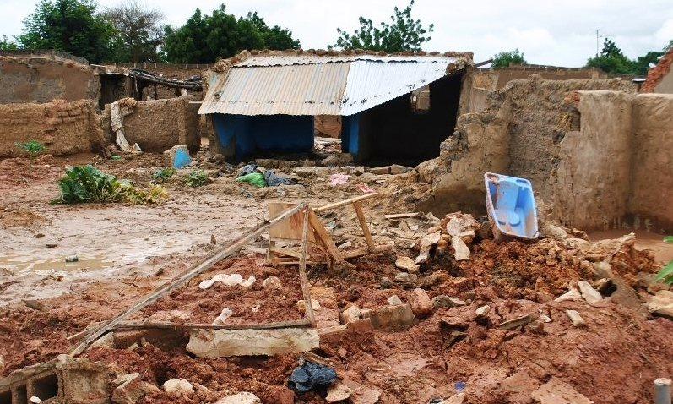
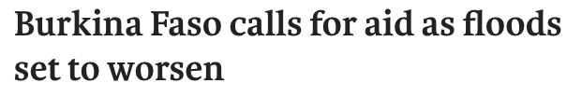

West Africa Floods, 2015
Burkina Faso
20,000 people affected
3,700 homeless
64 tons cereal harvest lost

Slide 8
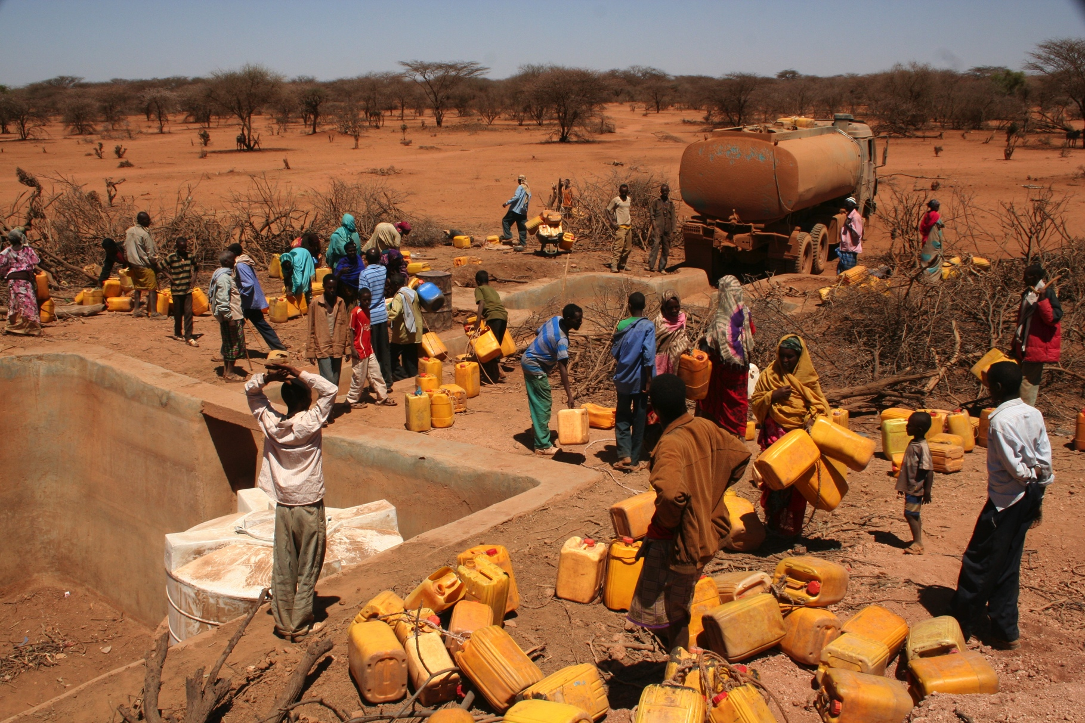
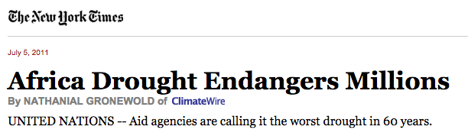
Eastern Africa Drought, 2011
Kenya, Somalia, Ethiopia, Eritrea, Djibouti
Worst drought in 60 years
50-100,000 died from famine
Mainly children under five

Slide 9
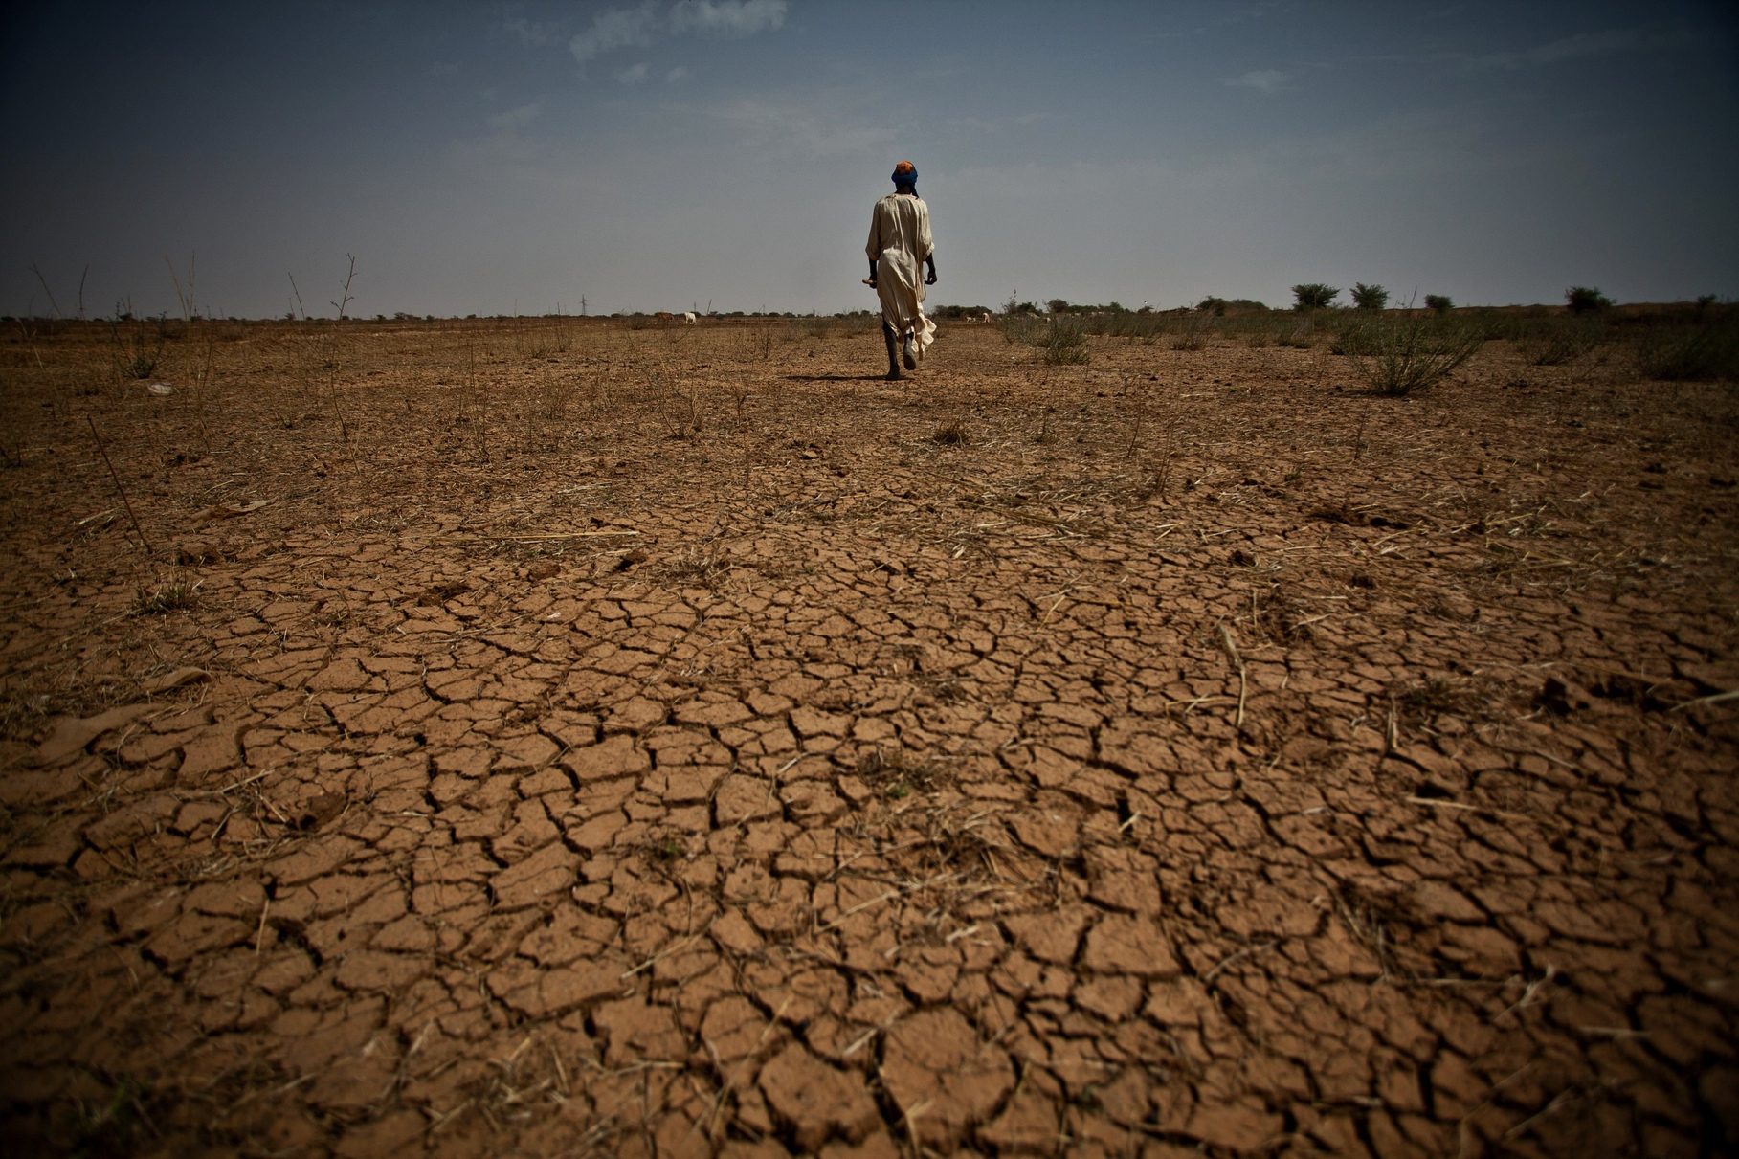
Ethiopian Drought (today)
75% of harvests lost
1 million livestock lost
10-15 million people in need of emergency food assistance
430, 000 children at risk of severe malnutrition
Risk of political and economic disaster

Slide 10
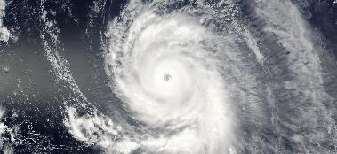
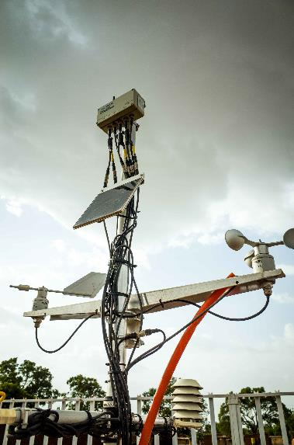
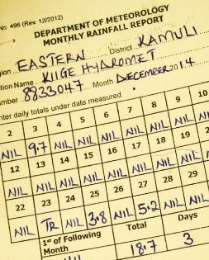
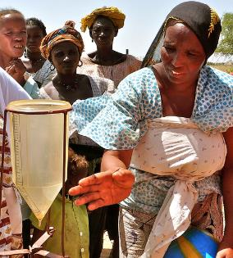
Advancing Climate Resilient Livelihoods
Climate Information
Community radio stations – disseminate info
Solar equipment – expand radio coverage
Farmer training and rain gauges – collect climate data
Mobile phones – local weather forecasts via SMS

Slide 11

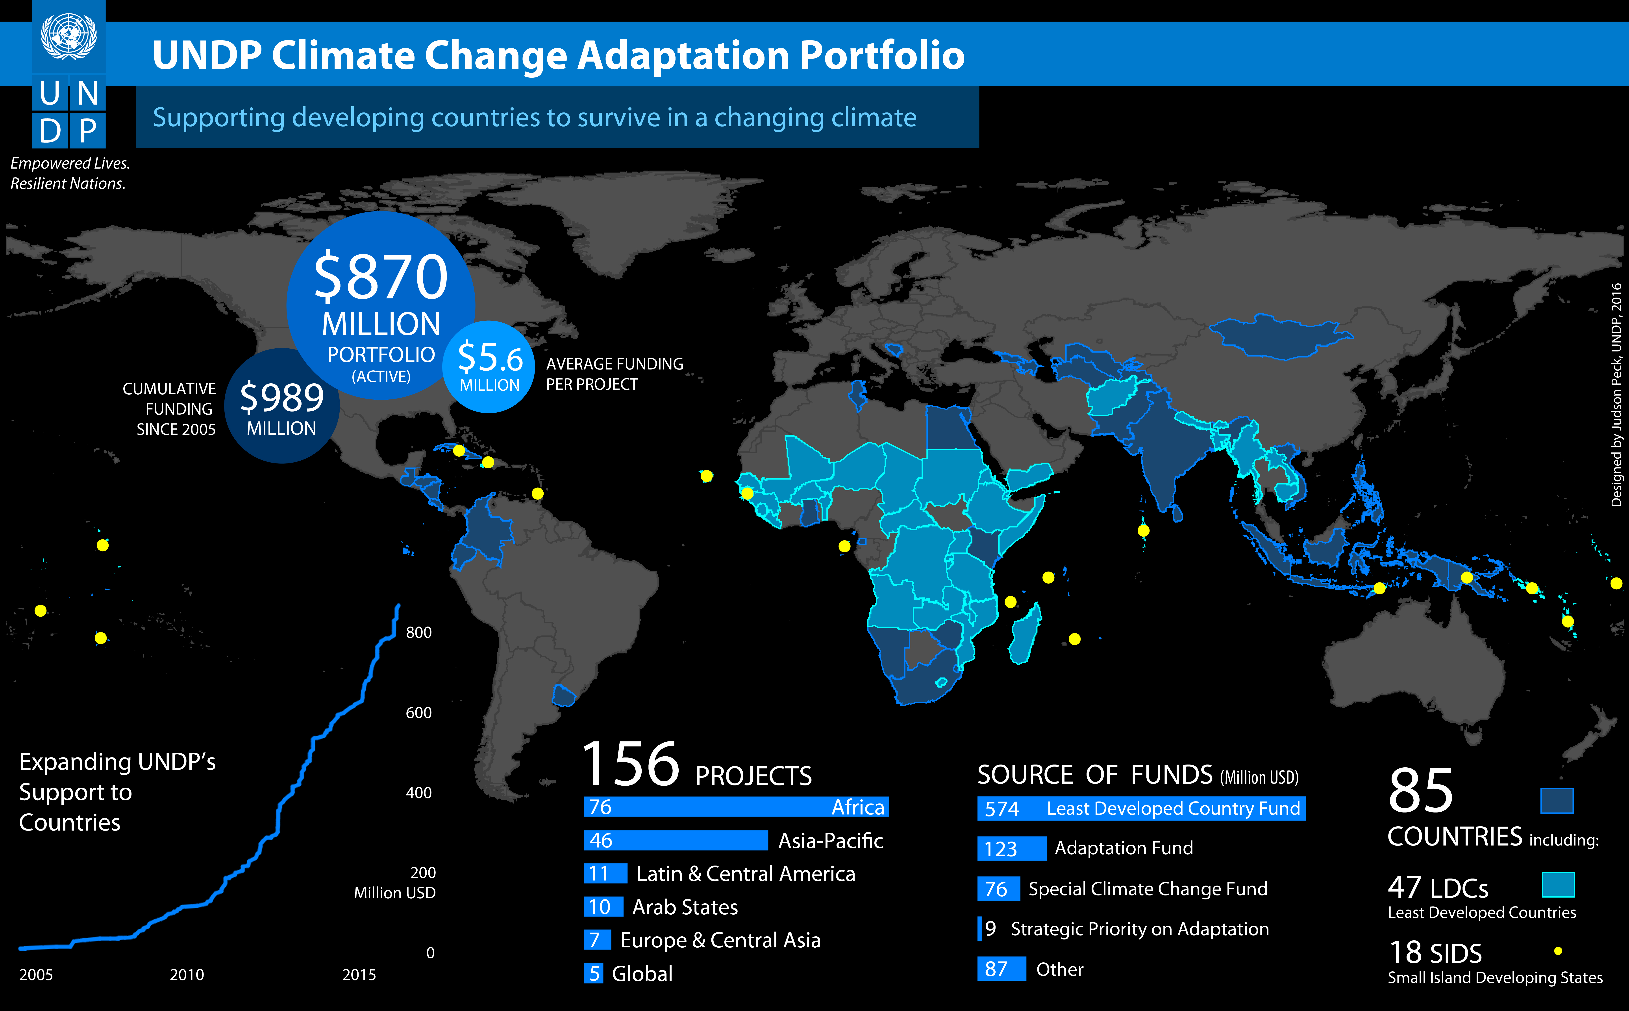
UNDP Climate Change Adaptation Active Portfolio
Supporting developing countries to survive in a changing climate

Slide 12

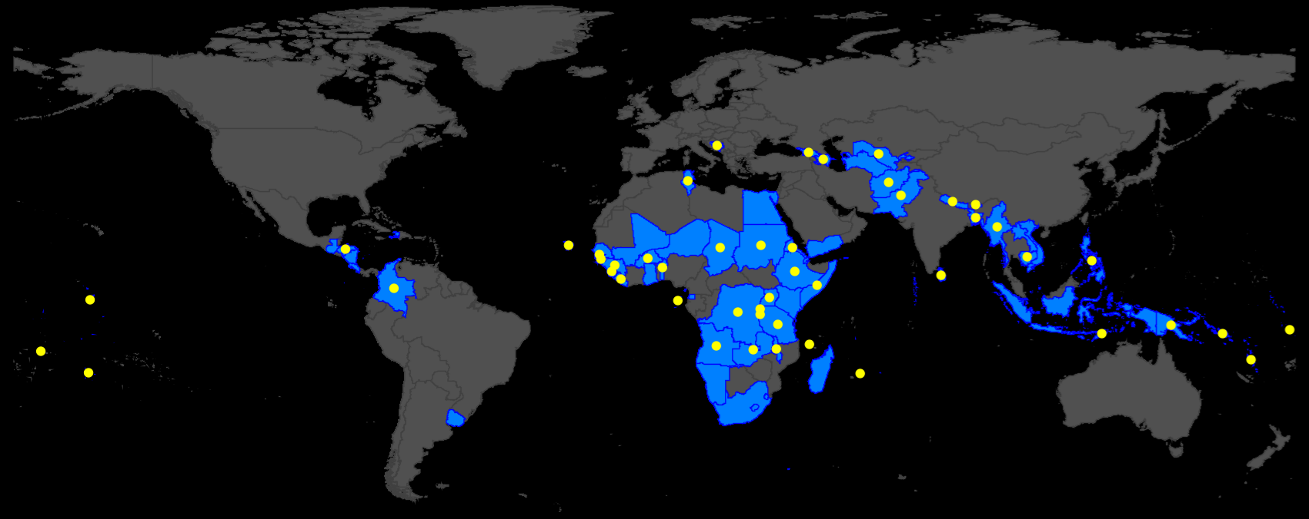




Climate Information Around the World
    Weather forecasts
    Climate projections
    Early Warnings
    Data processing/dissemination
    Technology transfer
    Capacity building
    Private sector engagement
Empowered lives.
Resilient nations.
Partners
Global
Environment
Facility
Green Climate
Fund
Adaptation
Fund
Canada
Climate Information in 75 countries
67 Early Warning Systems
$694
Million Portfolio
Notes:
Improving weather and seasonal climate forecasts, climate change projections
Tailoring advisories/bulletins/warnings for communities and users
Data processing - combining climate, satellite and vulnerability information to assess risk
Information dissemination and collection using mobile phones, TV and radio
Technology - lower cost AWS for reduced O&M, lightning detection alternatives to radar
Private sector - selling climate/weather services and public-private partnerships for O&M
*Shaded map area reflects climate info and DRR

Slide 13
Climate Information is a necessary ingredient for supporting adaptation
However, it alone is not sufficient

Slide 14
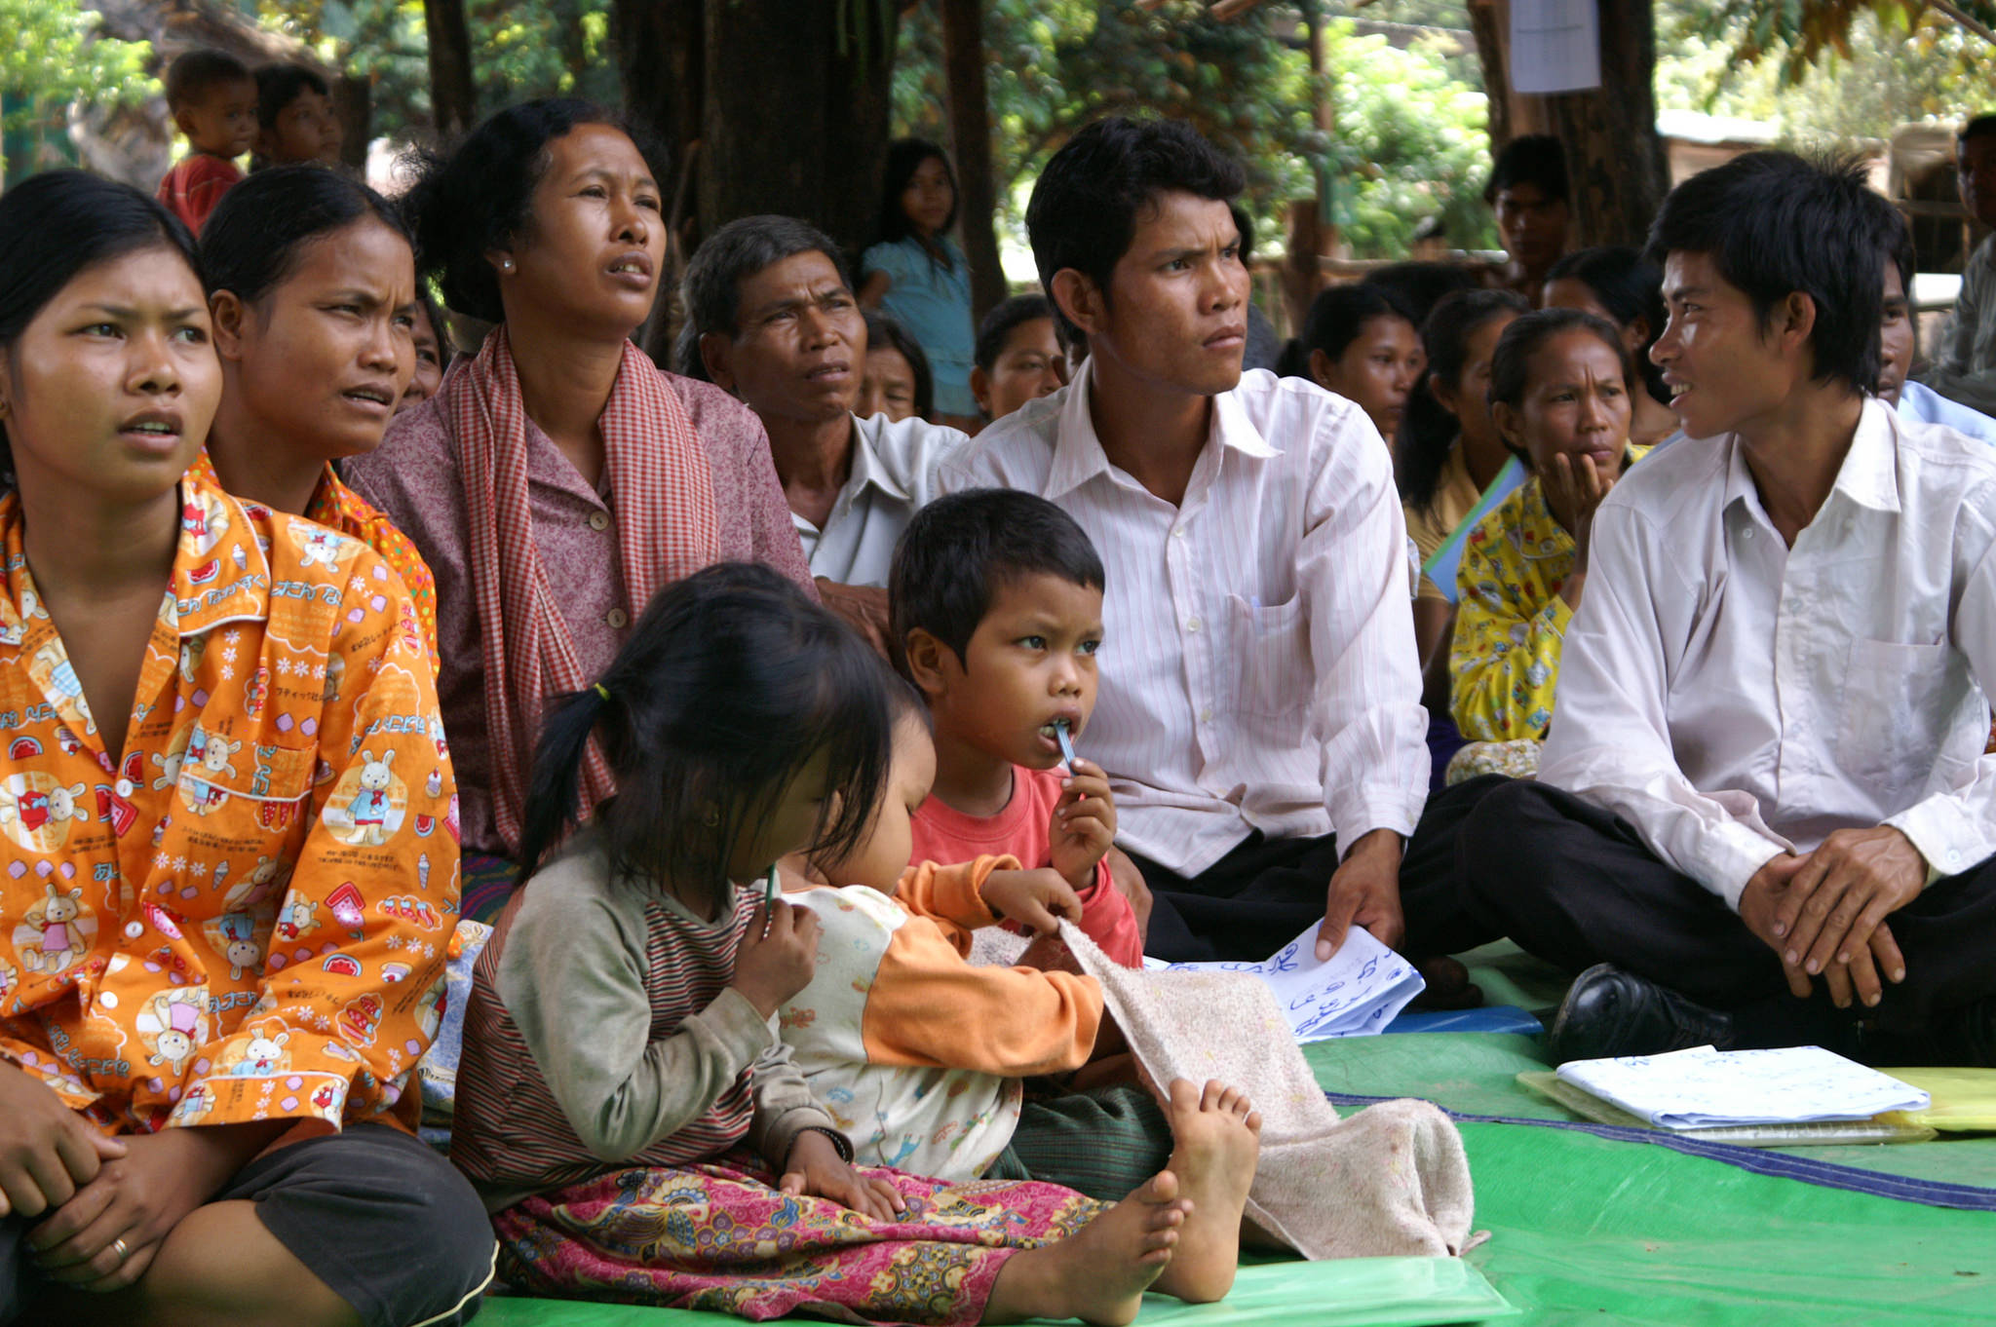
The Last Mile of EWS
Last Mile
Connects telecommunication networks (EWS) to end-users (local communities)
Final, most crucial stage of EWS
Reaches most vulnerable and those that face highest risk
Delivers timely, accurate and actionable weather and climate information from data collection and creation sources across the “Last Mile” to vulnerable end-users
Notes:
Stress that the ‘last mile’ is usually not a one-way process (the GLOF is perhaps the only example of a one-way process).
It involves discussions with end-users to understand their needs and revisiting the content and dissemination mechanisms based on those discussions

Slide 15

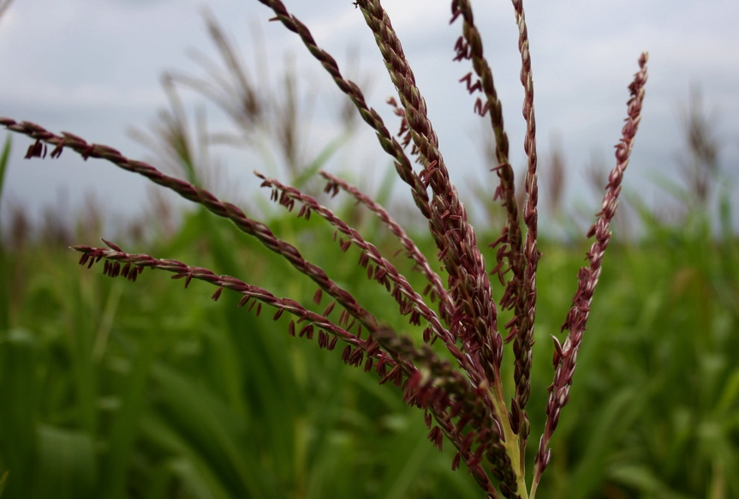
Cambodia – Drought/Flood
Information is not knowledge
facts ≠ understanding
Notes:
Uptake of early warning information is dependent on non-climatic factors e.g. access to seeds etc.
i.e. adaptation options need to be available/possible in order to consider using the information in the first place.
Use of low–tech solutions e.g. sirens, need to be part of a suite of communication options – don’t rely on one form of communication or high tech alone, have redundancy.

Slide 16
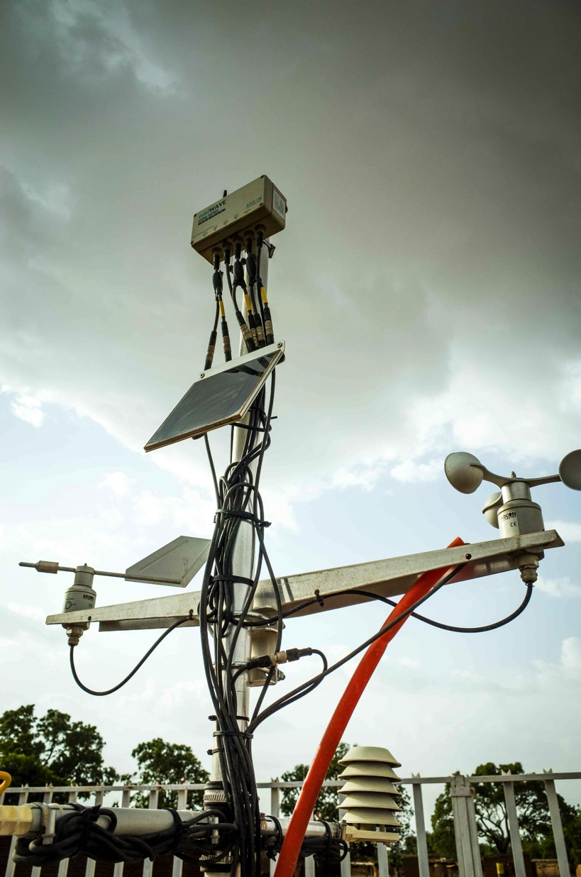
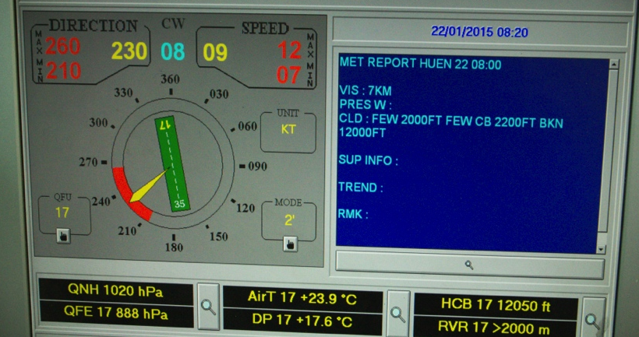
Ensuring Effective Communication
Timely, accessible, understandable, and actionable
Tailored to time and space scales that are relevant to users in various sectors
Utilize a combination of technologies—mobile telecommunications, radio, TV and internet
Function effectively within local capacities and constraints—often limited human, technical, and financial resources
Involve communities in the design, operation and maintenance of system—develop a sense of ownership
Review the quality, frequency and dissemination of data to improve system
Mix of high-tech and local resources
Mix top-down and bottom-up approaches
Notes:
This is really a summary slide of what you are going to emphasise in the following slides.
Stress that effective communications are at the heart of any EWS or climate information system:
Communications include both data sharing & communications with end users

Slide 17
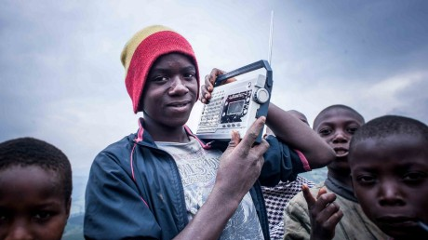
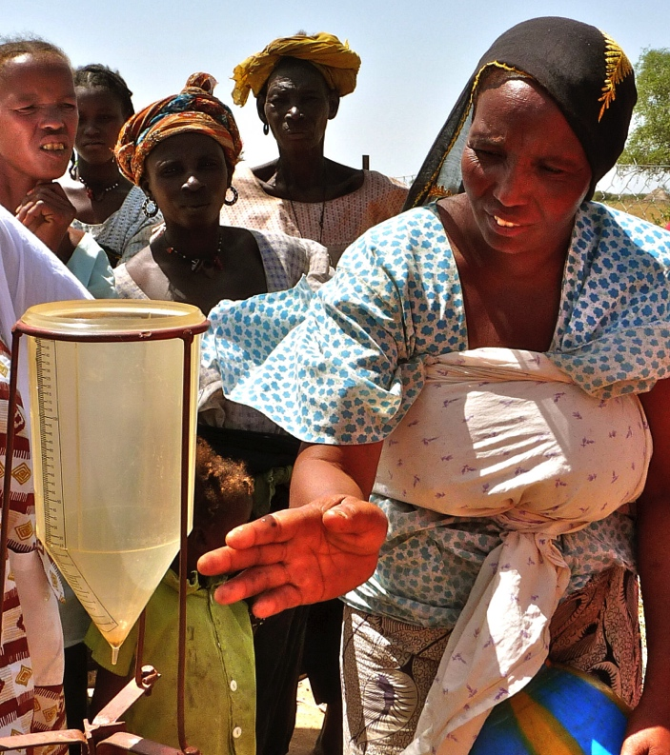
Niger – Weather Forecasts
Community Radio Stations
Educate and warn, uses existing modes of communication
Broadcast awareness campaign on climate risks
Tailor information – farmers, pastoralists, women
Translated in 5 national languages
Equipment extends radio coverage in rural areas
Train staff to maintain equipment
Community Involvement – Data Collection
Farmer training and rain gauges strengthen data collection
Advice on amount of rain needed to sow crops
Preparedness
Farmers use information to adjust agricultural practices:
  Grow drought-resilient varieties
  Diversify crop types
  Adjust planting dates
Exploring opportunity to use mobile phones to transmit local weather forecasts via SMS
Notes:
Important to emphasise:
Translation into 5 local languages essential
Community involvement in collecting data – develop sense of ownership and interest in climate information

Slide 18
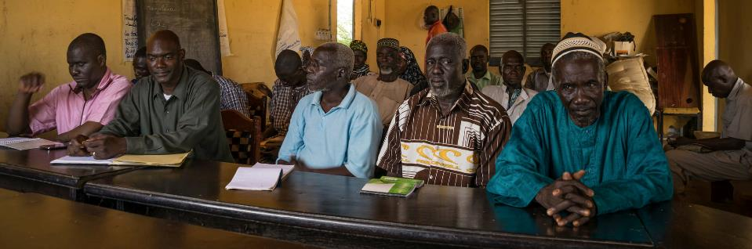
Supporting Integrated Climate Change Strategies
Assisting governments to develop and strengthen policies, institutions, capacities and knowledge
National Adaptation Plans (NAPs)
Identify priority activities to adapt
National Adaptation Plans of Action (NAPAs)
Implementation of projects to reduce
economic and social costs of climate change
Institutional framework to mainstream adaptation into development planning at national and local levels

Slide 19
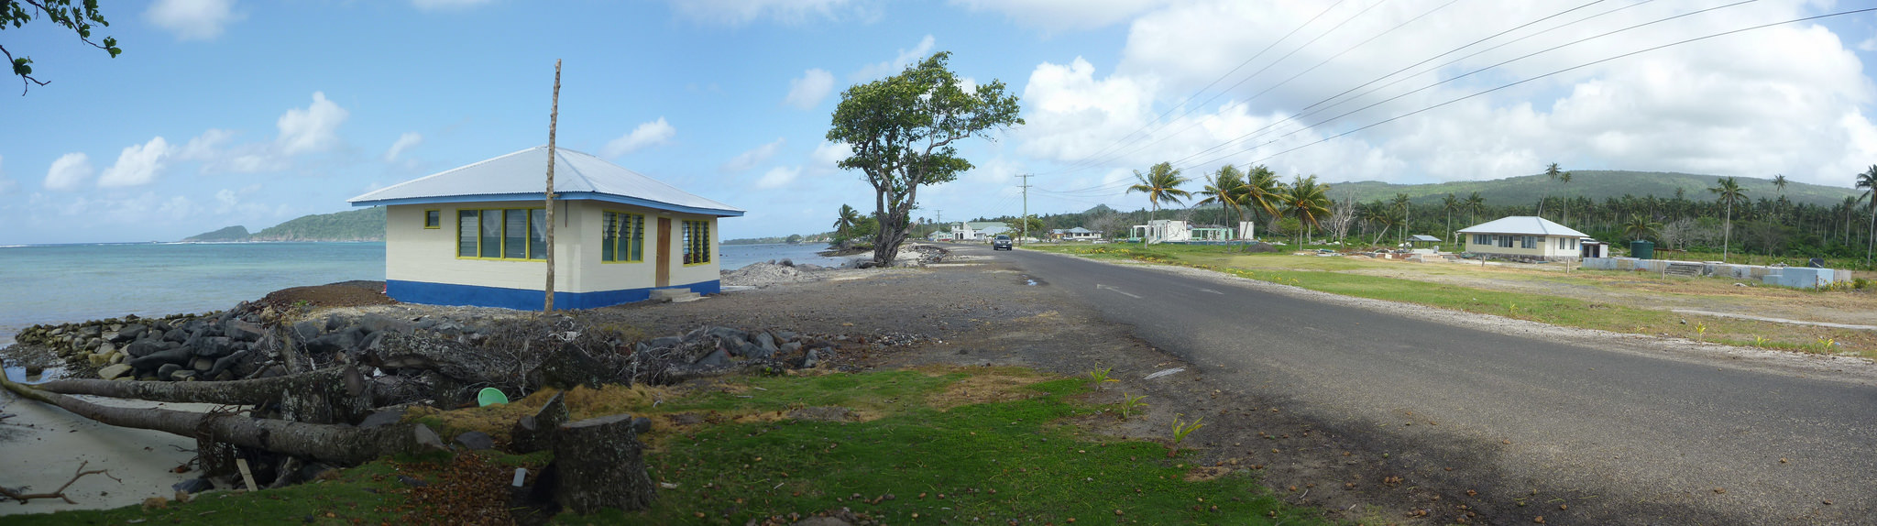
Knowledge as the ability to recall data or information.
Comprehension is understanding. The ability to translate, interpolate, or interpret and restate in one's own words is comprehension.
Application, which is the ability to apply something that was learned in a new and different scenario.
Bloom (1956)

Slide 20

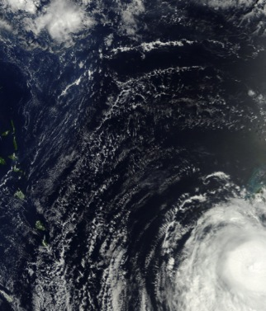
Approach to EWS Early Warning Systems
1
Build Services
Ensure people receive climate info
Challenges
equipment
resources
baseline data
technology
support
cooperation
2
End to End Approach
Identify gaps – find solutions
3
Promote Innovation
Lower-cost technology
Notes:
Challenges
Poor status of equipment
Limited operational budgets and human resources
Lack of baseline data, need to digitize
Reluctance to utilize innovative technologies and software
Inconsistent/inadequate technical support from external sources
Absence of regional cooperation

Slide 21

Climate Information Lessons Learned
Empowered lives.
Resilient nations.
No ‘one-size fits all’
Adapted for each country
Mixture of low-cost community-based EWS and national systems
Different
Information needs
Country context
Baseline infrastructure
Existing capacity
Climate Info & EWS
One component of a suite of resilient actions
Multiple communication channels to ensure redundancy
Notes:
No ‘one-size fits all’
Technologies and approach need to be adapted for each country. Links to different communities. Bottom up considerations.
Different
Information requirements, Country context, Baseline infrastructure, Existing capacity
Climate information & EWS
Usually one component of a suite of resilient actions. Needs to be appropriately contextualized and incorporated into local decision making approaches.

Slide 22
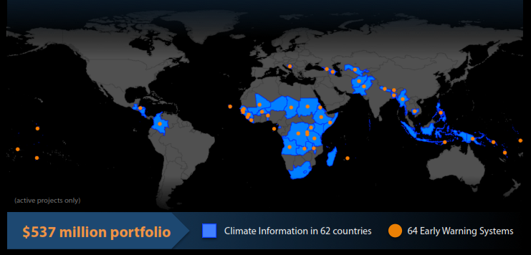


For further information, please contact:
Pradeep Kurukulasuriya
Head - Climate Change Adaptation
Bureau for Policy and Programme Support (BPPS)
United Nations Development Programme
Visit: www.adaptation-undp.org
Empowered lives. Resilient nations.

