Slide 1
UNDP CIRDA Country Program Managers Workshop
25-27 August 2015
Addis Ababa, Ethiopia
Reports from Strengthening National Climate Information/ Early Warning System (CI/EWS) Projects
BENIN
Dr-Ing. Arnaud ZANNOU
Benin CI/EWS Project Expert
Notes:
Instructions: Complete items in red italics

Slide 2
Benin Delegates
N° | Name | Occupation
1 | Dr Léonce DOVONON | Deputy Director of EWS-Project : Project management and coordination
2 | Mr Isidore AGBOKOU | Team Leader Sustainable Development and Inclusive Growth at UNDP CO : in charge of EWS-Project, Focal Adviser for Project implementation
3 | Dr-Ing. Arnaud ZANNOU | Expert in Climate Information and EWS : Provide technical advices and supports to National Director of Project and to UNDP CO Team Leader
Notes:
This slide and the two that follow are intended to help you make three slides per Department/Agency.
This effort will result in a stack of slides that cover your nation’s government agencies that are relevant to the accomplishing the objectives of the CIRDA program. You should have contacts in all these agencies. E.g., National Meteorological Service, Ministry of the Environment, Ministry of Agriculture/Ag Met Extension Program, Ministry of Water, Ministry of Emergency Management.
Do NOT make the slides too detailed. Focus on high-level, big-picture items.

Slide 3
Project accomplishments and progress at date
N° | Completed activities or obtained results
1 | Meteo, hydro and oceano equipments providers already contracted, delivery on going and incoming installation, rest is IT equipments (Server)
2 | Capacity building in EWS implementation at Kenya and Netherlands, set-up of National Inter-agencies Committee for hydro-climate forecasting and warning with 4 agencies, day-by-day manual monitoring river water level and flooding warning issuing in 2014 and 2015
3 | Implementation of both technical and institutional framework (chaired by Prime Minister) for carry-up economical modelling of climate change and his integration into Country Budget Law.
4 | Elaboration, scattering and popularization of seasonal agro-hydro-climate national forecasts towards farmers and water managers
5 | Implementation of SOP for warning bulletin communication and diffusion with National Disaster Management Agency
6 | Identification of climate products needs and opportunities for private sector
7 | Project global delivery at date = 61% ( including equipments procurement in process)
Notes:
This slide and the two that follow are intended to help you make three slides per Department/Agency.
This effort will result in a stack of slides that cover your nation’s government agencies that are relevant to the accomplishing the objectives of the CIRDA program. You should have contacts in all these agencies. E.g., National Meteorological Service, Ministry of the Environment, Ministry of Agriculture/Ag Met Extension Program, Ministry of Water, Ministry of Emergency Management.
Do NOT make the slides too detailed. Focus on high-level, big-picture items.

Slide 4
Procurement process in 13 steps by 22 months
N° | Date | Activities | Results
1 | Dec. 2013 | Support from UNDP-GEF by International Consultant Joseph INTSIFUL | 1st draft of technical specifications for standard meteo and hydro equipments
2 | Feb. 2014 | Sites identification mission by national agencies | Equipment list and type need for EWS available per site
3 | March 2014 | Taking into account of deployed equipments in the framework of others projects (synergy with World Bank PUGEMU initiative, French IRD AMMA-CATCH project and NAPA project (UNDP-GEF) | List of equipments to be acquired
4 | April 2014 | Taking to account of lessons learned and issued remarks from visits completed in Kenya and Netherlands, and exchanges with providers (CIRDA launching meeting here in Addis Ababa) | Finalization of equipment specifications
5 | May 2014 | Contact with WMO for advising us on technical specifications (without response) | Design of ITB draft by project team
Notes:
This slide and the two that follow are intended to help you make three slides per Department/Agency.
This effort will result in a stack of slides that cover your nation’s government agencies that are relevant to the accomplishing the objectives of the CIRDA program. You should have contacts in all these agencies. E.g., National Meteorological Service, Ministry of the Environment, Ministry of Agriculture/Ag Met Extension Program, Ministry of Water, Ministry of Emergency Management.
Do NOT make the slides too detailed. Focus on high-level, big-picture items.

Slide 5
Procurement process in 13 steps by 22 months
N° | Date | Activities | Results
6 | July 2014 | Analysis and amendments of ITB draft by CO Procurement Unit | Improved ITB
7 | August 2014 | Submission of draft ITB to UNDP HQ for advice | ITB submitted for validation
8 | Sep. 2014 | Integration of comments and amendments of UNDP HQ and final OK obtained | Final ITB to be published
9 | Oct. 2014 | Publication of ITB at international level | Proposals from providers OK
10 | Nov-Dec. 2014 | Selection of providers and report to UNDP HQ for advice | Proposals analysis report available
11 | February 2015 | Approval of UNDP HQ obtained | Purchase Order (PO) issuing
12 | March 2015 | Placing Order delivering to selected providers | Order on going
13 | July-Oct. 2015 | Equipments delivery, installation et set-up on going | Complete installation and set-up OK
Notes:
This slide and the two that follow are intended to help you make three slides per Department/Agency.
This effort will result in a stack of slides that cover your nation’s government agencies that are relevant to the accomplishing the objectives of the CIRDA program. You should have contacts in all these agencies. E.g., National Meteorological Service, Ministry of the Environment, Ministry of Agriculture/Ag Met Extension Program, Ministry of Water, Ministry of Emergency Management.
Do NOT make the slides too detailed. Focus on high-level, big-picture items.

Slide 6
Main involved Departments/Agencies
Climate info and warning producers
Warning bulletins Users
(Disaster and crisis focus)
Climate info Users (Development sectors managers and actors)
Development partners
Water Depart.
Disaster Mg Agency
CC Depart.
UNDP
Meterolog. Depart.
Disaster Committee
Environm. Depart.
GEF
ASECNA
Hum. NGO
Subst. Dev. Centre
Ocean Institute
UN System
Env-Clim. NGO
Notes:
This slide and the two that follow are intended to help you make three slides per Department/Agency.
This effort will result in a stack of slides that cover your nation’s government agencies that are relevant to the accomplishing the objectives of the CIRDA program. You should have contacts in all these agencies. E.g., National Meteorological Service, Ministry of the Environment, Ministry of Agriculture/Ag Met Extension Program, Ministry of Water, Ministry of Emergency Management.
Do NOT make the slides too detailed. Focus on high-level, big-picture items.

Slide 7
Contribution of each Department/Agency
UNDP-GEF (Technical and financial support)
Disaster Manag. Agency → +++
Disaster warning focus + 3 staffs + USD 20,000
Water Depart. → +++++
Project Management + hydro focus + 6 staffs + USD 130,000
Sust. Dev. Centre → +++
Climate info integration into sust. Dev focus + 3 staffs + USD 30,000
Met Office → ++++
Meteo focus + 4 staffs + USD 50,000
Clim. Chang. Depart. → ++
Climate info focus + 1 staff + USD 20,000
Hum. NGO → ++
Disaster warning focus + 2 staffs
Env-Clim. NGO → ++
CC integration into development + 2 staffs
Ocean Institute → +++
Oceano focus + 3 staffs + USD 26,200
Final beneficiaries = Population
Notes:
This should be a list of agencies (see previous slide) followed by a (brief) listing of the major contributions of services, technology, or other resources they have provided or will provide to the CiRDA program. Don’t try to list everything, just the major or unique resources – people, data and information products, funds, equipment, facilities, etc...

Slide 8
Contribution of each member of Forecasts and Warning Inter-Agengy Committee (CIPA)
UNDP-GEF (Financial and Technical Support)
Hydrological Department
Hydro Data + River flooding Warning
Meteo Department
Meteo data + Rain Flooding, Drought and Severe wind warning
University
Modelling and scientific expertise on all hydro-climate risks
WARNING
Disaster Manag.Agency
C I
P A
Oceanography Institute
Oceano data + coastal erosion and sea level rising warning
Final Beneficiaries = Population
Notes:
This should be a list of agencies (see previous slide) followed by a (brief) listing of the major contributions of services, technology, or other resources they have provided or will provide to the CiRDA program. Don’t try to list everything, just the major or unique resources – people, data and information products, funds, equipment, facilities, etc...

Slide 9
Ground Measurement
Data
Information
Warning

Slide 10
Information System of Early Warning System in Benin
Ground measurements
Respectively 50, 80 and 100 mm of rainfall on 3 nearest points from a same rainfall event
Data
Average rainfall observed is 70 mm on this area
What means 70 mm of rainfall in terms of flooding in this area ???
Information
In case of confirmed flood threat or disaster prediction
Warning

Slide 11
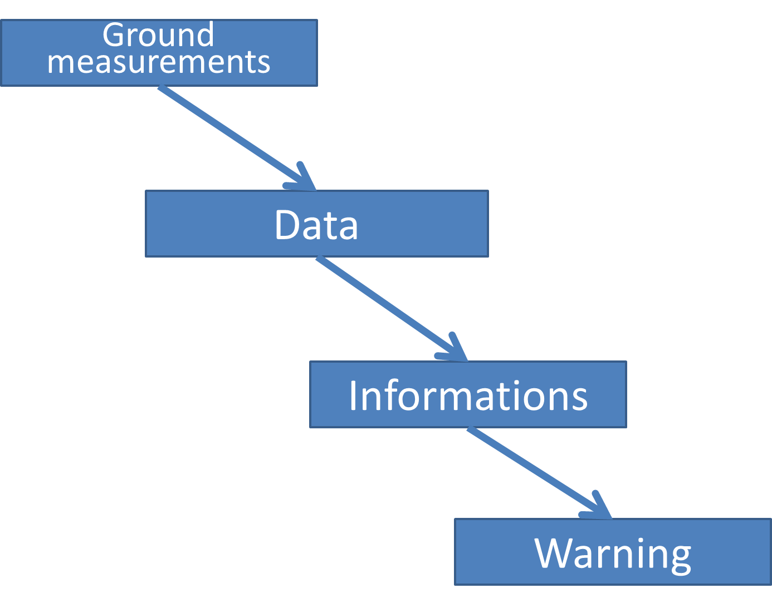
Information system of Early Warning System in Benin
WARNING LEVELS
 | GREEN : Monitoring (by automatic stations)
 | YELLOW : Vigilance (by forecasters)
 | ORANGE : Alert (by disaster managers)
 | RED : Crisis management (all stakeholders)

Slide 12
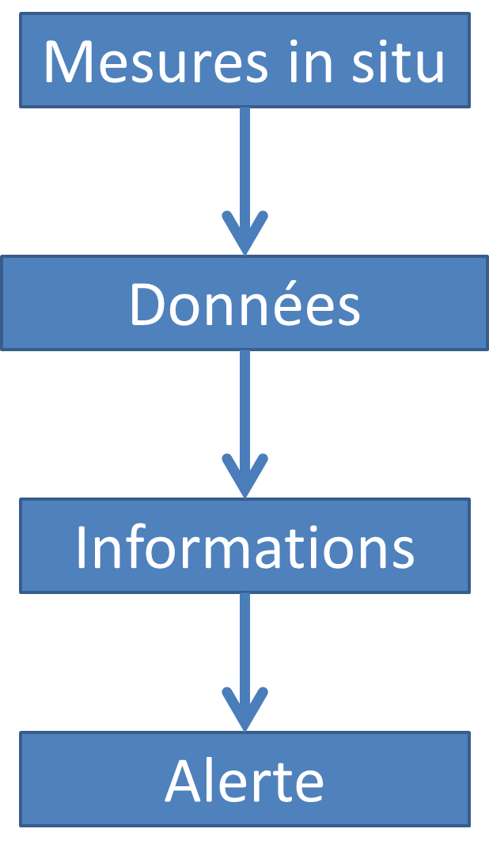
Manual reading
Manuel SMS
Automatic measurement
SMS via GPRS
Moov , MTN
SMS via GPRS
Moov , MTN
SMS via GPRS
Moov , MTN
EWS Central Server (located at Akpakpa)
Specific APN by
Moov , MTN
Specific APN by
Moov , MTN
Specific APN by
Moov , MTN
Local server at Met. Depart.
Local server at Hydro. Depart.
Local server at Ocean Institute
Free to Agency
Free to Agency
Free to Agency
Utilization and Diffusion
Utilization and Diffusion
Utilization and Diffusion

Slide 13
EWS Central Server (located at Akpakpa)
Measurement controle process
Valid measure
Invalid measure
Specific APN by Moov, MTN
SMS/mail to EWS staff
Specific APN by Moov, MTN
Intervention by EWS staff
correction/validation
Valid data
Specific APN by Moov, MTN
Local server at Met/Hydro/Oceano Agency
Free to Agency
Utilization and Diffusion

Slide 14
EWS Central Server (located at Akpakpa)
Process and compilation of all needed data
Observed discharge, discharge or water level forecasts for n-days, Observations and forecasts graph, etc…
Specific APN by
Moov , MTN
Customized climate Products and information services to requester on contract order
Local server hosted by Agency
Free to Agency
Internet
Utilization and Diffusion
Subscribers or customers

Slide 15
EWS Central server (located at Akpakpa)
Critical information detected by server (flooding, drought, severe wind, coastal erosion and sea level rising)
Human interpretation and warning bulletin issuing if necessary (CIPA)
Specific APN by
Moov , MTN
Specific APN by
Moov , MTN
Local server hosted by Agency
Local DeskTop in Disaster Mg.
Warning orders issuing
Libre à l’Institution
Internet, Téléphone …
Utilization and Diffusion
SOP set-up by Minister of Interior or related Authorities

Slide 16

Chart of SOP:
Standard Operating Protocol for warning messages communication and diffusion in case of hydroclimate disaster in Bénin

Slide 17
Main involved governmental agencies
President
Minister of Water
Minister Transports
Minister Sci. Reseach
Minister of Interior
Prime Minister
Minister of Clim. Chang.
Minister Agriculture
Water Office
Meteo Office
ASECNA
Research Centre
Disaster Manag. Ag.
Sust. Devel. Centre
Clim. Chang. Office
Environm. Office
Agro Info Diffusion Ag
Hydro Dep.
Observation Dep.
Forecasting Centre
Ocean Institute
Prevention Départ.
Sust. Dev. Dep.
Climate Info Depart.
Env. Risks Depart.
Diffusion Dep.

Slide 18
Technical Attributes and Financial Support of each Agency
Agency | Technical Attributes | Commercial capability | Financial support from Country and Partners | Financial support from private sector
Water Office | Hydro and water quality | yes | 98% | 2%
Meteo Office | Météo | yes | 90% | 10%
Ocean Institute | Océano monitoring | No | 100%
Disaster Manag. Agency | Disaster and Crisis | No | 100%
Climate Change Department | Climate Change management | No | 100%
Sustainable Dev. Centre | Partnership and sustainable Dévelopment | No | 100%
Environmental Depart. | Environmental managment | No | 100%
Farmers Info Depart. | Training and dissemination | No | 100%
Humanitarian NGO | Assistance in case of disaster | No | 100%
Env.-Climate NGO | Environmental Protection | No | 100%
Notes:
This should be a list of agencies (see previous slide) followed by a (brief) listing of the major contributions of services, technology, or other resources they have provided or will provide to the CiRDA program. Don’t try to list everything, just the major or unique resources – people, data and information products, funds, equipment, facilities, etc...

Slide 19
Provided services by each agency
Agency | Technical Attributes | Used Technologies | Service capacity of equipment | Partership with others agencies
Water Office | Hydro monitoring, water quality, IWRM, research | Limnigraph, Laboratory, piezo sensor | Good | Met Office, Disaster Mg. Ag., NGO
Meteo Office | Meteo forecasting, aviation | AWS, Satellite | Good | Water Office, ocean Institute and Disaster Ag.
Ocean Institute | Oceano monitoring, fisheries, research | Erosion control, pressure sensor, multiparameter | Fairly Good | Water office
Disaster Manag. Agency | Prevention/manag. of Disaster |  |  | Met Office, Water Office and NGO
Climate Change Depart | Climate Change management | AWS | Fairly Good | NGO
Sustainable Dev. Centre | Partnership and sustainable Dév.
Environmental Depart. | Environmental managment | Air quality survey station | Fairly Good | NGO
Farmers Info Depart. | Farmers training and dissemination
Humanitarian NGO | Assistance in case of disaster |  |  | Disaster Manag. Agency
Env.-Climate NGO | Environmental Protection |  |  | Clim. Chang. And Env. Deps.
Notes:
This should be a list of agencies (see previous slide) followed by a (brief) listing of the major contributions of services, technology, or other resources they have provided or will provide to the CiRDA program. Don’t try to list everything, just the major or unique resources – people, data and information products, funds, equipment, facilities, etc...

Slide 20
Social and economic impact
Development sector | Type of data or info required | Utilizations | Access mode to info and data
Agriculture | Meteo et flooding/drought warning | Early crop, farming calendar | Radio, TV, Internet, MetOffice, CIPA
Livestock | Meteo et flooding/drought warning | Animals moving to unaffected areas | Radio, TV, Internet, MetOffice, CIPA
Fisheries | Meteo et severe wind or rough sea warning | Making decision to go on water or not | Radio, TV, Internet, MetOffice, CIPA
Disasters and Crisis | Hydro meteo warning | Information et aid to population | Radio, TV, Internet, Cell Phones, NHMS, CIPA
Bank/Insurance | Meteo, hydro and warning | Climate risk insurance
Hostelry/Tourism | Meteo et severe wind or rough sea warning | Touristic agenda adapted | Radio, TV, Internet
Civil engineering | Meteo | Work planning adapted
Transports | Meteo, hydro and warning | Making decision to close some pists ou roads | Radio, TV, Internet
All sectors | All data or information | Integrated modelling of CC impacts | Met, Water, Ocean and CIPA
Notes:
This should be a list of agencies (see previous slide) followed by a (brief) listing of the major contributions of services, technology, or other resources they have provided or will provide to the CiRDA program. Don’t try to list everything, just the major or unique resources – people, data and information products, funds, equipment, facilities, etc...

Slide 21
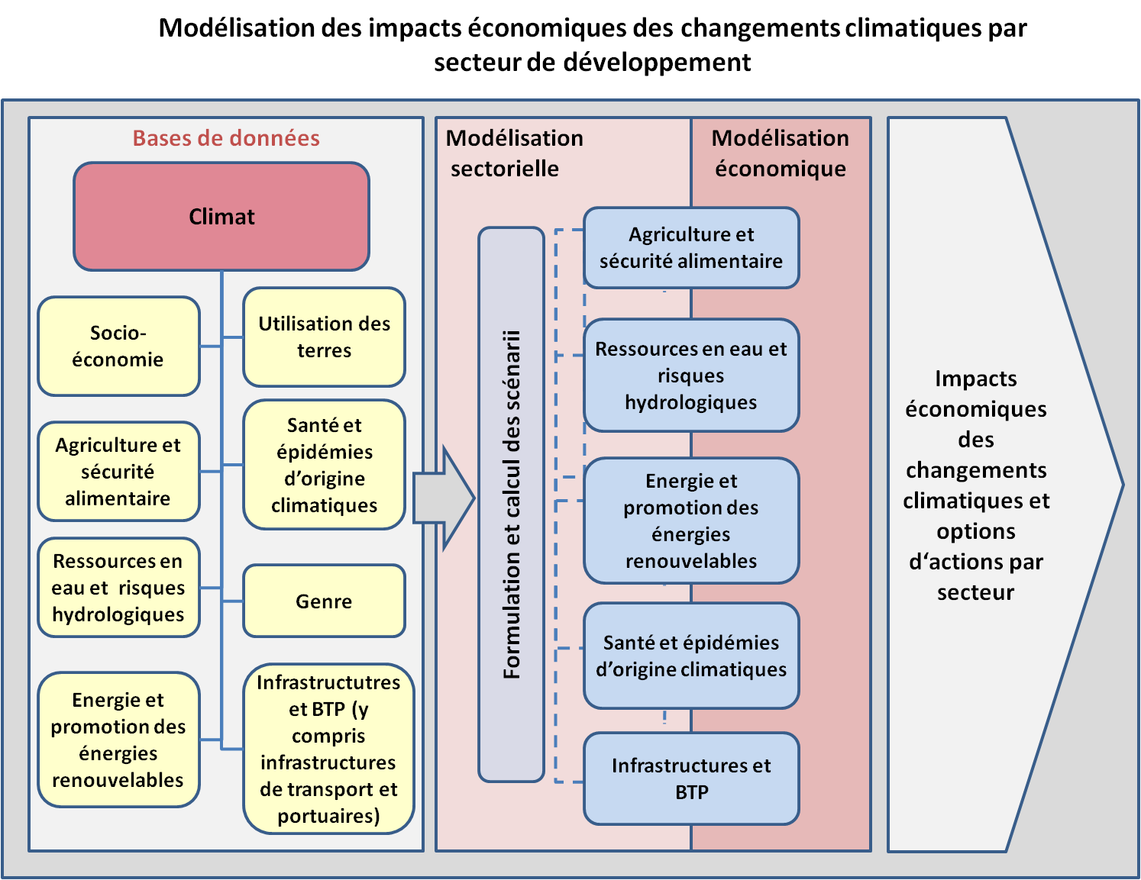
National technical framework forcapitalization of EWS climate data and information
Notes:
This should be a list of agencies (see previous slide) followed by a (brief) listing of the major contributions of services, technology, or other resources they have provided or will provide to the CiRDA program. Don’t try to list everything, just the major or unique resources – people, data and information products, funds, equipment, facilities, etc...

Slide 22
Issues and Success …
A lot of data to produce, manage, use and capitalize : new issue that require an appropriate capacity development
Success factors :
    Inter-agencies and inter-projects synergy upon project launching
    2 study missions to learn from EWS existing in others countries
    National (governmental) leadership Development in early way
Notes:
This should be a list of agencies (see previous slide) followed by a (brief) listing of the major contributions of services, technology, or other resources they have provided or will provide to the CiRDA program. Don’t try to list everything, just the major or unique resources – people, data and information products, funds, equipment, facilities, etc...

Slide 23
Ongoing or incoming actions
Ongoing Initiative :
  PUGEMU Project (World Bank) to develop an grassroot EWS and reinforce meteo and hydro observations network
  Mekrou Project (EU) to promote socio-economic development based on water resources well governance taking into climate change
Planned Actions of climate information producer Agencies at short, middle and long term :
  climate products ans services development and commercialization,
  meteo, hydro et oceano observations networks extension,
  data control process improvement.
Notes:
This should be a list of agencies (see previous slide) followed by a (brief) listing of the major contributions of services, technology, or other resources they have provided or will provide to the CiRDA program. Don’t try to list everything, just the major or unique resources – people, data and information products, funds, equipment, facilities, etc...

Slide 24
In Perspective : set up private sector contribution in the framework already established
UNDP-GEF (Technical and financial support)
Disaster Manag. Agency → +++
Disaster warning focus + 3 staffs + USD 20,000
Water Depart. → +++++
Project Management + hydro focus + 6 staffs + USD 130,000
Sust. Dev. Centre → +++
Climate info integration into sust. Dev focus + 3 staffs + USD 30,000
Hum. NGO → ++
Disaster warning focus + 2 staffs
Met Office → ++++
Meteo focus + 4 staffs + USD 50,000
Clim. Chang. Depart. → ++
Climate info focus + 1 staff + USD 20,000
Private sector→ +++
Clim. Info valorization + Financial support to EWS
Env-Clim. NGO → ++
CC integration into development + 2 staffs
Ocean Institute → +++
Oceano focus + 3 staffs + USD 26,200
Final bénéficiaries = Population
Notes:
This should be a list of agencies (see previous slide) followed by a (brief) listing of the major contributions of services, technology, or other resources they have provided or will provide to the CiRDA program. Don’t try to list everything, just the major or unique resources – people, data and information products, funds, equipment, facilities, etc...

Slide 25
For 2016
To complete the development of our EWS by IT equipments and servers procurement and implementation
To develop more the activities regarding data utilization, valorization and capitalization by government agencies, private sector, NGO and farmers including specific studies on economy of adaptation for the key affected development sectors
To Update some national policies and strategic documents for planning of sustainable development.
To Promote as project exit strategy the set-up of National hydro-climate risks forecasting Center based on all EWS equipments and human resources
Notes:
This should be a list of agencies (see previous slide) followed by a (brief) listing of the major contributions of services, technology, or other resources they have provided or will provide to the CiRDA program. Don’t try to list everything, just the major or unique resources – people, data and information products, funds, equipment, facilities, etc...

Slide 26
Thank for your attention !!!
Questions ???
Notes:
This should be a list of agencies (see previous slide) followed by a (brief) listing of the major contributions of services, technology, or other resources they have provided or will provide to the CiRDA program. Don’t try to list everything, just the major or unique resources – people, data and information products, funds, equipment, facilities, etc...

