Slide 1
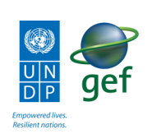
UNDP CIRDA Country Program Managers Workshop
25-27August 2015
Addis Ababa, Ethiopia
Reports from Strengthening National Climate Information/ Early Warning System (CI/EWS) Projects
Sao Tome and Principe
Laurent-Mascar Ngoma
Head of environment and Sustainable Development Unit UNDP/STP
Notes:
Instructions: Complete items in red italics

Slide 2
Reports from Strengthening National Climate Information/ Early Warning System (CI/EWS) Projects
Introduction
Key Implementing agencies
  Agencies identified
  High level contributions
  Social or economic impact
Update on project activities implementation
Future Plan
Opportunities

Slide 3
INTRODUCTION
São Tomé and Príncipe : small island state- 1001 km2. about 200.000 inhabitants
particularly vulnerable to climate-related hazards such as floods, flash floods and storms.
Increasing frequency and severity of flash floods, severe storms (hail, thunder, lightning and violent winds) and drought episodes, and their impacts on sectors such as agriculture, fisheries, as well as infrastructures mostly located in coastal areas have increasingly adverse effects on the development of the country.
Exposure to natural hazards, including those related to climate variability and change, is compounded by the level of poverty of its population: 43.5% of the population in São Tomé and Príncipe live under 1.25USD/ day (2010). A small island developing state, São Tomé and Principe has a Human Development Index value of 0.558 - which is in the medium human development category - positioning the country at 142 out of 187 countries and territories in 2013.

Slide 4
CONT---
The capacity of the country to reduce and manage disaster and climate risk, and to adapt to climate change cannot be decoupled from addressing its socio-economic developmental challenges effectively.
The Government of São Tomé and Príncipe showed willingness and potential to move from a reactive approach to a more proactive risk reduction and adaptation approach.
São Tomé and Príncipe ratified the UNFCCC on 26 September 1996, became signatory to the Kyoto Protocol and submitted its NAPA to the UNFCCC Secretariat in December 2006.
STP is a signatory of the Hyogo Framework for Action (HFA) 2005-2015 and the Sendai Framework for Disaster Risk Reduction (2015-2030), the internationally-endorsed framework for reducing disaster risk.

Slide 5
KEY IMPLENTING PARTNERS
Ministry of Infrastructure,
Natural resources
and Environment
Ministry of Internal
Affairs
Directorate Environment.
Meteo Institute
Gen. Dire. Nat. Resource Energy
CONPREC
Department of Statistics
Water Directorate
Geology Mines Direc.
Energy Direc.
CENOE
Coast Guard and Army
Firefighters
Red Cross
Civil Protetion
Environmental Ecological Observatory
Hidrology Dep.
Water
Suppy
Analysis
Lab.

Slide 6
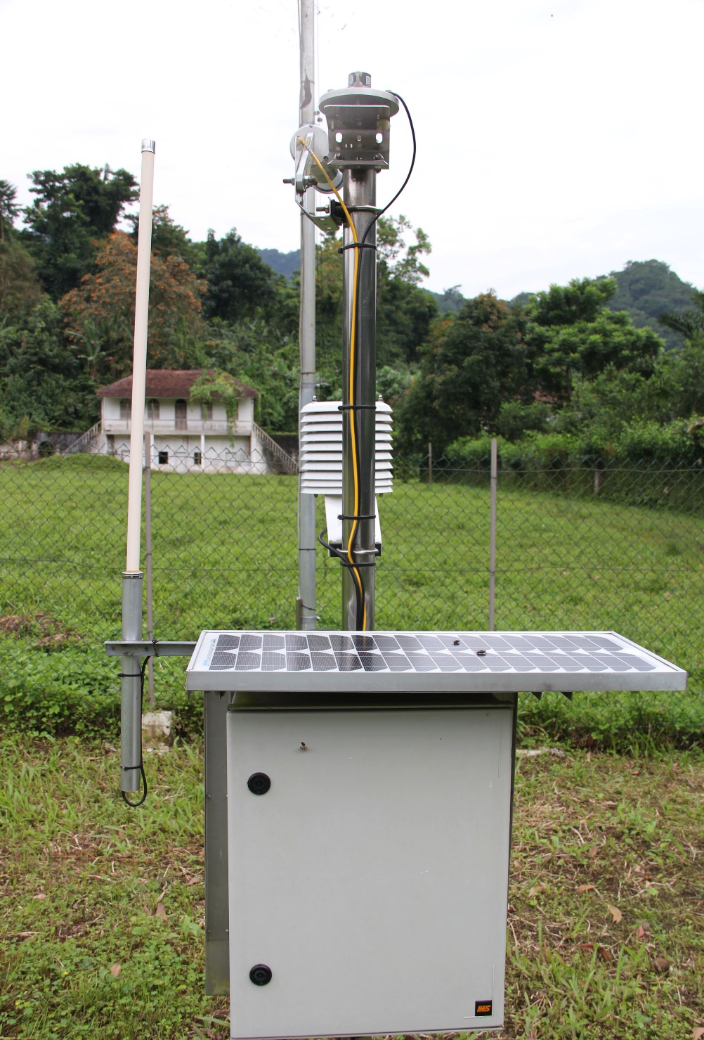
KEY INPLEMENTING PARTNERS
NATIONAL INSTITUTE OF METEOROLOGY
The National Institute of Meteorology, initially designated as
the Meteorological Service of STP was created in 1950 and has
worked until 1979 when it became known as the National
Institute of Meteorology.
It is the body responsible for the Management, coordination and carries out any activities, studies and provides information on meteorology, geophysics and astronomy, or any technical weather information required for air and maritime navigation, agriculture and fisheries, the use of water resources and all weather -related scientific and economic activities in the country.
The Institute is still financially dependent on the state budget allocated to its
ministry. Even though the institution is suppose to be financially autonomous
The National company of aviation has protocol with the institute. They are both
preparing a new MoU to define the cost of the service they are providing

Slide 7
EQUIPMENTS AT THE NIM
2 SYNOP. STATIONS
7 AWS
16 CLASSIC
7 RAIN GAUGES

Slide 8

General Directorate of Natural Resources and Energy
The General Directorate of Natural Resources and Energy (DGRNE) is the government institution
responsible for conducting studies and research on the characteristics and conditions of national natural resources
, its territorial distribution and the level of utilization to ensure effective implementation of
policies, laws and other policy instruments in the Natural Resources and Energy sector.
The DGRNE is organized into functional directorates as follow:
Directorate of Water, together with the Department of Hydrology, Water Supply and Analysis Laboratory;
Directorate of Geology and Mines.
Directorate of Energy.
The DGRNE is financially dependent on the state budget allocated to the ministry.
The DGRNE has only one automatic hydrological station ( not working order)

Slide 9
KEY INPLEMENTING PARTNERS
General Directorate for the Environment
The Directorate General for the Environment is in charge to coordinate the country's environmental
Activities. The DGE is an active actor in the definition, participation and implementation of government environ
mental policy.
Founded in 2007 by Decree No. 2/2007, comprises three Divisions: Legal Department, Administration,
Cooperation, Evaluation and Environmental Impact Studies - , the Department of
Conservation, Sanitation and Quality of Environment – DCSQA and Department of Statistics, Information,
Environmental Education and Communication - DEIECA
The direction is financially dependent on the state budget.
~
The environmental observatory assists in mapping project interventions

Slide 10
KEY INPLEMENTING PARTNERS
CONPREC – National Council for Preparedness and Response to Disasters
The National Council for Preparedness and Response to Disasters was created in 2011 by Decree-Law n º 17/2011,
in response to an institutional gap of a structure responsible of managing issues related to natural disasters in STP.
In addition given the total absence of an organized system in the country it has also the responsibility at
national and international level to channel and organize support to the country.
Amongst other tasks, it has the duty to contribute to the reduction of the vulnerability of communities, infrastructure and assets exposed to the negative effects of climate change and or natural disasters.
The Institution is financially dependent of the state budget and ongoing projects.

Slide 11
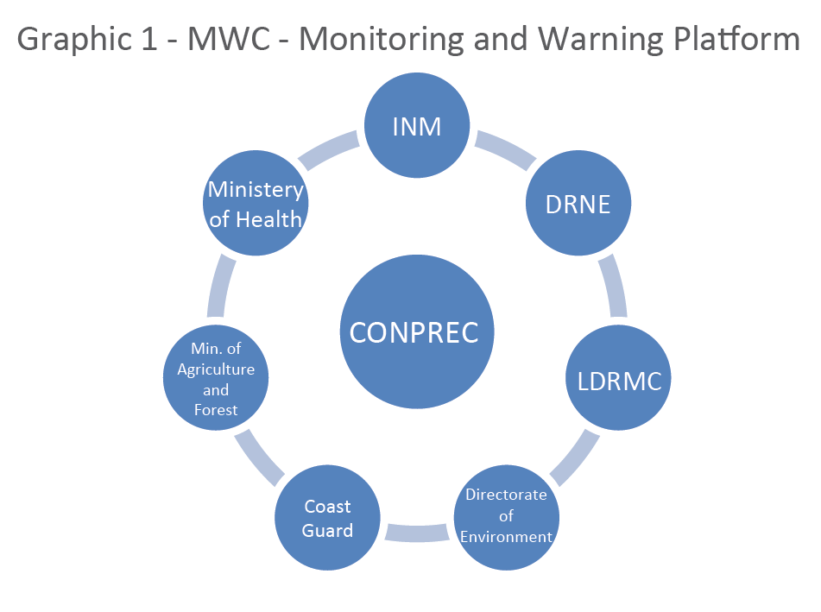
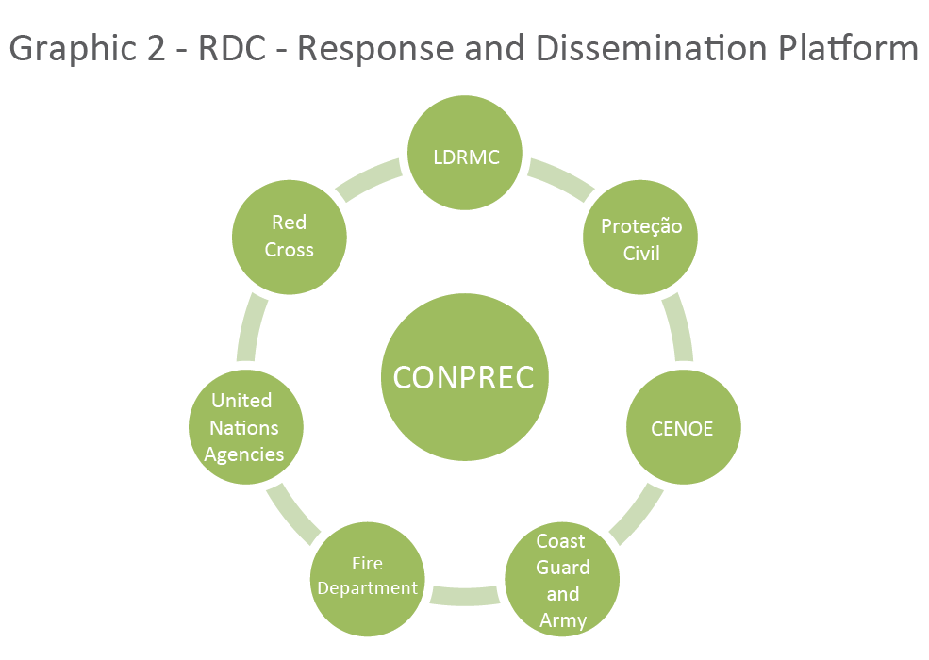
CONPREC ROLE WITHIN THE EWS PROJECT
Notes:
Os objetivos deste projeto são:
Desenvolver um SAP através das plataformas (MWC – Monitoramento e alerta / DRC – Disseminação e resposta) reforçando as Informações sobre o clima através do desenvolvimento resiliente e a adaptação às mudanças climáticas por meio de 2 componentes principais:

Slide 12
  HIGH LEVEL CONTRIBUTIONS OF EACH IMPLEMENTING PARTNERS
A national multi-stakeholder capacity assessment was undertaken under the leadership of the Government through the Meteorology Institute and the National Council for Preparation and Responses to Disasters (CONPREC), and supported by the UN System through the UN Country Team in São Tomé and Príncipe and member agencies of the Capacity for Disaster Reduction Initiative (CADRI).
The national capacity assessment identified existing capacities, gaps and needs related to disaster risk reduction and preparedness for response, and proposed a set of recommendations on how these capacities can be achieved
Based on the recommendations, priority actions will be articulated in a National Plan of Action/ Framework for of Action for Disaster Risk Reduction in São Tomé and Príncipe.
The National Plan will guide the efforts of all stakeholders involved in disaster risk reduction to implement the requirements of the future international framework.

Slide 13
HIGH LEVEL CONTRIBUTIONS
MULTI-MINISTERIAL STEERING COMMITTEE
MEETING EVERY THREE MONTHS FOR PROJECT ACTIVITIES OVERSIGHT
COORDINATED INTERVENTION AT DISTRICT LEVELS
NATIONAL AUDIT OFFICE INVOLVEMENT
APPROPRIATION AND DURABILITY
LOCAL COMMITTEES ESTABLISHMENT
PARTNERSHIP PRIVATE AND PUBLIC

Slide 14
Ministry of Infrastructure, Natural Resources and Environment
Ministry of Agriculture and Rural D.
National Technical Directorate
Audit Office
- Ministry of internal Affairs
Quality assurance
Audit
- Technical Supervision
Council District
- Periodic Audit
- Facilitation
- Law
- President of Municipalities
- Financial Control
Directorate Of Decentralization
Project Team
Capacity building and facilitation
Support to districts
UNDP Country Team
District
District
District
District
District
Annual work plan
Budget
Procurement plan
Annual work plan
Budget
Procurement plan
Annual work plan
Budget
Procurement plan
Annual work plan
Budget
Procuremenr plan
Annual work plan
Budget
Procurement plan
Stakeholders
Private Sector
Organizations
Community
Public Institutions
ONG’s
Offer of Services/ Co-participation/ Implementation/ Monitoring/ Co-financiament

Slide 15
Social, Economic impact
São Tomé and Principe has an estimated annual fishery potential of between 23,000 and 29,000 tones.
However the fishing communities around the coastal areas of Neves, Santa Catarina, Malanza and Ribeira Afonso
and Sundy in Principe Island are highly vulnerable to extreme weather events. All the above sites share a common features:
Nearly 20 percent of the nation’s workforce are employed in artisanal fisheries
the majority of the villagers are fishermen
These coastal fishing communities will be benefited from the future EWS primarily by reducing their vulnerability.
The project will provide means for more accurate, reliable and frequently updated weather and hydrological forecasts.
In addition it will strengthen the dissemination of forecasts and warnings and will provide means for the fishing community
to access information while at sea, ultimately reducing the risk of disasters and possibly casualties.
In this way the project will affect nearly 10,000 rural coastal dwellers, assisting more directly to around 1,400 fishermen
and 1,700 fishmongers who will benefit from improved weather forecast and warnings.

Slide 16
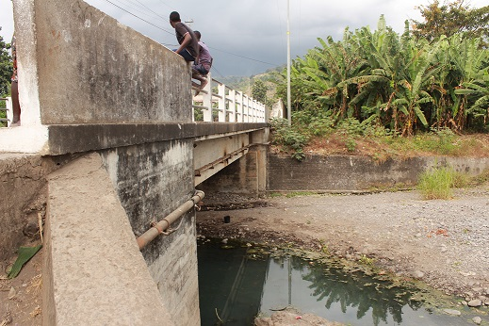
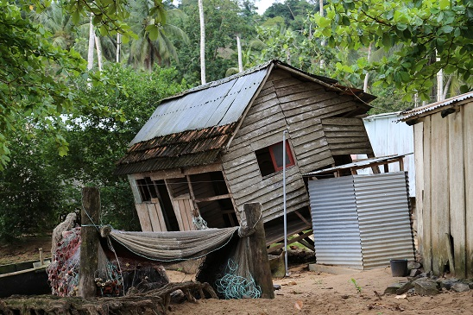
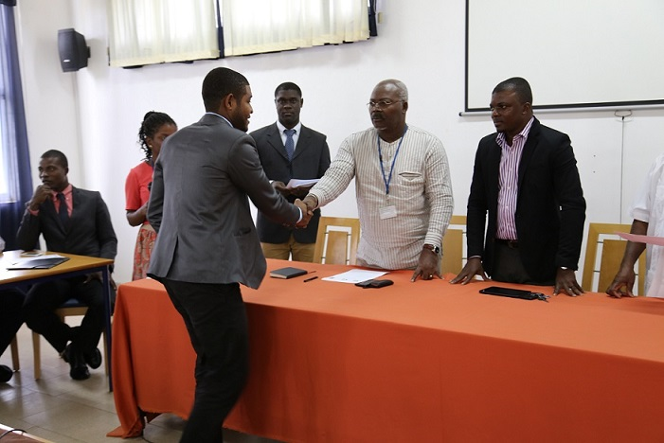
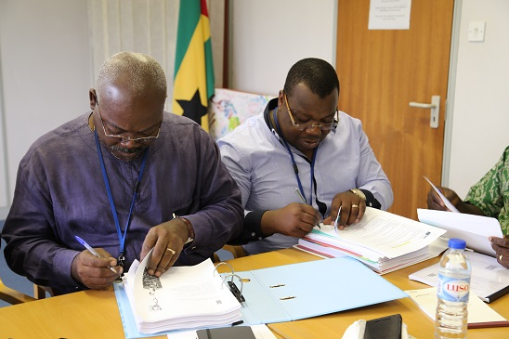
Social, Economic impact
AWARNESS AT LOCAL AND NATIONAL LEVELS
Capacity building and Resources Mobilization
Vulnerability Reduction for fishing communities
Disaster Reduction and rural poverty reduction Initiatives

Slide 17
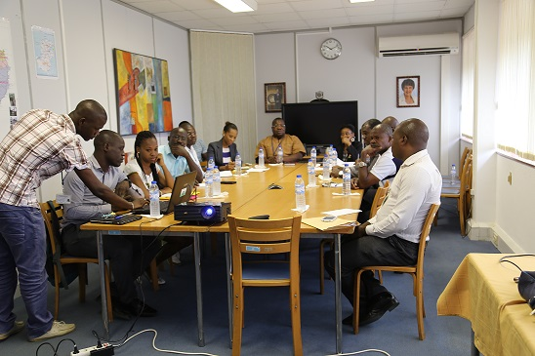
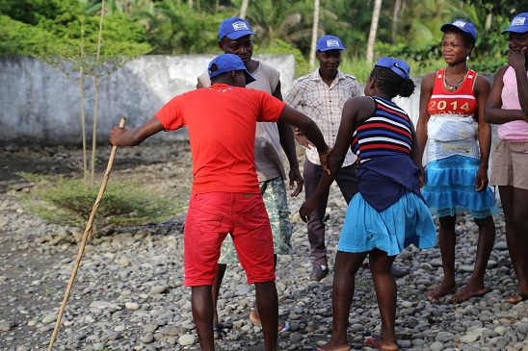
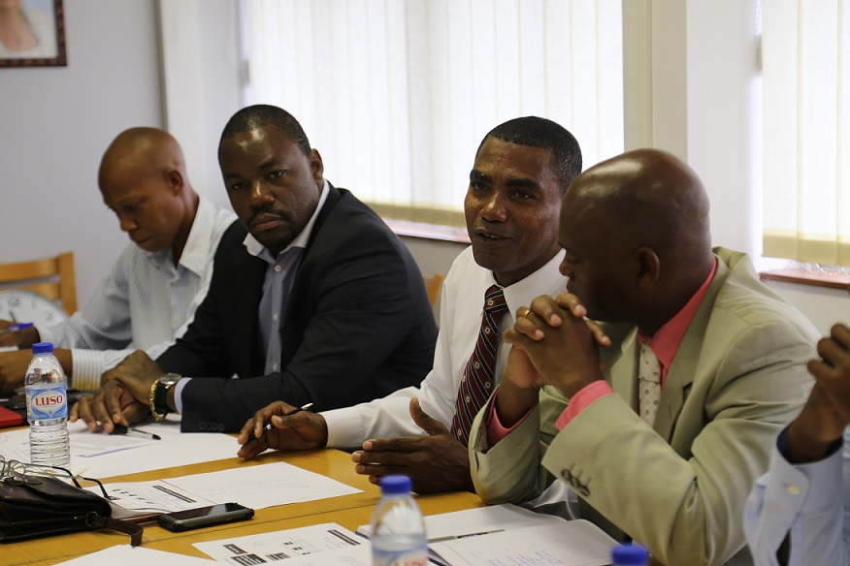
Social, Economic impact
Community Resilience development
Information in real time for farmers and fishermen
Development of national awareness,, appropriation
and sustainability of interventions
Development of social responsibility of economic actors in the country

Slide 18
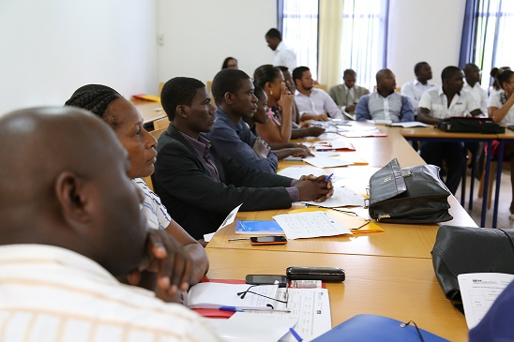
ACTIVITIES UPDATE
INTERNATIONAL TENDER PROCESS FOR EWS PROJECT
EQUIPMENTS ACQUISITION FINALIZED
CAPACITY BUILDING FOR TECHNICAL INSTITUTIONS
TRAINING OF DISTRICT STAFF AT NIM MODALITIES
ESTABLISHMENT OF PROJECT TECHNICAL AND STEERING COMMITTEES.
CREATION OF COMMUNICATION STRATEGY AND PROJECT SENSITIZATION MATERIELS

Slide 19
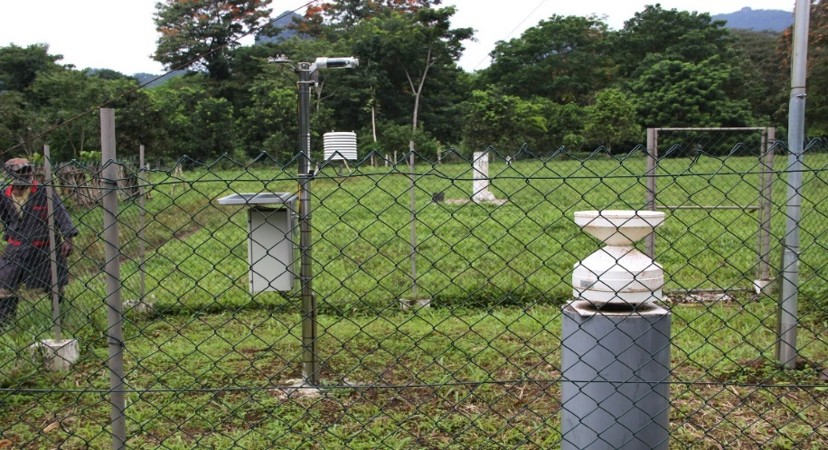
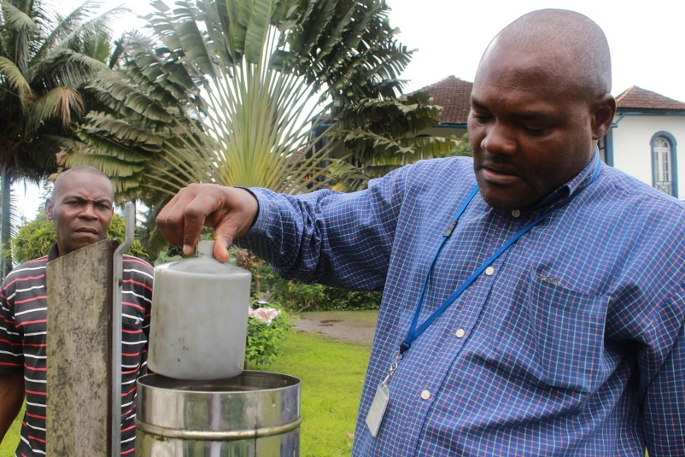
National Institute of Meteorology and General directorate of natural resources and Energy, General Directorate of Environment and Conprec
Activities
Update
Baseline study for all the Hydro meteorological Stations in the country
Sites Identification, selection, qualifications and preparation
Partnership with Telecommunications companies
Procurement for lightning detector and sadissystem acquisition
Training program for meteorologist and hydrologists Abroad
Collaboration with lusophone universities for training of 4 meteorologists
Process to train 4 hydrologists abroad. Agreement through
the STP and Portugal governments.

Slide 20
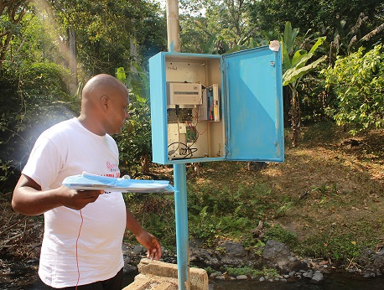
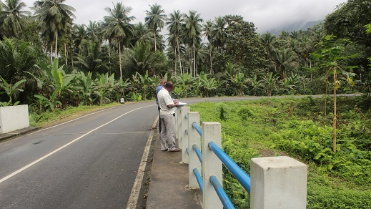
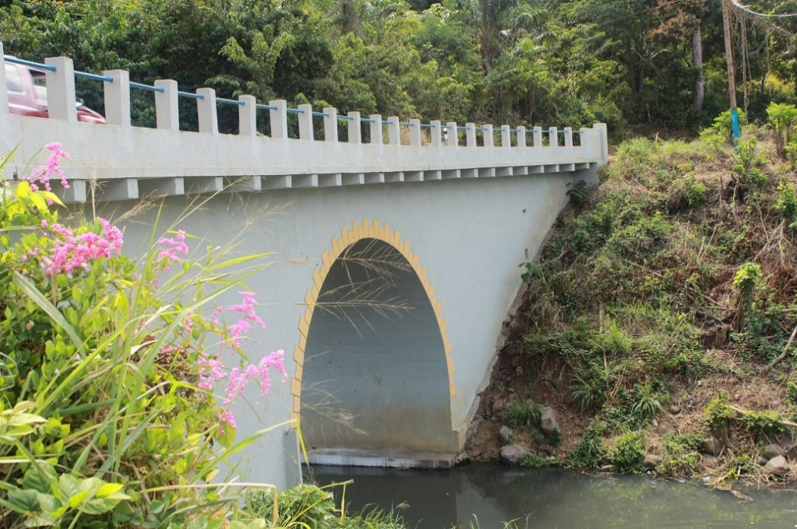
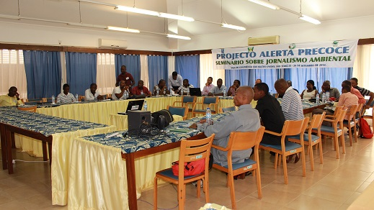
NIM and GDNRE - further activities
Training for journalists on public and private sector regarding “Environmental Journalism and disaster risk management” through South/South Cooperation
Process of automatic transfert of hydrometeorological data
Sensitization work in selected communities where stations to be
installed
Development of the program for training of Hydrological and meteorological observers

Slide 21
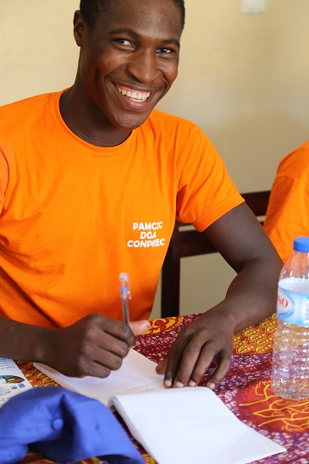
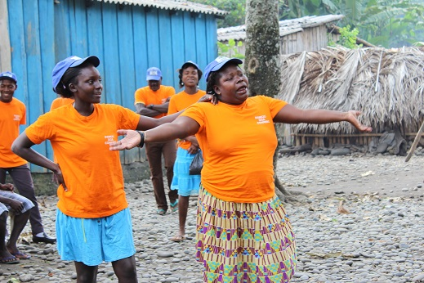
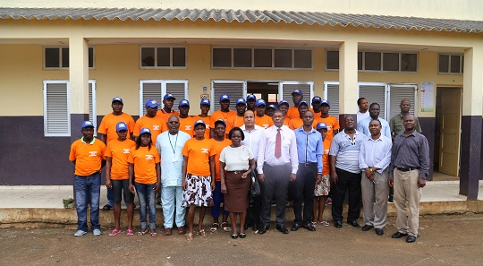
LOCAL COMMITTEES FOR DISASTER RISK MANAGEMENT
Creation / establishment of 24 local committees for disaster risk management in vulnerable communities.
Training content: How to identify Hydro meteorological occurrences, first aid,
how to create community vulnerability maps, and how to receive and
disseminate warnings. The SMS frontline-
community radios rehabilitation
Capacity building for community leaders

Slide 22
BUDGET USE 2014 AND UP TO JUNE 2015
Activity | Budget | Total Expenditure | Balance | %
Total Activity 1 | 928 180,00 | 893 537,34 | 34 642,66 | 96,30%
Total Activity 2 | 84 600,00 | 82 737,50 | 1 862,50 | 97,80%
Total Activity 3 | 47 820,00 | 44 146,40 | 3 673,60 | 92,30%
Total Year 2014 | 1 060 600,00 | 1 020 421,24 | 40 178,91 | 96,20%
Activity | Budget | Total Expenditure | Balance | %
Total Activity 1 | 992 000,00 | 641 903,20 | 350 096,80 | 64,70%
Total Activity 2 | 406 500,00 | 99 042,13 | 307 457,87 | 24,40%
Total Activity 3 | 30 000,00 | 9 632,19 | 20 367,81 | 32,10%
Total Year 2015 | 1 428 500 00 | 750 577,52 | 677 922,48 | 52,50%

Slide 23
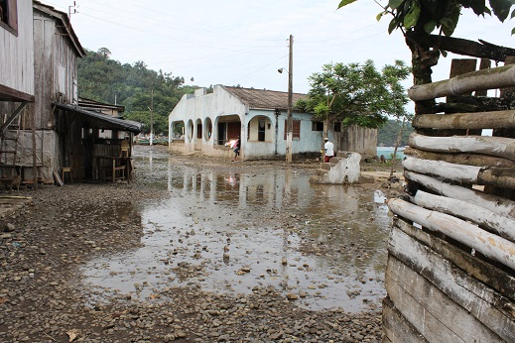
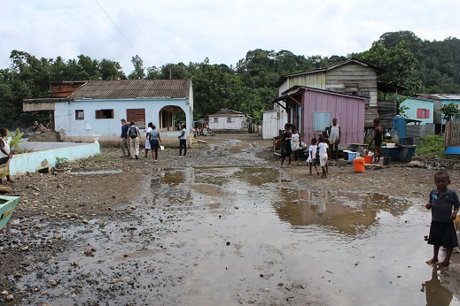
FUTURE PLANS
CONPREC OPERATIONALIZATION
EQUIPEMENT INSTALLATION
OPERATIONALIZATION OF THE EWS PLATFORMS
CREATION OF NATIONAL NETWORK FIREBRIGADES AND COASTAL GUARDS
CREATION OF NATIONAL NETWORKS OF LOCAL COMMITTEES
ORGANISATION AND DEVELOPMENT OF DRR POLICY FOR HUMANITARIAN INTERVENTION IN THE COUNTRY
ACQUISITION OF AN EMERGENCY STOCK

Slide 24
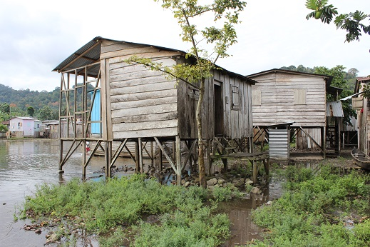
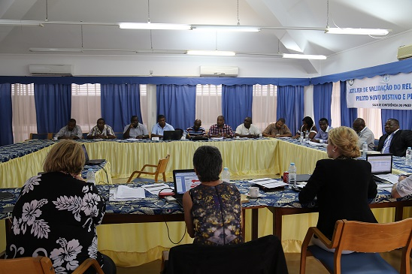
FUTURE PLANS
Strengthening the National DRR communication system for
the Center of Operations and Emergency
Acquire means for implementation of the CADRI report
and framework of action

Slide 25
OPPORTUNITIES
ENGAGEMENT OF LOCAL COMMUNITIES TO CHANGE BEHAVIOUR
POSSIBILITY OF PARTNERSHIP WITH PRIVATE SECTOR
MAINSTREAMING AT NATIONAL LEVEL OF ALL DRR RELATED PROJECTS
CREATION OF A NATIONAL EMERGENCY FUND FOR SUSTAINABILITY OF THIS INTERVENTION
SOUTH-SOUTH COLLABORATION ( BRAZIL AND MOZAMBIQUE)
FUNDS MOBILIZATION

Slide 26


