Slide 1
Innovating how we report on climate change
Caelainn Barr
The Guardian
@caelainnbarr

Slide 2
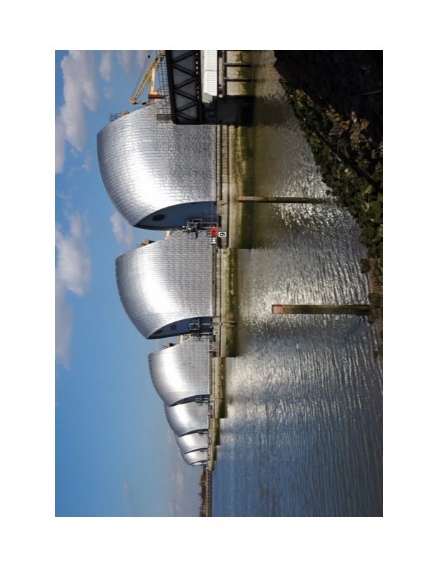
In London…

Slide 3

Case study – The Star, Kenya

Slide 4
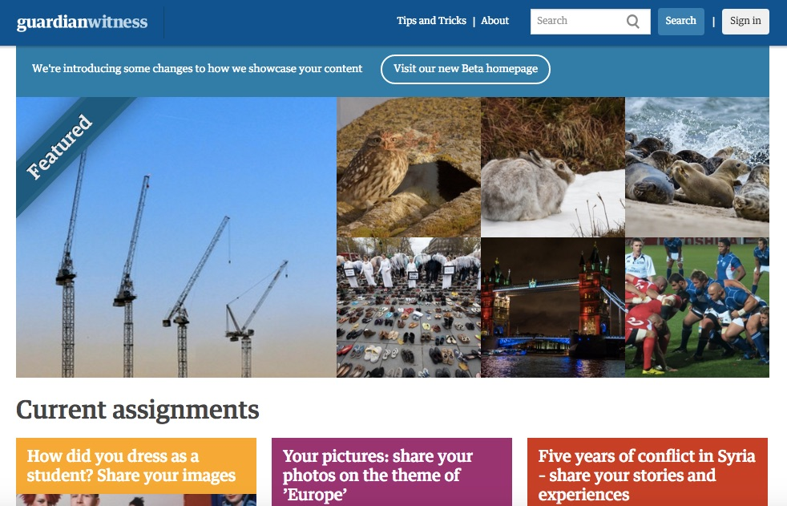
Involving citizens

Slide 5

Reflecting on alternative methods

Slide 6

How can government departments engage public?
Trust
Direct to citizens
Media relationships
Open data

