Slide 1
UNDP CIRDA Country Program Managers Workshop 25-27August 2015 Addis Ababa, Ethiopia
Reports from Strengthening National Climate Information/ Early Warning System (CI/EWS) Projects
The Gambia
Mr. Lamin Mai Touray
Department of Water Resources
Project Director
Notes:
Instructions: Complete items in red italics

Slide 2
Presentation Outline
Introduction
Project Organization Structure
Key Departments/Agencies
High Level View of Each Department/Agency
Social, Economic Impact
Future plans
Challenges

Slide 3
Introduction
As the Project Director (PD) I should ensure a continued cohesion between the two phases of the project, as well as with the mandate of the DWR and provide additional linkages and interactions with high level policy components within the Government.
In this way, the DWR – the lead agency will be in a good position to assume responsibility, on behalf of the GOTG, through the Ministry of Environment, Climate Change, Water, Forestry and Wildlife for successful implementation of the project.
Follow up on, supervise and coordinate the contributions of the GOTG

Slide 4
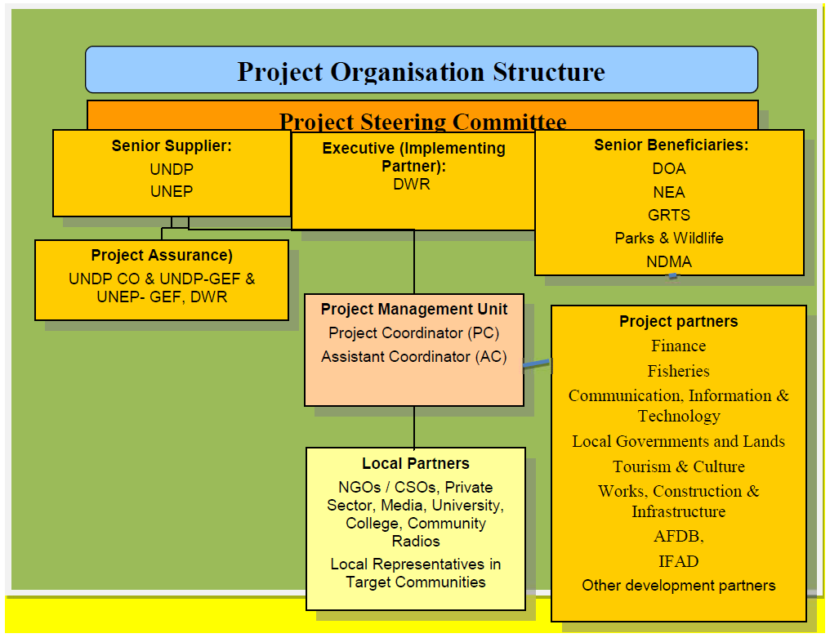

Slide 5
Outcomes
The four complementary outcomes are:
Outcome 1: The Gambia National Meteorological Services is supported in its transition to becoming a financially sustainable Meteorological Agency (supported by UNEP)
Outcome 2: Hydrometeorological infrastructure is upgraded/installed and maintained that will cover the full needs for 'optimal performance of EWS' as identified by recent needs assessment reports in the Gambia (Supported by UNDP)
Outcome 3: A critical mass of skilled human resources is able to operate the Gambia Early Warning System and perform medium and long-term climate adaptation planning beyond the project (supported by UNEP)
Outcome 4: Efficient and effective use of hydro-meteorological and environmental information for making early warnings and long-term development plans (supported by UNEP)

Slide 6
Key Departments, Agencies or Services
KEY STAKEHOLDERS ARE OF THREE CATEGORIES
Producers and Providers of Early Warning Products (e.g., the National Meteorological and Hydrological Services, and other related Services)
Communicators of Early Warning Products (NMHS, Media, MDFTs, Local Communicators (e.g., Kanyaleng, RLGs)
Users of Early Warning Products (All Stakeholders but particularly local communities)

Slide 7
Key Departments, Agencies or Services
Key Stakeholders:
The Multi-Disciplinary Facilitation Teams (MDFT), which operate in every Region as a structure that is responsible for extension service in the country.
The Regional MDFT is composed of Extension Agents from all central government sectors (Agriculture, Livestock, Fisheries, Health, Water Resources, Environment, Forestry, Wildlife and Biodiversity, Media/Communication (GRTS and Community Radios), etc), Civil Society (NGOs, CBOs, Women and Youth Groups, etc) and Local Government (Elected leaders, Local and Religious Leaders and Regional, District and Village Development Committees).
These will act as key intermediaries among the national, regional and local levels.

Slide 8
Key Government Stakeholders
The following government stakeholders are key implementers and beneficiaries to the project in that they will receive/disseminate tailored advisories and communication messages, and based on their value added and basic abilities, they will also receive capacity building and skills development.
Ministry of Environment, Climate Change, Water, Forestry and Wildlife;
Ministry of Fisheries;
Ministry of Agriculture;
Ministry of Lands and Regional Government;
Ministry of Finance and Economic Affairs;
Ministry of Health and Social Welfare.

Slide 9
Key Government Stakeholders
Stakeholders | Outcomes Stakeholders will be involved in
Ministry of Environment, Climate Change, Water, Forestry and Wildlife | 1, 2, 3 & 4
Ministry of Fisheries; | 1 & 4
Ministry of Agriculture; | 1 & 4
Ministry of Lands and Regional Government; | 4
Ministry of Finance and Economic Affairs; | 1 & 3
Ministry of Health and Social Welfare | 4
.

Slide 10
Key Government Stakeholders
Government Agencies that are key to the implementation of the Project include:
National Environment Agency (NEA)
National Disaster Management Agency (NDMA)
Gambia Radio and Television (GRTS)
Gambia Civil Aviation Authority (GCAA)
Gambia Ports Authority (GPA)

Slide 11
Key Government Stakeholders
Stakeholders | Outcomes Stakeholders will be involved in
National Environment Agency (NEA) | 1, 2, 3 & 4
National Disaster Management Agency (NDMA) | 1 & 4
Gambia Radio and Television (GRTS) | 4
Gambia Civil Aviation Authority (GCAA) | 1 & 4
Gambia Ports Authority (GPA | 1 & 4
Department of Parks and Wildlife Management | 1 & 4
.

Slide 12
Key Government Stakeholders
Civil Society Organizations (NGOs, CBOs) that will be fully involved in the projects include but not limited to:
Community Radio Stations
Kanyaleng Women’s Groups
TANGO
Stay Green Foundation
Famers Platform
Radio Listening Groups
WAWA
Fansung Jamano
Etc.

Slide 13
Key Government Stakeholders
The Private Sector
Gambia Chamber of Commerce and Industry (GCCI) is leading the engagement of the Private and Business Sector in Climate Change;
A Climate Change Forum was initiated under Phase I and will be strengthened during this Phase

Slide 14
High Level View of Each Department/Agency
Department of Water Resources provides the following services
Meteorological Services – Forecasting, service to aviation industry, disaster management, food security, research etc.
Hydrological Services – Water Resources Management, Monitoring River Level and Saline Front
Technology currently deployed in support of operation
Automatic Weather Stations (AWS) (3) expecting 9 AWS and 1 AWOS from ACPC and 7 AWS from UNDP, MSG Satellite Receiving Station (1).
Automatic Water Level, Temperature and Conductivity Measurement Instrument (10), Ground Water Monitoring Instrument (OTT data-loggers) (37)

Slide 15
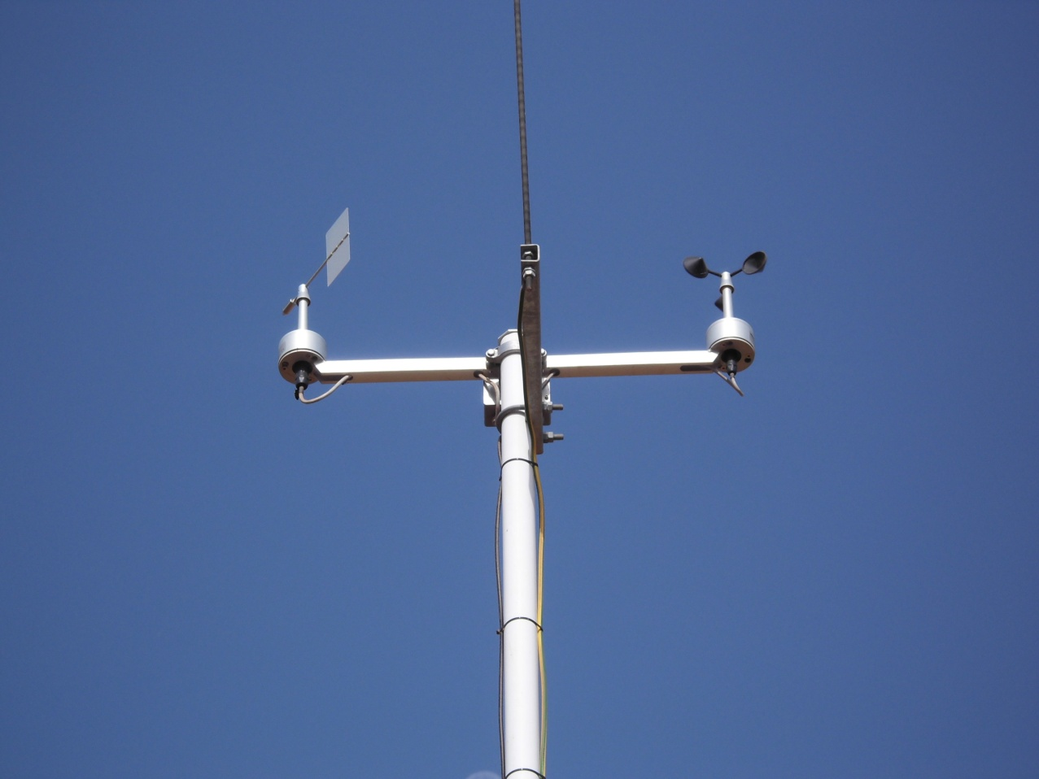
High Level View of Each Department/Agency
Automated Hydrological Station at Sami Tenda/ Ballingho
Automatic Weather Station in Keneba

Slide 16
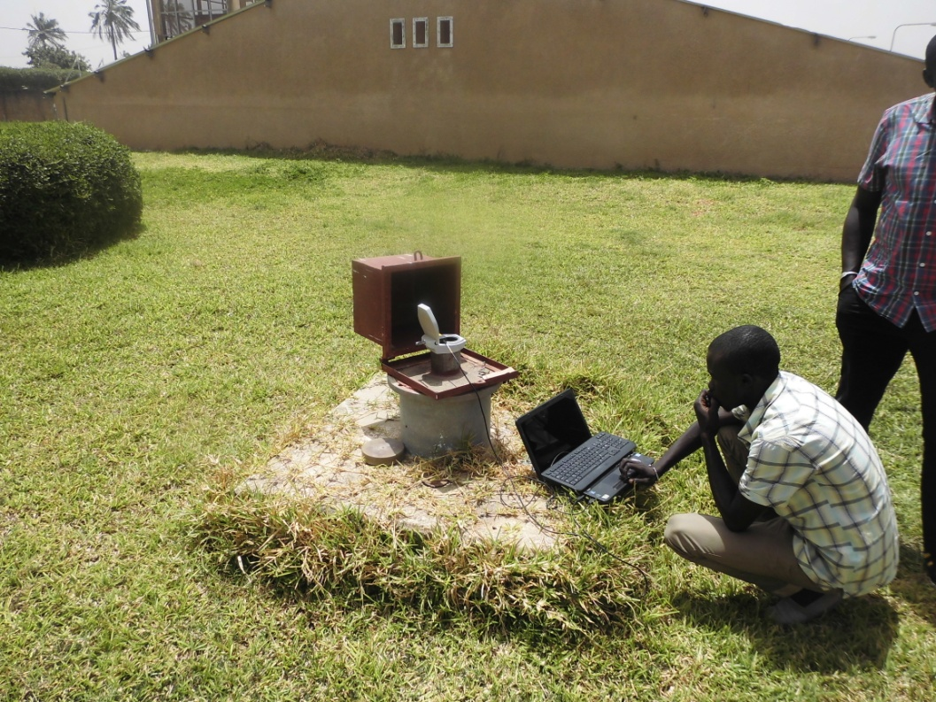
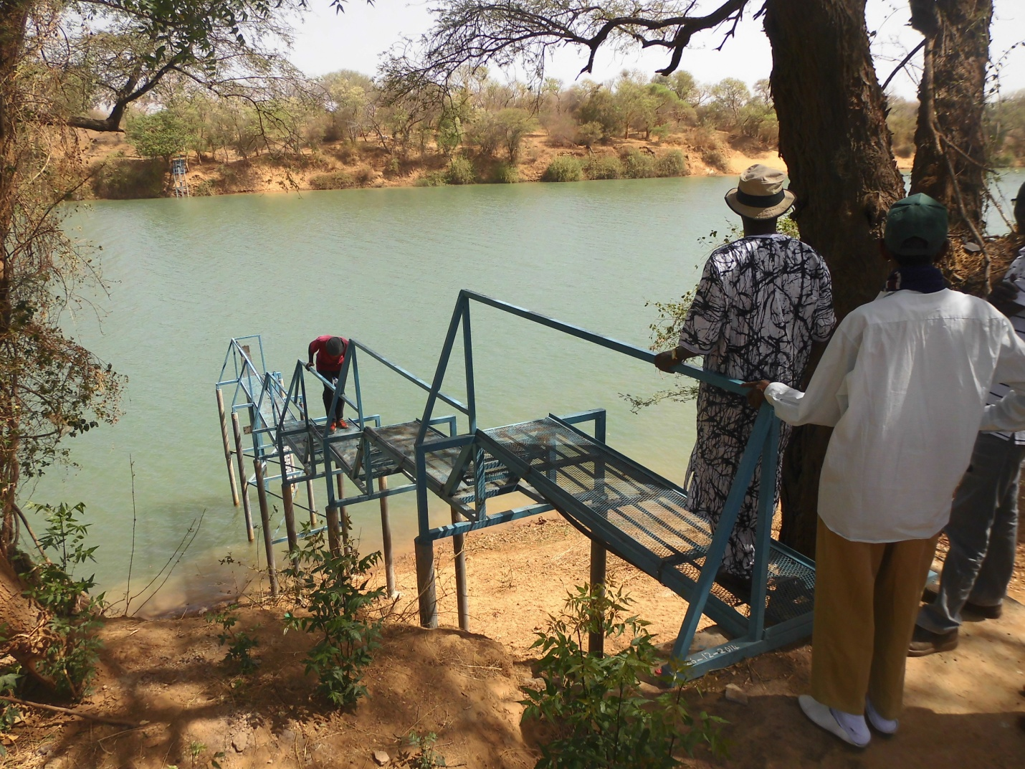
High Level View of Each Department/Agency
Observation Borehole at NAWEC Brikama Treatment Plant
Surface Water Monitoring in Fatoto

Slide 17
Social, Economic Impact
The following sectors are currently making use of the data/information
Agriculture (Crop and Livestock), Health, Aviation, Disaster Management, Construction, Water Resources, Marine, Fishers etc.
Access to this information is through
Radio, Television, Print Media, Internet and Extension Workers

Slide 18
Future Plans
Complete a market analysis to identify which services the new agency can provide and what possible fee management structure can be established
Develop a cost-recovery policy and overarching sustainable business plan, including list of hydro-met products, services, tariffs and prices for public and private clients

Slide 19
Future Plans
Develop a cost-benefit and economic model analysis for the new autonomous Met Agency and EWS
Acquire flood forecasting software and hardware and provide training on flood modelling, flood forecasting and flood risk management
Rehabilitate and repair the Bansang hydrological station which is the coordinating hub for all hydrological stations

Slide 20
Future Plans
Conclude a MOU between Ministry of Environment, Climate Change, Water, Forestry and Wildlife and Ministry of Information and Communication Infrastructure and use of airwaves, radio frequencies and sustained broadcasting of weather, climate and climate early warning information on National Broadcasting Services (GRTS) and Community Radios
Upgrade network of hydro-Meteorological stations

Slide 21
Challenges
Late start of the Project
The Project, which was set to start in August 2014 delayed till July 2015 (when PMU staff were appointed) and the first disbursement was not received until April 2015. Reasons for the delay in the appointment of the PMU staff are beyond the knowledge of the PMU as it was not in place at the time.

Slide 22
Challenges
Motivation of political will to support project which if lacked could pose potential to limit sustainability
Lack of coordination among government stakeholders may cause delay in implementation
Unavailability of requisite skilled human capital could cause implementation delay or failure of project results

Slide 23
Challenges
Inability to communicate effectively with local communities may lead to inadequate use of project products and limit sustainability
Telecommunication challenges hamper implementation of the project which may lead to low level utilization of project investments
Occurrence of extreme climate events may disrupt or damage project infrastructure

Slide 24
THANK YOU ALL FOR YOUR ATTENTION

