Slide 1
UNDP CIRDA Country Program Managers Workshop
25-27August 2015
Addis Ababa, Ethiopia
Zambia’s Experience Working with an LTA for Hydromet Equipment
Mukufute M Mukelabai and Chongo Simpasa
Notes:
Instructions: Complete items in red italics

Slide 2
Outline
Existing automatic weather stations (AWSs)
Standardization of AWSs
Procurement process
Use of LTA

Slide 3
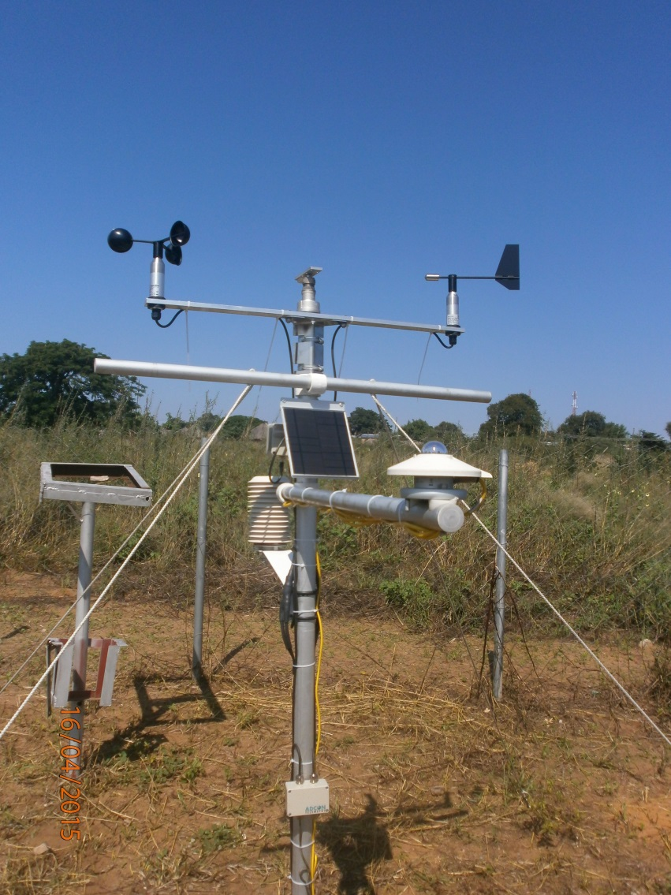
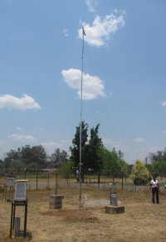
Makes of AWSs at ZMD stations
The observation network has a total of 31 AWSs

Slide 4
STANDARDIZATION OF AWSS
The first set of AWSs ZMD acquired were from DELTA T (8) – had no Remote Telemetry Units (RTU)
ADCON (23) with Remote Telemetry Unit
The challenges to have all AWSs automatically send data in real time – to one base station prompted ZMD to standardize its network of AWSs

Slide 5
ADCON AFTER SELL SERVICES
Training
Installation
Monitoring
Real time data display on google earth map

Slide 6
PROCUREMENT CONDITIONS
Ensure LTA is still valid
Ensure the originating Agency that set up the LTA permits its use by another Agency
The vendor has demonstrated performance under the LTA
Ensure specification and quantities are prepared and cleared for vendor to facilitate quotation
Purchase order issued to the supplier for goods under the LTA
Invoice received, goods delivered & checked for compliance and payment is made

Slide 7
Advantage using LTA
Shortened procurement procedures
Standardization of the weather observation network
  quality and technical standards met across the network
  Same types of spares

