Slide 1



Use of GEONETCAST near real time Earth Observation Data and open Tools for climate observation and early warning
Chris Mannaerts & Ben Maathuis
ITC - Department of Water Resources
Presentation at CIRDA “The Last Mile” Workshop,
March, 15-17 2016, Livingstone, Zambia

Slide 2

Overview
Near real time Data dissemination Infrastructures
  EUMETCast and GEONETCast systems
  Open Source Tools (ITC GEONETCast Toolboxes)
  Web-based data
Data streams for Weather, Climate and Early Warning Systems
Some project Use Cases
    GEONETCast 4 EW & Food Security – Ethiopia
    GIACIS: Geodata for Agricultural Credit Insurance
    AMESD-SADC Toolbox for Drought, Agriculture,
    and Fire Hazard risk monitoring
Closing remarks

Slide 3


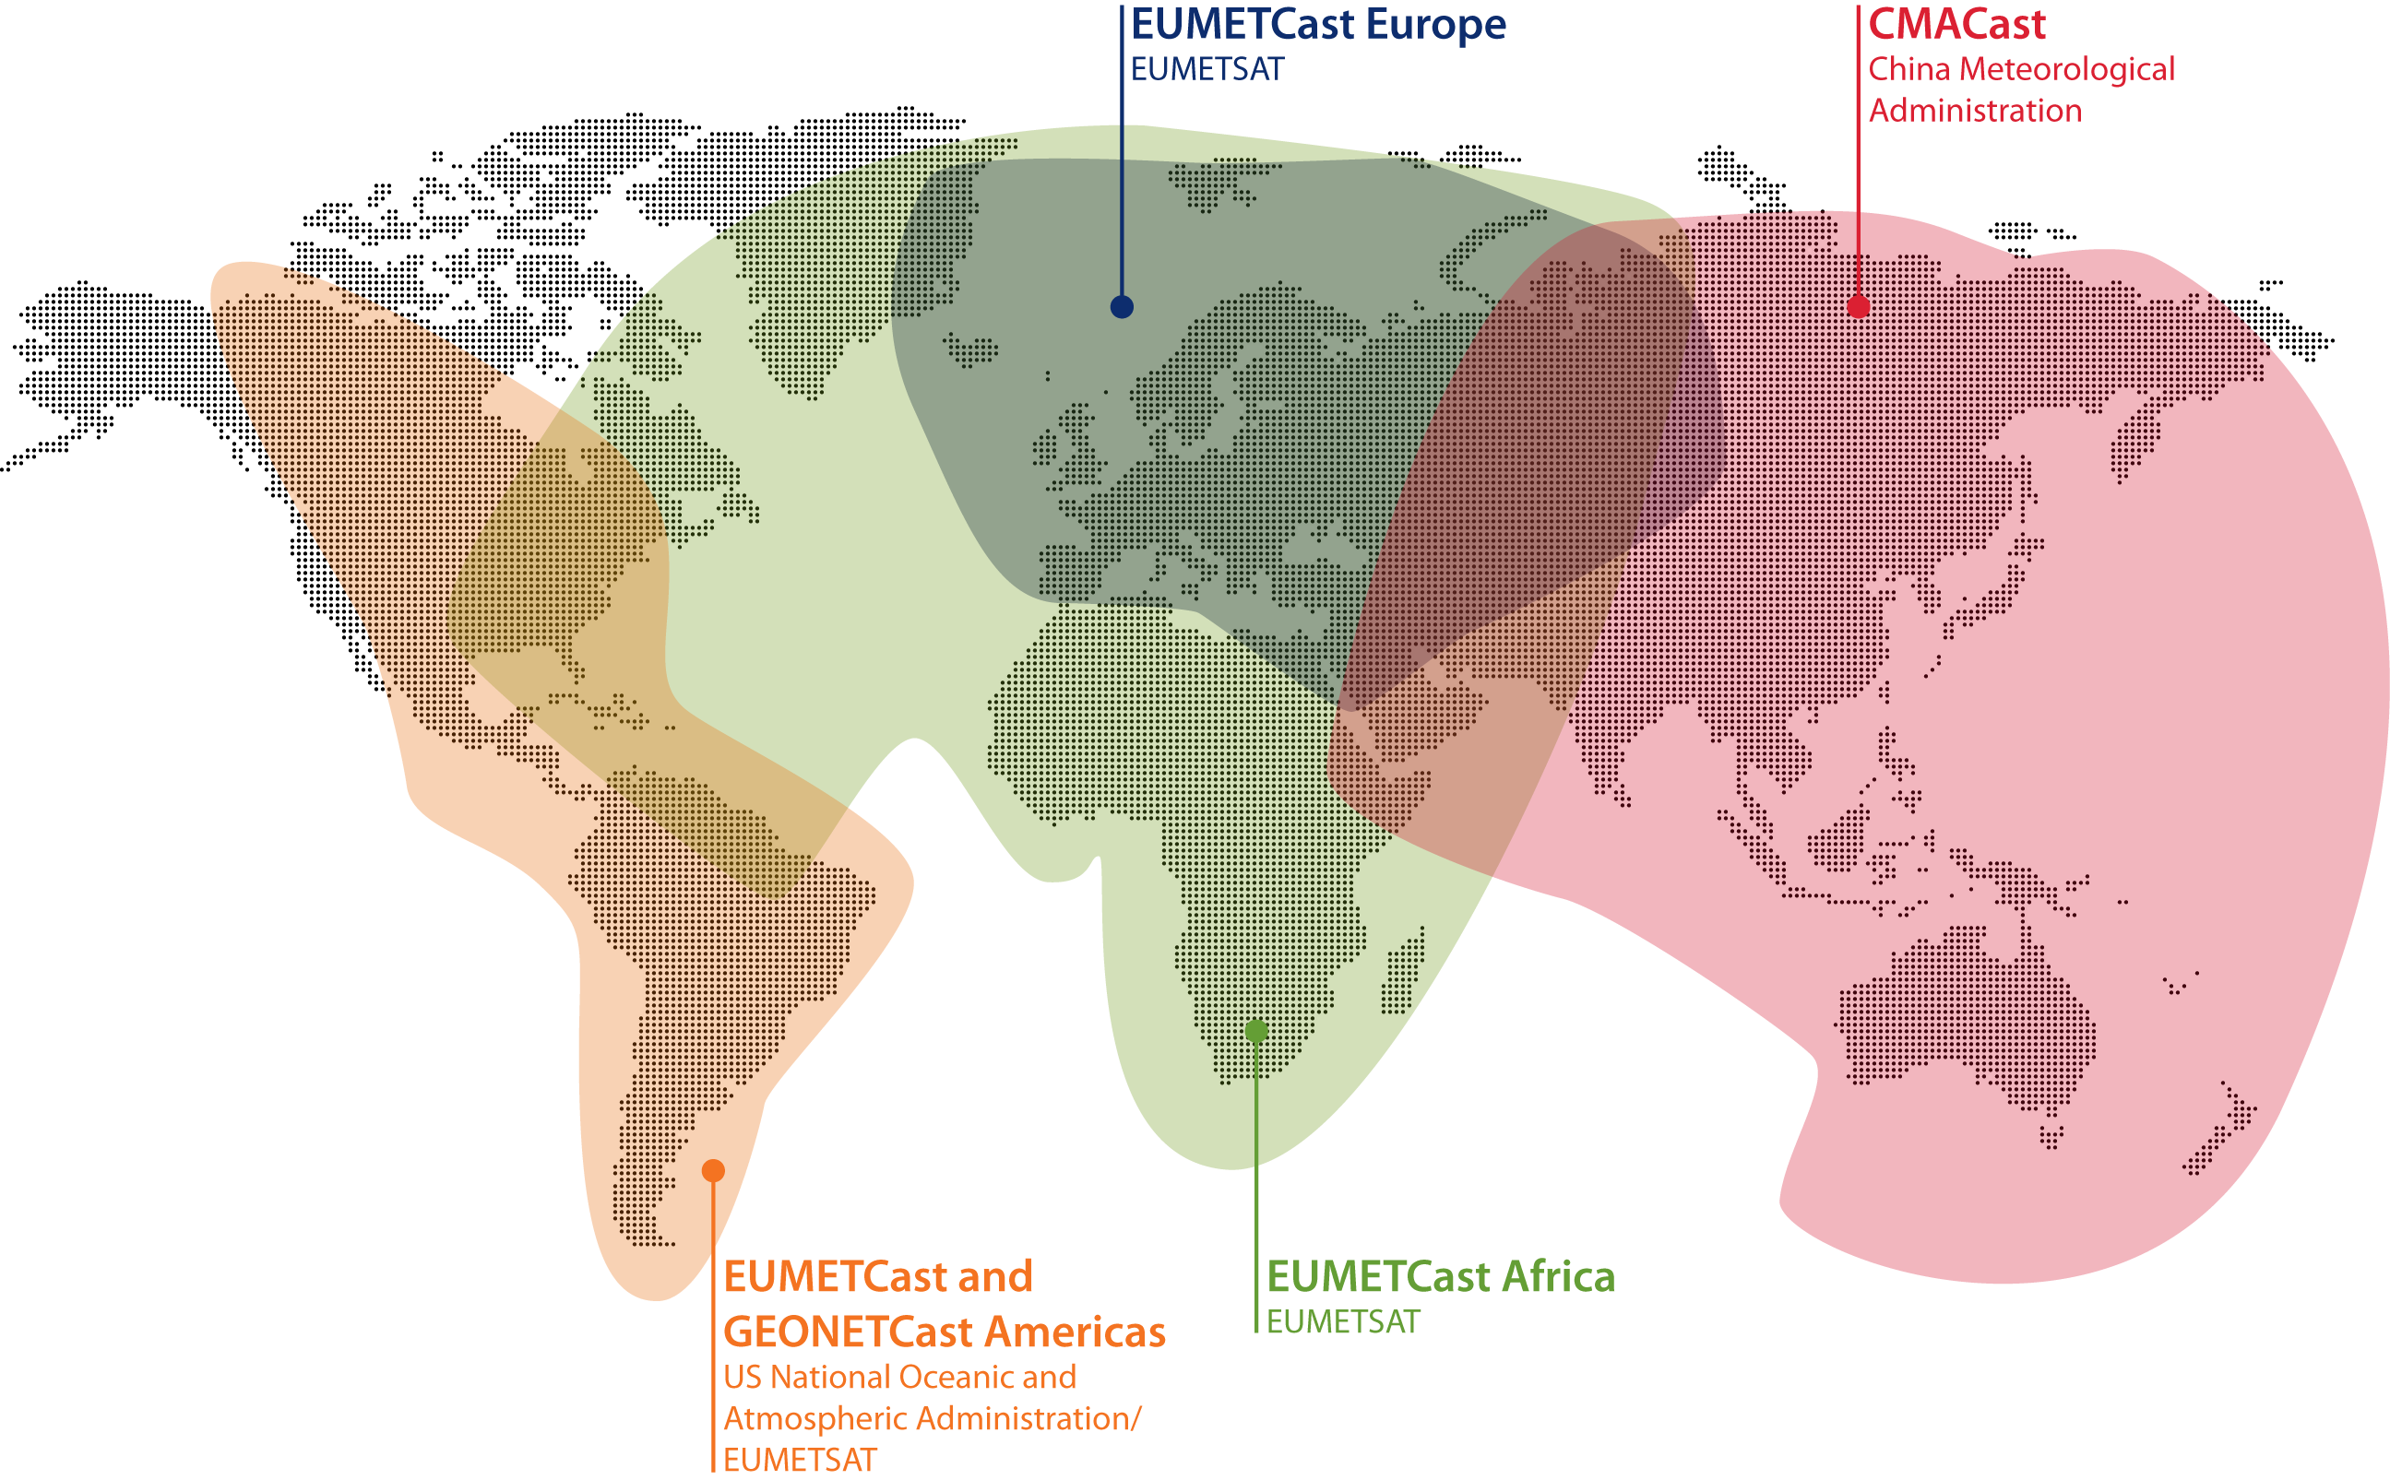
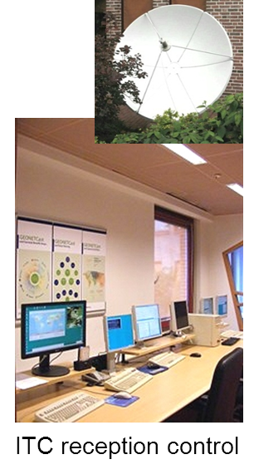
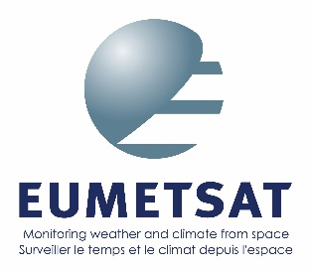
- GEONETCast is the global data dissemination system of GEO
- It provides free near real-time environmental and Earth
observation data and derived products to a worldwide user community
using a telecommunication satellite based data distribution system
Lead agency
www.eumetsat.int

Slide 4
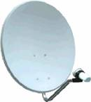
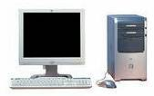
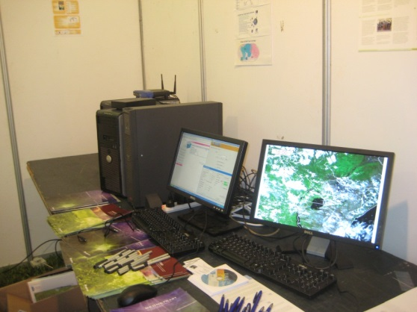
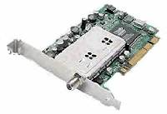


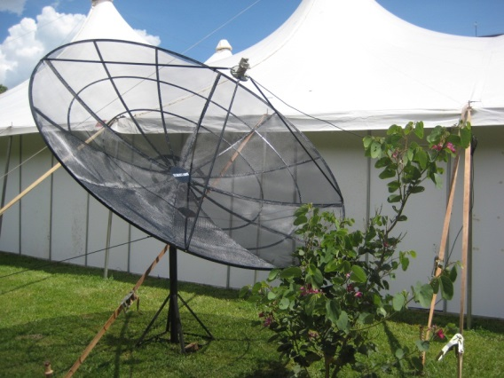
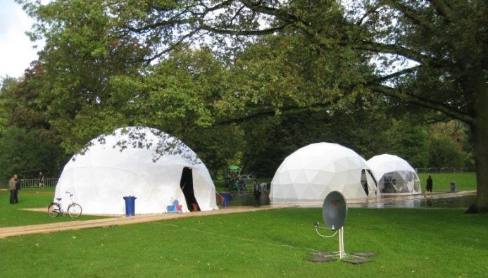
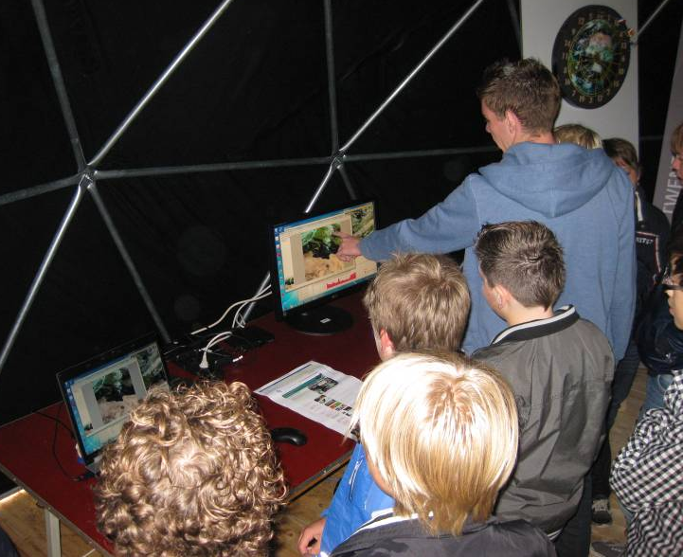
Geonetcast data receiving infrastructure:
hardware components (5 pieces)
From Low cost to high tech systems
Dish antenna
PC (or 2)
DVB-S i/o card
Data storage
USB key
Temporary setups at:
AfricaGis Conf. 2009, Kampala
UTwente, Open days Sep, 2012
(schoolchildren take a look)

Slide 5
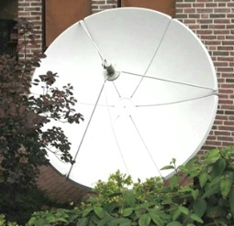
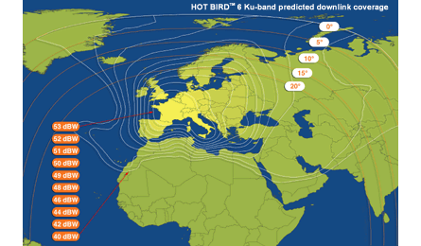
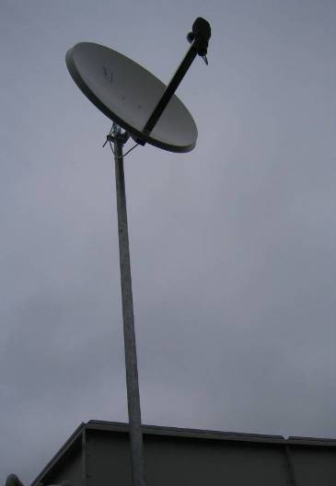
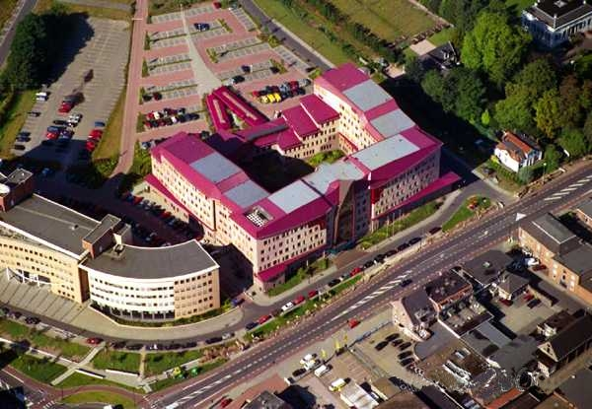
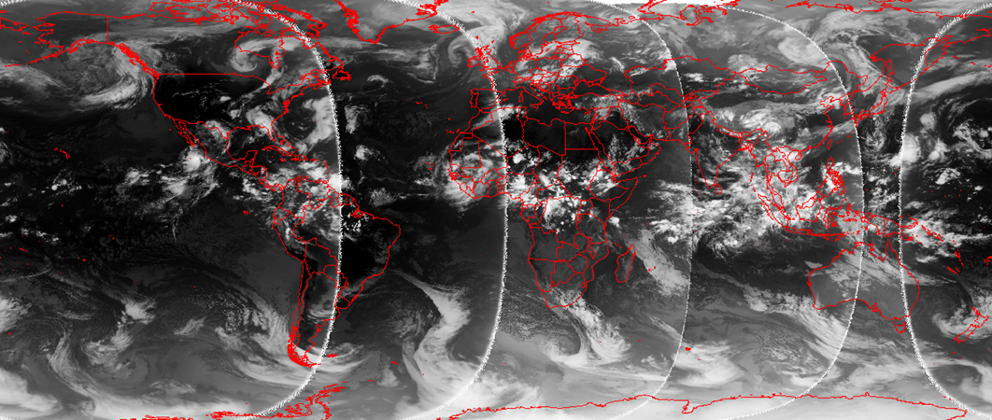
GEONETCast data reception over Europe & North
Africa:-> EUTELSAT DTV satellites (example ITC)
EUMETCast license (Science - Education)
EUTELSAT 10A Ku band & C-band (Africa system)
88 cm satellite dish (DTV for Europe reception)
Low cost
Global near real time data reception
Global NRT TIR composite from geostationary
orbits: GOES W/E, MSG, MET-7, FY-2E/MTSAT
ITC Enschede, NL
Notes:
ITC:
Hotbird 6 Ku band (Europe)
Atlantic bird C band (Africa): large dish

Slide 6
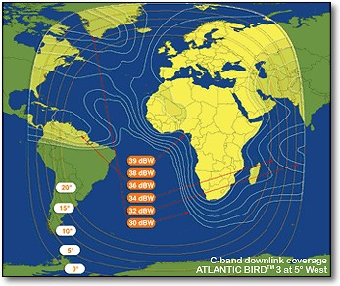
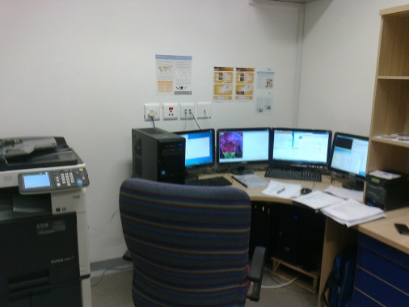
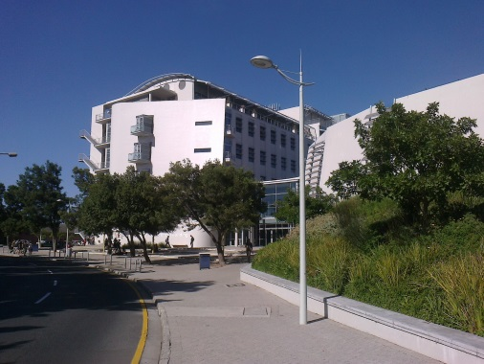
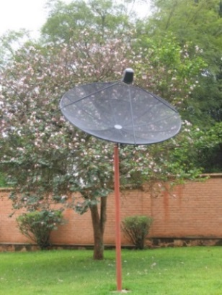
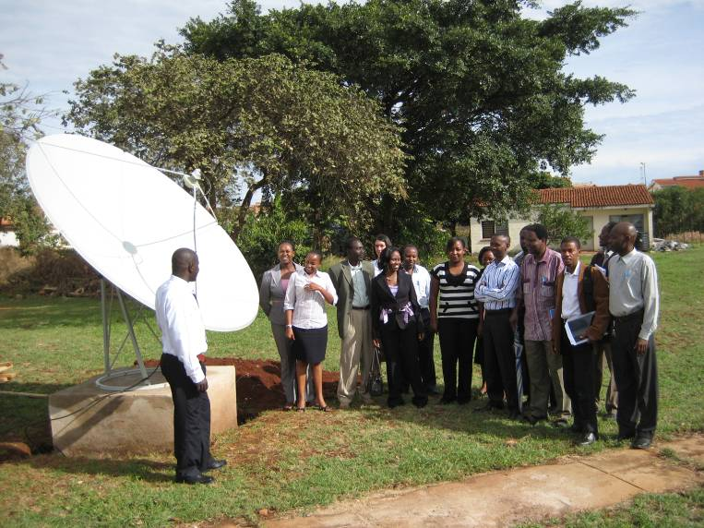
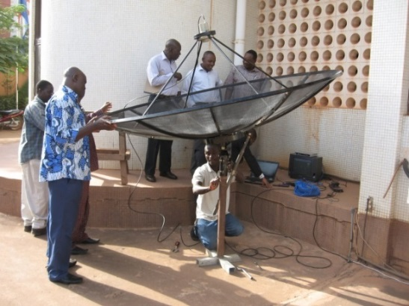
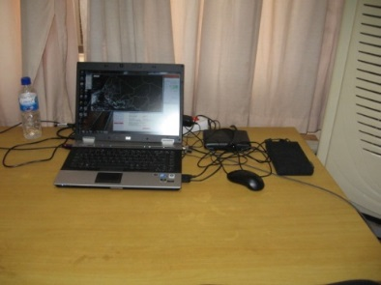
GEONETCast data reception in Africa and Latin America using C-band dish antennas -> research & training
GEONETCast Africa & Americas services
Dish at
CGIS-NUR
Rwanda
First ITC system setup
GNC reception room at UWC
Bellville campus, Cape Town, SA
2012
EUTELSAT 5 WEST C-band
dBW footprint
Setup for a training course in Ouagadougo Nov, 2013 using laptop
Satellite Dish installed at RCMRD, Nairobi

Slide 7
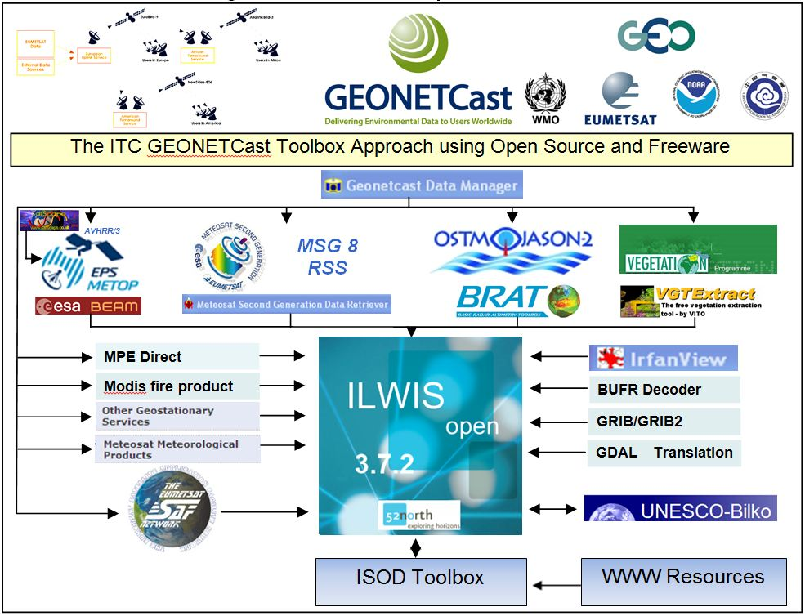
ITC: open data and toolbox approach

Slide 8
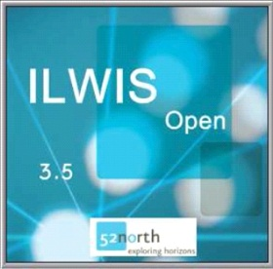
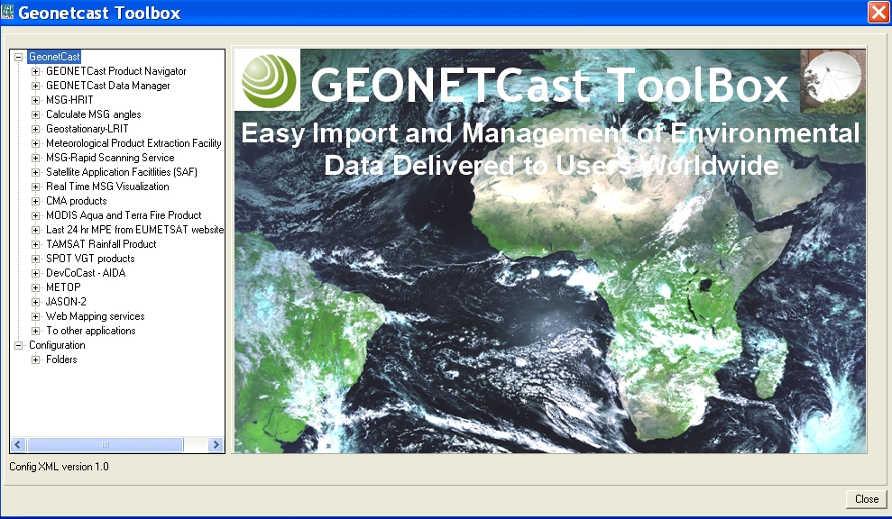
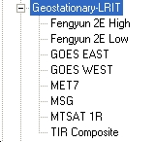

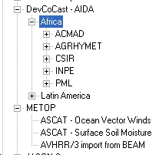
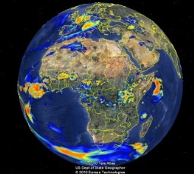
ILWIS Open GEONETCast TOOLBOX v.3.72
3.7

Slide 9
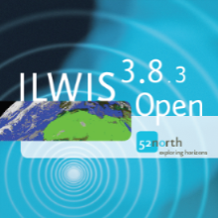
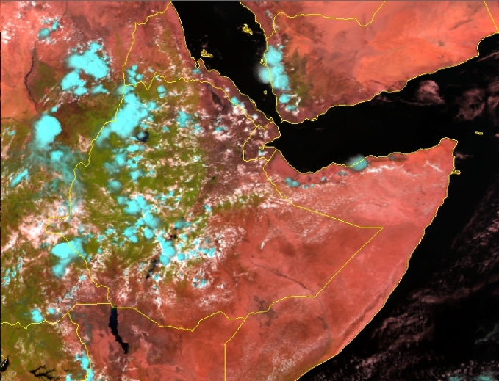
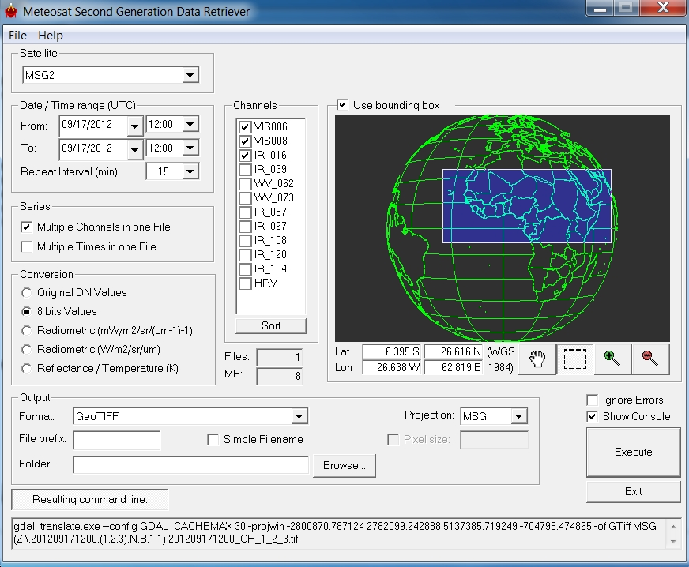
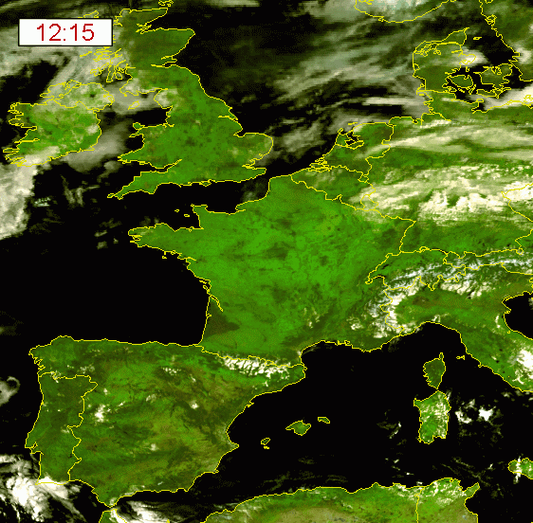
More than visualization: working with scientific sat data
Example: MSG data retriever
Rapid SEVIRI channel import, user-defined windowing
Optional resampling, (re)projection to MSG, Lat-Lon, UTM
Extraction of time series or channel composites in one file,
Various output formats: byte, radiances, reflectance, BT,..
Open code access (GDAL), choice output formats

Slide 10

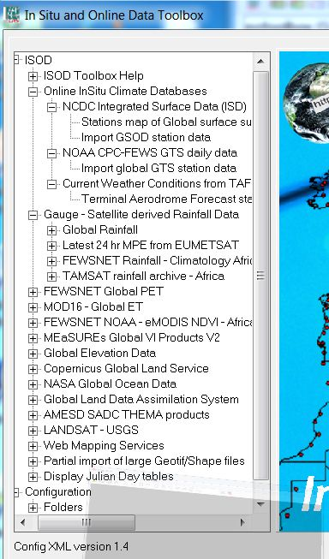
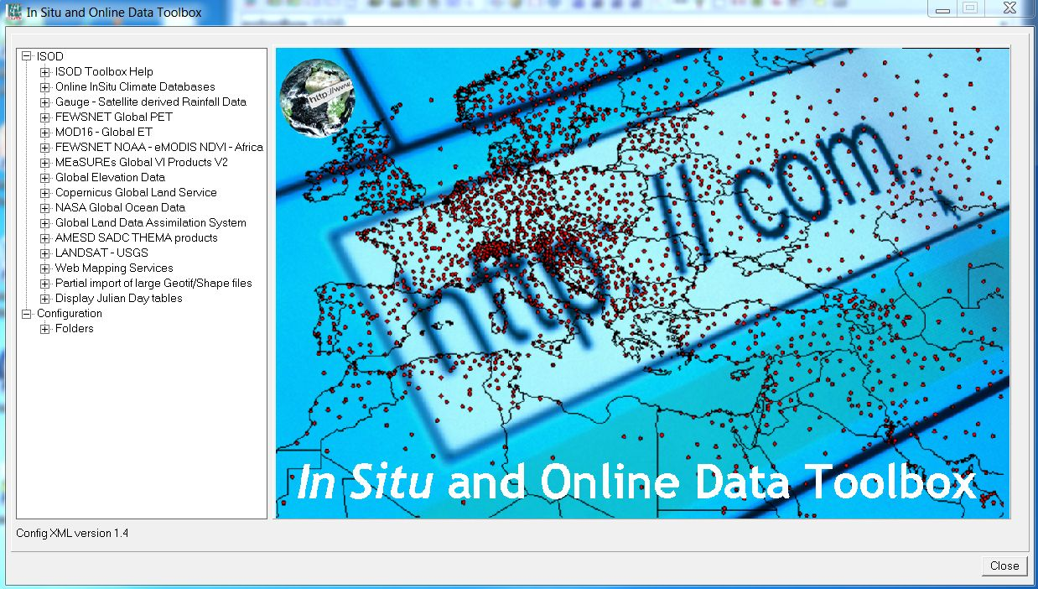
In-situ and on-line DATA toolbOx
NeaR real timE Surface OBSERVATIONS data: land & OCEAN
AND TIME SERIES OF WEB-BASED
EO DATASETS (OPEN ACCESS)
using ftp or http transfer

Slide 11
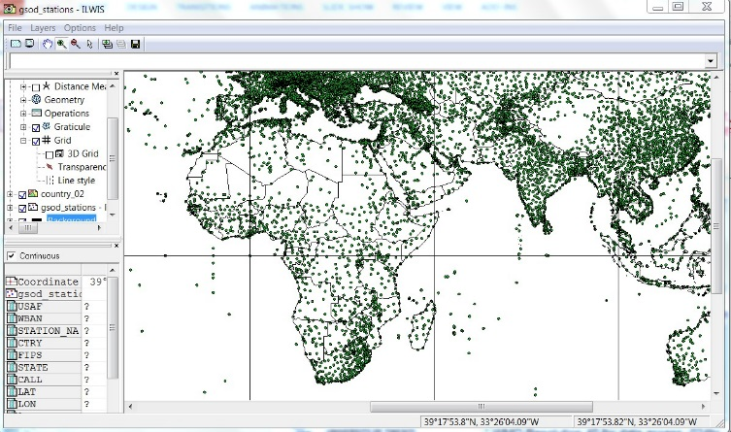
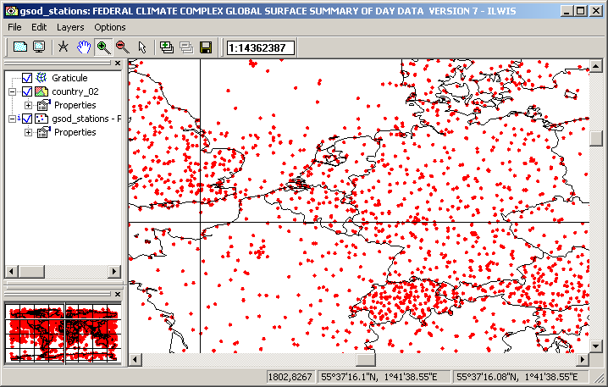
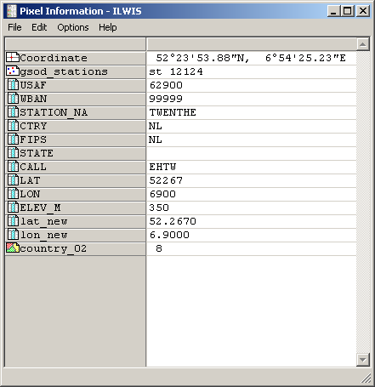
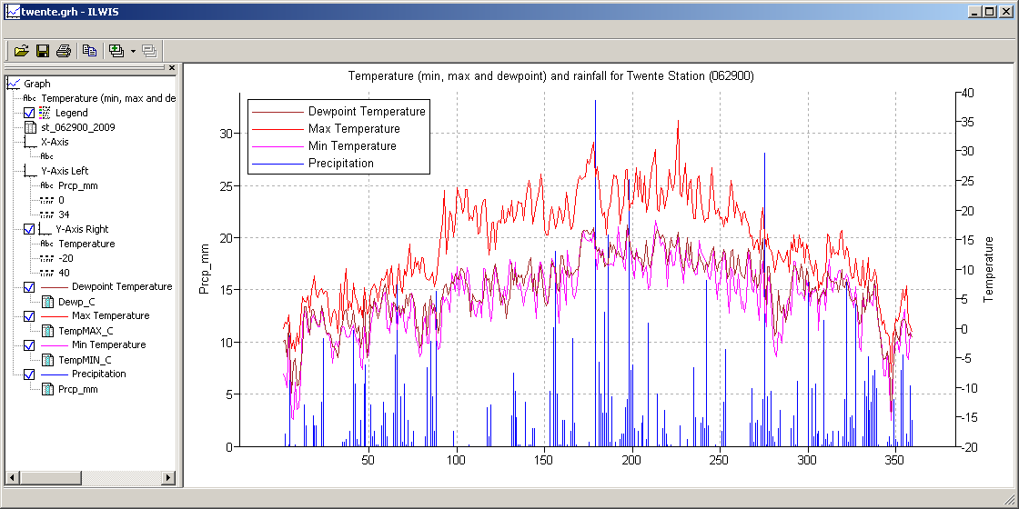
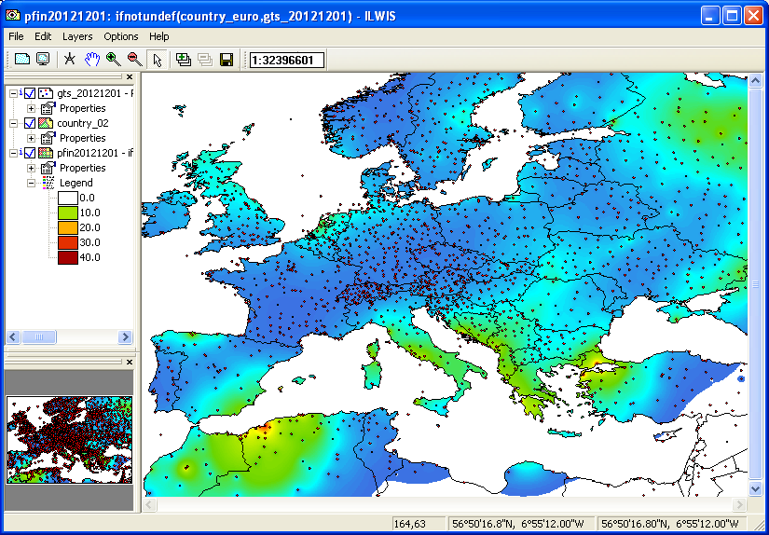
EXAMPLE
ROUTINE
On-line Weather & Climate Data -> laptop
Retrieval from databases and (pre-)processing to ILWIS open data
Various in-situ online climatological data resources:
SYNOP, *GSOD, METAR, TAF,..
GTS stations and precipitation
GSOD* station and yearly records
* WMO Resolution 40 for data access -024hr

Slide 12
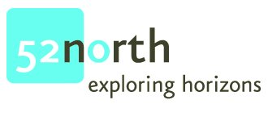

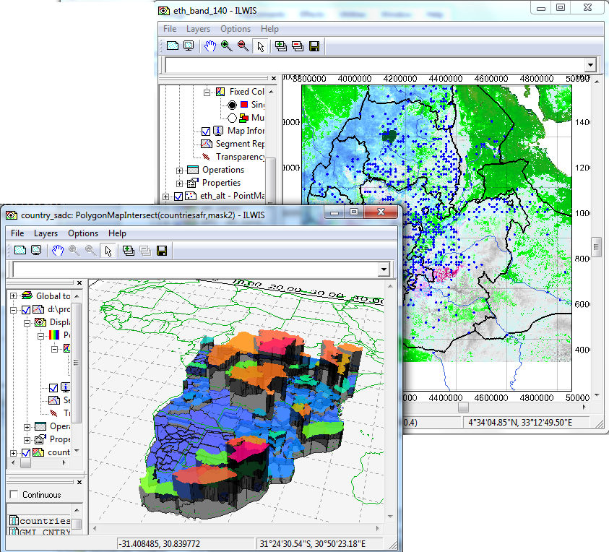
Ilwis open
open source eo & geospatial data analysis (core)
Key features:
integrated raster and vector design
import - export of widely used geospatial data formats
on-screen digitizing
comprehensive image processing tools
orthophoto, image georeferencing, transformation and mosaicking
advanced modeling and spatial data analysis
3D visualization & animation (optional 3D)
auto resampling of different spatial geometries
rich projection and coordinate system library
geo-statistical analyses & interpolators
Spatial Multiple Criteria Evaluation
Web Mapping & Processing Services
Hydrological digital terrain modeling
Surface Energy Balances (SEBS) functionality
Application Plug-in architecture (Toolboxes)
3.72
Compact main package: 25 MB only!

Slide 13
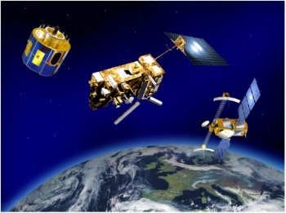
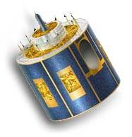
GEONETCAST and in-situ data streams for CLIMATE OBSERVATION & EARLY WARNING SYSTEMS
The Global Meteorological satellite constellation is data backbone with geostationary and polar orbiters, but also many 3th party providers (VITO, INPE,…) and other satellite data & products
WATER
Precipitation
MSGMPE NRT
TAMSAT 10-D
GPM NRT
FY-2D/E (ASIA)
INPE (LAm)
ET (evapotrans..)
LST, DWSF…
AET-LSASAF
SM (soil moisture
METOP SSM/I
SENTINEL-1A
Other
ENERGY
SOLAR Radiation
DWSF, DWLF, PAR
LST, SST
WIND Energy
MSG Atm.motion.vecs
Metop ASCAT winds
*GTS METEO MODEL
outputs -> Forecasts
(*MetService distribution)
-> Weather model but also
Agricultural and
Hydrological forecasting
FOOD SECURITY
LULC: Land Use – Land Cover
MSG NDVI, LST, FVC,…
SPOT-VGT, PROBA-V
METOP a/b, NPP
Many other via on-line
retrieval (e.g. ISOD OTB)
LDAAC: e.g. MODIS,…
USGS: LANDSAT-8
ESA: SENTINEL-2 (& 3)
INPE (Br): CBERS collection
- ….
Some GNC data snapshots ->

Slide 14

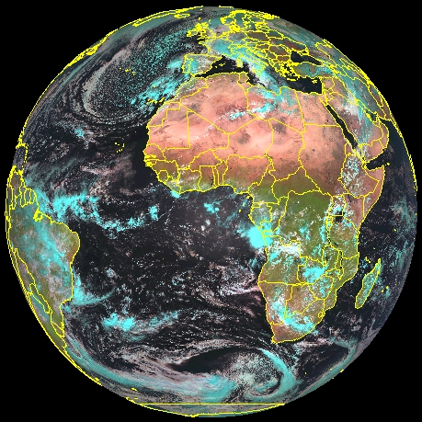
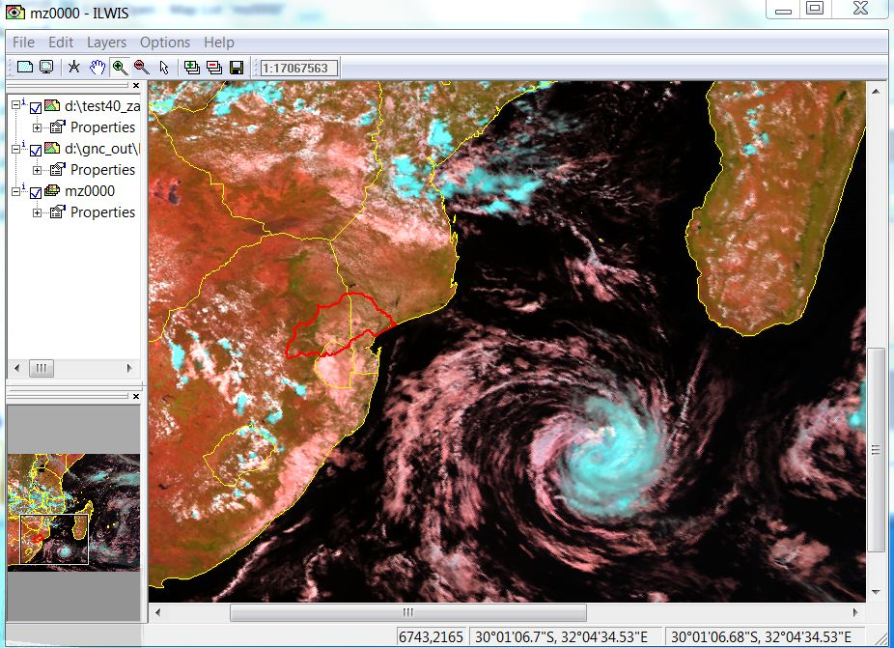
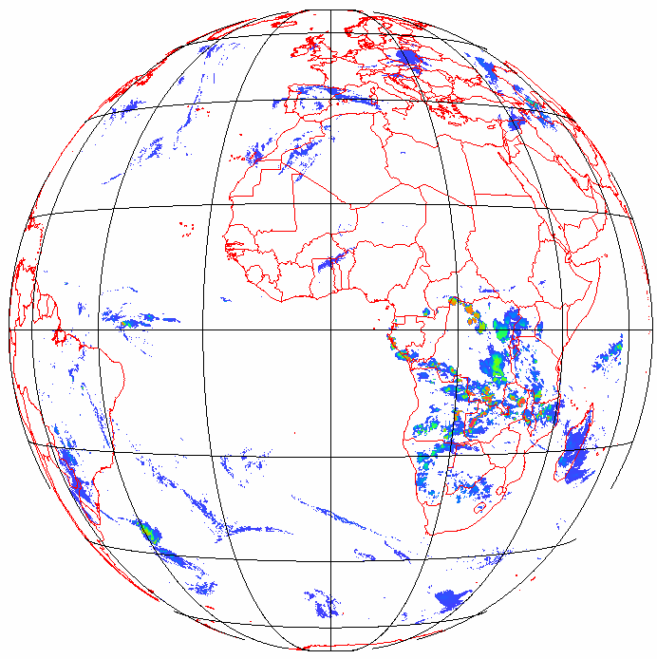
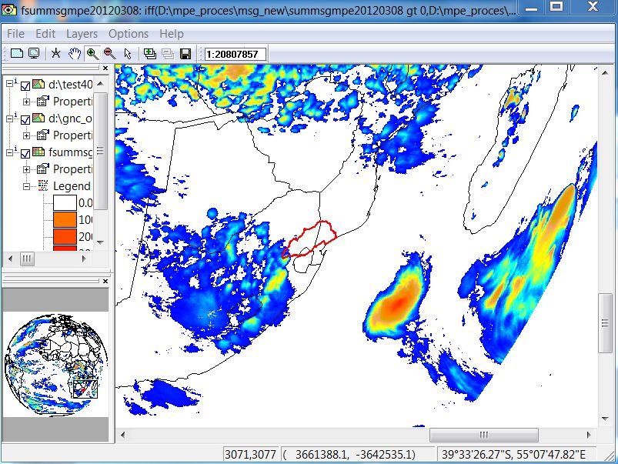
[1] MSG Real time weather and rainfall monitoring over Europe & Africa: ->ex. Incomati basin, SA
Event shown: 08 March 2012 (2012-03-08) 1100 UTC view and accumulated 24hr MSGMPE
Monitoring at 15-min intervals – 3 km resolution
Available less then 10’ after real observation via
GEONETCast DVB-S or EUMETSAT website
-> Use: Extreme rainfall estimation, tropical depressions, thunderstorm activity, etc.
-> e.g. Flood risk early warning, forecasting and prediction

Slide 15
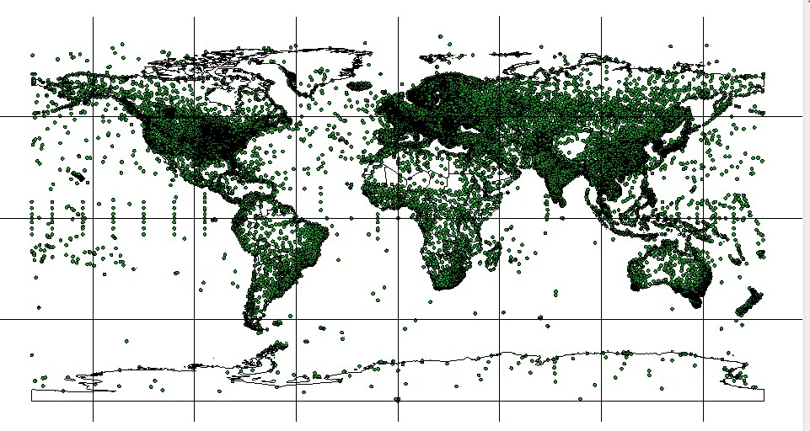
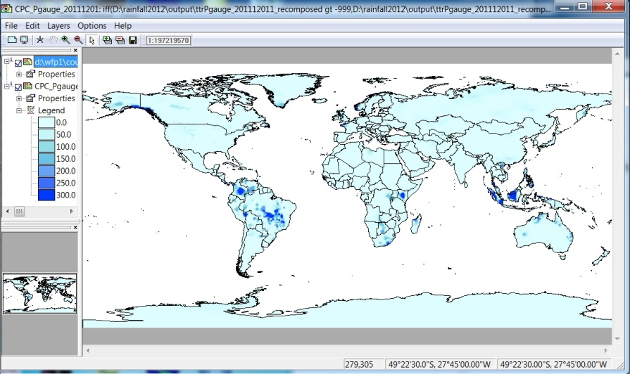
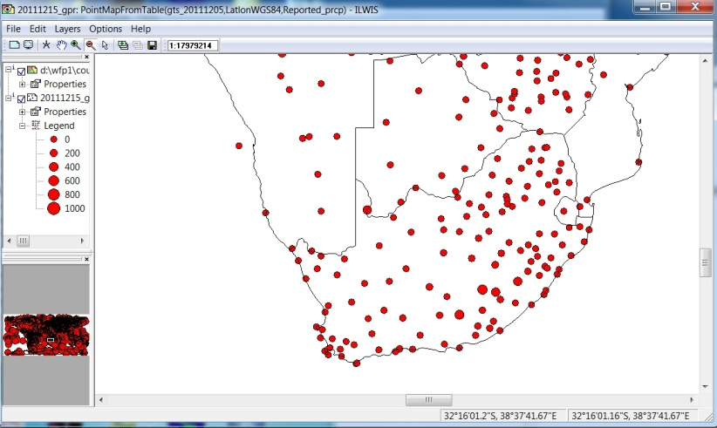

[1] Global in-situ (gauge) data analysis
Example GPR (precipitation) via GTS
Daily - 024hr delayed GTS (Global Telecommunication system - WMO)
Not only
satellite data
but also in-situ
data can be
accessed &
processed
by the OTB
e.g. For validation and bias control of space data

Slide 16



[2] Satellite ET: Monitoring of ET component of water cycle over large areas at med. spatial & high temporal frequency (e.g. 1km, daily to sub-daily)
ET: Evapotranspiration (example below)
Daily ET estimate - Zambezi basin – region using
SEBS - SURFACE ENERGY BALANCE SYSTEM –
ILWIS Open Plug-in
Ps. most of the EO and in situ meteorological data can be obtained from GNC DVB-S, ECMWF server

Slide 17



[2] Meteosat land surface & ET data in near real time Received every 30’ minutes & 24-7
A river Basin evaporative use monitor
Monitoring of land surface
variables at diurnal and
longer time scale over
Europe, Africa, Middle-East
e.g. evapotranspiration,
land surface temp,…
ET 30’ flux
20130808
1200 UTC
Time series
evaluation on
pixel, area
or basin (demo
dataset)

Slide 18





[3] Soil moisture estimates from satellites: Metop / ascat surface soil moisture index
Ref. quick look SA
Operationalization
research in progress
Ref. Geoville, etc.
ASCAT orbit 12.5 km scan during METOP-a/b satellite overpass, processed with Ilwis Open
Unit: % saturation [0-100]
METOP 2011-05-02 1839UTC

Slide 19




[4] Vegetation & land use monitoring: From coarse 3k, 1K to Medium high res. 10m
SATS: Meteosat- metop – spotvgt – modis & landsat (ftp) - cbers
Several indicators of land cover, vegetation status, crops can be observed
via GEONETCast data streams (or via ISOD). From simple vegetation indices
to biomass productivity, land surface temps, areal coverage and so on.
Choice of satellites:
MSG 3k – 30’
METOP 1k – 24h
SPOT-VGT 1k – 10d
PROBA-V 1k/300m – 10d
eMODIS 250/500m – 5/10d
LANDSAT8 30m – +-21d
CBERS2B 20m – 10m
Data source: NDVI Africa
- CBERS2b inset Maputo
- Seasonal pixel profile NDVI

Slide 20




Some project cases quick looks of open toolboxes for water & food security
-
Water & Food Security – Ethiopia Toolbox
  Assessing numbers of people at risk (UN-WFP 2011-13)
GIACIS project: GeoData for Innovative Agricultural Credit
Insurance Systems (2014-2017)
AMESD – SADC Toolbox (dedicated to SADC region)

Slide 21









GEONETCast services for food security early warning - Ethiopia
ITC cooperation with Government of Ethiopia and WFP: Early Warning for Food Security to support their Livelihood Early Assessment & Protection program
Use of GEONETCast satellite and in-situ data reception and analysis systems and GNC Toolbox open source software technologies
Focus: capacity development (training) & research
Partners:
  MOArD/DRMFSS Disaster Risk Management Food Security Sector Agency
UN World Food Program
Country Office Ethiopia
Department of Water Resources

Slide 22









Some wfs - Ethiopia project outputs : GEONETCast & in-situ DATA for food security early warning
GEONETCast4wfs project outputs (ITC-DRMFSS-NMA-WFP)
Satellite rainfall MSG MPE, TAMSAT,
Surface soil moisture indices e.g. Metop/ASCAT
actual evapotranspiration estimates (LSA-SAF AET) & in-situ NMA
vegetation indices (e.g. NDVI SPOTVGT, MSG, FVC)
To compute crop water requirement WRSI & crop yield reduction (YR)
affected population # early warning at district level scale (LEAP)

Slide 23




Current developments -> GIACIS
project (with Ethiopia)
Geodata for innovative agricultural credit insurance systems
Increase weather-based risk and agricultural forecasting capacity (in cooperation with Ethiopian actors (public private p.): NMA, ATA, Kifya Insurance, ITC
Data readers and visualizations for GEONETCast disseminated GTS forecast data; GFS, FS (Global and Integrated Forecasting Systems (of NOAA/NWS/NCEP, ECMWF, MeteoFrance Arpege, UK MetOffice UMD)
Development of spatial insurance model (applicable to small holders, farmers)
Ps. All made and processed using Ilwis Open

Slide 24








Dedicated GEONETCast Toolbox for SADC Earth Observation Services in ILWIS Open
Developed by SADC project & education partners: BDMS, CSIR, ARC, UZ, UB, BCA, ITC
Data products disseminated via EUMETCast

Slide 25






AMESD-SADC GNC toolbox: snapshots
An Ilwis open v.3.72 plug-in
Rainfall analysis and
Onset of rainy season
determination
Biomass and crops
Graphic output: Cumulative
dry matter productivity
Training opportunities (in 2013) using Distance
Education by our SADC partners UZ, UB & BCA
using the ITC digital BB environment
ABBA-MSG fire incidence
Automated Biomass Burning 3-band Algorithm

Slide 26




Develop your own earth observatory application
Open data & design permits to create your own dedicated OTB
Standard GEONETCast Toolbox v.1.3 -> generic & global application
Import of Geostationary Constellation: MSG-1,2, MET-7, GOES-E/W, FY-2D/E, MTSAT
Import of Polar Orbiting satellites: EPS/METOP-a, NOAA -series, JASON-2,..
EUMETSAT MPEF and Satellite Application Facilities (SAF) data e.g. LSA-SAF
3th party Data: NOAA, CMA , INPE-CPTEC, MODIS products, SPOT Vegetation, DevCoCast
Real time MSG visualization. calculation of solar and MSG zenith and azimuth angles,…
In-situ & Online Data Toolbox v.1.0 -> generic & global data
Direct import of data from internet online archives related to in-situ climatological observations, gauge and satellite derived rainfall estimates, weather forecasts, normalized difference vegetation indices and elevation information. Examples: GSOD, GLDAS, ERA-I, GPR, CMORPH, FEWSNET,..
AMESD SADC project Toolbox -> regional Southern African countries
Import and pre-processing of all products disseminated by the AMESD-SADC program related to agriculture, drought, fire and long range forecasting. Developed together with AMESD-SADC Regional Implementation Centre, Botswana Department of Meteorological Services (BDMS).
Early Warning for Water & Food Security -> project Toolbox for country
Import and processing of data from GEONETCast for water and food security monitoring in Ethiopia, like MPEF, SAF, VGT, TAMSAT and fire products, real time visualization, surface soil moisture and WMO GTS MDD service. Developed together with National Meteorological Agency, Ministry of Agriculture and UN-WFP Ethiopia.

Slide 27






concluding remarks (1): road ahead
The GEONETCast data dissemination system (backbone meteorological satellite constellation and data) contains and can provide important geo-information for weather and climate monitoring & early warning
Weather, hydrological and agriculture related satellite data are available
Fast and open access to satellite and in-situ data, combined with Open Source Tools foster rapid uptake of remote sensing concepts and design of own satellite applications for climate information provision to the public
EO for scientists, but we need more Earth Observations (EO) for the application sector and public

Slide 28







OPEN ACCESS to our OTB (OS TOOLBOXES)
Capacity Development & Research @
Software portal: @ 52NORTH (OS consortium partner)
  Software to handle and process the EUMETCast and GEONETCast data received is freely available through the Earth Observation Community @ (http://52north.org).
Capacity development portal: @ ITC
  Further information, hands on exercises, sample data
  http://www.itc.nl/Pub/WRS/WRS-GEONETCast)
Registered components of GEO
  -> GEOSS Common Infrastructure

Slide 29




Thank you and for further information, contact us @ www.itc.nl or www.utwente.nl
The ITC GEOSS – GEONETCast team
Chris Mannaerts c.m.m.mannaerts@utwente.nl
Ben Maathuis b.h.p.maathuis@utwente.nl
Bas Retsios
Martin Schouwenburg
Petra Budde

