Slide 1
Strengthening National Climate Information/ Early Warning System (CI/EWS) Projects
Country Report for Malawi
UNDP CIRDA Country Program Managers Workshop 25-27August 2015 Addis Ababa, Ethiopia

Slide 2
Outline
Introduction
Sectors contributions to CIRDA objectives and Social-economy
Future plans
Challenges

Slide 3
Roles and responsibilities of institutions and stakeholders

Slide 4
CIRDA overall objectives
Meet the need to generate, process and disseminate high quality and timely weather and climate data that is comprehensive, reliable, accessible and in a form that end users can understand and apply
Enable vulnerable communities, farmers and policymakers to access and use climate data to make informed decisions to respond to a changing climate
Bring innovative, reliable, low cost, easily maintained technologies with national coverage and cellular links to hydro met agencies
Engage private sector users of weather data as partners to ensure the sustainability of improved weather observation systems
Impact human lives, food and global security

Slide 5
Some key institutions/Agencies that contribute to the accomplishment of the CIRDA objectives
Office of the Vice President- Department of Disaster Management Affairs
Ministry of Natural Resources, Energy and Mining- Department of Climate Change and Meteorological Services
Ministry of Agriculture, Irrigation – Department of Water Resources
Famine Early Warning System Network
The Enhancing Community Resilience Programme (ECRP) - Christian Aid led Consortium
DISCOVER Programme Consortium led by Concern Universal
Farm Radio in Malawi
Civil Society Network on Climate Change -Participatory Scenario Planning

Slide 6
Key contributions to the CIRDA objectives
Department of Disaster Management Affairs (DoDMA)
Mandate : Coordinating and directing disaster risk management programmes in the country in order to improve and safeguard the quality of life of Malawians, especially those vulnerable to and affected by disasters
Key contributions:
Developed a National DRM communication strategy which highlights high quality and timely weather and climate information that is comprehensive, reliable, accessible and in a form that end users can understand and apply.
Completion of an assessment of existing centralized and decentralized EWS which will be used to inform development of communication protocols among stakeholders esp. gov.
Developed NDRM policy. The policy is advocating for the establishing comprehensive, effective and people centred EWS.
Enhanced coordination of DRM stakeholders at all levels through DRM platform

Slide 7
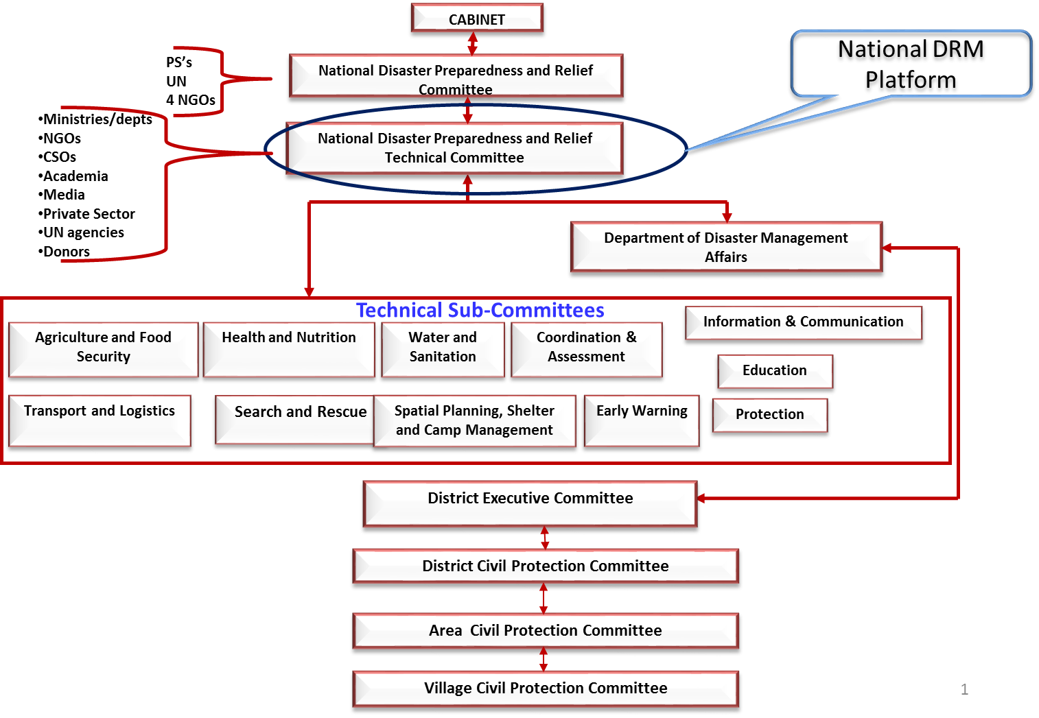
National DRM institutional structure

Slide 8
DoDMA Social Economic Contribution
Provision of data on social and economic losses through post disaster assessments e.g. recent Post Disaster Needs Assessment. Report launched, which reflects the damage and losses in monetary terms which has been factored in the national budget for recovery and reconstruction
In process of developing a national database for disaster Information management and sharing. It will also be linked to other portals.
Just launched hazards and vulnerability atlas and geo-data base that is providing information on areas that are affected by various hazards and also on vulnerable communities that are affected by the hazards

Slide 9
2. Department of Water Resources (DWR) contribution to CIRDA
Mandate :
Achieve sustainable and integrated water resources management and development that make water readily available and equitably accessible to and used by all Malawians in pursuit of their human development and socio-economic advancement of the country’s natural ecosystems.
Key contributions
Carried out a detailed analysis of hydrometric network in the seven flood prone areas and identified sites for setup of hydro monitoring sites for flood forecasting and warnings
Designed Data collection mechanism for daily transmission from remote sites to the base centre (GPRS/GSM technology)
Rehabilitated 14 hydrological stations and carried out community sensitization on the importance of hydrological equipment;
Construction of Data Collection Platform to house hydrometric data logging system is ongoing- so far 6……..
Installed 3 data loggers in three flooded rivers
Consultant/Supplier delivered manual gauge plates and data loggers for both hourly and daily transmission hydrological data

Slide 10
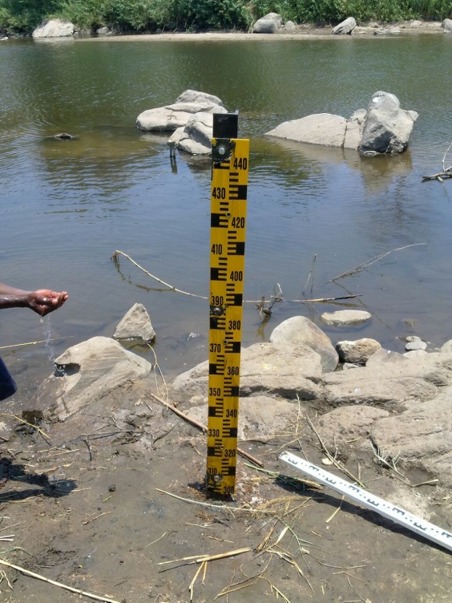
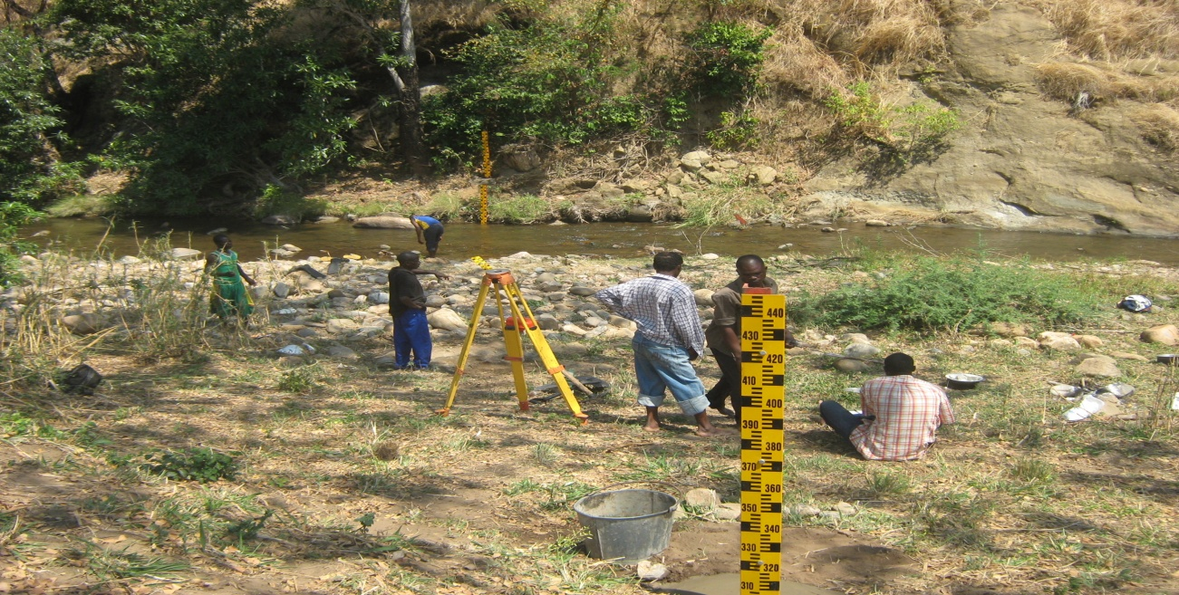
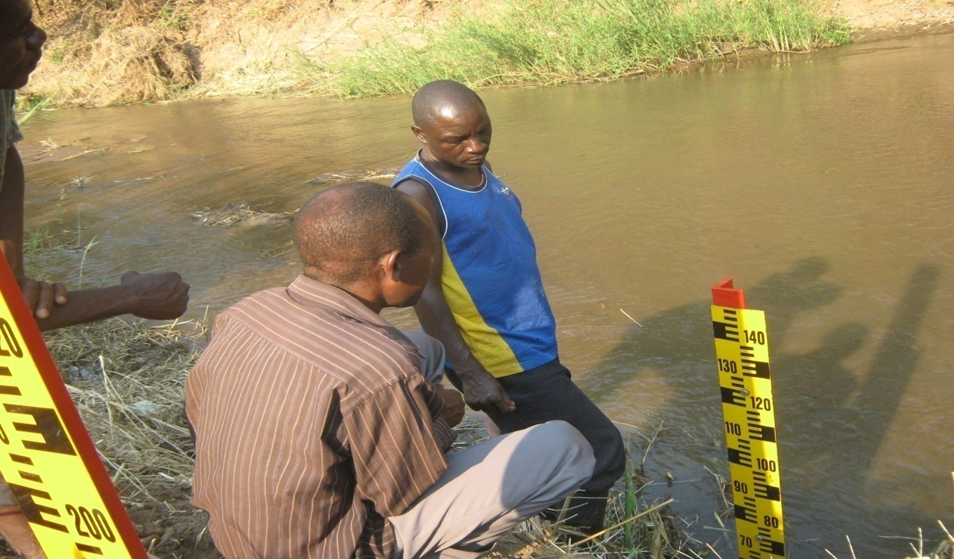
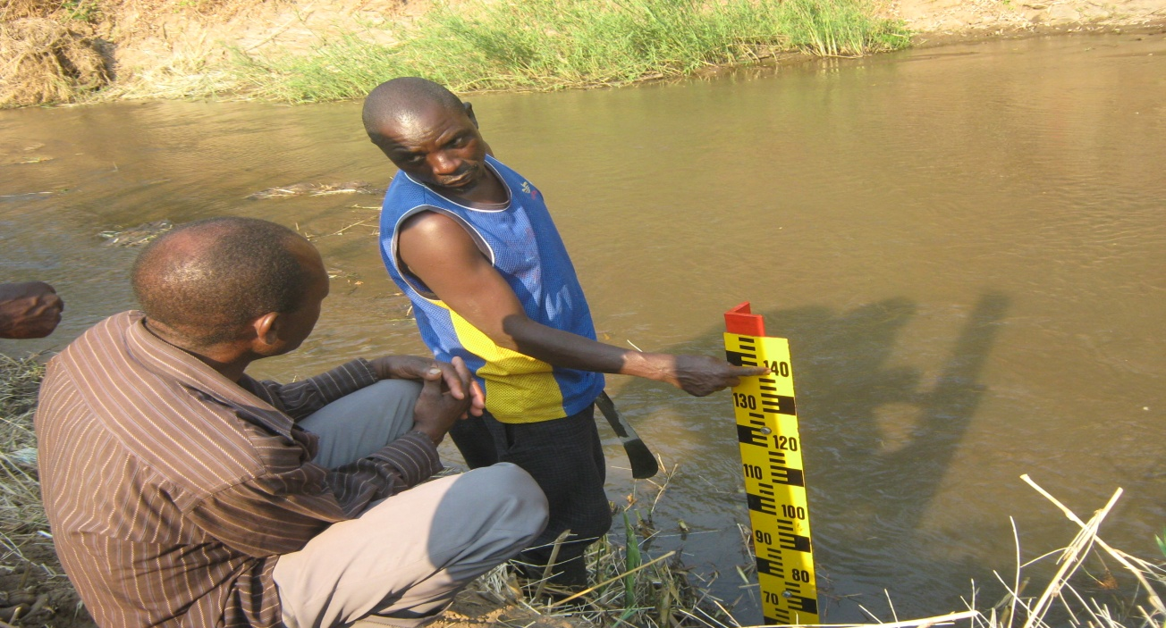
Pictures ….. Installations and rehabilitations

Slide 11
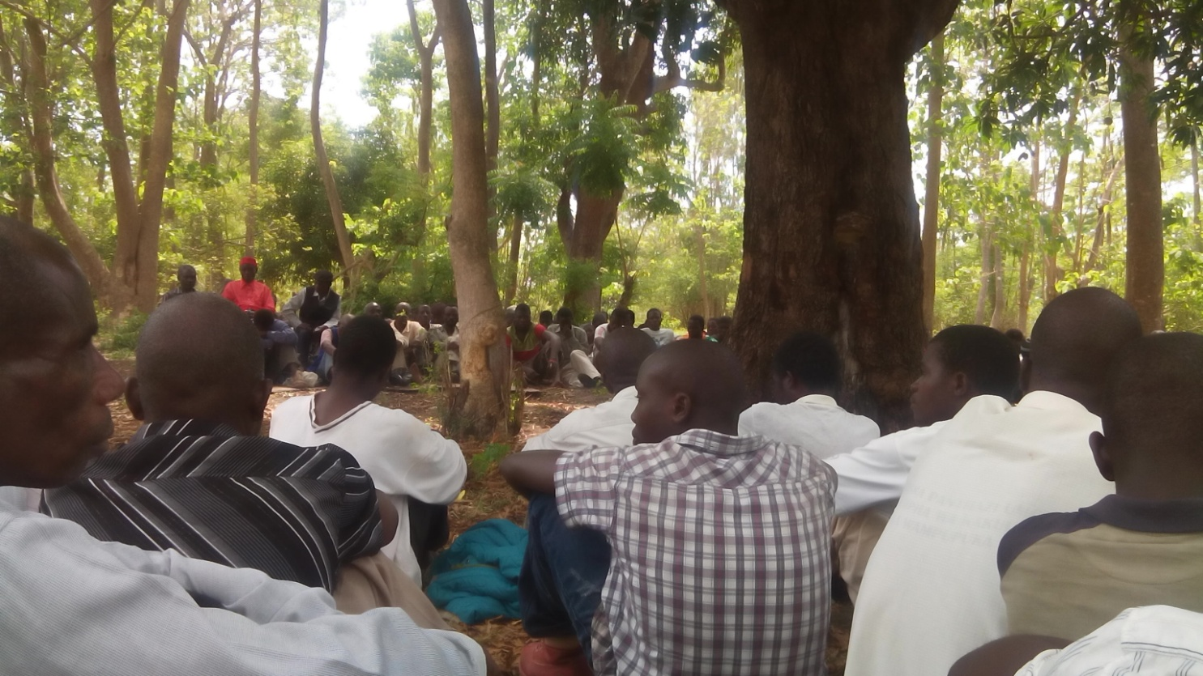
Sensitization and community trainings

Slide 12
DWR social economic impacts
Provide accurate and reliable information to the general public on water resources in general and specifically issue flood warnings with good lead time hence reducing the impacts the flood may cause on the inhabitants of the flood prone areas.
Provides hydrological data to Government, non Government institutions and water utilities that use the data for social and economic uses such as irrigation, hydropower generation etc
In liaison with the DCCMS provide information to the Agriculture sector on the impact of the water resources trend if has on farmers prior, during and after the rainy season.
Provide hydrological trends to water resources developers in the public infrastructure such dams, roads network, irrigation schemes
Back bone for water resources monitoring as a key element in monitoring of climate change impacts in Malawi

Slide 13
Department of Climate Change and Meteorology Services contributions to CIRDA objectives
Mandate:
Conserve, protect and manage the environment, climate, forests and other natural resources for sustainable socio-economic development of Malawi
Key Contributions
Procured and installed conventional instruments for 21 weather stations
33 AWS were rehabilitated using procured AWS spare parts
Procured 10 and installed 6 AWS which are fully functional
Linked community radios to the NMC and PWS as sources of weather information
Weather and climate early warning information disseminated through district climate information centres and CSOs (Red-cross, Christian Aid)
Incorporated weather and climate early warning in the national DRM communication strategy
Produced information, communication and education materials on weather related disasters such as leaflets, posters, pamphlets and documentaries targeting the general public and schools

Slide 14
DCCMS……….continued
Raised awareness through training of ACPC/DCPC / VCPC, District media staff and community radio stations on interpretation and utilization of weather forecasts and warnings
Capacity building for DCCMS staff in various areas of expertise i.e. CISCO NETWORKING, COSMO model, weather forecasting, factory training on installation and configuration of AWS.

Slide 15
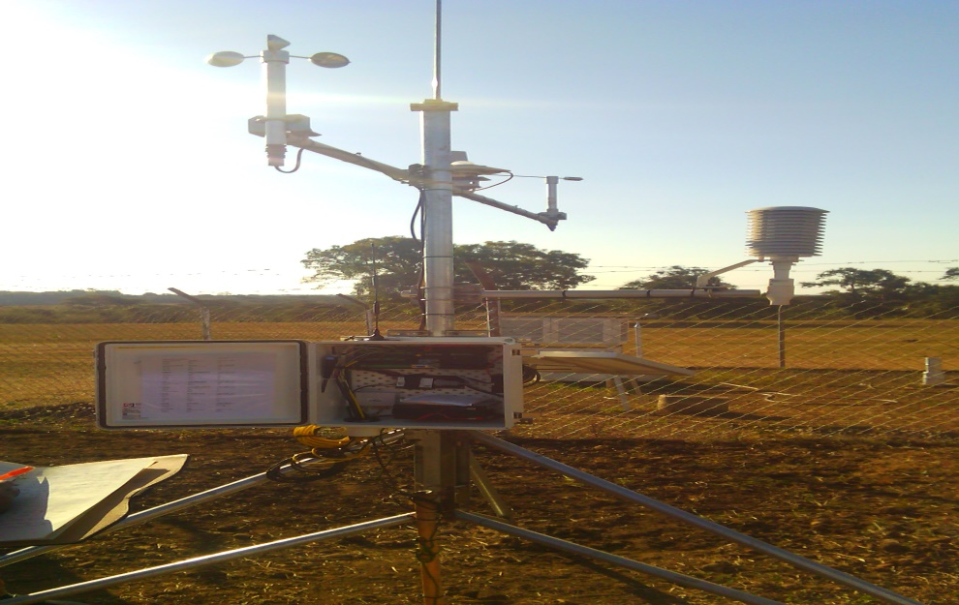
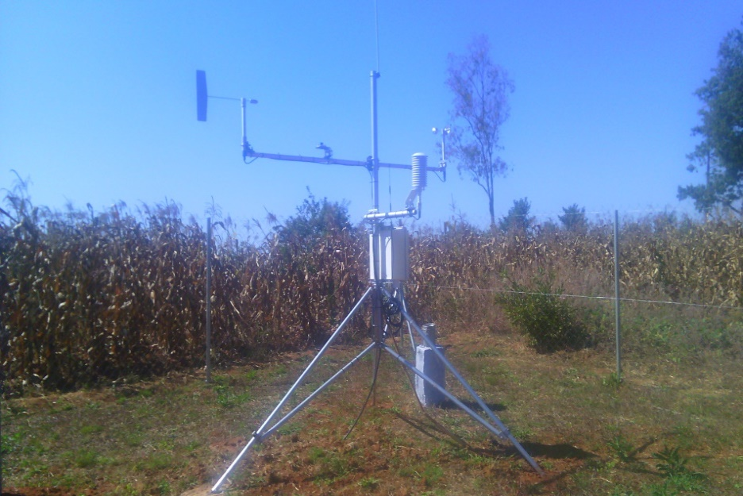
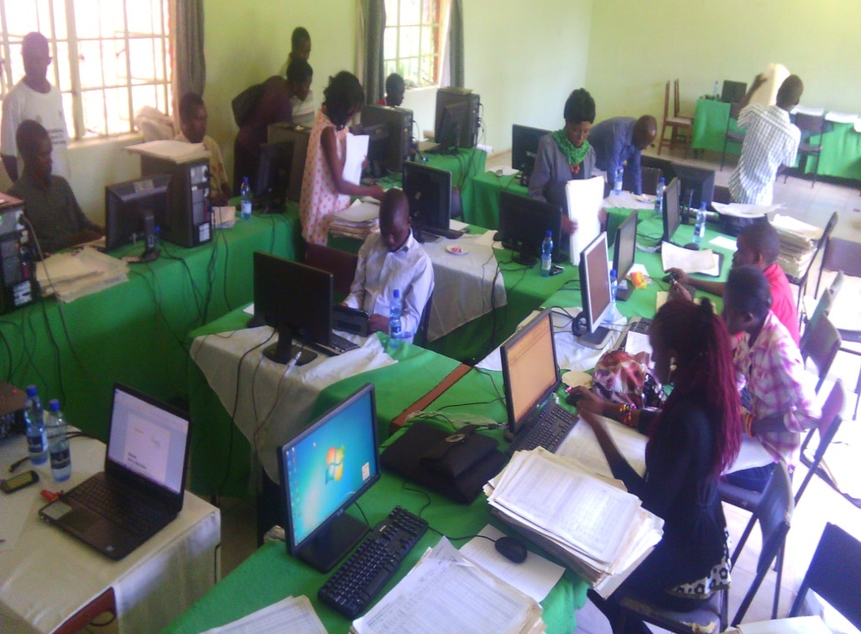
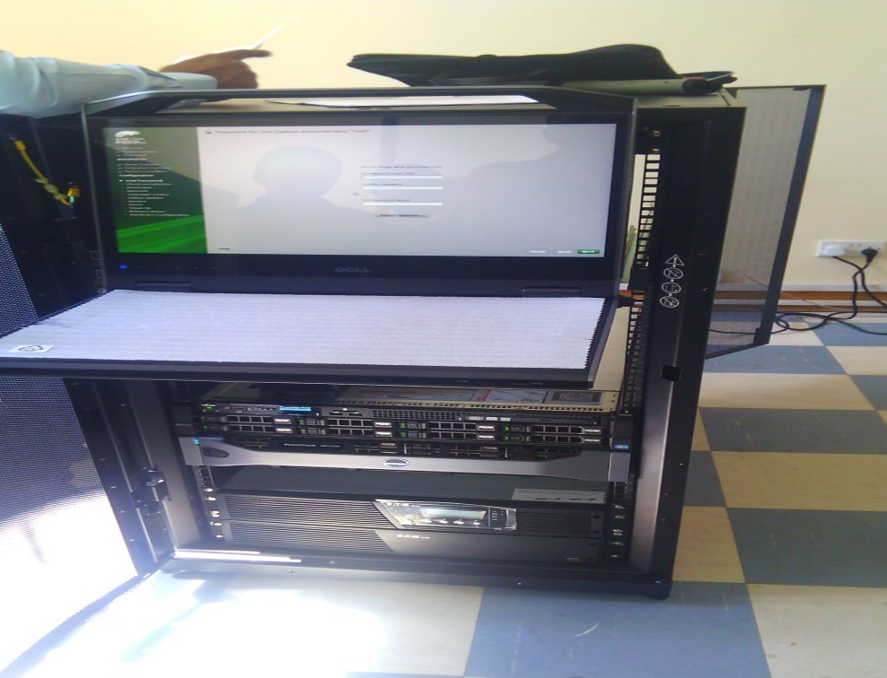
Installed automated weather stations and Training in COSMO model

Slide 16
DCCMS social economic contributions
Reduction of loss of life and property due to early warnings of natural hazards helps to minimize recovery costs hence resources can be redirected to other areas of development
Information provided to the Agricultural and Natural Resources sectors helps the sectors to prepare in advance as well as improve productivity
The public is made aware of impending hazards and they are advised to take appropriate action to ascertain their well being
Provide data and information for planning and implementation of various programmes

Slide 17
Some key institutions/Agencies that contribute to the accomplishment of the CIRDA objectives in Malawi
5. DISCOVER Programme Consortium( led by Concern Universal)
Collaborated with DCCMS and ESOKO to provide district specific weather messages to farmers in 5 districts of Malawi ( Karonga, Salima, Dedza, Balaka and Nsanje)
Capacity building of VCPCs in the establishment and monitoring of community based Early Warning Systems(involving satellite mapping, mobile phone technology, river gauges, radio etc).
VCPCs in upland and lowland areas are a part of communication network linked by cell phones that communicate alert status of river levels during the rainy season. For example, orange alert status activates VCPC evacuation plans mobilising vulnerable populations to designated evacuation points.

Slide 18
Key institutions/Agencies…continued
6. The Enhancing Community Resilience Project (ECRP) Christian Aid led Consortium
Collaborated with DCCMS and ESOKO to provide district specific weather messages to farmers in 7 districts of Malawi ( Kasungu, Machinga, Mwanza, Thyolo, Mulanje, Chikwawa and Kasungu)

Slide 19
Key institutions/Agencies…continued
6. Civil Society Network on Climate Change (CISONECC)
In partnership with EAM, TLC and CARD provides a platform that enables sharing, understanding, interpreting and communicating climate information, by giving space for dialogue on local adaptation issues and options. Target group is the local farmer
Through PSP, enables the communities and local governments to use seasonal forecasts to develop climate resilient plans and advisories for improved livelihoods

Slide 20
Key institutions/Agencies…continued
7. Famine Early Warning System Network-
a leading provider of early warning and analysis on acute food insecurity
support and conduct training and capacity-building for national early warning systems, weather services, and other agencies.
8. Farm Radio in Malawi
Timely dissemination of early warning information to communities around lake Chirwa, Zomba districts
Dissemination of information on weather forecast released by DCCMS to the local farmers in Zomba district

Slide 21
Future plans
Agreement with Globe Internet Ltd (ISP) to allocate DCCMS space in their server to host the ftp link for receiving data from DWD
Access Malawi (MSP) hosting AWSs and lightning detection system (demo with Earth Networks)
FFGS training and subsequent activities jointly conducted with Hydrologic Research Centre (HRC), California
Hosting of AWSs by Lilongwe Water Board, incl. support staff
Weather EW messages dissemination by NGOs and private radio stations
MOU with the Physics Dept, UNIMA, for creation of a microwave link between Weather Studio and MBC studio, and possible similar linkage between NMC and all Met stations in the future
Intensification of the awareness meetings targeting people at risk
Strengthen coordination forums through DRM platforms

Slide 22
Future plans
Finalization of procurement of various equipment;
Installation of remaining four automatic weather stations;
Continuation of the installation of spare parts for conventional and Automatic weather stations
Integration of early warning information in district development plans;
Data management using CLIMSOFT; and Digitization of meteorological data for 66 rainfall and subsidiary stations
Extend DCCMS WAN to principal meteorological stations
Development of training packages and tool kits
Undertake user needs assessments for meteorological information and services
Support the training of four meteorological forecasters

Slide 23
Challenges and Constraints in undertaking EWS projects in Malawi
Vandalism of installed solar panels
Coordination among projects promoting similar initiatives within the same catchment areas
lliteracy levels as evidenced by targeted communities not utilizing the forecasted information
Frequent black outs, hence failure of the automated EW equipment's to provide timely and reliable information
Inadequate budget allocations to sectors
Most of the DRM/ Climate Change projects being undertaken are pilots, hence failure to address underlying factors of Climate Change
Most activities largely procurement in nature, takes time

Slide 24
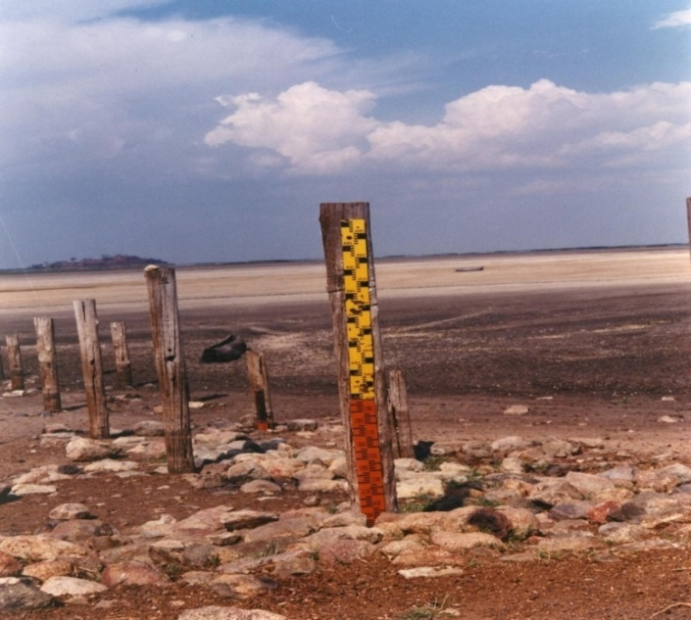
THANK YOU

