Slide 1
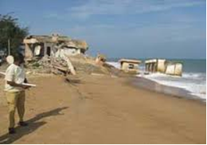
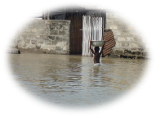
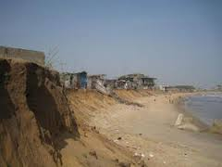
Reports from Strengthening National Climate Information/ Early Warning System (CI/EWS) Projects
BENIN
Dr-Ing. Arnaud ZANNOU
Benin CI/EWS Project Director
UNDP CIRDA Workshop, 15-17 March 2016, Livingstone, Zambia
Notes:
Instructions: Complete items in red italics

Slide 2
Benin CI/EWS Project Delegates
N° | Name | Occupation
1 | Dr-Ing. Arnaud ZANNOU | National Director of EWS-Project : Project management and coordination
2 | Mr Marcellin NAKPON | General Director of Benin National Meteorological Agency
3 | Mr Georgino HOUESSOU | Superintendent (policeman), Assistant to General Director of Benin National Civil Protection Agency (in charge of disaster management)
Notes:
This slide and the two that follow are intended to help you make three slides per Department/Agency.
This effort will result in a stack of slides that cover your nation’s government agencies that are relevant to the accomplishing the objectives of the CIRDA program. You should have contacts in all these agencies. E.g., National Meteorological Service, Ministry of the Environment, Ministry of Agriculture/Ag Met Extension Program, Ministry of Water, Ministry of Emergency Management.
Do NOT make the slides too detailed. Focus on high-level, big-picture items.

Slide 3
2 major project accomplishments since Addis
1 | Meteo, hydro and oceano equipments already installed, and data teletransmitted every hour
2 | Complete identification of the thresholds values related to 4 Alert levels ( green, yelow, orange and red) for 4 risks (flooding, drought, coastal erosion and sea level rising)
Notes:
This slide and the two that follow are intended to help you make three slides per Department/Agency.
Thigreens effort will result in a stack of slides that cover your nation’s government agencies that are relevant to the accomplishing the objectives of the CIRDA program. You should have contacts in all these agencies. E.g., National Meteorological Service, Ministry of the Environment, Ministry of Agriculture/Ag Met Extension Program, Ministry of Water, Ministry of Emergency Management.
Do NOT make the slides too detailed. Focus on high-level, big-picture items.

Slide 4
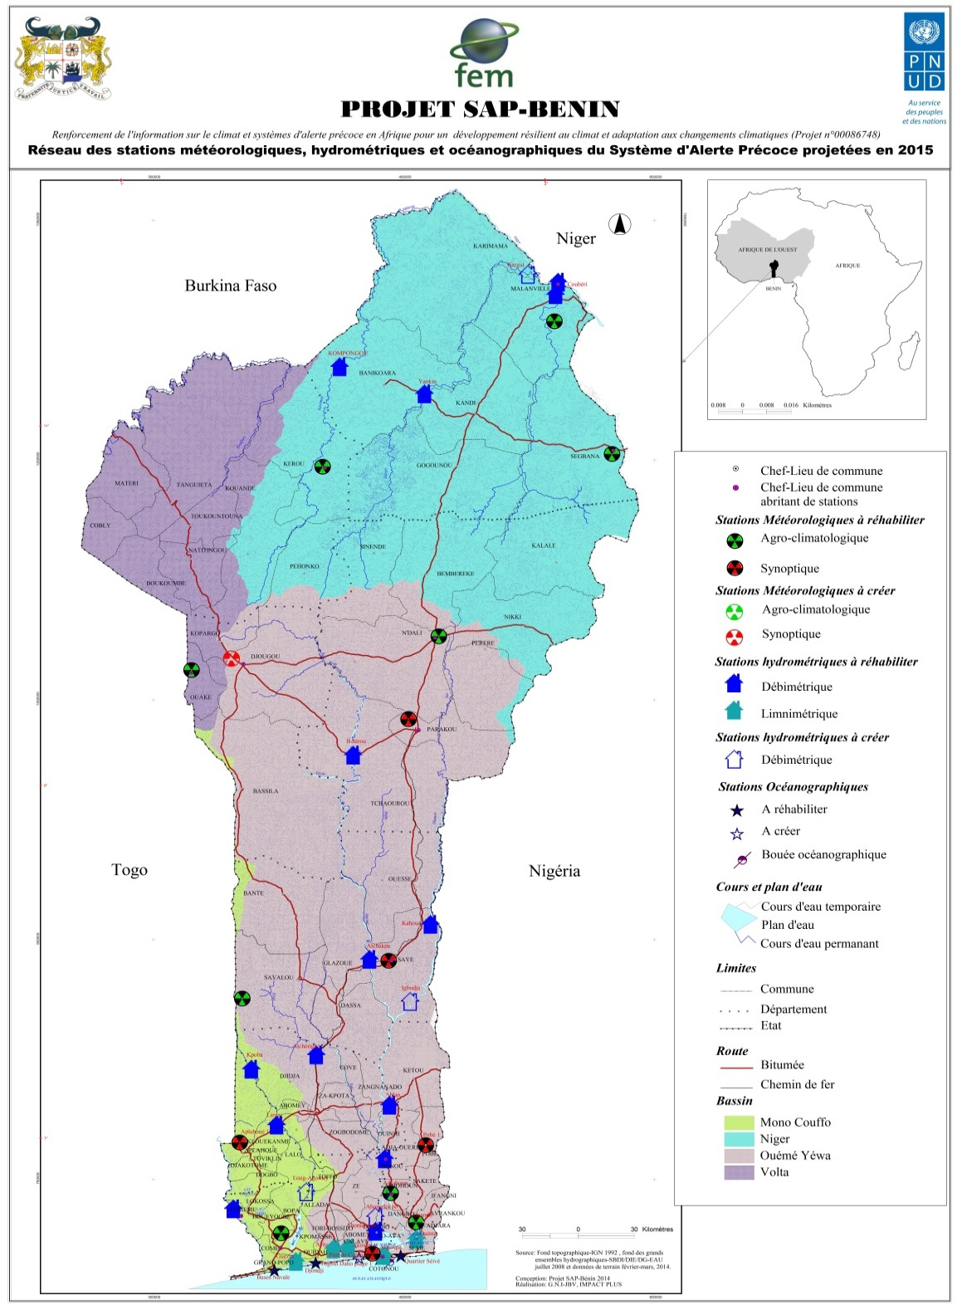

Slide 5
Main involved Departments/Agencies
Climate info and warning producers
Warning bulletins Users
(Disaster and crisis focus)
Climate info Users (Development sectors managers and actors)
Development partners
Water Depart.
Disaster Mg Agency
CC Depart.
UNDP
Meterolog. Depart.
Disaster Committee
Environm. Depart.
GEF
ASECNA
Hum. NGO
Subst. Dev. Centre
Ocean Institute
UN System
Env-Clim. NGO
Notes:
This slide and the two that follow are intended to help you make three slides per Department/Agency.
This effort will result in a stack of slides that cover your nation’s government agencies that are relevant to the accomplishing the objectives of the CIRDA program. You should have contacts in all these agencies. E.g., National Meteorological Service, Ministry of the Environment, Ministry of Agriculture/Ag Met Extension Program, Ministry of Water, Ministry of Emergency Management.
Do NOT make the slides too detailed. Focus on high-level, big-picture items.

Slide 6

Chart of SOP:
Standard Operating Protocol for warning messages communication and diffusion in case of hydroclimate disaster in Bénin

Slide 7
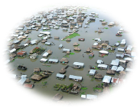
Thank for your attention !!!
Questions ???
Notes:
This should be a list of agencies (see previous slide) followed by a (brief) listing of the major contributions of services, technology, or other resources they have provided or will provide to the CiRDA program. Don’t try to list everything, just the major or unique resources – people, data and information products, funds, equipment, facilities, etc...

