Slide 1

Country Name
Presenter Name
BURKINA FASO
Rigobert BAYALA

Slide 2
Introduction
What will you cover in this presentation?
  Progress and Key Successes until Addis Ababa workshop
  Concerns, Challenges, Opportunities (HNI Service 3-2-1)
  Last Mile on acquisition and first mile for climate information and early warning dissemination to end users

Slide 3
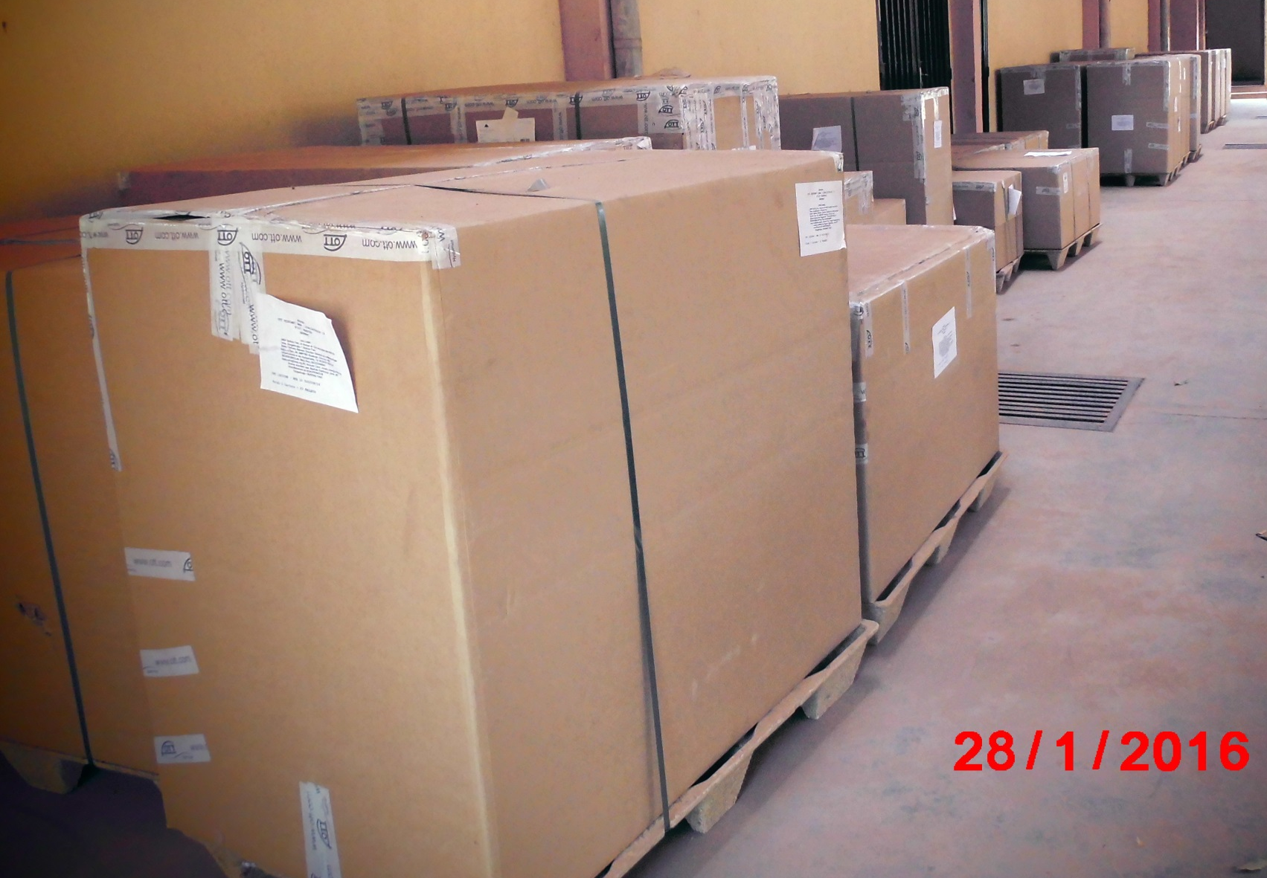
Progress and Key Successes
Meteorological Monitoring Equipment and Systems
10 synoptic weather stations
40 agroclimatic weather stations
100 rain gauges
ADCON Telemetry
Automatic stations equiped with
teletransmission system
Notes:
Some topics you may wish to consider:
Equipment ordered to date
Status of installation
Status of working monitoring systems in place
Status of data processes/systems
Successes in creation of of early warnings, communications, PPP and regional cooperation strategies
Priorities for these strategies.
Target markets and how will you reach them.

Slide 4
Progress and Key Successes
Hydrology Monitoring Equipment and Systems
16 acquisition and transmission HydroSystem units
3 ADCP flowmeters
1 software Hydras 3 Basic and communications license
1 software Hydras 3 RX receiver for data collection via sms
100 mires MIST
2 Mike Hydro licenses
1 data server
WAGTECH PROJECTS
Notes:
Some topics you may wish to consider:
Equipment ordered to date
Status of installation
Status of working monitoring systems in place
Status of data processes/systems
Successes in creation of of early warnings, communications, PPP and regional cooperation strategies
Priorities for these strategies.
Target markets and how will you reach them.

Slide 5
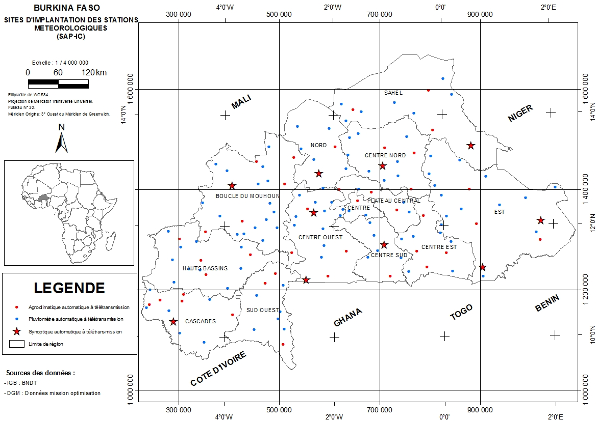
Notes:
Some topics you may wish to consider:
Equipment ordered to date
Status of installation
Status of working monitoring systems in place
Status of data processes/systems
Successes in creation of of early warnings, communications, PPP and regional cooperation strategies
Priorities for these strategies.
Target markets and how will you reach them.

Slide 6
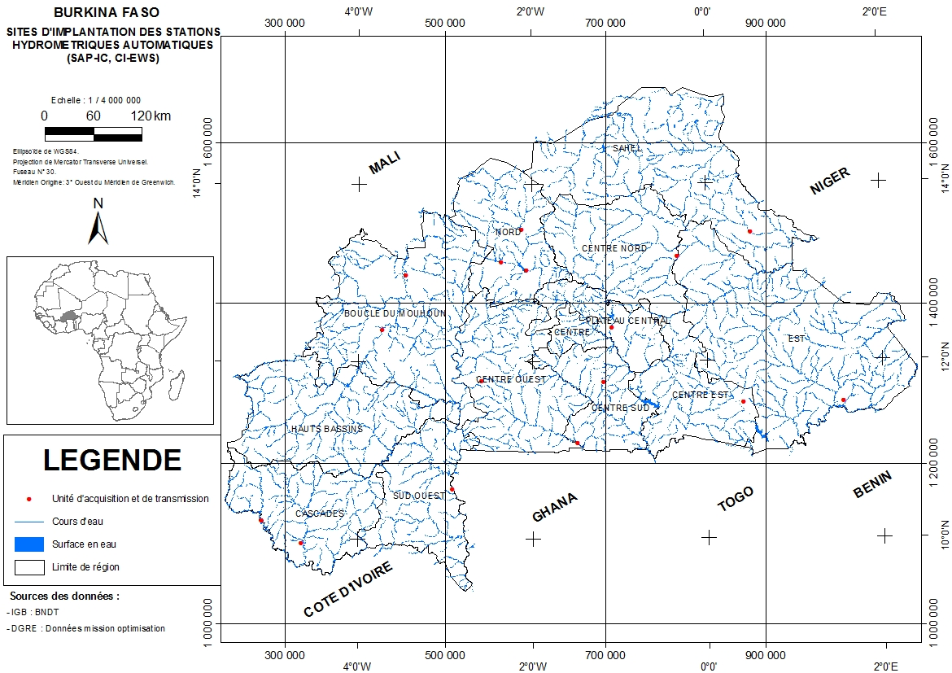

Slide 7
Progress and Key Successes
Early Warning Systems
Identification of early warning systems in place in Burkina Faso
SOS Sahel International
Self Help Africa : Human Network International 3-2-1
MARP network
IUCN
Agriculture : DGPV (Agricultural Content Committee)
Livestock: Sahel Regional Project Support pastoralism
Health: Nouna Health Research Centre
Building Resilience and Adaptation to Climate Extremes and Disaster
Ecosystem Based Adaptation
Notes:
Some topics you may wish to consider:
Equipment ordered to date
Status of installation
Status of working monitoring systems in place
Status of data processes/systems
Successes in creation of of early warnings, communications, PPP and regional cooperation strategies
Priorities for these strategies.
Target markets and how will you reach them.

Slide 8
Progress and Key Successes
Communications
Radios:
50 community radio stations ;
20 municipal radio stations;
04 institutional radios;
07 public sector radios ;
40 religious stations ;
40 commercial radio stations and 3 international radio.
Televisions:
06 religious television ;
01 community television ;
03 public sector television ;
13 commercial television ;
01 international TV.
Print media:
11 daily
24 weekly ;
25 monthly ;
02 bimonthly.
Online media: 18
Notes:
Some topics you may wish to consider:
Equipment ordered to date
Status of installation
Status of working monitoring systems in place
Status of data processes/systems
Successes in creation of of early warnings, communications, PPP and regional cooperation strategies
Priorities for these strategies.
Target markets and how will you reach them.

Slide 9
Progress and Key Successes
Each community radio has a coverage radius of 50 kms around and among them there that synchronize with the national radio.
Besides the community exist faith and trade whose task specifications require them to spend part of their program schedules to issues of public interest (public service from the private press). in the area of ​​climate services and early warning system
Notes:
Some topics you may wish to consider:
Equipment ordered to date
Status of installation
Status of working monitoring systems in place
Status of data processes/systems
Successes in creation of of early warnings, communications, PPP and regional cooperation strategies
Priorities for these strategies.
Target markets and how will you reach them.

Slide 10
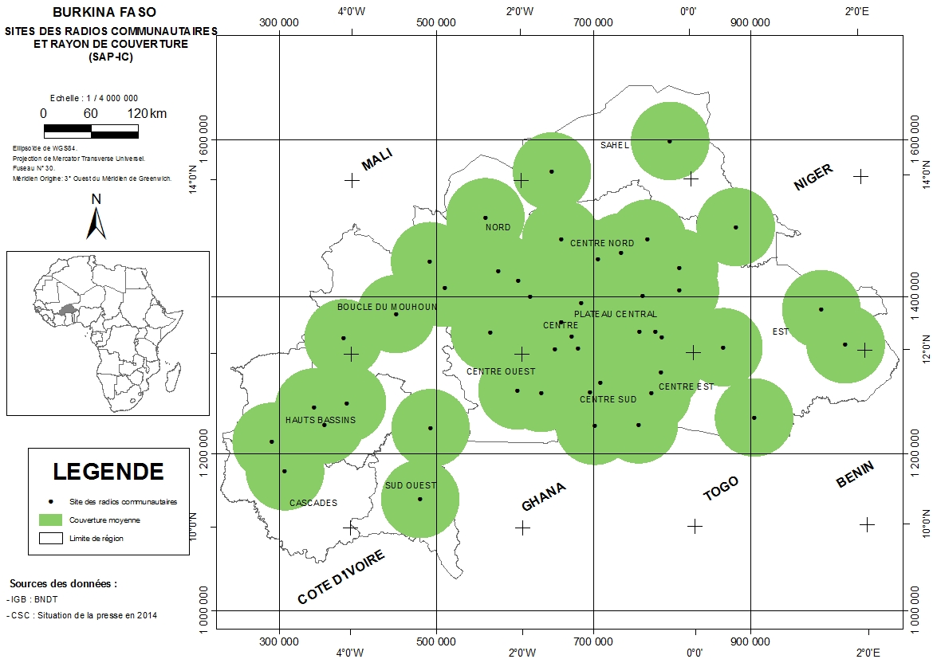
Notes:
Some topics you may wish to consider:
Equipment ordered to date
Status of installation
Status of working monitoring systems in place
Status of data processes/systems
Successes in creation of of early warnings, communications, PPP and regional cooperation strategies
Priorities for these strategies.
Target markets and how will you reach them.

Slide 11

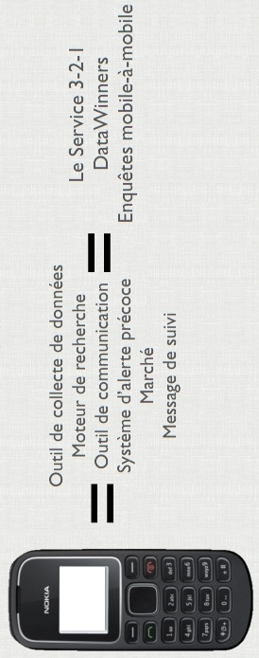
Private Sector Engagement
Notes:
Some topics you may wish to consider:
Equipment ordered to date
Status of installation
Status of working monitoring systems in place
Status of data processes/systems
Successes in creation of of early warnings, communications, PPP and regional cooperation strategies
Priorities for these strategies.
Target markets and how will you reach them.

Slide 12
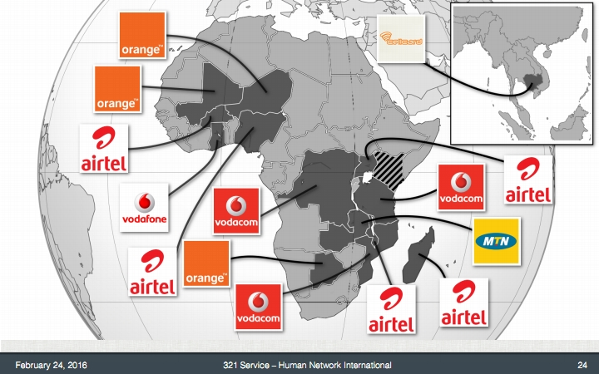
Private Sector Engagement
Notes:
Some topics you may wish to consider:
Equipment ordered to date
Status of installation
Status of working monitoring systems in place
Status of data processes/systems
Successes in creation of of early warnings, communications, PPP and regional cooperation strategies
Priorities for these strategies.
Target markets and how will you reach them.

Slide 13
Progress and Key Successes
Regional Cooperation
During November 2015, the Burkina Faso as other CIRDA partner countries received an invitation from the USTDA. During visits and exchanges with American solution providers in the meteorological field, the possibilities offered by lightning detectors have retained Burkina Faso delegation attention. We would like to receive on this meeting sideline the wise experience of countries that have experience. This would be considered the use of this technology in the context of cooperation with other country.
Notes:
Some topics you may wish to consider:
Equipment ordered to date
Status of installation
Status of working monitoring systems in place
Status of data processes/systems
Successes in creation of of early warnings, communications, PPP and regional cooperation strategies
Priorities for these strategies.
Target markets and how will you reach them.

Slide 14
Concerns, Challenges, Opportunities
Train NGO/CSO groups leaders broadcasters on the meaning alerts;
Develop a communication standard operating procedure involving all EWS agencies;
Implement a formal feedback mechanism that will allow local focal points of NGOs and government representatives in each department and in the major towns to relay lessons and suggestions / comments on the transmission of alert and information products climate (eg , useful seasonal newsletters ).
Notes:
You may wish to consider outlining:
Concerns based on policy, capacity, technology, etc.
Strengths, Weakness, Opportunities, Threats (SWOT) in addressing concerns.

Slide 15
Last Mile
Hydrometeorological equipment is acquired and implementation path on the sites.
In 2016 AWP, it is expected acquisition of SYNERGY a weather forecast system from meteo France. CIRDA program support mission is necessary for ToR development for the forecast system development and early warning. To save time, Burkina seeking the CIRDA or the UNDP Country Office uses the LTA in the area to put in competition the following companies: UBIMET , Earth Networks ...
Burkina Faso has developed in this year's multi- stakeholder platform. To prevent the platform no longer feed after the end of the project. We are planning to enroll in an existing multi-stakeholder platform proposed by Human Network International, which visited Burkina Faso during February 2016 for the development of Agriculture contents. This platform already exists in Mali, Niger and Ghana. End users of climate information and early warning systems, neighboring countries might benefit. This will contribute to the strengthening of sub regional cooperation.
Notes:
You may wish to consider including information on:
Overview of Last Mile processes
Overview of Last Mile technologies and applications
Overview of Last Mile challenges
Overview of Last Mile opportunities

Slide 16
Last Mile
Develop a public awareness campaign about the project in each of the vulnerable agro-ecological zones to promote the use of climate information and early warning system.
It will be undertaken in community radio, broadcast twice daily weather reports and possibly more in case of alert in a risk zone out. These bulletins will be in the national languages of relevant land and also in French.
Local development and climate change commissions of village councils (they are members of municipal councils) will be involved in climate information and early warnings dissemination.
Notes:
You may wish to consider including information on:
Overview of Last Mile processes
Overview of Last Mile technologies and applications
Overview of Last Mile challenges
Overview of Last Mile opportunities

Slide 17
Last Mile
Radio listening clubs will be created with farmers' umbrella organizations for monitoring, evaluation and capitalization of climate information and early warning in order to ensure communities ownership of the project objectives; this monitoring will also evaluate real-time end users responsiveness.
Partnerships will be developed with the mobile operators to develop SMS system coupled to the action of local radio stations to increase the penetration of information among end users.
Government Information Service (GIS) will increase its mailing list network to broadcast the same information with powerful new tools such as System 1.2.4.
Social networks and online media twenties will be closely involved in this exercise in order to expand and diversify the coverage radius of the national territory in climate information and early warnings.
Notes:
You may wish to consider including information on:
Overview of Last Mile processes
Overview of Last Mile technologies and applications
Overview of Last Mile challenges
Overview of Last Mile opportunities

Slide 18
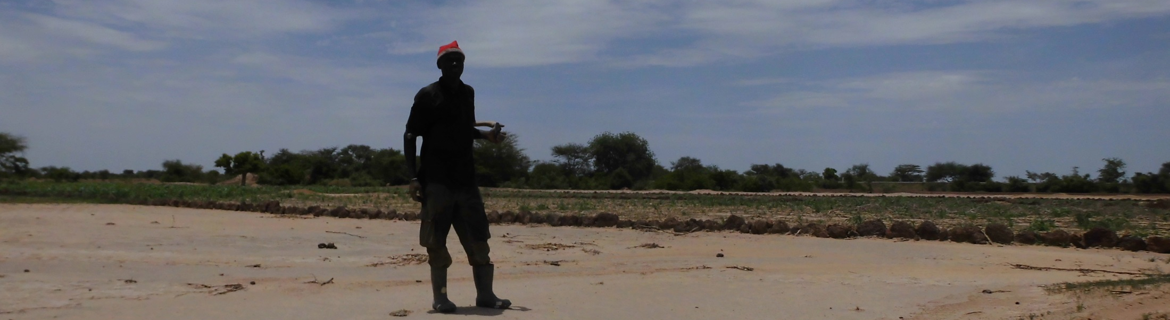
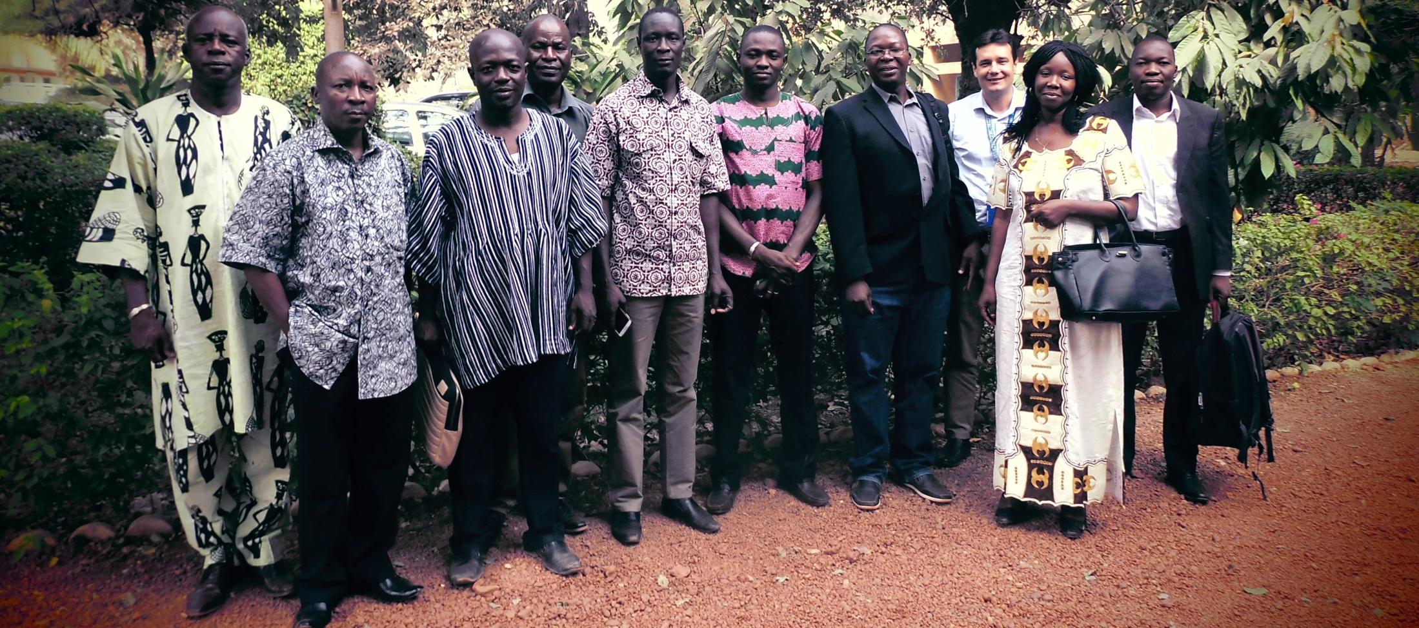
I grow sorghum on the land that I try to rehabilitate. We are in rainy season middle (July 2015) my sorghum is not higher than coca cola bottle. Would there be rainy until late November ?

