Slide 1
BURKINA FASO
LAST MILE SERVICE TARGET AND MESSAGES
Define target sector/audience | Agriculture/ Husbandry Health
Define specific group user within each target sector | Farmers Population
Define key emotional messages/ type of message | Safety, improved livelihood, resilience
Define delivering channels | Medias ( Radios , TV, internet, Cellphones) Hors-Medias: extension workers, farmers organizations, NGOs

Slide 2
LAST MILE SERVICE DATA. TECHONOLOGIES AND PARTNERSHIPS
Determine weather and climate data required to underpin the service | PET, Rainfall, temperature, SST, Onset/cessation, start/length of rainy season, water level. Rainfall, temperature, wind, visibility, relative humidity, haze, water level.
Determine additional data required | Soil moisture, agricultural technologies, market pricing, socio-demographic data Disease prevalence, socio-demographic data
Determine the technology required to deliver the message | ICTs

Slide 3
Determine the partnerships needed to create and distribute the Last Mile service | Research centers, Ministry of Agriculture, NMHS, CONASUR, HNI, private sectors, NGOs, GSM companies, International Organizations, Medias. Research centers, Ministry of Health, CSO, field workers, NGOs, CONASUR, and NMHS, private sectors, NGOs, GSM companies, International Organizations, Medias.

Slide 4
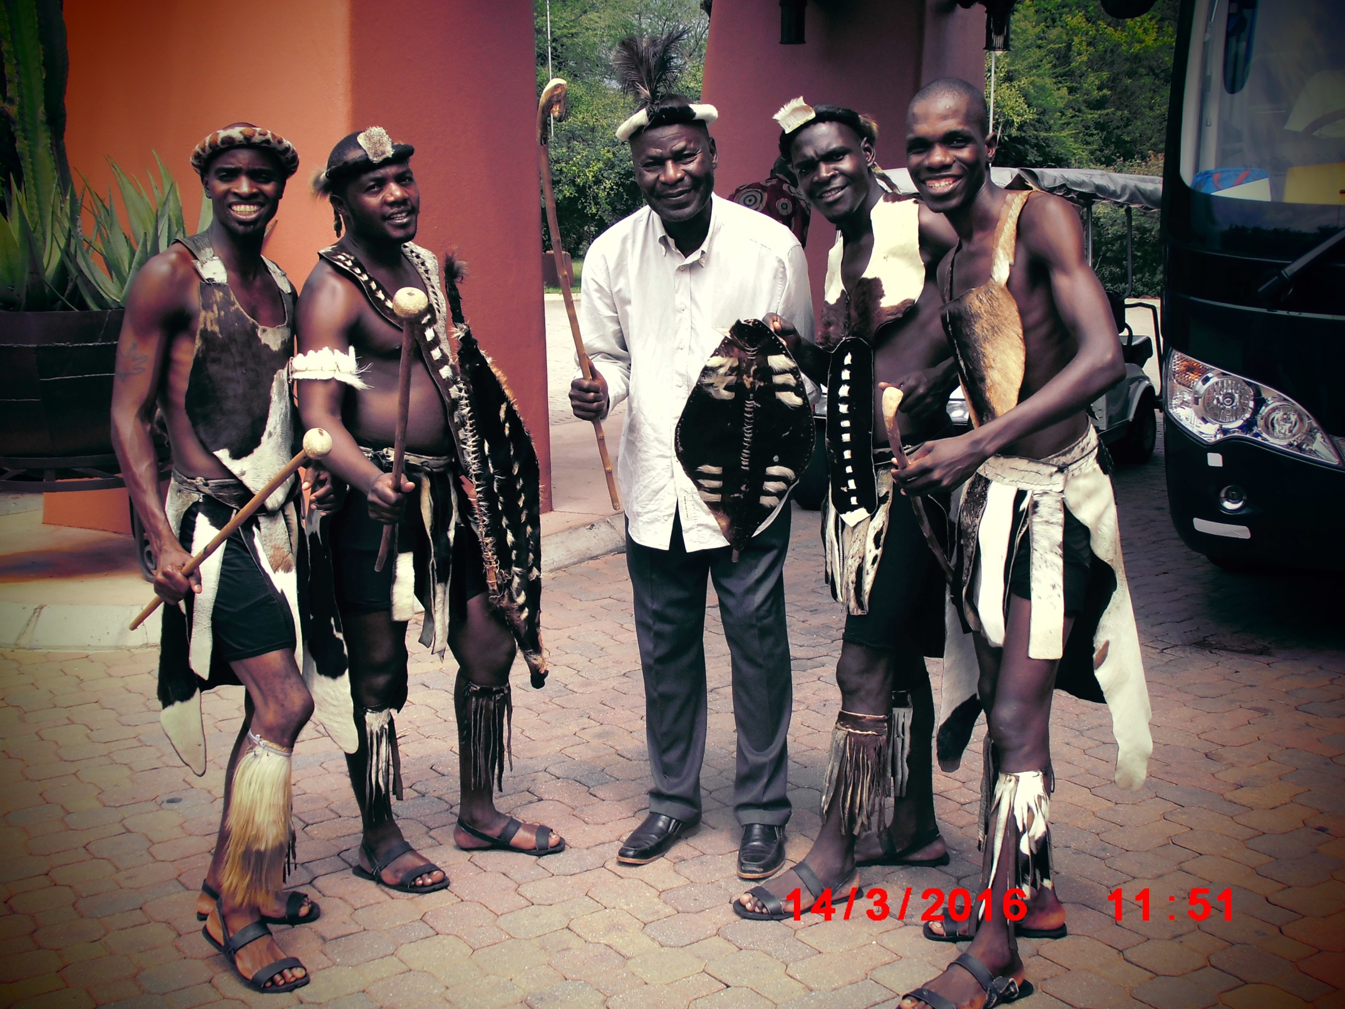
Merci, Obrigado, Thank you

