Slide 1
UNDP CIRDA Country Program Managers Workshop 25-27August 2015 Addis Ababa, Ethiopia
Reports from Strengthening National Climate Information/
Early Warning System (CI/EWS) Projects
Ethiopia
Ababu Anage
National Climate Change Specialist
Notes:
Instructions: Complete items in red italics

Slide 2
National Meteorological Agency
Director General
Meteorological Data and Climatology Directorate
Meteorological Forecast & Early Warning Decorate
Aviation Meteorology Service Directorate
Development Meteorological Service Directorate
Meteorological Research and Studies Directorate
Meteorological Electronic Stations and ICT Directorate
Deputy Director General
Public Relation & Communication Directorate
Change Management Directorate
Audit Service Directorate
Women Affairs Directorate
Meteorological Education and Training Directorate
Human Resource and General Service Directorate
Procurement, Finance & Property Administration Directorate
Planning and Budget Preparation, Monitoring and Evaluation Directorate
Meteorological Instruments and Building Directorate
Adama Meteorological Branch Directorate
Mekelle Meteorological Branch Directorate
Bahirdar Meteorological Branch Directorate
Kombolcha Meteorological Branch Directorate
Jigjiga Meteorological Branch Directorate
Balerobe Meteorological Branch Directorate
Assosa Meteorological Branch Directorate
Gambella Meteorological Branch Directorate
Semera Meteorological Branch Directorate
Hawassa Meteorological Branch Directorate
Jimma Meteorological Branch Directorate

Slide 3
Minster of Agriculture
Agricultural Development Sector
Agricultural Extension Directorate
Natural Resource Sector
Natural Resourced Development ,conservation and utilization Directorate
Rural Land Administration and Utilization Directorate
Disaster Prevention and Food security sector
Early Warning and Response Directorate
Food Security Coordination Directorate
Animal and plant health and quality control Directortae
Agricultural Input Marketing Directorate

Slide 4
Minister of Agriculture contd.
Agricultural Sector Reform Directorate
Legal Affairs Directorate
Internal Audit Directorate
Regions of Special Support Directorate
Planning & Programming Directorate
Public Relations Bureau
Women's Affairs Directorate
Procurement Finance & Property Administration Directorate
Information Technology Management Center
Human Resource Development & Administration Directorate

Slide 5
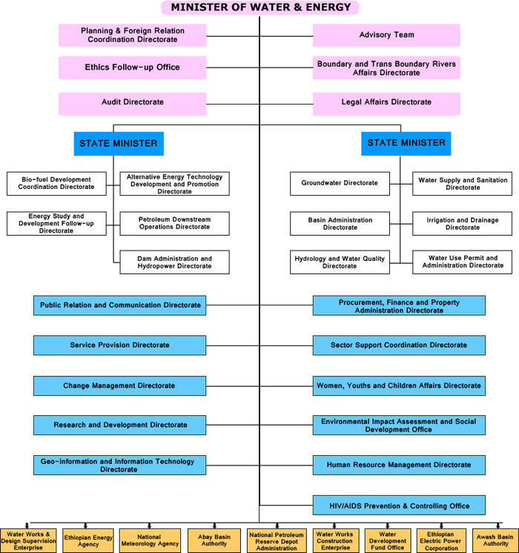

Slide 6
1.Key departments/ agencies that contribute to the accomplishment of the CRDA objectives
National Meteorological Agency and their offices in 11 regions ( MoWIE);
Disaster Risk Management and Food Security Sector (MoA);
Hydrology and Water Quality Directorate and their centers in 11 regions (MoWIE);
Addis Ababa University and other Research Institutions;
Ministry of Finance and Economic Development and
Ministry of Environment and Forest

Slide 7
2.High level contribution of each of the key departments/Agencies to the accomplishment of the CIRDA objectives
National Meteorological Agency
-Capacity Building : expansion of Meteorological station net work; training; climate and environmental data sharing, exploring and accessing,etc
-Fulfilling facilities: Modernization of existing conventional meteorological stations by installing AWS , Agro-Meteorological stations and establishing mobile calibration unit
- Modernization of computing facility, data risk and safety

Slide 8
High level contribution contd.
Climate Service delivery system
Enhancing food security through use of pre-season climate/agro metrological advisories;
Provision of farm level Agro-meteorlogical services;
Production of climate –based health bulletin for malaria and manegites monitoring;
Production of historical and real time climate information for renewable energy including hydropower
Multi lingual localized climate information services

Slide 9
High Level Contribution Contd.
NMA
40 Automated Meteorogical Monitoring Stations;
200 Conventional Meteorological Stations surveyed to identify gaps and rehabilitation
Six mobile calibration units
One Upper Air Observation System(Radio-sonde)
Hydrogen Generator
Instruments
200 maximum thermometer
200 minimum thermometer
100 dry bulb thermometer

Slide 10
High level contribution contd.
NMA contd.
100 wet bulb thermometer
100 measuring cylinder
20 Evaporation gauge
30 wind vane
30 sun shine recorder
10 Action graph etc

Slide 11
Social /economic value of the high level contributions
NMA contd.
Enhancing food security through use of pre-season climate/agro metrological advisories;
Provision of farm level Agro-meteorlogical services;
Production of climate –based health bulletin for malaria and manegites monitoring;
Multi lingual localized climate information services
Analysis on Existing satellite receiving and equipment and gaps identification

Slide 12
High level contribution contd.
Hydrology and Water Quality Directorate (HWQD)
Installing new and upgrade/maintain Hydrological Stations with telemetry systems
Capacity-building in areas of field hydrological stations maintenance and monitoring
Capacity-building in areas of data analysis and processing
Providing training to local data observers in the field
Checking and improving data quality

Slide 13
High level contribution cont.
HWQD contd.
Two complete hydrology equipment mobile calibration and maintenance unit;
5 Standard current meter for new and upgraded stations;
Acoustic Doppler Current profile accessories with river boat
5 sounding real
5 Notebook computer

Slide 14
High Level Contribution Contd.
Disaster Risk Reduction and Food Security Sector ( DRMFSS)
Disaster Risk /Hazard Monitoring, Early Warning, and Response;
Emergency Logistics Coordination;
Early Warning and Response Information Management

Slide 15
High Level Contribution Contd.
Disaster Risk Reduction and Food Security Sector ( DRMFSS) contd.
Training need assessment at federal and regional level for DRMFSS completed;
Preparation of District level Risk Profiling is on progress;
Procurement of generator completed

Slide 16
Other relevant partners
Ethiopian Meteorological Society
Climate Change Forum for Ethiopia Christian Aid (UK) Ethiopia
Action Fore Development
Oxfam UK BBC Media Action
Care-Ethiopia
WFP
African Development Bank (Clim-Dev)
Africa Climate Policy Center
European Union
USAID

Slide 17
Future Plans
Finalization of Installation and commissioning of the hydrological and metrological equipment in the selected sites and localities;
Hydrological and meteorological Information generation using the procured equipment
Finalization of the district Disaster Risk Profiling preparation;
Do more work on communication on the products of the project

Slide 18
Thank you very much

