Slide 1
Systems level Assessments
Samuel Tumwesigye, Agriculture & CC Adaptation Specialist, UNDP, SCALA Program
Elisa Distefano, ENRM & CC Adaptation Specialist, FAO, SCALA Program
Webinar on Systems-level Assessments: 9 March 2022

Slide 2
Outline
Context
IPCC AR6
Context
Transformational change => system thinking
Assessment criteria
Country priorities
Scope of System Assessment

Slide 3
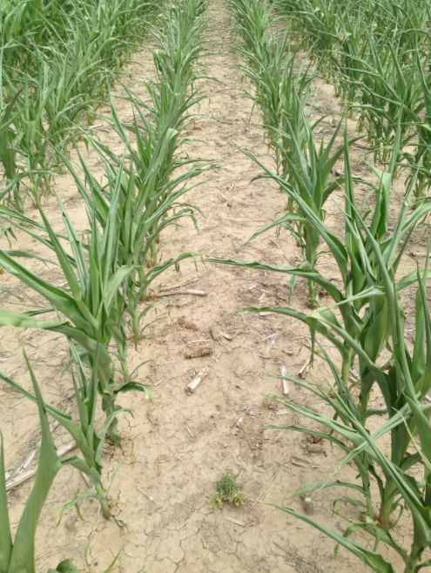
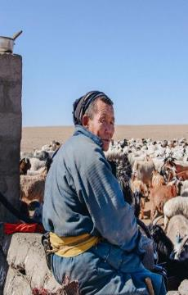
Context
Climate Change: complex challenge with increasingly severe, interconnected and often irreversible impacts on ecosystems (+ biodiversity), agri-food systems and human systems
Climate-related extremes have affected the productivity of all agricultural, fishery and land use sectors, with negative consequences for food security and livelihoods
The impacts are particularly acute & severe for people in SSA, Asia, Small Island States, Central & South America and the Arctic, and Small-scale producers globally: Impacts will be up to multiple times higher than currently observed
Most vulnerable groups: the Indigenous Peoples, Small-scale food producers (mostly women) and low-income households are/will continue to severely & disproportionately be affected
IPCC AR6 Report: Climate Change 2022 Impacts, Adaptation & Vulnerability
Notes:
IPCC's Sixth Assessment Reports: “Climate Change 2021: The Physical Science Basis” & “Climate Change 2022: Impacts, Adaptation and Vulnerability” confirm the “unequivocal,” “unprecedented,” “irreversible” trends of current and future climate risks the planet is possibly facing at this historic turning point. The reports reveal that the risks including ecosystem degradation and biodiversity loss, and the impacts of the climate crisis, ranging from flooding to heatwaves, droughts and wildfires are projected to continue intensively and are likely to increasingly affect food security and livelihoods.

Slide 4
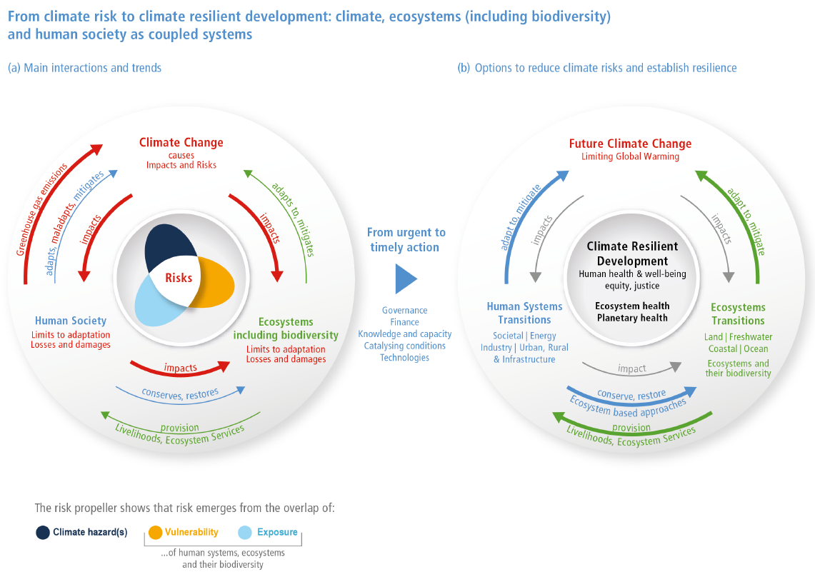
Interactions of the coupled systems (climate, natural/ ecosystems & human systems) are the basis of emerging risks from climate change, at the same time, offer opportunities for climate resilient development
Emphasis is on Transformation of the systems: a change in the fundamental attributes of natural and human systems
IPCC AR6 Report: Climate Change 2022 Impacts, Adaptation & Vulnerability
Notes:
IPCC's Sixth Assessment Report “Climate Change 2022: Impacts, Adaptation and Vulnerability” There are interactions among the coupled systems climate, ecosystems (including their biodiversity) and human society. These interactions are the basis of emerging risks from climate change, ecosystem degradation and biodiversity loss and, at the same time, offer opportunities for the future. (a) Human society causes climate change. Climate change, through hazards, exposure and vulnerability generates impacts and risks that can surpass limits to adaptation and result in losses and damages. Human society can adapt to, maladapt and mitigate climate change, ecosystems can adapt and mitigate within limits. Ecosystems and their biodiversity provision livelihoods and ecosystem services. Human society impacts ecosystems and can restore and conserve them. (b) Meeting the objectives of climate resilient development thereby supporting human, ecosystem and planetary health, as well as human well-being, requires society and ecosystems to move over (transition) to a more resilient state.

Slide 5
SCALA’s Seven dimensions of Transformation
Systems thinking
Climate
rationale
Innovation
SCALA’s overall objective is to enable transformational change within AFOLU
Private Sector Engagement
Gender and
social
inclusion
Sustainable development
Whole of government
Notes:
Transformation entails system transitions towards strengthening the resilience of ecosystems, agri-food systems and society (human systems) through embracing the idea of major, fundamental changes in society or natural systems as opposed to changes that are minor, marginal, or incremental.”
Deep-rooted transformational adaptation opens new options for adapting to the impacts and risks of climate change (high confidence) by changing the fundamental attributes of a system including altered goals or values and addressing root causes of vulnerability
SCALA’s overall objective is to enable transformative change. SCALA identified seven dimensions of transformation which are necessary for generating transformative change in the country.

Slide 6
Transformational vs Incremental
Transformational - implementation of climate actions that fundamentally alter the key aspects of a defined systems
Example: Shift towards agroecological coffee production in Ethiopia: implementation of systemic changes towards agroecological production practices; including adoption of agro-forestry /reforestation for additional shade for coffee trees, integrate farm-driven agricultural extension systems, inclusive collaboration of value chain actors, improved access to credit, inputs and processing facilities, functional marketing schemes, in addition to other long-term significant changes that would transform the agricultural production system in the coffee production agroecological zones
Incremental - making marginal adjustments to the existing systems to better manage the current climate variability and cope with near-term climate risks
Example: adjustments to cropping systems through new varieties, changing planting times, or using more efficient irrigation technologies
Key aspects for transformation: system-wide focus; aim for a shift either in the state/intensity or location or functional form of the system; focus on future long-term change

Slide 7
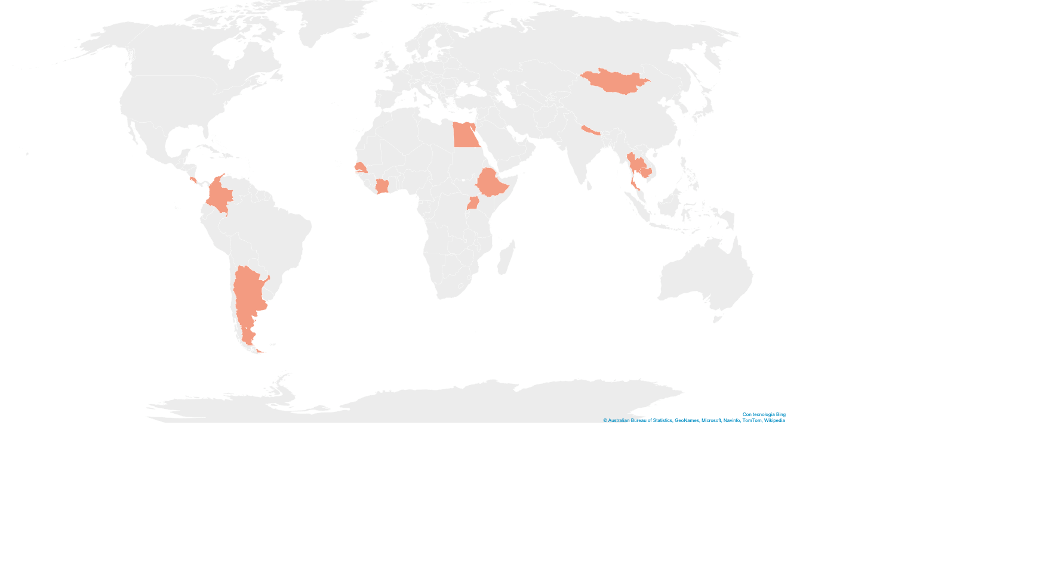
Specify the system:
Systems Assessment
Livestock Value Chains
Agroecological transition of Millet/Ground nuts Agricultural systems
System!
Complement NAP preparation process
Mongolia
Egypt
Nepal
System!
Livestock and coffee production systems ;
Beef VC
Thailand
Costa Rica
Senegal
Ethiopia
Livestock landscape / watershed in Agroecological zones
System!
NDC/NAP implementation in AFOLU
Cote d’Ivoire
Cambodia
Agri-food systems
Colombia
Uganda
Cocoa Value Chain
Cattle Corridor
Agricultural landscape
Agroforestry system
Argentina
Livestock VC
Simple- like Value Chains, Food system, Agroforestry systems or Complex - like Landscape-wide systems– Agroecology systems, Climate system:
6/12 countries – landscape systems; 4/12 – Value Chains
Notes:
A well defined system assessment should specify the system, the scale, general approach /methodology – participatory /multi-stakeholders, components tageted - CRV, Impacts, social including gender aspects, environmental, economic aspects, and the target output/result from the assessment
Type of systems Landscape, Value chain, agricultural production system

Slide 8
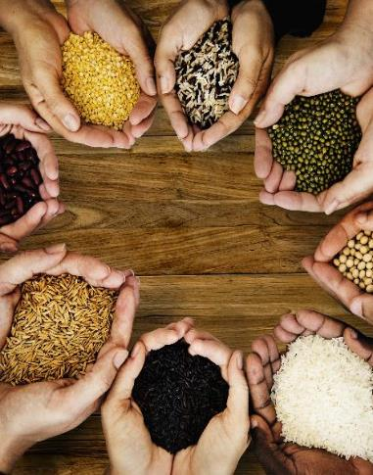
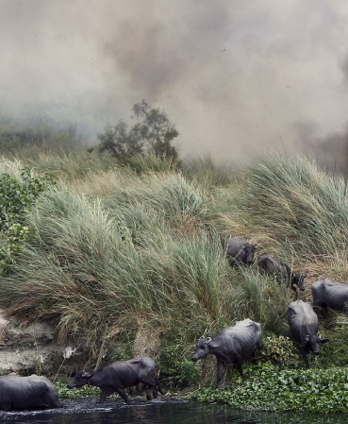
Systems Assessment
What is the Purpose? to identify and appraise climate risk and transformative action: generate evidence to support system transformative change
What are the dimensions?: Social, Economic, Natural / Environmental, Governance elements
Why target an entire system: understanding the different components, actors, dynamics and their interdependencies, as well as the risks, opportunities and solutions for transformational change

Slide 9
Systems Assessment
General questions that guide system assessment
What is the state of natural, ecological, social and economic elements in the defined scope?
How sustainable and climate-resilient are current practices and livelihoods?
What are the major climate impacts, vulnerabilities and risks?
Which adaptation and mitigation opportunities exist and where?
What are the innovations, and climate actions that can led to transformational adaptation / mitigation?
What are the costs and benefits of those climate intervention options?
Who would benefit from implementation and who might be left worse off?
What policy, financial and social incentives exist to facilitate transformative change?
Who are the stakeholders to be involved / engaged?

Slide 10
Assessment criteria – Methodologies and Tools
Scope of assessment | Assessment criteria | Relevant tools/methods
What is the state of natural resources and agriculture in the assessment area? | Natural resources / Environment Resilience Assessment | FAO. Global Livestock Environmental Assessment Model (GLEAM) Resilience Alliance. Assessing Resilience in Social-Ecological Systems here
 | Land use change analysis | Open Foris/Earth Map/ Collect Earth/SEPAL
How sustainable and climate-resilient are current practices and livelihoods? What are the major climate impacts, vulnerabilities and risks? Which adaptation and mitigation opportunities exist and where? | Climate risk and vulnerability Assessment | FAO. Modeling System for Agricultural Impacts of Climate Change (MOSAICC) FAO. Self-evaluation and Holistic Assessment of climate Resilience of farmers and Pastoralists (SHARP+) tool
 | GHG Emissions Assessment | FAO. EX-Ante Carbon Balance Tool (EXACT) Recarbonization of global agricultural soils (RECOSIL)
 | Gender Responsiveness | CARE. Gender and Inclusion Toolbox: Participatory Research in Climate Change and Agriculture

Slide 11
Methodologies & Tools
Scope of assessment | Assessment criteria | Relevant tools/methods
What are the innovations, and climate actions that can led to transformational adaptation / mitigation? What are the costs and benefits of those intervention options? Who would benefit from implementation and who might be left worse off? | Assessment for transformative potential Cost-benefit/Multi-criteria Analysis | SCALA’s CARM UNDP. Targeted Scenario Analysis here FAO/UNDP. Guide on CBA for climate change adaptation options – produced under NAP-Ag programme here
Do the right policy, financial and social incentives exist to facilitate the uptake of prioritized interventions? | Private sector Investment risks Analysis | UNDP and FAO. Toolkit for value chain analysis and market development integrating climate resilience
 | Policy Analysis
Who are the stakeholders to involve/engage? | Stakeholder mapping | UNDP/FAO Private Sector Mapping Tool UNDP – FACS tool

Slide 12
Emerging priorities for SCALA countries
Climate Action Review Matrix: review of the NDC/NAP to identify climate actions with transformative potential
(Uganda, Ethiopia, Cambodia, Mongolia, Nepal, Colombia, Thailand)
Type of Assessment
CRVA, evidence-based transformation
landscape-wide systems: 6 countries (Uganda, Ethiopia, Cote d’Ivoire, Colombia, Thailand, Mongolia, Nepal)
agroecological transition: 1 country - Senegal
VC analysis & development
mapping & market development: 3 countries - Ethiopia, Mongolia Cambodia
standards and certification: 1 country - Costa Rica
GHGs emission assessment
3 countries - Mongolia, Senegal, Costa Rica
Economic analysis
2 countries- Colombia, Cambodia
Landscape assessment: Mongolia assessment of pasture carrying capacity and plant community within the zone of the Khan Khentii Special Protected Area
Climate risk and vulnerability Assessment: Uganda to generate evidence support to district level A/M, DRR planning & budgeting in the cattle corridor

Slide 13
Emerging priorities for SCALA countries
Economic analysis: Colombia Cost-Benefit analysis for prioritized actions of the Comprehensive CC Management Plan for the Agricultural sector
GHGs emission Assessment: Costa Rica Carbon sequestration capacity assessment of soils in livestock and coffee plantations
Economic analysis: Cambodia feasibility study to implement Plan Vivo offset, in communities of REDD+ project
GHGs emission Assessment: Senegal assessment of on emission reduction of adaptation techniques in selected agroecological systems
Value chain analysis: Cambodia participatory mapping of key forest-risk commodities VCs in StunTreng
Value chain analysis: Costa Rica Beef value chain development: scoping for new certification standards:- beef produced without forest cover loss

