Slide 1
Landscape approaches to system assesments
Krystal Crumpler,
FAO Climate Change and Natural Resources Specialist

Slide 2
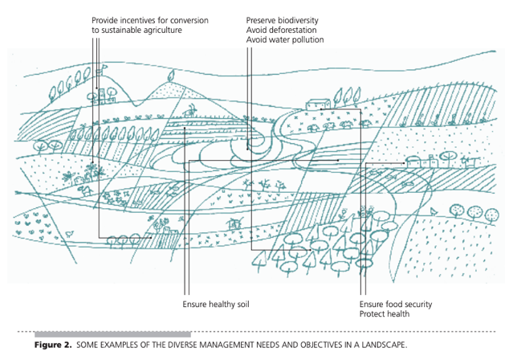
What is a landscape?
A landscape is a mosaic of different land uses with multiple components and functioning interactions between and across ecological, social and social-ecological processes (functional interactions), made up of multiple actors and stakeholders with varying interests (negotiated spaces), and made up of nested components occurring on different scales (multiple scales).
FAO. 2017.
Minang et al. 2015
Notes:
A landscape is a mosaic of different land uses with multiple components and functioning interactions between and across ecological, social and social-ecological processes (functional interactions), made up of multiple actors and stakeholders with varying interests (negotiated spaces), and made up of nested components occurring on different scales (multiple scales). A landscape therefore captures the complex matrix of individual units such as farms, families, communities and ecosystems, and relates patterns and processes between and across these units to larger scales. It may be defined by geographic boundaries (e.g. watershed), administrative boundaries (e.g. district) or both. In the search for solutions to reconcile conservation and development tradeoffs, integrated approaches to landscape management have gained prominence. In recent years strategies that recognize the inextricable link between forests, water, biodiversity, agriculture, energy and other elements are increasingly being developed, as is the understanding of how they are shaped by social, economic, political and environmental conditions.

Slide 3
What are landscape approaches?
Ten principles:
Continuous learning and adaptation
Common concern entry point
Multiple scales
Multifunctionality
Multiple stakeholders
Negotiated and transparent change logic
Clarification of rights and responsibilities
Participatory and user-friendly monitoring
Resilience
Strengthened stakeholder capacity.
‘A set of concepts, tools, methods and approaches deployed in landscapes in a bid to achieve multiple economic, social and environmental objectives through processes that recognize, reconcile and synergize the interests, attitudes and actions of multiple actors’ (Minang et al. 2015)
Sayer et al. 2013
Notes:
Landscape approaches refer to ‘a set of concepts, tools, methods and approaches deployed in landscapes in a bid to achieve multiple economic, social and environmental objectives (multifunctionality) through processes that recognize, reconcile and synergize the interests, attitudes and actions of multiple actors.’ A landscape approach therefore deals with large-scale processes in an integrated and multidisciplinary manner, combining natural resource management with environmental and livelihood considerations. It also factors in human activities and their institutions, viewing them as an integral part of the system rather than as external agents. While landscape approaches are context-specific, they typically embody a set of principles, including adaptive management, stakeholder involvement, and multiple objectives. Integrated landscape approaches for sustainable land-use and agriculture can encompass and cut across various options such as watershed management, biodiversity conservation, sustainable land management, forest and landscape restoration, ecosystems-based approaches and coastal area management.

Slide 4
Climate Smart Landscapes
Climate-smart agricultural landscapes operate on the principles of integrated landscape management with explicit incorporation of adaptation and mitigation goals along with improvements in food security, rural livelihoods, biodiversity conservation and ecosystem services (Scherr et al., 2012; Harvey et al., 2014).
Notes:
Climate-smart landscape approaches can be defined as landscape actions and processes that seek to integrate climate change mitigation and adaptation alongside multiple social, economic and environmental objectives (Harvey et al., 2013). Climate-smart agricultural landscapes operate on the principles of integrated landscape management with explicit incorporation of adaptation and mitigation goals along with improvements in food security, rural livelihoods, biodiversity conservation and ecosystem services (Scherr et al., 2012; Harvey et al., 2014). Such approaches are driven by the ultimate goal of ensuring resilience, productivity and sustainability with emphasis placed on adaptive management, stakeholder involvement and the simultaneous achievement of multiple objectives at the landscape scale (Sunderland et al., 2013). Research suggests that there is still a need for a number of transformative changes in current policies, institutional arrangements, and funding mechanisms to bring climate-smart landscapes from concept to reality (Scherr et al., 2012; Harvey et al., 2014).

Slide 5
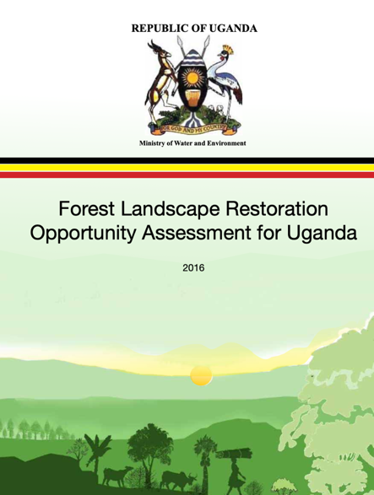
Case study

Slide 6
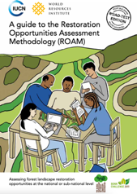
Restoration Opportunities Assessment Methodology
Objective: to rapidly identify and analyse forest landscape restoration (FLR) potential and locate specific areas of opportunity at a national or sub-national level
3 phased flexible and affordable framework:
1. PLANNING & PREPARATION
2. DATA COLLECTION & ANALYSIS
3. RESULTS TO RECOMMENDATIONS
Source: IUCN and WRI, 2014
Notes:
The Restoration Opportunities Assessment Methodology (ROAM) – an approach that was developed by IUCN and WRI – was used in Uganda to guide processes of developing forest restoration interventions at landscape level. ROAM is a stepwise and iterative application of a series of analyses used to identify the best set of Forest landscape restoration opportunities applicable to a specific site.
The Restoration Opportunities Assessment Methodology (ROAM) described in this handbook provides a flexible and affordable framework for countries to rapidly identify and analyse forest landscape restoration (FLR) potential and locate specific areas of opportunity at a national or sub-national level.
A ROAM application is generally undertaken by a small core assessment team through collaborative engagement with other experts and stakeholders. A national-level assessment typically requires 15-30 days of work by the assessment team spread over a two-to-three month period.
Where is restoration socially, economically and ecologically feasible?
What is the total extent of restoration opportunities in the country/region?
Which types of restoration are feasible in different parts of the country?
What are the costs and benefits, including carbon storage, associated with different restoration strategies?
What policy, financial and social incentives exist or are needed to support restoration?
Who are the stakeholders with whom we need to engage?

Slide 7
Phase 1: Preparation and planning
Notes:
This phase is likely to involve a series of discussions and meetings to help prepare and plan the assessment, culminating in a national inception workshop to share the plan and seek high-level endorsement of the assessment.

Slide 8
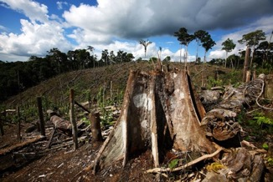
STEP 1: Defining the problem and objectives
What are the major problems?
What are the long-term objectives?
Sharp decline in forest land cover since 1990
Land degradation driven by soil erosion
Decline in soil fertility and crop loss
Overgrazing in grasslands
Inequitable land tenure systems
Uganda aims to restore degraded forest landscapes to improve ecosystem quality and resilience, provide new opportunities for rural livelihoods, while securing adequate water and energy supplies and supporting low carbon economic development.

Slide 9
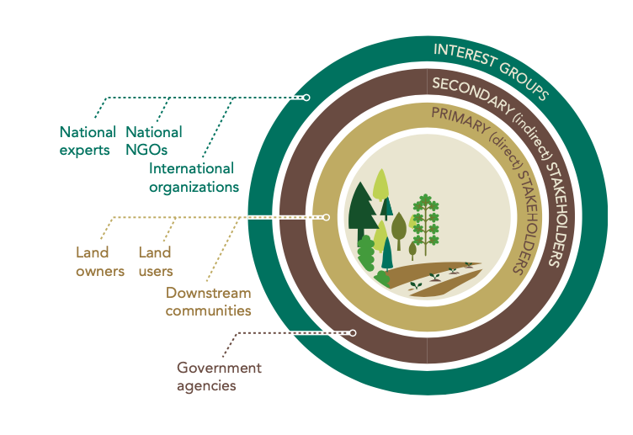
STEP 2: Engaging key partners
Which institution(s) would be most suitable for leading the assessment? Which other institutions should be closely involved?
What knowledge and skills are needed on the assessment team?
Who are the relevant stakeholders in the assessment area?

Slide 10
STEP 3: Defining outputs and outcomes of assessment
Landscape and stakeholder mapping
A shortlist of the most relevant and feasible restoration options across the assessment area
Quantified costs and benefits of each intervention type
Estimated values of additional carbon sequestered by these intervention types
A diagnostic of the presence of key success factors and identification of strategies to address major policy, legal and institutional bottlenecks
Analysis of the finance and resourcing options for restoration in the assessment area

Slide 11
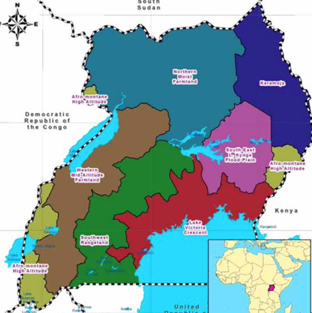
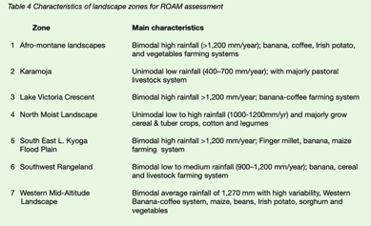
STEP 4: Defining the scope
Define the geographical scope of the assessment
At what scale will the assessment be done (national or sub-national)?
• Is this feasible, given the resources available?
Stratify the assessment area
• What are the main distinguishing features (in terms of restoration-relevant characteristics) between different parts of the assessment area?
• What are the factors (physical, social, economic) behind this heterogeneity?
• Can we base the stratification on the area’s agro-ecological zones or administrative boundaries?

Slide 12
STEP 5: Identifying the assessment criteria and indicators
What ecological and socio-economic restoration-relevant factors are we interested in?
What spatial data are available on these factors?
Are other data available that we could use as proxy indicators?

Slide 13
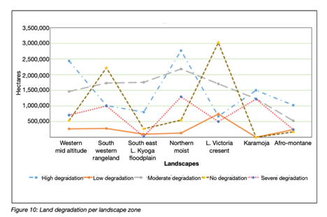
STEP 6: Identifying potential options
What kinds of restoration interventions do we know exist or are feasible in the area?
Which other kinds of restoration might be possible?

Slide 14
Phase 2: Data collection and analysis
Notes:
This chapter covers the core phase of ROAM, involving the collection and analysis of data

Slide 15
STEP 1: Data collection
Based on the assessment criteria identified previously, which data is needed and available?
Stakeholder/expert surveys
Spatial data
Scientific literature
New studies
Notes:
You will already have drawn up a list of the kinds of data you need to collect and a list of data that you understand to be actually available and accessible.
Data to inform a critical look at restoration options
Data on the costs and benefits of restoration
There are three main ways of sourcing relevant data for the assessment:
Collecting data directly from experts and stakeholders. Workshops, interviews and other meetings capture knowledge and perspectives from those who are famil- iar with the assessment area.
Using existing data sources. Requesting pre-existing data from technical agencies, statistics bureaux and research institutions searching the Internet and consulting specialist libraries and data collections for relevant maps and other secondary data.
Commissioning new information-gathering exercises. If necessary, commissioning new pieces of work such as surveys, satellite imagery and calculations to fill specific data gaps, verify existing data or update old data.

Slide 16
STEP 2: Analysis
Consider also integrating gender analysis
Restoration opportunity mapping
Cost-benefit analysis
GHG analysis
Diagnostic of key success factors
Finance analysis
Policy, legal and institutional analysis
Potential analytical components to include in a landscape assessment based on:
Which knowledge and data gaps exist?
Given the resources, which analyses are feasible in the assessment area?

Slide 17
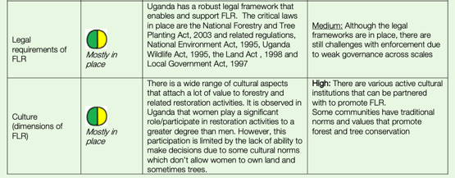
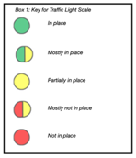
Diagnostic of presence of key success factors
To what extent are key success factors currently in place to facilitate restoration at scale?
And what is needed to address the missing key success factors?

Slide 18
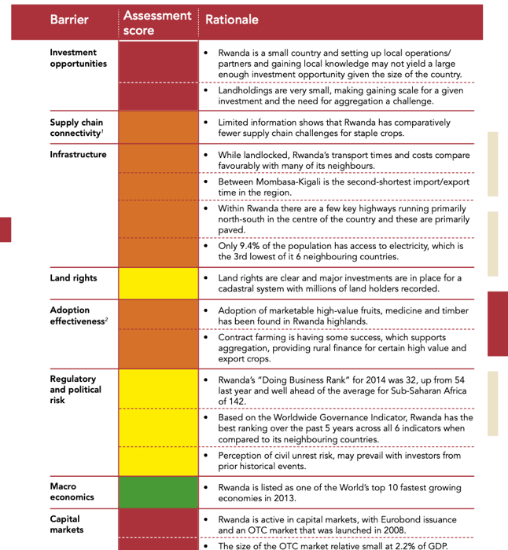
Evaluation of potential for private investments
What is the potential for private sector investment in the selected restoration options?
Which barriers exist and how might they be addressed?
Which de-risking instruments are available or are needed?

Slide 19
Phase 3: Results to recommendations
Inclusive stakeholder validation of results
Build support for the assessment results among decision-makers
Draft policy and institutional recommendations and plan for next steps.
Notes:
This final phase of ROAM therefore plays a critical part in ensuring its credibility and impact. The specific aims for this phase of the assessment are to:
Test the validity and relevance of the assessment results;
Analyse further the policy and institutional implications of the results;
Build support for the assessment results among decision-makers; and
Draft policy and institutional recommendations and plan for next steps.
While key decision-makers should have been kept abreast of developments from the outset, it is now particularly important that they are involved in this phase in order to strengthen their ownership of the assessment results and help set the stage for policy uptake of the recommendations that emerge.

Slide 20
Key outcomes of the landscape assessment
Landscape-level information for improved land-use and agriculture decision-making
Key inputs into national and sub-national strategies and programmes of work on adaptation, mitigation, forestry, agriculture, rural development, gender equality, etc.
A basis for better allocation of resources within restoration programmes
Engagement of multiple actors and key policy-makers and decision-makers from different sectors
Shared understanding of restoration opportunities and the value of multifunctional and inclusive landscapes.
Notes:
A national (or sub-national) FLR assessment can:
Provide missing landscape-level land-use and economic analysis and data that can be used to improve the quality of land-use decision-making and inform possible reforms (e.g. of land tenure or of agricultural and forestry sectors);
Set the stage for national-level strategies and programmes of work on FLR, sustainable land management and REDD+, by providing a general overview of the priority areas for restoration, the different restoration options available and their relative costs and benefits, and the key stakeholder groups who will need to be involved in any follow-up work on FLR in the country;
Build high-level support for FLR, by engaging key policy-makers and decision- makers from different sectors as well as other stakeholders with interests in, or influence on, how landscapes are managed;
Enhance a shared understanding of FLR opportunities and the value of a multi- sectoral, landscape-level approach to restoration, by bringing government agency staff, civil society actors and researchers together to work on the assessment.

Slide 21
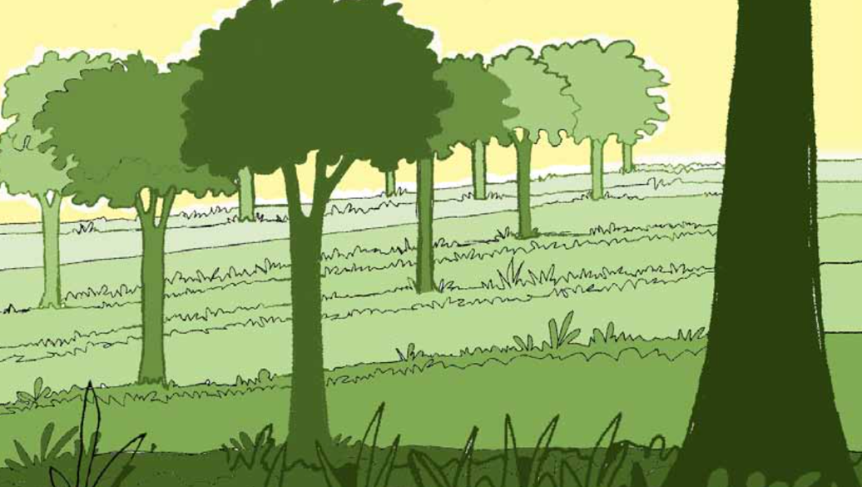
Thank you!

Slide 22
Key References
FAO. 2011. Land Degradation Assessments in Drylands (LADA): local level assessment manuals. https://www.fao.org/nr/kagera/tools-and-methods/lada-local-level-assessment-manuals/en/
FAO. 2017. Landscapes for Life. Approaches to landscape management for sustainable food and agriculture https://www.fao.org/3/i8324en/i8324en.pdf
Conservation International. 2017. Landscape Assessment Framework: Concepts and Guidelines. (also available at https://www.conservation.org/projects/landscape-assessment-framework)
FAO. 2017. Step-by-step guide to implement landscape approaches for climate-smart agriculture. https://www.fao.org/climate-smart-agriculture-sourcebook/concept/module-a3-landscapes/chapter-a3-3/en/
Minang et al..2015. Climate-Smart Landscapes: Multifunctionality In Practice. Nairobi, Kenya: World Agroforestry Centre (ICRAF). http://www.asb.cgiar.org/climate-smart-landscapes/digital-edition/resources/Climate-Smart_Landscapes-LR.pdf
IUCN and WRI. 2014. A guide to the Restoration Opportunities Assessment Methodology (ROAM). (also available at https://www.iucn.org/downloads/roam_handbook_lowres_web.pdf).

