Slide 1
Strengthening National Climate Information/ Early Warning System (CI/EWS) Projects
Country Report for Malawi to the
UNDP CIRDA Country Program Managers Workshop
15th to 17th March, 2015
Livingstone, Zambia

Slide 2
Project Specific Outcomes
Enhanced capacity of the Department of Climate Change and Meteorological Services (DCCMS) and Department of Water Resources (DWR) to monitor and forecast extreme weather, hydrology and climate change.
Efficient and effective use of hydro-meteorological and environmental information for making early warnings and long-term development plans.

Slide 3
Implementing Partners
Department of Disaster Management Affairs (Coordinator)
Department of Climate Change and Meteorological Services
Department of Water Resources

Slide 4
Progress Made under the Project
10 automatic weather stations procured and installed in key areas in the country
15 automated hydrological equipment have been procured-Installation awaiting construction of data collection platform houses
Data digitization done for 66 rainfall stations and subsidiary stations

Slide 5
Progress Made Under the Project
Procurement of various meteorological equipment which has been installed in various stations such as Stevenson screens, solar panels, batteries,
DCCMS has upgraded and updated its database and information management system through an expert from Kenya Meteorological Department
Facilitate inter-sectoral sharing of weather and climate through enhanced district climate information centers

Slide 6
Progress Made under the Project
Capacity Built for various officers:
  1 officer completed advanced diploma in Electrical Engineering
  Four officers from DCCMS are undergoing a two year Advanced Meteorological Forecasting Course (WMO CLASS II) at Institute of Meteorological Training and Research in Nairobi Kenya
  One Officer undergoing Post Graduate Diploma in Operational Hydrology In Nairobi, Kenya
  Training of community members on climate information interpretation and use
  Tailor made trainings eg. Three engineers underwent a weather observation networks factory training Campbell Scientific Factory in Cape Town, South Africa

Slide 7
National Plans for Communicating with End Users
Have developed a climate information dissemination mobile platform called 321 in partnership with Human Network International
  Users access free weather information
  Can choose to be reveing weather information through sms’s
  Working with HDI to advance the platform so that we use of disseminating specific warning alerts
Using social media: Facebook; Malawi Weather, Whatsapp group; Weather Watchers Malawi
Working with district officers and extension workers to bring climate information across to communities
Using print media, electronic media to disseminate climate information through among others, issuing short term and medium term weather bulletins and warning alerts

Slide 8
National Plans for Communicating with End Users
5. Weather EW messages dissemination by NGOs and private radio stations
6. Using community based early warning systems where the communities are responsible for generating and disseminating EW information
7. Undertook a comprehensive assessment of existing centralized and decentralized early warning systems.
    Inadequate monitoring and warning services
    Limited modes of communicating climate information

Slide 9
Further Plans for Communication with End Users
Conduct user need assessments for supporting production and dissemination of weather and climate information and warnings.
Produce tailored information for various institution and communities
Procurement of lightening detector systems will be done this year

Slide 10
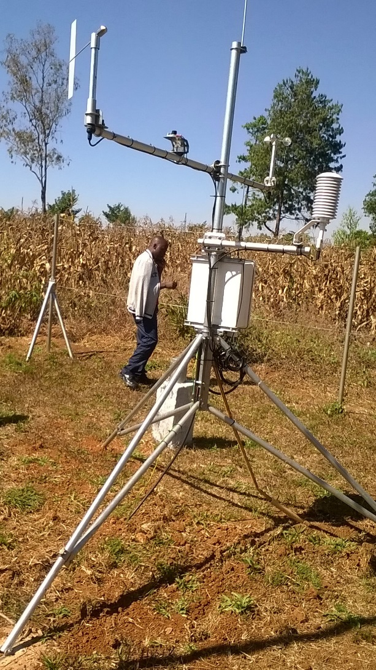
One of the AWS installed in Ntcheu district

Slide 11
THANK YOU

