Slide 1
Module 1: GLOBAL POLICY CONTEXT FOR CLIMATE CHANGE ADAPTATION
Integrating Adaptation and Agriculture in National and Sectoral Monitoring and Evaluation (M&E) Frameworks

Slide 2
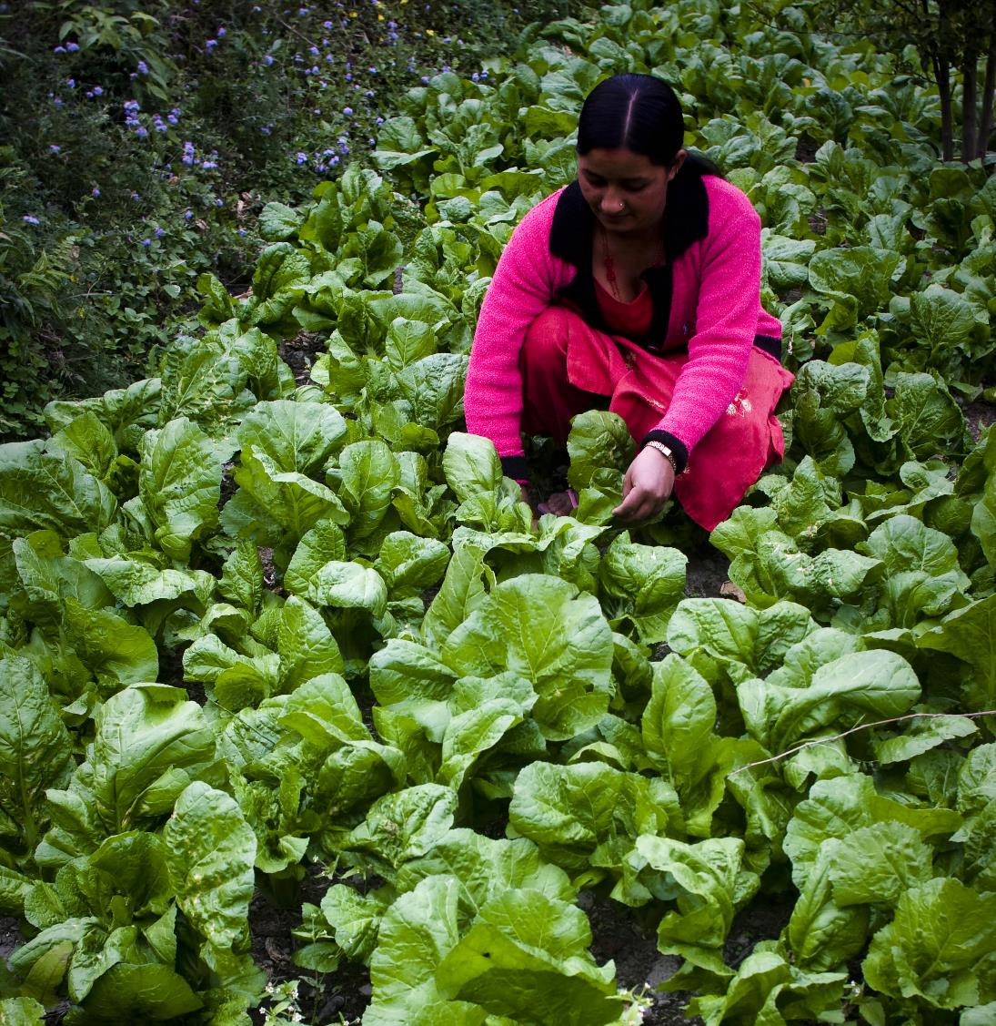
Objective
Understand key international and national policy frameworks for adaptation
Introduction to the NAP-Ag Programme
Overview
UNFCCC Paris Agreement
Enhanced Transparency Framework (ETF)
Sendai Framework for DRR
National Adaptation Plan
2030 Agenda, SDGs
Synergies in monitoring PA, SDG, Sendai Framework

Slide 3
Three Global Commitments
In 2015, countries committed to three international agreements that are shaping the global response to climate change, disaster risk reduction and sustainable development

Slide 4
Paris Agreement under the UNFCCC
The Paris Agreement, was adopted in 2015, and brings all UNFCCC signatory nations together to combat CC and adapt to its effects.
The agreement aims to respond to CC by keeping global temperature rise during this century well below 2 degrees Celsius above pre-industrial levels (Mitigation).

Slide 5
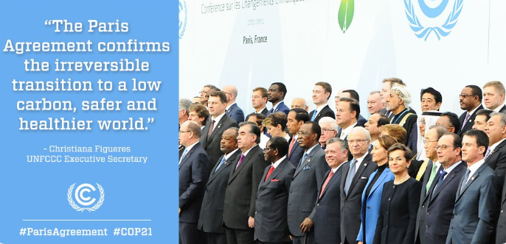
For the first time, the PA puts forward a global goal on Adaptation: “enhancing adaptive capacity, strengthening resilience and reducing vulnerability to climate change, with a view to contributing to sustainable development. All Parties should engage in adaptation, including by formulating and implementing National Adaptation Plans.

Slide 6
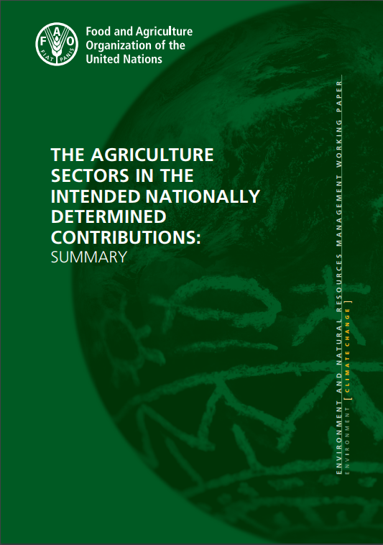
NDCs and adaptation
NDCs cornerstone of the Paris Agreement
102 countries have included adaptation and sometimes NAP in their NDCs
Of the developing countries that include adaptation in NDCs, 93% mention adaptation areas and/ or actions in the context of the agriculture sector:
crops and livestock (97%);
forests (88%); and
fisheries and aquaculture (64%)
FAO, 2016 http://www.fao.org/3/a-i5687e.pdf

Slide 7
UNFCCC: The Paris Agreement and M&E
The Paris Agreement states that: each Party shall, as appropriate, engage in adaptation planning processes and the implementation of actions, including the development or enhancement of relevant plans, policies and/or contributions, which may include […], (d) monitoring and evaluating and learning from adaptation plans, policies, programmes and actions (Decision 1/CP.21. Art.7.9.)
Global NDC commitment for M&E
According to FAO, most countries emphasize the importance of monitoring and evaluating the impact of their proposed strategies. Where countries plan to introduce M&E for specific regions or sectors, they often express the intention to scale these measures up to the national level in the long run. (FAO 2016. The agriculture sectors in the INDC).

Slide 8
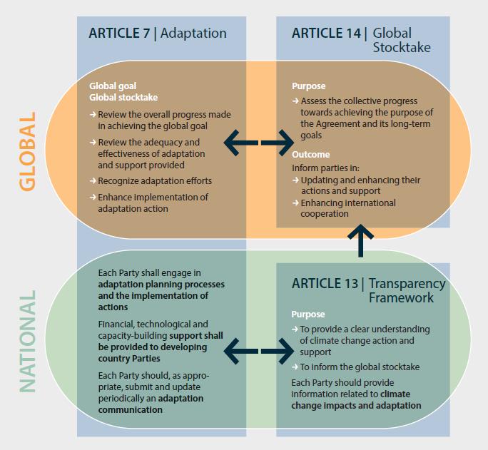
Key adaptation provisions under the PA and the interlinkages between them

Slide 9
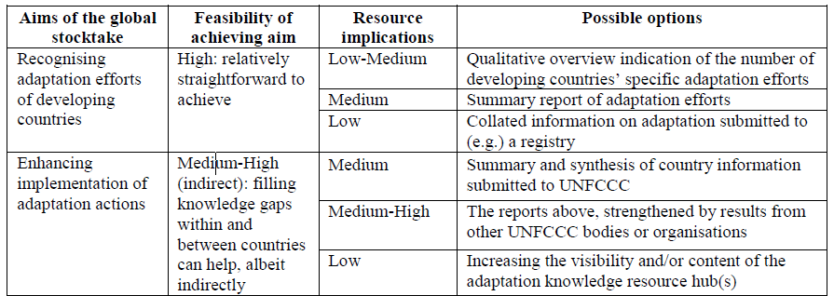

Slide 10
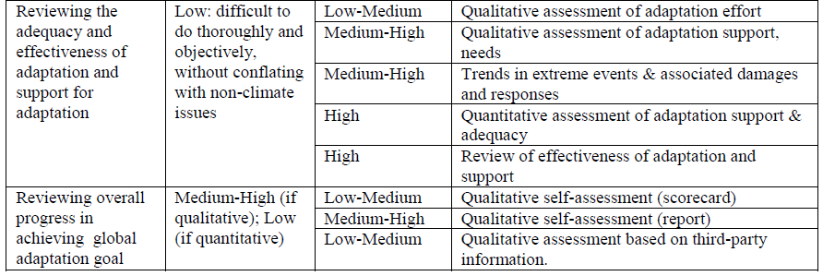

Slide 11
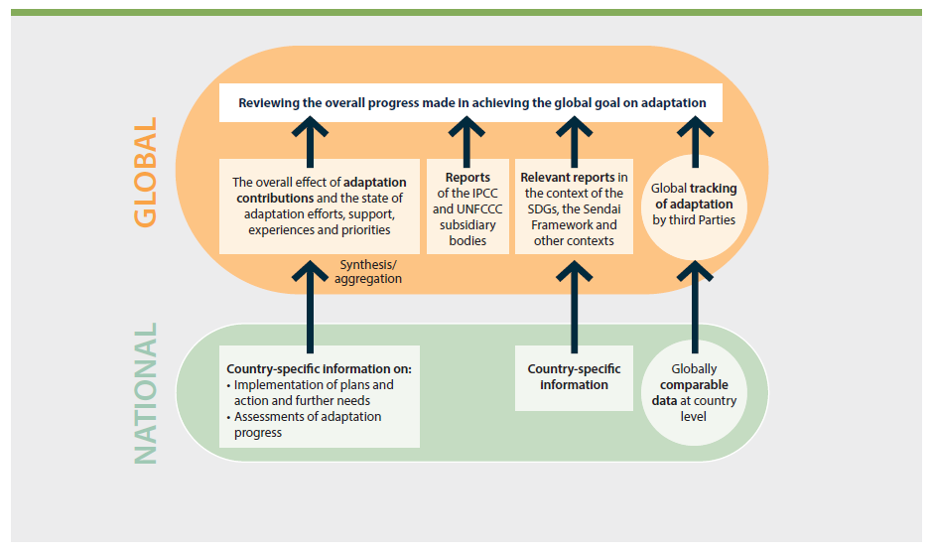
Notes:
.

Slide 12
Enhanced Transparency Framework (ETF)
Article 13 of the PA: The purpose of the ETF is to provide a clear understanding of adaptation action, including clarity and tracking of progress towards achieving Parties' individual NDC, and Parties' adaptation actions, including good practices, priorities, needs and gaps, to inform the global stocktake.
Information to be communicated: A national inventory report of anthropogenic emissions by sources and removals by sinks, prepared using methodologies accepted by the IPCC;
Information necessary to track progress made in implementing and achieving NDC
Information related to climate change impacts and CCA
Developing countries should provide information on financial, technology transfer and capacity-building support needed and received in the context of climate change actions, (….) to inform the global stocktake

Slide 13
From MRV and M&E to ETF
ETF is calling for a holistic NDC monitoring system of adaptation and mitigation and support (finance, technology and capacity building)
ETF requires a national monitoring system aggregating information from different levels
ETF will not provide a detailed methodology to be applied by all countries at all levels

Slide 14
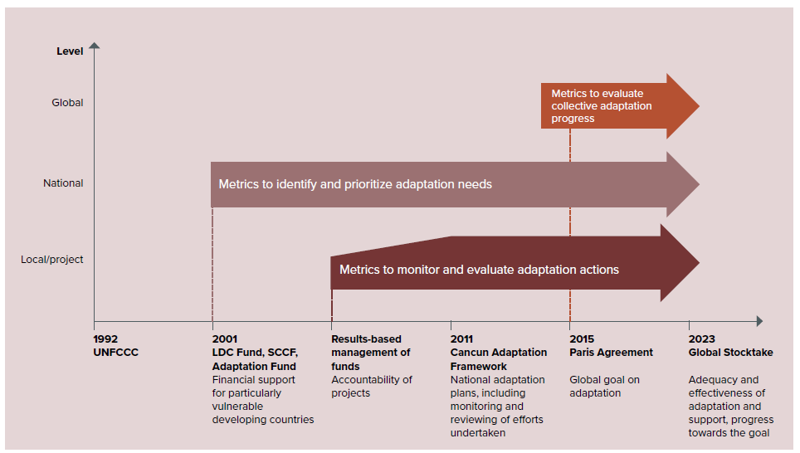

Slide 15
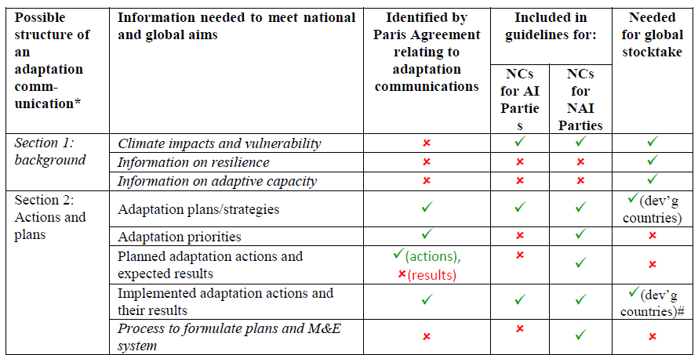

Slide 16
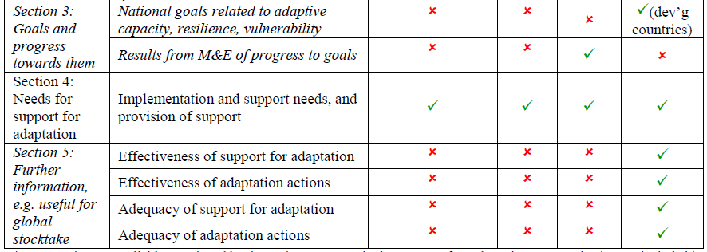

Slide 17
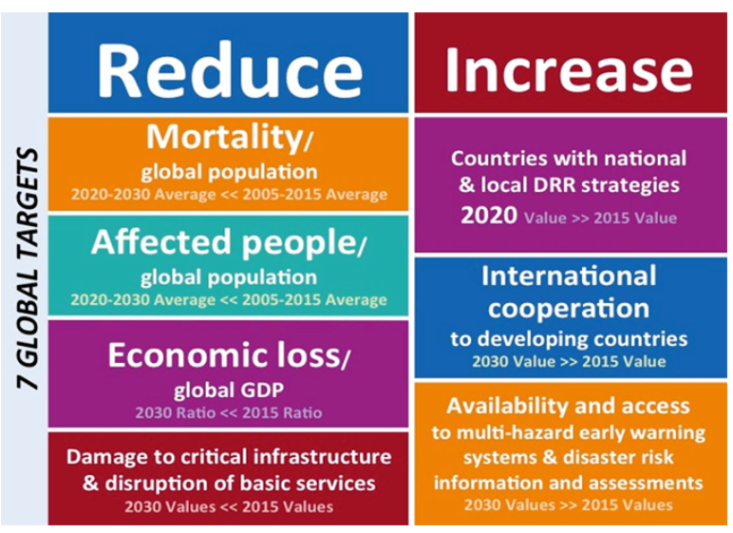
Sendai Framework for Disaster Risk Reduction 2015-2030

Slide 18
National Adaptation Plan
The national adaptation plan (NAP) process enables countries to identify medium- and long-term adaptation needs and develop and implemente strategies and programmes to address those needs.
According to the LEG Technical Guidelines, the adaptation planning process should:
be participatory and transparent, enhance coherence of adaptation and development planning
be guided by best available science, and take into consideration traditional and indigenous knowledge
be gender-sensitive
Under the Paris Agreement,. NAP process is well recognized

Slide 19
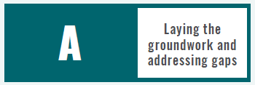
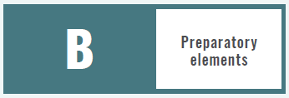
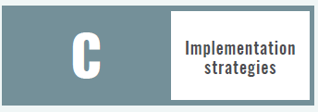
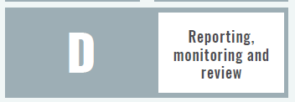
What is the NAP process?
The national adaptation plan (NAP) process was established under the Cancun Adaptation Framework (2010).
It is a continuous, progressive and iterative process which follows country-driven, gender-sensitive, participatory and fully transparent approach.
Under the Paris Agreement, Global Adaptation Goal, Adaptation Communications are important. NAP process is well recognized in Article 7

Slide 20
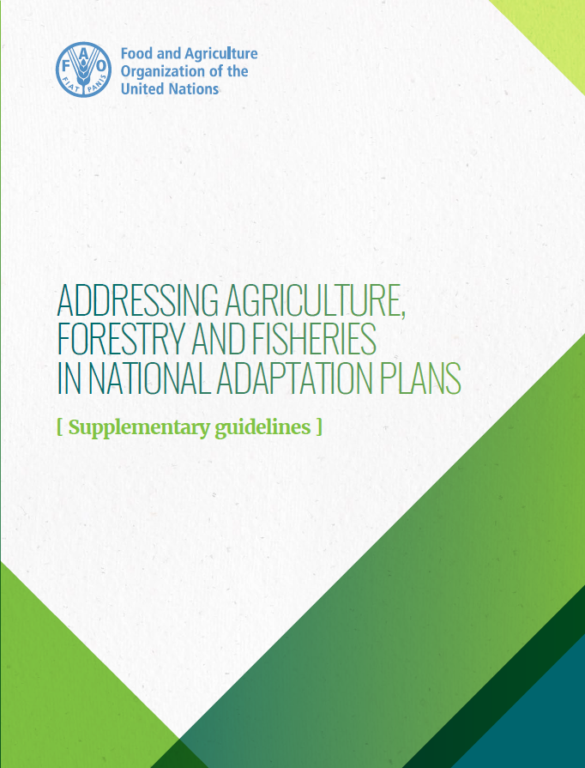
Addressing, Agriculture, Forestry and Fisheries in NAP {Supplementary Guidelines}
Highlight the agriculture sector-specific aspects in the process to formulate and implement NAPS
Integrate adaptation in the agriculture sectors’ policies, plans and programmes
Support countries’ efforts to reduce vulnerability of the agriculture sectors on the impacts of climate change
Notes:
The NAP-Ag Supplementary guidelines support developing countries in reducing vulnerability of agricultural sectors to the impacts of climate change by building adaptive capacities and resilience.

Slide 21
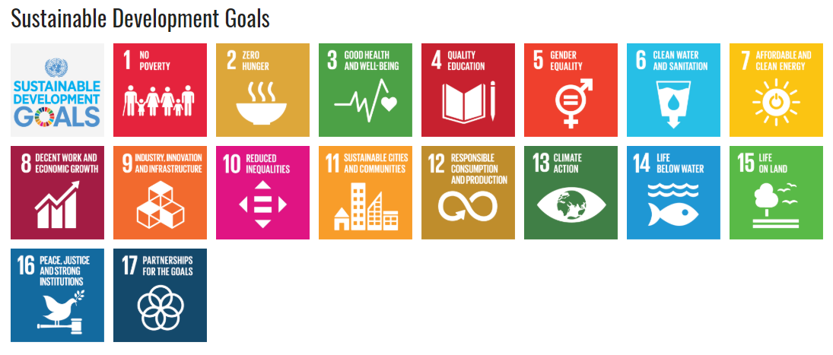
2030 Agenda for Sustainable Development
Notes:
The Sustainable Development Goals (SDGs) were adopted in 2015 by countries to end poverty, protect the planet, and ensure prosperity for all as part of a new sustainable development agenda.
17 Sustainable Development Goals (SDGs) and 169 targets. The Agenda commits the international community to end poverty and hunger and achieve sustainable development in all three dimensions (social, economic and environmental) over the next 15 years (2016-2030).
The SDGs are now the main reference for development policies and programmes at national level. Each country is reviewing the 17 goals to determine how they can be translated into feasible but ambitious development plans, and how they can commit national resources to produce real change.

Slide 22
Overview of the global SDG indicator framework
The global indicator framework (GIF) comprises 232 unique indicators, and was endorsed by the UN General Assembly in July 2017;
UN Statistical Commission is overall responsible for developing and implementing the SDG monitoring framework
Inter-Agency and Expert Group on SDG indicators (IAEG-SDG) to oversee this work through to 2030
28 countries as members, representing their respective regions;
International organizations only as observers;
Meets twice a year
=> The process has been fully led by countries

Slide 23
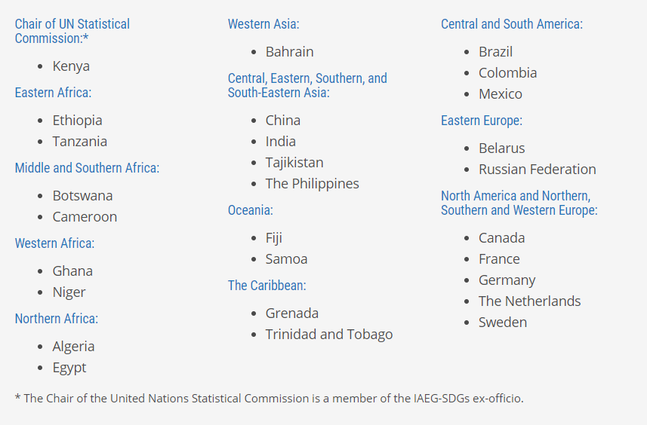
Member countries of the IAEG-SDG
Notes:
https://unstats.un.org/sdgs/iaeg-sdgs/members
As of May 2017, the following United Nations Member States are currently members of the Inter-Agency and Expert Group on Sustainable Development Goal Indicators:

Slide 24
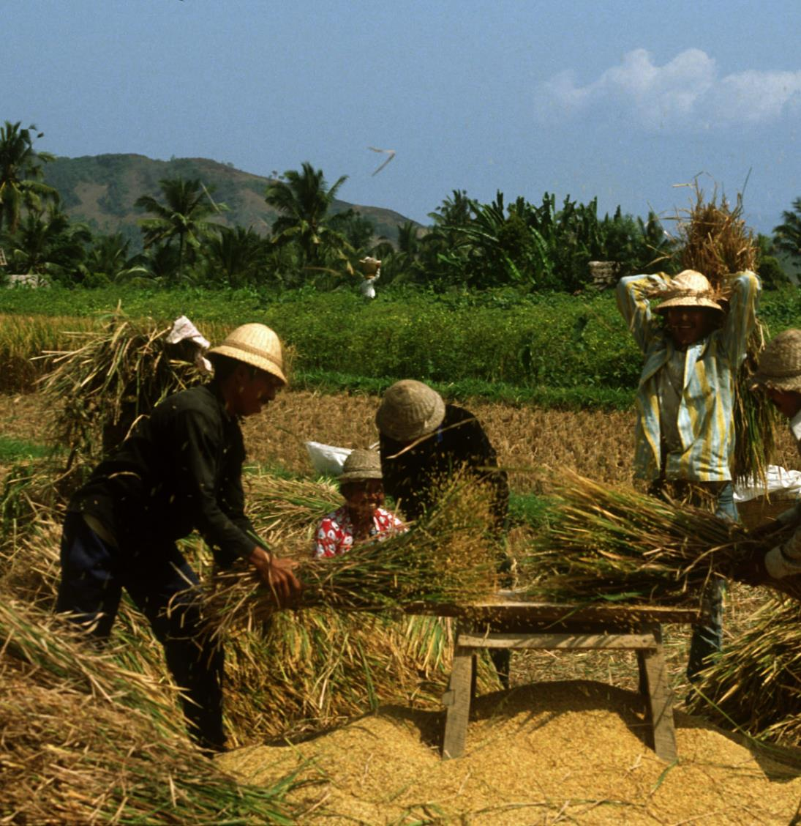
SDG and Adaptation
Countries are rolling actions on Paris Agreement and 2030 Agenda simultaneously
Coordination and linkages would allow to: i. Reduce vulnerability ii. Implement the Paris Agreement iii. Align long-term national development priorities with the SDG framework
Key goal for agriculture and adaptation: Goal 13 Climate Action
Notes:
- All countries have a stake in the implementing the Sustainable Development Agenda and the Paris Agreement; as a matter of fact, countries are rolling actions on both simultaneously.
- Ministries of Environment, Finance and Planning as well as sector ministries play a key role to with respect to NAPS, SDGs and NDCs and need to manage these processes effectively for the benefit of both development and climate action
-There is a strategic opportunity to improve adaptation planning and action on the ground as well as to enhance the scale and sustainability of impact from the three planning processes, by harnessing the linkages and leveraging each to the mutual benefit of all three.
1.Reduce vulnerability: integrate adaptation considerations into all relevant plans, policies, and strategies; prioritize and plan for adaptation
2. Implement the Paris Agreement: with NDCs as the primary vehicle for capturing, reporting and updating commitments and progress
3. Align long-term national development priorities with the SDG framework.

Slide 25
SDG Targets & indicators relevant to adaptation
Goal 1. End poverty in all its forms everywhere
Target:
1.5 By 2030, build the resilience of the poor and those in vulnerable situations and reduce their exposure and vulnerability to climate-related extreme events and other economic, social and environmental shocks and disasters
Indicators:
1.5.1 Number of deaths, missing persons and directly affected persons attributed to disasters per 100,000 population
1.5.2 Direct economic loss attributed to disasters in relation to global gross domestic product (GDP)
1.5.3 Number of countries that adopt and implement national DRR strategies in line with the Sendai Framework for Disaster Risk Reduction 2015–2030
1.5.4 Proportion of local governments that adopt and implement local disaster risk reduction strategies in line with national disaster risk reduction strategies

Slide 26
Goal 13. Take urgent action to combat climate change and its impacts
Targets:
13.1 Strengthen resilience and adaptive capacity to climate-related hazards and natural disasters in all countries
13.2 Integrate climate change measures into national policies, strategies and planning
13.3 Improve education, awareness-raising and human and institutional capacity on climate change mitigation, adaptation, impact reduction and early warning
13.a Implement the commitment undertaken by developed-country parties to the UNFCCC to a goal of mobilizing jointly $100 billion annually by 2020 from all sources to address the needs of developing countries in the context of meaningful mitigation actions and transparency on implementation and fully operationalize the Green Climate Fund through its capitalization as soon as possible
13.b Promote mechanisms for raising capacity for effective climate change-related planning and management in least developed countries and small island developing States, including focusing on women, youth and local and marginalized communities
Notes:
2 Acknowledging that the United Nations Framework Convention on Climate Change is the primary international, intergovernmental forum for negotiating the global response to climate change.
Indicators:
13.1.1 Number of deaths, missing persons and directly affected persons attributed to disasters per 100,000 population
13.1.2 Number of countries that adopt and implement national disaster risk reduction strategies in line with the Sendai Framework for Disaster Risk Reduction 2015–2030
13.1.3 Proportion of local governments that adopt and implement local disaster risk reduction strategies in line with national disaster risk reduction strategies
13.2.1 Number of countries that have communicated the establishment or operationalization of an integrated policy/strategy/plan which increases their ability to adapt to the adverse impacts of climate change, and foster climate resilience and low greenhouse gas emissions development in a manner that does not threaten food production (including a national adaptation plan, nationally determined contribution, national communication, biennial update report or other)
13.3 Improve education, awareness-raising and human and institutional capacity on climate change mitigation, adaptation, impact reduction and early warning
13.3.1 Number of countries that have integrated mitigation, adaptation, impact reduction and early warning into primary, secondary and tertiary curricula
13.3.2 Number of countries that have communicated the strengthening of institutional, systemic and individual capacity-building to implement adaptation, mitigation and technology transfer, and development actions
13.a.1 Mobilized amount of United States dollars per year between 2020 and 2025 accountable towards the $100 billion commitment
13.b.1 Number of least developed countries and small island developing States that are receiving specialized support, and amount of support, including finance, technology and capacity-building, for mechanisms for raising capacities for effective climate change-related planning and management, including focusing on women, youth and local and marginalized communities

Slide 27
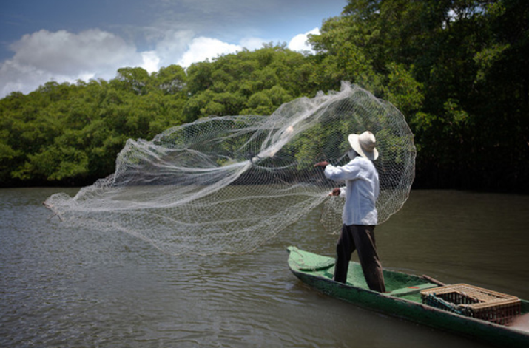
Goal 14. Conserve and sustainably use the oceans, seas and marine resources for sustainable development
Target:
14.2 By 2020, sustainably manage and protect marine and coastal ecosystems to avoid significant adverse impacts, including by strengthening their resilience, and take action for their restoration in order to achieve healthy and productive oceans
Indicator:
14.2.1 Proportion of national exclusive economic zones managed using ecosystem-based approaches

Slide 28
Goal 11. Make cities and human settlements inclusive, safe, resilient and sustainable
Target:
11.b By 2020, substantially increase the number of cities and human settlements adopting and implementing integrated policies and plans towards inclusion, resource efficiency, mitigation and adaptation to climate change, resilience to disasters, and develop and implement, in line with the Sendai Framework for Disaster Risk Reduction 2015–2030, holistic disaster risk management at all levels
Indicators:
11.b.1 Number of countries that adopt and implement national disaster risk reduction strategies in line with the Sendai Framework for Disaster Risk Reduction 2015–2030
11.b.2 Proportion of local governments that adopt and implement local disaster risk reduction strategies in line with national disaster risk reduction strategies
11.c.1 Proportion of financial support to the least developed countries that is allocated to the construction and retrofitting of sustainable, resilient and resource-efficient buildings utilizing local materials

Slide 29
NAP Contributes to the SDGs
GOAL | SDG INDICATORS | NAP
 | 1.b Create sound policy frameworks to support accelerated investment in poverty eradication actions | Creating policy frameworks to support investments for CCA and resilience
 | 2.4 By 2030, ensure sustainable food production systems and implement resilient agricultural practices | Mainstreaming CCA in agriculture and prioritizing agriculture adaptation options in development to increase food security
 | 3.d Strengthen the capacity of all countries, for early warning, risk reduction and management of national & global health risks | Getting a better understanding of health impacts of CC and building capacities to address these risks through NAP
 | 4.7 By 2030, ensure that all learners acquire the knowledge and skills needed to promote sustainable development | Engaging primary, secondary and higher education institutions to build capacities on CCA
 | 5.c Adopt and strengthen sound policies and enforceable legislation for the promotion of gender equality and the empowerment of all women and girls at all levels | Promoting gender-responsive and gender-transformative policies with regards to CCA
 | 8.3 Promote development-oriented policies that support productive activities, decent job creation, entrepreneurship, creativity and innovation | Promoting innovation and engagement of private sector in CCA planning
 | 16.6 Develop effective, accountable and transparent institutions at all levels | Strengthening institutional capacity for CCA coordination incl. M& E and stakeholder inclusion
Notes:
Source: UNDP NAP-Ag Programme Julie (any official publication)
Institutional arrangements. Stocktaking for NAP should also consider current arrangements and adapt for planning and cross-sector policy coordination around the SDGs related to CC
Data coherence. Stocktaking, collection of data and climate information, setting up of information system for NAP should feed into the SDG monitoring mechanism
Adaptation options could be proposed as SDG catalysts
Budget implications. CPEIR, climate budget tagging, and activities to support the development of annual and pluriannual budgetary frameworks could feed into SDG budgetary mainstreaming exercise.
Common messaging. Identifying opportunities for joint outreach and awareness-raising
Accessing climate finance

Slide 30
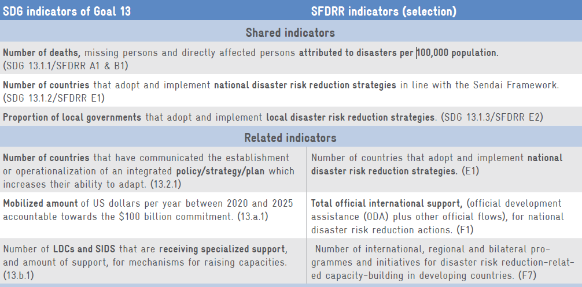
Synergies between SDGs and SFDRR Indicators
Notes:
The main difference is that the SDGs and the SFDRR have measurable targets at global level with corresponding indicators. Thus, their global monitoring reports use the same indicators for all countries which may be complemented by national indicators. In contrast the Paris Agreement does not have quantified global indicators for adaptation. Monitoring of the NDC adaptation targets will be inherently country-specific.
SOURCE: GIZ. 2017. CC Policy Brief. Synergies in monitoring the implementation of the Paris Agreement, the SDGs and the Sendai Framework

Slide 31
Comparison of the monitoring frameworks of the three Agreements
 | SDGs (Agenda 2030) | Sendai | Paris Agreement
Quantitative goals or targets at global level | 17 global goals with several targets each. Countries may define additional national targets. | 7 global targets. Countries may define additional national targets. | For mitigation (well below 2°C and pursuing efforts to 1.5°C). The global goal on adaptation is qualitative. Countries define their own targets (NDCs).
Development of global M&E framework | By an ‘Inter-Agency and Expert Group on Sustainable Development Goal Indicators’, adopted by UN General Assembly. | By an ‘open-ended intergovernmental expert working group’ comprising experts nominated by States and supported by the UNISDR; adopted by UN General Assembly. | Details of the Global Stocktake are still being negotiated (Art. 14). ‘Modalities, procedures and guidelines’ for national reporting under the transparency framework (Art. 13) and details of the Adaptation Communications (Art. 7) are still to be agreed upon by the COP; Parties may develop country-specific adaptation M&E systems (Art. 7).
Notes:
Objective of the agreement
SDGs (Agenda 2030): Contributing to the achievement of sustainable development and serving as a driver for implementation and mainstreaming.
Sendai: A substantial reduction of disaster risk and losses in lives, livelihoods and health and in economic, physical, social, cultural and environmental assets.
Paris Agreement: Holding the increase in the global average temperature to well below 2°C and pursuing efforts to limit it to 1.5°C (mitigation); increasing the ability to adapt to the adverse impacts of CC (adaptation); making finance flows consistent with a pathway towards low GHG emissions and climate-resilient development (Art. 2)
Purpose of monitoring
SDGs (Agenda 2030): Measure global progress towards achievement of the SDG goals and targets.
Sendai: Measure global progress in implementation of the seven Sendai targets.
Paris Agreement: Global Stocktake: ‘assess the collective progress towards achieving the purpose of this Agreement’ (Art. 14). ETF: ‘Clarity and tracking of progress towards achieving Parties’ individual NDCs and Parties’ adaptation actions’ (Art. 13).

Slide 32
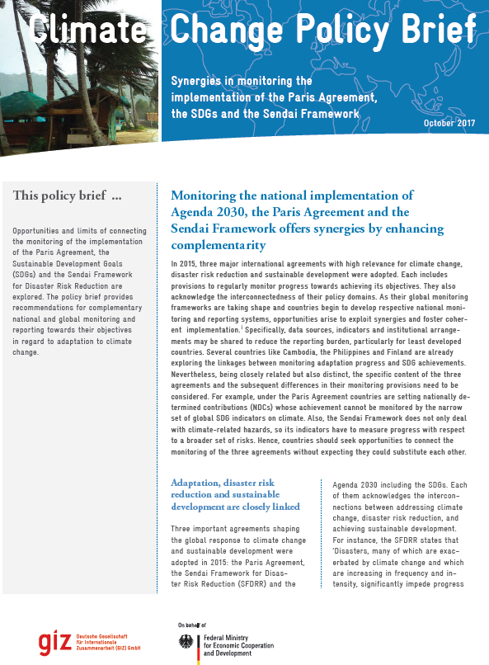
Recommendations for alignment
Consider the integration of SDG and Sendai indicators into country-specific adaptation M&E systems
Consider information from country-specific adaptation M&E systems for national reporting on SDGs and SFDRR
Look beyond SDG 13 (Climate action)
Utilize the political visibility of the SDGs to advance adaptation M&E
Foster coherence, avoid substitution
Utilize SDG and SFDRR information sources for the Global Stock take
Notes:
1. To enhance synergies for data compilation for the respective reporting channels.
3. CC and resilience feature in multiple SDGs including on poverty reduction (goal 1), end hunger (2), sustainable water management (6), energy access (7) and resilient cities (11). Accordingly, relevant data and indicators could be found under any of these themes and not just those of goal 13.
5. Each of the three agreements has distinct goals which require targeted indicators.
Help avoiding the pitfall that a single set of indicators (e.g. from the SDGs) could monitor all three agreements to a sufficient depth. Due to the NDCs being defined by each country, the Paris Agreement will continue to require information on country-specific adaptation achievements to determine progress towards its objectives.
ADAPTATION COMMITTEE: Although full and complete harmonization among the three agendas may not be feasible nor useful, some degree of synergy could be beneficial. Linking data gathering and reporting systems for the SDGs, the Sendai Framework and on climate change adaptation will help avoid the duplication of effort.
Enhancing individual and institutional technical capacity for data collection and assessment of adaptation is an ongoing task for many countries. Increased capacity can help to link data gathering and reporting systems for the three global agendas at national level

