Slide 1
Module 3: Introduction to M&E OF Adaptation
Integrating Adaptation and Agriculture in National and Sectoral Monitoring and Evaluation (M&E) Frameworks

Slide 2
Objective
Reach a shared understanding on the purpose, objectives of M&E of adaptation in the agriculture sectors
Overview
What is M&E: key concepts and definitions
Purpose, objectives, scales
Challenges
Global policy context
M&E in the NAP context
National and sectoral adaptation M&E systems: examples and early lessons learned

Slide 3
Key concepts and definitions

Slide 4
What is Monitoring and Evaluation?
Difference between monitoring and evaluation (USAID,2005)
Monitoring | Evaluation
Continuous: day-to-day | Periodic: important milestones
Progress reports | In-depth analysis off achievements
Focuses on inputs and outputs | Focuses on outcomes and impacts
Alerts managers about problems and progress that is unexpected or accelerated | Providers managers with strategy and policy options
Self-assessment | External analysis
Clarifies programme or policy objectives | Analyses why intended results were or were not achieved
Links activities and their resources to objectives | Assesses specific causal contribution of activities to results
Translates objectives into performance indicators and set targets | Examines implementation process
Routinely collects data on indicators and compares actual results with targets | Explores unintended results
Reports progress to managers and alerts them about problems | Provides lessons, highlights significant accomplishment and offers recommendations for improvement

Slide 5
What is Adaptation?
Adaptation refers to adjustments in ecological, social, or economic systems in response to actual or expected climatic stimuli and their effects or impacts. It refers to changes in processes, practices, and structures to moderate potential damages or to benefit from opportunities associated with climate change (IPCC, 2001).
Adaptation activities span five general components: 1. observation; 2. assessment of climate impacts and vulnerability; 3. planning; 4. implementation; and 5. monitoring and evaluation of adaptation actions.
Given the complexity and long-term nature of climate change, it is essential that adaptation be designed as a continuous and flexible process which includes feedback through monitoring and evaluation (M&E).

Slide 6
M&E as part of the national adaptation planning cycle
UNDP, 2017

Slide 7
Purpose, objectives and scale of M&E of adaptation
Measuring the process of adaptation such as advancement in implementing programs, policies and plans or building individual and institutional capacity
Measuring adaptation outcomes
Measuring the increases in adaptive capacity
Measuring changes in the impacts of climate change, quantify damages and losses (e.g. crop losses), and vulnerability to climate change
Measuring occurrence and frequency of climate hazards
Different levels of M&E
National
Sub-national
Programme and project levels
Sectoral

Slide 10
Different scales and entry points for doing M&E in a country
National level
National level planning and budgeting
National Programmes
National Adaptation Plan
(incl. agriculture)
Sector level
Sectoral planning and budgeting
Sector-specific programmes
(Climate Smart) Agriculture Strategy (incl. adaptation)
Local level
Sub-national/municipal level planning and budgeting
Programmes and projects
Impact evaluation of agriculture and adaptation programmes

Slide 11
Learning versus Accountability
Learning: improve the effectiveness and efficiency of the adaptation process and facilitate incorporation of emerging science, assessment and lessons learned
Accountability: ensure that resources for adaptation are efficiently allocated, demonstrate progress for taxpayers, constituents, and/or development partners, or showcase results on the international stage, provide information on national communications and other channels and effectiveness of adaptation planning and implementation

Slide 12
Challenges of national approaches to adaptation M&E
Baselines change over time
Several interventions and under-reporting
No one universal indicator for adaptation, there is a lack of a common metrics, and difficulty in defining what to measure
Many actors having different requirements
Difficulty of attribution of specific policies and actions to outcomes
Diversity of adaptation objectives
Uncertainty of the climatic and non-climatic drivers and risks
Long timeframes of impacts and adaptation
Lack of data and information for tracking
High costs of data collection

Slide 13
Emerging solutions I
A. STAKEHOLDER ENGAGEMENT AND ALIGNMENT
Articulate the development of the M&E system relevant policies/plans
Consult and coordinate with existing entities focusing on CCA and mitigation
Ensure the early involvement of a range of stakeholders in the design of the M&E system, e.g. forming a working group focused on M&E of adaptation
Conduct awareness raising about the role of M&E in adaptation
Training of adaptation technical staff as well as decision-makers
Notes:
Source: NAP Global Network. 2018

Slide 14
Emerging solutions II
B. RESOURCE STRENGTHENING
Conduct a realistic assessment of the capacities required to design and implement M&E of adaptation, provide capacity-building opportunities to address gaps
Participate actively in knowledge sharing on M&E of adaptation through existing networks
Encourage relevant ministries to consider the resources required for M&E as part of their planning and budgeting processes
Explore and mobilize a diverse range of funding sources for M&E. e.g., consider international funding opportunities such as GCF Readiness Programme to establish the M&E system
Notes:
Source: NAP Global Network. 2018

Slide 15
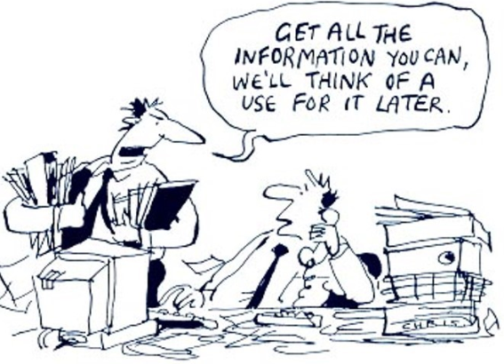
Emerging solutions III
C. DATA QUALITY AND EFFECTIVE USE
Foster reflection processes about the M&E outputs, involving stakeholders from multiple sectors and the scientific community as appropriate
Prioritize the data to be collected and the indicators to monitor
Build upon existing indicators and resources
Implement gender-responsive M&E for adaptation, and learning from sex-disaggregated data
Consider the use of Information and Communication Technologies (e.g., mobile phones) as part of data collection
Design communication strategies to disseminate M&E findings

Slide 16
GLOBAL policy context FOR M&e OF ADAPTATION

Slide 17
UNFCCC: NAP
The National Adaptation Plans were established in 2010, as part of the Cancun Adaptation Framework to enhance urgent action on adaptation, and were adopted by UNFCCCC Parties (UNFCCC Decision 1/CP.16.). NAPs enable countries to identify medium- to long-term adaptation needs, and develop and implement strategies and programs to address those needs.
NAP Technical Guidelines (LDC Expert Group, 2012)
The NAP Technical Guidelines recommend the establishment of an M&E system from the outset of a NAP process.
Steps of Element D. Reporting, Monitoring and Review
1. Monitoring the NAP process
2. Reviewing the NAP process to assess progress, effectiveness and gaps
3. Iteratively updating the national adaptation plans
4. Outreach on the NAP process and reporting on progress and effectiveness

Slide 18
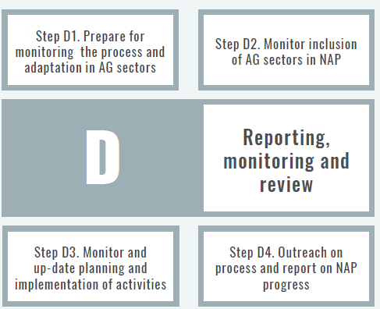
FAO NAP Supplementary Guidelines (FAO, 2017)
The focus of a NAP M&E is to:
1. Assess the progress, effectiveness and gaps in identifying and prioritizing adaptation options for the agriculture sectors
2. track national progress towards
adaptation targets and national development goals, through aggregation of outcomes of adaptation programmes and policies;
3. monitor and iteratively update the process of adaptation planning and implementation in the agriculture sector.

Slide 19
M&E of NAPs
According to the NAP Technical Guidelines, M&E of NAPs:
Should be designed and implemented throughout the NAP process
Be used to updated NAPs
Provide information for reporting on NAP progress
M&E of NAPs can be carried out at different scales, for example:
At national level, to review and assess the overall NAP process
At level of implementation, to see if goals and objectives are met
At programme or project level, to assess results of activities

Slide 20
UNFCCC: The Paris Agreement and M&E
The Paris Agreement states that: each Party shall, as appropriate, engage in adaptation planning processes and the implementation of actions, including the development or enhancement of relevant plans, policies and/or contributions, which may include […], (d) monitoring and evaluating and learning from adaptation plans, policies, programmes and actions (Decision 1/CP.21. Art.7.9.)
Global NDC commitment for M&E
According to FAO, most countries emphasize the importance of monitoring and evaluating the impact of their proposed strategies. Where countries plan to introduce M&E for specific regions or sectors, they often express the intention to scale these measures up to the national level in the long run. (FAO 2016. The agriculture sectors in the INDC).

Slide 21
national and sectoral experiences oF M&e SYTEM FOR ADAPTATION

Slide 22
Degree of advancement of M&E system in different countries
Notes:
Adaptation GAP Report 2017
More than 40 countries are advancing on the themes

Slide 23
Overview of existing national-level adaptation monitoring systems
Source: Naswa et al., 2015 and GIZ, 2014
Country | Approach
Australia | Identifies risks to essential services (e.g. energy and water supply) and allocation of responsibilities to persons or organisations best placed to address the risks. Indicators of adaptation drivers, activities and outcomes. Sensitivity of agricultural production is one of the proposed 12 national indicators.
France | Process indicators and some outcome indicators for twenty priority sectors, which include agriculture; forestry; fisheries and aquaculture.
Germany | Climate change impacts and response indicators for fifteen action and cross-sectional fields to monitor adaptation, including agriculture; woodland and forestry; fisheries. Periodic evaluation of the German Adaptation Strategy.
Kenya | Indicator-based system using outcome and process-based monitoring, reporting and verification (MRV) of actions under the indicators measured at the national and county levels. Agriculture and livestock are both sectors for which prioritised adaptation actions to be monitored are proposed.
Morocco | Using indicators to monitor changes in vulnerability, adaptation progress and their impacts. Around thirty indicators in each of the two pilot regions, focused on priority sectors agriculture, water and biodiversity/forestry.

Slide 24
Country | Approach
Mozambique | Monitor climate change impacts and inform national budget allocations and international climate finance.
Nepal | Programme-level indicators (based on Pilot Program for Climate Resilience – PPPCR) core indicators). Indicator system piloted for eight climate change projects and indicators linked to National Adaptation Programmes of Action (NAPA) priorities; matched by individual project-level indicators. 149 sub-national ‘environmentally friendly’ indicators for different sectors (including climate) and scales (household to district).
Norway | Process- and impact-monitoring using repeated surveys of exposure and adaptive capacity.
Philippines | Indicators linked to results chains for seven strategic priority sectors, including food security. Climate Change Vulnerability Indices for measuring, monitoring and evaluating local vulnerability and adaptation.
South Africa | Established outcome-based system will be used to monitor climate change impacts at appropriate spatial densities and frequencies. Report progress on the implementation of adaptation actions.
United Kingdom | Mixture of approaches: regular, detailed climate change vulnerability assessments; indicators to monitor changes in climate risks, uptake of adaptation actions and climate impacts; decision-making analysis to evaluate whether degree of adaptation is sufficient to address current and future climate risks. Agriculture and forestry one of seven policy themes of the NAP, to which M&E is applied.
Source: Naswa et al., 2015 and GIZ, 2014

Slide 25
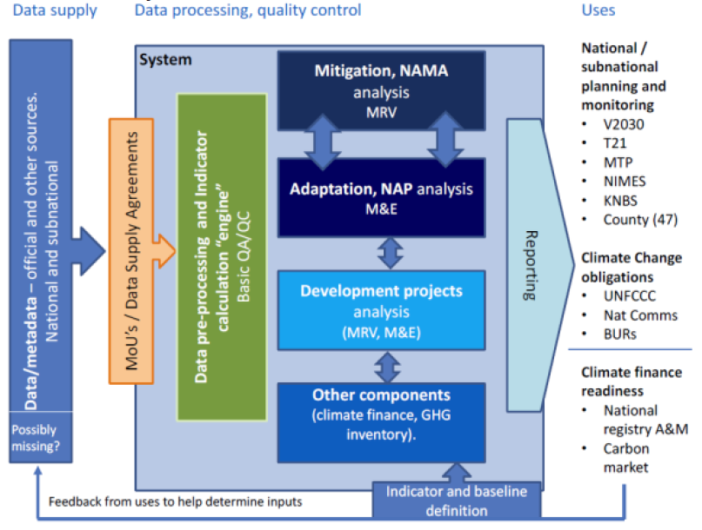
Kenya National Performance and Benefit Framework (NPBF)
The Kenya NPBF is designed to cover both adaptation and mitigation and the synergies between them

Slide 26
Exercise: purpose, challenges, experiences on adaptation M&E in the country
What would be the purpose of doing M&E of adaptation and agriculture?
What might be the key inputs (e.g. existing data sources)?
What are the opportunities and challenges for developing an M&E for adaptation for the agriculture sector?
What have we learnt from experiences to date on M&E of adaptation? What have we learn from M&E in the crop, forestry, fisheries sectors?
Notes:
Input from National Context: Existing monitoring systems, M&E frameworks in country: for agriculture, environment, forestry, fisheries for adaptation, for development; at different scales: national, sectoral, sub-national, portfolio and programmatic level
Split into small groups (15 minutes)
Answers to questions are written onto post-its and mapped onto a wall
Feedback to plenary and discussion (15 min)
Estimated time: 1 hr

Slide 27
Summary of the session

