Slide 1
Module 5: A TOC for M&E OF adaptation in the agriculture sector
Integrating Adaptation and Agriculture in National and Sectoral Monitoring and Evaluation (M&E) Frameworks

Slide 2
Objectives
Get a common understanding of the long-term adaptation goal for the agriculture sectors that can form the basis of the adaptation M&E system
Define the purpose and objective of the adaptation M&E framework for the agriculture sectors
Review of existing TOC for adaptation in the agriculture sector from key policies, where available
Identify the focus of what to monitor and evaluate on adaptation in the agriculture sector, e.g. impacts and vulnerabilities; processes; outcomes; budget

Slide 3
Overview
Step 1: Definitions, example of TOC in policies and programmes
Step 2: Define the purpose and objective of the adaptation M&E framework for the agricultural sectors
Step 3: Identify the focus of what to monitor and evaluate on adaptation in the agriculture sector, e.g. impacts and vulnerabilities; processes; outcomes; budget

Slide 4
Designing an M&E framework and plan for adaptation in the agriculture sectors
Step 1. | Understanding the policy context
Step 2. | Developing a shared understanding of the adaptation goal and pathways for integrating adaptation in the agriculture sector
Step 3. | Defining the purpose and focus of the M&E framework
Step 4. | Developing an M&E Framework for adaptation in the agriculture sector
Step 5. | Identifying indicators to track adaptation in the agriculture sector
Step 6. | Identifying the sources and type of data and information required for each indicator
Step 7. | Operationalising M&E for decision-making on adaptation in the agriculture sector

Slide 5
adaptation goals AND Adaptation TOC in policies and programmes

Slide 6
Adaptation goals for agriculture
Kenya NAP, agriculture action area: “Enhance the resilience of the agricultural value chain”
Philippines NCCAP food security intermediate outcome: “Ensured food availability, stability, access, and safety amidst increasing climate change and disaster risks”
Nepal ADS vision statement: “A self-reliant, sustainable, competitive, and inclusive agriculture sector that drives economic growth, and contributes to improved livelihoods and food and nutrition security leading to food sovereignty” – not specifically focused on adaptation

Slide 7
Definitions
1. A theory of change is a comprehensive description and illustration of how and why a desired change is expected to happen in a particular context
2. A TOC explains how a group of early and intermediate accomplishments sets the stage for producing long-range results. It articulates the assumptions about the process through which change will occur.
3. The causal sequence to achieve desired results (FAO)

Slide 8
TOCs NAP Global Network

Slide 9
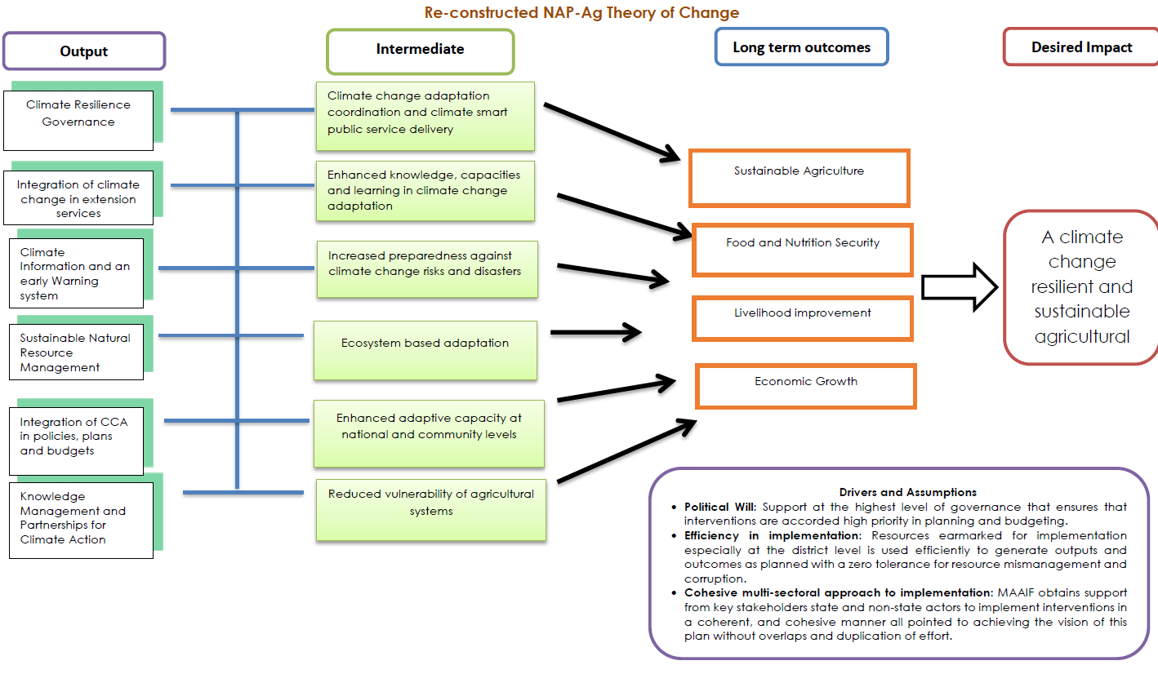
Uganda TOC for the agriculture sector NAP
Notes:
Hard copy of this slide can be distributed as it is difficult to read (source PM&E Framework)

Slide 10
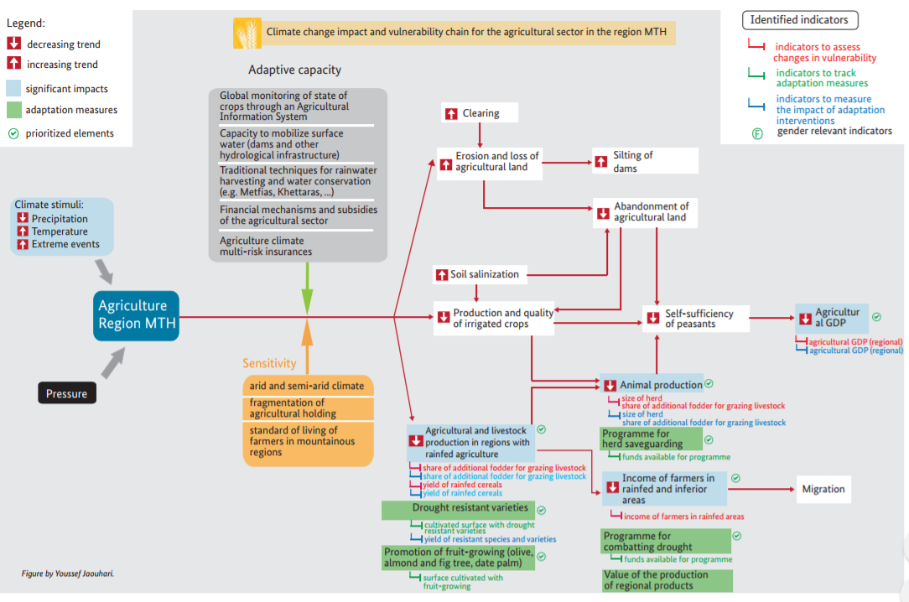
Morocco impact chain for Regional Environmental Information System
Notes:
Example of a climate change impact and vulnerability chain for the agricultural sector in the region Marrakech
Hard copy of this slide can be distributed as it is difficult to read (source http://www.adaptationcommunity.net/?wpfb_dl=226)

Slide 11
TOCs within country adaptation policies (content to be developed and presented by country team and consultant, revisions can be made during the discussion)
xxx

Slide 12
Key elements of a TOC or defining an adaptation goal
What is the adaptation goal you wish to achieve in the agriculture sectors? What are the outcomes and outputs? What is the role of the agriculture sector in reaching national adaptation goals?
What are the different pathways towards the final adaptation goal (they may already be articulated in e.g. the Agriculture Development Strategy, National Climate Change Strategy, NAP or other development or sectoral policies)? Determine the level of the ‘goal – national or sectoral´
How can the current policies, plans and programme portfolio within the agriculture sector help achieve the goal? Where are the bottle-necks to achieving the goal?
What are the barriers to achieve the adaptation goal?
What assumptions are you making?

Slide 13
Purpose, objective and focus of the m&E framework

Slide 14
What has already been monitored in terms of adaptation in the agricultural sectors (content to be developed and presented by consultant)

Slide 15
Exercise 1: Purpose of the M&E Framework
What purpose could an M&E framework for adaptation in the agriculture sector have? What are we trying to measure?
To learn how effective adaptation actions in the agriculture sector are being, and adjust course of future interventions? Including the measurement of differential impacts on women and men , socio-economic class, age, ability/disability
To monitor and evaluate the implementation of agriculture plans and strategies?
To report on adaptation spending in the agriculture sector?
For adaptive management of existing agricultural practices and sectoral priorities?
Who are the target users of the M&E results, both within and outside the Ministry of Agriculture?
Ministry of Agriculture sectoral experts and decision-makers, planning units and/or M&E units; national development planners or Ministry of Planning; national climate change coordination body; farmers associations, women’s groups, indigenous people groups?
Ministry of environment, local level authorities implementing agricultural activities, global stakeholders such as UNFCCC?
Notes:
1. Why do we want to do M&E for adaptation in the agriculture sectors?
2. This will determine the kind of information you will collect and how you may package the results of the M&E exercise.
Format: small groups discussion
Answers are pinned onto a wall
Feedback to plenary
Voting on different options, if needed
2 hrs
NOTE: the thinking/discussion should not focus on elite decision makers and neglect to include stakeholders/users like farmers, women’s groups, indigenous groups. In a participatory M&E framework, these groups should be part of defining indicators, collecting data for measurement, and should also be engaged in interpreting/using M&E results.

Slide 16
Potential focus of the M&E framework
M&E of climate change hazards, impacts and associated vulnerabilities in the agriculture sectors
M&E of adaptation processes in the agriculture sectors: how policies, plans or interventions to address climate change adaptation have advanced in the agriculture sectors, and how the capacity to deliver these has enhanced
M&E of adaptation outcomes in the agriculture sectors: changes brought about by the implementation of adaptation policies and interventions in the agriculture sectors, for example in terms of reduced losses and vulnerability to climate change or enhanced adaptive capacity at community, sub-national or national level

Slide 17
Exercise 2: Focus of the M&E Framework
Are you looking to monitor how the climate is changing and what the impacts are on the agricultural sector, as well as on different actors?
Are you aiming to monitor the advancement of a specific policy, plan or intervention and how this contributes to adaptation on the ground? E.g. a NAP, an Agriculture Development Strategy or Climate Smart Agriculture Strategy?
Are you looking to monitor and evaluate the outputs/outcomes and/or impact of a portfolio of adaptation programmes in the agriculture sector, evaluating what works, what doesn´t? Is this done to inform future investment decisions?
Are you looking to monitor and evaluate increased capacity of key (agricultural) stakeholders in delivering policies, plans and programmes related to adaptation?
Do you wish to monitor and evaluate adaptive capacity in the agriculture sector in terms of e.g. changes in agricultural practices that make them and dependent people less vulnerable to climate change?
Are you looking to monitor where and how adaptation funding is used, and by whom?
Notes:
Format: small groups discussion
Answers are pinned onto a wall
Feedback to plenary
Voting on different options, if needed
2 hrs

Slide 18
Focus of adaptation M&E for the agriculture sector in NAP-Ag countries
Kenya: an M&E System has being developed to monitor the implementation of the Kenya Climate Smart Agriculture Implementation Framework.
Uganda: a Performance Monitoring and Evaluation Framework was developed for the National Adaptation Plan of the Agriculture Sector. The draft Framework seeks to measure both adaptation processes and outcomes in the agriculture sector.
Uruguay: As part of the conceptualization of the National Adaptation Plan to Climate Variability and Change for the Agriculture Sector (PNA-Agro and the Action Plan for 2025), a matrix of 32 indicators was elaborated. The identification of the indicators was performed by searching for synergies with the PNA-Agro and other existing indicators in the NDC and the SDGs, in order to track progress in the implementation of the four adaptation dimensions, namely Production system (9 indicators), Ecosystems and natural resources (9 indicators), Livelihoods (9 indicators), Institutional Capacities (5 indicators).

Slide 19
Summary of the session

