Slide 1
Module 6: Design the M&E framework
Integrating Adaptation and Agriculture in National and Sectoral Monitoring and Evaluation (M&E) Frameworks

Slide 2
Objectives
Design a draft adaptation M&E Framework for the agriculture sector
Inputs
Theory of Change, purpose and focus (Module 4)
Adaptation M&E Guidance and tools
M&E Framework templates
M&E Framework example from a NAP-Ag Programme Country

Slide 3
Designing an M&E framework and plan for adaptation in the agriculture sectors
Step 1. | Understanding the policy context
Step 2. | Developing a shared understanding of the adaptation challenge, goals and the theory of change behind integrating adaptation in the agriculture sector
Step 3. | Defining the purpose and focus of the M&E framework
Step 4. | Developing an M&E Framework for adaptation in the agriculture sector
Step 5. | Identifying indicators to track adaptation in the agriculture sector
Step 6. | Identifying the sources and type of data and information required for each indicator
Step 7. | Operationalising M&E for decision-making on adaptation in the agriculture sector

Slide 4
Concrete experience in developing an m&E framework for the agriculture sector nap

Slide 5
The process of developing Uganda Performance M&E Framework for the agriculture sector NAP
The M&E Framework for the agriculture sector NAP is embedded in the existing MAAIF M&E framework.
Reviewed the Ministry of Agriculture, Animal Industry and Fisheries (MAAIF) regulatory, M&E and reporting frameworks and systems to guide the capture, management of data and reporting on adaptation and gender
Literature review to identify CCA and gender objectives and initiatives in agriculture sector, Agriculture sector NAP strategies
Develop a comprehensive PME Framework for adaptation in the agriculture sector and customize it to the existing National Performance Frameworks
Consultative and validation meetings to make the framework relevant to the users
MAAIF will take a lead in operationalizing the framework, and potential users were trained widely

Slide 6
LONG TERM OUTCOMES Agriculture Sector NAP
Increased crop yields increased growth rates of livestock population Increased fish stock Improved Agricultural risk management Increased prioritization of LULUCF A resilient agricultural sector Acquisition of information and communication systems that will aid decision making process Gender mainstreamed in CSA
FRAMEWORK COMPONENTS
Component 1: Crop production | Component 2: Livestock Development | Component 3: Fisheries and Aquaculture | Component 4: Climate Information, Early Warning and Disaster Preparedness Systems
Component 5: Land use and Land use change and forestry (LULUCF) | Component 6: Research for climate resilient agricultural development | Component 7: Knowledge Management and Partnerships for climate action | Component 8: Gendered Approach to climate change adaptation
Notes:
Goal A climate resilient and sustainable agricultural sector contributing towards achievement of the Uganda Vision 2040
Purpose/ Mission To reduce vulnerability and enhance adaptive capacity of Uganda's agricultural sector to the impacts of climate change in order to achieve sustainable agricultural development".
1 Goal - 8 Components - 19 Strategies 132 Activities
The performance of the Agriculture Sector NAP will be assessed against the following outcomes as shown in the table

Slide 7
Result framework for Component 1: Crop Production
Narrative Summary | Objectively Verifiable Indicators | Means of Verification
Objective 1.1 Promote climate resilient cropping systems and value chains
Strategy 1.1.1: Promote and encourage highly adaptive and productive crop varieties and cultivate in drought-prone, flood prone and rain-fed crop farming systems
1. Conduct a crop vulnerability and suitability assessment in all agro-ecological zones of Uganda | Number of climate resilient crops identified and profiled in all agro-ecological zones of Uganda | Crop vulnerability and suitability assessment reports from MAAIF, NARO and UBOS
2. Conduct studies on climate resilient crop varieties and cultivars (early maturing and drought tolerant) in the different agro-ecological zones | Number of studies carried out on climate resilient crop varieties and cultivars | Crop vulnerability and suitability assessment reports from NARO/ MAAIF
3. Conduct field trials and demonstrations and profile climate resilient crops | Number of field trials and demonstrations carried out of climate resilient crops and cropping practices | Field trials and demonstration reports, MAAIF reports
4. Build capacity of farmers and farmer groups in all agro-ecological zones and support them to upscale and improve access to high quality planting materials | Number of functional farmer groups in all agro-ecological zones | MAAIF, MTIC reports,
5. Build capacity of certified seed producers and support them to expand and improve the quality of seed | Number of certified seed producers % of farmers accessing certified seed and quality planting materials | MAAIF, UNADA, USTA, ISSD reports
6. Increase timely access to quality agricultural inputs and their efficient use | Number of farmers with timely access to quality agricultural inputs | MAAIF reports
 | Percentage increase in farmers using quality input | MAAIF reports
Notes:
Hard copy of this slide can be distributed as it is difficult to read (source PM&E Framework)

Slide 8
Result framework for Component 4: Use of climate indo and risk management tools and warning systems
Narrative summary | Objectively Verifiable Indicators | Means of verification | Key Assumptions
Strategy 4.1.2: Support innovative insurance schemes to protect farmers against climate risk related crop and livestock losses
1. Develop and implement varied innovative crop and livestock weather-indexed insurance packages | Weather-indexed insurance packages in place. | MAAIF report, MFI and Insurance Company Reports | Farmer have a variety of crops and livestock that are climate resilient
2.Conduct a study to explore other safety nets and alternative risk transfer mechanisms | Studies on alternative risk transfer mechanisms | As above | Responsiveness by key stakeholders
3. Enhance the capacity of micro-finance institutions to deliver innovative crop and livestock weather-indexed insurance packages | Training on financial management | As above | Farmers receive training on how to access low rate credit facilities and SACCOs
4. Raise awareness within the insurance industry of extreme weather and climate risks and communicate actions and opportunities | Awareness campaigns on extreme weather and climate risks | As above | Farmers are sensitized on the insurance of extreme weather and climate risks.
5. Undertake farmer education and address barriers to uptake of weather-indexed insurance products with a view to gain their trust | Farmers sensitized on weather-indexed insurance products | As above | Farmers apply knowledge to collect weather data, transmit, and validate it
Notes:
Hard copy of this slide can be distributed as it is difficult to read (source PM&E Framework)

Slide 9
Checklist for key performance dimensions
NAPs for Agriculture M&E framework Components | Performance dimension
Component 1: Crop Production | Record of vulnerability and crop suitability assessments
Component 2: Livestock Development | Adaptive and productive livestock breeds
Component 3: Fisheries and Aquaculture | Resilient and sustainable fishing practices
Component 4: Climate Information, Early Warning and Disaster Preparedness Systems | Weather monitoring stations and Timely information dissemination on weather patterns
Component 5: Land Use Land Use change and Forestry (LULUCF) | Increase water use efficiency in agricultural production; afforestation and SLM practices
Component 6: Research for climate resilient agricultural development | Adoption of best practises and local technologies
Component 7: Knowledge Management and Partnerships for climate action | Evidence of coordination and efforts to seek, obtain and utilize CCA partnerships
Component 8: Gendered Approach to climate change adaptation | Extent to which gender issues have been incorporated in the approaches to adapt to climate change effects
Notes:
Hard copy of this slide can be distributed as it is difficult to read (source Uganda PM&E Framework)

Slide 10
The Philippines Results-based Monitoring and Evaluation System
Notes:
SEE PHILIPPINES NCCAP pp.62-68 for MORE EXAMPLES https://drive.google.com/file/d/0B35ePJ5EjR1GUEotajFxVl9XRDA/view

Slide 11
Design the M&E framework

Slide 12
Exercise: Identify key elements of the M&E framework for adaptation in the agriculture sector
Review of the TOC, which identifies the overall goal, reflect on the following:
Goal/Impacts: Which goal/impacts will be monitored and evaluated by the M&E framework?
How to verify the achievement of the adaptation goal, as stated in the TOC?
Outcomes: Which outcomes will be monitored and evaluated by the M&E framework? How do we measure the achievement of the short and medium-term adaptation outcomes?
Outputs: Which outputs will be monitored and evaluated by the M&E framework? How do we measure the achievement of the short and medium-term adaptation outputs need to be produced or provided through adaptation programmes or policies?
Activities: Is there the need to monitor specific activities that will help to achieve the desired outputs? How do you measure or monitor these activities?
Discuss on the potential and available tools and means of verification to measure performance at different levels
Notes:
Outcome: What are the things that must be in place first before you can achieve your goals and have impact?
e.g. Increased skills, new employment opportunities, increased incomes in the agricultural sector etc.
Output: Reflect on the specific products, capital goods, and services that result from a development intervention, e.g. number of people trained, number of workshops conducted, number of bridges build, tons of food produced etc.
Activities: Reflect on the concrete actions and activities you will be undertaking, e.g. trainings on adaptation, planting of drought resistant varieties etc.
1. Participants can be split e.g. according to thematic issues; programmes; departments
2. Each group should work on sections of the M&E Framework
3. Plenary discussion on products
Estimated time: 3 hrs

Slide 13
Definitions
 | Results-based terminology
Goal/Impacts are the long-term consequences of the program and may be positive and negative effects, e.g. improved standard of living, improved national nutrition levels etc. | Goal/impact
The outcomes are the likely or achieved short-term and medium-term effects or changes of an intervention’s outputs, e.g. Increased skills, new employment opportunities, increased incomes in the agricultural sector etc | Outcome
The outputs are the specific products, capital goods, and services that result from a development intervention, e.g. number of people trained, number of workshops conducted, number of bridges build, tons of food produced etc. This can include the direct results of policies and programmes you are working on to deliver your goals and outcomes. | Output
Concrete actions and activities you will be undertaking, e.g. trainings on adaptation, planting of drought resistant varieties etc. | Activities

Slide 14
M&E framework for adaptation in the agriculture sector
Questions | Results-based terminology
What is your overall adaptation goal? What are you trying to achieve in the agriculture sector with regards to adaptation? Why are you working on this problem? This will have been articulated as part of the Theory of Change in Step 2. Impacts are the long-term consequences of the program and may be positive and negative effects, e.g. improved standard of living, improved national nutrition levels etc. | Goal/impact
Where do you want to be in 5 years in terms of adaptation in the agriculture sector? What are the most immediate things you are trying to change? What are the things that must be in place first before you can achieve your goals and have impact? The outcomes are the likely or achieved short-term and medium-term effects or changes of an intervention’s outputs, e.g. Increased skills, new employment opportunities, increased incomes in the agricultural sector etc. Reflect back on your Theory of Change in Step 2, and the purpose and focus defined in Step 3. This might be guided by pre-defined policy objectives. | Outcome

Slide 15
Questions | Results-based terminology
What are the things that need to be produced or provided through adaptation programmes or policies for you to achieve short-term and medium-term results? What are the things different stakeholders must provide? Reflect on the specific products, capital goods, and services that result from a development intervention, e.g. number of people trained, number of workshops conducted, number of bridges build, tons of food produced etc. This can include the direct results of policies and programmes you are working on to deliver your goals and outcomes. | Output
What needs to be done to produce these outputs? Reflect on the concrete actions and activities you will be undertaking, e.g. trainings on adaptation, planting of drought resistant varieties etc. | Activities
What are the ﬁnancial, human, and material resources needed for the development intervention? | Inputs
How will we know if we are on track to achieve what we planned? | Indicators
What is the level of change we want to see and by when? | Baseline and targets
What information do we need to measure progress? How will we obtain this information? | Means of verification

Slide 16
Adaptation M&E Guidance and tools

Slide 17

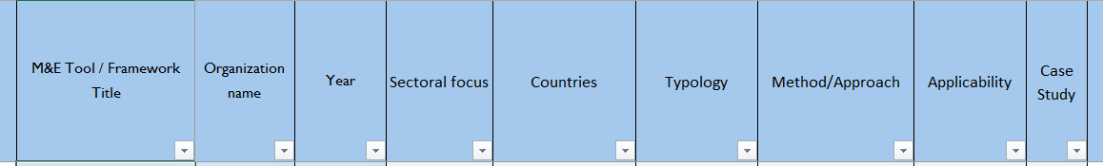
Adaptation M&E Guidance and tools
FAO and UNDP. 2019. Strengthening M&E for adaptation planning in the agriculture sectors.
http://www.fao.org/in-action/naps/overview/programme-activities/monitoring-and-evaluation/en/
Adaptation Committee (2016). Inventory of ongoing M&E work of adaptation prepared under the Nairobi work programme https://unfccc.int/files/adaptation/groups_committees/adaptation_committee/application/pdf/ac10_5b_m_and_e_.pdf

Slide 18
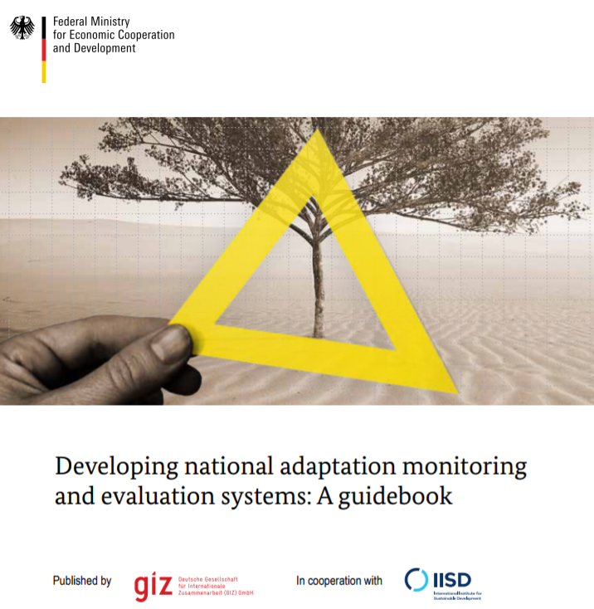
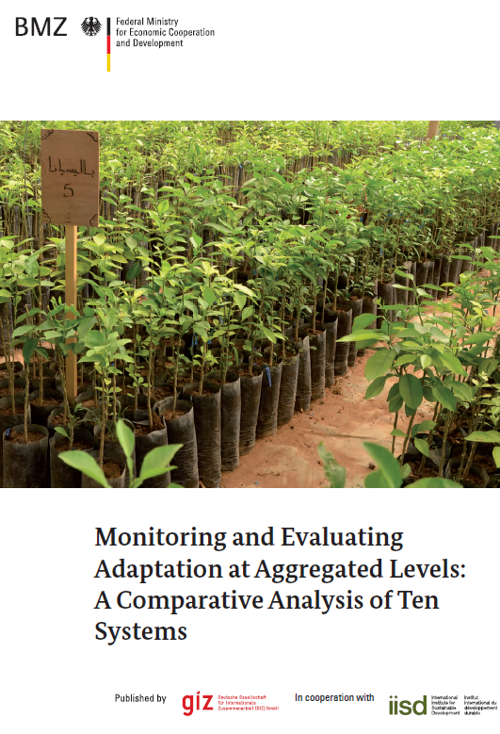

Adaptation M&E Guidance and tools
GIZ and IISD (2015), Developing national adaptation M&E systems: A guidebook http://www.adaptationcommunity.net/?wpfb_dl=268
OECD (2015b), National Climate Change Adaptation:
Emerging Practices in M&E Sectoral
http://www.oecd-ilibrary.org/environment/national-climate-change-adaptation_9789264229679-en
GIZ and IISD (2013), M&E Adaptation at Aggregated Levels: A Comparative Analysis of Ten Systems. https://www.climate-eval.org/sites/default/files/blogs/GIZ_2013-M%2BE_of_Adaptation_Comparative_analysis.pdf

Slide 19
Tools to Measure Performance
There are a variety of tools to capture data on adaptation
CARE Climate Vulnerability and Capacity Analysis
Community-based Risk Screening Tool Adaptation and Livelihoods - CRISTAL
Climate Change and Environmental Degradation Risk and Adaptation Assessment (CEDRA)
Framework of milestones and indicators for community-based adaptation (CBA)
Climate Context Monitoring Tool
National Adaptive Capacity (NAC) Framework
Captures Data on Climatic Variability
Records Adaptive Investment at farm level
Information is then aggregated for district or agro-ecological zone and analysed to attribute performance to CC or other risks

Slide 20
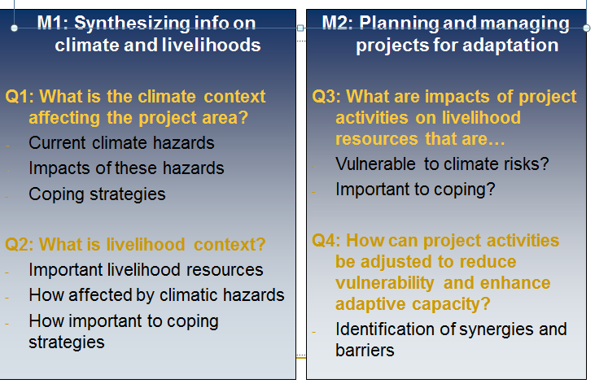
Community-based risk screening tool Adaptation and Livelihood

Slide 21
Summary of the session

