Slide 1
Module 7: Developing indicators for adaptation and agriculture, and identify data sources
Integrating Adaptation and Agriculture in National and Sectoral Monitoring and Evaluation (M&E) Frameworks
Notes:
7

Slide 2
Objectives
Review a set of draft indicators and prioritise those that are relevant for the country
Assess data availability; resources required; set baselines and targets

Slide 3
Overview
Select indicators for adaptation and agriculture and identifying data sources:
Step 1: Stocktake of existing adaptation indicators in policies, programmes and projects in-country
Step 2: Develop and agree on relevant indicators
Step 3: Identify data sources
Step 4: Identify baseline and target

Slide 4
Designing an M&E framework and plan for adaptation in the agriculture sectors
Step 1. | Understanding the policy context
Step 2. | Developing a shared understanding of the adaptation challenge, goals and the theory of change behind integrating adaptation in the agriculture sector
Step 3. | Defining the purpose and focus of the M&E framework
Step 4. | Developing an M&E Framework for adaptation in the agriculture sector
Step 5. | Identifying indicators to track adaptation in the agriculture sector
Step 6. | Identifying the sources and type of data and information required for each indicator
Step 7. | Operationalising M&E for decision-making on adaptation in the agriculture sector

Slide 5
FUNCTION AND TYPES OF INDICATORS

Slide 6
Why use indicators to track adaptation?
An indicator is a measurable variable that helps assess the current situation and track change over a period of time.
Adaptation indicators are essential to:
- monitor progress towards the implementation of adaptation policies, strategies and actions
- target, justify and monitor funding for adaptation programmes
- communicate adaptation priorities to policymakers and stakeholders
- compare adaptation achievements across sectors, regions and countries
- provide inputs for international climate change related processes and mechanisms
Notes:
Source: FAO. 2017. Tracking adaptation in agricultural sectors. CC adaptation indicators.

Slide 7
Essential characteristics of adaptation indicators
SPECIFIC. Indicators should be simple, clear and easy to understand and communicable.
MEASURABLE. Indicators should be based on readily available data, or on data that can be made available at a reasonable cost.
ACHIEVABLE: Indicators and their measurable units must be achievable and sensitive to change during the life of the project.
ANALITICALLY SOUND. Its validity should be widely accepted
RELEVANT. Indicator sets should reflect information that can be used for management or immediate analytical purposes. They should provide a balanced coverage of all key adaptation objectives.
TRANSPARENT. The indicators should be transparent and easy to interpret, i.e. users should be able to assess the significance of the values associated with the indicators and their changes over time.
TIME BOUND. Progress can be tracked at a desired frequency for a set period of time.
Notes:
SOURCE WB: https://siteresources.worldbank.org/EXTEVACAPDEV/Resources/designing_results_framework.pdf
Source: FAO. 2017. Tracking adaptation in agricultural sectors. CC adaptation indicators.

Slide 8
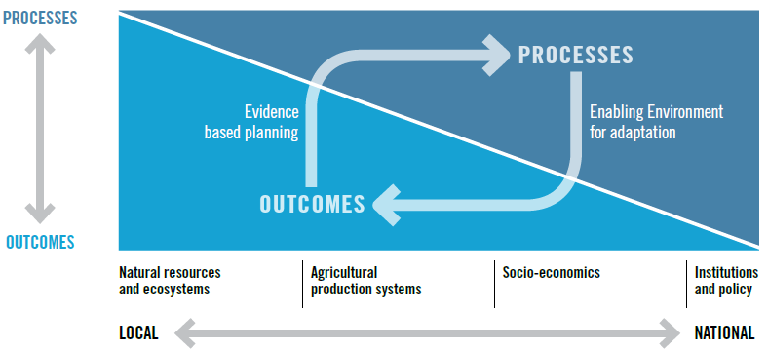
Type of indicators I
Process Indicators indicators measure progress in implementing adaptation policies, plans, projects or changes in institutional decision-making capacity, which create an enabling environment for adaptation.
ELEMENTS OF M&E FOR ADAPTATION IN AGRICULTURE
Outcome/Results Indicators
are used to evaluate whether
or not the activity, plan or
policy achieved the intended
objectives or results.
RESULTS
RESULTS
Notes:
Modified from : FAO. 2017. Tracking adaptation in agricultural sectors. CC adaptation indicators.

Slide 9
Case study: Selecting adaptation indicators in Morocco
Process indicators | Outcome indicators
Cultivated surface area with drought resistant varieties Forested areas covered by territorial plans Number of farmers involved in pilot irrigation services | Demand for water by sector Share of additional fodder for grazing livestock Poverty rate in rural areas
Notes:
Source: GIZ, 2014. Monitoring and Evaluating Adaptation at Aggregated Levels: A Comparative Analysis of Ten Systems, GIZ, Bonn and Eschborn

Slide 10
Type of indicators II
Quantitative indicators – these are the most commonly used. Quantitative indicators provide information on “how much” or “how many”
Qualitative indicators - Qualitative indicators provide information on how people feel about a situation, how things are done, how people behave, etc.
Results Indicators can be measured at different levels:
Output indicators illustrate the change related directly to the activities undertaken within the programme (e.g. percentage of cultivated surface area cultivated with drought resistant varieties.)
Outcome indicators relate to medium-to-longer term change (e.g. percentage of poor people in drought-prone areas with access to safe and reliable water)
Impact indicators measure the long-term effect of programme interventions (e.g. increase in adaptive capacity of farmers in community x, disaggregated by sex of household head*.)
Notes:
Source: FAO. 2017. Tracking adaptation in agricultural sectors. CC adaptation indicators.

Slide 11
Gender-sensitive indicators
Gender sensitivity. COP 23 adopted the Gender Action Plan and the prioritization of monitoring gender issues. On the recognition that gender shapes vulnerability and adaptive capacity, frameworks should include sex-disaggregated and gender sensitive indicators to monitor gender equality gaps and ensure adaptation efforts reach all groups.
What can the gender-sensitive indicators do:
- measure gender-related change in a condition or situation over time
- measure benefits to males and females as well as changes in relations between males and females
- use quantitative and qualitative data disaggregated by sex, age and other socio-economic variables
Examples of qualitative gender-sensitive indicators: levels of adoption of high yield varieties amongst male-headed compared to female-headed households; proportion of female compared to male workforce in agricultural organizations; percentage of male and female trainees who feel their knowledge of adaptation practices has increased.
Notes:
Modified from : FAO. 2017. Tracking adaptation in agricultural sectors. CC adaptation indicators.
COP 23 Gender Action Plan https://unfccc.int/files/meetings/bonn_nov_2017/application/pdf/cp23_auv_gender.pdf

Slide 12
GLOBAL ADAPTATION INDICATORS OF RELEVANCE

Slide 13
Relevant global sources of adaptation indicators
Several CC Funds have specific guidance on the development of adaptation indicators at programme level. Guidance includes:
Climate Investment Funds (CIF)/ Pilot Program for Climate Resilience (PPCR)
Adaptation Fund
Green Climate Fund
GEF SCCF and LDCF
OECD. 2012 Monitoring and Evaluation for Adaptation: Lessons from Development Cooperation Agencies presents a list of Indicators on Risk Reduction, etc.
USAID. 2016. Global Climate Change Standard Indicator Handbook: Definition Sheets
More in the following slides….
Notes:
Emerging lessons learned from M&E frameworks of a range of adaptation and agriculture programs.
This information can be useful when considering the development of adaptation indicators for priority programs of the agriculture sector. Guidance includes:
CIF/PPCR; https://www.climateinvestmentfunds.org/sites/default/files/knowledge-documents/ppcr_monitoring_and_reporting_toolkit_march_2016_revised.pdf
Adaptation Fund; https://www.adaptation-fund.org/wp-content/uploads/2015/01/Results%20Framework%20and%20Baseline%20Guidance%20final%20compressed.pdf
Green Climate Fund; https://www.greenclimate.fund/documents/20182/239759/5.3_-_Performance_Measurement_Frameworks__PMF_.pdf/60941cef-7c87-475f-809e-4ebf1acbb3f4
GEF/SCCF and LDCF https://www.thegef.org/sites/default/files/council-meeting-documents/GEF-LDCF.SCCF_.17-05%2C_Updated_RBM_Framework_for_Adaptation_to_Climate_Change%2C_2014-10-08_4.pdf
OECD. 2012. http://www.oecd-ilibrary.org/docserver/download/5kg20mj6c2bw-en.pdf?expires=1515762581&id=id&accname=guest&checksum=F94BE0ADE73ED9FC9971992B05B08D5A
USAID. 2016. https://www.climatelinks.org/file/2150/download?token=AOJRxWqy

Slide 14
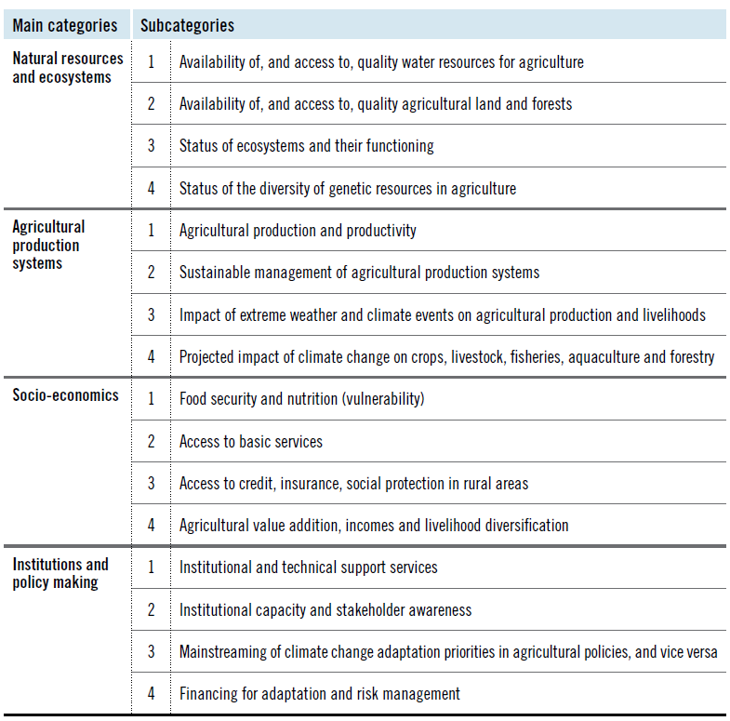
FAO Tracking adaptation in agricultural sectors
Notes:
FAO. 2017. Tracking adaptation in agricultural sectors.
The actual list of indicators (109) is provided in pages 62-70

Slide 15
International Institute for Environment & Development (IIED) – Tracking Adaptation and Measuring Development (TAMD) framework
Indicator 1: Climate change integration into planning
Indicator 2: Institutional coordination for integration of climate risk management
Indicator 3: Budgeting and finance
Indicator 4: Institutional knowledge and capacity
Indicator 5: Use of climate information
Indicator 6: Institutional capacity for decision-making under climatic uncertainty
Indicator 7: Participation, stakeholder engagement in decision-making to address CC
Indicator 8: Awareness among stakeholders of CC issues, risks and responses
Indicator 9: Numbers of people better able to cope with climate change and variability (disaggregated by gender/age)
Notes:
The Tracking Adaptation and Measuring Development (TAMD) framework uses two key measures to evaluate adaptation success: how widely and how well countries or institutions manage climate risks (Track 1) and how successful adaptation interventions are in reducing climate vulnerability and in keeping development on course (Track 2).

Slide 16
GIZ adaptation indicators for agriculture from 10 national adaptation M&E systems
Climate parameters | Change in annual temperature Mean monthly temperature Number of hot days Change in annual precipitation Monthly precipitation Extreme precipitation events
Climate impacts | Number of households affected by drought, disaggregated by sex of head of household % of total livestock killed by drought Number of surface water areas subject to declining water quality due to extreme temperatures Number of hectares of productive land lost to soil erosion % of area of ecosystem that has been disturbed or damaged Areas covered by vegetation affected by plagues or fires Shift of agrophenological phases of cultivated plants Losses of GDP in percentage per year due to extreme rainfall
Unit of measurement
Adaptation relevance
Potential limitations
Data needs
Data sources, collection methods
Calculation of the indicator
Spatial scale
Disaggregation
Notes:
The Repository of Adaptation Indicators (GIZ. IISD. Hammill et al, 2014, Real case examples from national M&E systems) provides a summary of indicators relevant for the agriculture, used in national M&E systems at different scales.

Slide 17
Adaptation action | Percentage of farmers and fisherfolk with access to financial services, disaggregated by sex Total sum of investments in programmes for the protection of livestock Number of inventories of climate change impacts on biodiversity Uptake of soil conservation measures Percentage of treated wastewater Percentage of agricultural land with improved irrigation Number of farmers involved in pilot irrigation messaging projects, Number of women organised in agricultural cooperatives Cultivation of varieties of red wine which like warmth
Adaptation results | % of poor people in drought-prone areas with access to safe and reliable water Number of cubic metres of water conserved % of water demand for cash crops being met by existing supply % of water demand for home gardens and cooking being met by existing supply % of livestock insured against death due to extreme weather events % of farmland covered by crop insurance % of additional fodder for grazing livestock Increase in agricultural productivity through irrigation of harvested land Increase in the percentage of climate resilient crops being used % of cultivated surface cultivated with drought resistant varieties Turnover generated by agricultural cooperatives

Slide 18
Case study: National adaptation indicators of Kenya MVR+ system (to be replaced by country´s own example, where possible)
Top-down county-level institutional adaptive capacity indicators (process) | Bottom-up vulnerability indicators (outcome)
% of population by gender in areas subject to flooding and/ or drought in the county who have access to information on rainfall forecasts % of poor farmers and fishermen in the county with access to credit facilities or grants % of total livestock numbers killed by drought in the county % of area of natural terrestrial ecosystems in the county that have been disturbed or damaged by what? % water demand that is supplied in the county % of poor people by gender in drought prone areas in the county with access to reliable and safe water supplies | Number of hectares of productive land lost to soil erosion % rural households with access to water from a protected source Cubic meters per capita of water storage % of land area covered by forest Number households in need of food aid

Slide 19
Case study: Kenya NAP indicators (to be replaced by country´s own example, where possible)
National | Sector | County (examples)
Human development index % of climate related national loss and damage in the public and private sectors Population living below the poverty line National vulnerability index | Number of sectors planning, budgeting and implementing adaptation actions National and county performance contracting systems integrating adaptation targets Amount of loss and damage from climate hazards per sector Amount of private sector financing for adaptation | Number of counties budgeting and implementing adaptation programmes; No of national and county level programmes incorporating adaptation Number of households with timely access to climate information Number of public servants trained on adaptation

Slide 20
Main issues to be considered for choosing indicators
Process and results. The selection of indicators should comprise both process- and result-based indicators.
Adaptation at the local level. Adaptation tracking should accurately capture changes at the local level, since adaptation is first and foremost a local issue.
Multifaceted nature of adaptation. Adaptation is a multifaceted process; therefore, multiple indicators should be used to track to adaptation.
Data availability. The availability and quality of data can be inadequate. To counter this problem, existing data sets, developed for other purposes, may be used.
Institutions and policy dimensions. Indicators from adaptation policies, programmes and projects that are implemented within a broader socio-economic and institutional context are to be considered.

Slide 21
STOCKTAKE and selection OF EXISTING national INDICATORS
Notes:
In policies, programmes

Slide 22
Stocktake of existing national adaptation indicators
(prior mapping to be carried out by national consultant or facilitator)
…….
Notes:
To be explored by the consultant
It there an existing adaptation M&E system? Does it include agriculture indicators? How are they monitored?
Is there an existing M&E Framework for the agriculture sector? Does it include adaptation indicators? Are they process or outcome indicators? What is missing? Which of the existing agriculture indicators might be relevant for adaptation
Which of the indicators in Climate Change Policies, NAP, NDC, UNFCCCC National Communications are relevant for the agriculture sector?
Are there adaptation indicators in agriculture programmes? Are they process or outcome indicators? Could they be scaled-up to sectoral level?
Identify which indicators have worked to date, which haven´t and why
What type of data and information do you require to fulfil the purpose of the M&E system? What indicators do you wish to use?
What data is available on climate change impacts and vulnerability?
What data is available on adaptation?
What data is available in the agriculture sector? Which available data sets are relevant for adaptation?
What development data sets are relevant? Is data sex-disaggregated?

Slide 23
Discussion/Exercise 1: Selection of indicators relevant for the country
Which of the global climate impact, vulnerability, process and/or outcome indicators might be relevant for your M&E Framework? Why?
Identify which indicators may be relevant for your country in plenary
Which of the indicators in e.g. Climate Change Policies, NAP, NDC, UNFCCCC National Communications are relevant for the agriculture sector?
Are there adaptation indicators in agriculture programmes? Are they process or outcome indicators? Could they be scaled-up to sectoral level?
What are their strengths and weaknesses? How credible and reliable is the data behind the indicator? How often is the data collected and by whom etc.?
Identify which indicators have worked to date, which haven´t and why
Notes:
NOTE: consider the issue of disaggregated indicators
Split into small groups
Answers to questions, written into post-its and mapped into a wall, vote if necessary
Relevant indicators pinned to the wall
Plenary discussion
Estimated time: 2 hrs

Slide 24
IDENTIFY DATA SOURCES, and BASELINE

Slide 25
Summary of selected indicators
…..
…..
Notes:
Overview of selected national indicators identified in the previous session

Slide 26
Case study: existing data sources in Kenya
Data source | Relevant sector | Description of data
Kenya Meteorological Department | All Agriculture | -Climatic data -Agro-meteorological stations collect data on climate
Kenya Agricultural Research Institute | Agriculture Livestock | -Data on food, horticultural and industrial crops, animal production, animal health, soil fertility, vegetation, agroforestry, and irrigation. *
Department of Resource Surveys & Remote Sensing | Forestry Wildlife Livestock | Data on livestock/wildlife numbers and distribution, vegetation cover, forests, species composition, biofuel, biomass, crops, land degradation, and human settlements.
Water Resources Management Authority | Water | Data on flow volumes at river gauging stations; from hydro meteorological weather stations.
Kenya Forest Service | Forestry | National-level statistics on forestry, forest cover, land use change, timber and fuelwood consumption.
National Environment Management Authority | Water | Data on water quality.
Kenya National Bureau of Statistics | All | Socio-economic data.
Monitoring and Evaluation Directorate | All | Process-based indicators on expenditure on adaptation and related activities.
Notes:
Source: Price-Kelly, H., Hammill, A., Dekens, J. (IISD) and Leiter, T. and Olivier, J. (GIZ), 2015. Developing national adaptation monitoring and evaluation systems: A guidebook, GIZ, Bonn and Eschborn.
* In future, data on household vulnerability and performance of various crops under changing climatic conditions will be collected.

Slide 27
Overview of existing data sources
(prior mapping to be carried out by national consultant or facilitator)
…..
…..
Notes:
Who provides the data identified in the previous mapping? Who gathers this data? Who stores this data? What is the capacity to analyse it? Who has access to it?
Is there new data that you will need to collect?
How will data from different sources be collected, aggregated and analysed, and by whom? Do data-collection teams have capacity to use gender-sensitive methods?

Slide 28
Exercise 2: Data sources and Baseline
Step 1: In small groups, review potential data sources (20 min)
Feedback to plenary and update mapping, as needed (20 min)
Step 2 In small groups, identify indicative baselines (20 min)
Feedback to plenary and update mapping, as needed (20 min)
Notes:
Split into small groups
Step 1. Participants review indicators and potential data sources
Considerations: Baseline data may already be available from ongoing national surveys etc or they can be gathered through for example vulnerability and impact assessment (VIA) for the agriculture sector. VIAs may already have been carried out as part of a broader adaptation planning process and provide useful baseline information for M&E. An important consideration is data availability – what data sources are readily available to measure the indicators, how is data stored, and is it accessible for the relevant M&E personnel or decision-makers working on adaptation and agriculture.
Add missing elements, identify gaps
Discussion
40 minutes
Step 2. Identify indicative baselines and targets
Split participants into groups by indicator clusters
Identify indicative baselines and targets
Add missing elements, identify gaps
Discussion
40 minutes
Step 3. Indicators, with indicative data source, baseline are summarised for consultation , into draft M&E Framework
30 minutes

Slide 29
Identify relevant data sources and baseline
What type of data and information do you require to fulfil the purpose of the M&E system?
What data is available on climate change impacts and vulnerability?
What data is available on adaptation?
What data is available in the agriculture sector? Which available data sets are relevant for adaptation?
What development data sets are relevant? Is data sex-disaggregated?
Who provides this data? Who gathers this data? Who stores this data? What is the capacity to analyse it? Who has access to it?
Is there new data that you will need to collect?
How will data from different sources be collected, aggregated and analysed, and by whom? Do data-collection teams have capacity to use gender-sensitive methods?
Notes:
Split into small groups
Summarise proposed data sources, gap analysis of existing data sources for consultation with broader group
It is crucial to consider the data that is already available on climate trends, vulnerabilities, economic and social dimensions, status of natural resources and land use. Building on existing data sources, research initiatives and monitoring systems within national statistics bureau, GIS Units, national and international research centres, helps to identify relevant information to feed into the M&E framework.
Inputs from the day are provided as ideas for further initial approval by a broader group; will require further research post workshop
1hr
Finally develop a chart with a profile and definition of each indicator including its metric, unit of measure, scale, the data source, frequency of updates, its geographic coverage etc. This will ensure that there is a common understanding of the indicator, how it is to be measured over the lifespan of the M&E framework and how it is to be used.

Slide 30
Summary of the session

