Slide 1
MODULE 8: OperationalisING the adaptation m&e framework

Slide 2
Objectives
Decision-makers provide feedback and approve outline of adaptation M&E Framework with proposed indicators
Identify a budgeted M&E workplan for next steps, with roles and responsibilities

Slide 3
Overview
What have we done so far?
What is an M&E plan and why do it?
Financial and human resources
Reporting and communicating
M&E for adaptation decision-making

Slide 4
Designing an M&E framework and plan for adaptation in the agriculture sectors
Step 1. | Understanding the policy context
Step 2. | Developing a shared understanding of the adaptation challenge, goals and the theory of change behind integrating adaptation in the agriculture sector
Step 3. | Defining the purpose and focus of the M&E framework
Step 4. | Developing an M&E Framework for adaptation in the agriculture sector
Step 5. | Identifying indicators to track adaptation in the agriculture sector
Step 6. | Identifying the sources and type of data and information required for each indicator
Step 7. | Operationalising M&E for decision-making on adaptation in the agriculture sector

Slide 5
What have we done so far?

Slide 6
What have we done so far?
Understood the policy context
Developed an adaptation goal or Theory of Change
Defined the purpose and focus of our M&E Framework
Identified indicators to track adaptation in the agriculture sectors
Identified type and sources of data needed to track adaptation
…..now we need to operationalise all of the above!

Slide 7
Present the M&E framework developed to date – electronic and handout format

Slide 8
What is an M&E plan?

Slide 9
M&E Plan
A management tool for M&E
“Owned” by lead agency/department
Specifies what measures are needed to do M&E:
What indicators, targets and milestones will be measured, when, how and by whom
What scale data will be gathered at
Identifies needed financial and human resources – budgets activities
How to report and communicate information
How to use information for adaptation decision-making

Slide 10
Key elements of the M&E Plan
Financial and Human Resources
Reporting and Communicating
M&E for adaptation decision-making
Presentation: Each of these elements will be presented in the following slides.
Exercise: After that, participants will be split into 3 groups (1) financial and human resources; 2) reporting and communicating; 3) decision-making), to discuss further in group and then feedback to plenary.

Slide 11
Financial and human resources
Notes:
Split participants into 3 groups – according to roles and interests
1 hrs for each thematic discussion
Feedback to plenary

Slide 12
Financial and human resources
Define the role of different institutions for doing M&E of adaptation, especially in the agriculture sectors
Incl. role of different Ministries, departments, partners such as research institutes
Review results of e.g. capacity assessments
Decide on a lead institution
Define what human resources are needed for:
Producing and gathering data
Analysing and processing data
Packaging, reporting and disseminating results
Using results for decision-making
Define a budget for the above activities and identify sources of finance

Slide 13
Example of human resources and implementation arrangements of Uganda Performance M&E Framework
Notes:
The M&E Framework for NAP of the Agriculture Sector for the NAP-Ag will be embedded in the existing Ministry of Agriculture Animal Industry and Fisheries M&E framework.

Slide 14
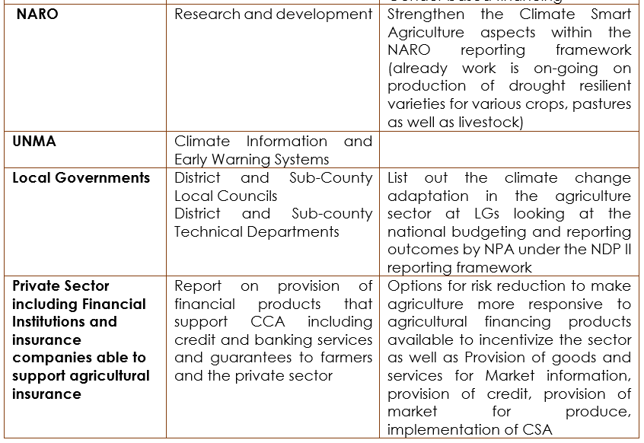

Slide 15
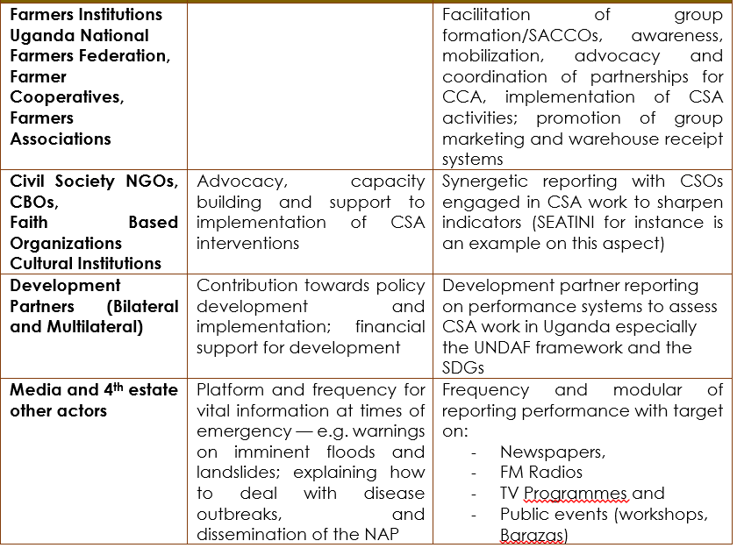

Slide 16
Exercise group 1. Financial and human resources
Which Ministries, units and departments work on M&E of adaptation? On M&E of agriculture? What is the level of capacity?
How many staff are needed, what are their responsibilities and linkages?
What are the financial resources available and needed to deliver a functioning M&E framework?
How can the involvement of other relevant Ministries, units and departments be ensured? What level of coordination is required to operationalize the M&E framework?
What capacity is there to carry out gender-sensitive M&E?

Slide 17
Reporting and communicating

Slide 18
Reporting and communicating
Define how M&E results will be presented
Define the frequency and timing of presenting results
Define target audience and users
Some reporting examples:
National development reporting;
Annual adaptation or climate change progress reports
International reporting, e.g. NDCs and National Communications
Identify dissemination and advocacy tools, e.g. reports, workshops, events, media
Define a set of targeted key messages, recommendations and lessons learned

Slide 19
Exercise group 2. Reporting and communicating
Are evaluations planned (e.g. mid-term evaluations) and if so when?
How will the results of agriculture and adaptation M&E be presented? In what format/s?
How frequently?
Who will disseminate results? How and to whom (incl. at local, sectoral, national and international levels)?
Will they feed into national or international reporting? E.g. annual sectoral reports, adaptation reports to the UNFCCC, NAP or NDC reports

Slide 20
M&E for adaptation decision-making

Slide 21
M&E for decision-making
M&E results should be used to inform national, sectoral and, where relevant, local level planning on adaptation
Results could feed into e.g.:
National planning processes e.g. around National Development Plans or adaptation planning such as NAPs
Sectoral planning and budgeting at Ministry level
Local Development Plans
International processes e.g. around SDGs
M&E results can support iterative adaptation planning and e.g. revision of policies, plans and programmes
M&E results can help inform prioritisation processes and investment decisions

Slide 22
Exercise group 3. M&E for adaptation decision-making
How will M&E results feed into planning and decision-making cycles? E.g. in terms of national development planning, NAP processes, agriculture sector planning processes etc.
Is there a process in place for revising adaptation plans, policies and programmes based on M&E results?
Can M&E results help prioritise future adaptation investments? If so, how?

Slide 23
Conclusion: way forward
Notes:
Plenary discussion

Slide 24
Feedback
Parallel group exercises provide feedback and receive inputs to M&E Plan
Notes:
PRESUMING SESSIONS ABOVE IN PARALLEL
Receive feedback in either plenary, working groups or carousel

Slide 25
Way forward
Next steps
Roles and responsibilities
Timeline
Notes:
Discuss in plenary or small groups

Slide 26
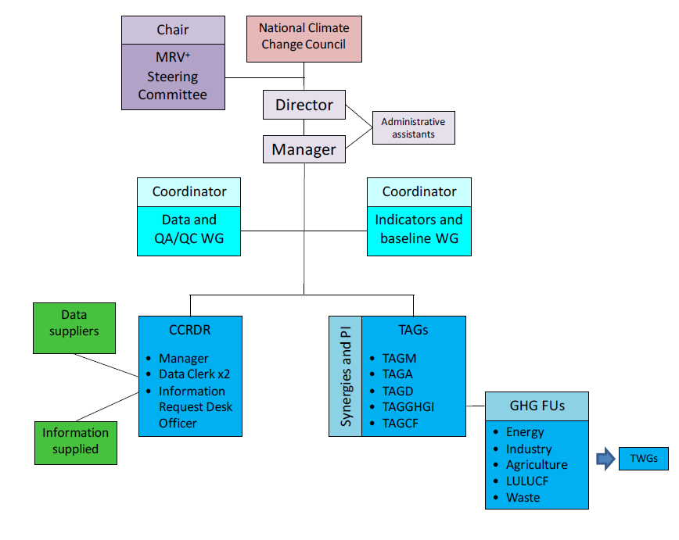
Example: roles and responsibilities for reporting lines of MRV+ system Kenya
Notes:
Source: http://www.kccap.info/index.php?option=com_phocadownload&view=category&download=311:section-a-monitoring-reporting-verification-system&id=40:national-performance-and-benefit-measurenment

Slide 27
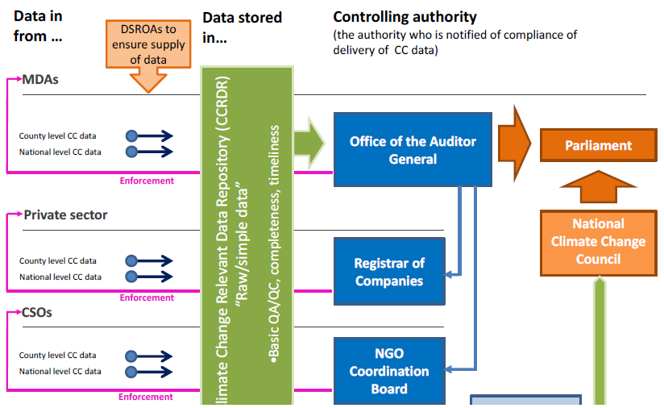
Legal & regulatory framework MRV+ system Kenya
Notes:
MRV+ data flow and compliance

Slide 28
Implementation arrangements Uganda M&E Framework
Level/Institution and detail | How to build the Systems for M&E at each level | Desired Outcome
National Government ministries: MAAIF and MWE | Policy implementation, Coordination of NAPs implementation, Resource mobilization. Extension services, Prioritize, Plan and budget for adaptation in the agriculture sector at central government level | Embed the M&E framework within the Agriculture sector strategic plan M&E. Taking into account some of the indicators into the Management Information System under the Ministry of Water and Environment
MoLHUD, MTIC, MoFPED, MoLG, NPA, OPM, MoGLSD | Participate to the Climate Change Taskforce and contribute to implementation | Strengthen the gender-based indicators
NARO | Research and development | Strengthen the Climate Smart Agriculture aspects within the NARO reporting framework
Local Governments | District and Sub-County Local Councils and Technical Departments | Report on adaptation in the agriculture sector at LGs, report outcomes to the National Planning Authorities
Notes:
Uganda Performance M&E Framework for the agriculture sector NAP

Slide 29
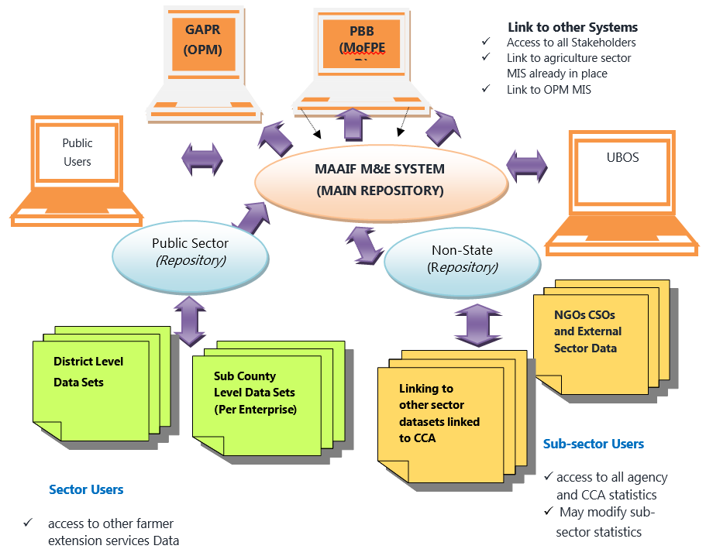
Coordination and role assignment to key actors
Notes:
Hard copy of this slide can be distributed as it is difficult to read (source PM&E Framework)

Slide 30
Summary of the session

