Slide 1
Re-cap of SCALA’s conceptual framing of systems-level assessments
Krystal Crumpler, Climate Change and Natural Resources Specialist – SCALA Programme, FAO
Samuel Tumwesigye, Agriculture and Climate Change Adaptation Specialist – SCALA Programme, UNDP
Internal Webinar and Exchange on Systems-level Assessments - Part 2
28-29 June 2022

Slide 2
Outline
Context
IPCC AR6
Theory
Transformation and systems-level change
SCALA conceptual framing
Systems-level assessments
SCALA country approaches
Applied systems-level assessments on the ground

Slide 3
Context: IPCC AR6
01.
Climate change impacts
02.
Current adaptation, limits and maldaptation
03.
Agri-food systems and GHG emissions
The majority of climate risk management and adaptation currently being planned and implemented is incremental.
Soft limits can be overcome by addressing financial, governance, institutional and policy constraints
Hard limts have been reached in some ecosystems and cannot be reversed
Agri-food systems contribute up to one-third of global GHG emissions.
Climate-related extremes have affected the productivity of all agricultural and fishery sectors, with negative consequences for food security and livelihoods
The impacts are particularly acute and severe for people living in sub-Saharan Africa, Asia, Small Island States, Central and South America and the Arctic, and small-scale food producers globally
Ecosystem-based approaches, agroecology and other Nature-based Solutions in agriculture and fisheries have the potential to strengthen resilience to climate change with multiple co-benefits, including mitigation co-benefits
Climate change will increasingly add significant pressure and regionally different impacts on all components of food systems, undermining all dimensions of food security
Indigenous Peoples and disadvantaged groups are especially adversely affected by maladaptation, which often deprives them of food and livelihoods and reinforces and entrenches existing inequalities
IPCC AR6 Report: Climate Change 2022 Impacts, Adaptation & Vulnerability

Slide 4
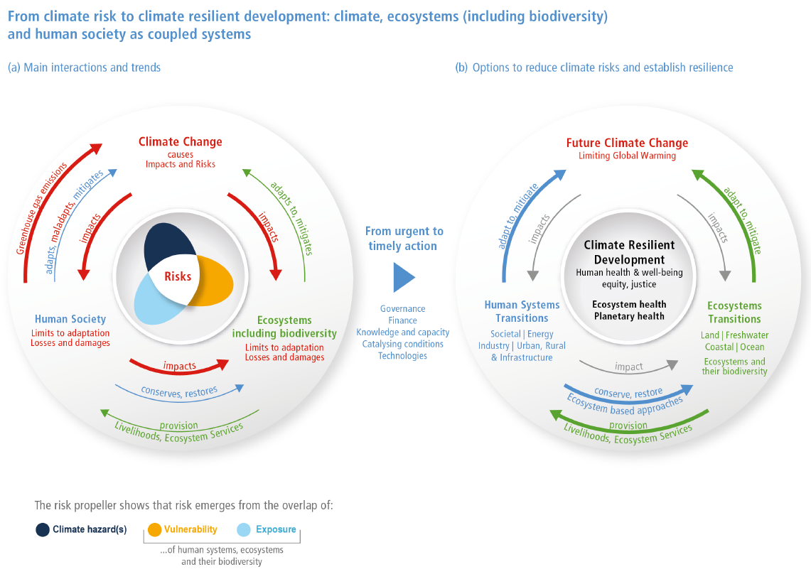
Context: IPCC AR6
AR6 highlights the role of transformation in meeting the Paris Agreement, the SDG and other policy goals.
“Transformative actions are urgently needed to shift systems because of the required urgency and scale of emissions, as well as the adverse impacts of escalating climate risks, poverty and vulnerability”
IPCC AR6 Report: Climate Change 2022 Impacts, Adaptation & Vulnerability

Slide 5
Evolving theories of transformational and transformative change
Incremental adaptation:
Adaptation that maintains the essence and integrity of a system or process at a given scale (IPCC, 2014)
Transformational adaptation:
Adaptation that changes the fundamental attributes of a social-ecological system in anticipation of climate change and its impacts (IPCC, 2019).
Transformative change:
A system-wide change that requires more than technological change through consideration of social and economic factors that, with technology, can bring about rapid change at scale (IPCC, 2022).
Example: implementation of systemic changes towards agroecological production practices
Example: adjustments to cropping systems through new varieties, or using more efficient irrigation technologies

Slide 6
SCALA’s approach to systems-level assessments
Research: 7 dimensions of transformative change identified based on literature review and case studies
Conceptual framework: Tools/methods developed to support conceptualization and planning for a systems-level assessment
Technical planning and country consultations: Internal webinars and bilateral calls with SCALA countries to discuss country approaches, needs and priorities for designing a systems-level assessment
On-the-ground application: Systems-level assessments will be carried out in SCALA countries in 2022/2023 to generate evidence for the implementation of transformative climate action in the land use and agriculture sectors
Systems thinking
Climate
rationale
Innovation
Private Sector Engagement
Gender and
social
inclusion
Sustainable development
Whole of government
7 dimensions of transformative climate action

Slide 7
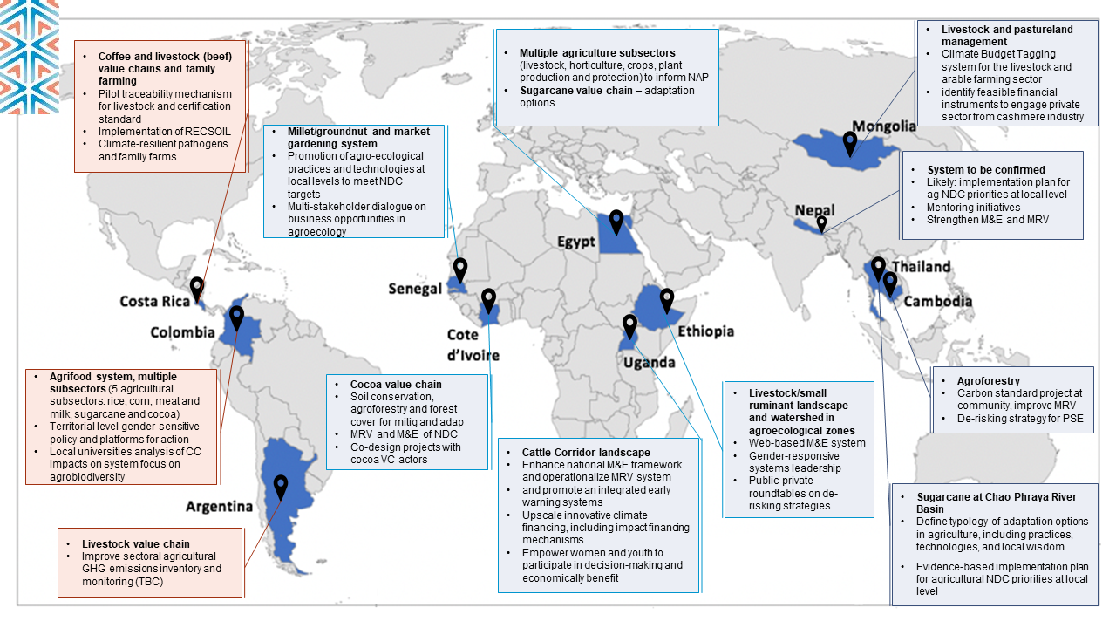
6/12 countries – landscape systems; 5/12 – Value Chains

Slide 8
www.fao.org/in-action/scala
www.adaptation-undp.org/scala

