Slide 1

Country Name
Presenter Name
São Tome and Principe
Cosme Dias

Slide 2
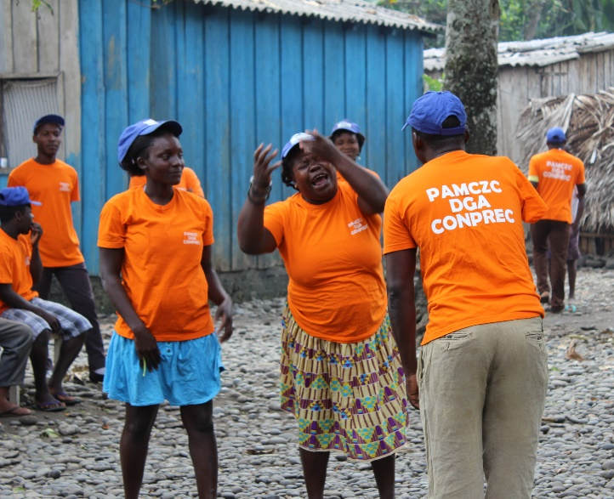
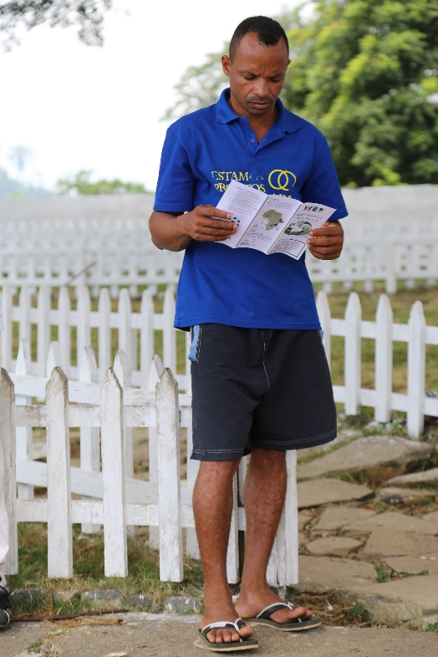
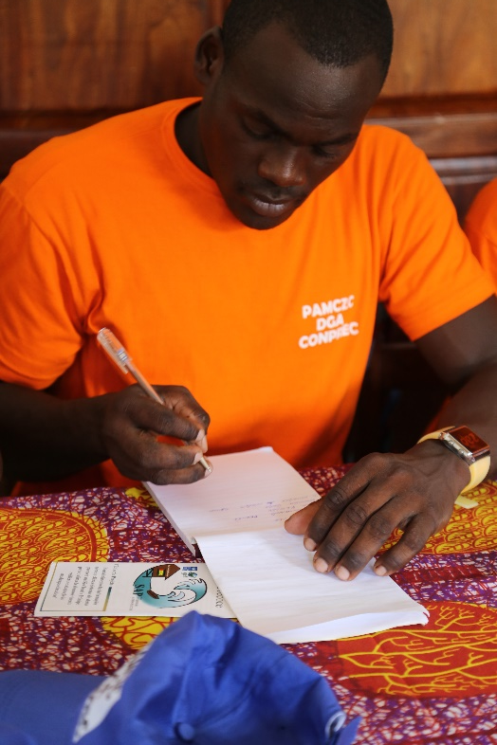
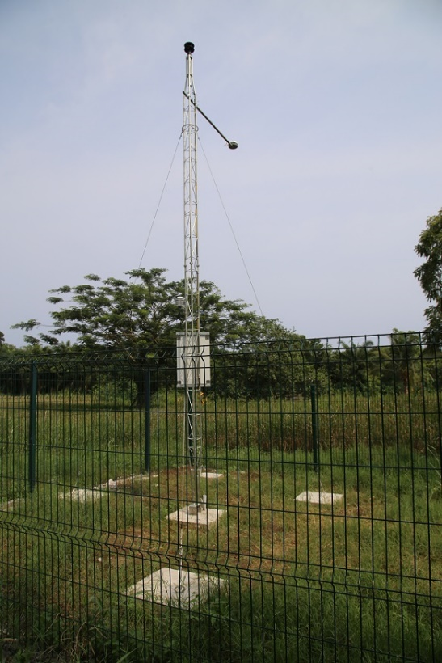
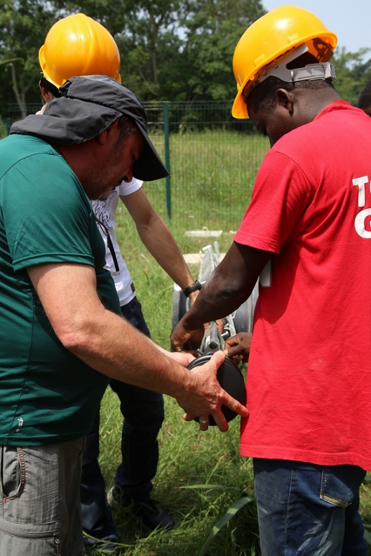

Country Name
Presenter Name
São Tome and Principe
Cosme Dias

Slide 3
Introduction
  Progress and key activities
  Challenges and Opportunities
  Next steps

Slide 4

Progress and Key Success - Implementing Partner - NIM
NIM – National Institute of Meteorologie
Has the national leadership of the implementation
It is the institution responsible to collecte and disseminate all the meteorologial information in the country.
Its coordinating implementation of activities together with the Hydrological department, the National council for preparation and responses to disasters and the Environment Observatory.
Notes:
Some topics you may wish to consider:
Equipment ordered to date
Status of installation
Status of working monitoring systems in place
Status of data processes/systems
Successes in creation of of early warnings, communications, PPP and regional cooperation strategies
Priorities for these strategies.
Target markets and how will you reach them.

Slide 5
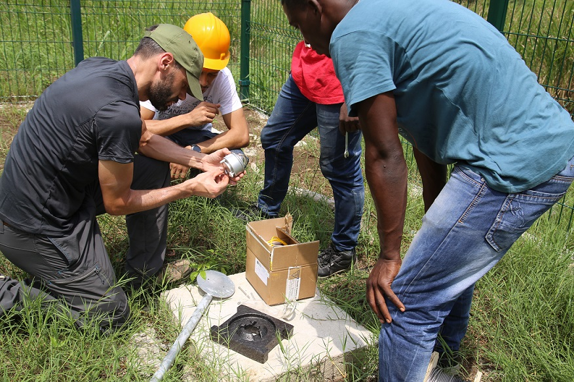
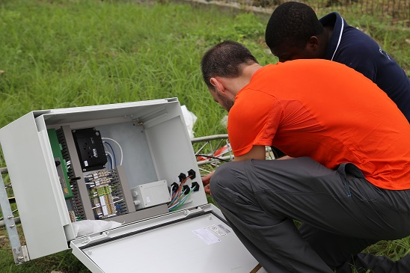
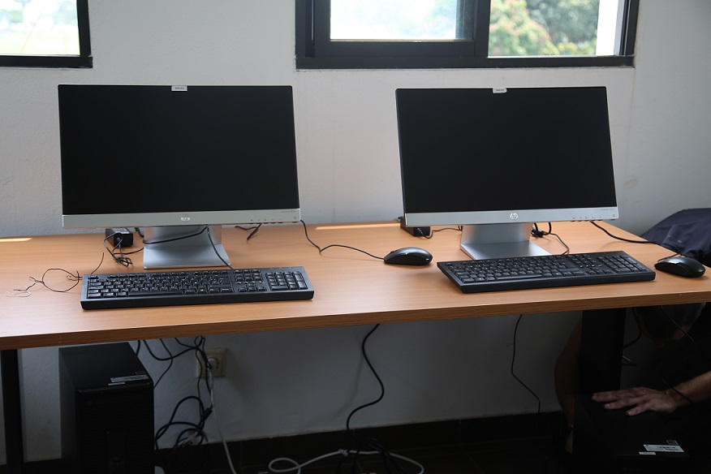
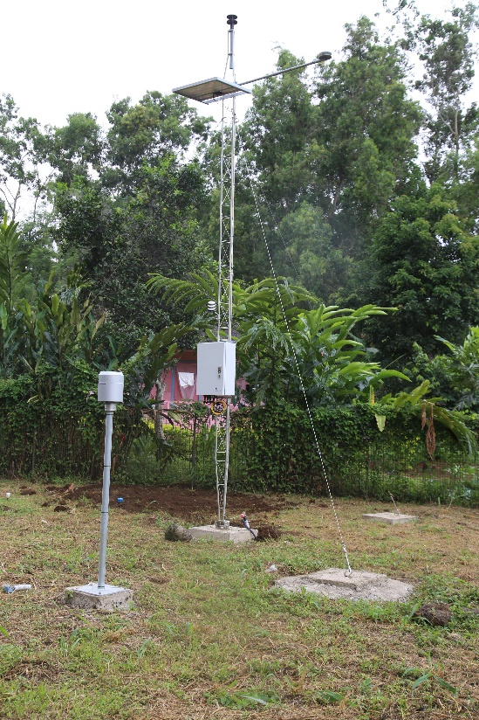
Implementation Progress and Key Success – Meteorological stations
14 meteorological stations
2 synpotics
System sadis
3 Lightning detectors
1 data mamangement centre

Slide 6
Implementing Progress and Key Success – Partner - NIM
Launch of international tender in 2014
To acquire hydromet equipments in order to
increase the country coverage up to 60%
26 hydrometeorological stations were acquired:
14 meteorological and 12 hydrological stations
Direct implementation of activities with partners institutions (NIM and GDNRE)
National led process for site building and equipment installation
Notes:
Some topics you may wish to consider:
Equipment ordered to date
Status of installation
Status of working monitoring systems in place
Status of data processes/systems
Successes in creation of of early warnings, communications, PPP and regional cooperation strategies
Priorities for these strategies.
Target markets and how will you reach them.

Slide 7
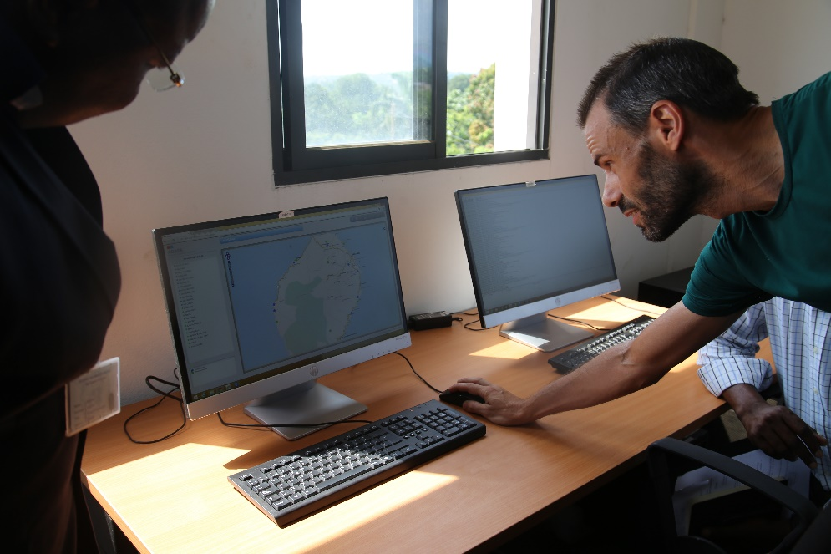
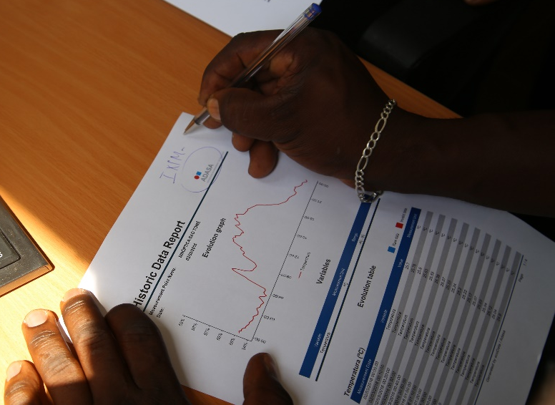
Implementing Progress and Key Success - Implementing Partner - NIM
Ongoing Installation process
9 meteorological Stations installed, 8 in São Tome Island and 1 ongoing in Principe Island.
All the station are already producing information to the data collection centrer also installed in the NIM
Four Students are doing a Bsc in Meteorology now at the University of
Aveiro, Portugal for 3 years.
Notes:
Some topics you may wish to consider:
Equipment ordered to date
Status of installation
Status of working monitoring systems in place
Status of data processes/systems
Successes in creation of of early warnings, communications, PPP and regional cooperation strategies
Priorities for these strategies.
Target markets and how will you reach them.

Slide 8
Progress and Key Success - Implementing Partner - GDRNE
GDNRE – General directorate of Natural resources and Energie
The actual Capacity of GDNRE to produce hydrological information is at the initiation point.
When the projet started there only one broken hydrological station existed
Now the project has acquired 12 Hydrological stations
To cover also 60% of the country with hydrological information
40 hydrological instrument for rivers
1 data management centre
Notes:
Some topics you may wish to consider:
Equipment ordered to date
Status of installation
Status of working monitoring systems in place
Status of data processes/systems
Successes in creation of of early warnings, communications, PPP and regional cooperation strategies
Priorities for these strategies.
Target markets and how will you reach them.

Slide 9
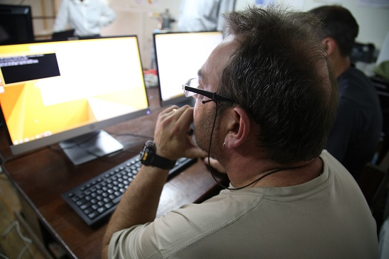
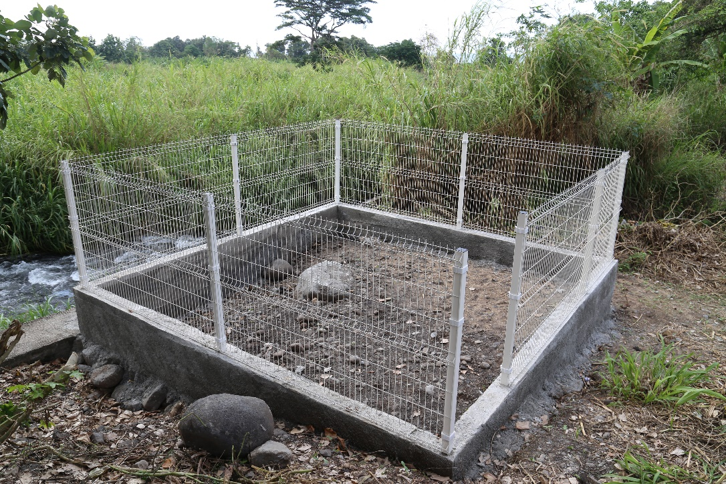
Implementing Progress and Key Success – Hydrological stations
Ongoing Sites building
Relocation and recalibration of hydrological equyipments for rivers.
Cabling work ongoing
Data management centre installation ongoing

Slide 10
Implementing Progress and Key Success - Partner - GDRNE
This is a new service which is being created in the country
A really meaningful intervention of the CIRDA project in the country.
This imply training of staff
Training of observers
Assistance is required to have a team fit for the purpose
Training of data management center technician
Notes:
Some topics you may wish to consider:
Equipment ordered to date
Status of installation
Status of working monitoring systems in place
Status of data processes/systems
Successes in creation of of early warnings, communications, PPP and regional cooperation strategies
Priorities for these strategies.
Target markets and how will you reach them.

Slide 11
Implementing Progress and Key Successes - CONPREC
National Council for the Prevention and disaster response
Created in 2011 but rendered operationnal through EWS STP
Goal: CONPREC is the institution responsible for management and responses in case of natural disasters at national level.
National Institutions Partners: Red Cross, Coast Guard, National Service of Civil Protection and Firefighters, National Institute of Meteorology General Directorate of Natural Resources and Energy, Local Government, Health care Management, National Police, Military Forces, Media, Directorate of Agriculture, Directorate of livestock Directorate general Environment
Notes:
Some topics you may wish to consider:
Equipment ordered to date
Status of installation
Status of working monitoring systems in place
Status of data processes/systems
Successes in creation of of early warnings, communications, PPP and regional cooperation strategies
Priorities for these strategies.
Target markets and how will you reach them.

Slide 12
Implementing Progress and Key Successes - CONPREC
They are responsible to manage the 24 local committee created in the context of the EWS.
Training of Local committees on DRR good practices
A total of 192 members among all the country benefited of it.
Realized sensitization of LC members in their respective communities-
They do act as a first aid for they own communities in situations of disasters.
Ews Project created the opportunity to operationalize the CONPREC giving them the means for them to work (Training, soft and hardware equipements-communication equipment, office, car …)
Notes:
Some topics you may wish to consider:
Equipment ordered to date
Status of installation
Status of working monitoring systems in place
Status of data processes/systems
Successes in creation of of early warnings, communications, PPP and regional cooperation strategies
Priorities for these strategies.
Target markets and how will you reach them.

Slide 13
Implementing Progress and Key Successes - CONPREC
For each 24 local committee was given also communication equipment to allowed them to communicate with the EWS platforms in disasters situation or to give alert on sea level rise, inundation , etc--
Now CONPREC has a full network in the country that will allow them to work properly with platform and other national institutions
Two platforms one for monitoring and alert and other for dissemination an response were created to work together with CONPREC in order to help the country in situation related with risk prevention, reduction and management
Notes:
Some topics you may wish to consider:
Equipment ordered to date
Status of installation
Status of working monitoring systems in place
Status of data processes/systems
Successes in creation of of early warnings, communications, PPP and regional cooperation strategies
Priorities for these strategies.
Target markets and how will you reach them.

Slide 14
Progress and Key Successes and Opportunities
CIRDA MISSION
create a huge opportunity for each country on this projeto because all of us have the opportiny to learn with other experience, to see how the other country his dealing with the same problema we are facing in outr country
Mozambique it's another portuguese speaking country in Africa who have a lot experience with risk reduction of disaster. Through this project we manage to create a south south cooperation with National institute of risk reduction (INGC) where the coordinator of platforms and one meteorologist went there to see how they work and how can use their experience in the country
Notes:
Some topics you may wish to consider:
Equipment ordered to date
Status of installation
Status of working monitoring systems in place
Status of data processes/systems
Successes in creation of of early warnings, communications, PPP and regional cooperation strategies
Priorities for these strategies.
Target markets and how will you reach them.

Slide 15
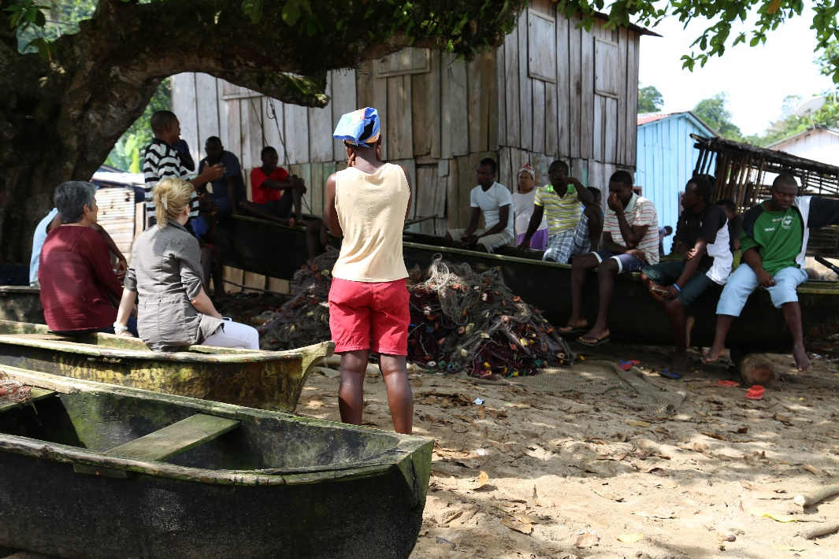
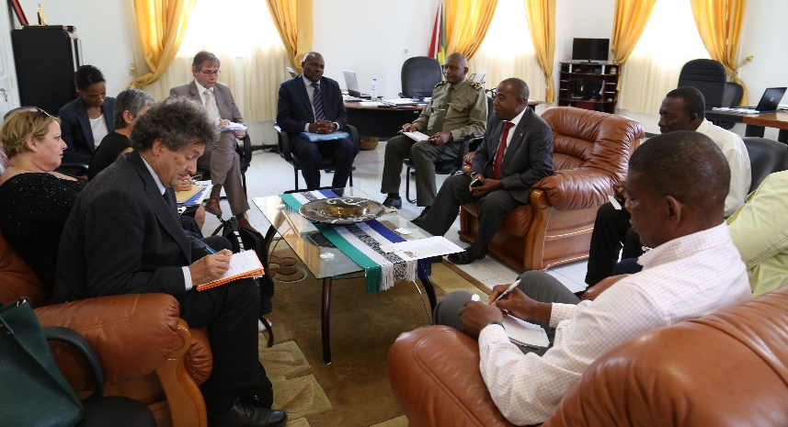
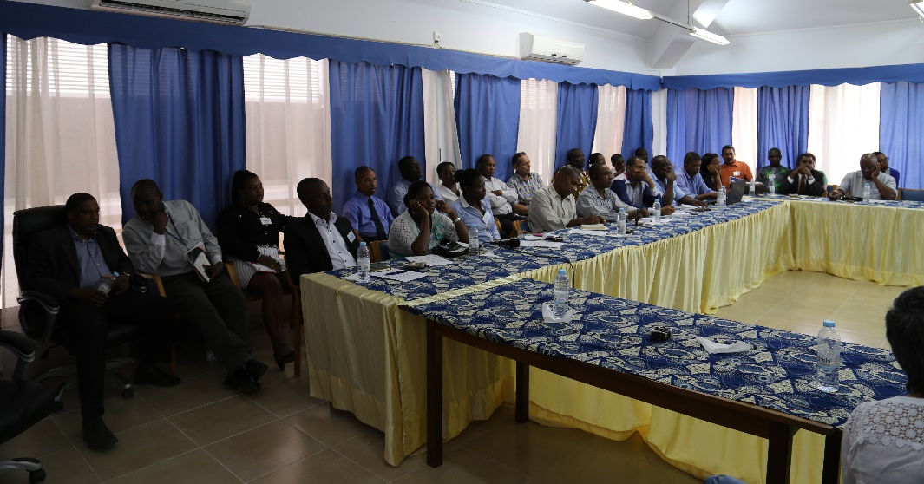
Implementing Progress and Key Successes
  CADRI MISSION VISITED STP
  TO REALIZE A DRR ASSEMMENT
  PRODUCED A NATIONAL PLAN OF ACTION
  BUDGESTISATION OF INTERVENTION IN DRR
  NATIONAL FRAMEWORK OF INTERVENTION
  CONTINGENCY PLAN REVISED AND OPERATIO
  NATIONAL STRATEGY FOR RESPONSES UPDATED AND FIT FOR THE PURPOSE
  CONSOLIDATION OF CONPREC WORK AT NATIONAL LEVEL
Notes:
Some topics you may wish to consider:
Equipment ordered to date
Status of installation
Status of working monitoring systems in place
Status of data processes/systems
Successes in creation of of early warnings, communications, PPP and regional cooperation strategies
Priorities for these strategies.
Target markets and how will you reach them.

Slide 16
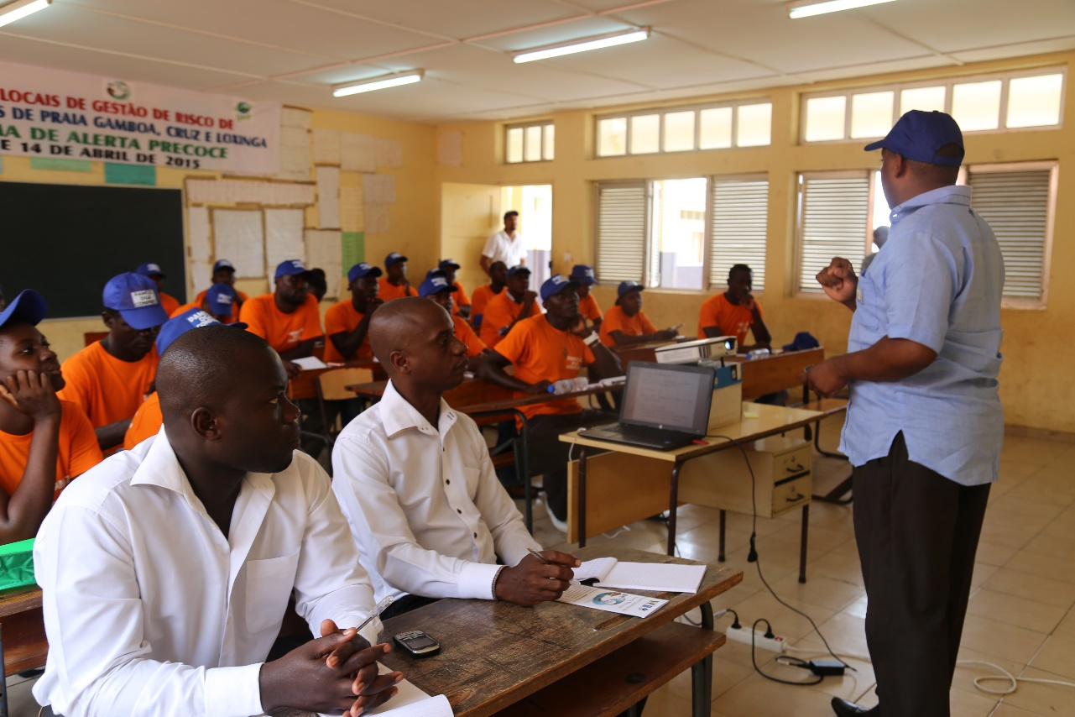
Last Mile – Next Steps
Finalization and operationalization of the
hydrometeorological stations
Full Operationalization of the two Platforms
National Simulation exercise through the National contingence Plan
Acquisition of Emergency kits for local Committee.
Training in first aid for Local Committees
Notes:
You may wish to consider including information on:
Overview of Last Mile processes
Overview of Last Mile technologies and applications
Overview of Last Mile challenges
Overview of Last Mile opportunities
Create an exit plan for the project that will help to strengthen the foundations created

Slide 17
Last Mile – Next Steps
PPPi with Community Radio for the dissemination of EWS bulletins
Formulation of an Exit strategy
Identification and defining the needs of our end-users and stakeholders
Operationalization of Community Radio in Ribeira Afonso and second training of Journalists
Establishment of the 321 communication system in the country with telecom companies
Notes:
You may wish to consider including information on:
Overview of Last Mile processes
Overview of Last Mile technologies and applications
Overview of Last Mile challenges
Overview of Last Mile opportunities
Create an exit plan for the project that will help to strengthen the foundations created

Slide 18
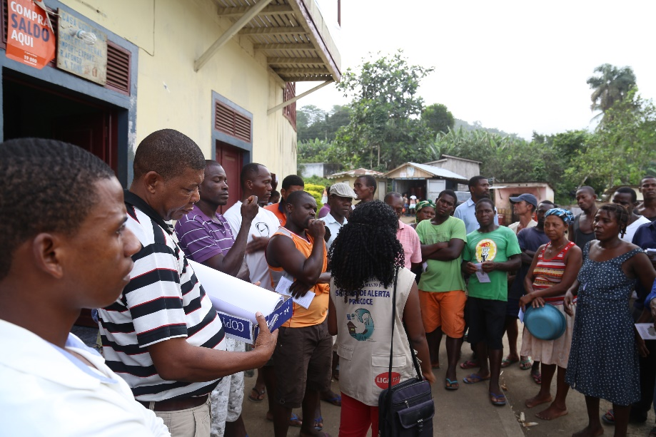
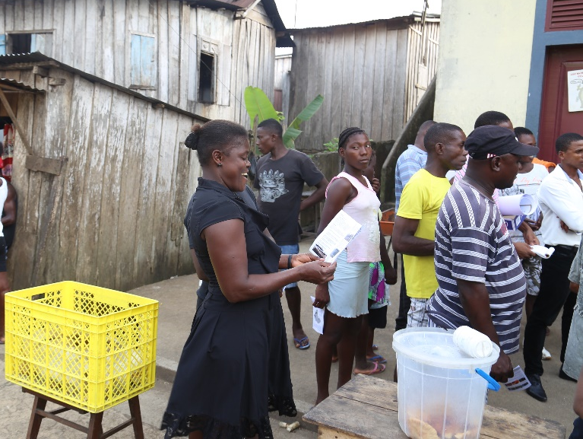
Last Mile - Challenges
Training to NIM and GDNRE technicians for strategic management of all system acquired through EWS project
Creation of mechanism of national appropriation and sustainability through activity consolidation and additional fund mobilization for EWS 2.
Partnership PPPi
Notes:
You may wish to consider including information on:
Overview of Last Mile processes
Overview of Last Mile technologies and applications
Overview of Last Mile challenges
Overview of Last Mile opportunities
Create an exit plan for the project that will help to strengthen the foundations created

Slide 19
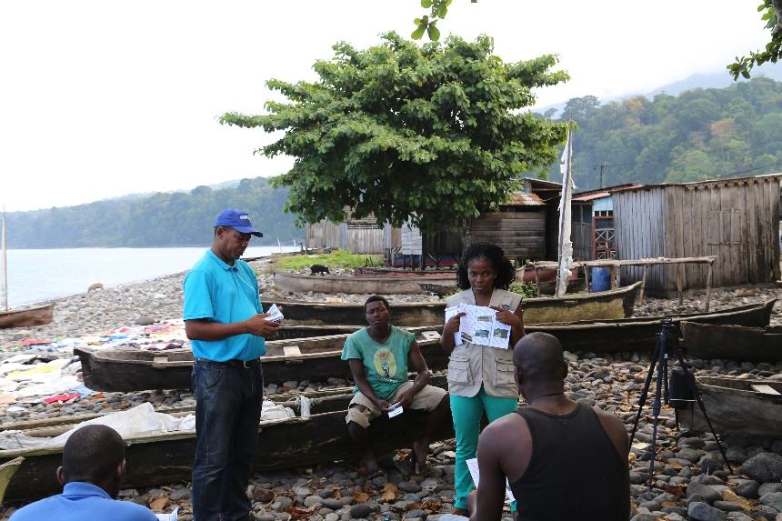
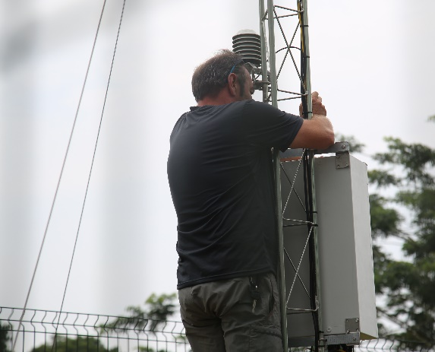
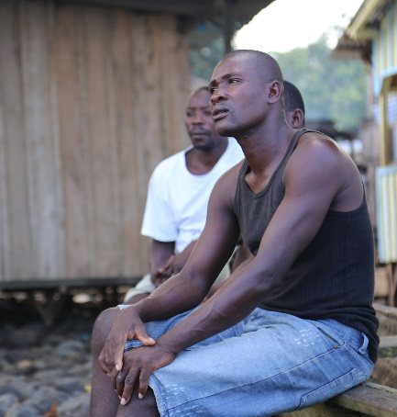
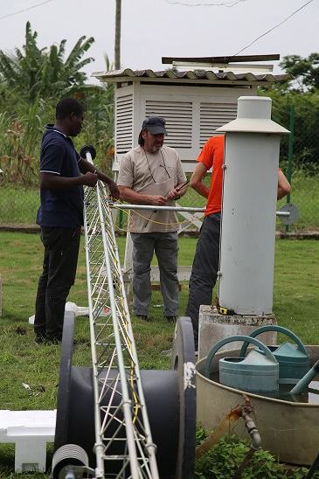
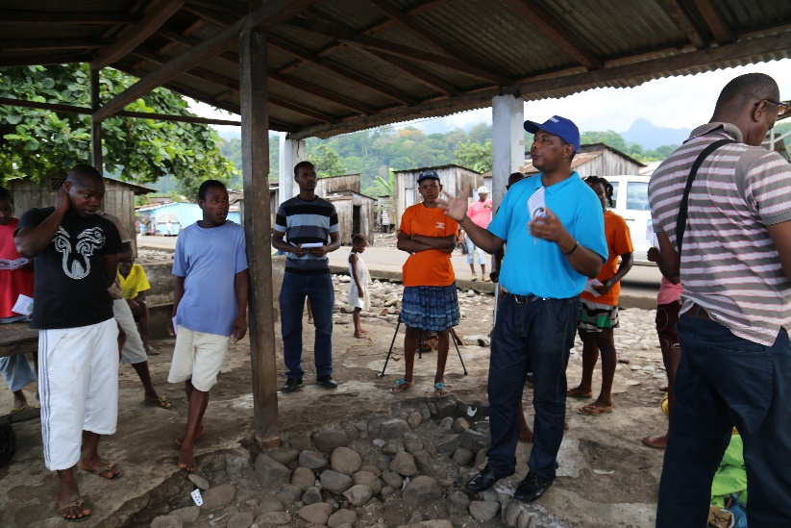
Conclusion
Desire to continue with EWS 2
Create mechanism of national appropriation
Sustainability of EWS is a must.
It is a common responsibility.

Slide 20
Obrigado
Thank you
Merci

