Slide 1



UNDP/GEF SUPPORT TO THE GOVERNMENT OF UGANDA ON STRENGHTENING CLIMATE INFORMATION AND EARLY WARNING SYSTEM(SCIEWS)
AN OVERVIEW OF 2015/15

Slide 2
Ugandan Team:
Dr. Robert Rutaagi; Chairperson UNMA Board;
Mr. Deus Bamanya; Director Data & Applied Meteorology, UNMA;
Mr. Gerald Menhya; Assistant Commissioner, Relief, Disaster Preparedness & Management, OPM;
Mr. Robert Kintu, Director FIT Uganda;
Mr. Pascal Onegiu Okello, Project Manager-UNDP/GEF/SCIEWS.

Slide 3
INTRODUCTION
OVERALL OBJECTIVE:
To strengthen the weather, climate and hydrological monitoring capabilities, EWSs and available information for responding to extreme weather and planning adaptation to climate change in Uganda.
CHANGING LANDSCAPE:
The following frameworks are operational:
National: New National Development Plan (2016-2020);
Country Office: Country Programme Document(2016-2020)

Slide 4
UNDP UGANDA’s DISASTER REDUCTION “VEHICLES”:
1.0. Strengthening Capacities for Disaster Risk Management and Resilience Building: 2013-2016 (end 30 June) Total Budget: USD 3.9 million (funded) Responsible Partners: OPM, Academia, CSOs, local governments and communities
2.0. Strengthening Climate Information and Early Warning Systems (SCIEWS) for Climate Resilient Development and Adaptation to Climate Change: 2014-2017 Total Budget: USD 23 Million (USD 4 million funded) Implementing Partner: MWE/UNMA Responsible Partners: DWRM,OPM, MAAIF, MoLG, UCC, MFPED.
3.0. Strengthening Community Resilience to Climate Change & Disaster Risks (SCORE): 2016-2020 Total Budget: USD 23 million (8m funded) Implementing Partner: OPM Responsible Partners: MWE, MAAIF, MoFPED, MLHUD, NPA, UNMA, CSOs, private sector, local governments and communities

Slide 5

SUMMARY OF ACHIEVEMENTS 2015/2016
OUTCOME 1: Enhanced capacity of UNMA and DWRM to monitor and forecast extreme weather, hydrology and climate change
PLANNED OUTPUT | RESULT/STATUS
1. 16 AWLS installed and 40 Hydro-met. stations rehabilitated; | At contracting stage
2. 30 AWSs installed and 32 stations rehabilitated; | 20 base AWSs procured, installation to end by 15 April; 5 Total Solutions AWSs at contracting stage; Rehabilitation of weather stations completed; AMSS procured and installed.
3. Integrated (UNMA&DWRM) hydro-met. data mgmt system & on-line platform operationalized | MoU and Protocol for data sharing (UNMA&DWRM) ready for signing; Protocol and Linkages with MDAs, Integration of information and data rescue focus of 2016.
4. Capacity for operating and maintaining observation networks and related infrastructure developed | 1 UNMA Systems Engineer underwent training in India ;Supported 9 personnel from the IP/RPs to participate in GHACOF 41&42; 2 sub-national workshops held & more training in 2016

Slide 6

OUTCOME 2: Efficient and effective use of the hydro-meteorological and environmental information for making early warnings and long term development plans
PLANNED OUTPUT | RESULT/STATUS
1.Technical capacity of UNMA and DWRM strengthened: training 16 forecasters; | 5 UNMA staff on the job trained in KMD; 10 DWRM staff to be trained at KMD November 2015; 17 UNMA technicians and stations managers trained on AMSS operations and installation of AWS
2.Tailored weather and climate information made accessible to decision makers, private sector, MDAs and communities; | Focus of 2016
3.Weather and climate information mainstreamed into National Policy(Disaster) and District Plans; | Focus of 2016
4. Govt. and NG communication channels for issuing alerts strengthened; | Focus of 2016
5. Sustainable Financing Options (for UNMA) identified, developed and implemented | 10 consultancies carried out to inform planning: IT Specialist; Synoptic, Agro-Hydromet analysis; Hydromet AWLSs assessment; Protocol & Agreements; Monitoring and Evaluation; Cost Benefit and Market Study; Communications Strategy for UNMA; Hazard and Vulnerability Mapping Training of Trainers; Early Warning System survey.

Slide 7
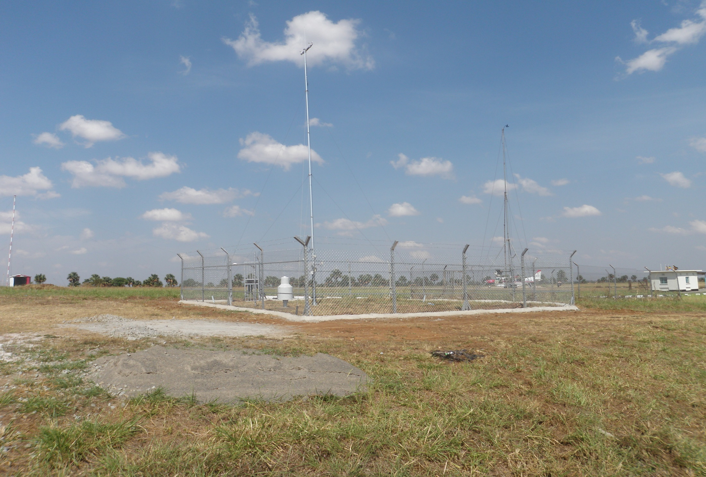

Newly renovated weather station: Gulu Airfield

Slide 8

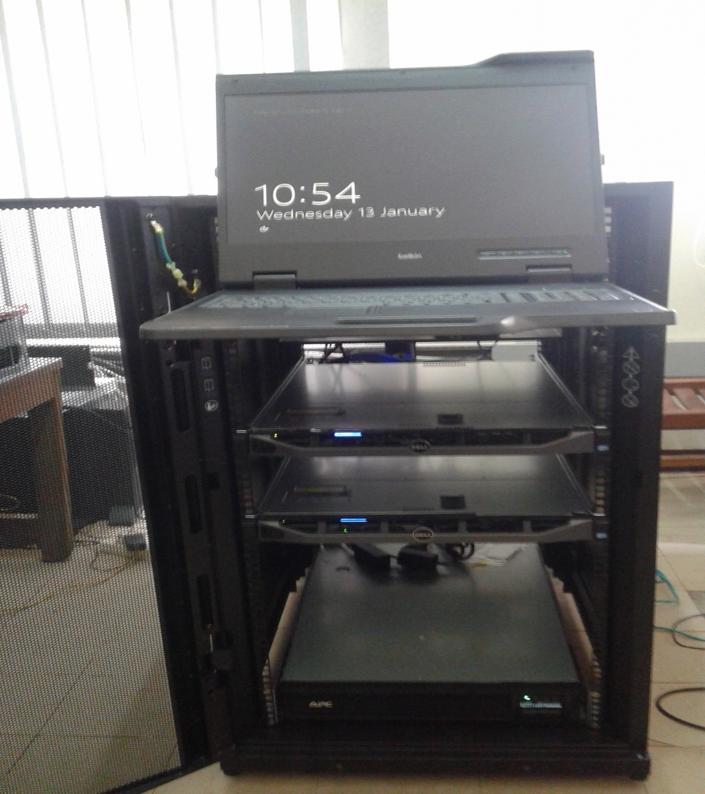
The AMSS
Capabilities:
Compliant with all WMO stds;
Allows management of regional GTS circuit (RTH) and national data (NMCs) & observing stations countrywide;
Data transmission modes: FTP, SFTP, WMO socket, https, email, SADIS 2G, MSG, RETIM, AFTN, GSM, SMS;
Has integrated FTP server; supports secure communication protocols;
Processes and generates meteorological data (SYNOPS, METARS, SPECI, CLIMAT, BUFR e.t.c)

Slide 9

SOME POSITIVE OUTCOMES:
More reliable information(pressure, wind) for the aviation sector hence increased confidence in forecasts;
Public perception about meteorological products improving(seasonal forecast and recent El-nino);
Interest by Telecommunications Companies to partner with UNMA;
Connectivity to the Regional Meteorological Center in Nairobi and the GTS ; Uganda once more on the global meteorological highlight.

Slide 10
CHALLENGES:
Operational:
UNMA still operating at 70% capacity due to insufficient personnel(forecasters, Agro-meteorologist, data archivers & retrievers, data analysts);
Though achieved 90% delivery in 2015, the procurement process is still lower than expected;
Constrained Budget due to high prices of equipment procured;
Procurement of Total Solutions AWSs presented with constrained negotiations.
Programmatic:
Little flexibility for innovation due to resource constraint;
Poor visibility of UNMA(DoM);
Need for improved packaging and dissemination of products: Dekadal, monthly and seasonal forecasts, tailored weather & climate information

Slide 11
OPPORTUNITIES:
Maximizing the DDMC structures, WMZs, MDAs (e.g. ACCRA), schools and SCIEWS Sub-National Committees for dissemination of data to communities and protecting base stations;
Partnering with Telecommunications Companies including TVs and Radios for dissemination of data;
Innovation: possible partnership with WIMEA project, to locally produce components of weather stations equipment for sustained maintenance.

Slide 12
WHAT NEXT??:
Improve on the quality of meteorological products and their dissemination(PPP workshop-May 2016); NECOC;
Scale up sub-national stakeholders involvement in the use of early warning information;
Link EWS outcomes with new projects, for sustainability of services;
Collaborate with local initiatives(WIMEA) for innovations;
Track the outcome of investments through the EWS Project.

Slide 13
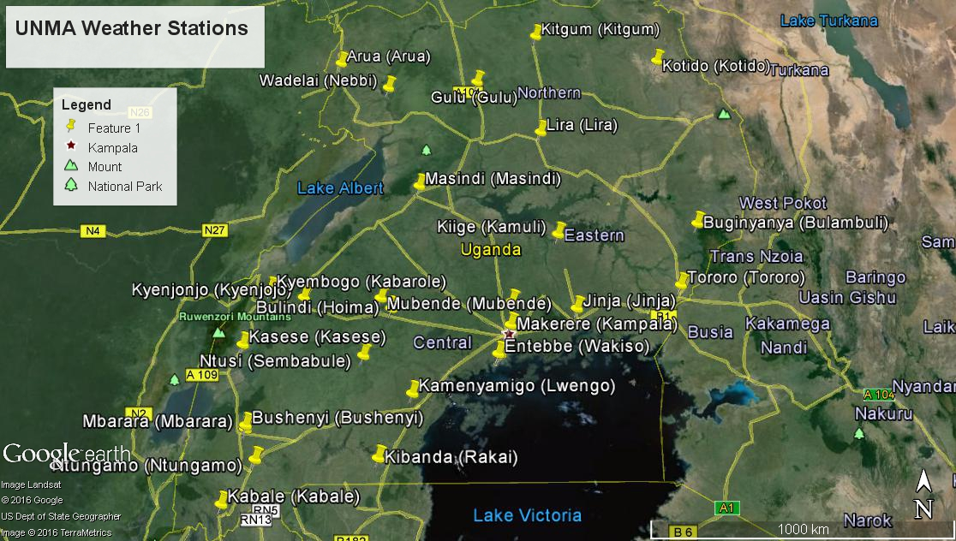
Questions?

